Slide 1
The UN SDGs approach and process
Committee on Earth Observation Satellites
Alex Held, CSIRO & CEOS Chair Rep.
(w. MJ Bourassa, F. Kerblat, K. Holloway)
SIT Tech Workshop 2016 Agenda Item #20
Oxford, UK
14th-15th September 2016

Slide 2
Context
Global political impetus is rising fast !
GEO initiative (GI-18) established to support UN SDG coordination of observational efforts; making good progress
Increased engagement by various UN Agencies charged by UN Stats to develop specific ‘indicators’ and monitoring guidelines
Selected CEOS Space & technical agencies being approached by their national Stats Agencies for advice on role of EO in SDG monitoring
Australia: CSIRO, GA and Aust. Bureau of Statistics
S. Africa – SANSA (including other countries in Africa?)
Japan – Cabinet Office
CSIRO given direct consultancy to provide ‘good practice guidance’ for EO-based monitoring of indicators 15.3.1 (“Proportion of land that is degraded over total land area”)

Slide 3
Status so far of CEOS support for the UN SDGs process
SIT-31 Frascati, Italy, April 2016
Decision 3: ‘The CEOS way forward on the UNSDGs will be undertaken in conjunction with GEO & UN-GGIM, supplemented by a top-down dialogue with relevant UN Agencies and with individual CEOS Agencies making connections within their governments.’

Slide 4
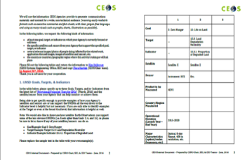
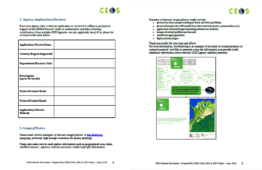
CEOS support for UN SDGs process
CEOS communications activities
Set up of a dedicated webpage on CEOS website: http://ceos.org/ourwork/other-ceos-activities/sustainable-development-goals/
Collect examples/concrete information from CEOS agencies
A few responses so far: more needed please
CEOS actively supporting GEO (GI-18):
Participate in the regular conference calls,
Provide inputs to key documents (4-pager for a dedicated side-meeting at the UN 47th UNSC meeting (March 16); Data Cube proposal for the Implementation Plan – to be kept for the Work Plan),
Exchange information (creation of the CEOS template, CSIRO and ABS work for Australia, etc.)

Slide 5
CEOS supports the UN SDGs process
IAEG-SDGs
3rd meeting of the IAEG-SDGs in Mexico (30 March-1 April ‘16): creation of a geospatial information subgroup
CEOS dialogue with relevant UN Agencies should take place with the so called “SDG indicators' custodian agencies" as identified in the document of the IAEG-SDG from their 3rd meeting: “Provisional Proposed Tiers for Global SDG”: http://unstats.un.org/sdgs/files/meetings/iaeg-sdgs-meeting-03/Provisional-Proposed-Tiers-for-SDG-Indicators-24-03-16.pdf
Tier I: Indicator conceptually clear, established methodology and standards available and data regularly produced by countries.
Tier II: Indicator conceptually clear, established methodology and standards available but data are not regularly produced by countries.
Tier III: Indicator for which there are no established methodology and standards or methodology/standards are being developed/tested.
=> CEOS Agencies should contribute to the development of these methodologies (for the most relevant indicators)

Slide 6
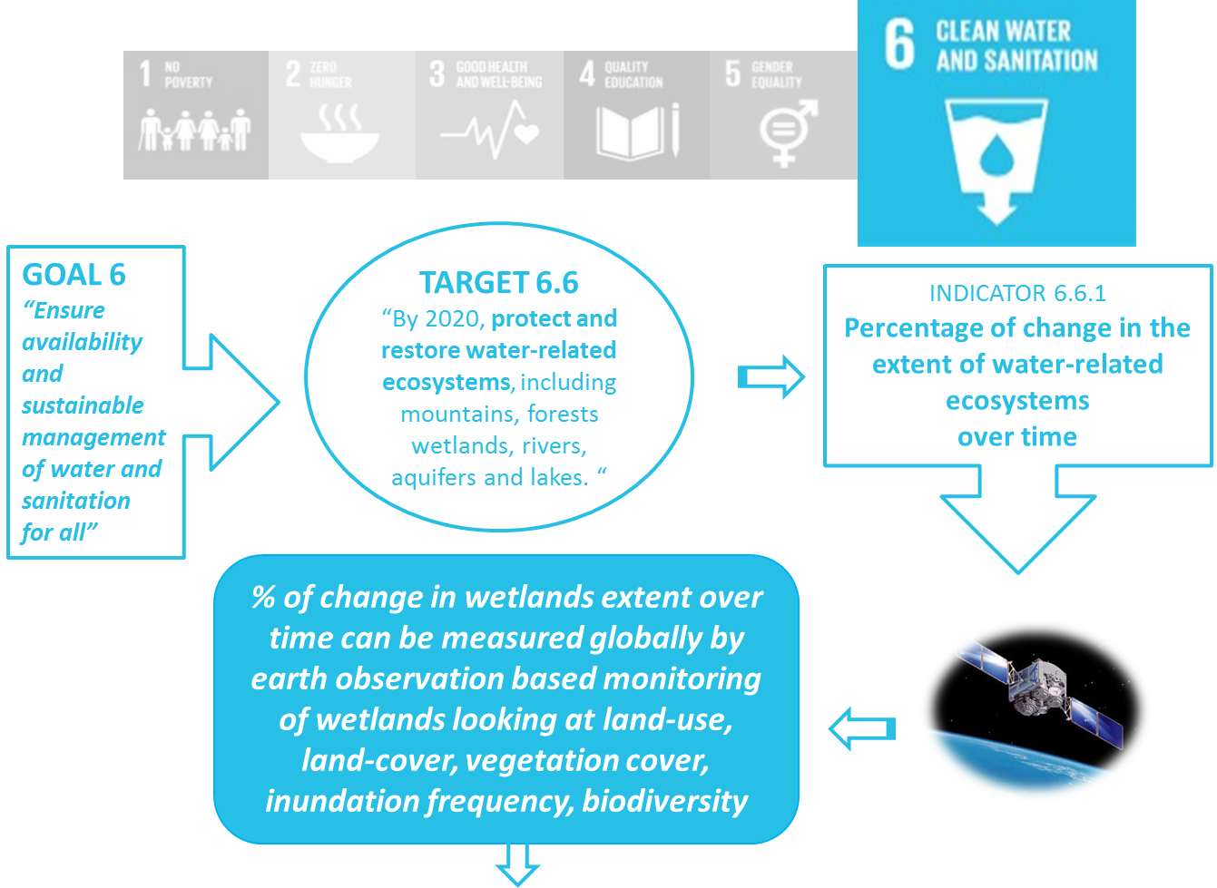
Example for GOAL 6

Slide 7
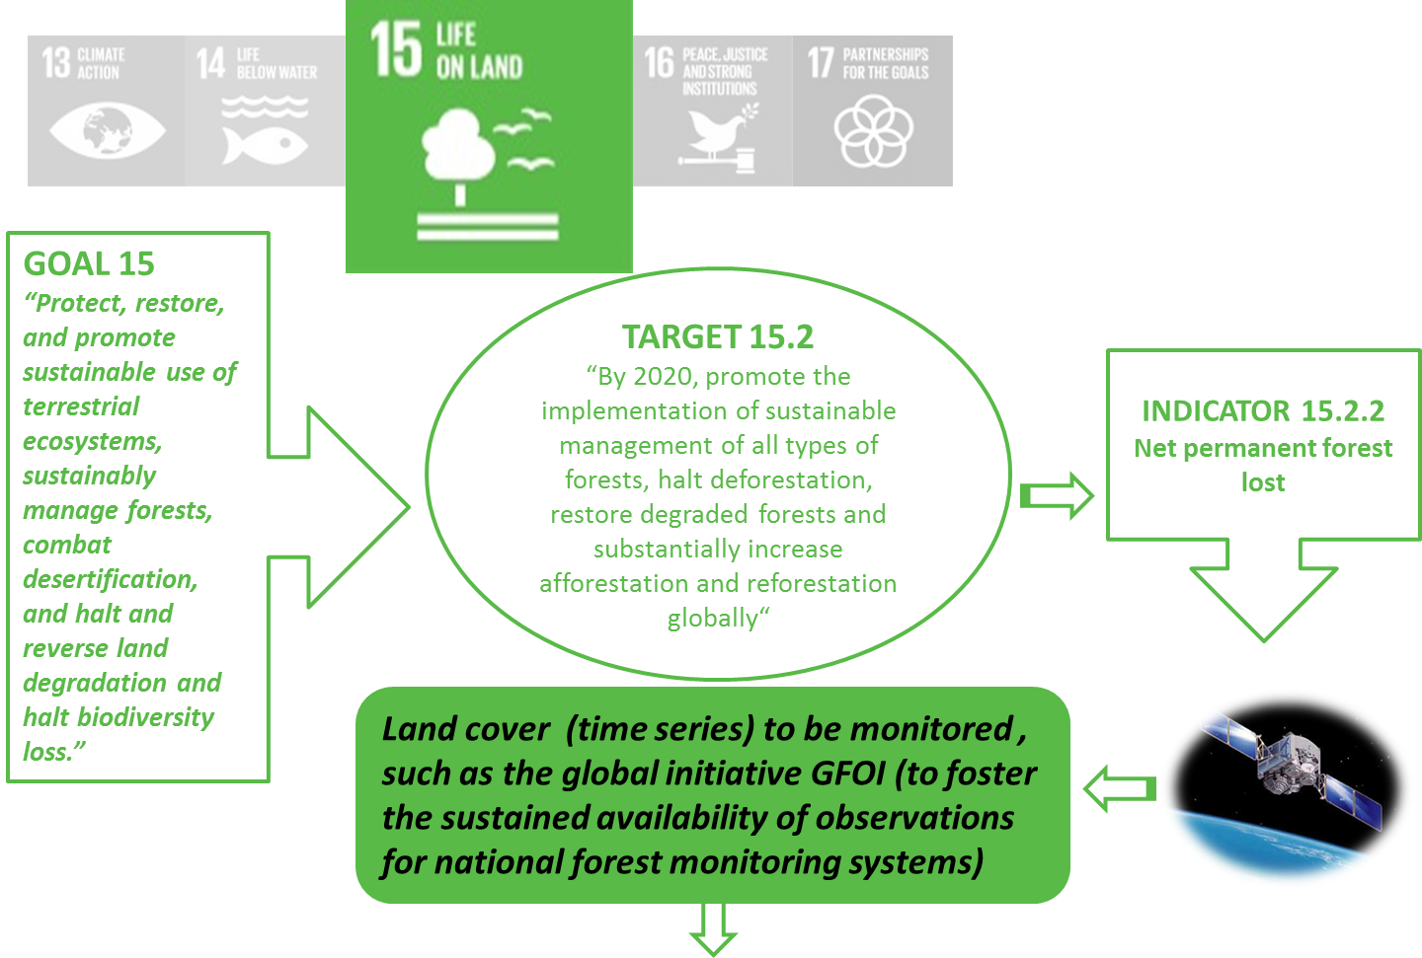
Goal 15, SDCG and GFOI Links

Slide 8
Commonwealth Scientific & Industrial Research Organisation (CSIRO)
Target 6.3: Improve Water Quality
Indicator 6.3.2: % of Water Bodies w/Good Ambient Water Quality
Target 6.6: Protect & Restore Water-Related Ecosystems
Indicator 6.6.1: Change in Extent of Water-Related Ecosystems over Time
Target 14.1: Prevent & Reduce Marine Pollution
Indicator 14.1.1: Index of Coastal Eutrophication & Floating Plastic Debris Density
Target 15.3: Combat Desertification, Restore Degraded Land
Indicator 15.3.1: Proportion of Land that is Degraded Over Total Land Area
Notes:
Neil Sims submitted the inputs from CSIRO. He included other valuable details in the template he returned to us, but for the purpose of summarizing, I’ve left those out of these charts.
He provided three examples of how several products from Landsat and Sentinels 1 and 2 instruments support the first 3 SDG Targets and Indicators shown here.
And he named one CSIRO Service/Application that supports SDG Target 15.3.1 (namely,a CSIRO Land & Water project that is producing Good Practice Guides for 15.3.1 subindicators)

Slide 9
European Space Agency (ESA)
Target 6.6: Protect & Restore Water-Related Ecosystems
Indicator 6.6.1: Change in Extent of Water-Related Ecosystems over Time
Target 11.3: Sustainable Urbanization
Indicator 11.3.1: Ratio of Land Consumption Rate to Population Growth Rate
Target 15.3: Combat Desertification, Restore Degraded Land
Indicator 15.3.1: Proportion of Land that is Degraded Over Total Land Area
Notes:
Marc Paganini submitted the inputs from ESA. Again the valuable detail provided in the template isn’t shown here, but in summary,
He submitted that for 6.6.1 and 11.3.1, ETM+ and ASAR on Envisat and Landsat 5-7 could provide historical baselines and sensors on Sentinel 1 and 2 & Landsat 8 would provide 2015 baselines for wetland and urban extent products and automated wetland habitat/urban cover mapping products.
He also listed how ENVISAT, SPOT 4-5, PROBA-V, and Sentinel 3 sensors could inform land cover and land productivity trend products in support of 15.3.1.
All of this accomplished through three ESA projects: GlobWetland Africa, SAR4URBAN, and the Land Cover CCI – and all of it is being done in collaboration with Ramsar, GEO, UNCCD – and demonstrates international collaboration and cooperative effort.
So in the section on Agency applications and services that support the UNSDG process, he listed two international collaboration frameworks:
The 1st is the new GEO Wetlands Initiative:
Led by the University of Bonn, the Ramsar Secretariat, and Wetland Internationals with ESA and JAXA as active members, which contributes directly to SDG 6.6.1
And the 2nd is the LDN Target Setting Program (LDN-TSP), which is a
Global Mechanism (GM) of the UNCCD, so its being done in close collaboration with the UNCCD secretariat and with the support of ESA & EC-JRC, and aims to provide participating countries with the necessary tools, methods, and data to implement SDG 15.3.1.

Slide 10
Mexican Space Agency (AEM)
Target 2.4: Sustainable Food Production/Agriculture
Indicator 2.4.1: Proportion of Agricultural Area Under Productive & Sustainable Agriculture
Target 15.3: Combat Desertification, Restore Degraded Land
Indicator 15.3.1: Proportion of Land that is Degraded Over Total Land Area
Notes:
Mr. Urdapilleta from the Mexican Space Agency submitted that they have two projects going on in Mexico and Latino-America that support SDGs 2 and 15 as shown here:
They are a new Mexican Precision Agriculture Project and the Droguth Monitoring System, but I’m not actually familiar with those projects so that’s all I’ve got for Mexico.

Slide 11
Japanese Aerospace Exploration Agency (JAXA)
Target 3.9: Reduce Death & Illness from Pollution
Indicator 3.9.1: Mortality Rate Attributed to Household & Ambient Air Pollution
Target 6.6: Protect & Restore Water-Related Ecosystems
Indicator 6.6.1: Change in Extent of Water-Related Ecosystems over Time
Target 11.6: Reduce Environmental Impact of Cities
Indicator 11.6.2: Annual Mean Levels of Fine Particulate Matter in Cities
Target 15.1: Conservation, Restoration & Sustainable Use of Terrestrial & Inland Freshwater Ecosystems
Indicator 15.1.1: Forest Area as Percentage of Total Land Area
Notes:
JAXA’s template, sent by Matsuo-san, showed support to these four SDG indicators via aerosol data products from Himawari, EarthCARE, GCOM-C, & GOSAT-2 instruments,
A product called GSMaP from GPM and GCOM-W instruments, and
Forest Area products derived from JERS-1, ALOS, and ALOS-2 instruments’ data.
And JAXA didn’t specify any particular agency applications or services to promote in support of the UNSDG process.

Slide 12
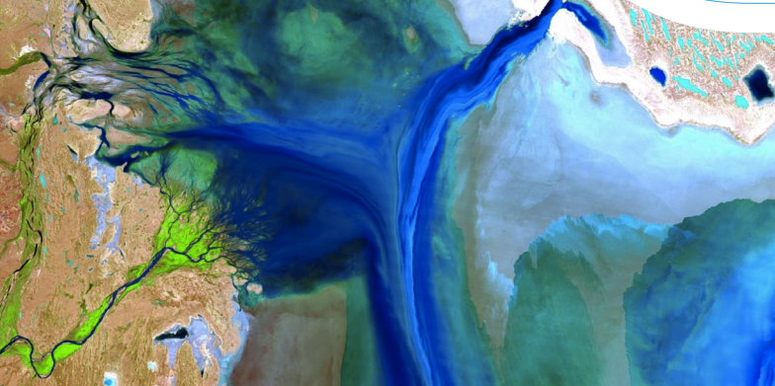
Example: Commonwealth Scientific & Industrial Research Organisation (CSIRO)
Landsat, TM 8 Product: Water Suspended Sediment Concentration
Target 6.3 – Improve Water Quality
Indicator 6.3.2 – % of Water Bodies w/Good Ambient Water Quality
Top right Image From: https://publications.csiro.au/rpr/download?pid=csiro:EP117441&dsid=DS10
Notes:
So that was just a high-level summary of the inputs we got in the templates, but just as an example, I took one of CSIRO’s inputs for SDG Target Indicator 6.3.1, and not being a graphic designer by any means, slapped together this little flow chart that might look something like the examples we could show online to convey the work CEOS Agencies are doing in support of the SDGs. We could do something like this for all the various activities you guys are doing to support the SDGs.
Another idea, would be that we design one image that represents a high-level summary of all CEOS Agency contributions to the SDGs, instead of doing this for each individual example, which I lean a little closer towards.

Slide 13
Recommendations
Formalize coordination of SDG-specific activities into a new CEOS Ad-Hoc team whose will be to:
Interact with-, and supports GEO through their initiative GI-18
Coordinate:
Development of a small CEOS brochure (content, timeline, audience?)
Updates on the dedicated webpage for SDGs on the CEOS website (http://ceos.org/ourwork/other-ceos-activities/sustainable-development-goals/)
Actions for GEO Plenary (exhibition, and any GI-18 side meetings)
CEOS participation in key international SDG-related meetings e.g. ISRSE (SA, 2017)
Liaison w. WGCapD around future workshops on EO and monitoring of SDGs, guidance on the use of EO for official statistics, etc.
Engagement as needed with key UN agencies or other players (eg World Bank, etc.)

Slide 14
Work Ahead
Proposed future activities (for SDG AHT ):
CEOS collect, analyse and use information provided by Agencies (so far from AEM, ESA, JAXA… others?) – through the CEOS template
CEOS link the SDGs with the MIM database: creating a tabular list of SDGs, map those SDGs to the MIM measurement parameters (~30 total) and make the connections to the relevant CEOS missions through a dedicated webpage
CEOS external representation on the UN SDGs:
CEOS “PowerPoint template” for any presentation on SDGs – available on the CEOS website, ready to be used by any CEOS representatives when participating in international conferences
CEOS session at the ISRSE in South Africa, April 2017: any staff, material?
CEOS representation at other international seminars/conferences on Big Data, UN SDGs, data and official statistics?
CEOS CapD WG new activities related to the UN SDGs: organise a workshop (RS and statisticians communities) to help Statisticians using EO data to help achieve or monitor the UN SDGs (start with one indicator?)
CEOS communique to reaffirm its commitment to support the 2030 Agenda: endorsement at the CEOS Plenary? Distributed at the GEO Plenary?

Slide 15
Addendum: Latest documentation on the UN SDGs
CEOS Document Management: UNSDGs (http://ceos.org/documents/#elf_l1_VU5TREc)
the latest report on SDGs (released in July by the UN: http://unstats.un.org/sdgs/report/2016/The%20Sustainable%20Development%20Goals%20Report%202016.pdf)
the ECOSOC latest draft resolution about the Geospatial information management (about the UNGGIM activities): http://ggim.un.org/docs/E_2016_L.28_Draft%20Resolution_en.pdf
the SDGs template prepared by CEOS and sent to principals
IAEG-SDG - 3rd meeting in Mexico - “Provisional Proposed Tiers for Global SDG”: http://unstats.un.org/sdgs/files/meetings/iaeg-sdgs-meeting-03/Provisional-Proposed-Tiers-for-SDG-Indicators-24-03-16.pdf
Other supporting documentation
White Paper from DigitalGlobe and Geospatial Media (acknowledging knowledge partners GEO and UN GGIM): http://explore.digitalglobe.com/rs/782-PEE-248/images/White%20Paper%20-%20Geospatial%20and%20Sustainable%20Development.pdf
Other key relevant webpages?

Slide 16
THANK YOU FOR YOUR ATTENTION
For more information – main CEOS contacts for the UNSDGs:
Marie-Josee Bourassa (CSA, CEOS DCEO) marie-josee.bourassa@canada.ca
Alex Held (CSIRO, CEOS Chair) alex.held@csiro.au
Flora Kerblat (CEOS Chair team) fkerblat@yahoo.com

