Slide 1
GEOGLOWS – GEO Global Water Sustainability Initiative
Committee on Earth Observation Satellites
GEO Water
SIT Tech Workshop 2016 Agenda Item #17
CEOS Strategic Implementation Team Tech Workshop
Oxford, UK
14th-15th September 2016

Slide 2
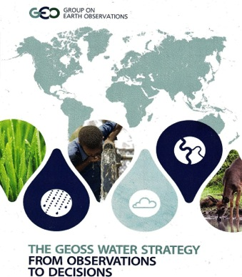
GEOGLOWS and the GEOSS Water Strategy
The GEOSS Water Strategy was prepared in 2014 to communicate the capabilities and needs of the GEO Water community to GEO members and the broader community as plans are made for the next phase of GEO.
GEOGLOWS is a new GEO initiative which received approval from the GEO Programme Board in August, 2016.
It is a voluntary, international program that currently encompasses experts and projects in North America, South America and Europe and is exploring linkages in Asia and Africa.
GEOGLOWS provides a framework for enabling GEO Members to address many of the Water Strategy’s 58 recommendations.
General: The GOESS Water Strategy gives priority to :
Water security
Climate change adaptation
Water and poverty
Extremes: floods and droughts
Water-Energy-Food Security Nexus
Water for ecosystems and biodiversity

Slide 3
The Evolution of GEOGLOWS
2014: GEOGLOWS as a NASA contribution to U.S. GEO. Applications projects were mapped to the GEOGLOWS themes.
2015: GEOGLOWS as a USGEO initiative: NOAA and the USGS engaged and IWP, Water Quality and Water Use became essential elements.
2015-2016: GEOGLOWS as a GEO initiative: AmeriGEOSS, SDGs and the work of the JRC-EU and Japan became more visible.

Slide 4
OBJECTIVES
Strengthen capacity to understand water data needs and develop user-driven applications products from EO data and applications
Engage end users and boundary organizations to understand needs by region and decision making process and prioritize activities based on vulnerability analyses
Coordinate and leverage GEOGLOWS partners to more effectively provide information and expertise to international stakeholders and end user communities
Strengthen global capacity to use water EO and science effectively across spatial and temporal scales
Contribute to the assessments of impacts of climate change with population and economic growth on water resources and their availability, and to inform planning and adaptation activities

Slide 5
GEOSS WATER STRATEGY IMPACTS
The GEOSS Water Strategy identified areas that need to be strengthened in its implementation. GEOGLOWS supports the following issues:
1. Commitments for GEO Members and GEO POs are needed to address specific recommendations
GEOGLOWS provides a framework within which GEO members can coordinate their responses to the GEOSS Water Strategy.
2. Strengthen User Engagement through relationships
with users and product co-design.
As an example for other GEO Members, AmeriGEOSS members will develop mechanisms for user interaction.

Slide 6
GEO Global Water Sustainability (GEOGLOWS)
1. Enhancing Global Water Sustainable Development Water and the SDGs Scarcity and Access Climate Change Cold Regions Ecosystems and Biodiversity | 2. Minimizing Basin and Regional Risk Integrated Water Prediction Floods Droughts Transboundary Issues (IWRM) Land Use Change Water-Energy-Food-Environment-Health Nexus Climate Change Adaptation | 3. Understanding Essential Water Variables (EWV) Water Quality Water Use Water Cycle Variables (Precipitation, Soil Moisture, Groundwater, Evapotranspiration, Stream Flow, Surface Water Storage (Includes Snow Pack))
4. Earth Observations, Integrated Data Products and Applications, and Tool Development 5. Data Sharing, Dissemination of Data, Information, Products, and Knowledge 6. User Engagement, Capacity Building and AmeriGEOSS

Slide 7
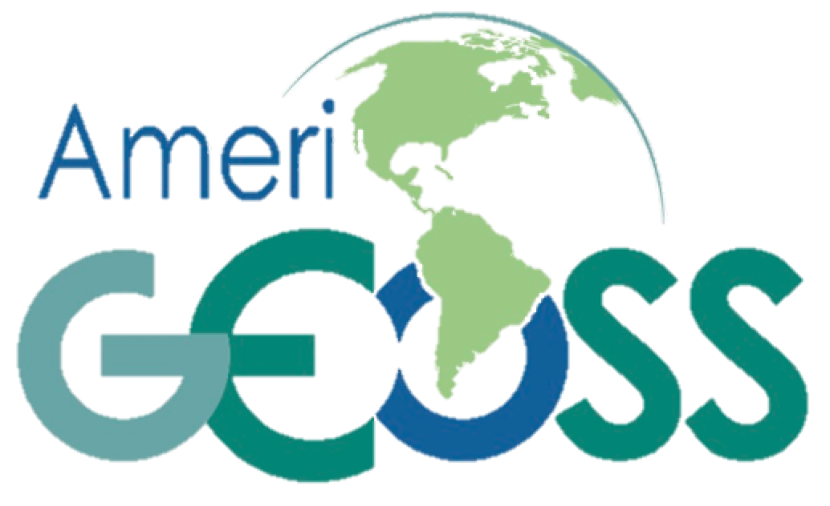
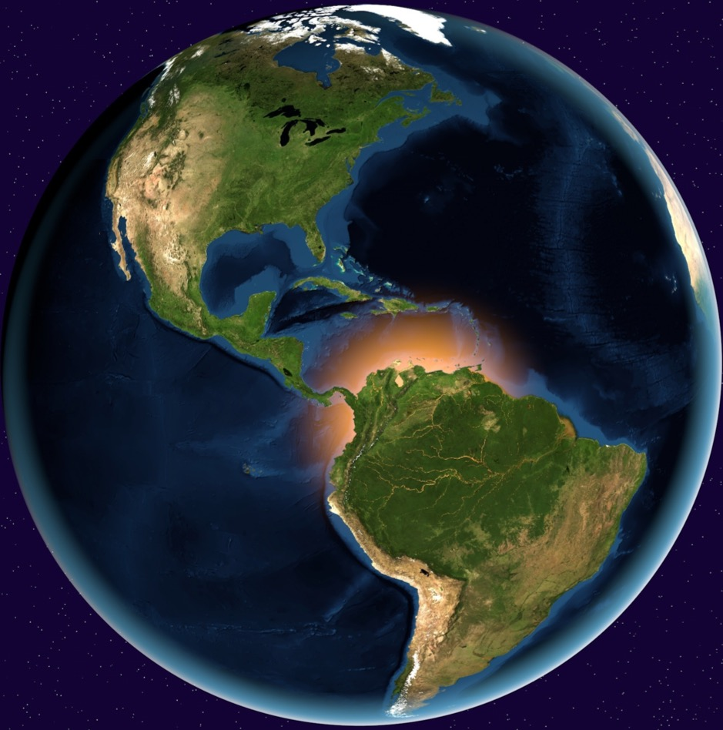
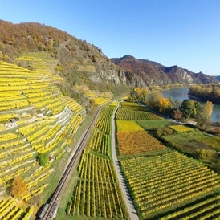
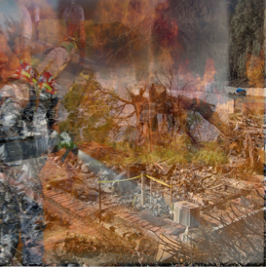
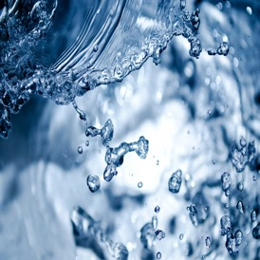
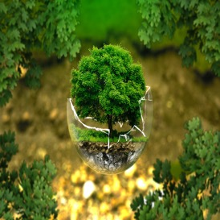
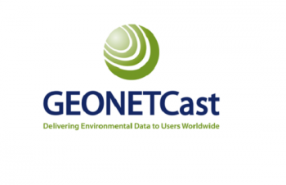
About AmeriGEOSS Data Tools Products Services News Events Contact Us
Your Source for Earth Observation Data
Search AmeriGEOSS
Search
Agriculture
Disasters
Water
Biodiversity
Foundational
The AmeriGEOSS community site is a regional resource to share, find, discover, learn and participate in efforts to discover, understand and respond to societal needs
CEOS Water is one of the AmeriGEOSS ”Tools”
7

Slide 8
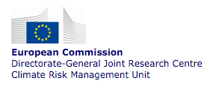
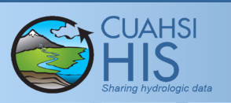
GEOGLOWS: Partnerships for Capacity Building, Applications and Tool Development...
GLoFAS SOS server: JRC of the EU Commission is planning to implement a GloFAS SOS server, similar to “HydroServer” (OGC SOS) for the GloFAS forecasts. This would allow users to link observations with forecasts either within GloFAS or within the HydroServer visualization interface or, in fact, with any interface capable to work with OGC SOS.
HydroServer and Tethys Plaform are standards-based, open source tools, which are used for data management and dissemination, modeling, visualization, and decision support. HydroServer and the Tethys Platform were successfully used through NOAA's National Flood Interoperability Experiment (NFIE) and GEO's CIEHLYC training program in Cartagena, Colombia during the summer of 2015.
Notes:
Established by MOU in 2011, expanded in 2015 to include FEMA, recertified in 2016 for +5 years
New business model for interagency collaboration
Share technology, information, models, best practices
Operations focused
Members agree to work towards:
Interoperability of key systems and data synchronization
Standardized data formats
Enhanced geospatial information and visualization
Common Operating Picture
Coordinated R&D portfolio investments
Leverage multi-disciplinary skills to formulate effective solutions
Joint governance structure – shared leadership model
Joint stakeholder outreach, educational efforts
In summary, NWS water prediction today is done at 4000 locations
These are all stream gage locations
The modeling is done by averaging conditions over large catchments (what we call lumped modeling), and this is rooted in a legacy of when we didn’t have much data or sufficient computers to model the true hydrology explicitly
With the opening of the NWC, we are preparing to provide water predictions at all 2.7 million stream reaches across the CONUS, expanding to Alaska, Hawaii, and Puerto Rico.
This is driven by access to big data, increased availability of supercomputing, and the latest scientific research and development
The NWC is transforming water prediction into the realm of Earth system modeling, and coupling this with comprehensive infrastructural and demographic information to provide water intelligence
8

Slide 9
PIONEERS OF THIS NEW “official” GEO INITIATIVE
Organizations which are currently leading GEOGLOWS include:
NOAA (National Oceanic and Atmospheric Administration) – USA
NASA (National Aeronautics and Space Administration) – USA
USGS (United States Geological Survey) – USA
IDEAM (Instituto de Desarrollo del Ambiente) – Colombia
JRC (Directorate-General JRC, European Commission, Europe
Collaborating organizations include:
CIMH (Caribbean Institute for Meteorology and Hydrology) - Barbados
CIRMAG (Centro de Investigación Científica del Rio Magdalena) – Colombia
Deltares – the Netherlands
EC (Environment Canada) – Canada
ENAP (Escuela Naval Almirante Padilla) – Colombia
Federal Institute of Hydrology - Germany
IMN (Instituto Meteorológico Nacional) – Costa Rica
INPE (Instituto Nacional de Pesquisas Espaciais) - Brazil
MARN (Ministerio de Medio Ambiente y Recursos Naturales) – El Salvador
SENARA (Costa Rica’s National Service of Underground Water, Irrigation and Drainage)– Costa Rica
SEMARNAT (Mexican Secretariat of the Environment and Natural Resources) - Mexico
UBY (University of Brigham Young) – USA
UNAL (Universidad Nacional de Colombia)
Questions

