Slide 1
GEO and GEOSS status SIT Technical Workshop Osamu Ochiai GEO Secretariat 14-15 September 2016 Oxford, UK

Slide 2
Unique Time in GEO’s History
Transition to next decade 2016-2025
Recognition of GEO’s convening power – Members, POs, Development Banks, Foundations, emerging Commercial Sector
Evolution & Recognition of Policy Mandates
New Strategic Plan with new programmatic mechanisms – community activities, foundational tasks, initiatives and flagships

Slide 3
Governance
GEO Plenary
103 Member Countries, 103 Participating Organizations, 12 Observers
GEO Executive Committee
Africa: Egypt, Senegal, South Africa
Americas: Colombia, Mexico, United States
CIS: Armenia, Russia
Asia/Oceania: Australia, China, Japan, Korea
Europe: EC, Finland, France, Germany
Observers from Program Board: CEOS, GOOS, WMO
GEO Programme Board
Oversees the establishment of the multi-year GEO Work Programmes
42 members from GEO Members and Participating Organizations
GEO Secretariat

Slide 4
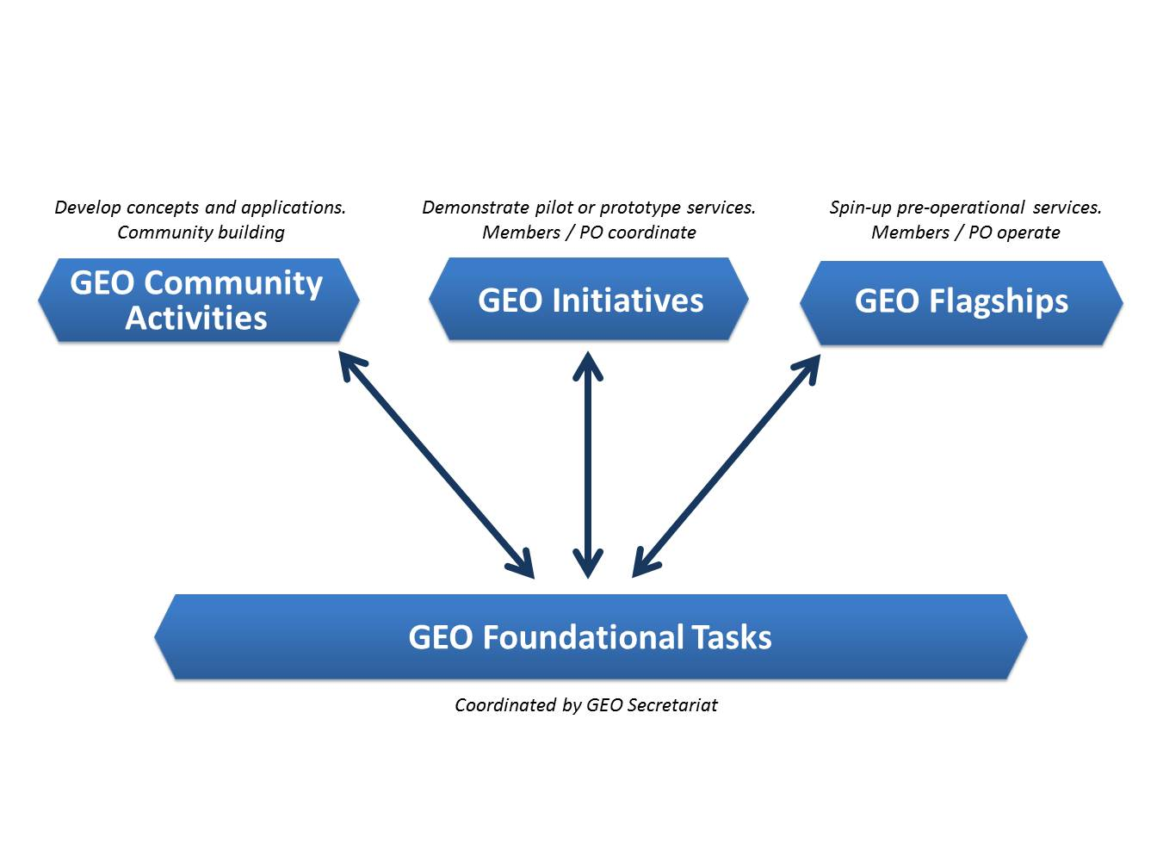
Four Types of GEO Implementation mechanisms

Slide 5
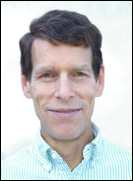
SBAs, Community Activities and Initiatives
SBA | GEO Initiatives |  | Community Activities
 | GI-02 | GEOBON-Global Biodiversity Observation (GEO BON) | CA-29 | Using Geospatial Data to Identify and Monitor Ecosystem Service and Track in a Natural Capital – Ecosystems Accounts Framework
 | GI-03 | GFOI Global Forest Observation Initiative | CA-30 | Harmful Algal Bloom (HAB) Early Warning System
 | GI-14 | GEO ECO: the GEO Global Ecosystem Initiative | CA-31 | For Global Mangrove Monitoring
 | GI-15 | GEO-GNOME Initiative: GEO Global Network for Observation and information in Mountain Environments
 | GI-08 | GEO Geohazard Supersites and Natural Laboratories (GSNL) | CA-23 | Space and Security
 | GI-09 | Global Wildfire Information System | CA-26 | Towards Chinese tsunami mitigation system under GEO framework
 | GI-16 | GEO-DARMA = Data Access for Risk Management (to support the implementation of Sendai framework). | CA-27 | Foster Utilization of Earth Observation Remote Sensing and In Situ Data for All Phases of Disaster Risk Management (new-CEOS)
 |  |  | CA-28 | Global Flood Risk Monitoring
 | GI-10 | EO data and renewable energies | CA-06 | EO data and mineral resources (Includes Impact Monitoring System for Geo-Resource Exploration and Exploitation)
 |  |  | CA-25 | Africa Global-scale Geochemical Baselines for mineral resource and environmental management: Capacity-building phase

Slide 6
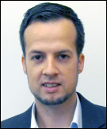
SBAs, Community Activities and Initiatives
SBA | GEO Initiatives |  | Community Activities
 | GI-01 | GEOGLAM-Global Agricultural Monitoring and Early Warning
 | GI-04 | Global Observing System for Mercury and Persistent Pollutants | CA-07 | Integrated Water-cycle Products and Services - Overall coordination
 | GI-12 | Integrated Information Systems for Health (Cholera, Heat waves) | CA-14 | GEO Water Quality
 | GI-13 | Integration of Methods for Air Quality and Health Data, Remote Sensed and In-Situ with Disease Estimate Techniques | CA-18 | Water Cycle Integrator (WCI)
 |  |  | CA-19 | E2E Water Indicators
 |  |  | CA-22 | Linking water tasks with wider societal benefit areas and the post-2015 global development framework
 | GI-17 | Global Urban Observation and Information | CA-24 | Earth Observation in Cultural Heritage documentation
 | GI-21 | Human Planet Initiative

Slide 7
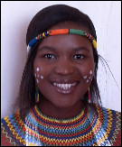
GEO Initiatives not associated with one SBA
GI-05 | Global Carbon Observation and Analysis System | Climate
GI-06 | Reinforcing engagement at regional level: AfriGEOSS for Africa | Regional coordination
GI-19 | AmeriGEOSS (new)
GI-22 | Asia-Oceania GEOSS –Asia-Oceania regional comprehensive earth observation application system
GI-07 | Ocean and society - Blue Planet
GI-18 | GEO and SDGs. EOs role in providing support to countries in achieving SDGs and in defining and monitoring the associated indicators.

Slide 8
Community Activities not associated with one SBA
CA-01 | Global Land Cover
CA-02 | Land Cover for Africa
CA-03 | Access to model data in GEOSS | Climate
CA-04 | Strengthen collaboration between GEO and GFCS
CA-05 | TIGGE (Thorpex Interactive Grand global Ensemble) evolution into a Global Interactive Forecast System (GIFS)
CA-32 | Research Data Science Summer Schools | Capacity Building
CA-33 | Building capacity for Forest Biodiversity in Asia and the Pacific Region
CA-34 | Multi-source Synergized Remote Sensing Products and Services | Support to GEOSS

Slide 9
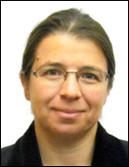
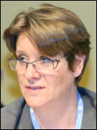
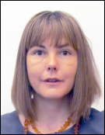
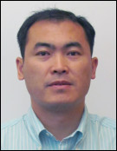
Foundational Tasks – Current List
GD | GEOSS Development and GCI Operations
GD-01 | Advancing GEOSS Data Sharing principles
GD-02 | GCI Operations (including access to Knowledge)
GD-03 | Global Observing and Information Systems (new) (includes systems like WIGOS. GCOS; …. And reference datasets)
GD-04 | GEONETCast Development and Operations
GD-05 | GEOSS satellite Earth Observation Resources (includes advocacy for continuity)
GD-06 | GEOSS in situ Earth Observation Resources (includes inclusion of citizens’ observatories) (includes advocacy for continuity)
GD-07 | GCI Development (includes development of Data Management guidelines)
GD-08 | SBAs processes: Systematic determination of user needs / observational gaps
GD-09 | Knowledge Base development
GD-10 | Radio-frequency protection
GD-11 | Utilization of Communication Networks
CD | Community Development
CD-01 | Capacity Building coordination
CD-02 | Reinforcing engagement at national and regional level
CD-03 | Assess the benefits from EOs and of their socio-economic value
SO | Secretariat Operations
SO-01 | Management and Support
SO-02 | Communication and Engagement
SO-03 | Monitoring and Evaluation
SO-04 | Resources Mobilization

Slide 10
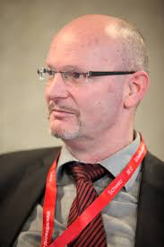
GEO Water tasks restructuring (1/2) Community activities
CA-11: Soil Moisture
CA-12: River Discharge
CA-13: Groundwater
CA-14: GEO Water Quality
CA-15 (part of): Water Cycle Capacity Building
CA-18: Water Cycle Integrator (WCI)
CA-20: EarthH2Observe
CA-19: E2E Water Indicators
CA-22: Linking water tasks with wider SBA & the post-2015 global development framework
in-situ observations for Water Cycle
(standards, archiving, analysis and disseminations) (New CA)
AquaWatch
DIAS, including WCI, AWCI, AfWCCI (New CA)
EartH2Observe
Water-Energy-Food Nexus (New CA)

Slide 11
GEO Water tasks restructuring (2/2) Initiatives
CA-16: global drought information system (GDIS)
CA-07: integrated water-cycle products and services
Ca-08: water vapor and clouds (and aerosol and precipitation)
Ca-9: precipitation
Ca-10: evapotranspiration
Ca-15: water cycle capacity building
Ca-17: geo great lakes activity
GI-20 GEO Global Water Sustainability (GEOGLOWS)
GI-11: Information Services for Cold Region (GEOCRI)
GI: Global Drought Information System (GDIS)
GI-20 GEO Global Water Sustainability (GEOGLOWS)
GI-11: Information Services for Cold Region (GEOCRI)

Slide 12
Communities of Practice - Aquawatch & IGWCO
IGWCO (Integrated Global Water Cycle Observations Community of Practice)
Providing a framework for guiding decisions
Promoting strategies
Coordinating & facilitating the inputs
Fostering the development of tools, applications & systems
Supports the plans of the International Groundwater Resource Assessment Centre (IGRAC) & its Global Groundwater Monitoring Network (GGMN)
AquaWatch
In response to the need for an international operational water quality information system
Support water resource management & decision making
Transforming data to information based on user needs
Deliver water quality data products & information
Produce a global water quality monitoring & forecasting service
http://www.geo-water-quality.org/home

Slide 13
GD-08: SBAs process: Systematic determination of user needs / observational gaps “Task Description”
General description
Undertake regular, systematic analysis of global observational requirements
Societal Benefit Areas will provide the framework to perform this analysis
Other key outputs such as contributing to user engagement and to knowledge development.
Implementation approach and respective responsibilities
The GEO Secretariat will activate this SBA-related process
The GEO Secretariat will coordinate the participation of key stakeholders to the agreed activities and create the relevant linkages to GEO activities (Community, Initiatives and Flagships) and other ongoing global and regional processes.
Planned activities and outputs in 2016
The 2016 will be used to activate this process, starting from the SBAs already active and ensuring participation Expected outputs:
Issue a document describing the process and how it will be run (planned by end October)
Define initial plans for each SBA
Activate of the process for at least three SBAs by 2016

Slide 14
GD-08: SBAs process: Systematic determination of user needs / observational gaps “Phased approach”
Phase 1: June 2016 – Dec 2017 Process validation and interim results (light central coordination, no synthesis, just SBA by SBA)
June 2016 – Nov 2016
Run the SBA process for two SBAs and present reports to GEO-XIII Plenary
Food Security and Sustainable Agriculture
Sustainable Urban Development
January 2017 – Nov 2017
Refine the SBA process (if necessary), implementing Plenary recommendations and lessons learned
Revise the two SBA reports accordingly
Run the SBA process for two additional SBAs
Present the four reports to GEO-XIV Plenary
Phase 2: January 2018 - onwards
By 2019, run the process for the remaining SBAs, revise the first four and produce the first Summary Report "User needs and observations/information gaps for an extended use of EOs in decision making”.
Continue the rolling process and update all the reports in 2021, 2023 and 2025.
From DRAFT WG Report

Slide 15
GEO Work Programme: GEO Initiative GI-18
Earth Observations in Service of the 2030 Agenda for Sustainable Development
GEO Initiative GI-18
GEO’s role in defining the indicators for the Sustainable Development Goals (SDGs) and providing support to countries in measuring, monitoring and achieving the SDGs.
EO provides direct measures of some Indicators and indirect support to others.
EO contribute to achieve progress on the Targets, which will show up in the Indicators.
Notes:
GEO Work Programme and GEO Initiative GI-18 on the SDGs
The following text is the description of GEO Initiative GI-18 in the proposed GEO Work Programme v3 (GEO Plenary XII Document 15, pp. 96/138).
GEO Initiative GI-18
GEOs role in defining the indicators for the Sustainable Development Goals (SDGs) and providing support to countries in measuring, monitoring and achieving the SDGs.
Overview
GEO’s existing strategic engagement with several key Member States and UN Agencies regarding the important role of Earth observations in measuring, monitoring and achieving the emerging Sustainable Development Goals (SDGs) provides a strong foundation to deepen GEO’s involvement and contributions in this critical and timely area.
Goals:
1) To engage with Member States, the UN Statistics Division and other partners in the development of the indicators supporting the SDG Goals and Targets to be approved by the UN Statistical Commission in March 2016.
2) Develop pilot projects in one or more GEO Member countries focused on integrating Earth observations with national statistical accounts to better measure, monitor and achieve the SDGs.

Slide 16
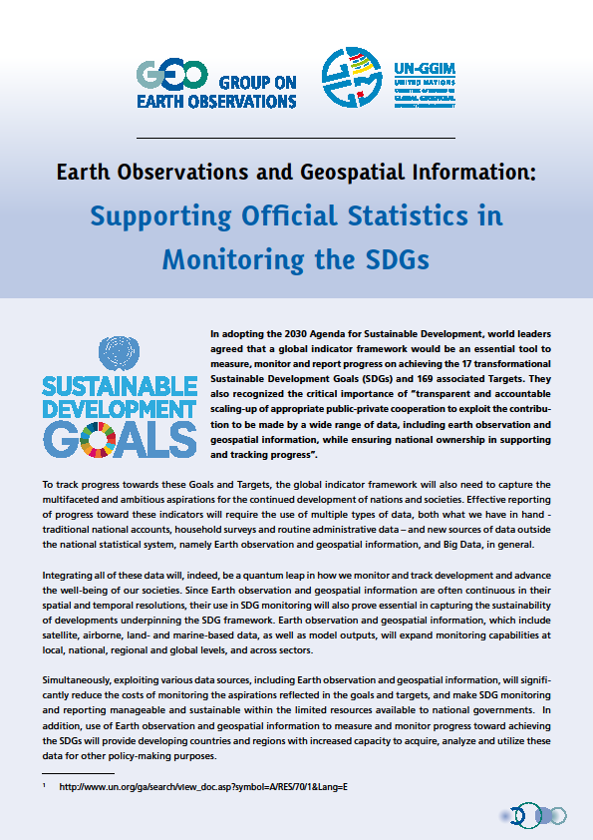
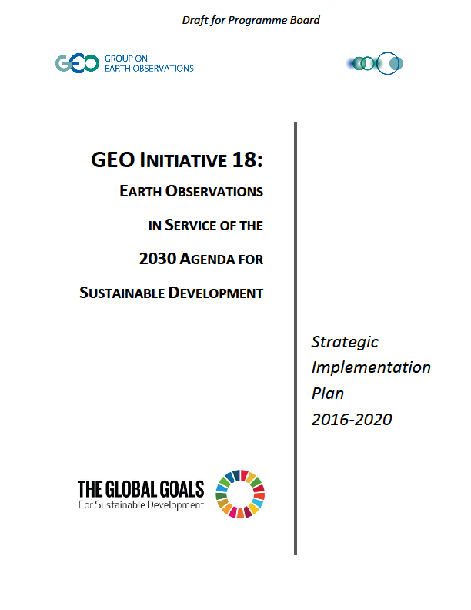
GEO Initiative 18: Earth Observations in Service of the 2030 Agenda for Sustainable Development
Goal I: Earth observations and geospatial information contribute in novel and practical ways to support achievement of the SDGs.
Goal II: Increase skills and capabilities in uses of Earth observations for SDG activities and their broader benefits.
Goal III: Broaden interest and awareness of Earth observations support to the SDGs and social, environmental, and economic benefits.

Slide 17
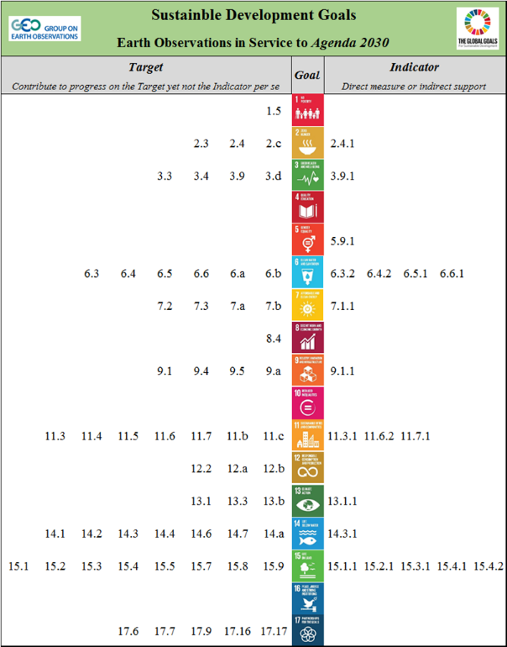
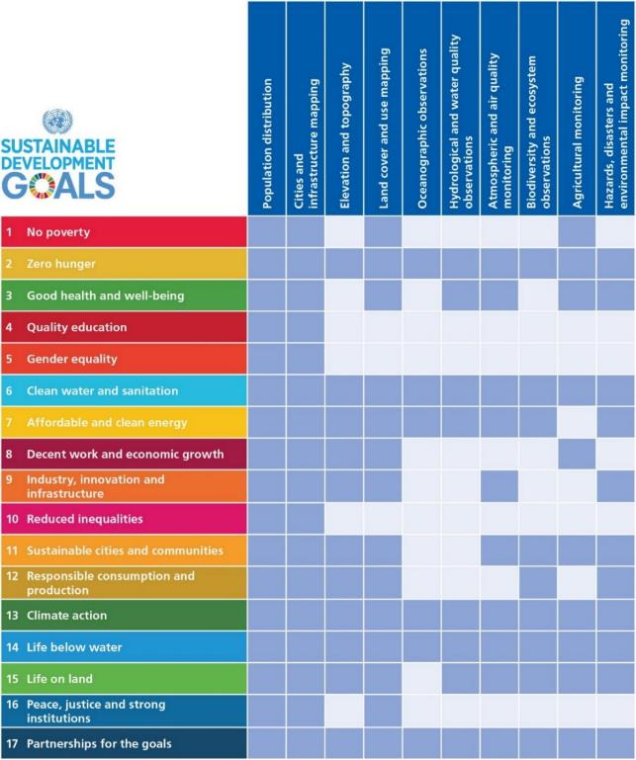
GI-18: Draft Implementation Plan
Focus Preliminary Assessments guiding GI-18 implementation.
Most likely Targets and Indicators that Earth obs. can contribute to (directly or indirectly)
Alignments of the Goals with specific types of Earth obs. and geospatial info.
draft
Notes:
This can be included in the Extra Slides (or at the end of this session)

Slide 18
GI-18: Taking it to scale . . .
Next Steps
Work with statistical agencies to ensure the methods are sound for use with Indicators and Targets
Ensure the methods and solutions are available for all to use
Support countries and stakeholders to use the methods and build capacity
others
Notes:
Global Partnership for Sustainable Development Data
strengthen the inclusivity, trust, and innovation in the way that data is used to address the world’s sustainable development efforts.
Sustainable Development Solutions Network (SDSN)
Develops research themes around various “solutions” topics globally.
Reports on the SDG framework as well as the associated monitoring indicators, and it seeks to play a significant role in their implementation and in the associated processes.
International Institute for Sustainable Development (IISD)
Provides practical solutions to the challenge of integrating environmental and social priorities with economic development.

Slide 19
GI-18: Status and Next Steps
GEO (through GI-18) participation to the Geospatial Working Group set up by the IAEG (Inter Agency Expert Group), in charge of moving forward the implementation of the SDG Indicators framework.
Two side events in the UN Statistic Office in NYC
Continue mapping SDG indicators vs EO data / information
Quick assessment which GEO WP 2017-2019 tasks can support to SDGs by the PB team – to be reported to the GEO-XIII Plenary
Linking the Global Partnership for Sustainable Development Data (GPSDD)
http://www.data4sdgs.org
Support GEO M&POs to apply to the GPSDD Grant Proposal - 2 GEO supported proposals (Univ. of Geneva and IBM) out of 18 total proposals

Slide 20
GEO-XIII Plenary
St. Petersburg, Russia
9-10 November 2016
http://www.earthobservations.org
Twitter: @geosec2025 @barbararyangeo
Facebook: Group on Earth Observations

