Slide 1
CEOS Information Systems Survey
Committee on Earth Observation Satellites
I Petiteville, ESA
SIT Tech Workshop 2016 Agenda Item #8
CEOS Strategic Implementation Team Tech Workshop
Oxford, UK
14th-15th September 2016

Slide 2
Survey Objective
Conducted as part of ongoing efforts to improve the services offered by several core CEOS information services
EO Handbook: http://www.eohandbook.com/
CEOS Database: http://database.eohandbook.com/
COVE: http://www.ceos-cove.org/
CEOS Data Policy Portal: http://www.ceos-datapolicy.org/
Form a better understand how these resources are used, and to study possible future enhancements
Collaboration between the ESA CEOS Database / EO Handbook and SEO teams

Slide 3
Survey Contents
User profile
organisation, location, uses, frequency of use, applications
EO Handbook and CEOS database
current and future features, content, linkages, Climate Chapter, suggested improvements
COVE
use cases and tools, suggested improvements
Data Policy Portal
use cases and tools, suggested improvements

Slide 4
Possible New CEOS DB Features
Suggestions put to users compiled by CEOS DB team:
User assessment of instrument measurements
Note: suggestion not necessarily acceptable by all satellite operators.
User content / tags on Missions and Instruments
Custom Timeline Generator
API access to database information
More historical mission and Instrument content
User community features
Links to:
COVE coverage assessments
WMO's OSCAR/Satellite Database
Data Archives
ECV Inventory

Slide 5
Possible New Features for COVE and Data Policy Portal
Greater links between COVE and the CEOS DB
For example, ability to see COVE coverage assessment embedded in the CEOS DB or linked directly
Improved future COVE forecasting
Product layer overlays
Improved links to and from the Data Policy Portal (e.g. to CEOS DB)
Notes:
COVE just has basic info mission & instruments: name, status, dates, names of instruments …. Could get more if linked to CEOS DB.
Current internal table contains less info than MIM.
Longer time periods and automated reports on the fly coverage forecast tool (check with Brian) to be used for projects e.g. GEOGLAM
Product layer: a few products today like NDVI ,, phenology . New products can be added on request.
Provide dynamically data policy info to CEOS MIM

Slide 6
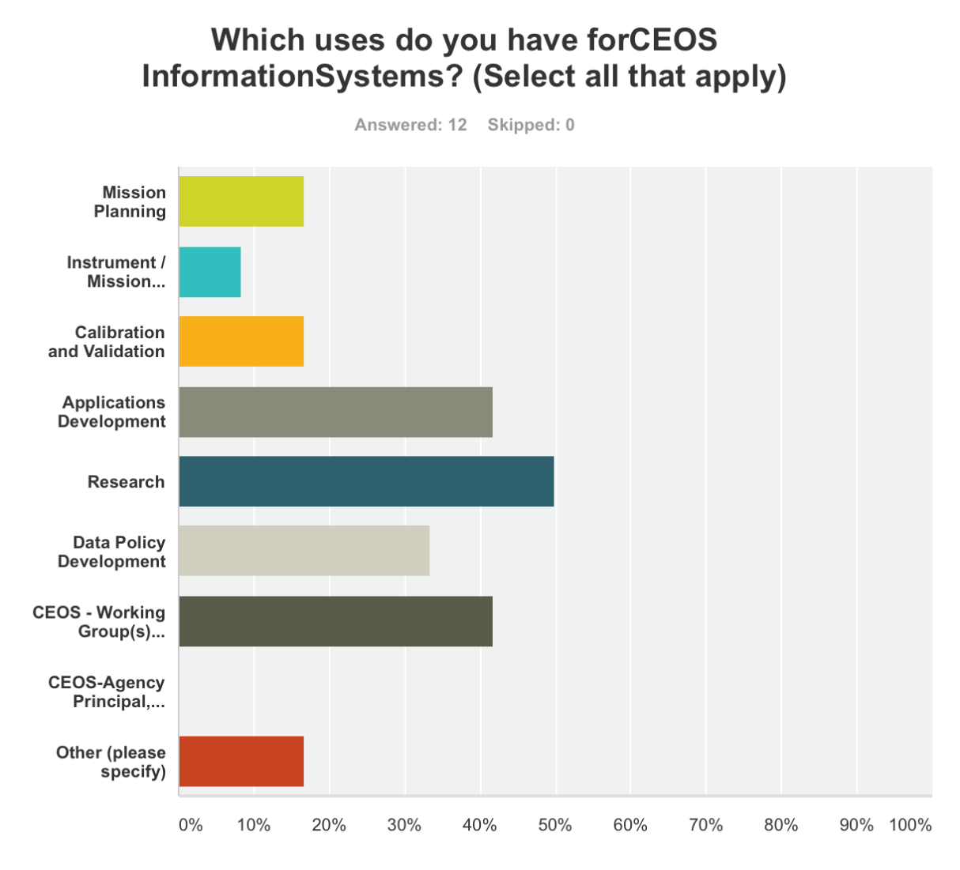
In Progress Response Assessment
12 complete responses since early August opening
Target 50 responses by the end of September
ACTION: Agencies to encourage their members to respond to the CEOS Information Systems Survey by end of September at https://www.surveymonkey.com/r/ceos-info-systems

Slide 7
Sample Responses
Sample of user responses submitted to date:
“Used for coordinating the planning of observations in response to the needs of CEOS Disasters pilots and Geohazard Supersites & National Laboratories (GSNL)”
“Allow the database to provide direct discovery and access of CEOS data.”
“File format information. Data volume calculator.”
“Emergency response - determine which of my missions of interest will cover an area within a specific time frame so I can organise tasking”
Notes:
2nd bullet: access to last products

Slide 8
Next Steps
Keep survey open until end of September and promote response
SIT TWS ACTION
In parallel: complete 2016 agency update survey, and release for CEOS Plenary
Analyze responses received and publish results of analysis prior to Plenary
Work on prioritisation of responses and implementation of selected enhancements after Plenary

Slide 9
Content Questions and Suggestions?
If you have any good ideas, please, respond to the CEOS Information Systems Survey by end of September at
https://www.surveymonkey.com/r/ceos-info-systems

