Slide 1

Analysis Ready Data
Committee on Earth Observation Satellites
LSI-VC – Adam Lewis Co-chair
SIT Tech Workshop 2016 Agenda Item 6
CEOS Strategic Implementation Team Tech Workshop
Oxford, UK
14th-15th September 2016

Slide 2
Analysis Ready Data
LSI-VC were tasked (Nov 2015) to “Define intercomparable Analysis-Ready Data (ARD) products within the context of land surface imaging”
CEOS Analysis Ready Data for Land (CARD4L) is defined at two levels, a General Description and Technical Specifications:
Mature content, ‘on target’
Future refinements to content and
expression may be needed
General Description
minimum characteristics
Technical Specifications
specifically, what is needed
for optical, radar or other
datasets to be CARD4L?
E.g., what is CARD4L
surface reflectance?
Under development, early days.
This will continue to evolve and will
require ongoing work.
Specifications will not change the
General Description

Slide 3
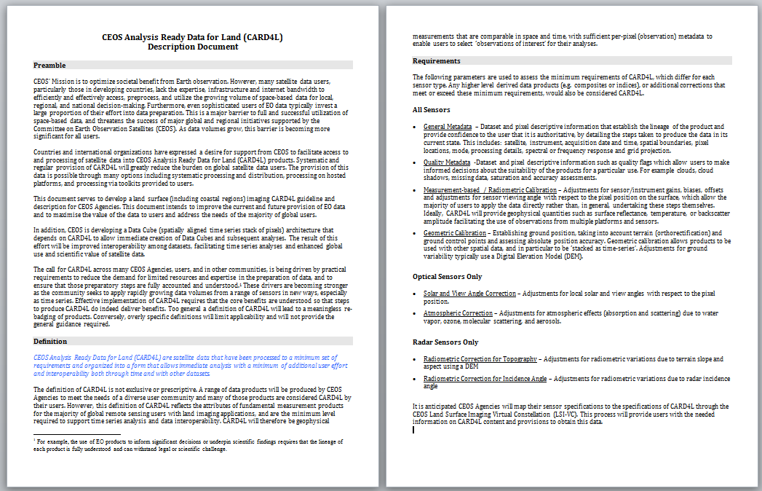
CARD4L – General Description

Slide 4
CARD4L – General Description
Preamble
(1) Data preparation is a major barrier
(2) There is a call for analysis ready data
(3) The need is growing:
data volumes are increasing;
time series analyses are needed;
constellations must be supported

Slide 5
CARD4L – General Description
Definition paragraph
CEOS Analysis Ready Data for Land (CARD4L) are satellite data that have been processed to a minimum set of requirements and organized into a form that allows immediate analysis with a minimum of additional user effort and interoperability both through time and with other datasets
Caveats: not the only products that Agencies will produce for their users.

Slide 6
CARD4L – General Description
Requirements (minimum)
General metadata
lineage; authoritative data
Quality metadata
quality flags; suitability for a particular use
Corrections
allow the users to use the data directly; geophysical measurement of the land surface
Geometric correction
accurate location; data can be ‘stacked as time-series’

Slide 7
CARD4L – General Description
Requirements (optical and radar)
Optical : atmospheric and
solar view angle corrections
Radar: radiometric corrections for
topography and incidence angle

Slide 8
CARD4L – Specifications
LSI-VC were tasked (Nov 2015) to “Define intercomparable Analysis-Ready Data (ARD) products within the context of land surface imaging”
CEOS Analysis Ready Data for Land (CARD4L) is defined at two levels, a General Description and Technical Specifications:
Mature content, ‘on target’
Future refinements to content and
expression may be needed
General Description
minimum characteristics
Technical Specifications
specifically, what is needed
for optical, radar or other
datasets to be CARD4L?
E.g., what is CARD4L
surface reflectance?
Under development, early days.
This will continue to evolve and will
require ongoing work.
Specifications will not change the
General Description

Slide 9
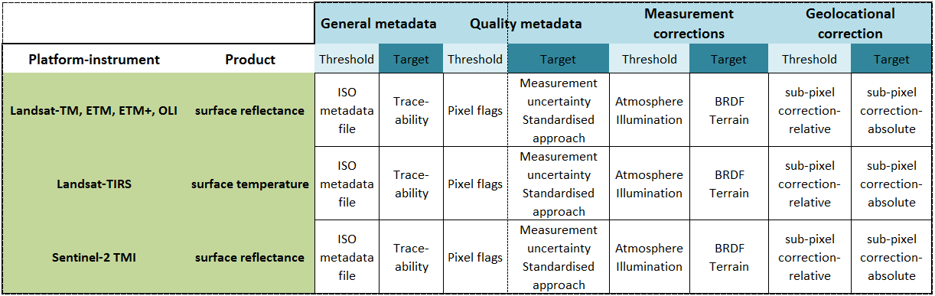
CARD4L – Specifications
Developing specifications (next steps / future work)
Materials will be developed that map CEOS agency products to the high level requirements for CARD4L (possible focus for LSI-VC-3)

Slide 10
CARD4L – Benefits
CARD4L has major benefits for CEOS and users of CEOS data
Many data users will be better off, and more able to make practical use of CEOS data products because they will not need to pre-process the data. Even sophisticated users invest a large proportion of their effort into data preparation.
E.g.: Norm Campbell, CSIRO, 9th Sept 2016, using ARD from the Australian Geoscience Data Cube
“Many thanks, Adam. I’ve been looking at calibrated cloud-free Landsat images for 111-082 for some farms near Quairading, east of Perth, for the period May – October for 2014, 2015 and 2106, which Suzanne Furby downloaded for me. The advantage of the calibrated images is that I can apply the same stretch to all the scenes. Visual inspection of the images shows at a glance the changes that have taken place during the growing season, and the similarity in the responses of the wheat paddocks from year to year. My first impressions of the calibrated data are very positive.***”

Slide 11
CARD4L – Benefits
CARD4L will enable CEOS agencies to better provide interoperable data that can be used for time-series analysis because the data are stackable as time-series and measurement-based.
CARD4L will help users to overcome the challenges of big EO data, by removing the need for users to pre-process larger and larger data volumes.
CARD4L will lead toward more interoperable data between like instruments (eg., Landsat-OLI and Sentinel-2 MSI), supporting CEOS constellations.

Slide 12
Challenges
Closure on the high level definition / description document is needed to allow LSI-VC to focus on the next level of detail
Increased participation is sought from agencies to lead and participate in sub-teams to take this work forward
Specifically, a team is needed to work on specifications for Radar data, with involvement of the major Radar providers

Slide 13
Plenary
DRAFT - Request that Plenary:
Note
the work of the Land Surface Imaging Virtual Constellation to produce a high level definition of analysis ready data (CARD4L) which will deliver significant benefits to many users by removing common pre-processing steps
Accept
the high level definition of CARD4L (CEOS Analysis Ready Data for Land) presented by the LSI-VC
Endorse LSI-VC to continue work
to trial and validate the definition, developing specifications that map CEOS agency missions and instruments to CEOS Analysis Ready Data products through the LSI-VC

Slide 15
Guidance
Presenter Guidance
The SIT Chair Team asks that presenters allow for substantial time (> 50% of allocation) for discussion so be mindful of the agenda time you have been allocated.
Materials should be clearly aligned with the agenda objectives, and formulated in collaboration with the SIT Chair Team prior to the submission deadline.
Reporting to support discussion is encouraged, but historical context and detailed reporting (e.g. review of past meeting dates) should be provided as pre-reading or in background slides.
Materials should be sent to george@symbioscomms.com
  Presentations: no later than Wednesday 7th September

Slide 16
Plenary
Preparations for CEOS Plenary
One of the main objectives of the SIT Technical Workshop is to prepare for CEOS Plenary.
Presenters are encouraged to include a 1-2 slides on the main issues that you are facing for CEOS Plenary, including explicitly highlighting any decisions, endorsements, outcomes, or actions your group will be seeking at Plenary.
Your materials should also highlight any actions or decisions you might require between the Workshop and Plenary.
The more explicit you are with the required actions, the better. i.e. do feel free to propose draft action text for consideration - it may be revised, but will help in the efficient preparation for Plenary.

