Slide 1
Ocean Surface Vector Winds VC status report
Julia Figa-Saldaña, Paul Chang, B.S. Gohil
EUMETSAT, NOAA-NESDIS, ISRO
CEOS WG/VC working day
EUMETSAT, Darmstadt, Germany
16th September 2015

Slide 2
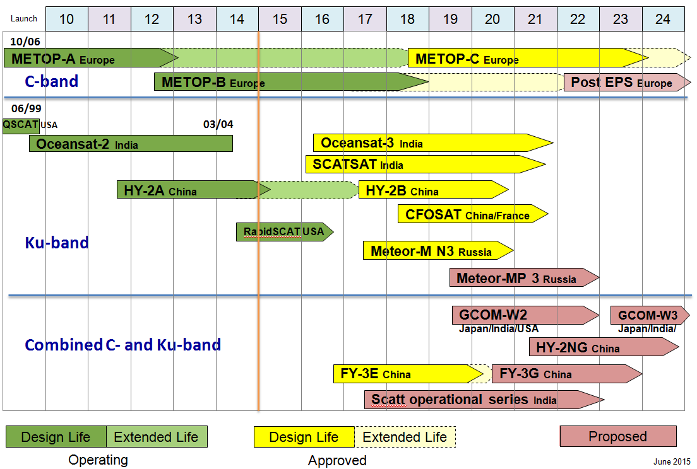
Scatterometer constellation status

Slide 3
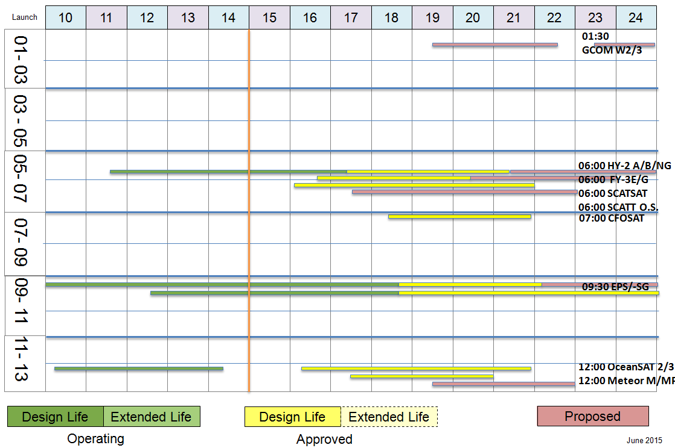
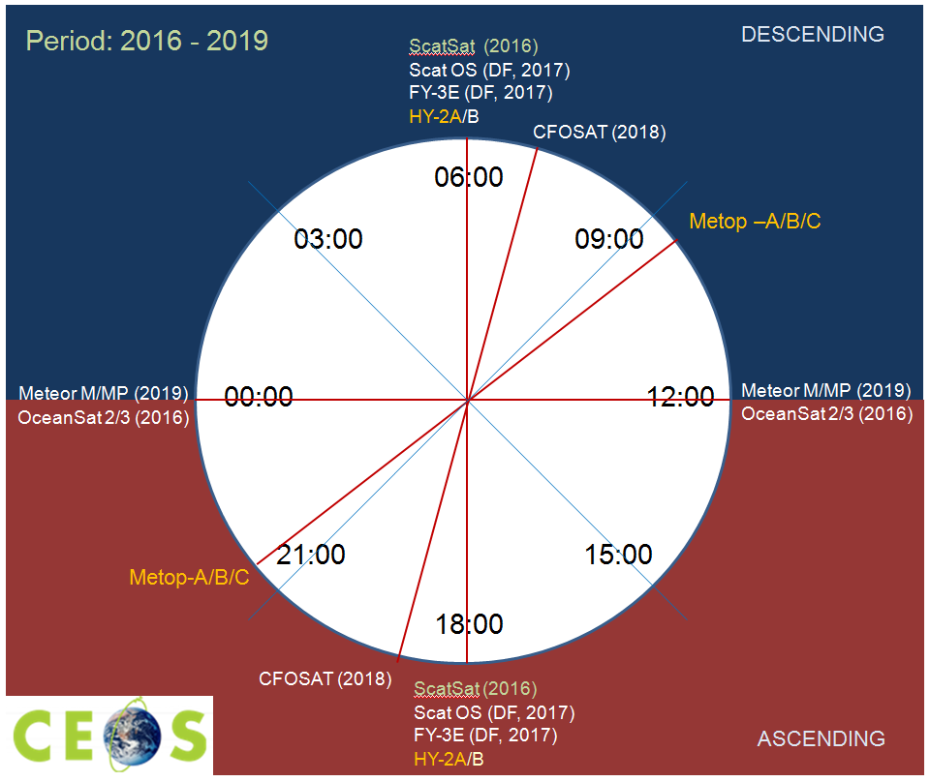
Scatterometer constellation status

Slide 4
Status and main topics since last VC day
Addition of RapidSCAT to the constellation – first opportunity to look into the diurnal cycle, helping to refine the optimum constellation requirement: at least three missions in sun-synchronous orbit (WMO driven), plus one in non sun-synchronous orbit to resolve the diurnal cycle to improve inter-calibration
ScatSAT launch and validation expected early 2016 - work on facilitating data access operationally already ongoing
Updated our CEOS web page
Progress on updating the IDN for ASCAT data sets
IOVWST working groups followed up and with VC participation:
  On data formats and standards
  On climate data sets – main focus being the integration of Ku- and C-band winds
  On high winds characterisation and validation - workshop coming up in December 2015

Slide 5
THANKS

Slide 6
Title
Presenter Guidance
Please focus you presentation on discussion and decision points required to prepare for CEOS Plenary.
Specifically, please present 2-3 slides summary slides addressing:
  Slide 1: Status summary of group / entity CEOS 2015-2017 Work Plan Objectives and Deliverables
  Slide 2: Issues preventing progress towards the realisation of those objectives
  Slide 3: Required steps and/or decisions to overcome or circumvent issues
Please refrain from detailed status updates, but do include relevant background detail in backup slides for participant review offline.
  Do not submit more than 1 non-background slide per minute of item time.
  Additional background slides and/or written reports provided for context and detailed reporting against Work Plan outcomes are welcome.
Presentation materials should be sent to george@symbioscomms.com no later than Monday 7th September 2015.

