Slide 1
Status of ACC Activities
Claus Zehner
ESA
VC/WG Day
EUMETSAT, Darmstadt, Germany 16th September 2015

Slide 2
Overview
ACC Meeting at ESA/ESRIN 28-30 April 2015
Long-Term Ozone Data Set Harmonization
Greenhouse Gas Constellation
Air Quality Constellation

Slide 3
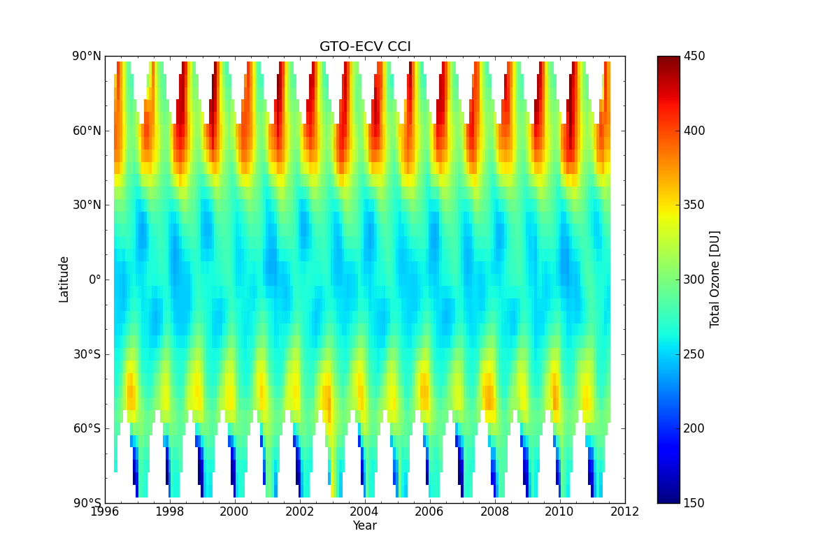
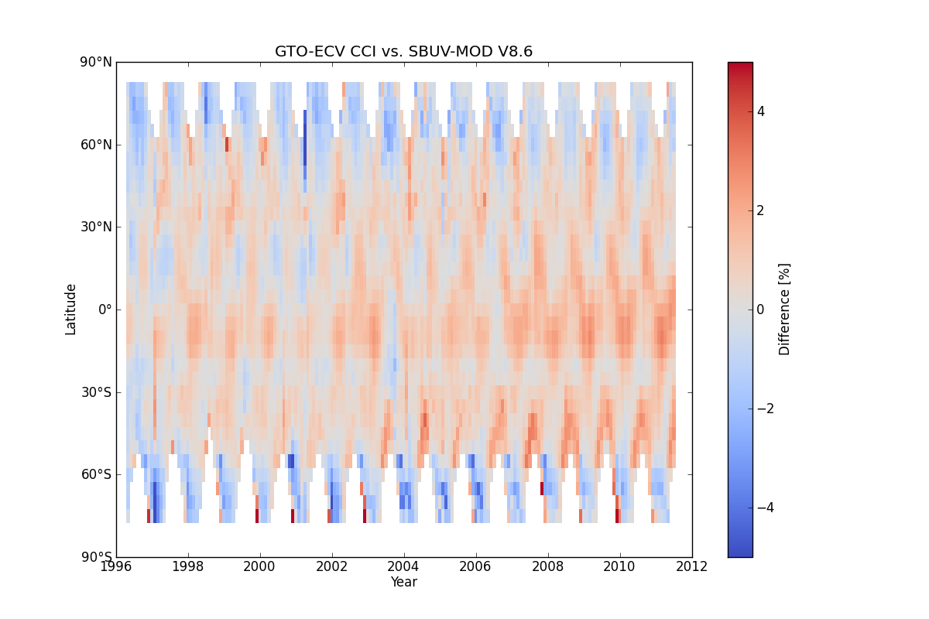
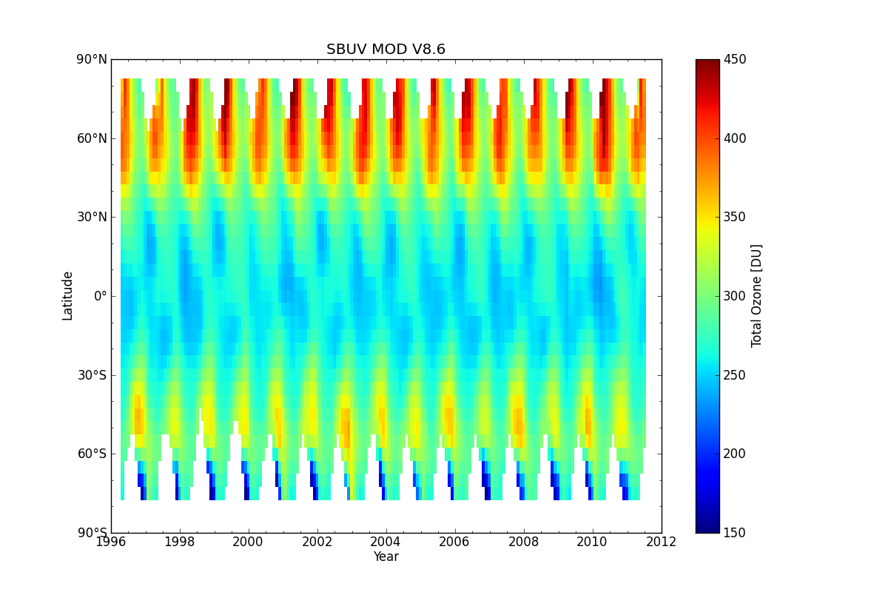
Long-Term Ozone Data Set Harmonization
Total Ozone time-series Intercomparison: NASA SBUV/ESA CCI data sets – very good agreement (~1% range)

Slide 4
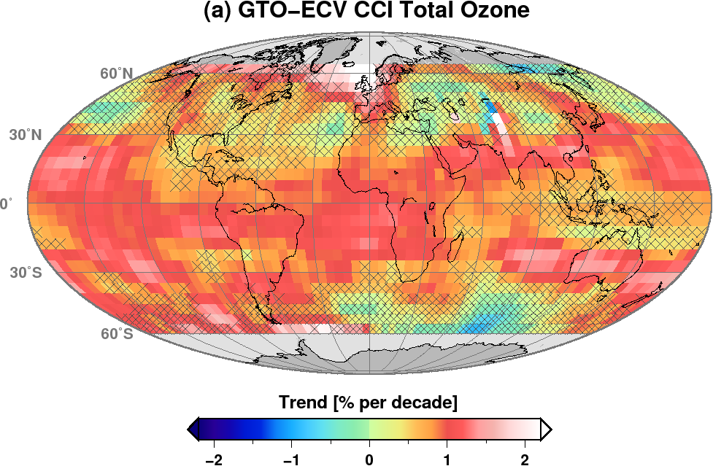
Long-Term Ozone Data Set Harmonization
Ozone Trend Detection: Global and Regional
ACC Data Sets:
replace (monthly) zonal mean values by 5 x 5 deg values – need for taking sampling errors into account
Extend total ozone activities to nadir profile data

Slide 5
Air Quality Constellation
3 geostationary missions on AQ to be launched in the timeframe 2020 in Europe (S4), Korea (GEMS) and in the USA (TEMPO)
1 polar orbiting AQ mission to be launched in Europe next year (S5P)
Ongoing Activities:
Data harmonization activities are underway: Mission leads have been sharing specifications;
An AQ Constellation Geophysical Validation Document is being prepared based on mission specific requirements being developed by the respective agencies
Next: identify goals/approaches for common constellation products and their validation;
Past and upcoming airborne field campaigns offer potential for ongoing collaborative GEO mission preparation and possibly early S-5P cal/val;
AROMAT Romania 2015, 2016 (ESA)
KORUS-AQ Korea 2016 (Korea NIER, US NASA)

Slide 6
GHG Constellation
Huge efforts ongoing in Europe (CCI), Japan and the US to exploit SCIAMACHY, GOSAT, IASI and OCO data
A series of GHG missions are being proposed/under preparation (Japan - GOSAT-2, China – TanSat, Europe – MERLIN, CarbonSat, MicroCarb, IASI-NG, G3E)
Ongoing Activities:
ACC will support the organization of the annual International Workshop on Greenhouse Gas Measurements from Space (IWGGMS)
Agree on an open data policy for GHG data from space and ground-based/in-situ data
Share/agree on mission requirements and support the establishment of a common product format (share specifications, metadata definition, etc.)
Improve interaction/co-operation among space agencies on GHGs
Ensure close interaction between GHG and AQ measurements
Support the establishment of common cal/val standards (e.g. pre-calibration procedures, perform algorithm intercomparisons, provide traceability information, use the same spectroscopy)
Undertake best efforts to add future GHG satellites that overlap with existing GHG satellites missions by at least one year (to, e.g., improve spatial resolution and temporal coverage).
Support the continuation/possible extension of the TCCON network
Link into other related activities, including in-situ measurement coordination (e.g. An Integrated Global Greenhouse Gas Information System)

Slide 7
Planning/Interaction
Next ACC meeting is planned during summer 2016 in Korea (National Institute for Environment Research)
Interaction with other VCs/WGs:
Data harmonization activities
Preparation of instrument inter-calibration of future missions
Preparation of common constellation products and their validation
Long term data sets (e.g. ECVs): are they consistent with other VC data sets?
Synergistic data usage?
Training?

