Slide 1
Information Management
Committee on Earth Observation Satellites
Systems Engineering Office (SEO, NASA)
SIT Workshop Agenda Item #24
CEOS Work Plan Deliverable # OUT-6
2014 SIT Technical Workshop Action # 19
CEOS SIT Technical Workshop
EUMETSAT, Darmstadt, Germany
September 17-18, 2015

Slide 2
Bodhi Morgan Holloway
Born June 4, 2015
Committee on Earth Observation Satellites

Slide 3
CEOS SIT Technical Workshop
EUMETSAT, Darmstadt, Germany September17-18, 2015
CEOS Website
CEOS Social Media Strategy
CEOS Exhibit at the GEO-XII

Slide 4
CEOS SIT Technical Workshop
EUMETSAT, Darmstadt, Germany September17-18, 2015
CEOS Website
CEOS Social Media Strategy
CEOS Exhibit at the GEO-XII

Slide 5
CEOS SIT Technical Workshop
EUMETSAT, Darmstadt, Germany September17-18, 2015
The CEOS Website
Updated appearance
Consistent style/design
User-friendly
Collaborative updating
Document Management
Meeting Registration
News Items & Faces of CEOS Videos

Slide 6
CEOS SIT Technical Workshop
EUMETSAT, Darmstadt, Germany September17-18, 2015
The CEOS Website
Updated appearance
Consistent style/design
User-friendly
Collaborative updating
Document Management
Meeting Registration
News Items & Faces of CEOS Videos

Slide 7
CEOS SIT Technical Workshop
EUMETSAT, Darmstadt, Germany September17-18, 2015
The Document Management System
LOGIN
(contact me for your individual log-in details)
Resources > Document Management

Slide 8
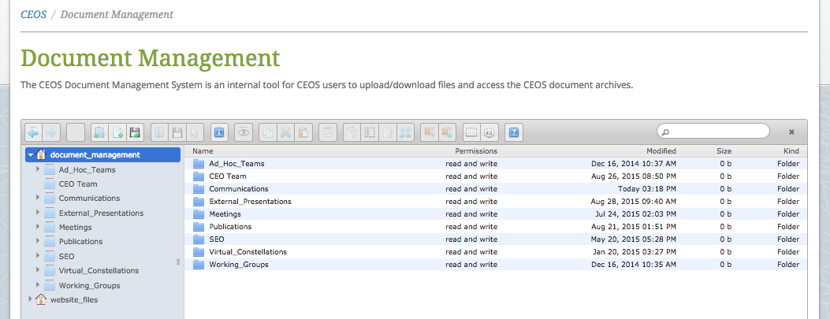
CEOS SIT Technical Workshop
EUMETSAT, Darmstadt, Germany September17-18, 2015
The Document Management System
Contact Kim Holloway for Support

Slide 9
CEOS SIT Technical Workshop
EUMETSAT, Darmstadt, Germany September17-18, 2015
The Document Management System
Upload Files
Download the files you need
Get the link (URL) to your file and share it
Archived Historical Files
Note: Please do not rename/move/change/delete
any file that is not yours.

Slide 10
CEOS SIT Technical Workshop
EUMETSAT, Darmstadt, Germany September17-18, 2015
The CEOS Website
Updated appearance
Consistent style/design
User-friendly
Collaborative updating
Document Management
Meeting Registration
News Items & Faces of CEOS Videos

Slide 11
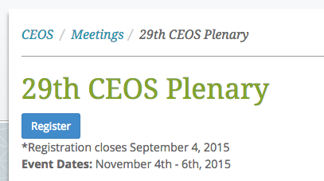
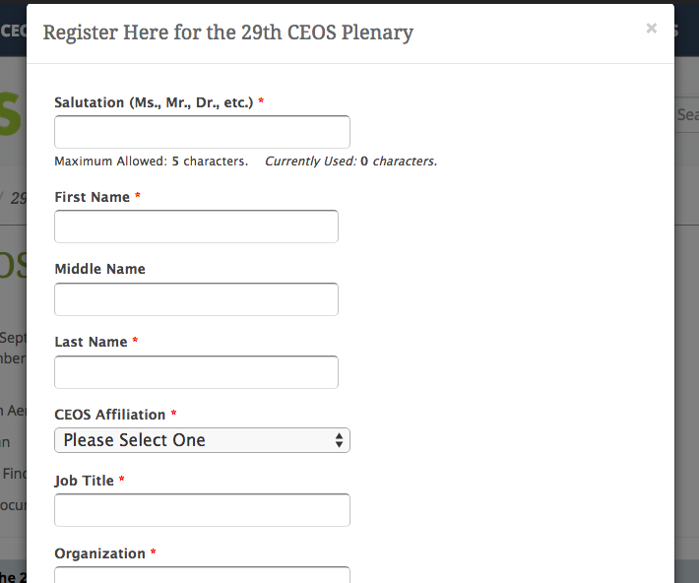
CEOS SIT Technical Workshop
EUMETSAT, Darmstadt, Germany September17-18, 2015
CEOS Meeting Registration
Contact Kim Holloway for Support

Slide 12
CEOS SIT Technical Workshop
EUMETSAT, Darmstadt, Germany September17-18, 2015
The CEOS Website
Updated appearance
Consistent style/design
User-friendly
Collaborative updating
Document Management
Meeting Registration
News Items & Faces of CEOS Videos

Slide 13
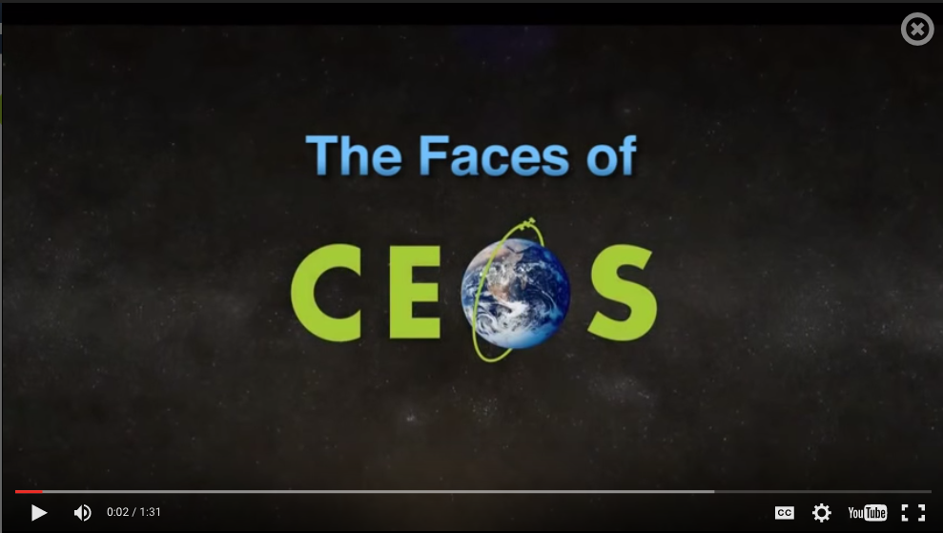
CEOS SIT Technical Workshop
EUMETSAT, Darmstadt, Germany September17-18, 2015
Feature CEOS
News &Events
on the
CEOS Website
Introduce Ourselves: Who We Are &
Why Our Work is
Important
(Plenary, then every 3-4 months)

Slide 14
CEOS SIT Technical Workshop
EUMETSAT, Darmstadt, Germany September17-18, 2015
CEOS Website
CEOS Social Media Strategy
CEOS Exhibit at the GEO-XII

Slide 15
CEOS SIT Technical Workshop
EUMETSAT, Darmstadt, Germany September17-18, 2015
CEOS Social Media Strategy:
Outline the target audience,
objectives, implementation, &
governance of our social
media efforts to:
Engage people interested in CEOS
Create/discover collaborative
opportunities
Share news & information
Manage our reputation
176 Followers!
766 Likes!

Slide 16
CEOS SIT Technical Workshop
EUMETSAT, Darmstadt, Germany September17-18, 2015
Social Media Strategy
Next Steps:
Present at 2015
SIT Technical Workshop
Implement feedback
Submit for decision
at the CEOS Plenary
Contact Kim Holloway to help administer
the CEOS Social Media presence.

Slide 17
CEOS SIT Technical Workshop
EUMETSAT, Darmstadt, Germany September17-18, 2015
CEOS Website
CEOS Social Media Strategy
CEOS Exhibit at the GEO-XII

Slide 18
CEOS SIT Technical Workshop
EUMETSAT, Darmstadt, Germany September17-18, 2015
The CEOS Exhibit @ GEO-XII:
Small exhibition booth
50-inch digital display
Visual content designed
to encourage conversation
& engagement
Outreach materials

Slide 19
CEOS SIT Technical Workshop
EUMETSAT, Darmstadt, Germany September17-18, 2015
The visual content will focus on CEOS activities around:
Climate change
Disaster response
Deforestation
Food security
We will showcase recently launched CEOS Agency missions and released datasets related to these topics, the GEO Societal Benefit Areas, and the GEO "Flagships".

Slide 20
CEOS SIT Technical Workshop
EUMETSAT, Darmstadt, Germany September17-18, 2015
Outreach materials will include:
CEOS and COVE banners
CEOS-branded microfiber cloths
CEOS Newsletter
Other CEOS handouts

Slide 21
CEOS SIT Technical Workshop
EUMETSAT, Darmstadt, Germany September17-18, 2015
Thanks,
everyone!
Contact:
Kim Holloway (SEO)
kim.e.holloway@nasa.gov

