Slide 1
CEOS EO Handbook & MIM Database
Committee on Earth Observation Satellites
Pascal Lecomte, ESA
SIT Workshop Agenda Item #18
CEOS SIT Technical Workshop
EUMETSAT, Darmstadt, Germany
17th – 18th September 2015

Slide 2
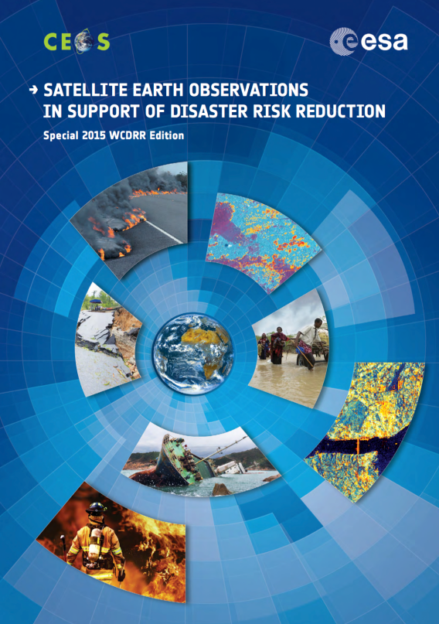
Two EO Handbooks were released in 2015, in support of:
The 3rd UN World Conference on Disaster Risk Reduction
UNFCCC COP21
The CEOS EOHB presents the main capabilities of satellite EO, their applications and a systematic overview of present and planned CEOS agency EO satellite missions and their instruments.
Includes articles tailored to the conference themes.
Aims at raising the awareness of politicians and decision-makers on the benefits satellite EO can bring to society
Disasters
Climate
1900 copies distributed
3600 copies printed

Slide 3
Disasters
Prepared for the 3rd UN World Conference on Disaster Risk Reduction.
Explores how satellite EO can contribute to the related information challenges, across a range of different countries and addressing varying capacity and infrastructure.
Highlights some of the main capabilities of satellite EO, their applications, and the challenges in converting remote sensing data into risk information, helping decision-makers to take appropriate DRR and resilience measures.
Multimedia e-book available for tablets
http://www.eohandbook.com/wcdrr/

Slide 4
Climate
Prepared for the COP21 meeting in late 2015.
Aims to develop a broader understanding of the fundamental importance of satellite EO to the information needed to inform our climate policies on all scales.
Explores how satellite EO can contribute to the challenges of providing the information that society needs in order to accurately characterise the nature of changes to our climate and to help define the most cost-effective strategies for mitigation and adaptation.
Multimedia e-book in development
http://eohandbook.com/cop21/

Slide 5
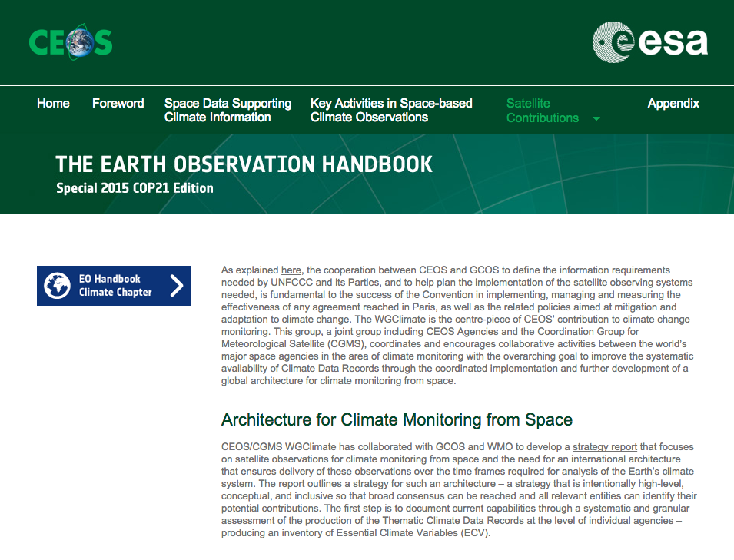
Climate
In addition to CEOS Members and Associates, copies are being sent to key delegates and organisations in advance of COP21 to ensure maximum impact.
Copies will be distributed at COP21, the JAXA Data Applications Symposium, CEOS Plenary, GEO Plenary (and SIT Technical Workshop!)
Significant work is also being done to include the GCOS IP and CEOS Response to the GCOS IP in expanded EO Handbook climate pages prior to COP21

Slide 6
CEOS MIM Database
COP21 Edition web content will link to the expanded EO Satellite Capabilities content available from the last ‘full-size’ EO Handbook and to the CEOS MIM Database, including:
Instrument type explanations
Measurement type explanations
Detailed supply timelines
Comprehensive missions and instrument tables
Information on about 270 EO satellite missions, 800 instruments.
Powerful query and export tools via the database
2015 survey process very smooth – thanks to all Agency Contacts
A number of exciting new capabilities on the slate
31 of 34 surveys returned – only 1 major agency missing

