Slide 1
Update on CEOS Support to GFOI
S. Briggs, S. Ward
ESA, GFOI Office
SIT Workshop Agenda Item #9
CARB-3/4/5 CEOS SIT Technical Workshop
EUMETSAT, Darmstadt, Germany 17th-18th September 2015

Slide 2
GFOI Components
Space Data
GFOI works with space agencies through CEOS to ensures the long-term, world-wide acquisition of core satellite data
Capacity Building
GFOI provides capacity building in coordination with others such as UN-REDD. It supports the use of satellite and ground data to monitor forests, and estimate GHGs.
Methods and Guidance
Guidance on integrating remote-sensing and ground-based observations for estimation of emissions and removals of greenhouse gases in forests.
Research and Development
Identifying and promoting R&D needed for practical, global implementation of National Forest Monitoring
GFOI Office
Coordination and Management
helps countries meet their individual data needs

Slide 3
Plan for CEOS Plenary
Documents
The following documents have been prepared for SIT Technical Workshop for information:
2014 Global Baseline Data Acquisition Strategy Implementation Report
The SDCG will present the following documents to CEOS Plenary:
Updated SDCG 3-Year Work Plan [in response to SIT 30-16]
SDCG Mandate
SDCG will seek an extension of its mandate at CEOS Plenary

Slide 4
Issues for Attention
Global Data Flows Study
The Global Data Flows Study has been initiated to define efficient and effective data flows, in particular in support of GFOI Standard Products derived from core data streams (currently Landsat-7/8 and Sentinel-2A).
It seeks to develop a more strategic understanding, including in light of the trends towards ‘analysis-ready data’, about where data needs to be and in what format, and how it can most efficiently get there.
Three scenarios are being compared and contrasted:
Business as Usual – Level 1 data is delivered to the user. All processing and analysis is done by the user;
New Scenario #1 – Analysis Ready Data is transferred to an intermediate location (commercial cloud, partner agency, regional hub etc.) and only the final products are downloaded;
New Scenario #2 – Analysis Ready Data products are shipped to the user. These are hosted locally, and all of the analyses are done in country – whether that be scene based or Data Cube based is up to the user.
(See slide 10 for more information on the scenarios)

Slide 5
Issues for Attention
Global Data Flows Study
Includes references to USGS Analysis Ready Data, the Geoscience Australia Data Cube, as well as pilot efforts being led and implemented by the SEO.
Participation in the study team has been confirmed (representatives from EC, GA, CSIRO, NASA, ESA and USGS).
Will support the 2016 CEOS Chair initiative on Next Generation Data Architectures
The SIT is asked to notify SDCG of any relevant activities underway within CEOS agencies or CEOS groups

Slide 6
Issues for Attention
Succession of the CEOS GFOI Lead
Stephen Briggs will step down in February after the GFOI Plenary at ESA ESRIN. The ideal candidate will be:
able to attend the majority of GFOI Lead meetings (1-2 annually in person, 2 by phone)
available for 1 SDCG meeting annually (associated to the above)
able to attend 1 major CEOS meeting annually (SIT or Plenary)
hold a senior position in an (existing or potential) GFOI space data provider agency
a strong advocate and ambassador – not necessarily technical
A CEOS Plenary action is anticipated to ensure that a replacement is identified sufficiently ahead of time
SIT is asked to consider possibilities ahead of CEOS Plenary

Slide 7
CEOS 2015-2017 Work Plan Objectives and Deliverables
Latest Action Status
CARB-03
Strategy on supply of data in support of GFOI R&D activities
Complete. The Element 3 strategy was endorsed at SIT-30.
CARB-04
CEOS delivery of coordinated land surface observations for GFOI countries
CEOS is acquiring coordinated land surface observations for GFOI countries in accordance with the endorsed strategies. This activity also includes support for the delivery of a Data Services Pilot Project for Kenya, which is being developed in part with the support of the CEOS SEO; the pilot will test data storage, processing, and archive search/discovery tools. The implementation will be based on Data Cube technology.
CARB-05
Updated Global Baseline Data Acquisition Strategy for GFOI and Space Data Services Strategy for GFOI
Updates to these strategies will be discussed next week at SDCG-8, but are likely to be minimal.

Slide 8
Background/Reference Slides

Slide 9
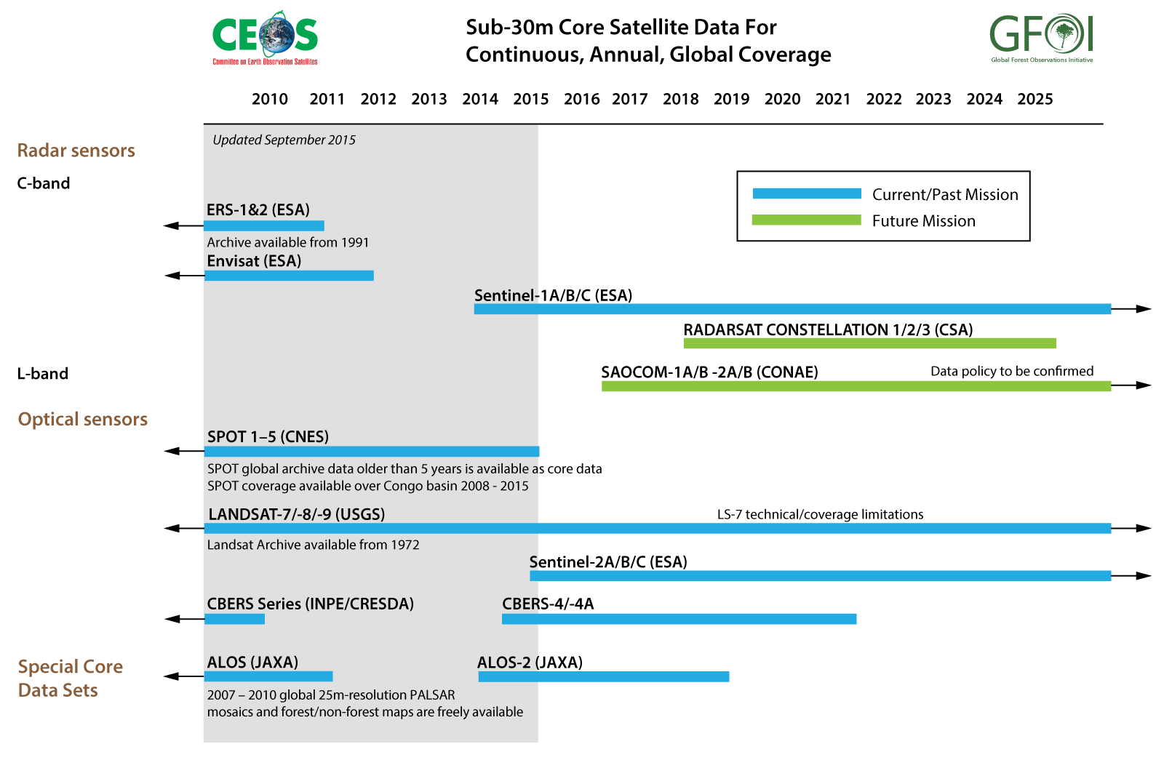
Element 1 – Global Baseline

Slide 10
Element 1 – Global Baseline
Global Baseline Data Acquisition Strategy Update
Latest Core Data Satellite: Sentinel-2A launched on 23 June 2015
Data available publicly after end of commissioning phase in Oct. 2015
➔ https://sentinel.esa.int/
Notes:
Example over Amazon forest in Brazil ➔ zoom to full resolution

Slide 11
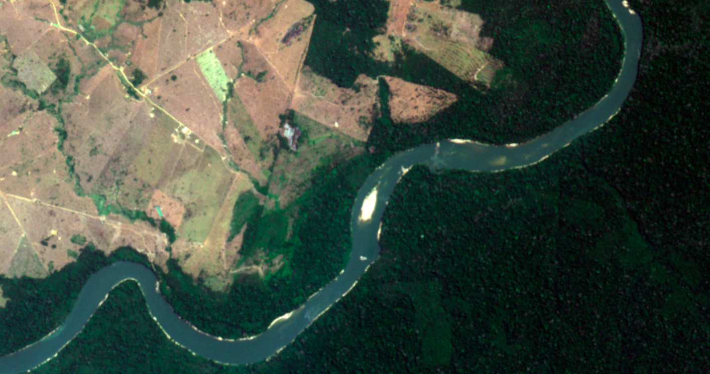
Element 1 – Global Baseline
Global Baseline Data Acquisition Strategy Update
Latest Core Data Satellite: Sentinel-2 launched on 23 June 2015
data available publicly after end of commissioning phase in Oct. 2015
➔ https://sentinel.esa.int/
Notes:
Example over Amazon forest in Brazil ➔ zoom to full resolution

Slide 12
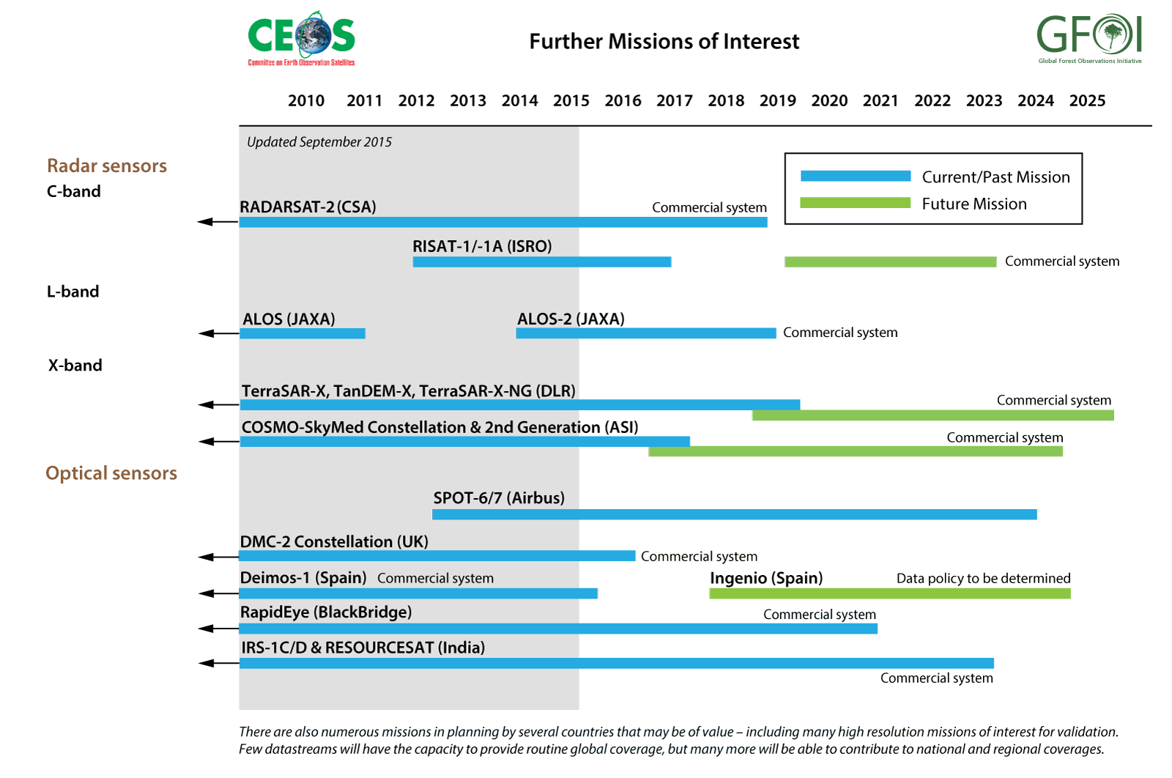
Element 1 – Global Baseline

Slide 13
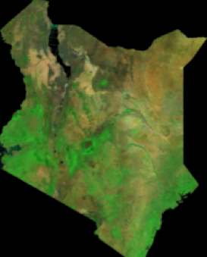
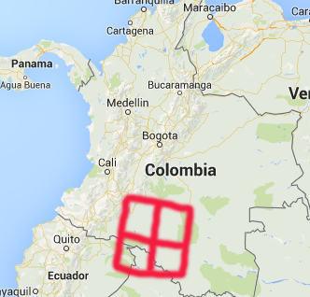
Element 2 – Space Data Services
The SEO is making good progress on the development of the Kenya Data Cube. Currently completed ingestion software to create a 15-year Landsat cube of Kenya and a reference user interface for custom mosaic creation to support forest mapping.
The SEO is working with CSIRO and GA to release all of the Data Cube infrastructure elements on an open source software site in Sept 2015. Countries will be able to develop their own Data Cubes and connect it to a reference user interface, for free!
The Data Cube project will expand to Colombia in 2016 and will expand dataset layers (e.g. ALOS mosaics, Sentinel-1/2, SRTM, MODIS, SPOT-5).
The SEO will continue to develop and support traditional scne-based tools, similar to SEPAL (used by FAO). These tools will also be available in the open source site.

Slide 14
Global Data Flow Scenarios
Space Agency
In-Country Users
Hard Drive Delivery or Internet Download
Countries perform processing and data analysis locally
Satellite Level-1 Data
BAU
Business-as-Usual
Space Agency Processing into Level-2 SR products
Hard drive delivery or internet download
Local storage and processing
Country analyses using scene-based tools or a Data Cube (assumes countries create their own Data Cubes using CEOS open source tools or utilize CEOS support to initialize a baseline Data Cube)
Scenario-2
Satellite “Analysis Ready” Data Products
Scenario-1
Intermediate Data Storage and Processing (Cloud-based or Data Hubs)
Scene-based tools
Hosted Data Cube and tools
Country analyses performed on Cloud or Data Hub
Countries download analysis products via Internet

Slide 15
Element 3 – R&D
Data Supply in Support of GFOI R&D Activities Update
SDCG Element 3 strategy endorsed at SIT-30.
R&D focus provides a means for CEOS agencies with commercial missions to actively contribute to GFOI objectives.
GFOI R&D Plan
- Coordination of R&D towards GFOI priority topics
- Mechanism for integration of new methods in GFOI MGD
- Management of research groups
- New management and coordination by GOFC-GOLD LC Office (Oct 2015)
Element-3 contributing agencies: ASI, CNES, CSA, DLR, JAXA + “Core Mission” agencies: ESA, INPE and USGS.
SDCG Element-3 coordination of satellite data acquisitions and dissemination to GFOI R&D teams is on-going.

Slide 16
SDCG-8
8th Space Data Coordination Group Meeting (SDCG-8)
23rd – 25th September 2015, DLR, Bonn, Germany
SDCG-8 is the first SDCG meeting since the adoption of the group’s 3-Year Work Plan, and will be structured in accordance with the Plan structure and outcomes.
Follow on from a two-day REDD+ workshop co-hosted by DLR and BMZ/GIZ on the development of national MRV systems – with an emphasis on forest degradation issues.
Of note is the SDCG-8 GFOI Space Data Commercial Provider Day
For more information: http://www.gfoi.org/sdcg-8/

Slide 17
Other GFOI Component Updates
In the period 2015-17 each of the GFOI components will be working to improve existing outputs and to build new capacity in the following directions:
Methods and Guidance: Development of basic methodological guidance documents in several languages; translation of methodology into a hands-on user-driven MGD Web Application, which will target MRV in-country technical specialists, present material tuned to individual needs based on guidance presented in the MGD, and provide linkages between pillars of GFOI such as available tools and training materials; continued generation of MGD Rapid Response Modules and Training Materials to respond to new technologies and emerging reporting approaches; and production of MGD Version 2.0 as an update and improvement on V1.0, increasing its ease of use for non-specialists

Slide 18
Other GFOI Component Updates
Capacity Building: Continued GFOI regional capacity building workshops with increased MGD integration, based on regional capacity building needs and requests from countries; development of a bilateral capacity building plan for 10 countries to support specific MRV technical capacity needs; increased contributions to the MGD; preparation of training materials; and hosting of the Second GFOI Capacity Building Summit to assess progress on the Manual for Best Practices to Implement Capacity in REDD+ Countries, which was recommended as an outcome of the first Summit.
R&D: New R&D component management by GOFC-GOLD LC Office (under ESA contract for 1.5 y); initialisation and coordination of R&D activities in parallel with SDCG Element-3 strategy implementation; managing participating (external) research teams and reporting; coordinating Expert workshops and a GFOI Science meeting; updating the GFOI Review of Priority R&D Topics and R&D Plan; contributing to the update of the GFOI MGD and the REDD Sourcebook.

