Slide 1
CEOS WG Disasters Report
Committee on Earth Observation Satellites
Ivan Petiteville, ESA
SIT Workshop Agenda Item # 7 e
CEOS Action / Work Plan Reference
CEOS SIT Technical Workshop
EUMETSAT, Darmstadt, Germany
17th – 18th September 2015

Slide 2
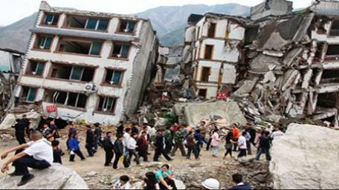
CEOS Activities in Support to DRR
Single Hazard:
Floods, Seismic Hazards & Volcanoes Pilots
Multi-Hazard:
Geohazards Supersites
Recovery Observatory Pilot

Slide 3
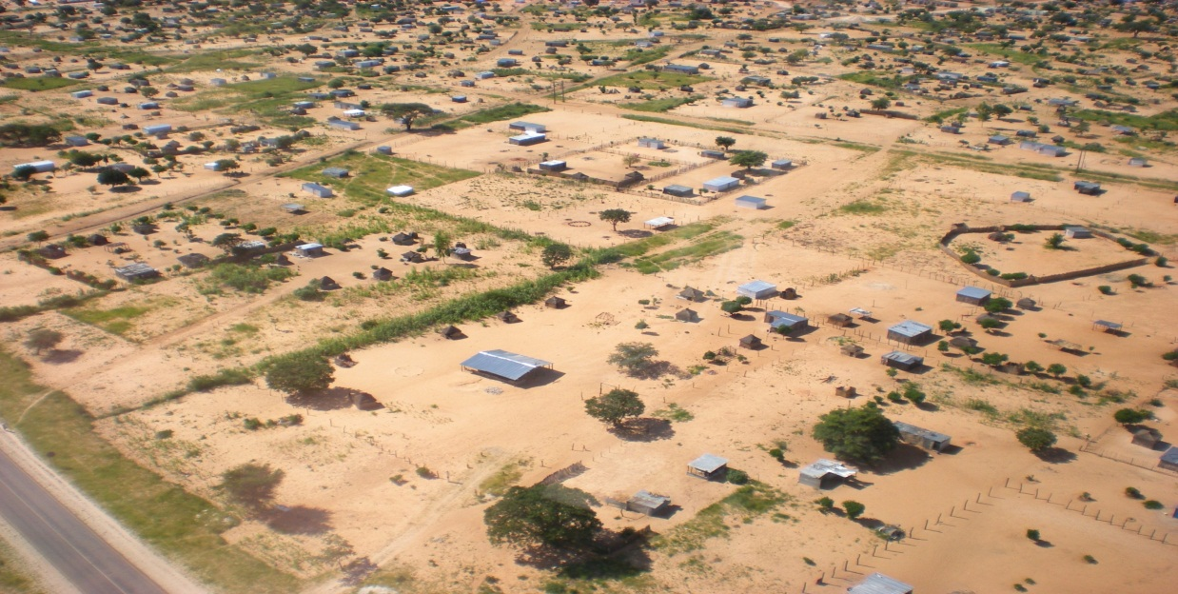
Single Hazard Pilot Projects
Series of on-going end-to end projects (end in 2017) to demonstrate benefits of satellite EO to ALL DRM phases, with strong user involvement
Floods, Seismic Hazards and Volcanoes are progressing very well with several positive feedback from end users.
Conditions met to start a new pilot focused on landslide following a multi-hazard approach.
NASA staff with two Namibian agents (Namibian Department of Water Affairs and Forestry) and one villager
Courtesy NASA.
Notes:
ESA with NASA are exploring the value of a multi-hazard landslide pilot, which includes
- Primary triggers from other hazards (wildfires, rainstorms, earthquakes, volcanoes, permafrost degradation, sedimentation, high stream flows, and inundation) and man-made development activity;
- Secondary cascading hazards from slope failures, mudslides, diverted or blocked streams, dam burst floods, debris flow, displacement waves and tsunamis; and
- Infrastructure impacts such as damaged roads-rail lines and utilities

Slide 4
Why a Landslide Programme ?
Several CEOS agencies (NASA, USGS, ESA, CSA, ASI) are or have been involved in various landslide research projects (optical, radar and precipitation based methods).
Pooling satellite assets in coordinated framework offers broader range of observations to support research.
Take advantage of newly available (e.g. Sentinel-1 and 2, ALOS-2) and planned EO missions (e.g. the NASA-ISRO Synthetic Aperture Radar, NISAR).
High priority needs and objectives from user community rather well known

Slide 5
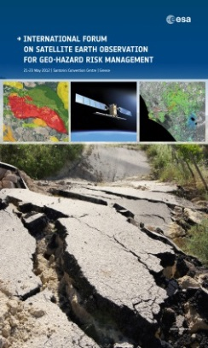
Objectives of the Landslides community
Defined through an open review process (the Santorini Conference, 2012):
Objective A:
Develop comprehensive EO-based inventories of known landslide hazard areas currently unmapped or insufficiently mapped to better understand the extent of the hazard.
Objective B:
Within priority areas, monitor hotspots using regular satellite EO monitoring on a semestrial to monthly basis, using both optical and radar imagery and derived products.
Objective C:
Develop outreach programs, capacity building and demonstration projects with national authorities to increase use of EO and promote acceptance of EO as a standard.

Slide 6
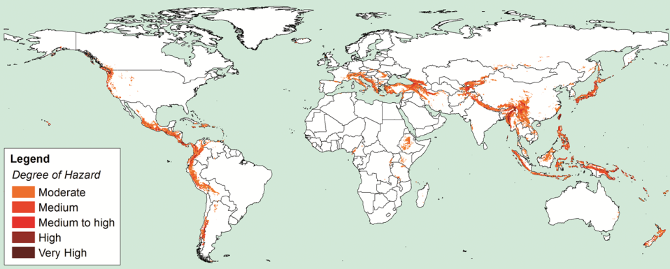
Long-term Landslide Priority Areas
Global Landslide Hazard Distribution, Nadim et al., 2006

Slide 7
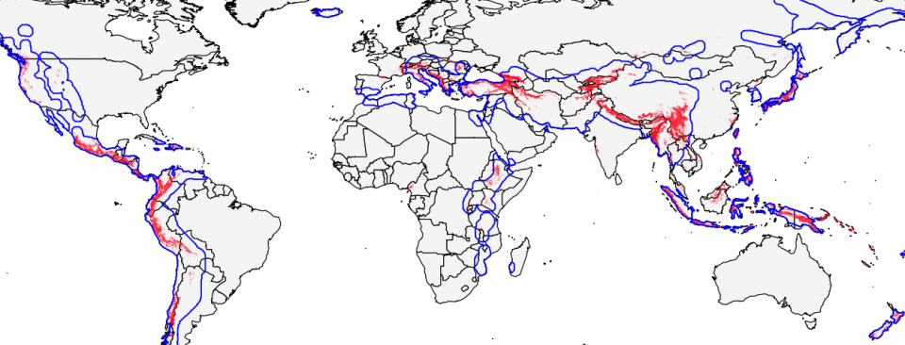
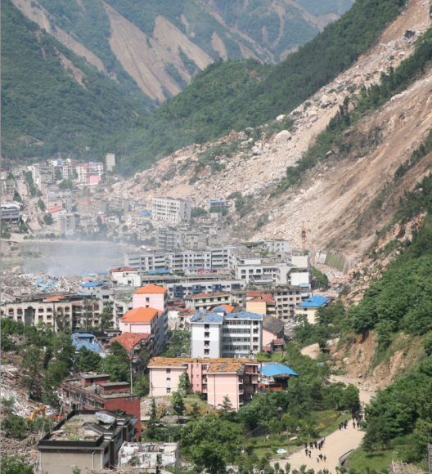
Landslide priorities and Seismic hazards
Priority areas (red): comparison with priority areas of CEOS Pilot on seismic hazards (blue)
Large overlap overall.
Identical observation requirements (e.g. concerning INSAR).

Slide 8
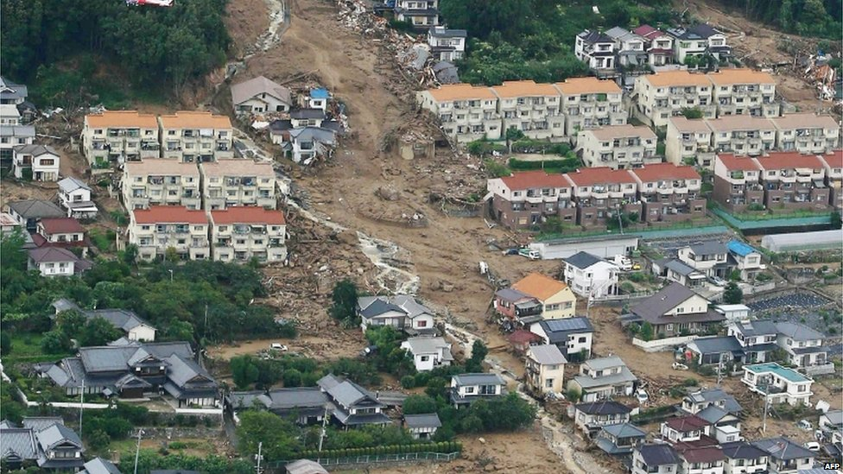
Landslide Pilot – Who are the Users ?
Landslides Pilot users are typically:
Scientists
Civil Protection Authorities
Organisations with a mandate in DRR
Policy Makers & Planners
Citizens
Other end–users
Areas identified by preliminary contacts (national users, international organisations e.g. UNITAR, UN ESCAP, etc):
Africa (Uganda, Burundi, Rwanda)
Latin America (Central America/Caribbean)
North America (USA, Canada)
Europe (Italy, Spain, Swizerland, Greece)
South Asia (Nepal, Bhutan)
Major landslide near Hiroshima, Japan (72 deaths, 2 missing), August 2014. Credit: AFP

Slide 9
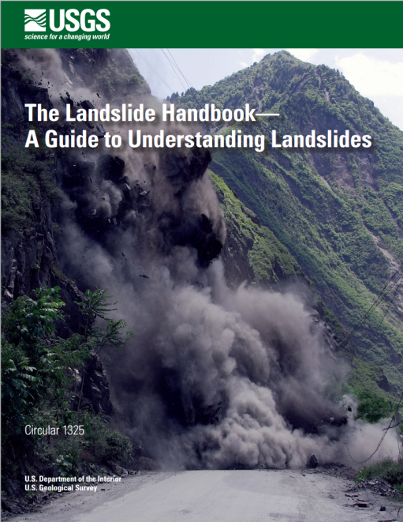
Landslides Pilot Team
Several agencies interested to cooperate on landslides, induced by geohazards and hydromet hazards:
NASA, ASI, ESA, CNES, CSA and CAS
TBC for USGS, NOAA, DLR and NRCAN
Dahlia Kirschbaum (NASA) and Fausto Guzzetti (Director of Italian Research Institute for Geo-Hydrological Protection – CNR) volunteer to co-lead the Landslide Pilot team
Project Proposal will be refined and presented to CEOS Plenary for endorsement

Slide 10
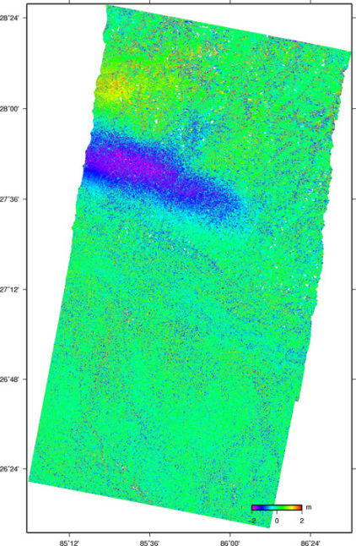
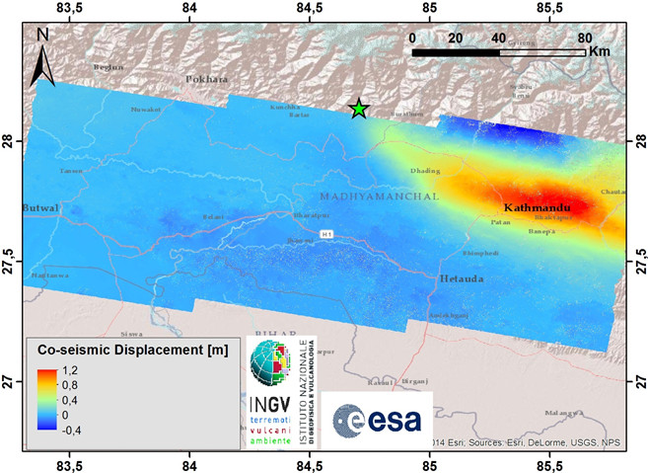
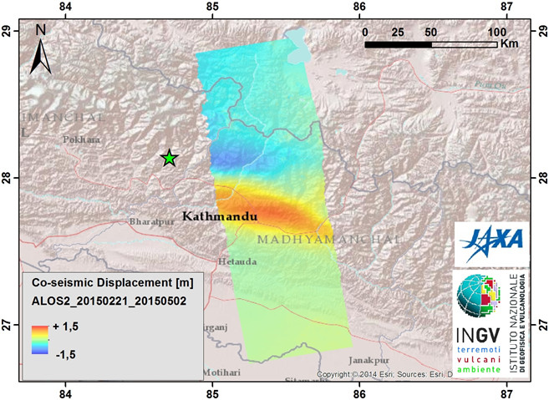
Multi Hazard Pilot Projects –
Supersites
Data delivered to all Supersites incl. last ones endorsed by CEOS :
Tungurahua & Cotopaxi volcano (Ecuador) | COSMO-SkyMed and TerraSAR X
Taupo volcanic zone (New Zealand) | TerraSAR X and RADARSAT-2
Nepal earthquakes | +600 images from COSMO-SkyMed, TerraSAR X, RADARSAT-2, Sentinel-1 and ALOS-2)
RADARSAT-2
interferograms
(©NRCAN)
Coseismic displacement field (25 Apr. 2015,)
M 7.8 Gorkha, Nepal Earthquake, Sentinel-1
images (Apr. 17 and Apr. 29, 2015).
Same product with ALOS2 images,
(Feb. 21 and May 2, 2015)
Notes:
Stakeholders actively engaged or being engaged
GFDRR/World Bank and UNDP have joined RO Oversight Team. Discussion with Red Cross.
EC being approached through “Copernicus EMS”

Slide 11
Multi Hazard Pilot Projects –
Recovery Observatory
RO TEAM:
Space agencies: CNES, ASI, DLR, ESA, JAXA, NASA
DRM Stakeholders: UNDP, UNOSAT, World Bank/GFDRR.
Copernicus EMS Risk and Recovery interested to join.
Other partners: CURBE (Univ. of Cambridge), COPE (Univ. of Copenhagen)
STATUS:
Recovery Observatory ready for triggering since early 2015.
Collaboration attempted on Cyclone Pam (Vanuatu –Lessons Learned Report with recommendations).
Possible further collaboration (Post Disaster Needs Assessments (PDNA) before RO?) late 2015 to establish operational linkages.
Updated RO Triggering procedure issued.
Significant progress made in past few months on End user product definition, Infrastructure and Licensing issue.
Notes:
Stakeholders actively engaged or being engaged
GFDRR/World Bank and UNDP have joined RO Oversight Team. Discussion with Red Cross.
EC being approached through “Copernicus EMS”

Slide 12
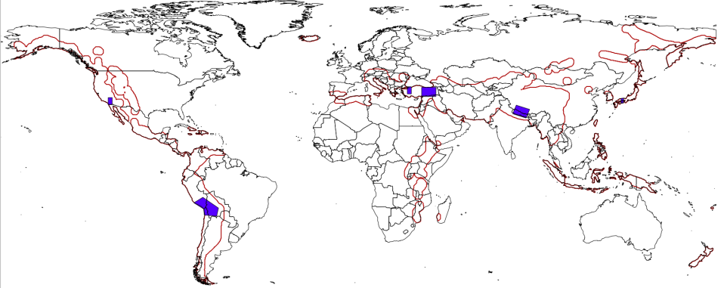
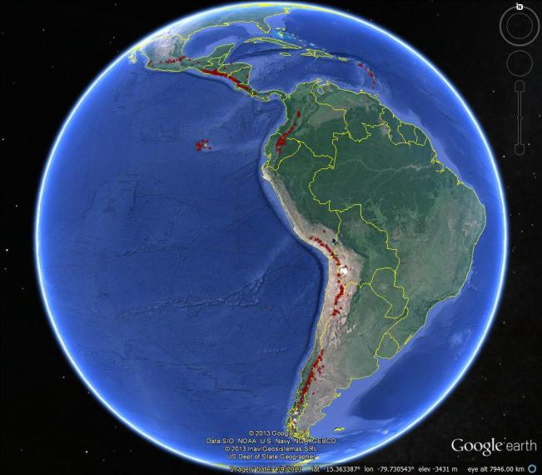
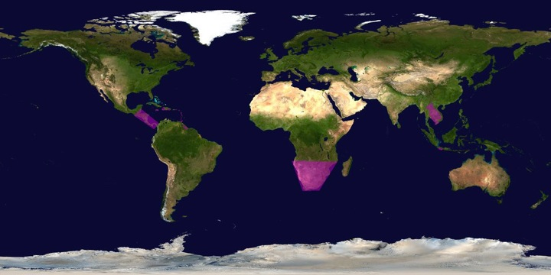
Some Pilots’ Success Stories
Both global and regional activities.
SEISMIC HAZARDS
VOLCANOES
FLOODS

Slide 13
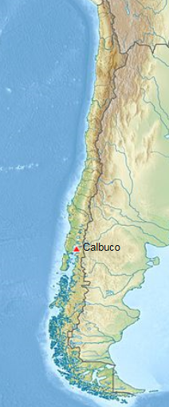
Volcanoes: Calbuco, Chile
After 43 years of quiescence, Calbuco, Chile, began erupting on 22 April 2015, with very little warning.
Large amount of ash (more than 0.1 km3) with significant impact on air traffic on Chile and Argentina. Several thousand people were evacuated from villages closest to Calbuco .
Ash was tracked using data from the pilot and was communicated to VAAC in Buenos Aires.
SAR data from the pilot project were used to characterize co-eruption surface deformation, which helps to constrain the location of the magma body that fed the eruption.
Other interferograms constrain the deformation to have started no later than 1.5 days before the eruption, and to have lasted no more than 1 day.
Partner agencies: SERNAGEOMIN (Chile); Buenos Aires Volcano Ash Advisory Center (Argentina); University of Bristol (UK); Cornell University (USA); NOAA (USA)
Notes:
Preliminary model of the deflation indicates that the source is located about 5 km SW of the volcano’s summit at a depth of 9.3 km beneath the surface, with a volume changes of ~0.045 km³. This source geometry and strength is consistent with recordings from a tiltmeter located 4 km W of the volcano.

Slide 14
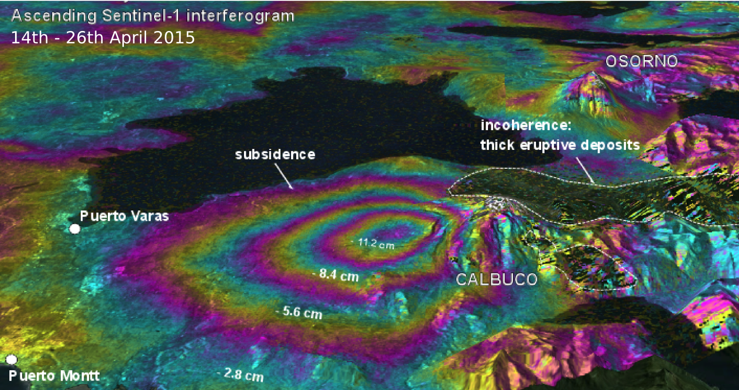
Volcanoes: Calbuco, Chile
Perspective view of deformation at Calbuco as determined from a Sentinel-1a interferogram
Coeruptive ascending Sentinel-1 interferograms show deflation with a maximum line of sight change of 12 cm located on the west flank of the volcano.

Slide 15
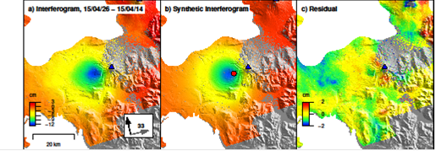
Volcanoes: Calbuco, Chile
Observed (left), modeled (center), and residual (right) deformation at Calbuco from a Sentinel-1a interferogram spanning April 14–26, 2015. Deformation can be approximated by a source at ~9 km depth beneath the volcano’s west flank.
Observatorio Volcanológico de Los Andes del Sur (OVDAS) used this source model to validate their tilt meter records

Slide 16
Volcano Pilot: User Communities in Latin America
SERNAGEOMIN, Observatorio Volcanológico de Los Andes del Sur (OVDAS) Chile;
Observatorio San Calixto, Bolivia;
Instituto Geofísico del Perú;
Instituto Geofísico de la Universidad Nacional de San Agustín, Peru;
Instituto Geofísico, Escuela Politécnica Nacional, Ecuador;
Servicio Geológico Colombiano, Colombia
Buenos Aires Volcanic Ash Advisory Center, Argentina
Instituto nacional de sismología, vulcanologia, meteorología e hidrologia, (NSIVUMEH), Guatemala
Instituto Nicaraguense de Estudios Territoriales (INETER), Nicaragua

Slide 17
Floods Pilot: How Data Are Being Exploited
Geographic Area | Product | Value Added Partner
Haiti | Flood extent maps, flood risk maps, landslide maps, flash flood guidance / threat maps, integrated risk assessment platform | SERTIT, CIMA, INGV, Altamira, CIMH, RASOR FP7, NOAA/HRC
Other Caribbean islands, Central America | Flood damage maps, change detection products, co-registered map overlays | CATHALAC, CIMH, NASA/GSFC
Namibia | Flood extent maps, flood warning products, co-registered map overlays | Namibia Hydrology Dept, Namibian Water Authority, NASA
Zambezi basin | Flood extent maps, flood forecast models, flood hazard maps, flood depth forecasts | Lippmann Institute (PAPARAZZI, HAZARD, WATCHFUL), DELTARES, NASA/JPL
Mekong | Flood extent maps, flood risk maps, flash flood guidance / threat maps | Mekong River Commission, NASA, NOAA/HRC, USGS, University of South Carolina, Texas A&M
Java (Bandung, Jakarta, Cilacap) | Flood risk maps, subsidence maps tied to flood risk, tsunami risk maps (Cilacap only), flood extent maps | SERTIT, Deltares, CIMA, Altamira, INGV, RASOR FP7
Products used by: national end users, civil protection agencies, World Bank,
Red Cross, World Food Program, River Commissions (Kavango, Zambezi,
Mekong)

Slide 18
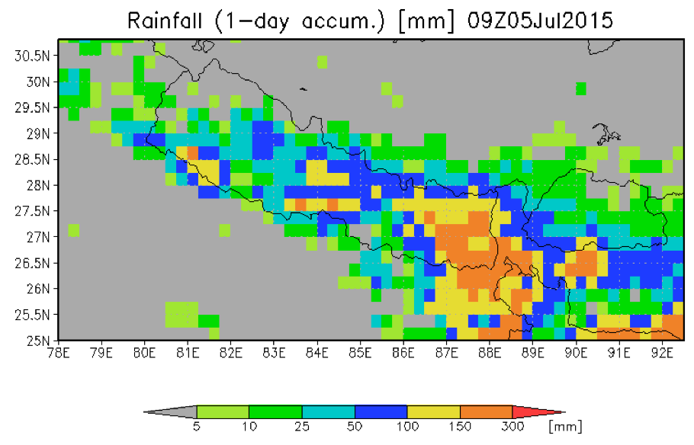
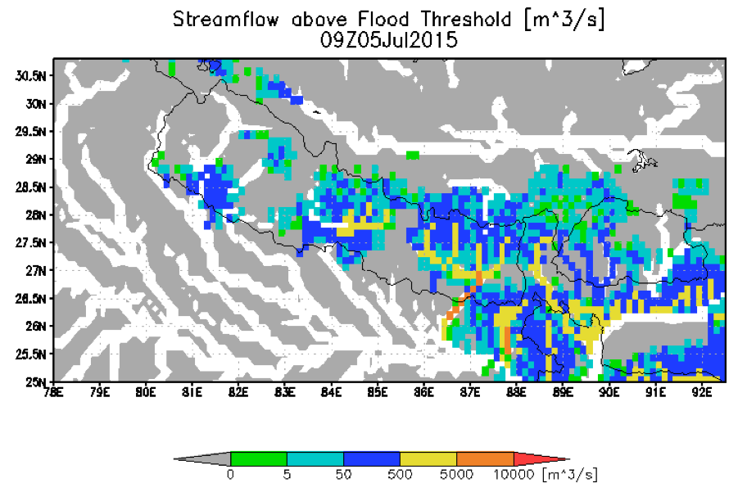
Floods Pilot: Obj. A Global Component : GFMS
GFMS cited by UN World Food Program:
"The Global Flood Monitoring System (GFMS) provides one key step further by indicating how an excess rainfall event will impact river flow, and also whether there is a potential for flooding downstream away from the heavy rain event," said E.Niebuhr, World Food Program. "We check the GFMS nearly every single day to monitor current flood concerns, and also to assist in discovering new flood events that may not have been reported yet or are developing”.
Nepal Department of Hydrology and Meteorology and ICIMOD used GFMS data after the Nepal earthquake

Slide 19
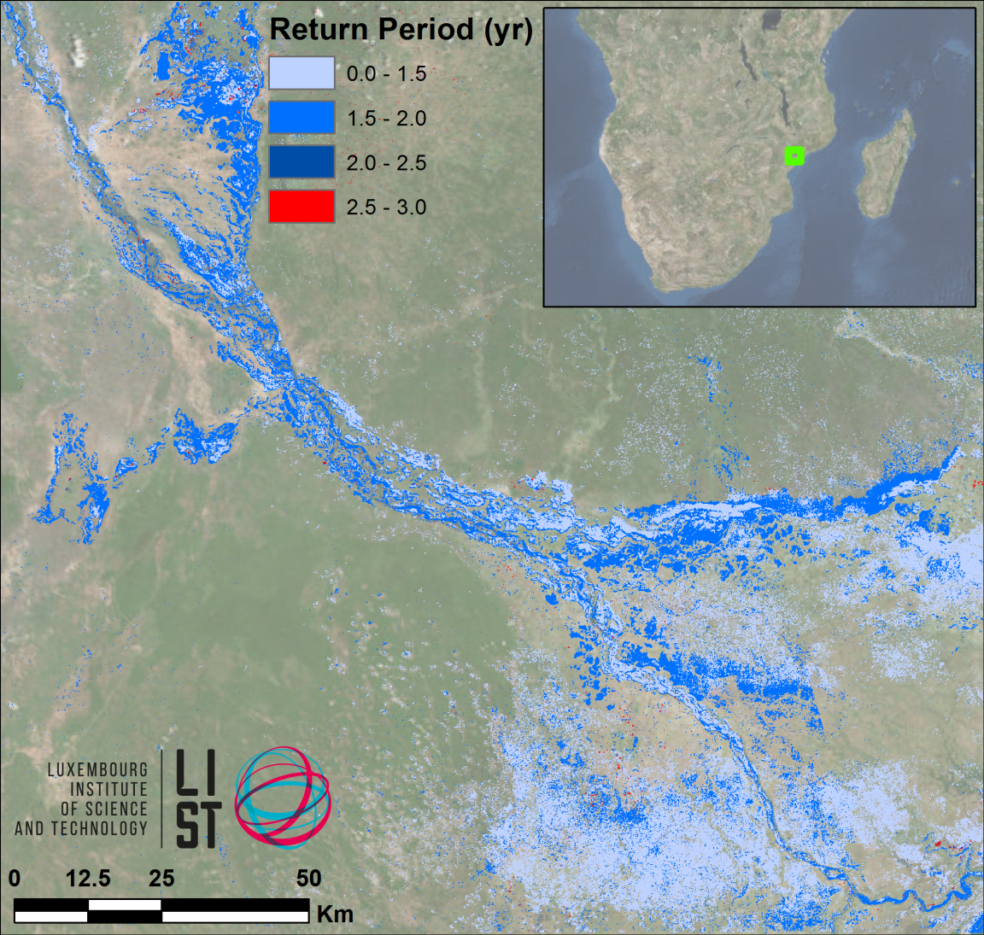
Floods Pilot: Obj. B - Southern Africa
LIST flood hazard maps determine flood severity by comparing flood extent in a SAR image with computed extent / return period from simulated historic floods
The UN World Food Programme has shown interest

Slide 20
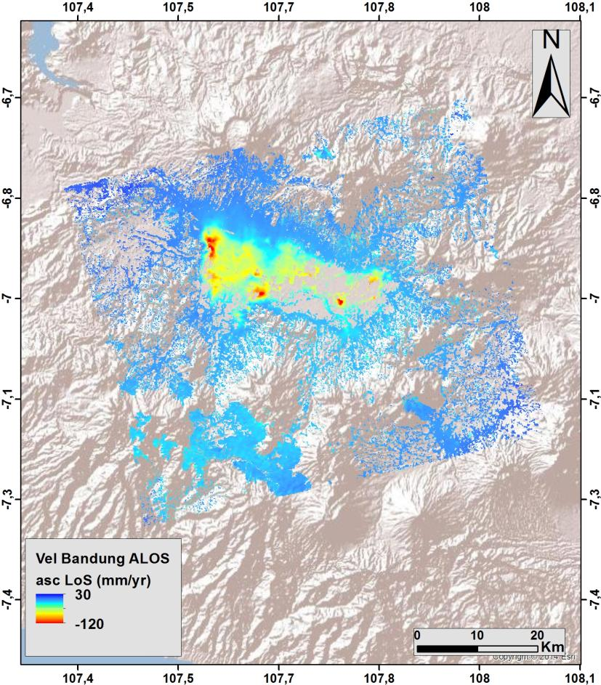
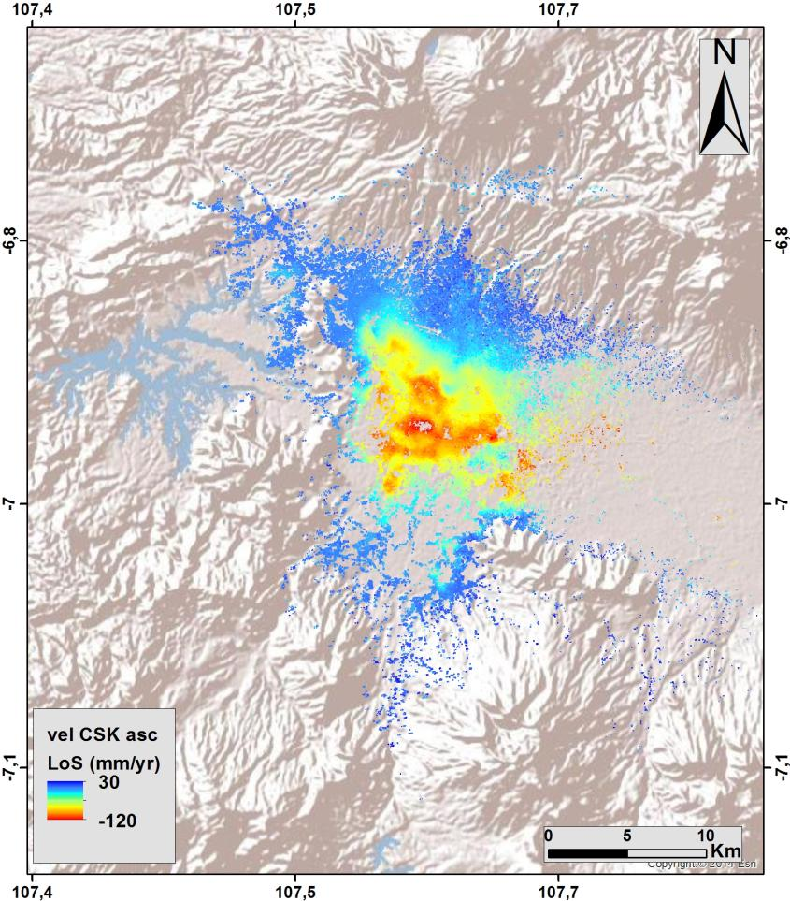
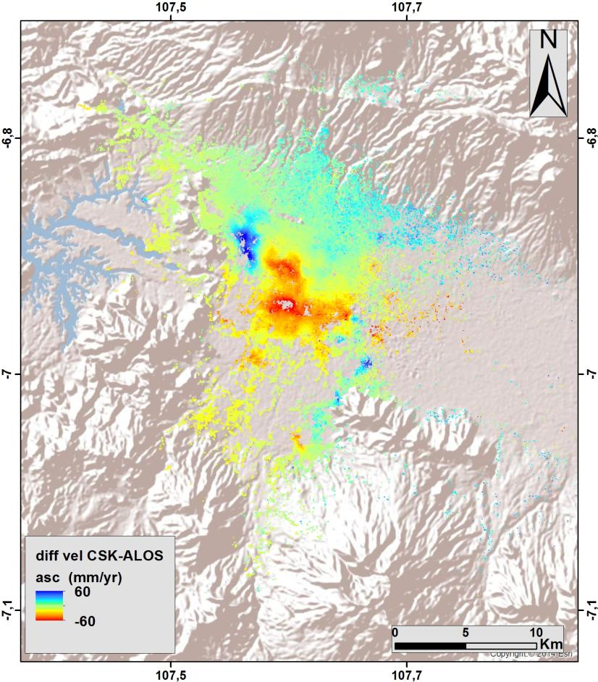
Floods Pilot: Obj. B - South-East Asia
ALOS ascending (2007-2011)
CSK ascending (2013-2015)
Difference (CSK-ALOS)
(red = increased rate of subsidence)

Slide 21
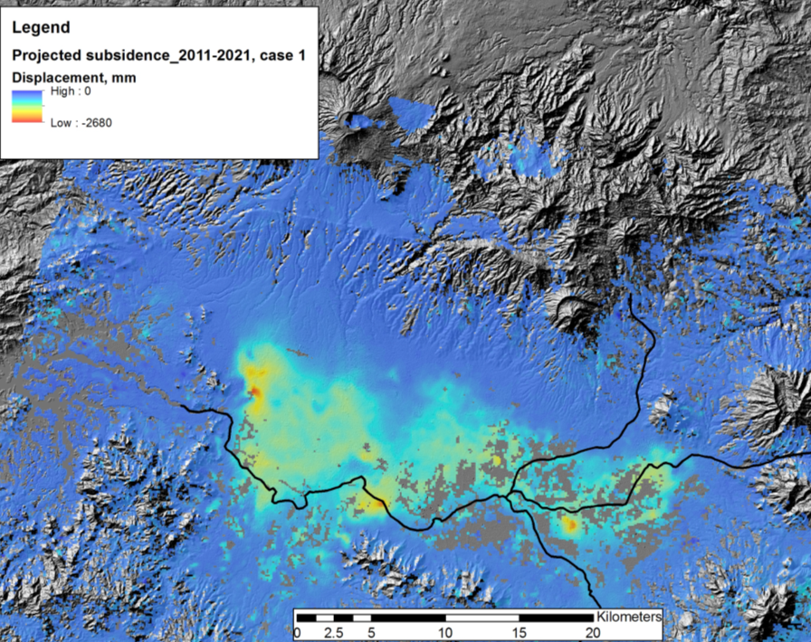
Floods Pilot: Obj. B - Subsidence Projection
Other Activities:
Consultations on new pilot
products with UN, World Bank, and ICRC
Asian Disaster Preparedness
Center (ADPC, Bangkok
Thailand) to setup instance of
flood modeling and monitoring
processing and distribution
software installed under
cooperation with SERVIR and
USAID Oct-Nov 2015
Projected total subsidence by 2021 of up to 2.2 m along main drainage areas.
© INGV
21

Slide 22
Floods Pilot: Obj. B - Texas
Data provided: EO-1, ASTER, COSMO-SkyMed, Sentinel-1, and LANDSAT, plus high-resolution GFMS forecasts
Users: FEMA, US Forest Service, EPA, Texas Water Development Board and Texas Commission on Water Quality, plus briefings by UT-Austin personnel to Texas Emergency Operations Center and Governor’s Emergency Management Council
Feedback from Theresa Howard and Gordon Wells (UT-Austin):
“The imagery offered a detailed view of inundation impacting agriculture in rural areas, which is information that can be difficult to obtain from other sources. The imagery also helps to fill in the coverage gaps between stream gages that are monitored for current and forecast conditions.”

Slide 23
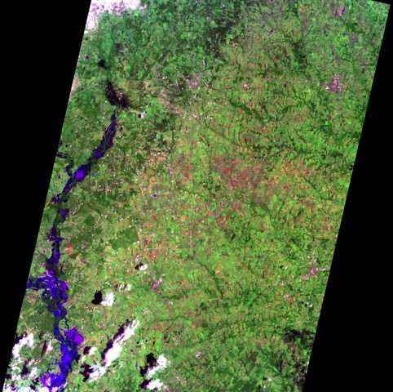
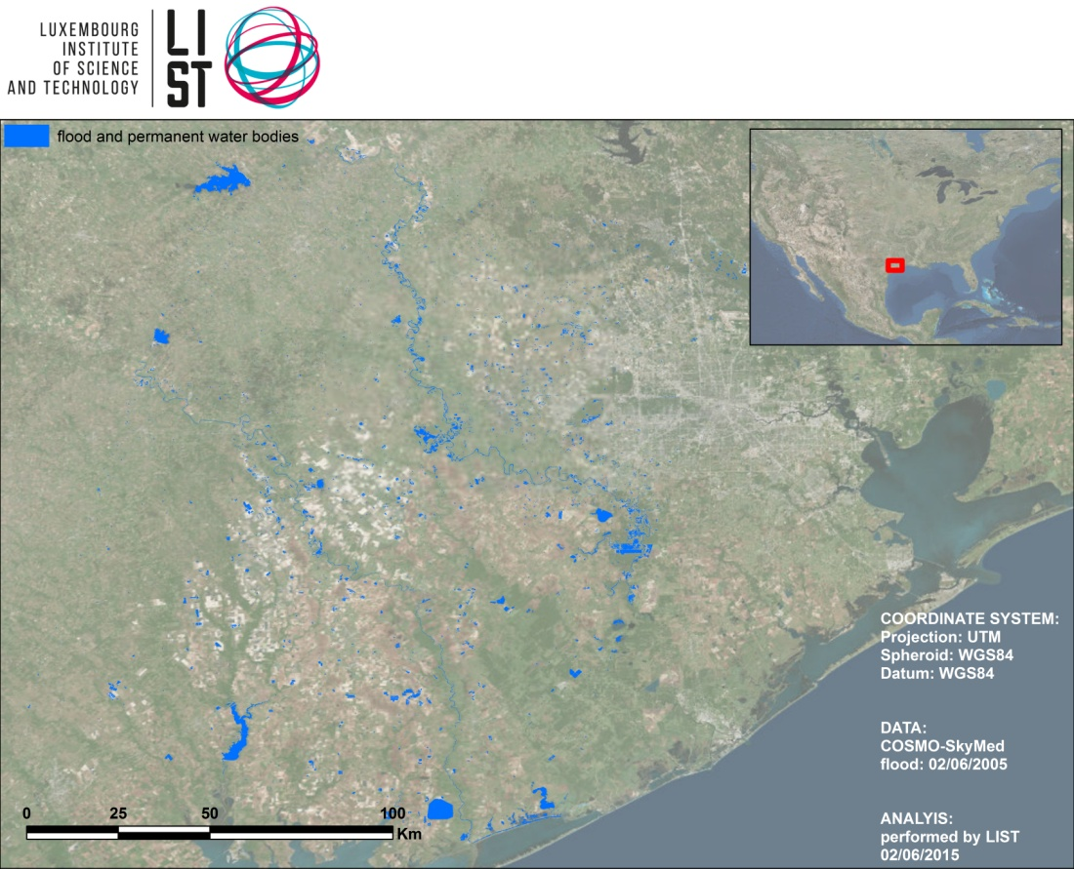
Floods Pilot: Obj. B - Texas
COSMO-SkyMed, 2 June 2015 as processed and analyzed by LIST
EO-1, 1045 CDT 27 May 2015
Imaged processed by Texas partners

Slide 24
CEOS Activities in Support to DRR
Disaster Component # 5 of the CEOS 2015-2017 Work Plan deals with the CEOS Pilots
Activities are progressing quite well with all Objectives reached and Deliverables produced as originally planned
Current GEO Disasters components will be rearranged in GEO Transitional 2016 WP.
GEO-DARMA proposed by CEOS as new GEO initiative for 2016.
Issues preventing progress:
None as of today

Slide 25
Decisions @ CEOS Plenary
Required steps and/or decisions at next CEOS Plenary:
Endorse the updated RO triggering procedure
Endorse the creation of a new Pilot on Landslides (in a multi-hazard approach)
Endorse the CEOS support to three new supersites (still TBC as proposals still being consolidated):
San Andreas fault (USA), Gulf of Corinth fault zone (Greece), and Straits of Messina (Italy)

