Slide 1
CEOS-CGMS Working Group on Climate
John Bates
NOAA/NESDIS/NCEI
SIT Workshop Agenda Item 7
CEOS Action / Work Plan Reference
CEOS SIT Technical Workshop
EUMETSAT, Darmstadt, Germany
17th-18th September 2015

Slide 2
Climate Monitoring, Research, and Services – CEOS 2015-2017 Work Plan Objectives and Deliverables Status
Objective/Deliverable | Projected Completion Date | Status and Comments
CMRS-2: Gap analysis (first version) | Q2 2015 | Complete for high-definition gap analysis of few selected ECVs spanning the Atmospheric, Oceanic, and Terrestrial GCOS domains. Two documents (A Questionnaire Guideline and a Gap Analysis) are under review and will be released by plenary.
CMRS-3: Action plan (first version) | Q3 2015 | At this stage, there is not enough results to derive a complete Action Plan. Nevertheless, some preliminary indications have been included in the Gap Analysis document to be released.
CMRS-4: Case studies linking CDRs to societal applications and informed policy decisions | Q1 2015 | Complete. Final typeset version to be released in September.
CMRS-7: CEOS Response to the GCOS IP and Satellite Supplement for submission (via GCOS) to COP-21 | Q2 2015 | Complete and delivered to GCOS. GCOS acknowledged receipt and results have been used in draft GCOS 2015 status report.
CMRS-10 : CEOS-CGMS Report on Progress to SBSTA-43 | Q3 2015 | Draft complete and comments received from WGClimate members. Revised draft to be sent to CEOS SEC for review in late September. Final report due to SBSTA by end of October.
CMRS-8: Incorporation of in situ data holdings within the ECV inventory | Q4 2015 | Questionnaire complete and handed off to WCRP Data Advisory Council.
CMRS-9: Update of ECV inventory, gap analysis and action plan (Version 2) | Q2 2015 to Q4 2016 | Will be covered by the four years WGClimate activity Plan that will be presented at plenary.
CMRS-11: Analysis report on implications of new climate change treaty | Q1 2017 to Q4 2018 | Will be covered by the four years WGClimate activity Plan that will be presented at plenary.
Notes:
CMRS-10:
We need to remember that with respect to the Convention we (historically CEOS now CEOS and CGMS through the joint WG) are reporting on “behalf of the space agencies”.
We are reporting on the space agencies contributions to the RSO aspects of the Convention.
So although (hopefully) most of this will be adequately reflected through the work of WGClimate we have to acknowledge other contribution when they are appropriate and relevant.
Of course there are also individual agency contributions through their specific programmes (NOAA CDR, CCI, SAF etc.), but this time we are focusing on the output from the various international coordination efforts.

Slide 3
Experience with Applying ECV Assessment and Gap Analysis
ECV Reference Assessment Results
ECV Gap Analysis Results
GCOS Guideline | Atmospheric | Oceanic | Terrestrial
1. Full description of all steps taken in the generation of FCDRs and ECV products, including algorithms used, specific FCDRs used, and characteristics and outcomes of validation activities | 71% | 75% | 75%
2. Application of appropriate calibration/validation activities | 74% | 55% | 66%
3. Statement of expected accuracy , stability and resolution (time, space) of the product, including, where possible, a comparison with the GCOS requirements | 73% | 72% | 56%
4. Assessment of long-term stability and homogeneity of the product | 50% | 44% | 48%
5. Information on the scientific review process related to FCDR/product construction (including algorithm selection), FCDR/product quality and applications | 50% | 48% | 48%
6. Global coverage of FCDRs and products where possible | 88% | 92% | 91%
7. Version management of FCDRs and products, particularly in connection with improved algorithms and reprocessing | 100% | 73% | 95%
8. Arrangements for access to the FCDRs, products and all documentation | 66% | 69% | 67%
9. Timeliness of data release to the user community to enable monitoring activities | 47% | 46% | 52%
10. Facility for user feedback | 100% | 69% | 77%
11. Application of a quantitative maturity index if possible | 4% | 0% | 0%
12. Publication of a summary (a webpage or a peer-reviewed article) documenting point-by-point the extent to which this guideline has been followed | 68% | 52% | 61%

Slide 4
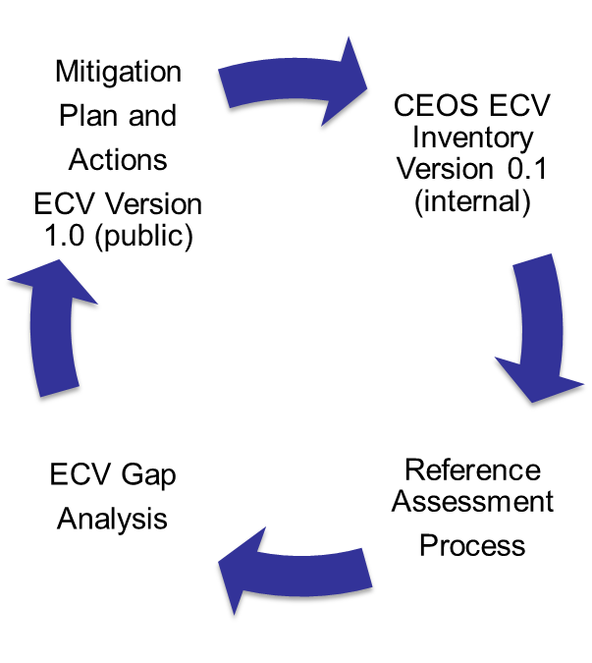
Experiences with ECV Inventory Collection, Assessment, Gap Analysis and Action Plan Cycle
ECV Inventory is the principle activity of WGClimate to capture the physical architecture of climate observing systems
Each step was an opportunity to develop further Best Practices.
ECV Inventory data call was interpreted differently by different agencies and participation varied.
Reference Assessment scored ECV inventory answers against GCOS data set guidelines.
High-Definition Gap Analysis considered gaps spanning 41 conditions.
Mitigation Plan and actions are very difficult to develop and needs harmonization with GCOS responsibilities.

Slide 5
Thoughts and Feedback Requested from CEOS on WGClimate and the ECV Inventory
International coordination is always dependent on a ‘coalition of the willing’
  WGClimate is a worthwhile effort requiring community participation.
  Moving forward, WGClimate should explore complementary ways to accomplish the next steps in the ECV inventory cycle.
For ECV Inventory - Data Calls are essential yet difficult and participation is mixed.
  Consider using a data set metadata model Obs4ECV that would include most of the parameters of the ECV inventory (proposed to WDAC)
For ECV Assessment – Systematic assessment worked well once implemented and so should continue in the future
For ECV Gap Analysis – Several options should be explored, for example:
  Ask Agencies to consider implementing gap analysis as part of programs.
  Host gap analysis workshop to perform analysis every few years (possibly co-hosted with GCOS).
  Formalize WGClimate support for ECV inventory (EU contribution appreciated).
For ECV Action Plan and Mitigation – Same as Gap Analysis

