Slide 1
WGISS
Richard Moreno CNES
SIT Workshop Agenda Item #7
WGISS working group CEOS SIT Technical Workshop
EUMETSAT, Darmstadt, Germany 17th-18th September 2015

Slide 2
Recovery Observatory
Status
Development ended during summer 2015
Ready for a triggering of Recovery Observatory by Disasters WG
Used operationaly by KalHaiti project in CNES
Project still open in WGISS, waiting for an potential triggering
Depending on the event and on the manipulated data, some slight modifications could be done
ACTION DATA-04 - In cooperation with WG Disasters, WGISS will develop and make available the Recovery Observatory infrastructure (see Section 3.5 for details). Version 2 will be available end in Q1 2015 and Version 3 (final) will be available end of Q2 2015. TO BE CLOSED

Slide 3
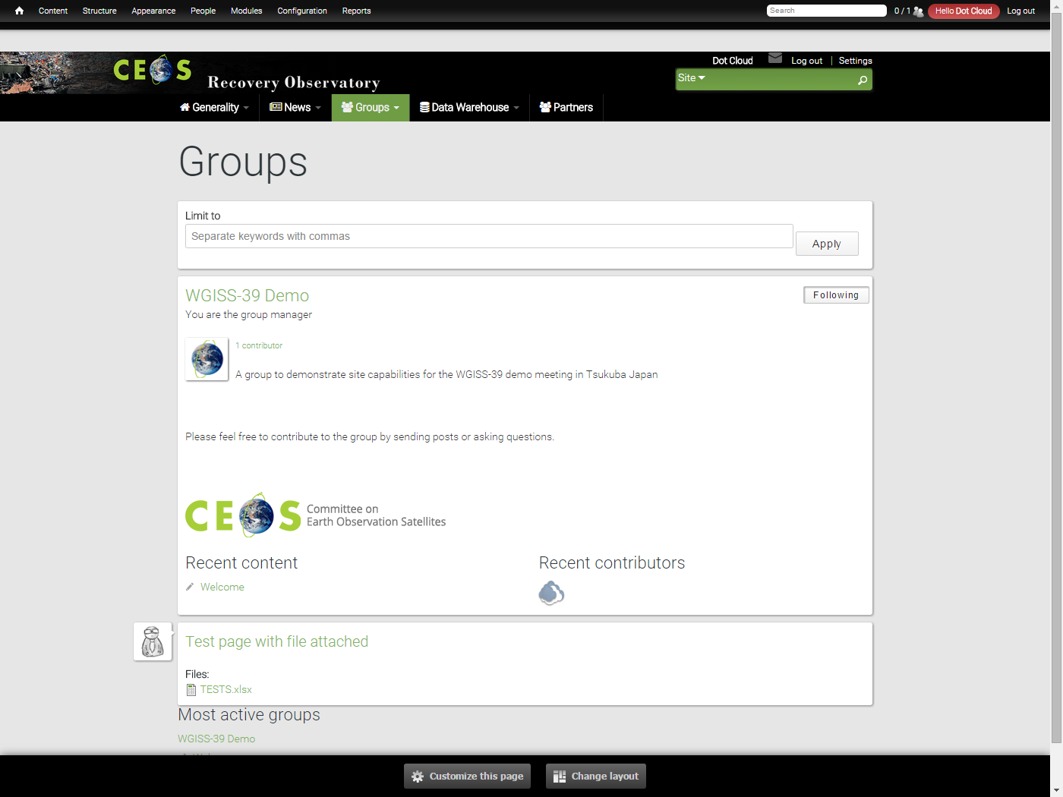
Recovery Observatory
Editorial content
Project presentation
General News & events
Fed by webmaster
Collaborative groups
To allow users to post information
& data within groups
To provide security management
Private groups
Semi private groups
Public groups
License management

Slide 4
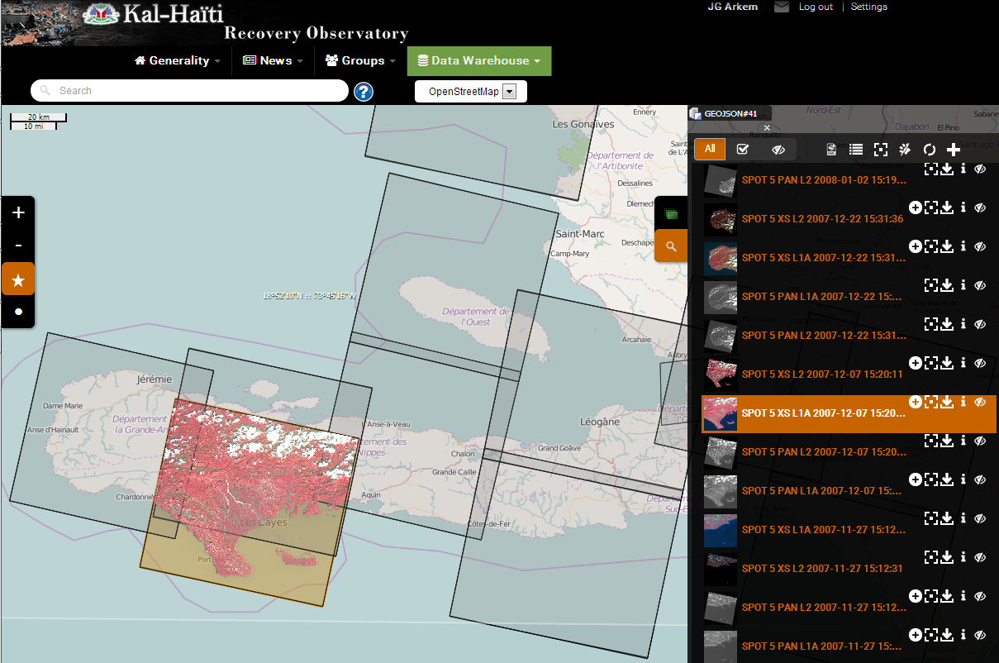
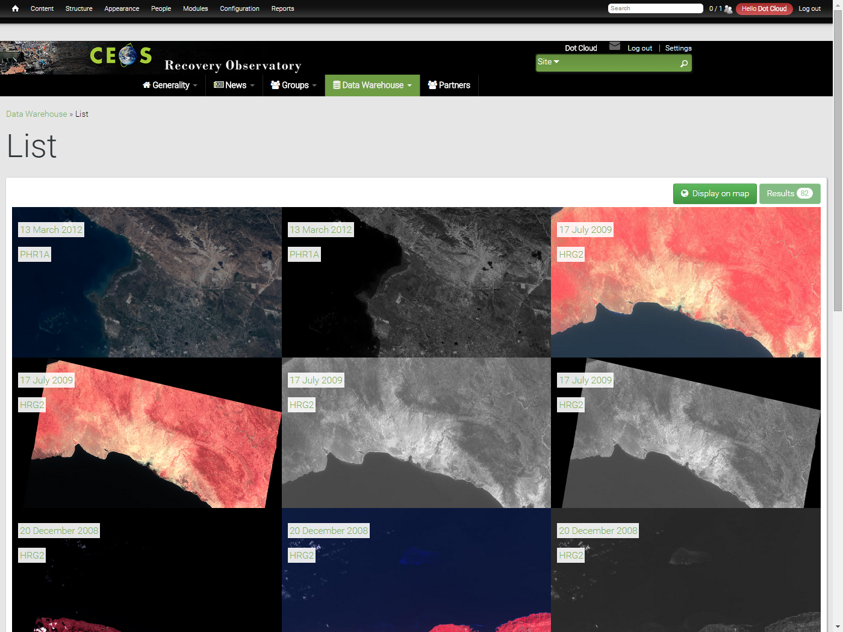
Recovery Observatory
Map with products footprints
Full resolution products displayed on the map
Product download
List of available products
List of products ordered by date of acquisition
Product download
Product details with metadata , quicklook and footprint
Products ingestion
Ability for users to send a geographical product
Multi criteria search form

Slide 5
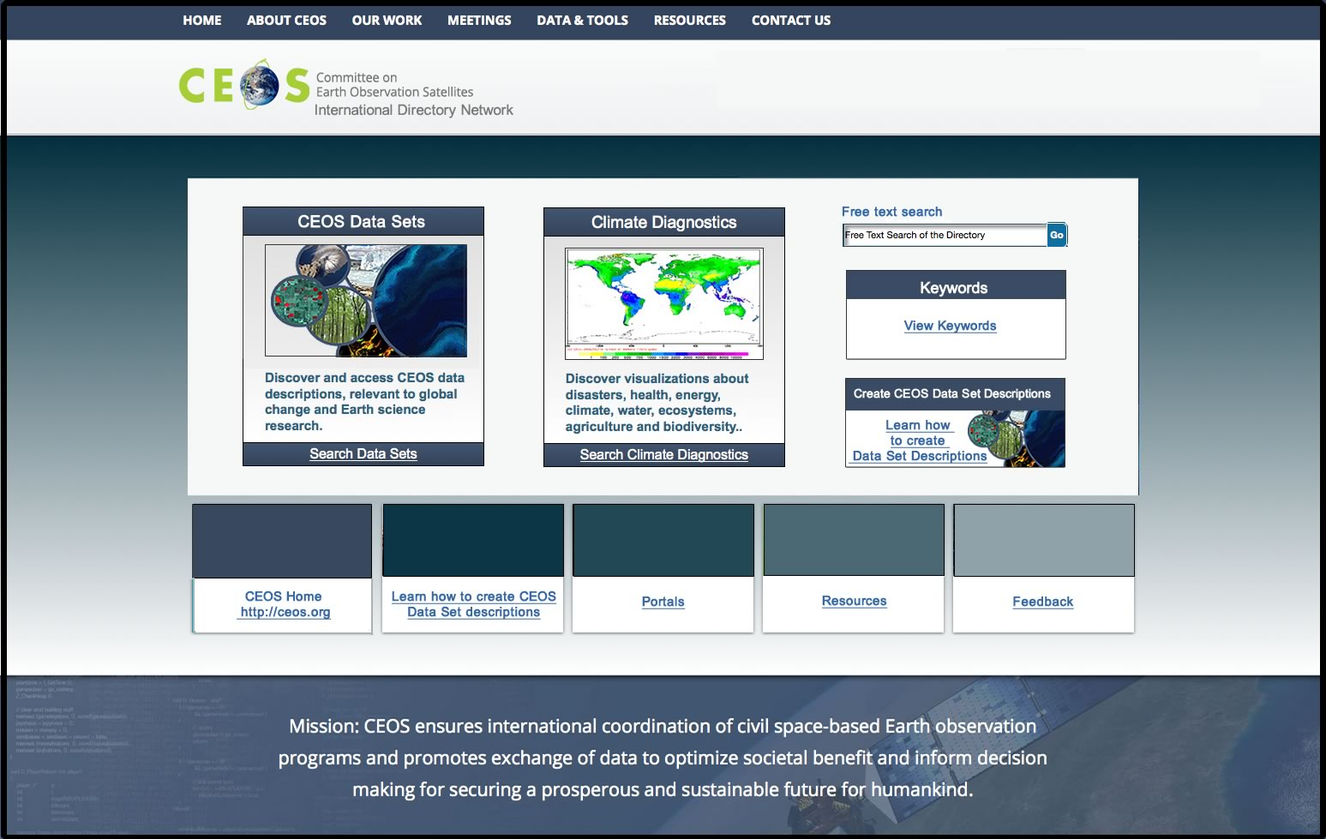
Interoperability - IDN
Upgraded IDN site
Aim: Incorporate current look/feel GCMD search to improve navigation
New data
ROSCOSMOS, EUMETSAT, CNES, ISRO
…
TAGGING : allow portal, VCs, … to directly identify their datasets
ACCESS : address (opensearch, CWIC FEDEO) is provided
Allow to access the data after discovery

Slide 6
Interoperability - IDN
ACTION DATA-02 - Full representation of CEOS Agency datasets in the IDN and accessible via CWIC/OpenSearch : PERMANENT
ACTION VC-01 - Each VC will provide WGISS with a list of relevant datasets that its respective constellation members desire to access. WGISS will work with CEOS data providers to ensure search and accessibility (when possible) of these datasets are available so as to ensure coverage of all datasets required by VCs
These are essential and permanent actions
The access URL endpoint shall be provided to allow access after discovery
Need for better interaction with VCs

Slide 7
Data Stewardship
Best practice documents
Three new documents have been reviewed and issued :
Preservation Workflow
Generic EO Dataset consolidation Process
Persistent Identifiers Best Practices
ACTION DATA-05 - Two documents dedicated to CEOS best practices in the domain of Data Stewardship will be issued by WGISS : - Persistent Identifier Best Practice document - EO Data Preservation Workflow document. CLOSED
ACTION DATA-06 - In order to provide a support to the CEOS Working Groups and Virtual Constellations, but also to SEO, WGISS will develop a web page containing a list of best practice documents and opensource software. These will be material directly usable by VCs and WGs for their work related to Information Systems and Services.. CLOSED

Slide 8
Data Stewardship
Purge alert
Situation:
It is a responsibility of all organizations holding EO space data to assess the relative value of their holdings and to preserve them for the long term.
Sometimes an organization must make the decision to “purge” one or more datasets that could be important to help meeting the mission requirements of another organization
Data Purge: to permanently and irrecoverably remove all copies of an EO dataset held in an organization.
The “Data Purge Alert” procedure aims at preventing, or at least minimizing, the loss of EO space data.
Question
Who should validate Purge Alert procedure : CEOS chair or SIT chair ?

Slide 9
Technology Exploration
WGISS is a forum where new technologies, future architecture are discussed and presented
Distributed architecture
Big data technologies (Hadoop)
Cloud computing
Distribution protocols
GA datacube is a technology which is explored and discussed within WGISS
Collecting use cases from our agencies
Realizing this will not be a solution for all situations
Ground Segment Evolution Workshop
Will be held in 2 weeks in UKSA during next WGISS meeting

Slide 10
Technology Exploration
ACTION DATA-03 - CEOS has made considerable progress in coordinating data acquisition to support important stakeholder initiatives, a number of which have a goal of becoming operational over the coming years. The challenges of routinely processing and analyzing full archives of data to produce operational products are very different to those of producing one-off example products. Traditional ?clip and ship? approaches are proving not to work. This presents a significant ?big data? challenge for both the user communities and the space agencies who wish to support them, but whose programs must also be sustainable. In response to this strategic challenge, WGISS will propose recommendations to SEO for exploring options for how international activities that target an operational state, such as GFOI and GEOGLAM, may be sustainably supported by CEOS and CEOS Agencies into the future. A number of pilot projects are underway that will provide important learnings. These recommendations will be a key input into broader discussions on governance, finance and management.
WGISS and SEO are permanently working on this topic
We will be working more closely together to do more real work in common

Slide 11
Carbon
ACTION CARB-08-35 - The CEOS Carbon Subgroup (recommended in Carbon-Action-38) will develop guidelines for appropriate data use of satellite data and data products.? This will require improved interactions between the carbon cycle community and the satellite community; comprehensive review of the current use of data products, including current data limitations; and reconciliation of methodological differences and spatial compatibility.? Such interactions may include co-sponsorship of joint workshops targeting specific data needs and investment in community product assessments, especially for key intercomparison exercises..
Action not yet started
Need to organize telecon with WGCV & Carbon
We will take the opportunity of the joint WGISS/WGCV meeting in march 2016 to finalize or at least make a huge progress

