Slide 1
Committee on Earth Observation Satellites
Mechanisms for Collaboration between VCs and WGs - Summary
Eric C. Wood, USGS
Steven P. Neeck, NASA
SIT Workshop Agenda Item #5
CEOS Action / Work Plan Reference
CEOS SIT Technical Workshop
EUMETSAT, Darmstadt, Germany
16th September 2015

Slide 2
Current P-VC Training Activities
Have not been a high priority for the P-VC to date although its members conduct them
Resource limitations (intellectual and budgetary) a factor
Efforts have been ad hoc and based on existing training programs of P-VC member agencies/participating organizations, e.g.
SERVIR (NASA) “Satellite Remote Sensing Applications for Water Resources Management” one week course for ICIMOD
VISIT (NOAA)
WMO-CGMS VLAB (NOAA, EUMETSAT, INPE)
GPM Applications Workshops and associated webinars (NASA)
Operational agency mandates generally more aligned with supporting training than research agencies
Exploring interactions with the IPWG which already conducts related training activities
*

Slide 3
Very Brief History of WGCapD
In 2010 reorganized WGEdu to Working Group on Capacity Building and Data Democracy (WGCapD) with new mandates:
Reaching more people(including underserved communities) e.g., explore Internet based delivery systems
Better meeting needs of CEOS, members, WGs
More emphasis on all aspects of data democracy

Slide 4
What we did in 2014/2015 in response to last year’s VC/WG Day
Workshops:
SRTM 30m Elevation Data in Disaster Response Management (focus on flood modeling)
South Africa (hosted by SANSA)
Mexico (hosted by CRECTEALC)
Webinars
8 session series : Webinar Series on Remote Sensing Technology for DIsaster Management
GEO Support
GEOCAB
SRTM (AfriGEOSS)
VC / WG support
SST-VC collaboration
WGDisasters

Slide 5
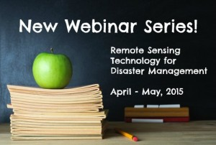
Webinar Series
WGCapD & WGDisasters Distance Education Course
Webinar Series on Remote Sensing Technology for Disaster Management
(INPE and ISRO)
http://ceos.org/meetings/wgcapd-distance-education-2015/
Comprehensive series of 8 introductory webinars that address the use of remote sensing technology for DM.
What makes this course unique?
Offered free of charge
Provides access to expertise from space agencies around the world
Links participants to a global network of experts and policymakers
Creates awareness about CEOS and the International Charter for Space and Major Disasters
Provides access to datasets and useful tools available from CEOS Members
Builds skills on Disaster Management (DM)

Slide 6
Lessons Learned from those Activities t
WGCapD’s limited by its resources – funding, people
Often our activities are as much “awareness” as “capacity” building.
Can’t successfully support VCs or WGs without true collaboration. Has been supply driven, but needs to be demand driven
Should there be more focus on CEOS as an organization? At cost of support to VCs and WGs? To GEO?
We have to bring something worthwhile to CEOS, CEOS members. Provide something they won’t have without WGCapD inputs.
ARD will change how we do business. How exactly?

Slide 7
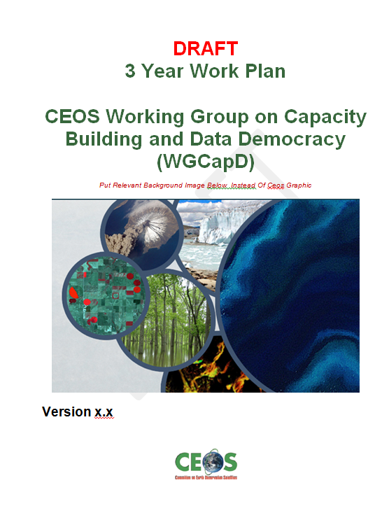
WGCapD Strategic Planning
In response to lessons learned, we have begun a strategic planning exercise that will result in a 3 Year Work Plan and a basic restructuring of the WG.

Slide 8
Preliminary WGCapD Restructuring - Goals
To highlight (build awareness of) new CEOS missions and datasets, and how to use the latter within the context of existing datasets or in support of CEOS/GEO projects;
To increase the ability of the WGs/VCs to provide their own capacity building (vs CapD doing it for them);
To improve communications and coordination between member agency and WG/VC/CapD capacity building and education activities as well as related international activities/practitioners
To continue to increase access to data, products, and tools and ability to use them (data democracy);

Slide 9
…with new Examples for 2015/16
Highlight CEOS:
SRTM/Elevation data workshops continued
CEOS Exhibit at GEO Plenary / Ministerial
ESA/DLR webinar series on European SB EO (proposed)
Support VC WG
e.g., LSI, SEO and other ARD/data cube partners
Collaborate with other CB activities/practioners
CSA, CRETEALC , VLAB, ESA, VCs
Data Democracy;
AfriGEOSS, AmeriGEOSS
Final SRTM workshops addressing regional issues
Directed webinar series

Slide 10
Summary -
WGCapD restructuring to meet perceived needs in supporting CEOS, CEOS member agencies, and society in for both “ awareness” and “capacity” building in SB EO.
Examples of VC generated ideas:
Work with VCs on AB/CB gap analysis
Templates for conducting, capturing training sessions
Consider outside, online course providers e.g., Future Learn
Better utilize awareness or capacity building experience / expertise that exists in VCs and WGs.
Suggested numerous opportunities for collaborations
Can’t successfully support VCs or WGs without true collaboration. Has been supply driven, but needs to be demand driven

