Slide 1
Review of Key Actions from 28th Plenary and SIT-30
G Dyke SIT Chair Team
SIT Workshop Agenda Item #2
EUMETSAT, Darmstadt, Germany 17th-18th September 2015

Slide 2
Summary
SIT-30 and 28th Plenary Action Status Summary
28th Plenary
10 actions
8 COMPLETE
2 ONGOING to be reported during SIT Workshop
SIT-30
19 actions
15 COMPLETE going into SIT Workshop
4 ONGOING to be reported during SIT Workshop
Detailed status table on SIT Workshop website

Slide 3
Summary
Action WS Item # | Noun + Verb Action Summary | Status as of SIT WS
Plenary 28-04 #6 (LSI) | LSI-VC (T Cecere) to prepare IP | Draft LSI IP has been prepared
Plenary 28-04 #10 (Carbon) | SIT Chair to coordination implementation of CEOS Carbon Strategy actions | Coordination ongoing across CEOS under leadership of Stephen Briggs / SIT Vice Chair
SIT-30-16 #9 (GFOI) | SDCG Exec to refine SDCG 3-Year Work Plan | Updated SDCG 3-Year Work Plan agreed
SIT-30-17 #9 (GFOI) | Data providers to implement Space Data Strategy for GFOI | In progress
SIT-30-18 #11 (GFOI) | WSIST to propose CEOS response to GEO Water Strategy | In progress
SIT-30-06 #18 (COP21) | SIT Chair Team to circulate details about the COP21 event | SIT Chair coordinating

Slide 4
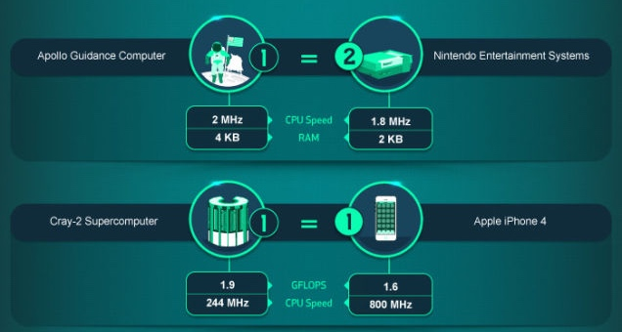
SIT Workshop 2015
SIT Workshop Actions
A table of SIT Workshop 2015 actions will be developed and presented under Agenda Item #23 tomorrow
Wherever possible, deadlines will be short term and no later than CEOS Plenary

Slide 5
Background

Slide 6
28th CEOS Plenary
Plenary Actions
28-04: The LSI-VC, led by Tom Cecere (USGS), to prepare a draft Implementation Plan, based on the "Space Segment Coordination" option and including a proposed update to the LSI-VC ToRs, for review prior to, and discussion at, SIT-30.
Agenda Item #6
Draft LSI IP has been prepared
28-06: SIT Chair in conjunction with the relevant WGs and VCs, to determine by SIT- 30 whether appropriate implementation arrangements are in place for all actions associated with the CEOS Strategy for Carbon Observations from Space.
Agenda Item #10
Coordination of carbon actions ongoing across CEOS groups under leadership of Stephen Briggs / SIT Vice Chair

Slide 7
SIT-30
SIT-30 Actions – Carbon / Water-related
30-16: SDCG Exec to work with DLR to ensure that the SDCG 3-Year Work Plan reflects the discussion at SIT-30 regarding the scope of CEOS efforts for GFOI and the eventual transition to operational entities. The amended Plan will be submitted to CEOS Plenary for information.
Agenda Item #9
Updated SDCG 3-Year WP revisions agreed with DLR
30-17: Core and contributing data stream providers to work with SDCG to implement the 3 Elements of the Space Data Strategy for GFOI in 2015
Agenda Item #9
30-18: WSIST to propose a consolidated CEOS response to GEO Water Strategy; and VCs and WGs requested to provide support
Agenda Item #11

Slide 8
SIT-30
SIT-30 Actions – COP21-related
30-6: SIT Chair Team to circulate additional details about the COP21 event being prepared for the Grand Palais, Paris, referenced by Nicolas Bériot
Agenda Item #18
SIT Chair / CNES to report

