Slide 1
28th Plenary Preparations
Paul Counet
EUMETSAT
SIT Workshop Agenda Item 20
CNES, Montpellier, France 17th-18th September 2014

Slide 2
28th Plenary - Expected Outcomes
Expected outcomes already indicated as part of agenda item 4, viz:

Slide 3
28th Plenary - Expected Outcomes

Slide 4
28th Plenary - Tromsø Statement
A Tromsø statement will be developed:
Summarising CEOS’s past contributions
Looking forward to CEOS’s potential contributions to significant events in 2015, such as:
WCDRR
COP-21
GEO Ministerial
A first draft of the statement will be presented at the start of the Plenary and a final draft, for endorsement, will be presented at the end of the Plenary

Slide 5
28th Plenary - Draft Agenda
Plenary agenda is structured around 8 main topics:
Welcome and Opening
GEO Matters
WGs and VCs
Ad Hoc Initiatives
Coordination and Outreach
Organisational Issues
Agency Reporting
Future Vision and Handover

Slide 6
28th Plenary - Draft Agenda

Slide 7
28th Plenary - Draft Agenda

Slide 8
28th Plenary - Draft Agenda

Slide 9
28th Plenary - Draft Agenda

Slide 10
28th Plenary - Draft Agenda

Slide 11
28th Plenary - Draft Agenda
Schedule for agenda finalisation
Event | Date
Release of updated draft agenda to CEOS agencies for review (reflecting SIT Workshop conclusions) | 25 September
Deadline for submission of comments by CEOS agencies on draft agenda | 9 October
Release of final draft agenda | 16 October

Slide 12
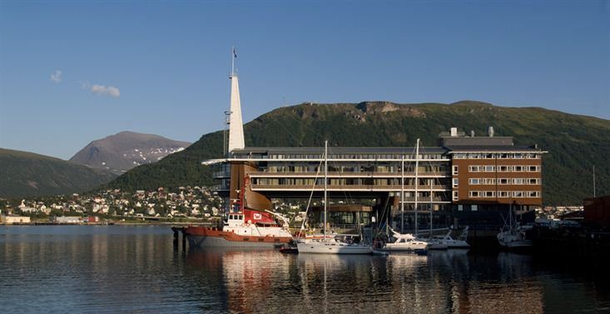
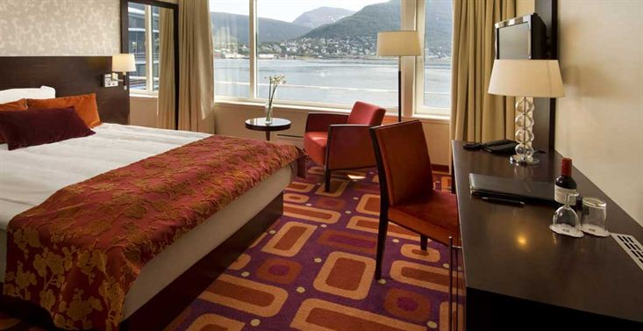
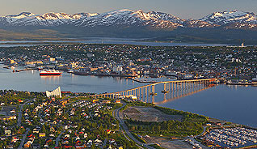
28th Plenary - Logistics and Key Dates
MEETING VENUE - Rica Ishavshotel, Tromsø, Norway
http://ceosplenary2014.info/Participation.aspx#venue
ACCOMMODATION - Rica Ishavshotel, Tromsø, Norway
http://ceosplenary2014.info/Participation.aspx#accomodation
Deadline to benefit from the block booking: 22 September 2014
(Tromsø is a very popular conference town, hence the early deadline).

Slide 13
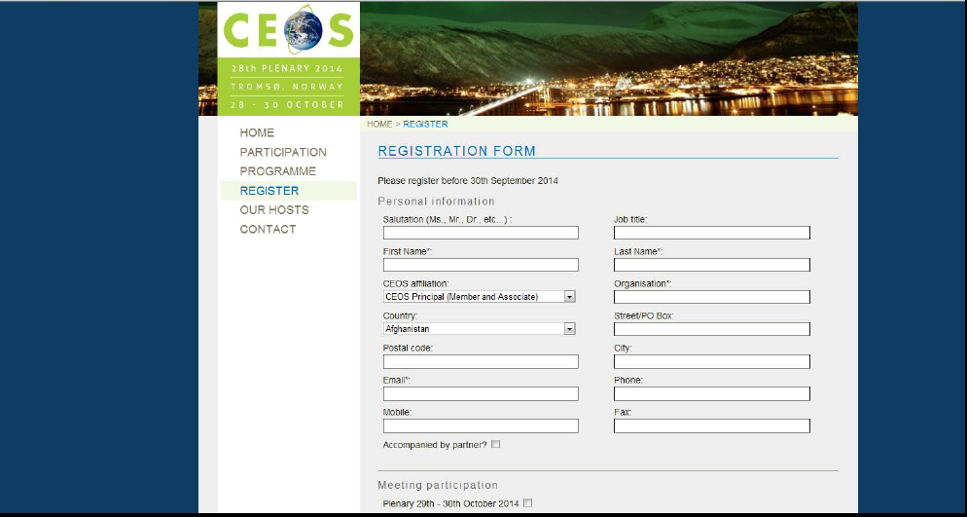
28th Plenary - Logistics and Key Dates
VISA SUPPORT
http://ceosplenary2014.info/Participation.aspx#visa
Deadline: The sooner the better…
MEETING REGISTRATION (46 registrations as of 10 Sep 2014)
http://ceosplenary2014.info/Register.aspx
Deadline: 7 October 2014

Slide 14
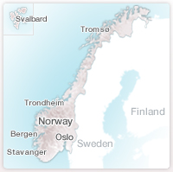
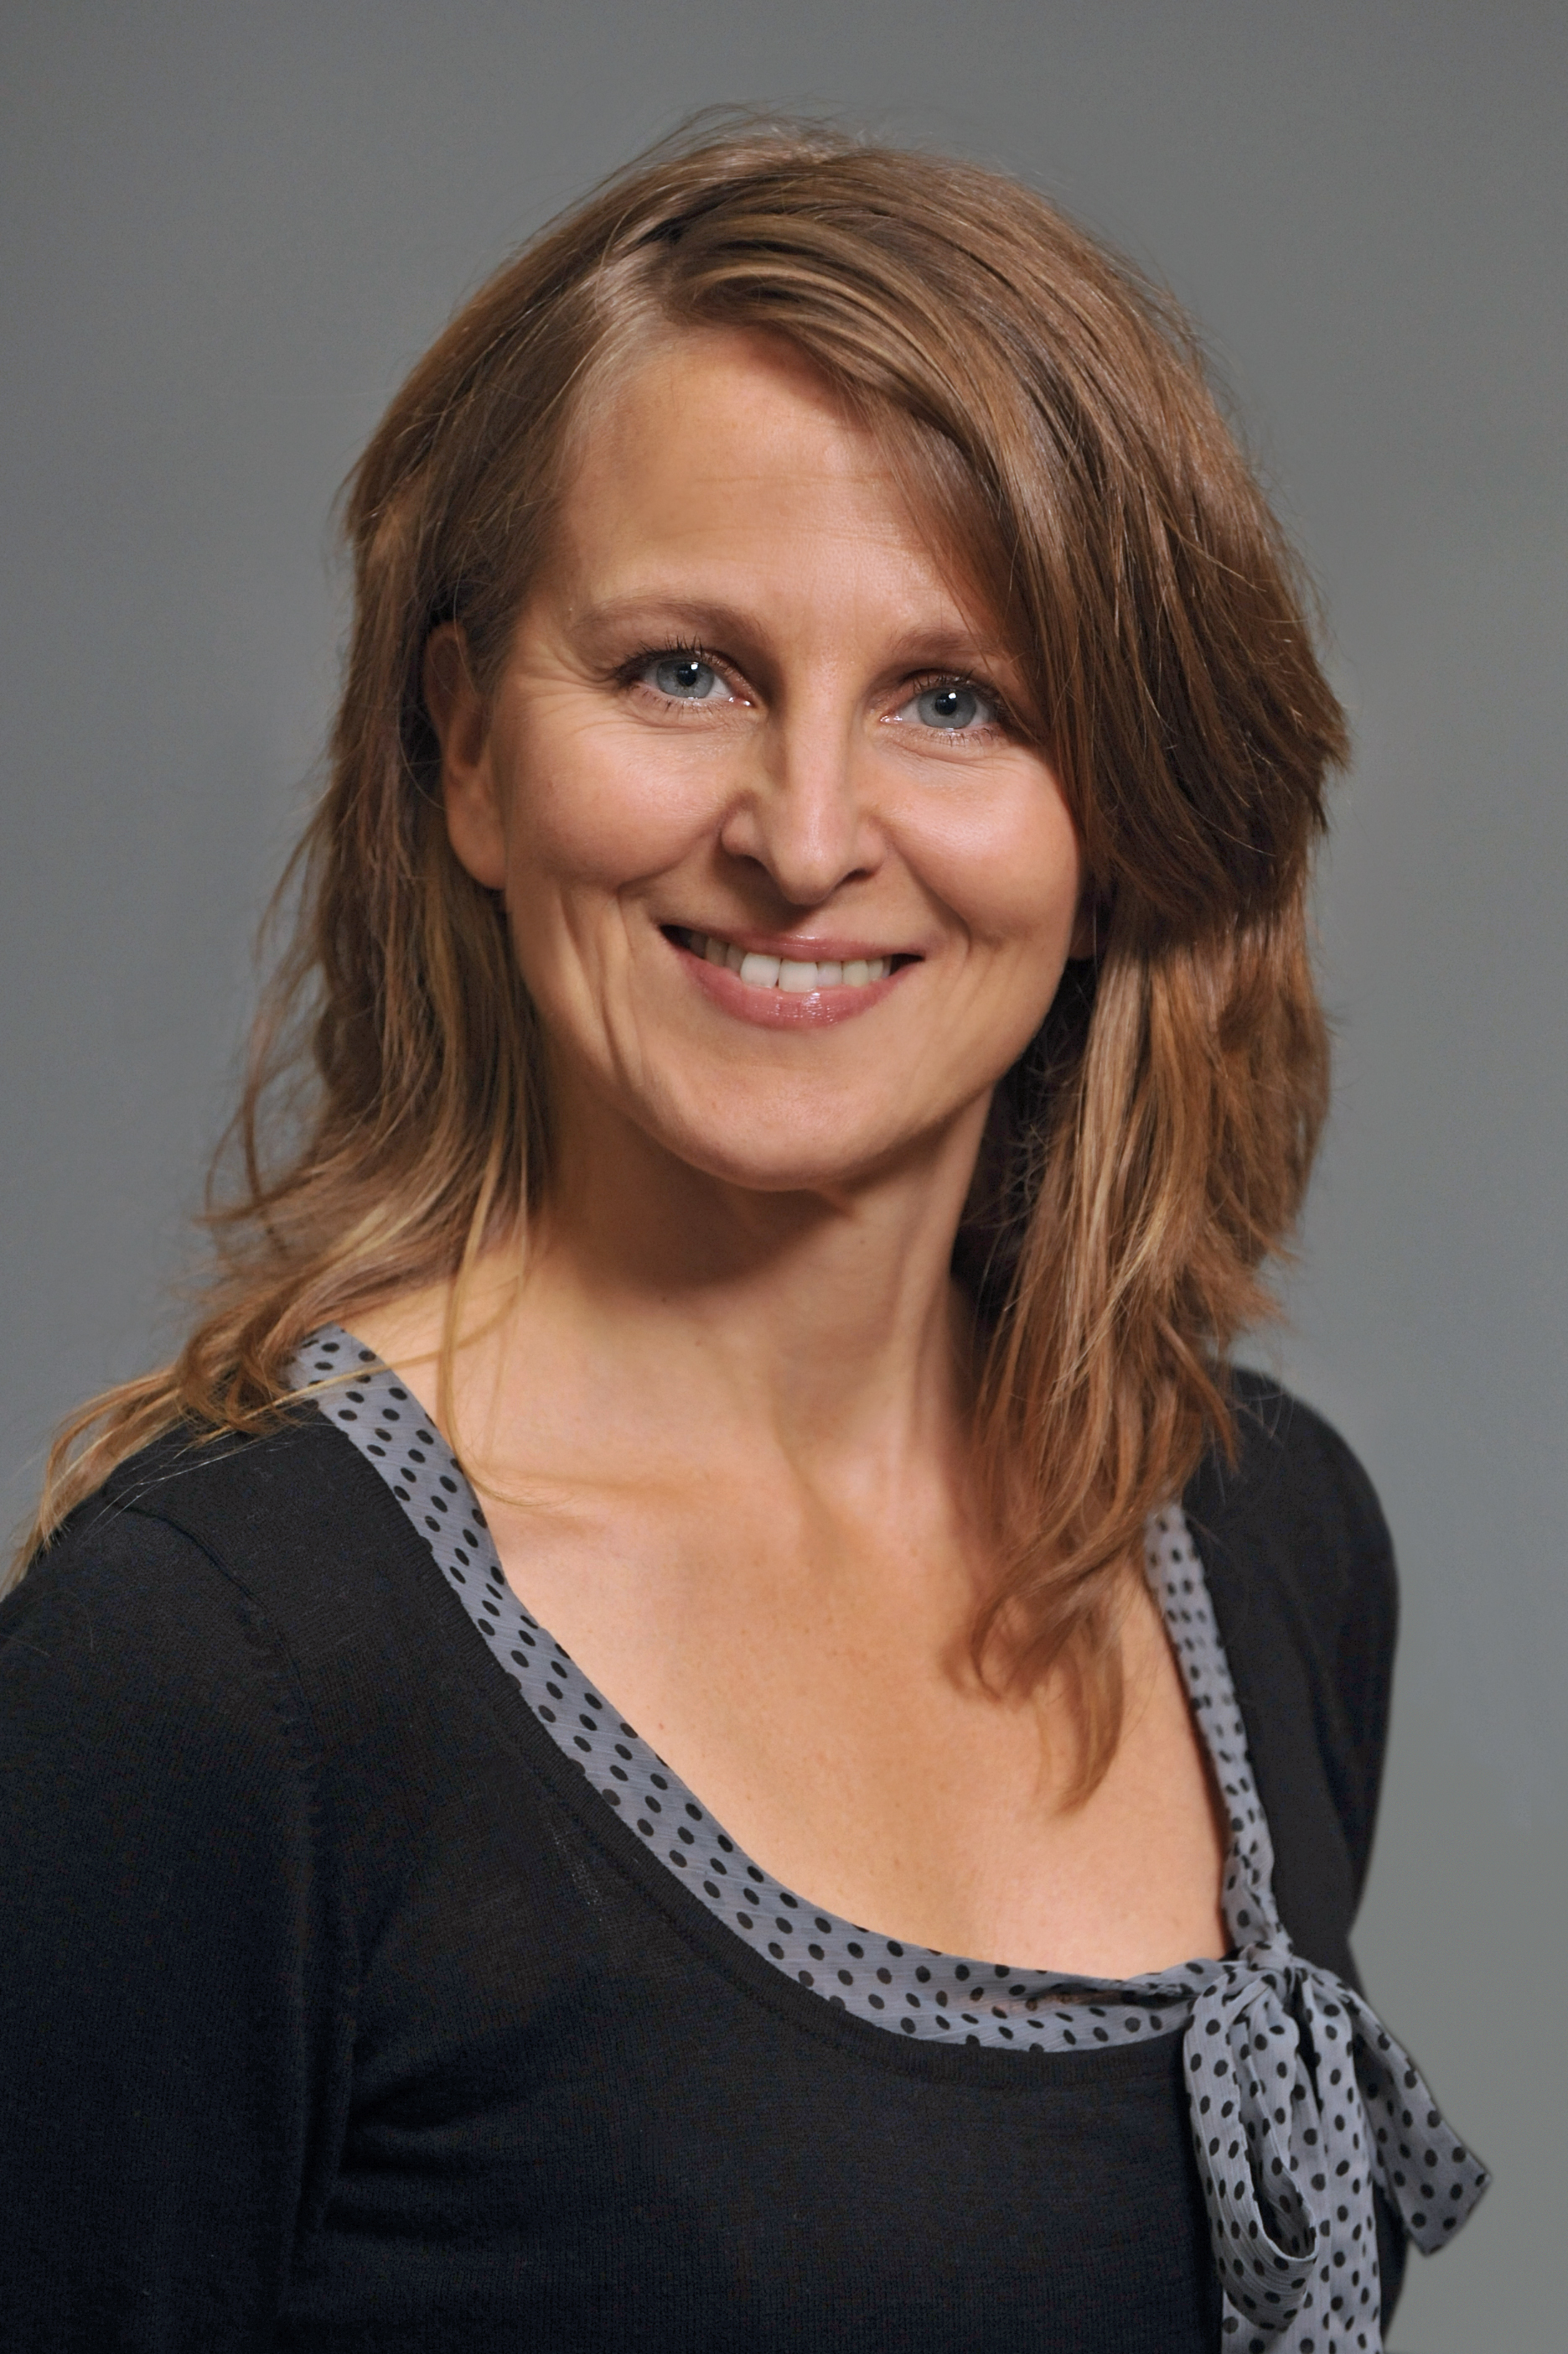
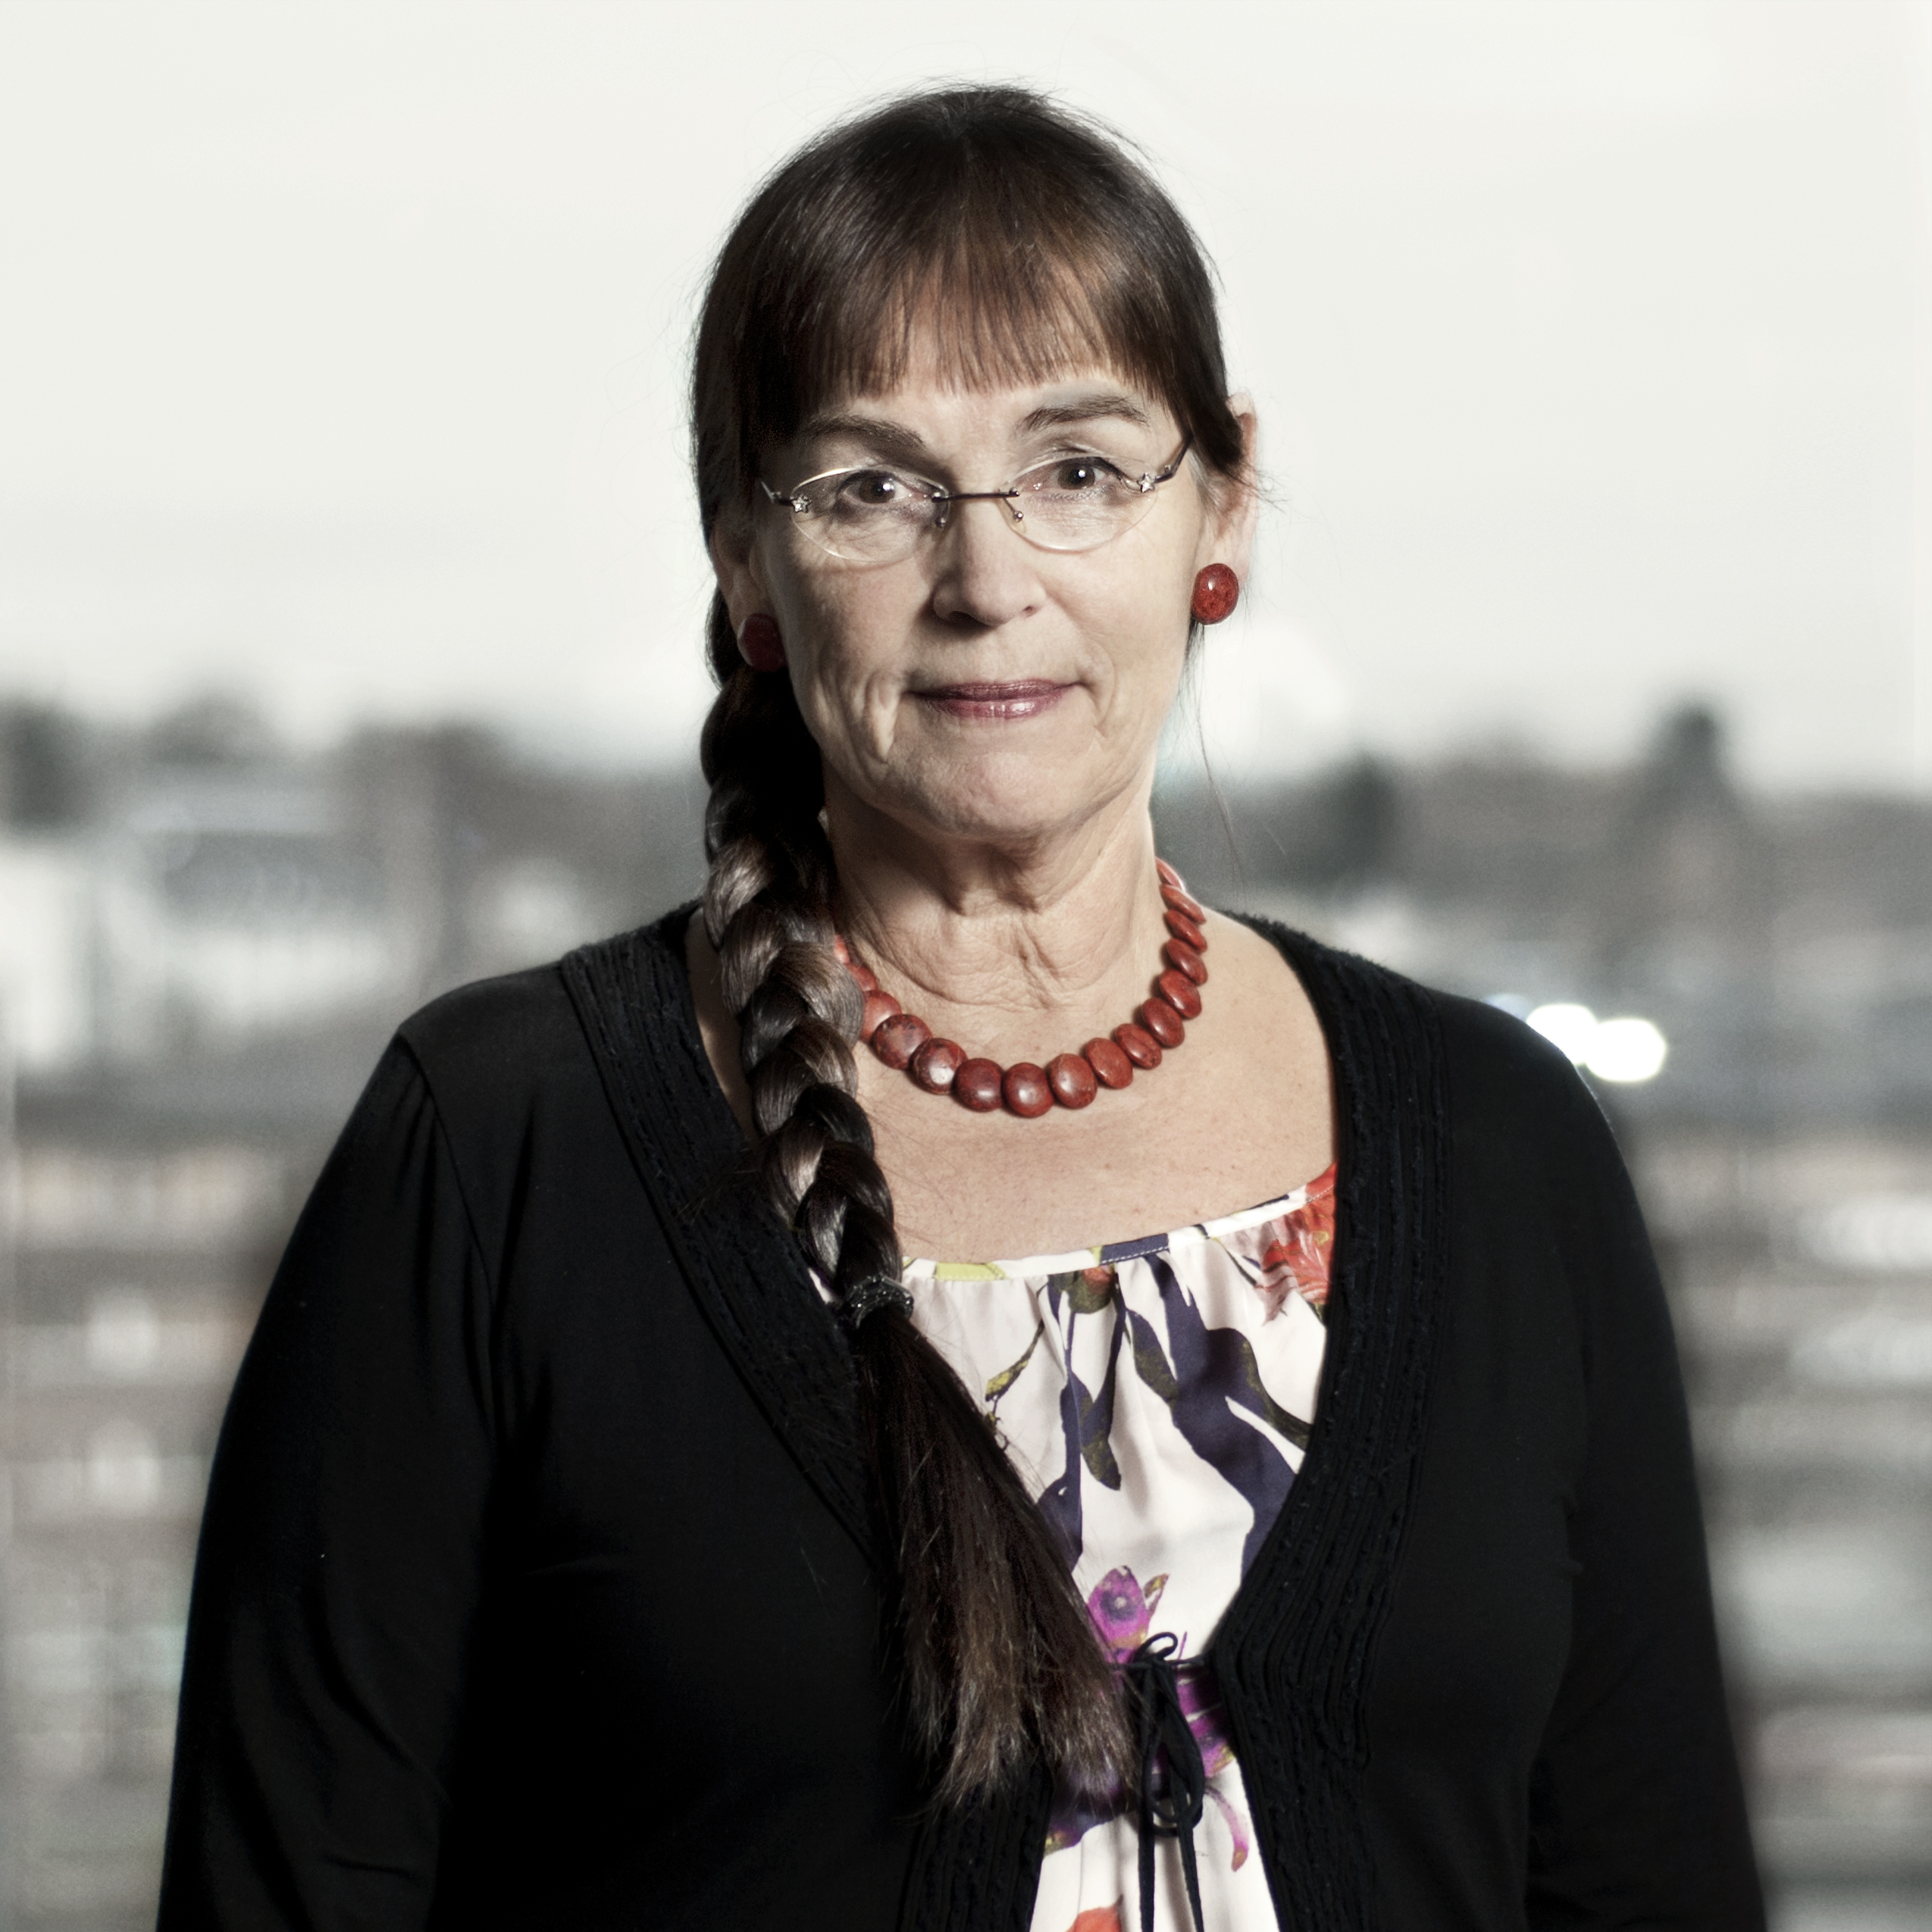
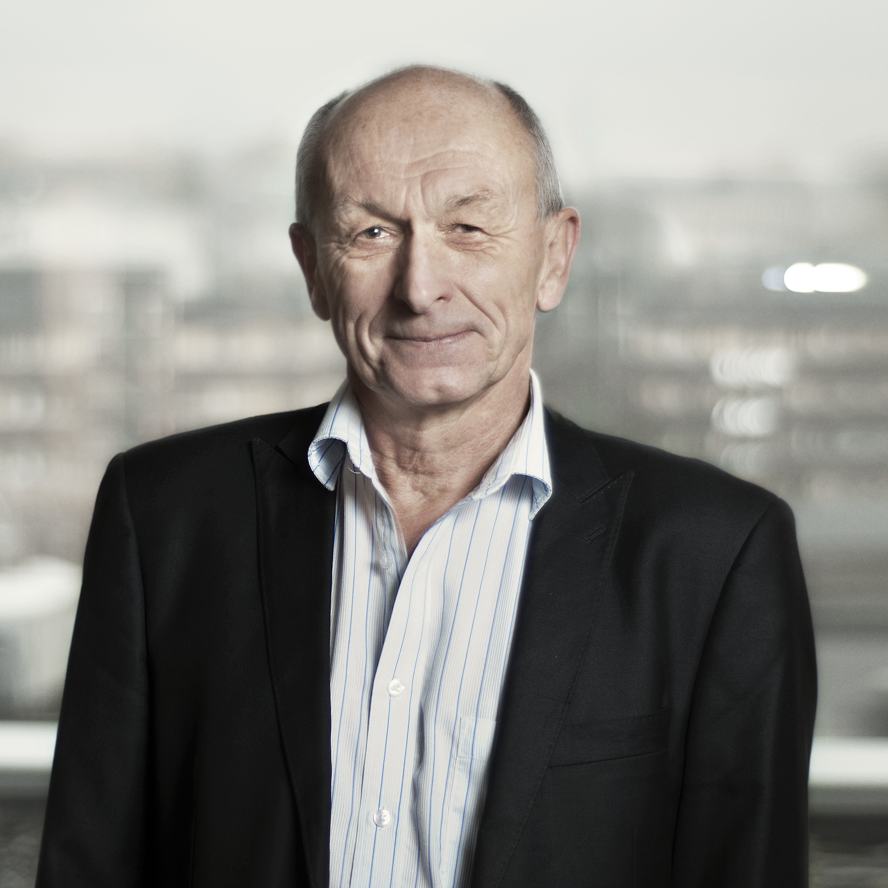
28th Plenary - Logistics and Key Dates
SIDE MEETINGS
Please indicate in the meeting registration form if you would
like to hold side meetings (as far as is possible including title,
duration, preferred date, expected number of participants etc.). The local organising committee will then contact you to coordinate the various side meetings.
QUESTIONS?
In case of any questions related to the logistics of the plenary meeting,
please do not hesitate to contact:
Ms Anne Taube [ceosplenary2014@eumetsat.int]
Mrs Ann-Lisbeth Ruud [ann.lisbeth.ruud@spacecentre.no]
Mr Per-Erik Skrøvset [Per.Erik.Skrøvseth@spacecentre.no]

Slide 15
Climate Research and EO from Space
Darmstadt Germany 13 – 17 October 2014
www.theclimatesymposium2014.com
Register now

