Slide 1
GFOI Status & Issues Sept 2014
Stephen Briggs, Space Data Lead - CEOS
SIT Technical Workshop, 16th – 18th September 2014

Slide 2
Status Report

Slide 3
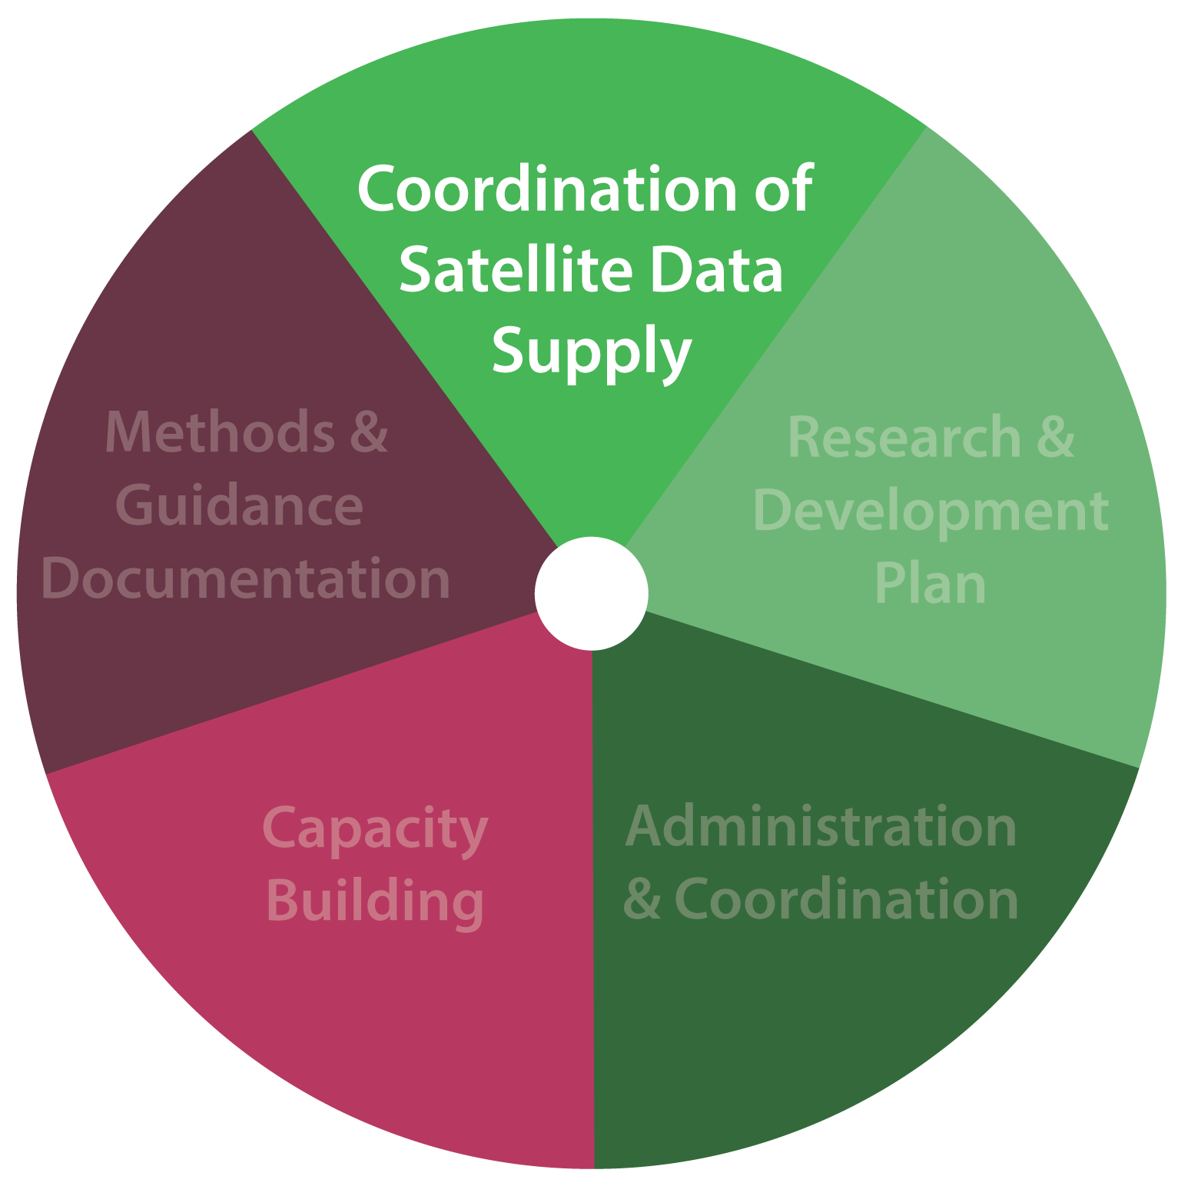
The Space Data Component of GFOI
CEOS effort to coordinate the satellite data contribution to GFOI.
Aim to ensure regular and systematic observations and measurements for effective reporting.
Continuity of data supply for the maintenance of consistent time series.
3

Slide 4
Space Data Coordination Group (SDCG) Three-part Strategy for GFOI
Baseline Global Data Acquisition Strategy
Space Data Services
Data Supply in Support of GFOI R&D Activities
4

Slide 5
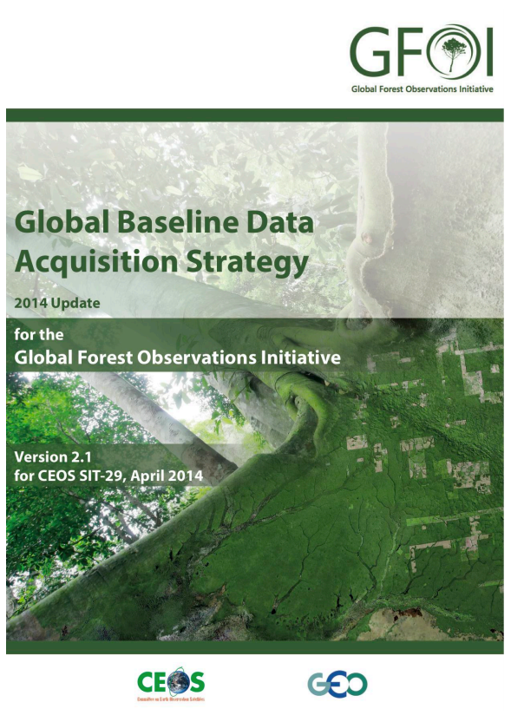
1: Global Baseline Acquisition Strategy for GFOI
Absolute minimum requirement is the successful acquisitions of at least one annual national cloud-free optical coverage over each target country.
Objective to assure the availability of temporally and spatially consistent time-series of optical and Synthetic Aperture Radar (SAR) satellite data over global forest cover.
Initial priority on tropical forest countries developing national MRV systems for REDD+
Element 1 focus on publicly open (“core”) satellite data
Phased implementation with aim at full global coverage by 2016
5

Slide 6
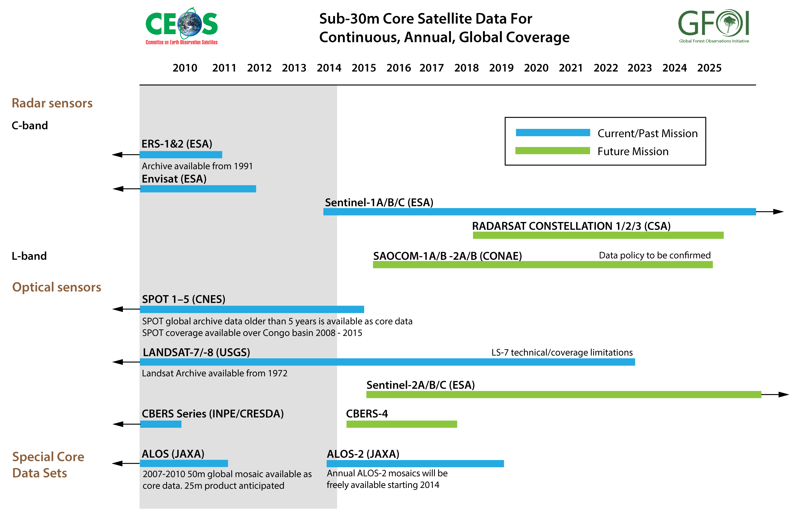
Core Data
6

Slide 7
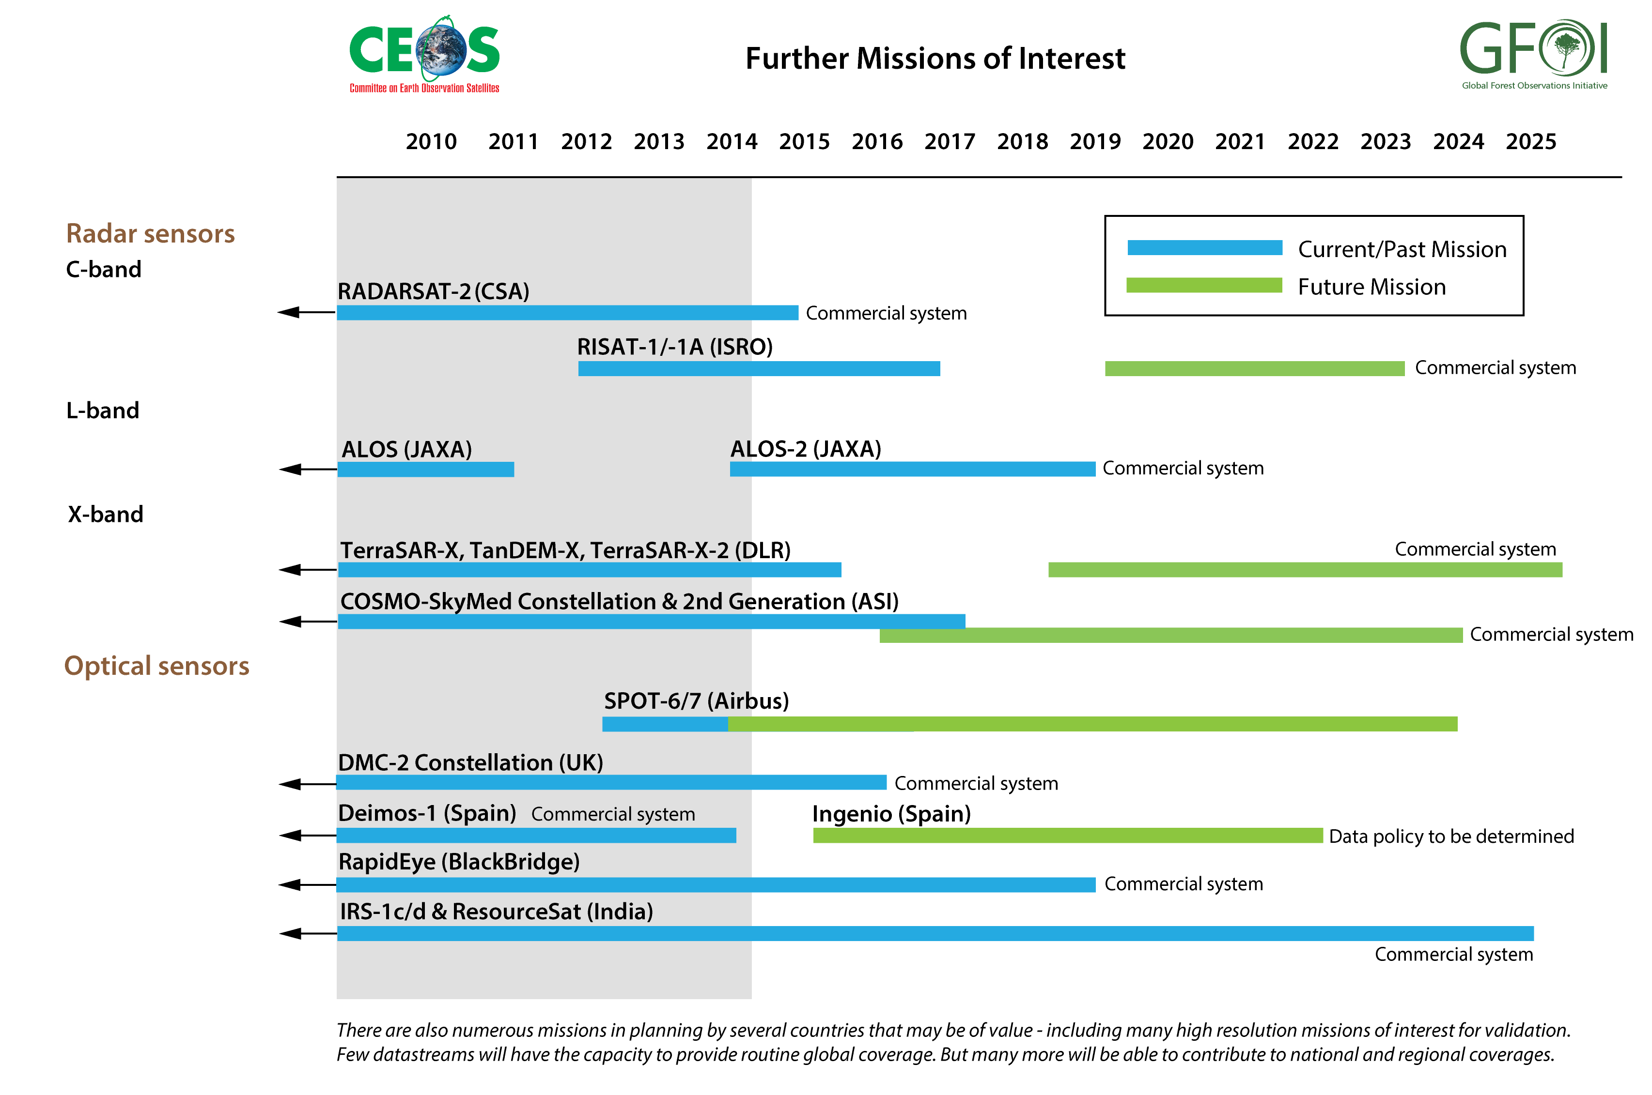
Contributing Data
7

Slide 8
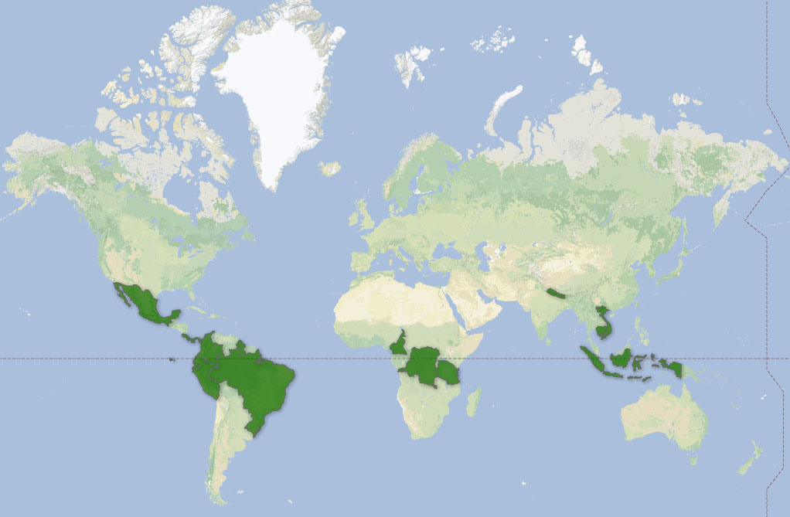
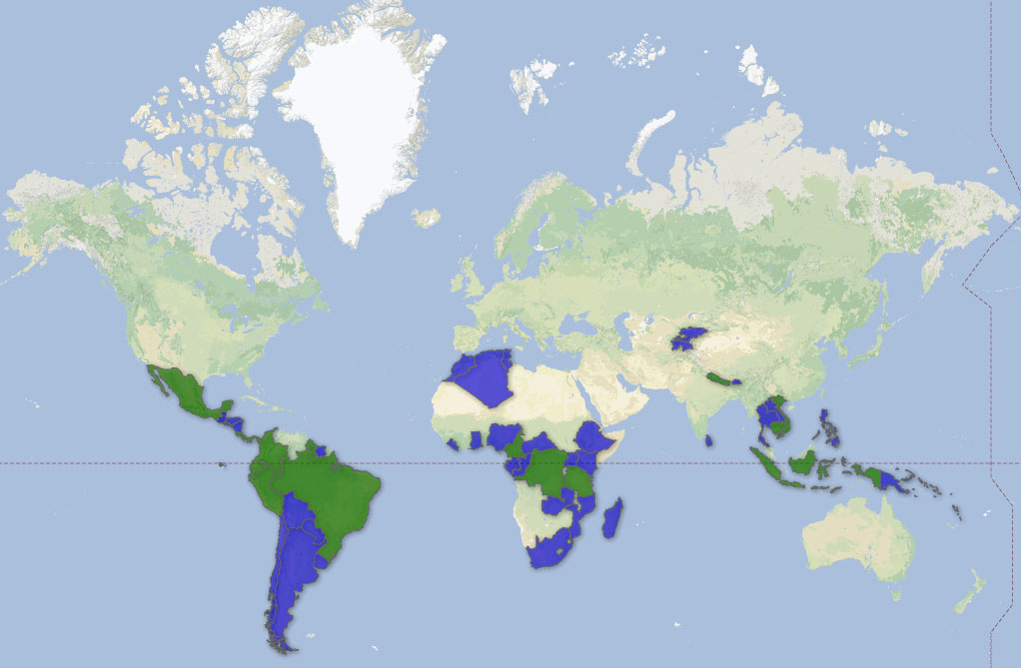
Global Baseline Acquisition Strategy for GFOI
Absolute minimum requirement is the successful acquisitions of at least one annual national cloud-free optical coverage over each target country.
Ultimate aim: inter- and intra-annual multi-mission time-series observations
2013
Year | Countries | Area (Mkm²) | Total Area (Mkm²)
2013 | 15 | 20.5 | 20.5
2014 | 36 | 18.5 | 39.0
2015 | 17 | 9.0 | 48.0
2016 | 127 | 84.8 | 132.8
2014
8

Slide 9
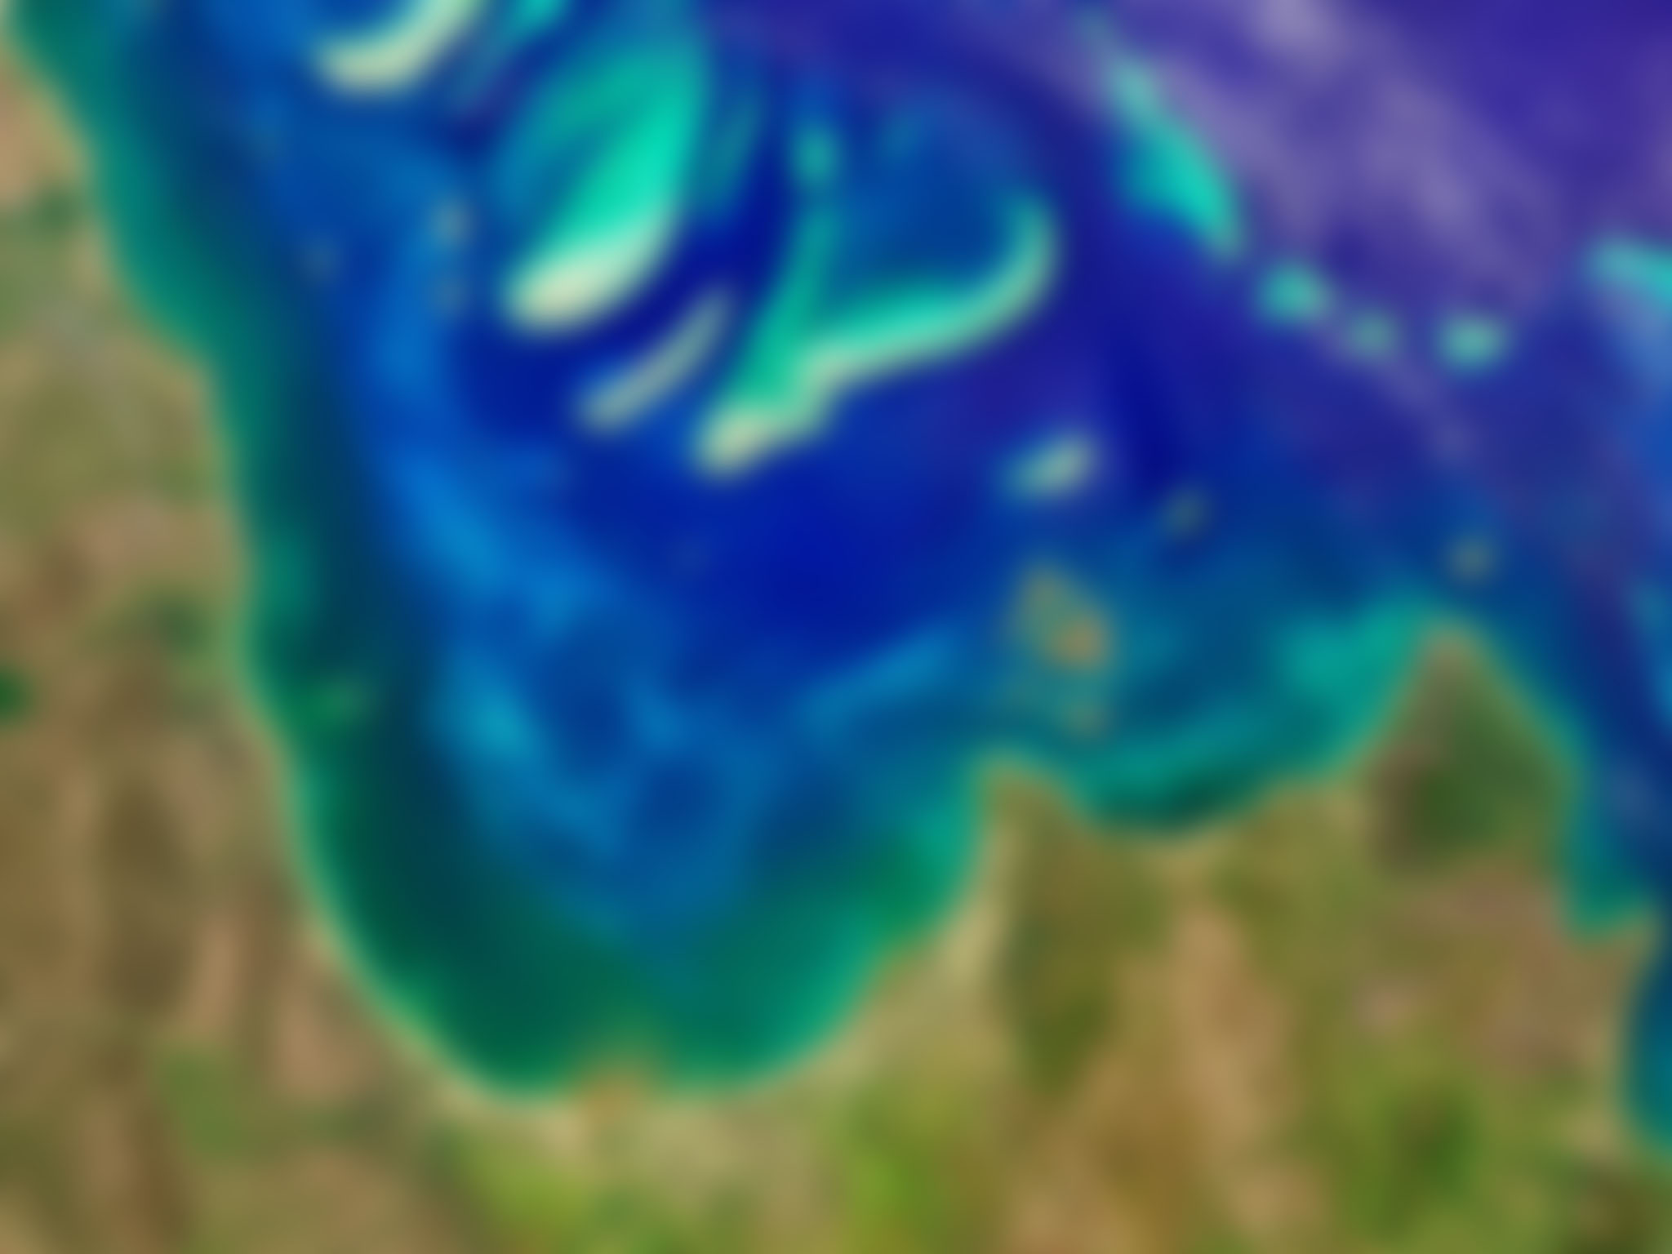
Current Mission Status
Landsat-7 and -8 are the only Core missions currently operating
Landsat-8 acquisitions are being progressively increased by USGS (peak of 725 scenes a day in July).
Landsat-8 is now capturing 650 scenes per day, covering all mid-latitude landmasses.
Sentinel-1A (ESA) was launched on the 3rd of April 2014, and is currently in its commissioning phase.
ALOS-2 (JAXA) was launched on the 24th of May 2014 and is also in a commissioning phase.
Sentinel-2A upcoming (early 2015), Radarsat-2, TerraSAR-X/TanDEM-X, and COSMO-SkyMed in operation.
It is also hoped that CBERS-4 will be launched in late 2014.
9

Slide 10
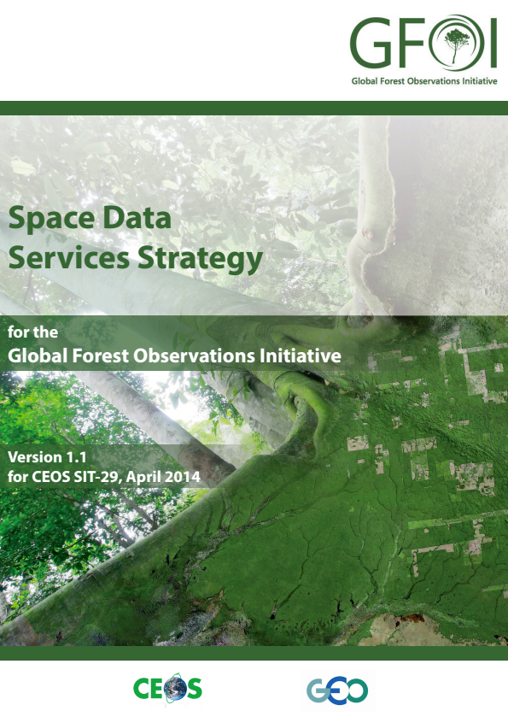
2: Space Data Services Strategy for GFOI
A coordinated strategy for national data acquisitions.
Accommodate countries’ specific technical requirements, heritage, or experience with a particular EO data source or type.
Accommodate any intergovernmental arrangements.
Wider range of satellite data sources, including commercial.
A collection of six services.
10

Slide 11
3: Data Supply in Support of GFOI R&D Activities
Includes support for science studies assisting:
The development and evolution of the MGD for GFOI.
Satellite sensor interoperability.
Time series consistency.
Forest degradation.
Validation activities.
The CEOS SDCG strategy for R&D is being developed through consultations with stakeholders at a series of expert workshops:
Date | Location | Topic
June 10 – 11 2014 | Woods Hole Research Center, MA, USA | Sensor interoperability and complementarity
October 1 – 3 2014 | Wageningen, Holland | Measurement of forest degradation
February 2015 | Brisbane, Australia | Above-ground biomass
11

Slide 12
Next Steps for the SDCG
3 year vision in development as foundation for Workplan to deliver the space data outcomes required for GFOI – next SIT meeting likely venue for requested endorsement of plan
Continued coordination of core data streams and addition of new core data streams and products
Continued development of data services tools for data acquisition planning, data storage, and data processing to support country needs
Expansion of R&D data supply and improved coordination of efforts
Engagement of priority countries through pilot projects (more below)
12

Slide 13
Pilot Project Status

Slide 14
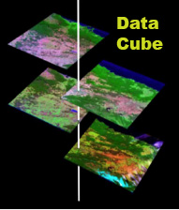
Element 2, Pilot Project Status
FAO Space Data Management System (SDMS) – Contract between KSAT (Norway) and AMA (SEO contractor) in place (Aug 13) with a prototype delivery in late October. Serving Ecuador, Tanzania and Uganda in cooperation with UN-REDD. Landsat-7 data used for initial testing of cloud-based storage, Open Foris processing, and product development.
Kenya – Landsat 7/8 scenes from 2013/2014 utilize cloud-based storage and processing. Initial system in place and under in-country testing. Supported by Kenya’s SLEEK program, supported by Australia.
Colombia – SEO proposal for TanDEM-X datasets (submitted in March) was accepted. Plans to test cloud-based storage and SAR processing tools, pending resolution of data download issues.
Tanzania Data Cube – SEO working with Geoscience Australia (GA) to develop a data cube concept to query Landsat and MODIS data in time and space without using individual scenes. Preliminary requirements scoping underway with a meeting between SEO and GA planned for early 2015.
14

Slide 15
Strategic Issues

Slide 16
Strategic issues
Process of negotiating the move of the GFOI office to be embedded within FAO has identified issues regarding the engagement of FAO within the GFOI partnership
GEOSEC Director visit to FAO on 4 Sept with CEOS Lead
SDCG seeks to embed Space Data Services within in-country programmes of UN-REDD and FCPF and to support their leadership of the delivery of the Services to relevant government agencies .
Multiple personnel changes among Leads (Australia, Norway, and notably FAO) has not helped continuity of discussion
Next Leads meeting in Oslo the week before CEOS Plenary will be crucial in establishing a basis for going forward
Information session proposed for Oslo meetings
16

Slide 17
Thank you
Thank you for your attention and feedback!
Contact:
Matthew Steventon
matthew@symbioscomms.com
www.gfoi.org www.ceos.org/sdcg

