Slide 1
WG Issues and Topics for
Plenary Preparation
WGDisasters
Ivan Petiteville, ESA
SIT Workshop Agenda Item # 8
CEOS SIT Technical Workshop
CNES, Montpellier, France
17th-18th September 2014

Slide 2
For Information, status of the 4 SIT Actions :
  WGDisasters [SIT-29-17, SIT-29-18]
  SIT-29-17: data supply to 3 supersites approved @ SIT-29
  SIT-29-18: data supply to 3 pilots (flood, seismic, volcano)
  World Conference on Disaster Risk Reduction [SIT-29-19 and SIT-29-20]
  <to be covered by Chu in session 4, item # 16>
For Plenary Decision: new Permanent Supersites to be approved:
Ecuador and New Zealand (Volcanoes)

Slide 3
Overall Status (1/4)
Pilots:
Significant progress since approval of pilots (2012 Plenary)
Data flow started (ramping up) to all 3 Pilots & Supersites; first results produced. Waiting for Sentinel-1 , ALOS-2 data
Includes Supersites activities. Selection process for Event Supersites and Engagement of Users being improved. 2 new Supersites (Ecuador & NZ) to be approved at Plenary
Examples of results for 3 pilots in next slides
Proposal for a new pilot on Landslides (presentation @ 2015 SIT meeting)

Slide 4
Overall Status (2/4)
Recovery Observatory:
Progress in implementation of IT infrastructure (lead by WGISS). First version by CEOS Plenary, 2nd version in July 2015
Meeting with Stakeholders (UNISDR, UNOSAT, World Bank/GFDRR, UNDP, Red Cross and UNEP) to develop institutional relationship and to engage the Stakeholders in the Observatory triggering process (Geneva, 7 Oct. 2014)

Slide 5
Overall Status (3/4)
  WCDRR & HFA2: (More details in Chu’s presentation –item 18)
  Participation in several WCDRR preparatory meetings (e.g. Ministerial Regional Platform meetings, Preparatory Committee meetings)
  Preparation of CEOS active participation in WCDRR (Request for Accreditation, Working session in Sendai with 14 co-organisers, CEOS booth, CEOS EO HB Special WCDRR edition,..)
  Coordinated action with GEO, UNOOSA, UNITAR for improving draft HFA2. Support from governments being sought

Slide 6
Overall Status (4/4)
Outreach:
  Organiser of Side event at Asian Ministerial Conference on Disaster Risk Reduction
  Presentations of CEOS activities (and paper) at Davos IDRC, in Athens (2nd GEO), Understanding Risk Haiti (WB, July)
WG organisation:
  Former Supersites Coordination Team (lead was DLR) responsibilities have successfully been subsumed in new Data Coordination Team (Brenda Jones, USGS is Lead)
  Still vacant positions. On-going actions to find candidates.
    Liaison(s) to User Communities
    GEO Disaster Task Coordinator (Letter from CEOS Chair)

Slide 7

Proposed WG Internal Organisation:
Teams & Functions
GEO Secretariat
ESA
WGDisasters
Experts
WG Chair
(single person with secretarial support)
Liaison to GEO Disaster SBA
(single person)
GEO Disaster Task Coordinator
(single person)
Still TBD
WG Vice-Chair (single person)
CSA
Liaison to User Communities
(one or two persons)
Still TBD
NASA & NOAA
ESA & DLR
USGS & ASI
FLOODS
Thematic Team
(2 co-leads + experts)
SEISMIC
RISKS
Thematic Team
(2 co-leads + experts)
VOLCANOES
Thematic Team
(2 co-leads + experts)
…
…
…
CNES
Recovery Observatory Team (1 Lead + experts)
…
2015 WCDRR – HFA2 Team (1 Chair + experts)
JAXA
…
Data Coordination Team (1 Chair + 1 Representative per Space Agency .
Includes the former Supersite Coordination Team )
USGS
…

Slide 8
First results from 3 pilots ….

Slide 9
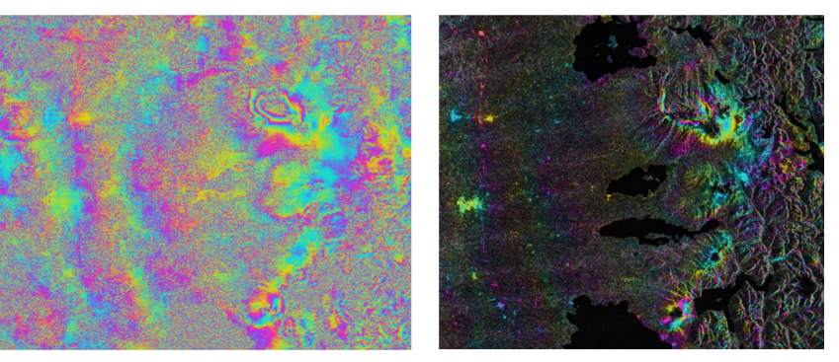
Volcanoes: Objective “A” results
RADARSAT-2 interferogram from Cordon Caulle volcano, Chile, spanning December 12, 2012 – March 27, 2013 (left: phase difference; right: phase difference overlain on amplitude image). The volcano erupted in 2011-2012. This interferogram shows post-eruptive inflation which would not otherwise have been known without the CEOS pilot program.
Figure and … comment !!: courtesy of Matt Pritchard (Cornell University)
Notes:
Nine scenes from Cordón Caulle have been processed (spanning dates in 2012-2014) and several show ground uplift after the 2011-2012 eruption, indicating that the magma chamber is re-filling.

Slide 10
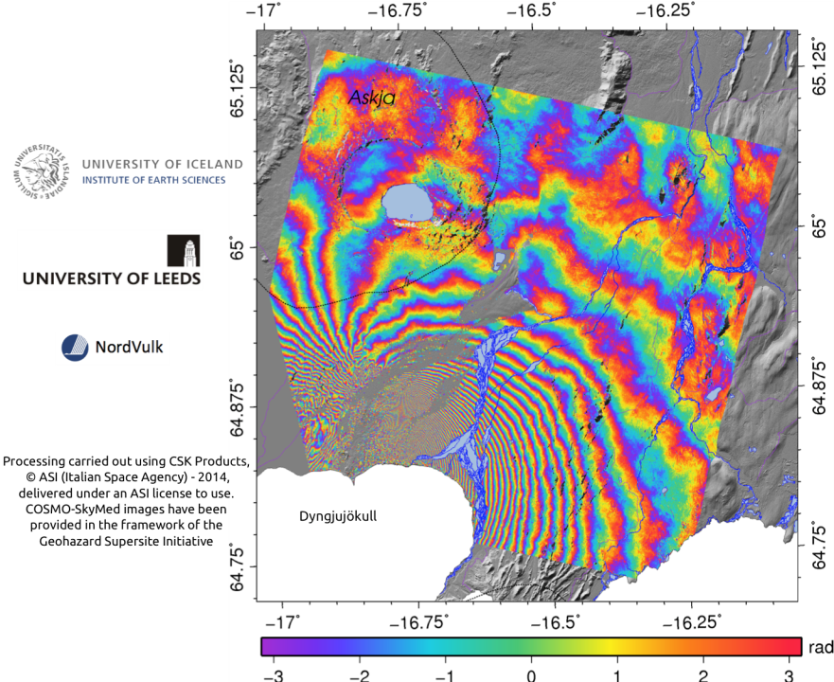
COSMO-SkyMED descending interferogram spanning the period 13th August 2014 - 29th August 2014. Each fringe represents ~1.5 cm of displacement in the satellite's line-of-sight.

Slide 11
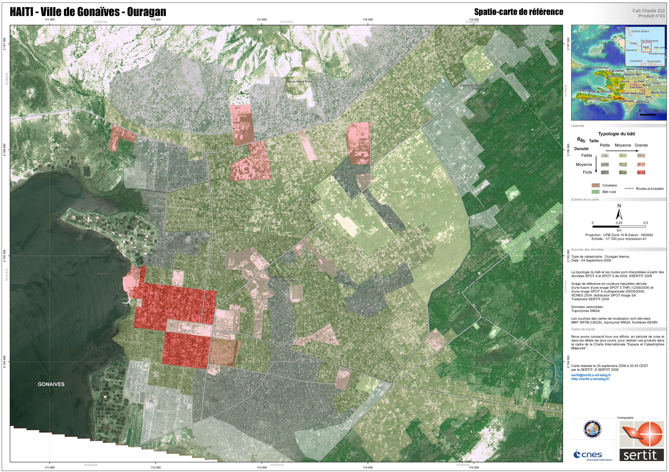


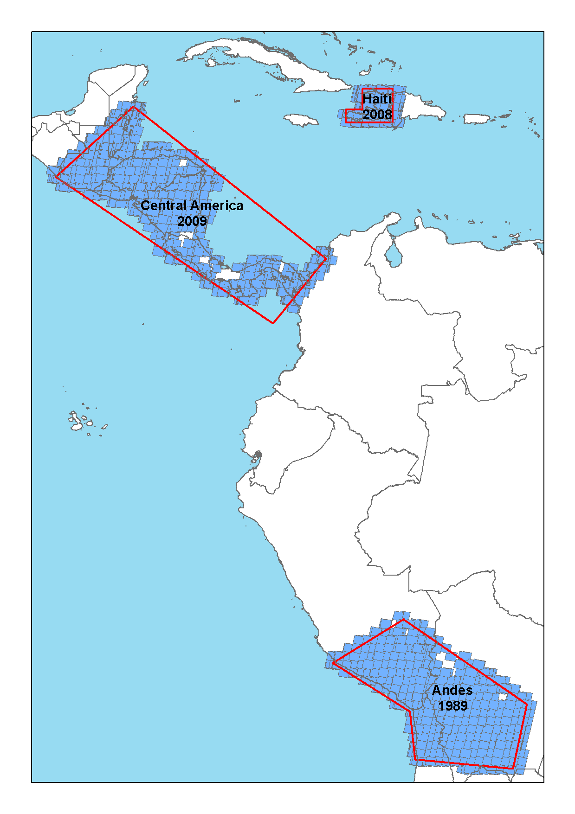


Floods: HAITI
Lead: RASOR/Athena Global/CIMA
Risks: Seismic, landslide and hydro-met event
Importance: model for poor in-situ data and high development interest
Deliverables: multi-hazard risk assessment, integration with operational warning, national risk assessment and prevention products; Work with regional partner CIMH allows roll-out of RASOR to other national civil protection agencies and geospatial organisations
EO Data: optical and SAR
End Users: CNIGS, CIMH, Haiti Civil Protection
Localization map
SPOT World Heritage Archive: 2008 Haiti images for historical flood record; 2009 Central American images

Slide 12







Floods: INDONESIA
Internal Lead: RASOR/Deltares
Risks: Three hotspots: Jakarta, Bandung and Cilacap
Storm surge and rainfall-induced flooding, tsunami
Risk is exacerbated by land subsidence
Importance: Densely populated, industrial production
Deliverables: Flooding scenarios, flood extent,
flood frequency, economic quantification of risk
EO Data: DEM, SAR and Optical
End Users: BNPB (National Disaster Management Agency), PUSAIR (Ministry of Public Works)
TanDEM-X 12 M DEM being processed for Jakarta, Bandung and Cilicap coast for accurate flow model

Slide 13
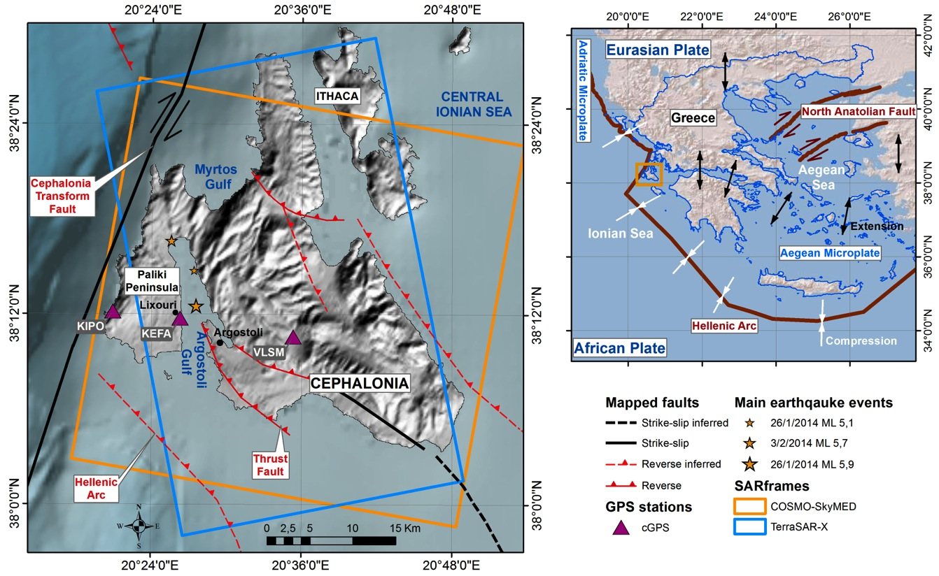
Seismic Risks: 2014 Cephalonia
M_{w} 5.9
3 Feb., 2014
M_{w} 6.0
26 Jan., 2014

Slide 14
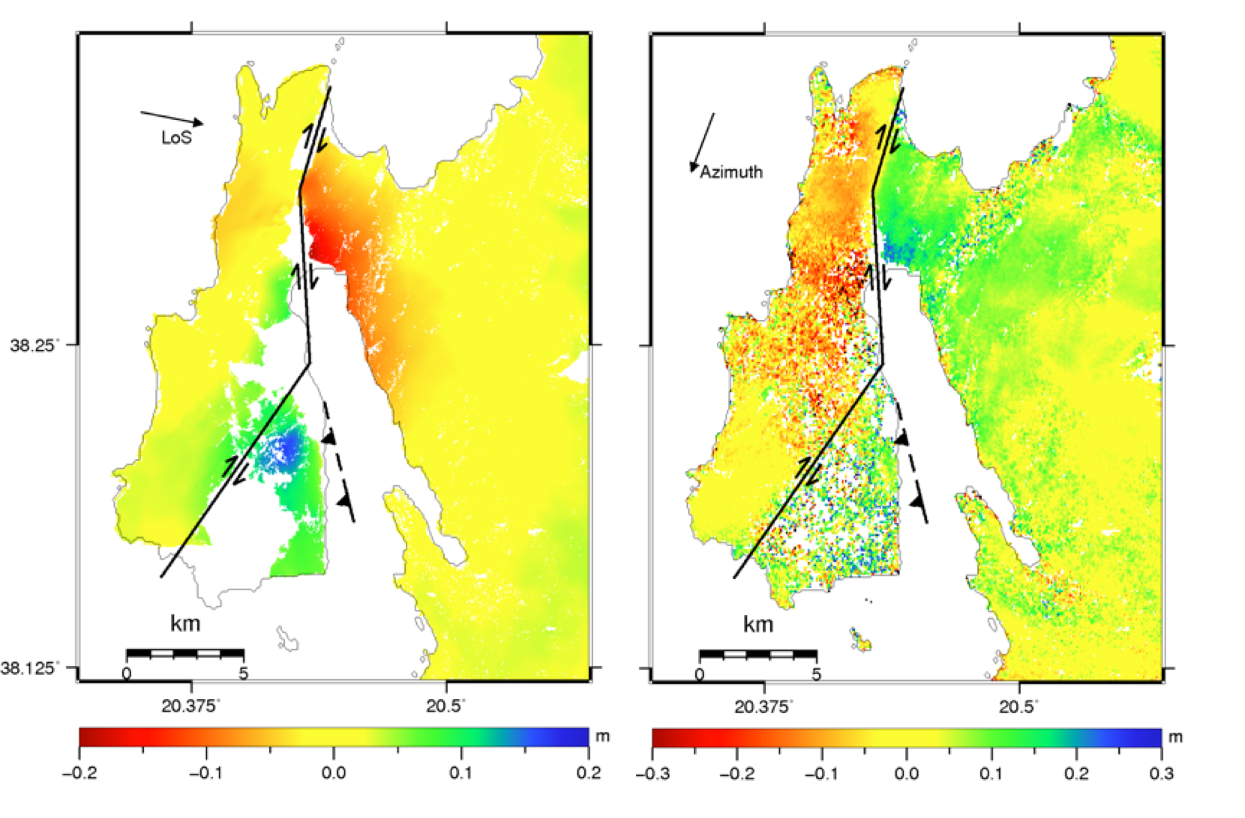
Descending orbit
COSMO-SkyMed DInSAR (15 m)
COSMO-SkyMed MAI (∼100 m)
Merryman et al., in prep.

Slide 15
Supersites
Relevant for Seismic Risks and Volcanoes Pilots objectives
Recent Event supersites (earthquakes and eruptions):
  Sinabung eruption, 2014 approved by CEOS – EO data (ASI, CSA)
  Earthquakes in Ludian (China), Napa Valley (both in 2014) being assessed by DCT
Selection process for Event Supersites is being revised / improved
New focus for coming months: involvements of end-users and decision makers in GSNL

Slide 16
THANK YOU …..
QUESTIONS ?

