Slide 1
WGISS
Richard MORENO CNES
SIT Workshop Agenda Item #8
CEOS SIT Technical Workshop
CNES, Montpellier, France 17th-18th September 2014

Slide 2
Summary
Recovery Observation Infrastructure Project
Technology Exploration Interest Group
Interoperability Interest Group
Opensearch
CWIC
FedEO
IDN
Data Stewardship Interest Group

Slide 3
Recovery Observatory Infrastructure Project

Slide 4
Recovery Observatory Infrastructure
Recovery Observatory Infrastructure roadmap
Version 1, very limited for CEOS Plenary (end of October)
Version 2 – End of July 2015
Version 1.1 – End of December 2014
Version 1.2 – End of March 2015
Version 1.3 – End of June 2015

Slide 5
Recovery Observatory Infrastructure
Recovery Observation Infrastructure organization
WGISS Interest group
NASA
NOAA
ESA
CNES
UKSA
CHINA / CODATA
WG Disasters
CNES contractor : AKKA for development & Integration

Slide 6
Recovery Observatory Infrastructure
Recovery Observatory Events
Q2 2014 – ITT by CNES
AKKA company was selected to develop/integrate RO
Sept 2014 : participation to WGDisaster meeting in Paris
Sept 2014 : RO workshop during WGISS meeting
Oct 2014 : RO presentation during Plenary
April 2014 : RO presentation during SIT
May 2014 : RO workshop during WGISS meeting
Regular Interest Group Telecon

Slide 7
Recovery Observatory Infrastructure
Recovery Observation Infrastructure scope
Development and support for usage
Out of scope
Governance
Hosting (Hardware)
Exploitation
Maintenance ?

Slide 8
Technology Exploration Interest Group

Slide 9
Technology Exploration
Side meeting at the Plenary
WGISS is proposing to have a side meeting at the Plenary in Tromso called “Emerging Technologies”.
This meeting would highlight a few key emerging technologies that have been discussed during recent WGISS Tech Exploration sessions.
The goal would be to explain how these technologies have the potential to change the way agencies operate.
White paper
The Technology Exploration Interest Group is developing a white paper summarizing the discussions held at past WGISS meeting Technology Exploration sessions on the topics of Big Data, Cloud Computing, Semantics and Virtualization.

Slide 10
Technology Exploration
The Technology Exploration Interest Group is developing a web page to advertise resources from the WGISS agencies that fall under the following categorization:
Search & Order,
Data Handling,
Subsetting & Filtering,
Geo-location, Re-projection & Mapping
Data Visualization& Analysis
They are also developing a web page to advertise open source software and to promote software reuse.

Slide 11
Interoperability Interest group
Opensearch
CWIC
FedEO
IDN

Slide 12
Opensearch
CEOS opensearch ?
Standard for interoperabilty (discovery and access of data)
Now an OGC standard
CEOS opensearch best practice document
To help implementers
To precise some technical elements left open in OGC

Slide 13
Opensearch
CEOS opensearch
Applied by most of CEOS agencies
Including CWIC and FedEO federations
Easy and simple to implement
CEOS Best Practice document
Reference document for implementation
Will be issue at the end of September 2014
CEOS opensearch Workshop for developers
During next WGISS meeting from 28th Sept to 3rd Oct

Slide 14
CWIC
CWIC supports both 2 standards for search and access
including OpenSearch and OGC CSW
Provides search and access to
over 1900 data collections
with over 70+ million granules.
All data collections currently accessible via CWIC are “GEOSS Data Core” except for 2 data collections.

Slide 15
CWIC
Operational data partners:
NASA,
NOAA/GHRSST,
USGS,
INPE
CCMEO
Developing data partners:
ISRO (will become operational in late fall),
EUMETSAT (will be operational in the next several months),
AOE,
NOAA,
ROSCOSMOS

Slide 16
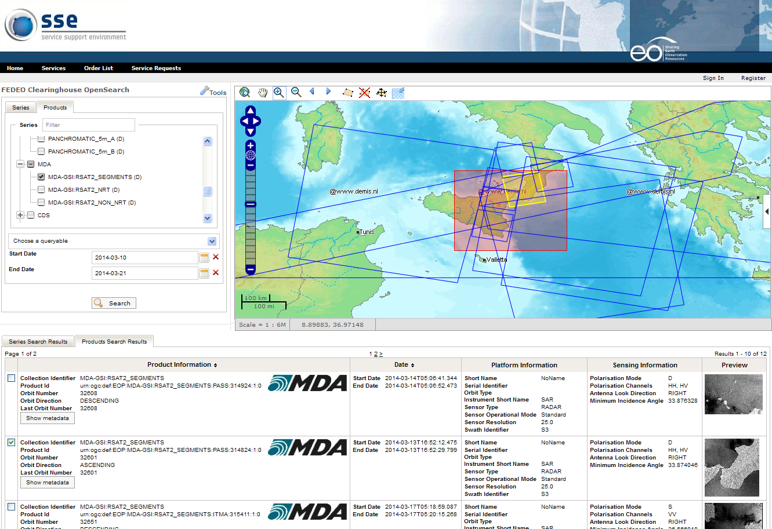
FedEO – Federated Earth Observation
FedEO System:
Allows to provide brokered discovery (and access) capability for (European and Canadian) EO data through HMA standard interfaces
Implements the OpenSearch OGC interfaces for an increased number of discoverable and accessible EO data collections, and for interfacing with CEOS Community Catalogues and Clients

Slide 17
FedEO – Last 6 months activities
FedEO infrastructure being consolidated.
Opensearch interface from/to FedEO implemented according to CEOS Opensearch.
Opensearch gateway available at: http://geo.spacebel.be/opensearch/readme.html
M2M External access with GEO Discovery and Access Broker (DAB) implemented: data discovery/access on GEOSS Portal.
Further catalogues interfacing progressing within dedicated ESA project.
Drafted FedEO Partners and Clients Guide.

Slide 18
FedEO – Last 6 months activities
FedEO infrastructure being consolidated.
Opensearch interface from/to FedEO implemented according to CEOS Opensearch.
Opensearch gateway available at: http://geo.spacebel.be/opensearch/readme.html
M2M External access with GEO Discovery and Access Broker (DAB) implemented: data discovery/access on GEOSS Portal.
Further catalogues interfacing progressing within dedicated ESA project.
Drafted FedEO Partners and Clients Guide.

Slide 19
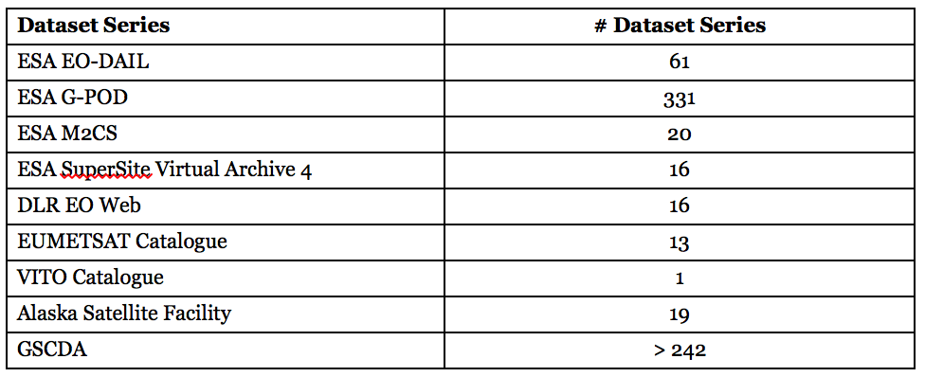
FedEO Statistics (end 2013)
# of discoverable and accessible collections = 477
# of discoverable granules > 6 millions
In addition CWIC collections discoverable & accessible

Slide 20
IDN
On going action with support of all CEOS agencies.

Slide 21
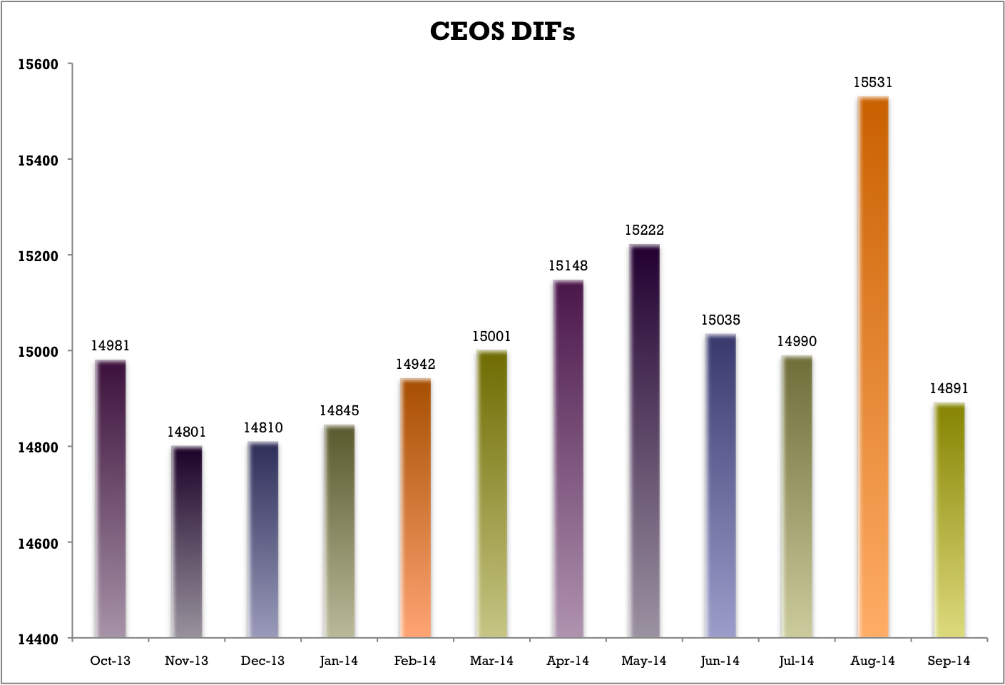
IDN
# of DIF charts: Jan 2014 to Sept 2014
The reason for the big drop in DIFs in August 2014 - Sept 2014 was because updates/deletions from the Australian Antarctic Data Centre.

Slide 22
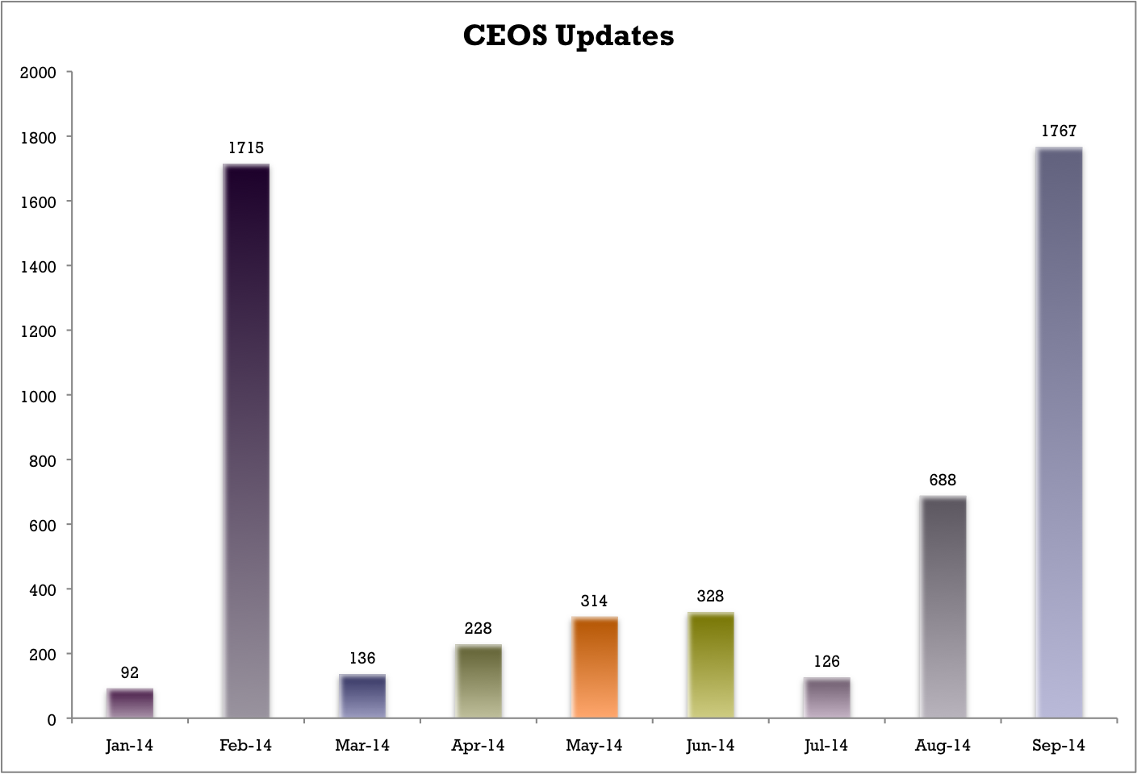
IDN
# of updated DIFs chart: Jan 2014 to Sept2014

Slide 23
Data Stewardship Interest Group

Slide 24
DSIG - Data Stewardship
Purpose: Provide WGISS EO Data Stewardship Guidance
Goals:
Sharing of agency investigations, developments, and lessons-learned relating to EO data stewardship
Share experiences and lessons learned
Draft common cross-agency best practices or guidelines of data stewardship for possible adoption by WGISS
Sponsor technical exchanges at WGISS meetings or elsewhere
Scope: Focus on Data, Metadata and Product Topics Including:
Long-Term Archive Strategies
Data Formats
Data Preservation
Data Lifecycle Concepts
Archive Media
Background: Former WGISS Archive Task Team
Renewed Interest by WGISS Dating to WGISS-27 (Toulouse)

Slide 25
DSIG - Data Stewardship
PREVIOUS ACHIEVEMENTS
White Papers/Reports:
Long-Term Archive Strategies
Data Preservation Techniques
Data Lifecycle Models and Concepts
Browse Survey 1997-2010
Guidelines for GIS-Ready Products
Browse Guidelines Document (version 2)
Offline Media Trade Study
Best Practices/Recommendations:
European Long Term Preservation of Earth Observation Space Data
Preview Image Principle
Data Management Statement

Slide 26
DSIG – Future activities
Sharing Information and experiences about agency investigations, developments, studies, and lessons-learned relating to EO data stewardship
Periodic report from CEOS agencies during WGISS meetings
Draft common cross-agency best practices or guidelines on data stewardship for possible adoption by WGISS:
Preservation Workflow
Preservation Guidelines (update)
Preserved Data Set Content (update)
E2E Level-0 data consolidation
Archived data media transcription
Persistent Identifiers
Purge alert procedure
Appraisal procedure
Propose CEOS DSIG best-practices/guidelines for adoption in GEO and as input to standardization activities (e.g. OGC/CCSDS)

Slide 27
DSIG – activities last 6 months
DSIG Plan of activities agreed at WGISS#37 and new chairmanship identified.
DSIG reporting session set-up for CEOS interested agencies starting from WGISS#38
Started drafting of Best-practices/recommendations on:
Preservation Workflow
Persistent Identifiers
Started updating of CEOS Purge Alert procedure and mailing list
Review of GEO Data Management Principles drafted by “GEO Data Management Principles Task Force (DMP TF)” and covering the entire data life cycle from planning, to acquisition, quality assurance, documentation, access, archiving and preservation: feedback sent to GEO Secretariat.

