Slide 1
Position Paper and Recommended Way Forward Regarding Land Imaging Coordination
Thomas Cecere & Jonathon Ross USGS and Geoscience Australia
SIT Workshop Agenda Item #7
CNES, Montpellier, France 17th-18th September 2014

Slide 2
LSI Position Paper
Initial LSI Primary Objectives (Plenary 20)
“to define a broad range of rather detailed characteristics (or standards) that describe optimal, end-to-end capabilities (and policies) to acquire, receive, process, archive, and distribute space-acquired land surface image data to the global user community” and
“to address current and shorter-term problems and issues facing the land remote sensing community today, such as seeking ways to work more cooperatively in the operation of existing land surface imaging systems and helping to accomplish tangible benefits to society through application of land surface image data.”

Slide 3
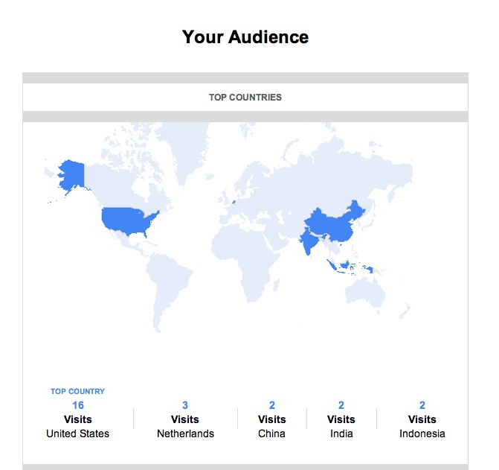
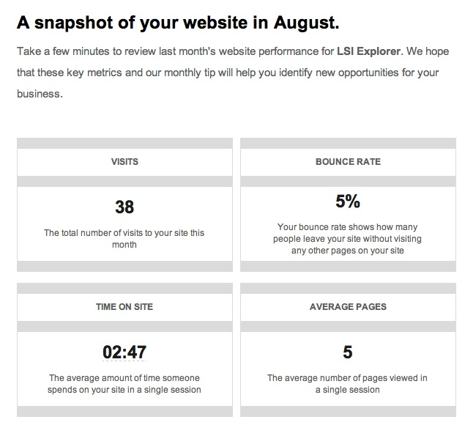
LSI Position Paper

Slide 4
Yesterday

Slide 5
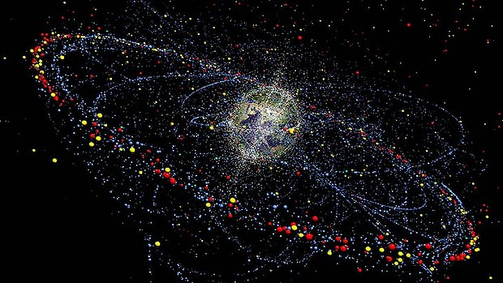
CEOS
Thanks Craig!

Slide 6
What is the plan for sustaining the excellent work
Of the ‘Ad Hoc Teams’ in the long term?
Thanks SEO!

Slide 7
Already some difficulties … (1/2)
CEOS supports some major international initiatives, by supplying large volume of EO satellite data. Potential conflicts in data provision between various Projects.
GFOI: “internal” data coordination is supervised by SDCG
GEOGLAM: much higher demand for data than GFOI
Disasters Pilots: “internal” data coordination is supervised by Data Coordination Team (DCT).
Thanks Ivan and Co!

Slide 8
Already some difficulties … (2/2)
Some EO missions have no or few limitations in terms of data sensing & data provision BUT …..
…. Some other “highly requested”- missions face either sensor operations constraints or data policy issues
Disasters Pilots: limitations in data volume (e.g. 100 ALOS-2 images / pilots / year ) and in sensor operations (e.g. background mission of Sentinel-1 during ramp-up phase)
Need for CEOS to maximize the overall response (i.e. data provision) to those major initiatives, following priorities agreed at CEOS level.
Thanks Ivan and Co!

Slide 9
So …is there a problem?

Slide 10
WGISS
Ad-Hoc Teams
WGClimate
Synergies?
WGDisasters
VCs?
WGCapD

Slide 11
LSI Position Paper
The Need
Land is important. We all depend on it.
Flexible space assets that can serve many domains across many SBAS are good!
But how do we ensure that:
Use of assets (satellites, ground stations, communications and data storage) is coordinated and optimised.
Potentially conflicting acquisition priorities are effectively managed across domains.
Agency programs are sustainable in the long-term, maximising the likelihood that long-term continuity of data required to deliver current & future societal benefit.
Users, activities and entities are supported to ensure the data actually get used, addressing real user requirements across a wide variety of domains and promoting and encouraging openness and inclusivity among data providers.
How can we help the contacts at the space agencies
who are trying to do their best to provide
data to support all the great ideas?

Slide 13
LSI Position Paper
Options
The following primary options have been identified and initially analysed:
Option | Concept
1 | Do nothing (i.e. allow the Land surface imaging VC to dissolve)
2 | Land surface imaging VC – end to end
3 | Land surface imaging VC – space segment and associated land imaging assets
4 | Multiple VCs (optical land, radar land, thermal land)
Are there any other options that should be considered here?
Notes:
Should note that Option 2 is pretty close to the model adopted by SDCG and is working quite well for GFOI.

Slide 14
LSI Position Paper
Top Down Analysis Criteria
How well are the CEOS objectives supported?
How much benefit is there likely to be to internal stakeholders?
How much benefit is there likely to be to external stakeholders?
Does the approach align with the defined roles of Working Groups and Virtual Constellations?
Does it address an unmet need in the existing organisational mechanisms?
These criteria were derived from guiding documents.
Are there others we should be using?

Slide 15
LSI Position Paper
Bottom Up Analysis Criteria
Does it address a real and pressing issue that needs action right now?
Do agencies possess the necessary personnel and fiscal resources to support the initiative?
Will a critical mass of key agencies support it, and does it provide feasible avenues for other agencies to participate?
How well does it leverage, and support, existing activities and mechanisms?
Is there a logical pathway to ‘kick off’ and ‘ramp up’ the new initiative?
These criteria were derived from guiding documents.
Are there others we should be using?

Slide 16
… And is there a solution?

Slide 17
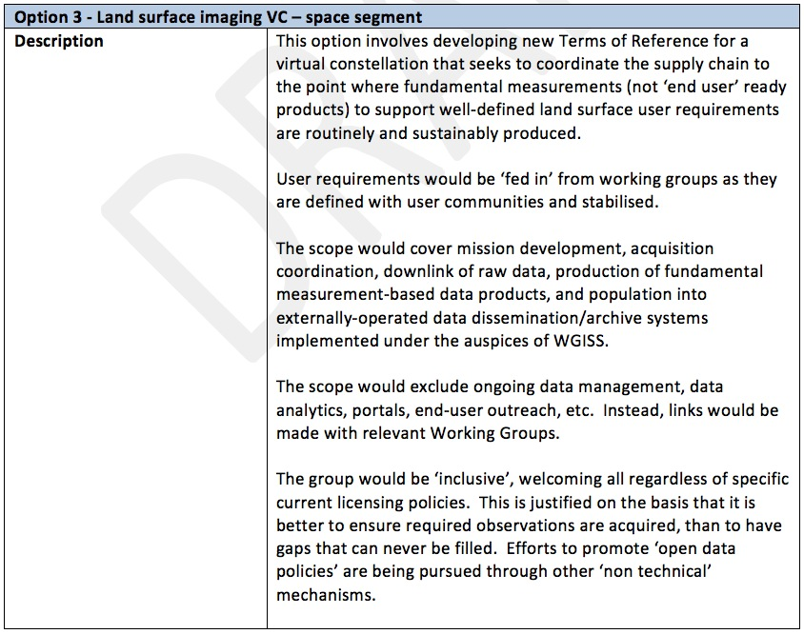
LSI Position Paper
Sample Analysis

Slide 18
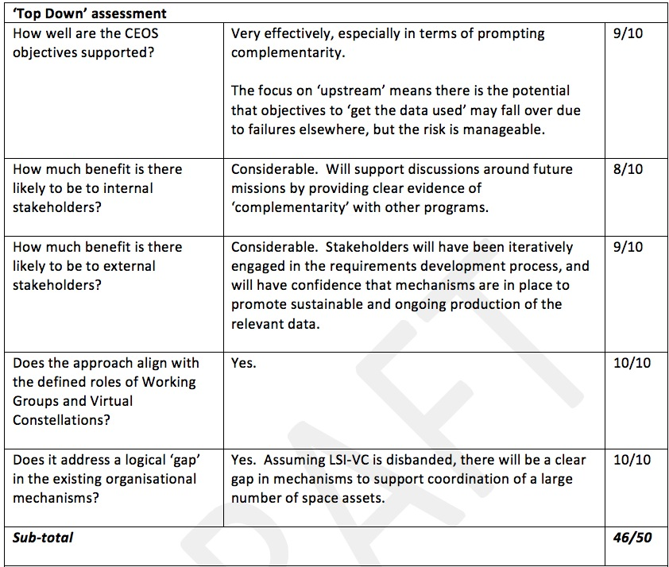
LSI Position Paper
Sample Analysis

Slide 19
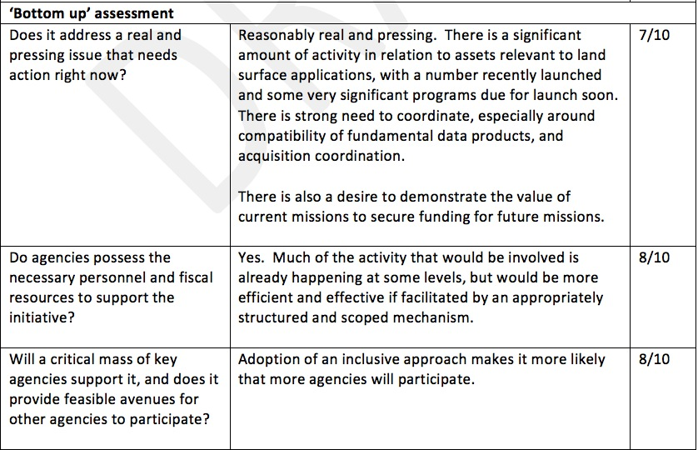
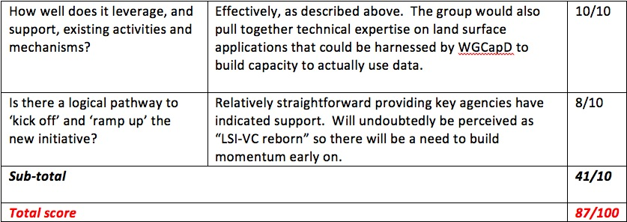
LSI Position Paper
Sample Analysis
41/50

Slide 20
LSI Position Paper
Can it work?
Analysis showed a prima facie solution.
But it was undertaken by a very small group.
And it is unclear:
Will a critical mass of key agencies support it?
Does it provide feasible avenues for other agencies to participate?

Slide 21
LSI Position Paper
Immediate next steps:
Feedback by end of the week:
Finalize Options
Finalize Top Down and Bottom Up Criteria
Form an evaluation team composed of CEOS internal stakeholders:
Develop a standard scoring for each identified criteria
1-10 scale tricky
Perhaps ‘Strong disagree … to … Strongly agree’
Perform an analysis for each option
Results would need to be completed by mid-October and it is proposed that they will be presented at the CEOS Plenary
41/50

