Slide 1
28th Plenary Expected Outcomes
Paul Counet
EUMETSAT
SIT Workshop Agenda Item 4
CNES, Montpellier, France 17th-18th September 2014

Slide 2
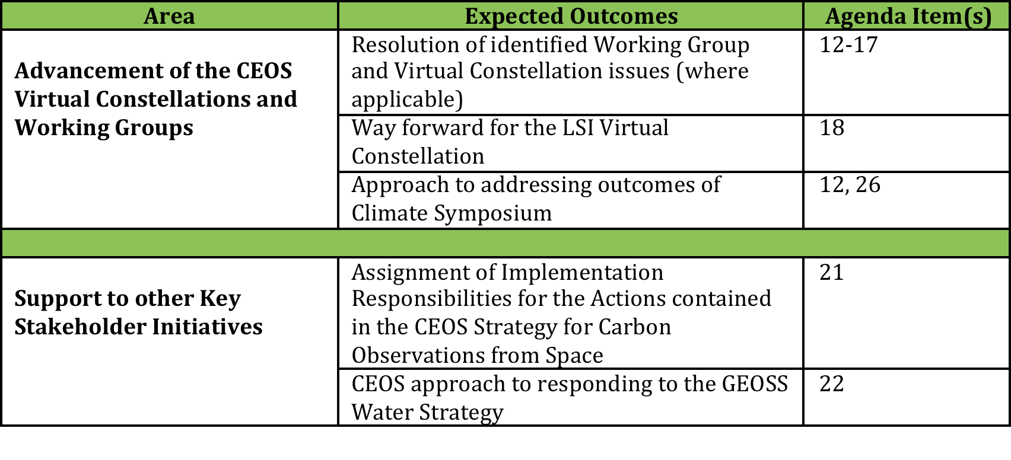
28th Plenary Expected Outcomes

Slide 3
28th Plenary Expected Outcomes

