Slide 1
SIT Technical Workshop Summary on the Status of Remaining 2013 CEOS Open Actions
Entire CEOS 2013 Work Plan
Kerry Ann Sawyer
CEOS Executive Officer

Slide 2
A Few of My Favorite Things
And Warm
Woolen…
ACTIONS

Slide 3
Overview
Accomplishments since 2012 Plenary
Why are Actions important?
Future remaining activities and milestones
Main issues/concerns

Slide 4
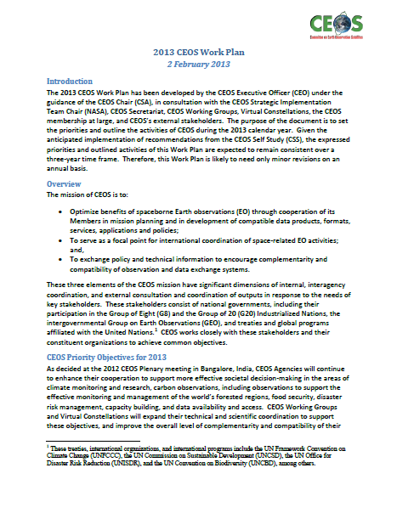
Why Are CEOS Actions Important?
Highlight the commitment of Space Agencies to implement the Global Earth Observation System of Systems (GEOSS)
Actions focus exclusively on space segment aspects and efforts of Space Agencies to implement Components of the GEO Work Plan and GEOSS
Address the Elements of the Annual CEOS Work Plan

Slide 5
Priority Objectives for 2013 2013 CEOS Work Plan: 2 FEB 2013 FINAL
CEOS Agencies will continue to enhance their cooperation to support more effective societal decision-making in the areas of climate monitoring and research, carbon observations, including observations to support the effective monitoring and management of the world’s forested regions, food security, disaster risk management, capacity building, and data availability and access.
CEOS Working Groups and Virtual Constellations will expand their technical and scientific coordination to support these objectives, and improve the overall level of complementarity and compatibility of their Earth observation and data management systems for societal benefit.
CEOS will consider other requests from external stakeholders and determine what, if any, support is possible and appropriate. CEOS will also continue its outreach and communications efforts.
CEOS will continue its consideration of 2011 CEOS Self-Study recommendations, with near-term (e.g., 1-3 years) decisions anticipated on its organization, structure, decision-making processes, and stakeholder relations.

Slide 6
Eight Elements of the 2013 CEOS Work Plan
Climate Monitoring and Research
Carbon Observations, including Observations to Support the Effective Monitoring and Management of the World’s Forested Regions
Food Security
Disaster Risk Management
Capacity Building and Data Availability and Access
CEOS Support to Further Key Stakeholder Initiatives
Continued and Enhanced CEOS Outreach to Key Stakeholders: GEO, UNFCCC, UN ISDR, UN CBD, G8/G20, and Others
Adoption of Recommendations from the 2011 CEOS Self-Study

Slide 7
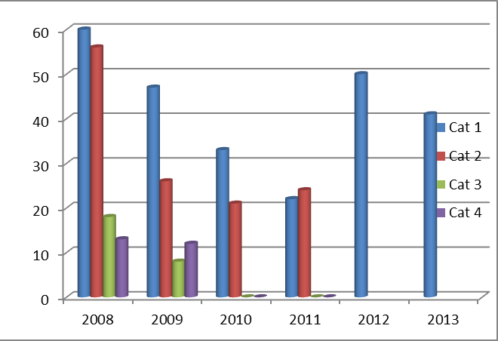
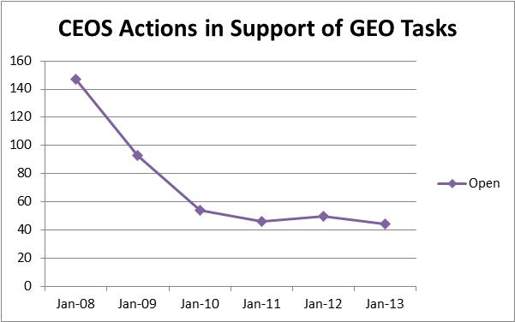
Accomplishments Since 2012 Plenary: Actions 2008-2013

Slide 8
Action History
Issue
2011
81 Slides with full review of each of the 46 Actions
2012
2 Slides of public shaming of 16 “unaccounted for” of 50 Actions
And what is in store for 2013?

Slide 9
Another Plea
Current State of Affairs of CEOS Actions
44 Actions for 2013
30 have been updated within the past month (Merci!)
And of those 30 that have been updated, there are still 13 Actions that are past due or where a due date does not exist. Hmmmmm…..
Which leaves…14 Actions completely “unaccounted” for and without updates.

Slide 10
“Unaccounteds”
Action | Lead Agency | Short Description | Last Update
AG-01-C1_2 | USGS, NASA, ISRO | Global croplands and water use assessments | 2 Sep 12
AG-01-C1_3 | USGS, NASA, ISRO | Global croplands and water use assessments (but different than C1_2) | 2 Sep 12
BI-01-C1_2 | DLR | Implementation of RS parameters in Biodiversity application | 1 Mar 13
CL-01-C1_1 | NOAA, NASA, ESA | Reanalysis and NWP | 1 Mar 13
CL-01-C1_3 | CSA | Ice sheet monitoring | 1 Mar 13
CL-01-C2_2 | EC-JRC, NASA, NOAA, ESA, EUM | Climate ECV meta-analysis with WGClimate | 1 Mar 13
CL-02-C1_3 | JAXA | WGCV GHG Subgroup | 1 Mar 13
IN-01-C3_1 | GGOS, ASI | Geodetic reference frames and networks | 1 Mar 13
IN-02-C1_3 | CSA, NASA, CNES, ESA, UKSA | CEOS QA4EO for CEOS data and info | 28 Feb 13
Green text identifies Lead Agency
Red text identifies past due date

Slide 11
“Unaccounteds”
Action | Lead Agency | Short Description | Last Update
IN-02-C1_5 | CSA, UKSA, NASA, CNES, ESA | Data and Information interoperability and harmonization | 28 Feb 13
IN-02-C2_1 | UKSA, DLR, NASA, USGS | Global datasets for land-continental shelf DEM | 28 Feb 13
SB-01-C1_1 | EC-JRC | Contribute to Blue Planet White Paper | 1 Mar 13
WA-01-C1_6 | JAXA | Participate in GEO Water Cycle CoP | 1 Mar 13
WA-01-C5_1 | JAXA | Regional water initiatives | 1 Mar 13
Green text identifies Lead Agency
Red text identifies past due date
Orange text identifies needed change to POC

Slide 12
A Look Toward the Future
How do we address actions that are being accomplished in execution of other high priority CEOS initiatives, especially under the next chapter of CEOS?
SDCG
Disaster
GCOS Climate Actions
CTF Strategy Actions
Implementation Plan – Is there a future? And has anyone noticed there was not a 2012 IP prepared?
Updates to the 2012-2015 GEO Work Plan
Rev 2.1 just released for GEO Principal level review with comments due 22 October

