Slide 1
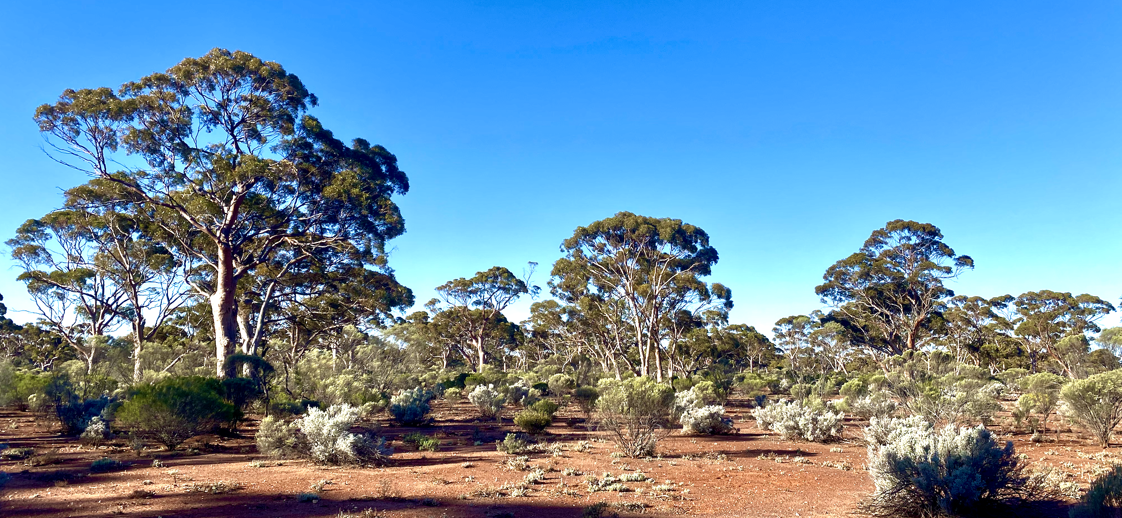

Great Western Woodlands

Slide 2
EETT Demonstrator update
Great Western Woodlands (Australia)
Shaun Levick & Adriana Parra Ruiz
Zheng-Shu Zhou, Matt Paget, Matt Garthwaite, Amy Parker

Slide 3
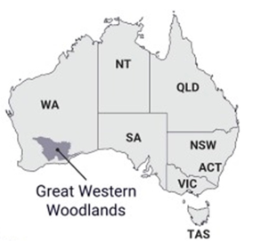
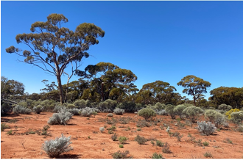
Great Western Woodlands
Largest remaining area of temperate woodlands on Earth with significant biodiversity and cultural values
Under growing pressure from climate change and land-use intensification
High-quality maps of ecosystem extent are needed to inform conservation, restoration, and adaptation strategies
Key questions to be addressed.
  Can the spatial delineation of vegetation types be improved with multi-wavelength SAR?
  Can stand age be reliably mapped from multi-sensor satellite imagery?
  Can historic stand growth rates be derived from time-series imagery?

Slide 4
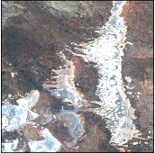
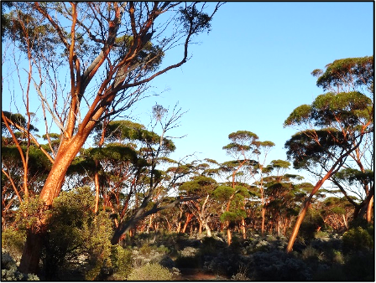
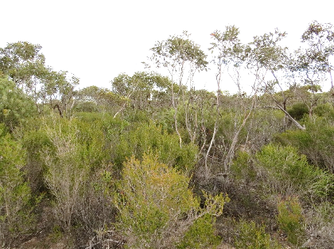


Great Western Woodlands
Distinguishing vegetation assemblages and stand ages is critical for effective land management and conservation
  Conversion of obligate-seeder eucalyptus woodlands into base resprouting mallee stands
  Ecosystem extent mapping underway using CSIRO’s EASI platform
  Testing the fusion of Sentinel-1, ALOS-2, Sentinel-2 and Landsat-5/-7/-8/-9

Slide 5
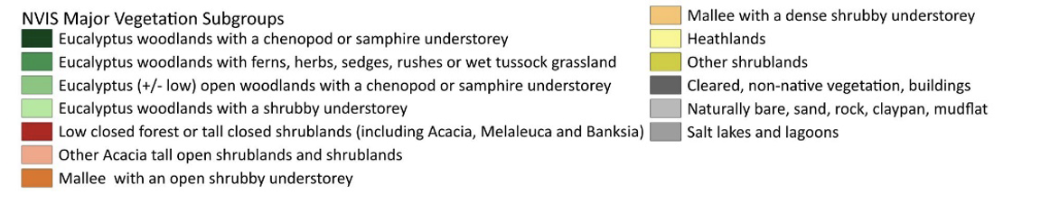
Great Western Woodlands
Classification scheme according to the IUCN Global Ecosystem Typology (GET) 2.0, Terrestrial realm:
  T.4. Savannas and Grasslands - biome
  T.4.4. Temperate Woodlands - ecosystem functional group
Finer scales evaluated with available National level datasets and received feedback from collaborators working in the GWW region.
  National Vegetation Information System (NVIS) classification scheme
  Integration of the NVIS classification scheme with lower levels of the GET will be evaluated in future work.

Slide 6
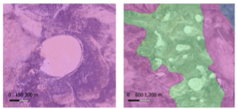
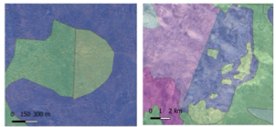
Great Western Woodlands
Training data and labelling
  NVIS has high thematic resolution, but coarse spatial resolution, which results in omission errors for small features.
  NVIS dataset relies in data generated by different agencies, so data integration can result in inconsistent boundaries between ecosystems
NVIS omission errors
NVIS arbitrary split errors

Slide 7
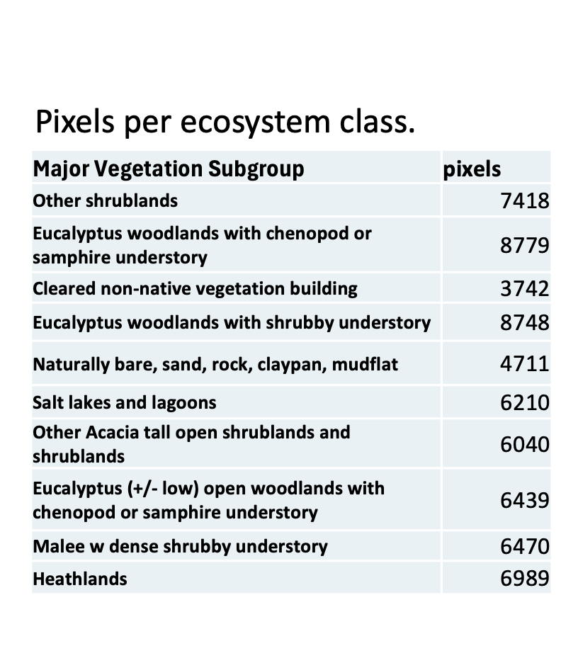
Great Western Woodlands
Training and validation dataset
  300 polygons of 100 x 100 m were randomly located within each of the 10 major vegetation subgroup of the AOI
  The polygons were visually evaluated using base imagery, and the Sentinel-2 median composite for 2021
  The location or shape of the polygons was modified to guarantee that they represented the correct ecosystem class
  After the photo-interpretation and manual correction process, a total of 2710 polygons remained in the training dataset
  The 20 m pixels within each polygon were used as training and validation data for the classification process: A total of 65542 pixels

Slide 8
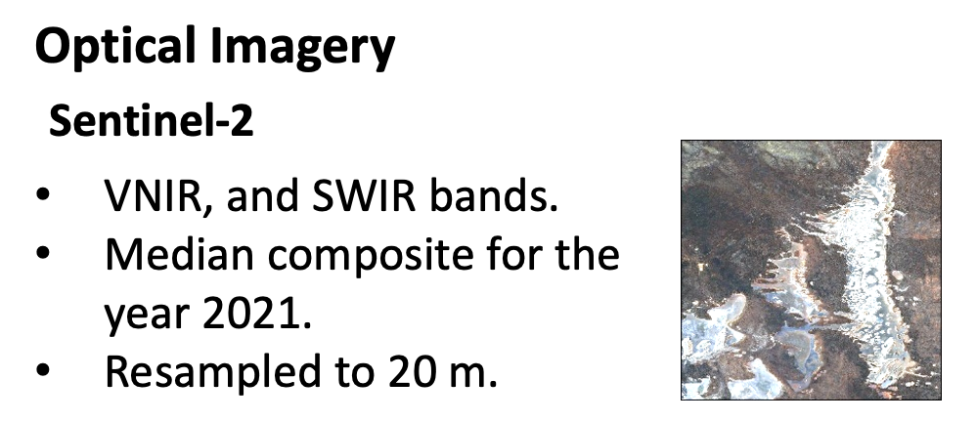
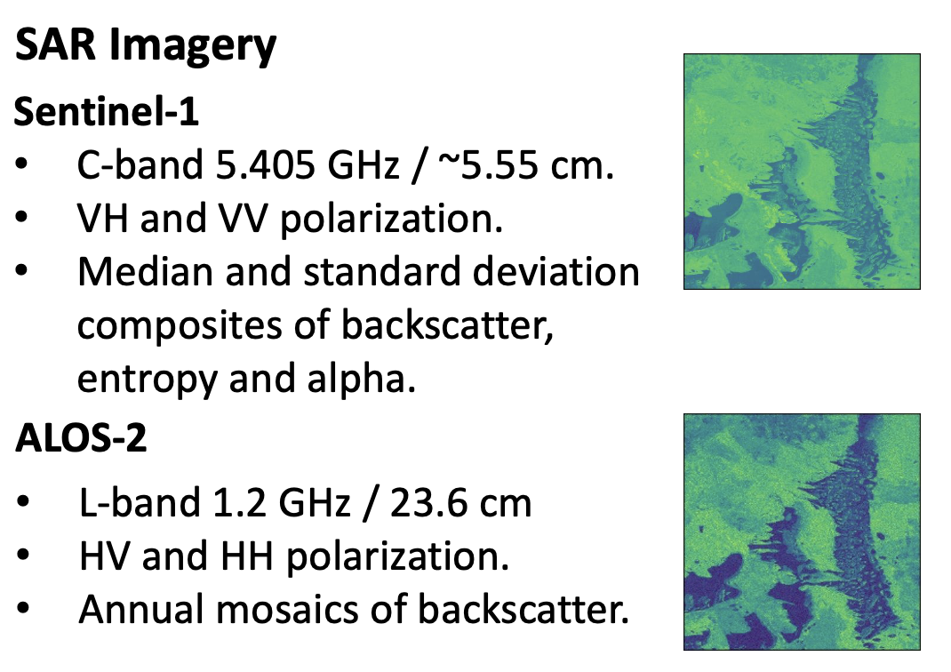
Great Western Woodlands
Input satellite data
  Initially focused on the year 2021 as all the instruments have available data for this year

Slide 9

Great Western Woodlands

Slide 10


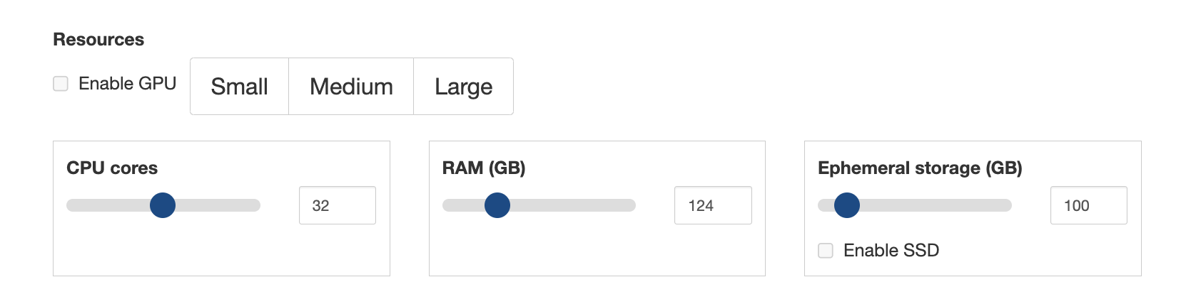
Great Western Woodlands

Slide 11
Great Western Woodlands
Random Forest Modelling
  Three models were constructed: Optical only, SAR only, Optical + SAR.
  Separation of training/validation data into 70% - 30% for each ecosystem class.
  For the model construction, we assigned weights to each class inversely proportional to their frequencies to account for differences in sample sizes.
  Predictor variables:
  Sentinel-2: Blue, Green, Red, RedEdge-1, RedEdge-2, RedEdge-3, NIR-1, NIR-2, SWIR-1, SWIR-2
  Landsat 8-9: Blue, Green, Red, NIR, SWIR-1, SWIR-2, Median Absolute Deviation (MAD) cosine distance, MAD Euclidian distance, MAD Bray Curtis dissimilarity
  Sentinel-1: VH median, VV median, entropy median, alpha median
  ALOS2: HV median, HH median (other parameters in progress)

Slide 12
Great Western Woodlands
Ecosystem | Total | Optical Accuracy 87.1% |  | SAR Accuracy 59.7%
 |  | Producer | User | Producer | User
Eucalyptus woodlands with shrubby understory | 2624 | 74% | 80% | 45% | 53%
Other Acacia tall open shrublands and shrublands | 1812 | 78% | 84% | 24% | 41%
Malee with dense shrubby understory | 1941 | 83% | 86% | 47% | 48%
Heatlands | 2097 | 94% | 91% | 69% | 51%
Other shrublands | 2225 | 91% | 94% | 60% | 73%
Naturally bare, sand, rock, claypan, mudflat | 1413 | 90% | 92% | 68% | 70%
Salt lakes and lagoons | 1863 | 100% | 100% | 94% | 97%
Eucalyptus (+/- low) open woodlands with chenopod or samphire understory | 1932 | 86% | 86% | 55% | 56%
Eucalyptus woodlands with chenopod or samphire understory | 2634 | 86% | 73% | 71% | 52%
Cleared non-native vegetation building | 1123 | 95% | 100% | 71% | 70%
Total training: 45882 pixels
Total validation: 19664 pixels
The optical model performs better than the SAR model, both in overall accuracy and across the user and producer accuracy per class.
Notes:
SAR helps mostly with the Eucalypt woodland classes

Slide 13
Great Western Woodlands
 |  | Predicted Optical + SAR
Real |  | Eucalyptus woodlands w shrubby understory | Other Acacia tall open shrublands and shrublands | Malee w dense shrubby understory | Heathlands | Other shrublands | Naturally bare, sand, rock, claypan, mudflat | Salt lakes and lagoons | Eucalyptus (+/- low) open woodlands w chenopod or samphire understory | Eucalyptus woodlands with chenopod or samphire understory | Cleared non-native vegetation building | Total | Producer Accuracy
 | Eucalyptus woodlands with shrubby understory | 2066 | 23 | 48 | 4 | 6 | 7 | 0 | 40 | 428 | 2 | 2624 | 78.7%
 | Other Acacia tall open shrublands and shrublands | 33 | 1575 | 40 | 39 | 22 | 3 | 0 | 17 | 83 | 0 | 1812 | 86.9%
 | Malee with dense shrubby understory | 36 | 38 | 1734 | 63 | 15 | 9 | 0 | 36 | 10 | 0 | 1941 | 89.3%
 | Heathlands | 10 | 19 | 40 | 2017 | 7 | 0 | 0 | 3 | 1 | 0 | 2097 | 96.2%
 | Other shrublands | 14 | 42 | 26 | 34 | 2098 | 2 | 0 | 3 | 6 | 0 | 2225 | 94.3%
 | Naturally bare, sand, rock, claypan, mudflat | 0 | 7 | 18 | 2 | 3 | 1306 | 0 | 70 | 7 | 0 | 1413 | 92.4%
 | Salt lakes and lagoons | 0 | 0 | 0 | 0 | 0 | 0 | 1862 | 0 | 0 | 1 | 1863 | 99.9%
 | Eucalyptus (+/- low) open woodlands with chenopod or samphire understory | 50 | 18 | 10 | 3 | 5 | 23 | 0 | 1733 | 90 | 0 | 1932 | 89.7%
 | Eucalyptus woodlands with chenopod or samphire understory | 152 | 37 | 5 | 0 | 5 | 9 | 0 | 48 | 2378 | 0 | 2634 | 90.3%
 | Cleared non-native vegetation building | 15 | 5 | 5 | 1 | 3 | 0 | 0 | 2 | 10 | 1082 | 1123 | 96.3%
 | User accuracy | 87% | 89% | 90% | 93% | 97% | 96% | 100% | 89% | 79% | 100%

Slide 14
Great Western Woodlands

Slide 15
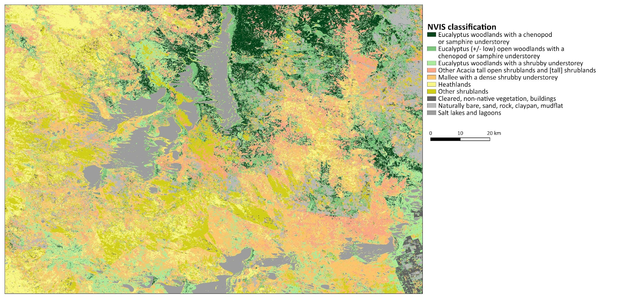
Great Western Woodlands

Slide 16
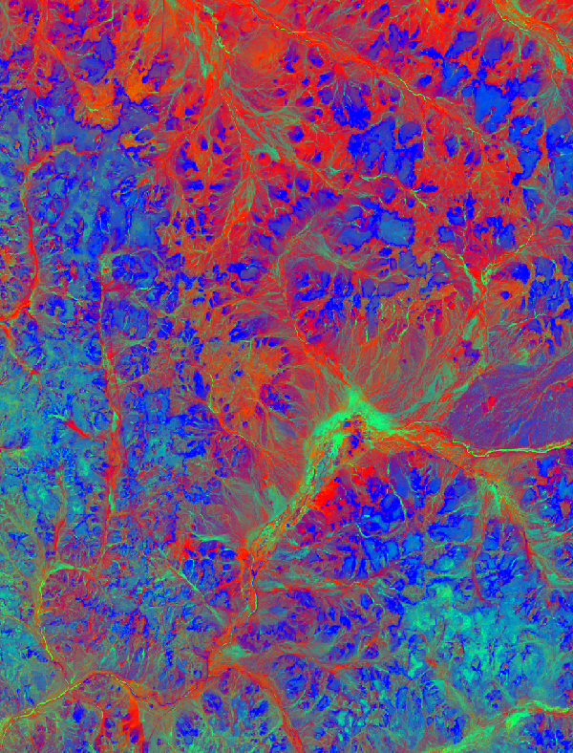
Great Western Woodlands
Key learnings to date
  The value of multi-sensor / multi-agency imagery
  The efficiency of EASI/ODC
  The importance of ARD
  The need for large sample sizes of field data/labelling
  The value of a dedicated postdoc role to progress this research
Next steps
  Use of ALOS-2 scenes and higher order products
  Utilization of the full Landsat archive (-5/-7/-8/-9) for:
    Fire history mapping
    Fractional cover mapping
  Utilization of GEDI for training wall-to-wall height canopy height model

Slide 17
Thank you

