Slide 1
Ecosystem Extent Task Team
Side Meeting - Demonstrator Updates
Gary Geller
NASA Jet Propulsion Laboratory
California Institute of Technology
Shaun Levick, CSIRO
Sandra Luque, INRAE/CNES
Roger Sayre, USGS
38th CEOS Plenary
Montreal, Canada
23rd - 24th October, 2024
(c) 2024 California Institute of Technology.
Government sponsorship acknowledged.

Slide 2
Introduction
Purpose
Provide updates on EETT Demonstrators
Hear your thoughts and suggestions
Agenda

Slide 3
EETT History
~2012: Biodiversity Activity initiated
~2020: Informal discussions on increasing engagement
Triggered by biodiversity crisis
Goal: Long term engagement
2021 (35th Plenary): “Discussion Group” initiated
2022 (CEOS Plenary): Ecosystem Extent Task Team established
2023 (CEOS Plenary): EETT White Paper endorsed
2024 (CEOS Plenary): Demonstrator completion acknowledged (TBC)
2025 (TBD)
Notes:
Biodiversity Discussion Group was to begin increased CEOS engagement with biodiversity

Slide 4
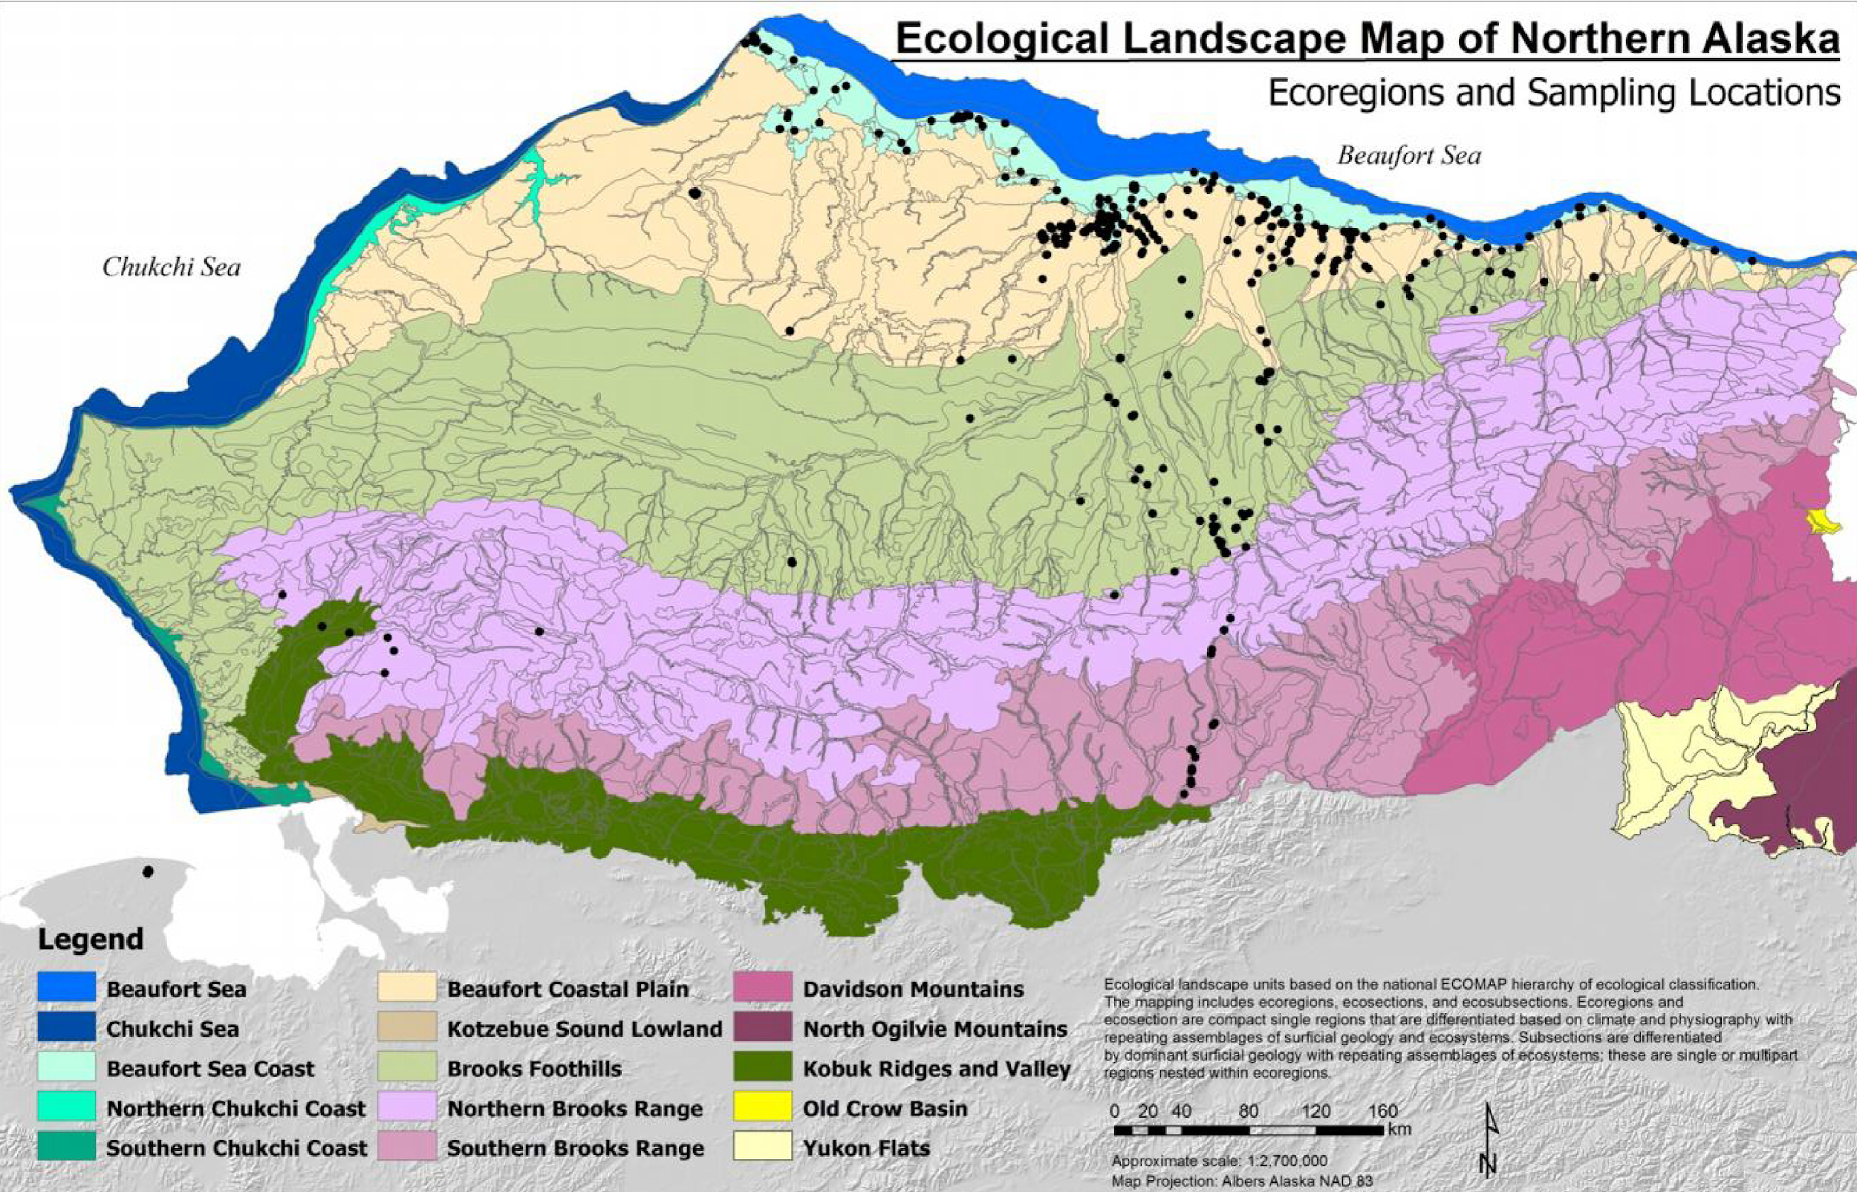
Task Team Basics
Purpose
Assess the utility for mapping Ecosystem Extent using current and forthcoming space-based observations
Two Deliverables
White Paper
Demonstrator
Notes:
White Paper (delivered November 2023)
Demonstrator (HBL-Wapusk NP wrapping up)

Slide 5
Three Demonstrator Studies
EETT was tasked to deliver one demonstrator but had three opportunities
(1) Hudson Bay Lowlands
ECCC had relevant work underway
Offered to develop a demonstrator on Wapusk National Park
Now wrapping up (broader HBL work will continue)
(2) Great Western Woodlands (Australia) & (3) Tropical Forests (Costa Rica)
Shaun Levick (CSIRO) and Sandra Luque (INRAE/CNES) submitted proposals to their funding agencies
Successful - funding started near end of 2023
Work still underway - will present results-to-date

Slide 6
Ecosystem Characteristics
Physical environment
Physical structure
Taxonomic composition
Functions & processes
Demonstrators measure these to discriminate ecosystem classes
US NPS
Notes:
Characteristics” = “features”
For nice discussion on the conceptual basis of classification, see:
https://www.fao.org/3/X0596E/x0596e01f.htm There, features are discriminated using “classifiers”. The discussion includes the FAO Land Cover Classification System, though it seems to not include ecosystem functions/processes
Composition: Species…or level of biodiversity
Environment: climate, slope, aspect, elevation
Structure: height, vertical biomass distribution
Functions & processes: GPP, ET, nutrient retention…
FAO Land Cover Classification System
USGS Global Ecosystem Land Units
IUCN Ecosystem Typology V2.0

Slide 7
Demonstrator 1
Hudson Bay
Jason Duffe, Laura Dingle Robertson, Marie-Bé Leduc, Kasun Hiripitiyage, Emily Ogden, Jason Beaver & Taylor Biccum

Slide 8
Slides Here

Slide 9
Demonstrator 2
Great Western Woodlands (Australia)
Shaun Levick & Adriana Parra Ruiz
Zheng-Shu Zhou, Matt Paget, Matt Garthwaite, Amy Parker

Slide 10
Slides Here

Slide 11
Demonstrator 3
Tropical forest (Costa Rica)
Sandra LUQUE, Mona Bonnier, Remi Cresson, Samuel Alleaume, Florian de Boissieu, Jean Baptiste Feret, Mairi Souza-Oiveira (PhD candidate)

Slide 12
Slides Here

Slide 13
Thank you

