Slide 1
Ecosystem Mapping of the Hudson Bay Lowlands
Jason Duffe, Laura Dingle Robertson, Marie-Bé Leduc, Kasun Hiripitiyage, Taylor Biccum, Jason Beaver, Emily Ogden, Shane Timbers

Slide 2
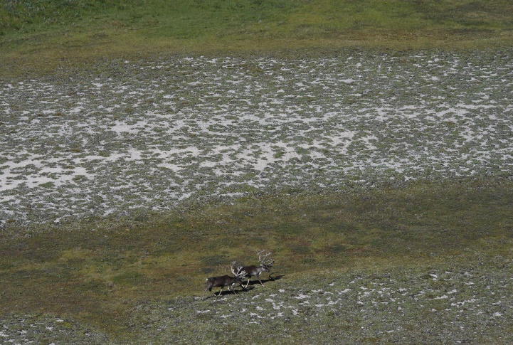
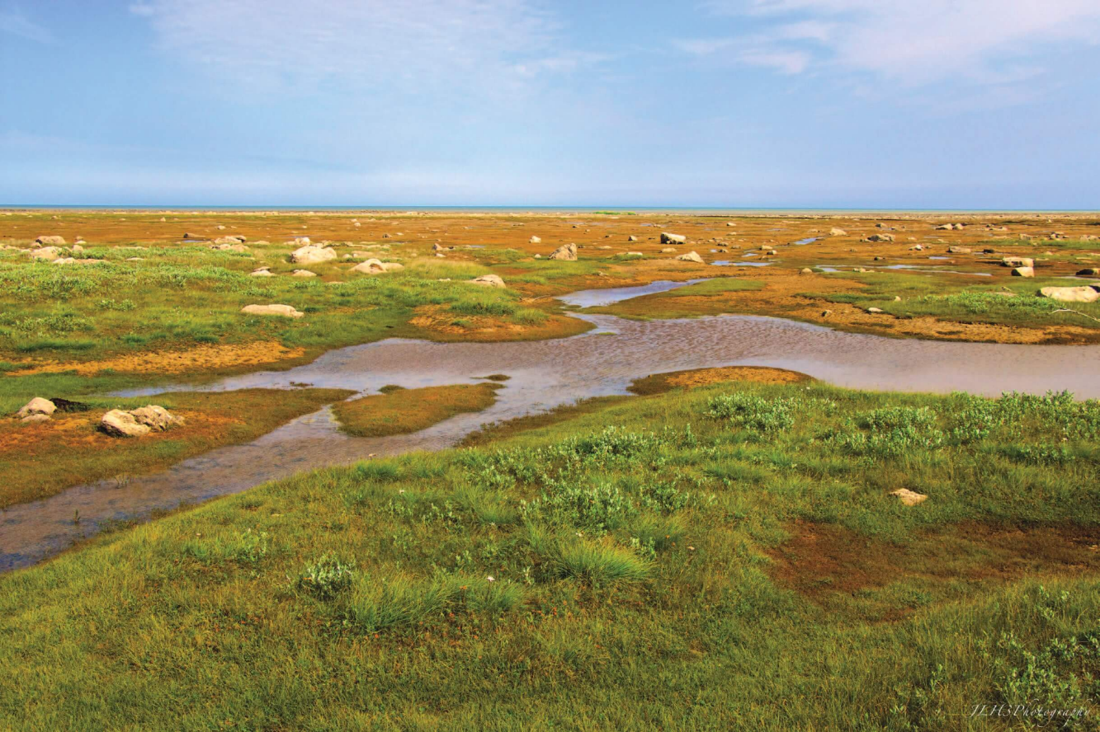
Enhanced Nature Legacy & CEOS (Committee on Earth Observation Satellites) Biodiversity Demonstrator
A quarter of the globe’s wetlands, the HBL represents the third largest wetland in the world.
Dominated by peatlands, accumulated over 3+m in certain habitats

Slide 3
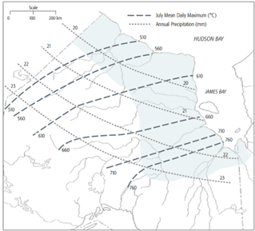
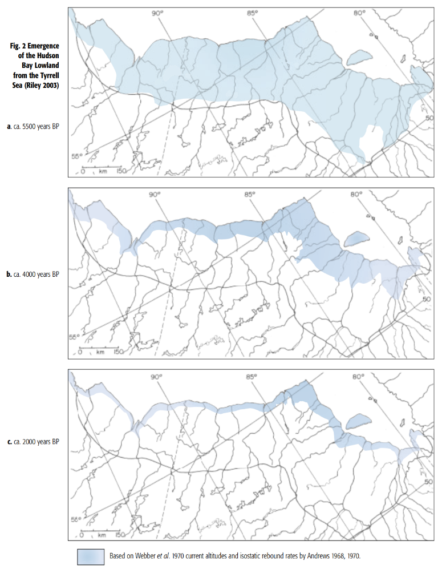
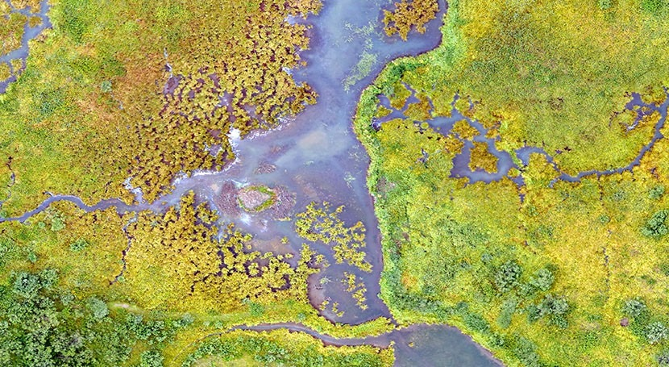
Dynamic ecosystem
Undergoing isostatic rebound: 1 to 1.3 meter per 100 years
Subarctic ecoregion with a strong temperature and precipitation gradient
Influence of southward wind, tides, permafrost

Slide 4
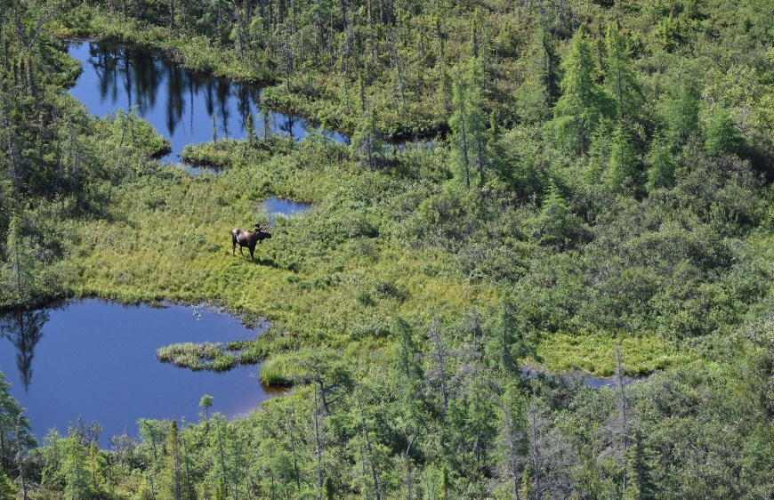
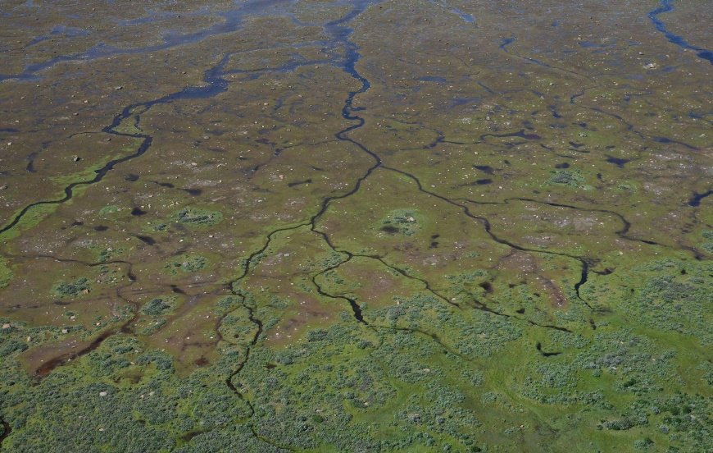
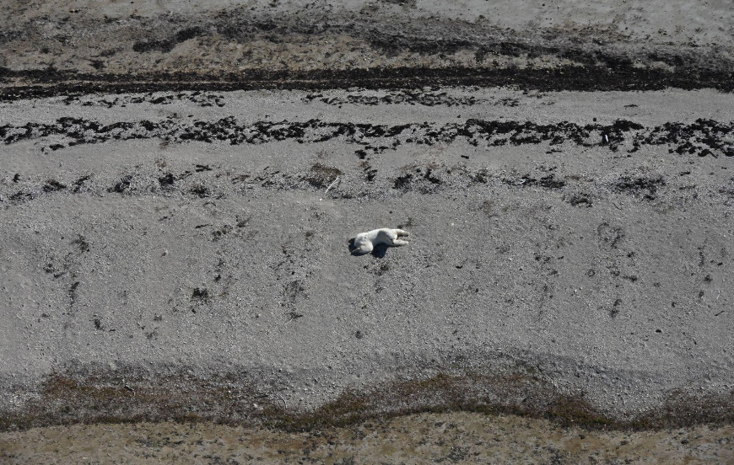
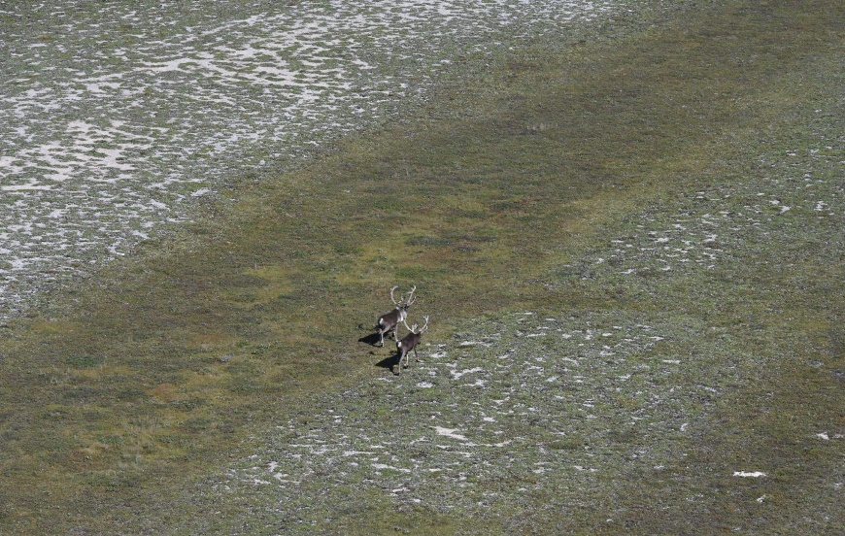
Photos: Leduc, August 2024

Slide 5
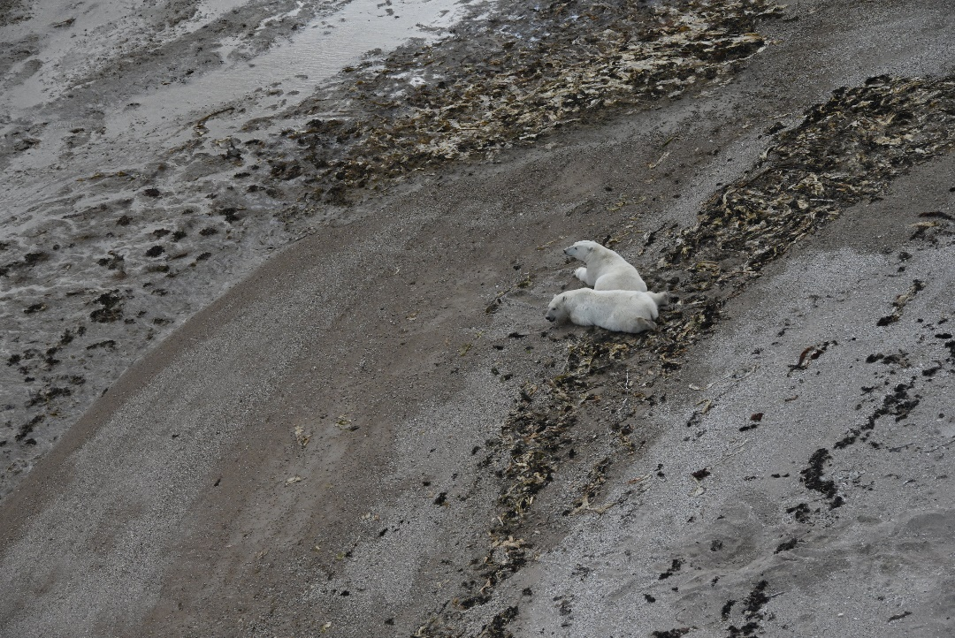
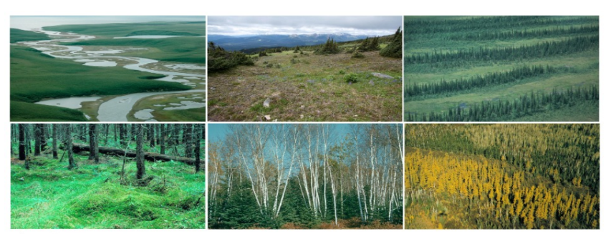
Ecosystem Mapping Objectives
Objectives:
Develop standardized ecotype mapping approach with machine learning, AI, cloud computing & EO to operationally monitor biodiversity across HBL & eventually all of Canada
Standardizing vegetation ecotypes to the IUCN 2.0 Typology, a comprehensive hierarchical classification framework for Earth's ecosystems. Committed to mapping all of Canada to Level 3 – Functional Groups by 2026

Slide 6
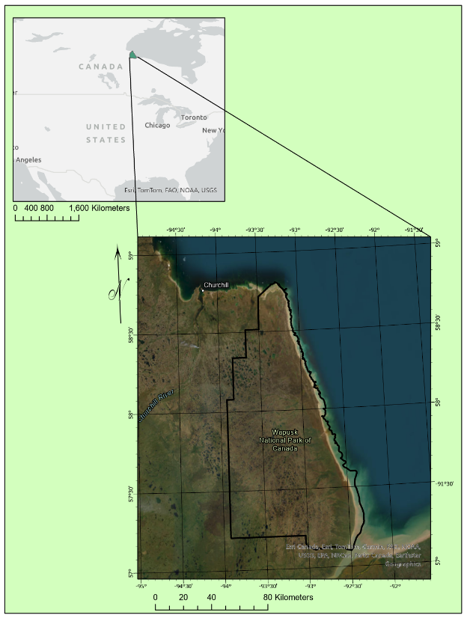
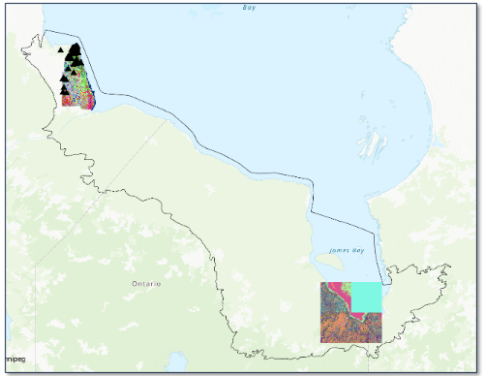
Wapusk NP & HBL Lessons
Determine what predictor variables contribute most to the discrimination of ecotypes for biodiversity monitoring
Then expand that monitoring capacity to the rest of the HBL and Canada
Training Area
Wapusk National Park
Predicting Area

Slide 7
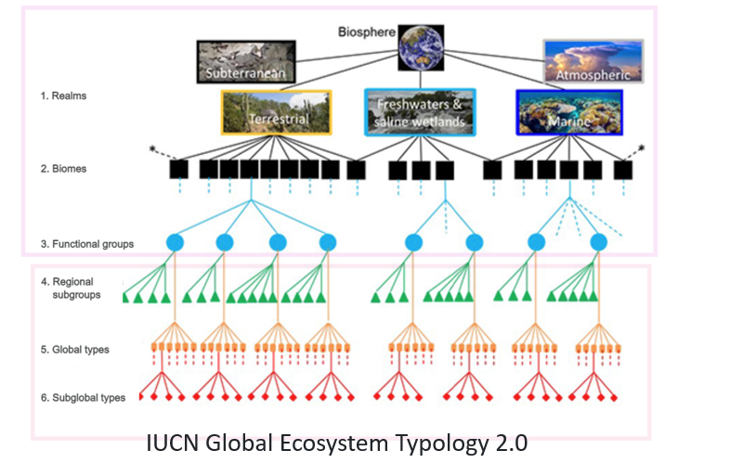
Cross-walking Local Ecotypes to National Systems to Global Ecosystem Typology

Slide 8
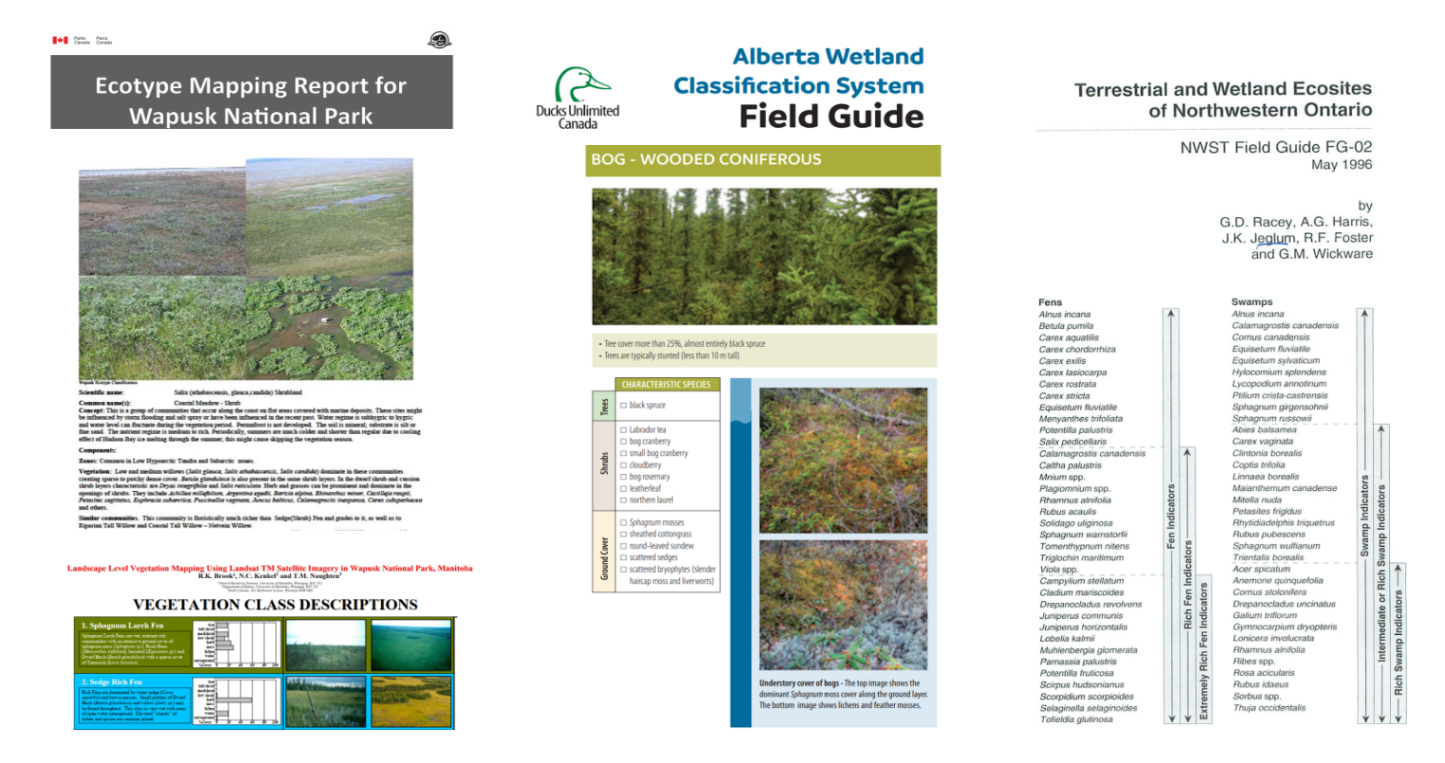
Cross-walking local vegetation/ecotypes to national systems to global ecosystem typology
Local ecosystem typologies

Slide 9
Standardizing vegetation to ecotypes
Formation
(subclass)

Slide 10
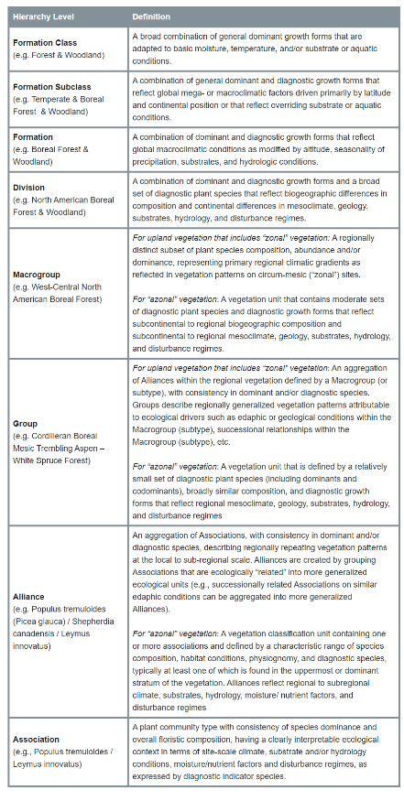
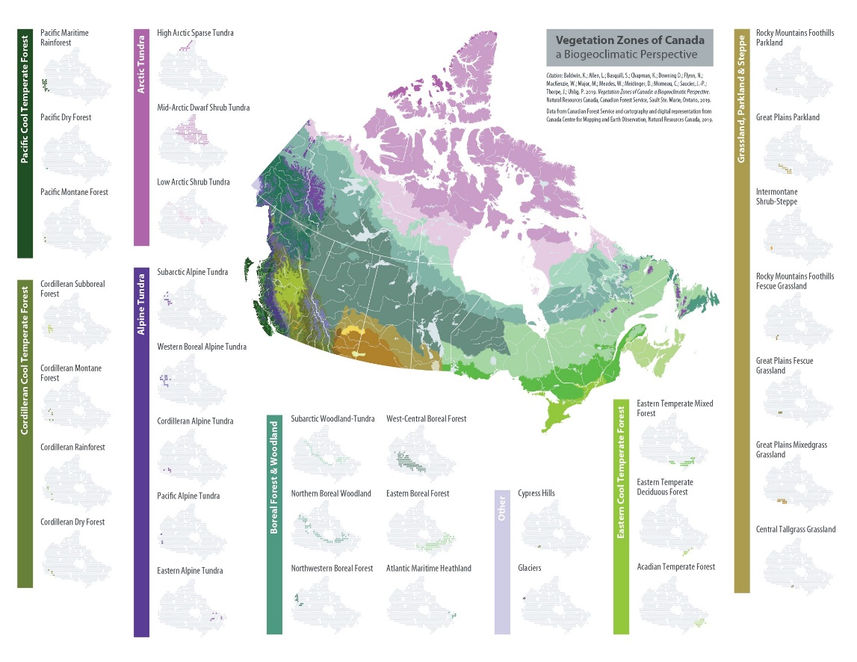
Canadian National Vegetation Classification (CNVC)
National-based ecosystem/vegetation typology

Slide 11
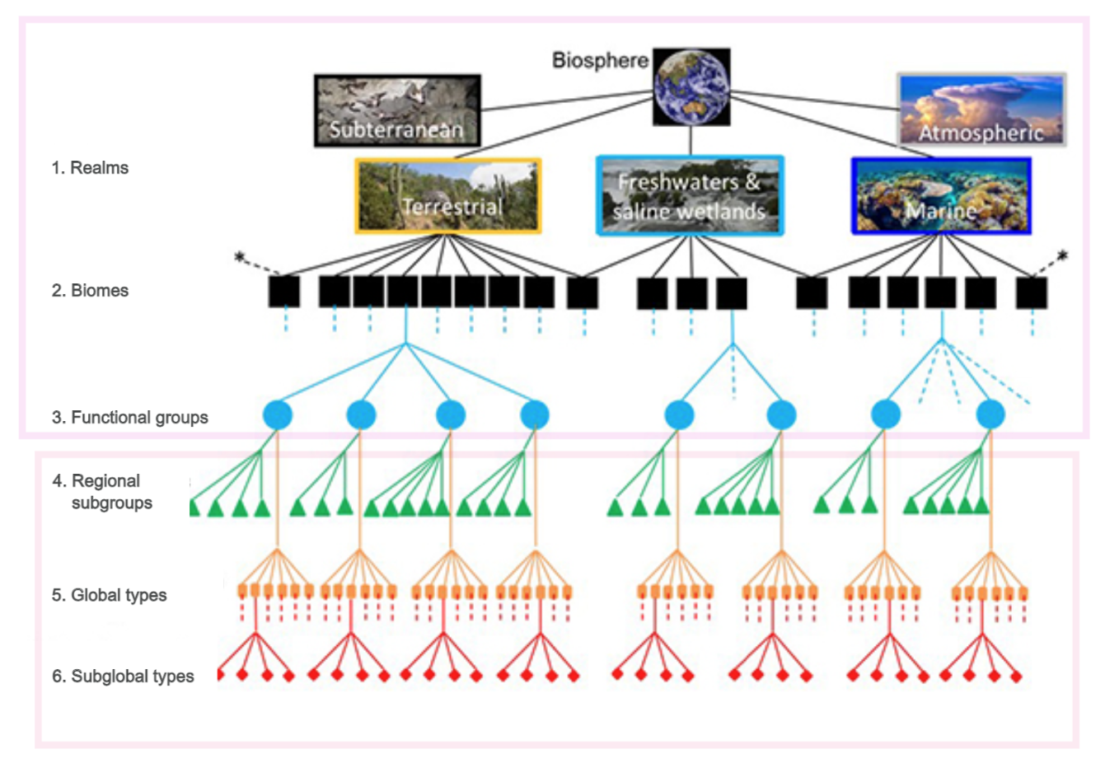
IUCN Global Ecosystem Typology
IUCN Global Ecosystem Typology 2.0

Slide 12
AI for Ecosystem Mapping of the Hudson Bay Lowlands
Employing various machine learning/deep learning algorithms for the purpose of ecosystem classification.
‘The primary difference between machine learning & deep learning is how each algorithm learns and how much data each type of algorithm uses.’
We have successfully implemented RandomForest (RF), Convolutional Neural Networks (CNN) and the U-Net architecture for the classification of Ecosystems/Wetlands. Additionally, we are deploying machine learning algorithms to perform similar classifications on cloud platforms within the CEOS Analytical Laboratory (CAL).
U-NET Architecture:

Slide 13
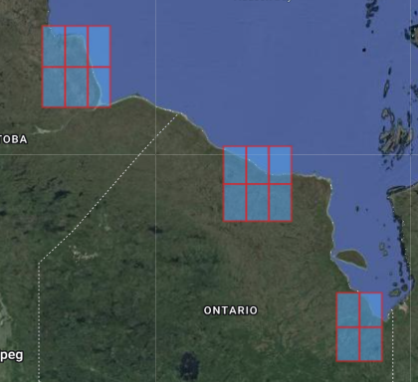
EO Imagery Predictor Variables
 | ESA Sentinel 1 & Sentinel 2 | CSA RCM | JAXA ALOS2-PalSAR2 | DLR ENMAP | DLR TanDEM-X
 | S1 EW - HH, HV intensity (2022, 2023, 2024 85 Images; S1 IW – VV VH intensity 2021 20 images (Total S1 105)) S2 Multi-Year Composites & Individual images | 30m Compact Pol – Intensity, mChi Decomp (2023 & 2024 – 51 Images) | Dual Polarimetric Dual pol HH, HV intensity processed (2023 & 2024 31 images) Fully polarimetric (partial coverage – 33 images) | 2 Strips (7 and 4 images – July 2024) Surface Reflectance 238 bands | 12 m X-band DEM – 16 images Elevation, Slope, Aspect, Dissection
RF, UNET, & CNN Local | RF (S2 & S1), UNET (S1) | RF (Decomp) | RF (Intensity) | RF (238 bands)
CEOS Cube | Sentinel 2 Spring, Summer, Fall Composite Bands + NDVI & EVI
TanDEM-X 12 m
(16 Tiles <100,000 km²⁾

Slide 14
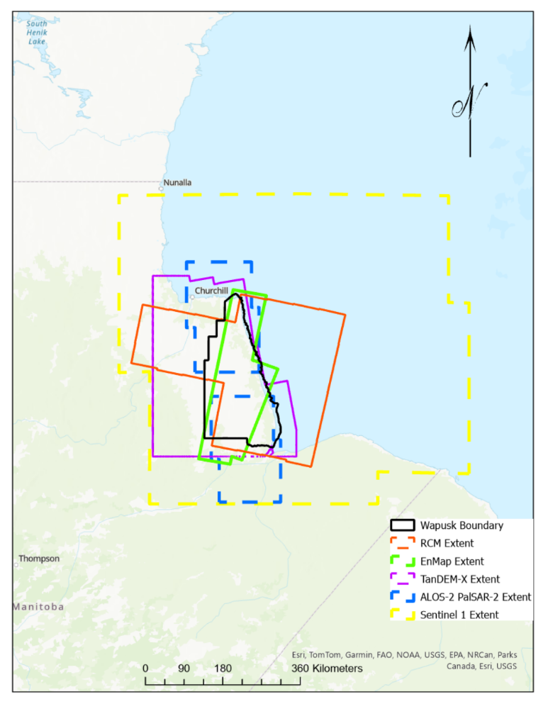
EO Imagery Data Extent Coverage
Sentinel 1 (yellow) had the largest spatial and temporal coverage (105 dates of images due to orbit overlap and multiple years)
EnMAP (green) has the smallest spatial coverage and least temporal coverage (2 concurrent July dates)
RCM (red) & ALOS-2 PalSAR-2 (blue) had inconsistent acquisitions temporally and spatially but full coverage of Wapusk was obtained several times throughout the growing season by both systems

Slide 15
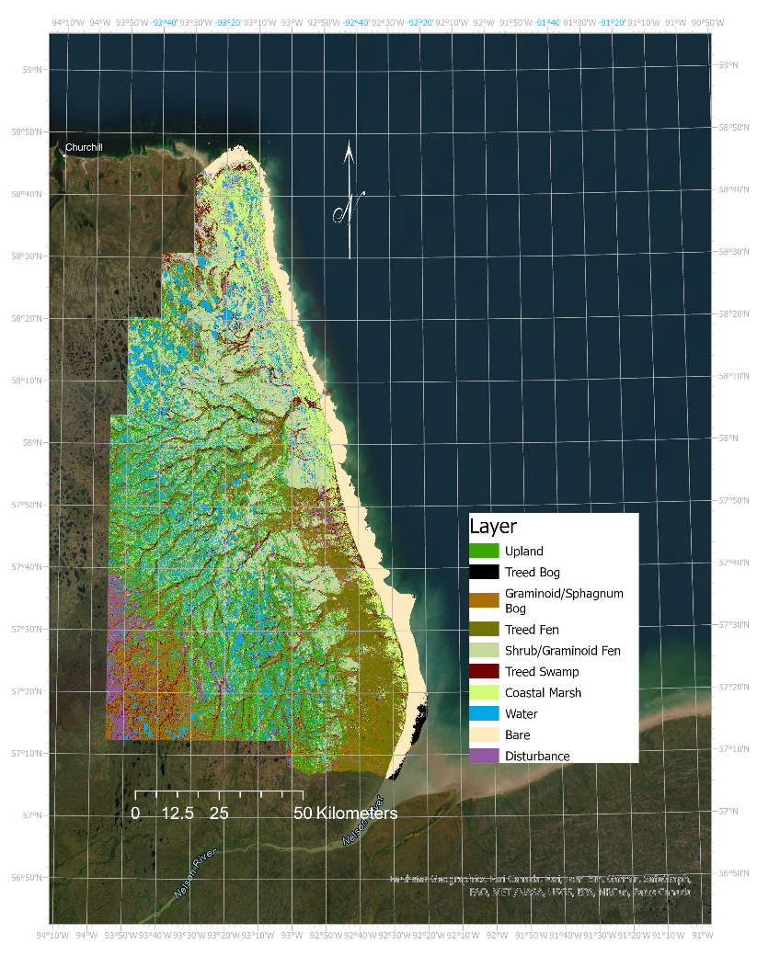
Random Forest Results: Single EO Types
Overall classification accuracies range 54-72% (for individual EO type data stacks – no combinations):
Optical datasets had higher accuracies over simple SAR backscatter/intensity:
CSIRO data cube w/ 3 years Sentinel 2 data (71%)
2 July dates in 2024 of ENMAP data (69%)
RCM Intensity only (66%)
Sentinel-1 Intensity only (63%)
ALOS-2 PalSAR-2 Intensity only (54%)
However, specific SAR sensors intensity improved particular ecotype classes’ accuracies over optical imagery alone :
RCM improved treed fen and upland classes.
ALOS-2 PalSAR-2 improved treed bog class.
Sentinel-1 improved upland class
RCM polarimetric parameter stacks had comparable overall classification accuracies to optical imagery:
RCM m-Chi decomposition (72%)
RCM Stokes Vectors (71%)
RCM general pol. (e.g., deg of polarization) parameters (65%)
Wapusk 2024 Ecotype Classification
Notes:
To data the preprocessing and analysis of particular data derivatives have been completed and classifications of the specific datasets have been completed for 10 ecotypes over Wapusk National Park. The far figure shows the highest accuracy achieved classification using the CSIRO data cube and optical Sentinel 2 data. The next steps to improve the classification include stacking multiple data types together – particularly it was seen that optical imagery provides good results for mud flats and shrub/graminoid fens, the SAR imagery provided good results for Treed ecotypes such as treed fen, treed bog and upland.
Some issues with data quality and processing techniques
E.g. EnMAP example: clear north-south gradient with decreasing reflectance values with northerly images
Some data lack consistent coverage (spatially & temporally)
Lack of consistent coverage makes it difficult to make direct comparison and evaluation of results

Slide 16
Outcomes Combined EO datasets: Overall Accuracies
Combining data types (e.g. optical and SAR or different SAR frequencies) improved overall accuracies along with individual class accuracies
EO Combinations | Overall Accuracies | Best Ecosystem Classes | Worst Ecosystem Class
S1, S2, RCM, ALOS, EnMAP, TanDEM-X, RCM - (‘Kitchen Sink’) | 81% | Bare, water, coastal marshes, upland | Treed bog
S1, RCM, ALOS-2 PalSAR-2 (SAR Only) | 76% | Bare, water, treed bog | Swamp (treed/shrub)
S2, RCM, ALOS-2 PalSAR-2 (SAR & Optical minimized – CEOS cube) | 80% | Bare, water, treed fen, upland | Treed bog

Slide 17
Class Comparison S2 Only & Combined Results
Class | Producer’s Accuracy (%) | User’s Accuracy (%)
Upland | 77.6 | 79.2
Treed Bog | 34.5 | 96.0
Bog (Graminoid/Sphagnum) | 56.6 | 23.0
Treed Fen | 85.0 | 52.0
Fen (Shrub/ Graminoid) | 60.0 | 74.0
Swamp (Treed / Shrub) | 71.2 | 38.0
Coastal Marsh | 63.0 | 50.4
Water | 93.5 | 91.4
Bare | 85.2 | 95.2
Class | Producer’s Accuracy (%) | User’s Accuracy (%)
Upland | 81.8 | 85.4
Treed Bog | 3.5 | 50.0
Bog (Graminoid/Sphagnum) | 94.4 | 54.7
Treed Fen | 95.0 | 63.5
Fen (shrub/ Graminoid) | 71.0 | 84.0
Swamp (Treed / Shrub) | 80.3 | 43.0
Coastal Marsh | 86.6 | 72.4
Water | 94.6 | 95.2
Bare | 83.9 | 99.0
CSIRO Data Cube/Sentinel 2
S1, S2, RCM, ALOS, EnMAP, TanDEM-X, RCM

Slide 18
Outcomes Combined EO: EO Feature contributions
Rank | Feature
1 | TanDEM-X 12 m Elevation
2 | ALOS-2 PalSAR-2 July 5, 2024 HH Intensity
3 | S2 Coastal Blue 60 m Summer Composite
4 | ALOS-2 PalSAR-2 July 5, 2024 HV Intensity
5 | S1 August 8, 2022 HH Intensity
6 | S1 August 27, 2022 HH Intensity
7 | S2 NIR 10 m Spring Composite
8 | S2 RED 10 m Spring Composite
9 | S1 October 14, 2022 HH Intensity
10 | S2 NIR 20 m Summer Composite
11 | RCM 30m CP August 15, 2023 RV
12 | S2 Red Edge 1 20 m Summer Composite
13 | S2 NIR 20 m Spring Composite
14 | ENMAP July 23, 2024 2437 nm
15 | ENMAP July 23, 2024 616 nm
16 | S2 Red Edge 1 20 m Spring Composite
17 | S1 September 15, 2023 HV
18 | RCM 30m CP August 6, 2024 Stokes 3
19 | RCM 30m CP May 22, 2023 Stokes 1
20 | S1 August 4, 2024 HH
21 | ENMAP July 23, 2024 647 nm
22 | S2 Blue 10 m Spring Composite
23 | ENMAP July 23, 2024 482 nm
24 | ENMAP July 23, 2024 622 nm
25 | S1 August 27, 2023 HV Intensity
Feature importance testing using ‘Conditional Permutation Importance’ ranking
For optical imagery (Sentinel-2 & EnMAP) the blue, red, red edge, and NIR bands were the highest contributing features from spring and summer imagery
For SAR imagery (ALOS-2 PalSAR-2, RCM & Sentinel 1) HH intensity consistently was the highest contributing feature no matter the frequency (C-band or L-band) and typically were from spring and late summer/ fall imagery

Slide 19
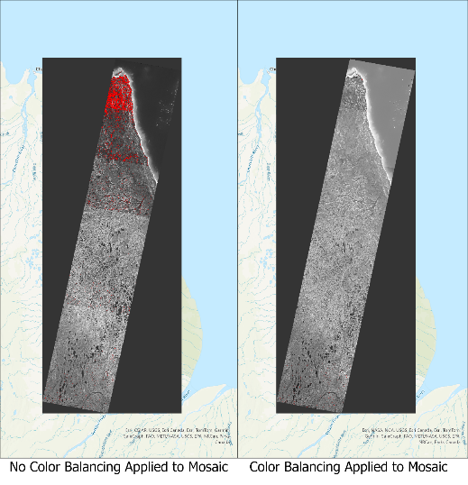
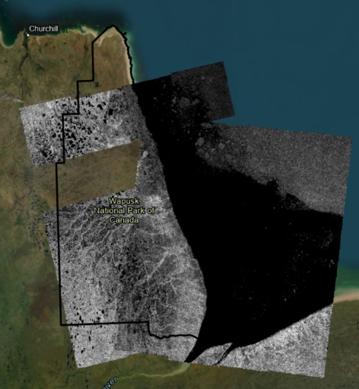
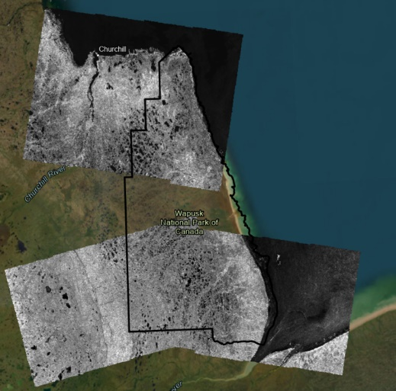
Ongoing challenges
Some issues with data quality and processing techniques
E.g. EnMAP example: clear north-south gradient with decreasing reflectance values with northerly images
Some data lack consistent coverage (spatially & temporally)
Lack of consistent coverage makes it difficult to make direct comparison and evaluation of results
Field data collections – logistics, coverage, effort
EnMAP Gradient Differences:
Left: Uncorrected Right: Corrected
RCM Spatial Coverage Challenges (Left: Early July 2024 Coverage, Right: Early August 2024 Coverage)
Individual datasets continue to be processed and combined
Accuracies range: 59% to 75% (individual EO data stacks – mixing data should improve accuracies)
Some issues with data quality and processing techniques
E.g. EnMAP example: clear north-south gradient with decreasing reflectance values with northerly images
Some data lack consistent coverage (spatially & temporally)
Lack of consistent coverage makes it difficult to make direct comparison and evaluation of results
Issues with processing
Hudson Bay Lowlands 2024 Ecotype Classification

Slide 20
Recommendations from HBL Demonstrator
EO Ecosystem Mapping (Extent, Condition, Function) is by vegetation proxy
Ecosystems driven by climate, site factors, hydrology, nutrients/substrate,
High Resolution Bare Earth Model is required for ecosystem mapping & change analysis
SAR derived surface models are limiting
Processing to remove artifacts needed – AI/ML algorithms
Signal to noise ratio is important
Calibration
Compositing
Noise floor
Fully polarimetric (quad-pol or pseudo QP) is as good a multi-spectral optical
Consistent acquisitions are required for optimal biodiversity results
Truly BIG DATA – Compute power becomes limiting
Hyperspectral is important – but more work needed to implement research into at-scale products

Slide 22
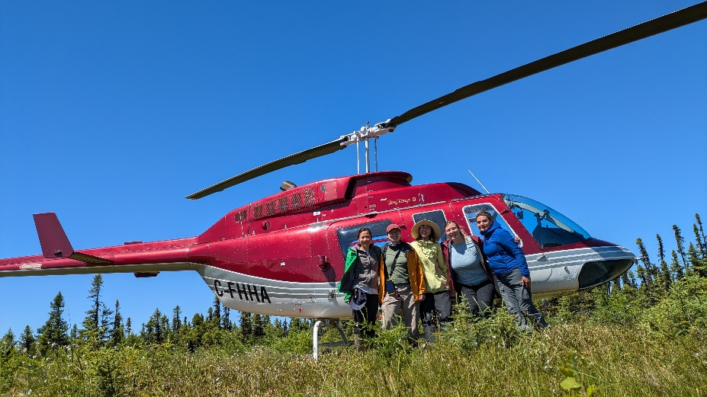
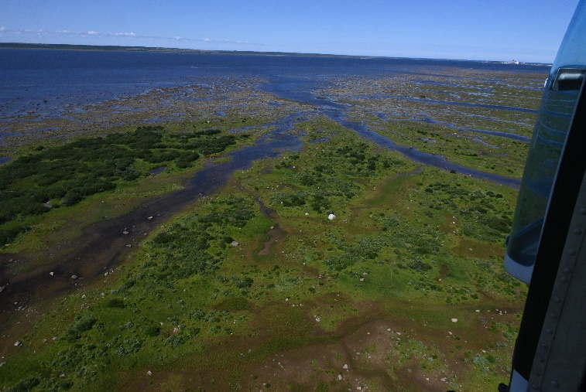
Field Data & Field Visits
Training & validation data were initially generated from older (2014) field data.
Field campaigns commenced 2024 in Hudson Bay Lowlands using helicopter transects, air calls & ground plot sampling.
July 4st - 13th - Moosonee Ontario
Helicopter Vegetation Surveying
Field based vegetation/ecotype plots
August 1st to 8th - Churchill, Manitoba
Helicopter Vegetation Surveying
Field based vegetation/ecotype plots
Moosonee, ON
(All female ECCC field team including helicopter pilot from the Attawapiskat First Nation)
Wapusk National Park, MB

Slide 23
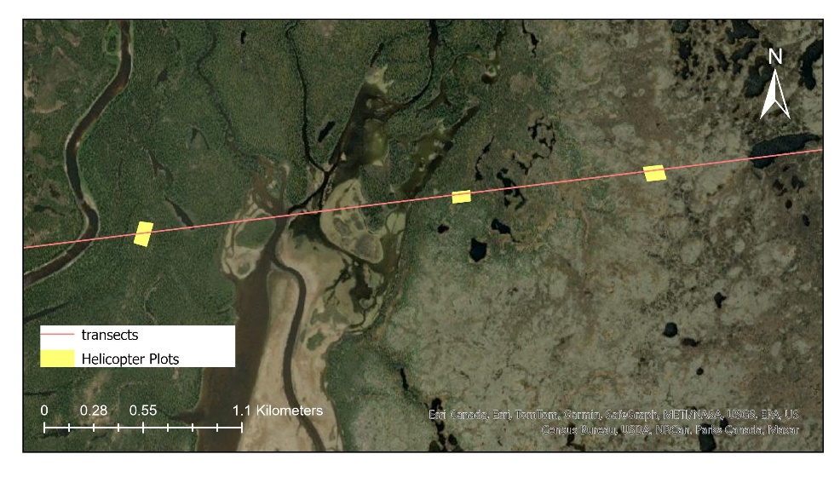
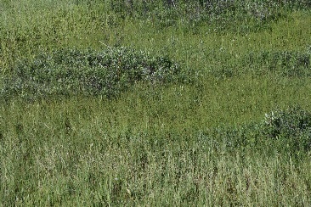
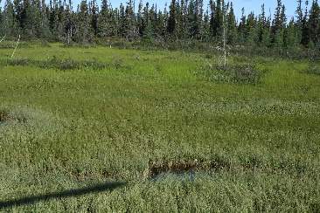
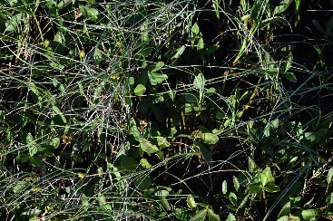
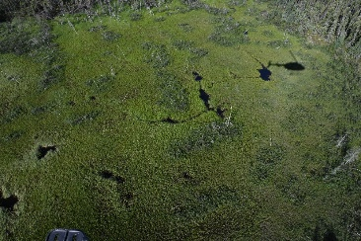
HBL Helicopter Plots
Preparation
Created and chosen using a segmented classification of Sentinel-2 imagery
Polygons were intersected within a minimum distance of the transect line and 20 polygons were randomly selected along each line
~10 polygons/transect were completed
Method
Helicopter hovered over each plot at varying heights.
Data collection included:
Percent cover of vegetation structures (trees, shrubs, graminoids, moss, etc)
Vegetation identification of dominant vegetation where possible
low, mid and high level photos
For further identification of vegetation and physiognomic group classification in post processing
Top: Oblique angle photos taken over site plot, helicopter hovering low, approximately 2-5 m off the ground.
Bottom left: zoom photos for vegetation id
Bottom right: wide angle photo encompassing full plot.

Slide 24
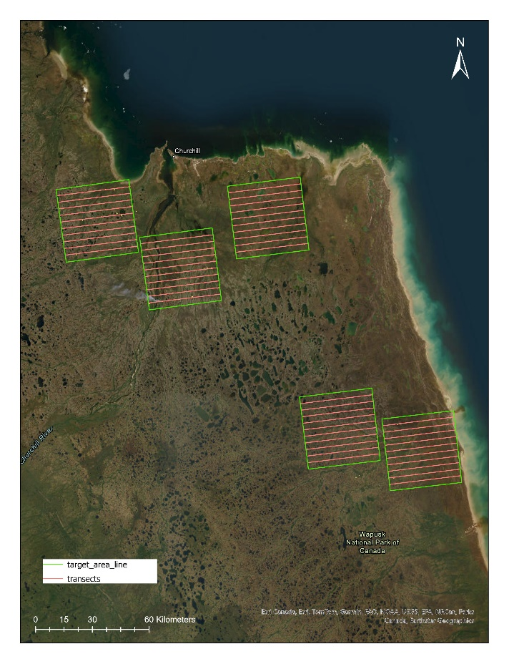
HBL Target Areas and Transect
Target areas were chosen based on diversity of landcover from segmented Sentinel-2 image
10 transects, 20 km in length were created within each target area
3 transects were chosen per target area for data collection
Once helicopter plot data was completed , each transect was flown in one straight continuous flight.
Oblique photos of the ground were taken with i overlapping between the photos
Helicopter flew at approximately 200ft above sea level and 50km/hr
Helicopter doors were removed to allow for steeper angle of photo collection, creating a better representation of ground cover along the transect line.

