Slide 1
CEOS Missions, Instruments and Measurements (MIM) Database Report
For Information
Marie-Claire Greening, ESA
Agenda Item #10.3
38th CEOS Plenary
Montreal, Canada
23rd - 24th October, 2024

Slide 2
Current Status - Summary
Database online at database.eohandbook.com
2024 update survey complete
Quarterly Report
Considering plans for website enhancements (visual)
Refresh of GHG mission portal database.eohandbook.com/ghg
Engaging with the broader community - OSCAR, EO Portal, etc.

Slide 3
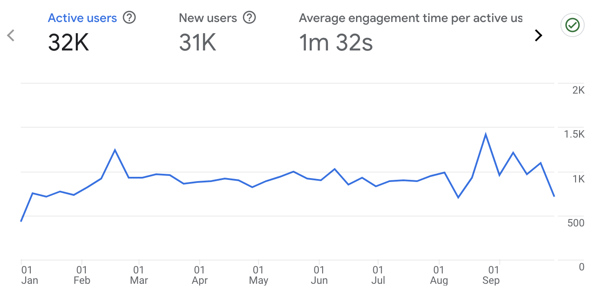
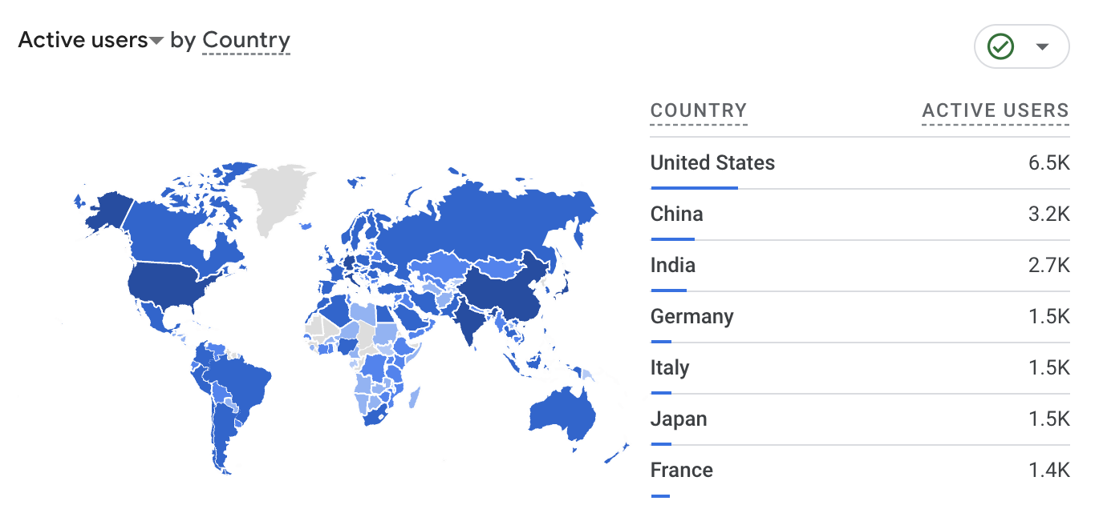
Website Audience - 2024
International audience
Users up across highest use countries
Steady and slightly increasing traffic numbers
32,000 users Jan-Oct 2024

Slide 4
2024 Survey
32/40 agencies responded
No updates from:
AEM, CRESDA, NASRDA, NRSCC / CAST / CNSA, NSAU, PTSpace, SANSA, UAE SA
Updated survey results published 11 Oct
New missions include:
Sentinel-1, -2 & -3 Next Generation
Sentinel-6 C
GeoXO series
Atlantic Constellation Pathfinder
EUMETSAT Polar System - Sterna
TerraSAR Follow-On X-band Mission
QuickSounder
Stats
490+ missions updated
17 new missions
330+ instruments updated
13 new instruments
4074 instrument - measurement pairs
Thanks to agencies and contacts for your contributions!

Slide 5
Quarterly Reports
Published once every three months
Recent launches & mission completions
Upcoming launches
Distributed to CEOS mailing lists & available on the CEOS website: ceos.org/mim-reports-archive
Helps lighten the load at survey time, and keeps the database a current & accurate resource

Slide 6
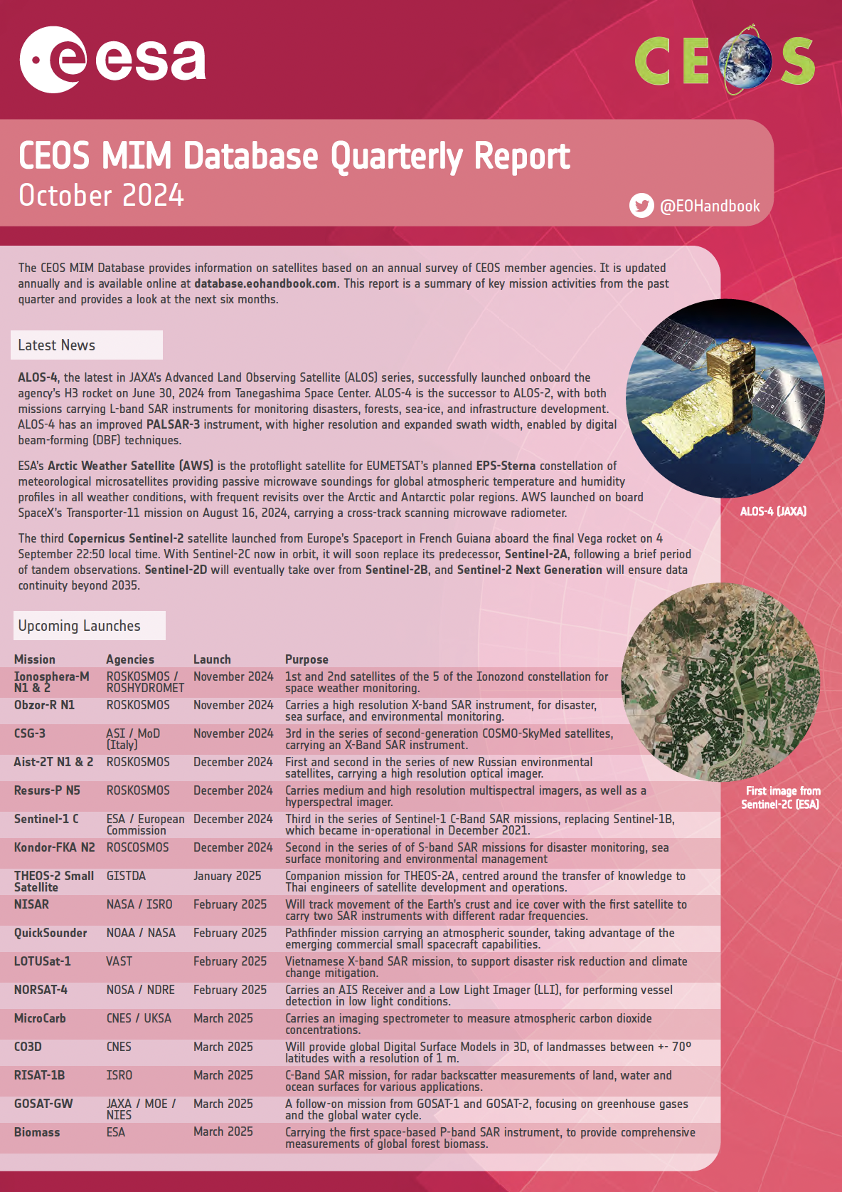
Quarterly Reports - Q3 2024
Launched in Q3 2024:
ALOS-4
ESA’s Arctic Weather Satellite (EPS-Sterna precursor)
Sentinel-2C
Nine more satellites planned for launch before the end of 2024
Ten satellites planned for launch in Q1 2025
Read more

Slide 7
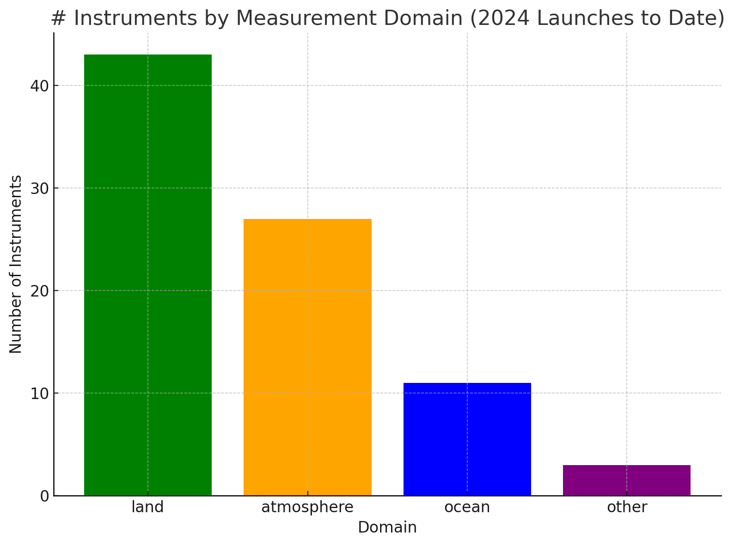
2024 Launches - Measurements
Top Measurements Launched | #
Aerosols | 11
Cloud type, amount and cloud top temperature | 9
Multi-purpose imagery (land) | 8
Sea ice cover, edge and thickness | 8
Vegetation | 6
Snow cover, edge and depth | 5
Albedo and reflectance | 5
Cloud particle properties and profile | 4
Ocean colour/biology | 4
Radiation budget | 4
Surface temperature (land) | 3

Slide 8
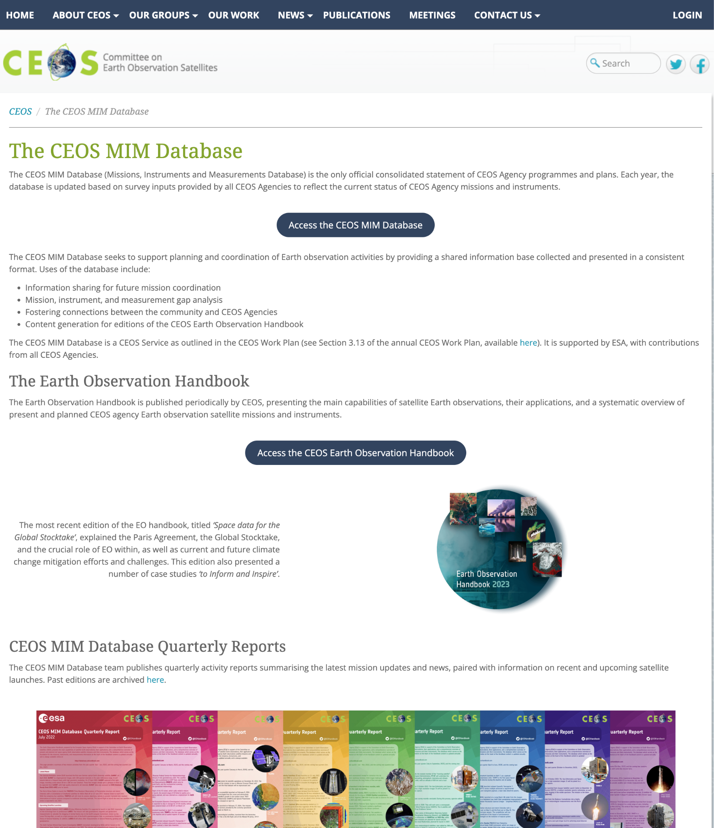
Enhancements
Added: ceos.org/mim-database/
Currently undertaking a set of visual enhancements of the current website
Improve the look, feel, and performance
Relatively modest effort but hopefully a nice refresh

Slide 9
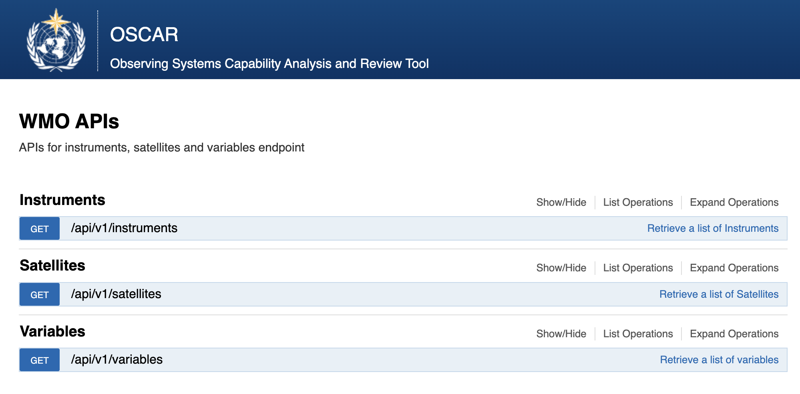
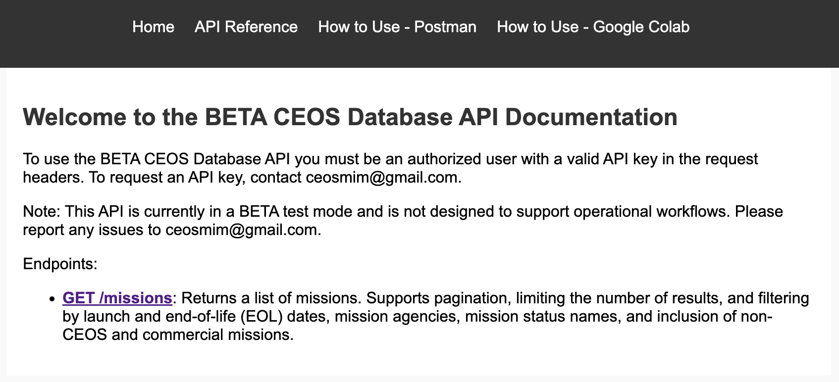
OSCAR
Clear adjacency - different mandates and constituencies
Continuing periodic correspondence with the OSCAR team
Sharing information and the updates from the quarterly report process

Slide 10
ESA Science Strategy
The Database has been the principal reference for the ESA Science Strategy foundational study
Providing the ‘program of record’ - current and future planned capabilities
Similar to the role the CEOS Database played for the NASA Decadal Survey
Fulfilling its mandate: providing capabilities to undertake informed coordination decisions

Slide 11
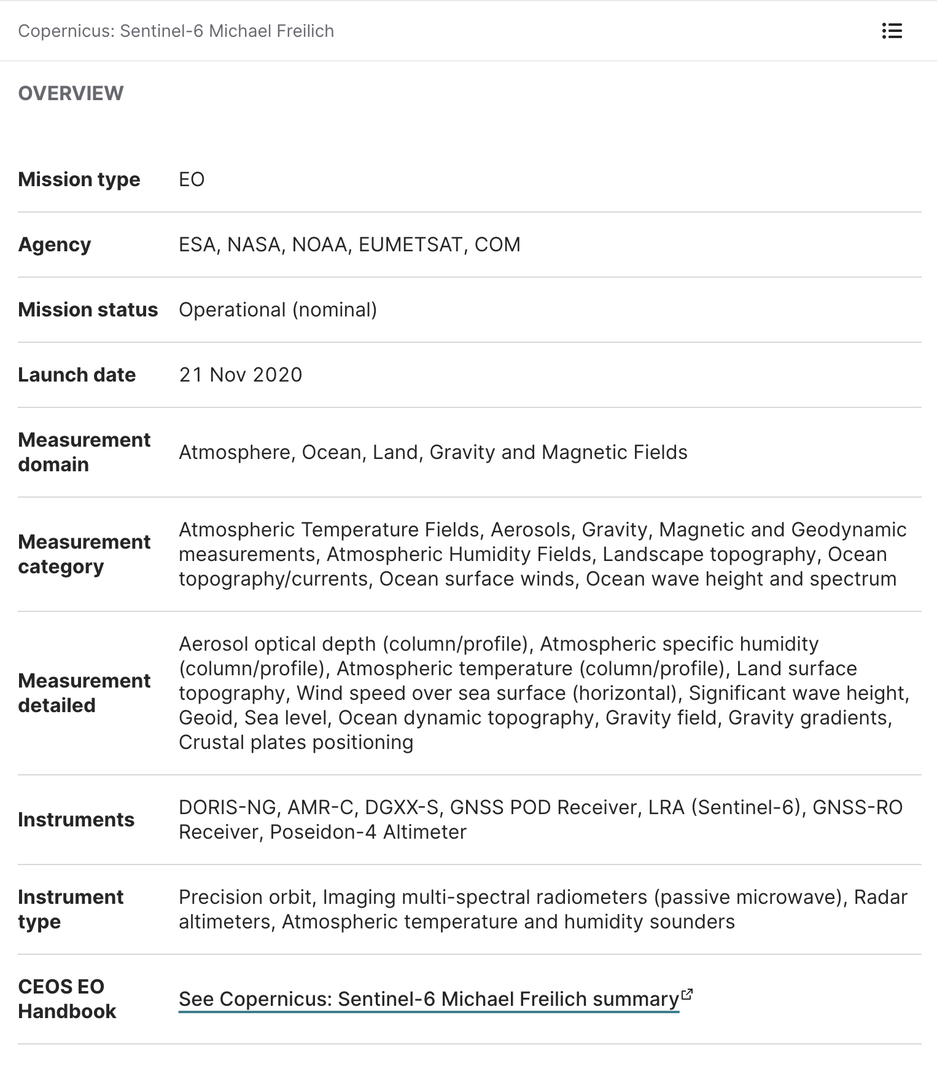
EO Portal
EO Portal metadata powered by the CEOS Database
Independent ‘sister site’ - with more in depth information about the missions, in particular spacecraft and instrument structure
Scope of EO Portal broader than CEOS Database - includes information about commercial and non-governmental missions alongside CEOS Agency missions
eoportal.org/about-eoportal

Slide 12
Thanks!
Questions welcome now, after, or via email
Thanks to agencies and contacts for your support in making this community resource possible

