Slide 1
CEOS Plenary 2024
ASI Report
Laura Candela, ASI
Agenda Item 7.1.7
38th CEOS Plenary
Montreal, Canada
23rd - 24th October, 2024

Slide 2
COSMO-SkyMed
COSMO-SkyMed:
  CSK-3 deorbiting procedure started on May 2022
  CSG-2 is operational: After successfully passing the test and in-flight qualification stage, the data acquired by the CSG2 satellite are made available to users by the Italian Space Agency and Ministry of Defence).
  Now, on the same orbit, 3 CSK + 2 CSG
  CSG mission will be upgraded with third and fourth satellites CSG
An “Open Call for Science” on the use of CSK and CSG data is available on the ASI website: https://www.asi.it/bandi_e_concorsi/open-call-for-science-data-utilization-of-the-cosmo-skymed-mission-first-and-second-generation-english-version/

Slide 3
PRISMA, SAOCOM & Other WG
PRISMA is operating nominally (https://prisma.asi.it/) and PRISMA SG Phase A activity concluded.
B/C/D/E1 contracts KO planned in Q4/2024.
Since 20 July 2021, ASI has been started the provision of SAOCOM data within the ASI ZoE: https://www.asi.it/en/2021/07/asi-starts-the-exploitation-phase-of-data-acquired-in-europe-by-the-l-band-sar-sensors-of-the-argentinean-saocom-constellation/. For accessing the products it is sufficient to download the SAOCOM Registration Data Package and submit via email a registration request. SAOCOM data will be accessed and disseminated through a dedicated ASI SAOCOM portal.

Slide 4
Space mission with ASI as Lead Agency
  LAGEOS-2 (http://database.eohandbook.com/database/missionsummary.aspx?missionID=238):
    Instrument: Laser Retroreflector Array
    Measurements: Gravity field, Gravity gradients, Crustal plates positioning, Crustal Motion
  LARES (http://database.eohandbook.com/database/missionsummary.aspx?missionID=19):
  LARES-2 (http://database.eohandbook.com/database/missionsummary.aspx?missionID=968)
    Instrument: Laser Corner Cube Reflector Assembly
    Measurements: Gravity field, Gravity gradients, Crustal plates positioning, Crustal Motion
  PLT-1 (http://database.eohandbook.com/database/missionsummary.aspx?missionID=1282)
    Instrument: Synthetic Aperture Radar
    Measurements: Land, multi-purpose imager
  PLT-2 (http://database.eohandbook.com/database/missionsummary.aspx?missionID=1283)
    Instrument: Multi-Angle Imager for Aerosol (MAIA)
    Measurements: Aerosol
  SBG-TIR (http://database.eohandbook.com/database/missionsummary.aspx?missionID=975)
    Instrument: VNIR Camera (SBG-TIR)
    Measurements: Land surface imagery

Slide 5
Space Missions with ASI as Contributing Agency
  CSES (http://database.eohandbook.com/database/missionsummary.aspx?missionID=849):
    Instrument: High Energy Particle Detector
    Measurements: Electron Energy and Pitch Angle Distribution
  LAGEOS-1 (http://database.eohandbook.com/database/missionsummary.aspx?missionID=201):
    Instrument: Laser Retroreflector Array
    Measurements: Gravity field, Gravity gradients, Crustal plates positioning, Crustal Motion
  NORDSAT-TD (http://database.eohandbook.com/database/missionsummary.aspx?missionID=1012)
    Instrument: CORA-micro
    Measurements: VHF Data Exchange maritime communication
  SAOCOM (http://database.eohandbook.com/database/missionsummary.aspx?missionID=405)
    Instrument: Synthetic Aperture Radar
    Measurements: Land, multi-purpose imager

Slide 6
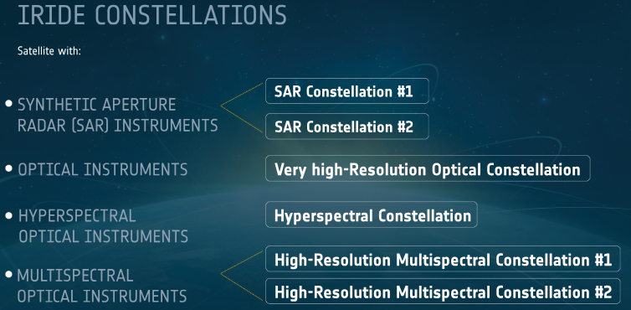
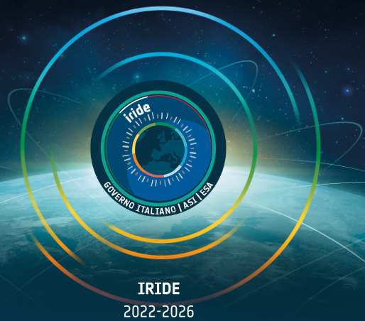
IRIDE system
Europe’s foremost EO space programs, initiated by the Italian Government, coordinated by ESA in collaboration with ASI with PNRR resources along with CNP funding. Expected both to achieve full operational capability and ASI lead by June 2026.
Constellations of satellites in Low Earth Orbit (LEO) (Upstream), ground operational infrastructure (Downstream), and services for the Italian PA (Services).
Geospatial services for each application domain:
  Coasts
  Air quality
  Land motion
  Land cover
  Hydro-Meteo-Climate
  Water resources
  Society
  Emergency
  Security
https://indd.adobe.com/view/189e6abd-0804-4430-b6a5-79a89f56f347

Slide 7


Services: Development Principles
iterative development, progressive growth (precursor, v1, v2)
immediate start: Precursor version improving the State-of-the-Art
multi mission, multi source input data
users in the loop (regular checkpoints)
focus on the ‘last mile”: inclusion of IRIDE services in the user workflow
sustainability post June 2026
Service Portfolio Specification
Service Segment Cycles
Service Value Chains design & development
Precursor Phase (one cycle):
In input: existing data sources
Services include improvement with respect to State-of-the-Art
Phase 2 (two cycles):
Progressive integration of IRIDE data
Integration in IRIDE MArketplace
Improvement of Services with respect to Precursor
Benefit analysis assessment
Quality control & testing
Geospatial products
generation
ESA unclassified - releasable to the public

Slide 8
GEO 2025 Global Forum
GEO 2025 Global Forum will take place in Rome on 5-9 May 2025 hosted by Italy, organized by the Italian Space Agency (ASI), with the financial contribution of European Commission and it will include a Ministerial Segment.
Topic: “Earth Intelligence for all (users)” - how to implement the GEO post 2025 strategy so that Earth Observation data and derived information and knowledge will be laid down at local scale to implement cost-effective strategies to mitigate the effects of major global threats (climate change, biodiversity loss, natural disasters, urban areas).
Reference: The GEO post-2025 Strategy endorsed by Ministers at the GEO Ministerial Summit held in Cape Town in November 2023
Venue: The venue has been selected, Auditorium della Tecnica, contract under finalization .Official announcement by mid November
ASI PoC: Giovanni Rum (giovanni.rum@est.asi.it

Slide 9
THANK YOU FOR THE ATTENTION
Laura Candela,
ASI Principal

