Slide 1
JAXA Agency Report
Hironori Maejima
Senior Chief Officer of
Earth Observation Missions
Japan Aerospace Exploration Agency
2024 CEOS Plenary

Slide 2



JAXA’s Satellite Development and Operation Schedule
Original Mission Period
Extended Mission Period
JFY |  | 2019 | 2020 | 2021 | 2022 | 2023 | 2024 | 2025 | 2026 | 2027 | 2028 | 2029 | 2030 | 2031 | 2032 | 2033
JAXA Earth Observation
ALOS-2/PALSAR-2
Land Monitoring
ALOS-4 (L-SAR)
Next Generation Optical
Observation Satellite
Concept Design
Front-loading
Development and In-orbit Demonstration
Water Cycle
GCOM-W/AMSR-2
GPM/DPR
AMSR-3 (Hosted by GOSAT-GW)
Precipitation
Post DPR mission - PMM
Vegetation
Aerosol
Pre-phase A Study
Phase A
Phase B
Phase C, D
Launch
GCOM-C/SGLI
Forest
Multi-footprint Observation LIDAR and Imager (MOLI) - planned to observe forest 3-D structure and ground height by LIDAR sensor onboard ISS.
Clouds
EarthCARE/CPR
GOSAT/FTS
GHG
GOSAT-2/FTS-2
GOSAT-GW (MEXT＆MOE)

Slide 3


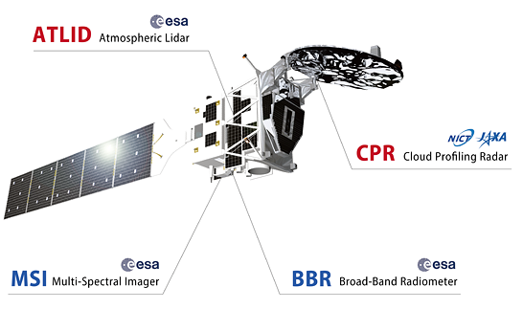
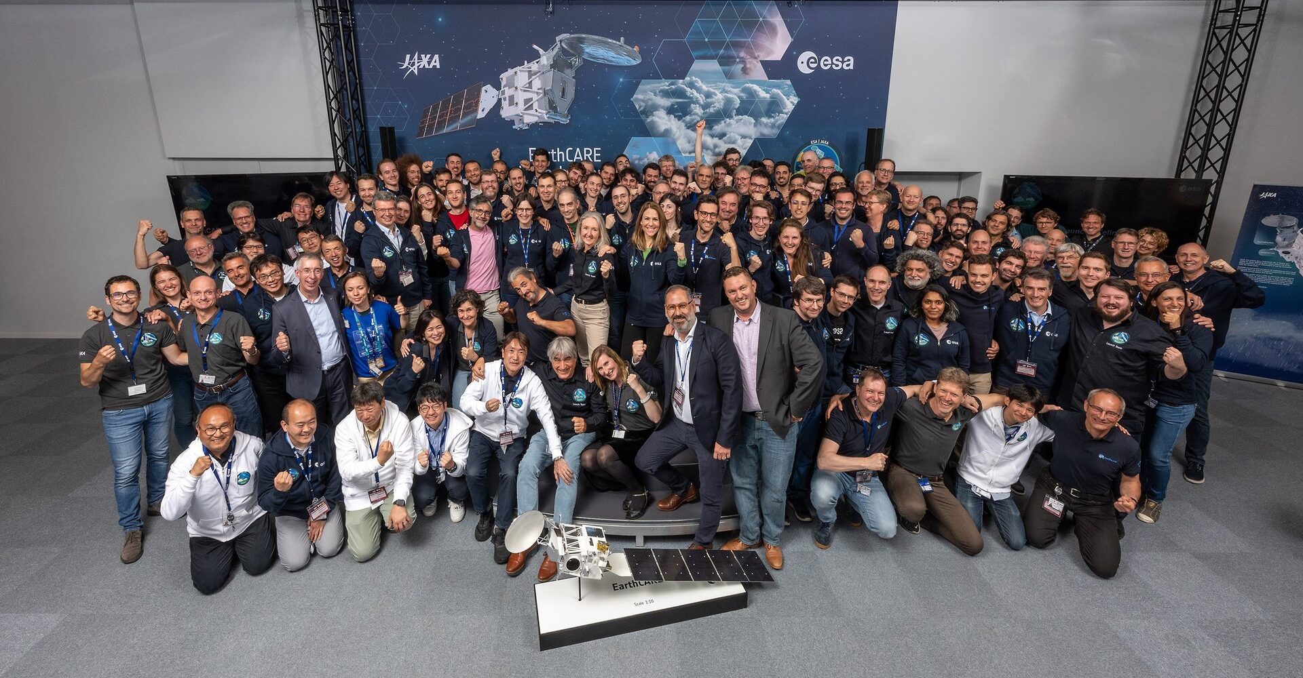
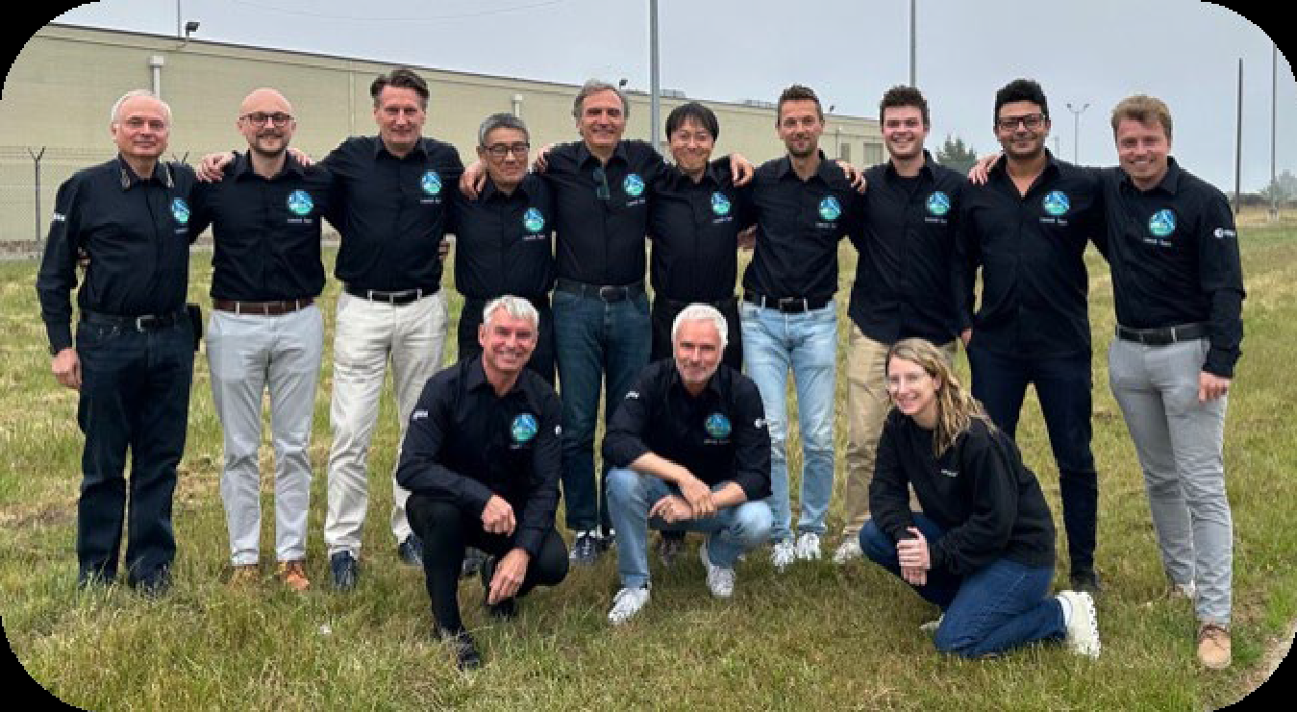
Launched
Earth Cloud Aerosol and Radiation Explorer (EarthCARE)
Launched on 28 May 2024
Mission Status
  ‘Launch and Early Orbit Phase (LEOP)’ was successfully completed on 30 May.
  CPR observation started on 12 June.
  Initial functionality and performance verification was successfully completed on 20 September.
EarthCARE is a collaborative mission between Europe and Japan, aimed at measuring global distribution of cloud and aerosol profiles.
Its goal is to assess their impact on radiation and improve projections of global warming by reducing uncertainties in climate models.
JAXA and NICT developed world's first spaceborne radar at 94 GHz with Doppler Capability, Cloud Profiling Radar (CPR).
©ESA
EarthCARE Operation Team at ESOC
©ESA
EarthCARE Launch Team at Vandenberg

Slide 4
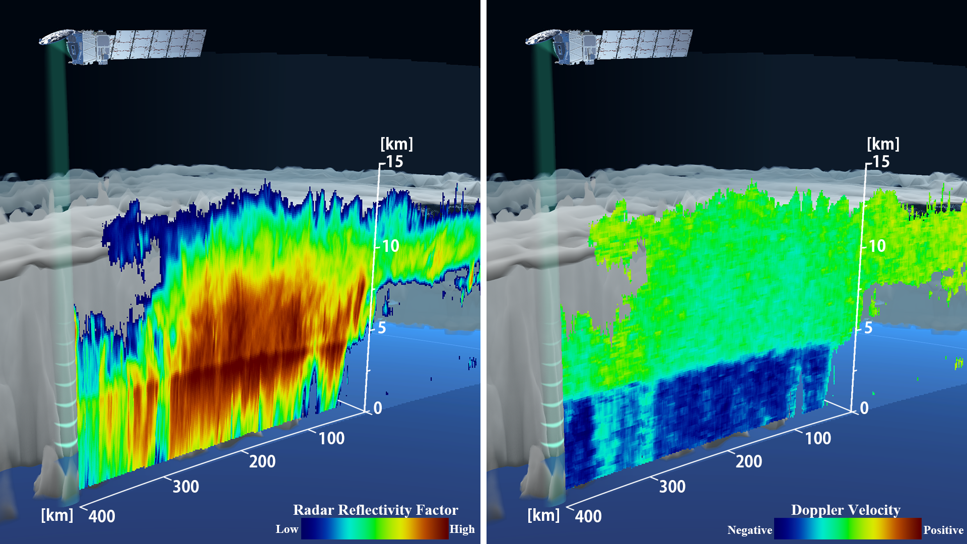
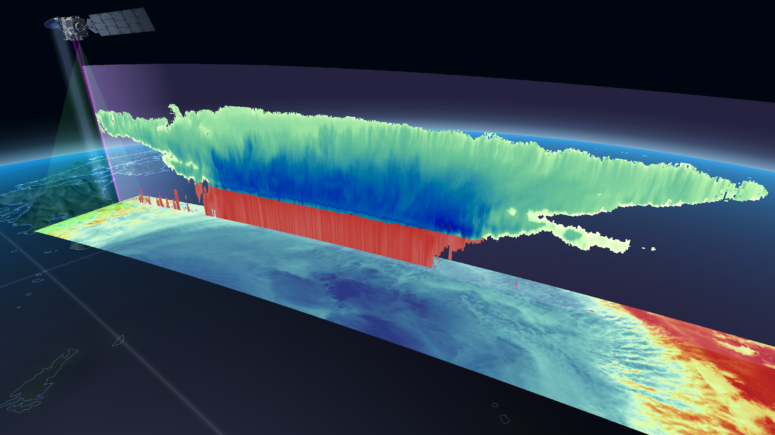
EarthCARE First Images and
Synergistic Cloud Images
CPR First image (June 2024)
Synergistic cloud images by sensors onboard EarthCARE
Vertical:
Synergistic images by CPR, Atmospheric Lidar (ATLID), and MSI
Horizontal:
Multi-Spectoral Imager (MSI)
https://global.jaxa.jp/press/2024/06/20240627-1_e.html
World's first measurement of vertical cloud motion from space
(Rainy cloud over the ocean at east of Japan on 13 June)
The CPR measured the internal structure of cloud, and succeeded in the world's first measurement of vertical cloud motion from space.
https://www.satnavi.jaxa.jp/en/news/2024/10/04/9923/index.html
Measure the clouds more accurately to contribute to improvement of the climate model
(Typhoon Shanshan (2024) approaching Japan on 28 August)
The CPR is sensitive to thick clouds, while the ATLID is sensitive to thin clouds. By combining the two, a wider range of cloud types can be observed vertically. Furthermore, integrating MSI enhances the precision of cloud measurements.

Slide 5
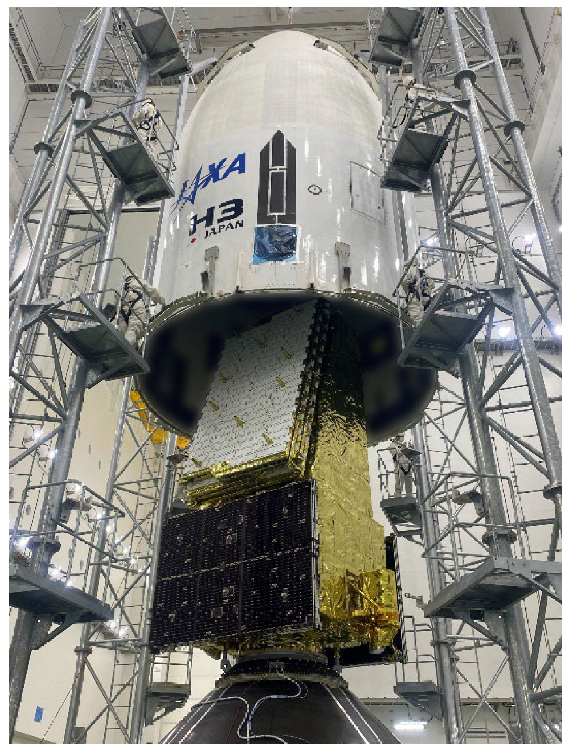
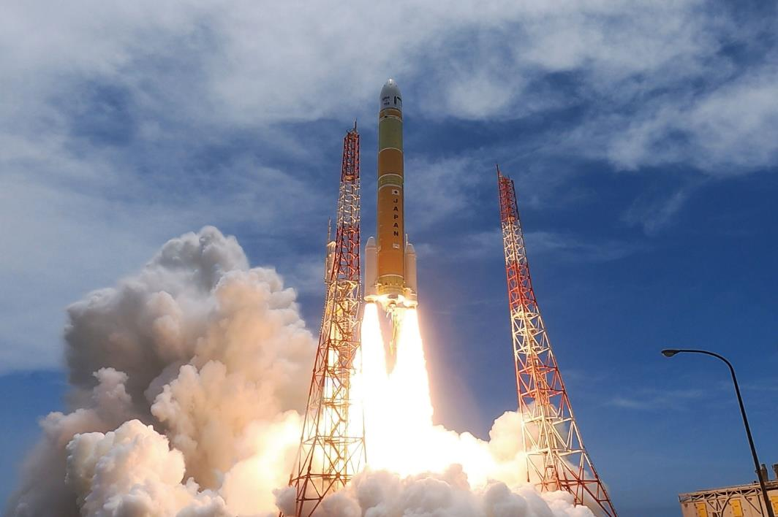
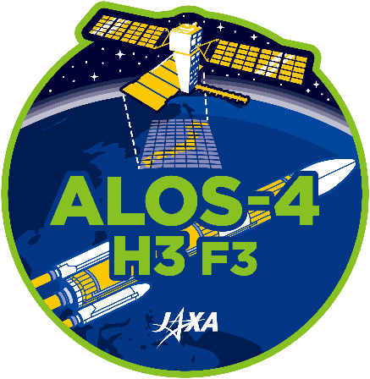
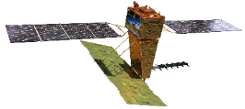

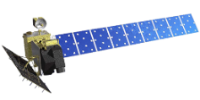
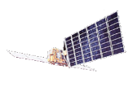
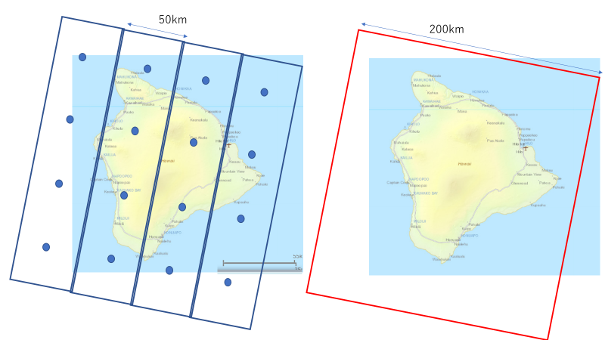
Launched
Advanced Land Observing Satellite-4
Launched at 12:06:42 (JST) on 1 July 2024
High-resolution
Resolution
(2) Wider observation
3m
▼
ALOS-2
(2014-)
▼
ALOS-4
(JFY2023-)
Maximum L-band SAR resolution
10m
ALOS ▼
(2006-2011)
(1) Higher resolution
Mission Status
  Critical operation was successfully completed on 3 July.
  Initial calibration and validation is being performed.
  Data provision is planned around January 2025 or onwards.
16m
JERS-1 ▼
(1992-1998)
50km
70km
75km
200km
Swath
Wide-swath
High-performance radar technology enables to find early signs of disasters faster than ever.
  Monitoring land deformation and subsidence up to a few centimeters by comparing by comparing acquired data in the same area at different times.
  Increasing the observation frequency (once in 2 weeks) so that disaster prevention agencies can find abnormal changes in timely manner.
  Increasing the swath from 50 km to 200 km while keeping the high resolution which enables to observe a broader area at the same time.
Other applications:
  Forest management.
  Monitoring infrastructure displacement.
Coverage of 1 repeat cycle (14 days)
ALOS-4/PALSAR-3 (200 km)
3m resolution
50 km swath width
3m resolution
200 km swath width

Slide 6
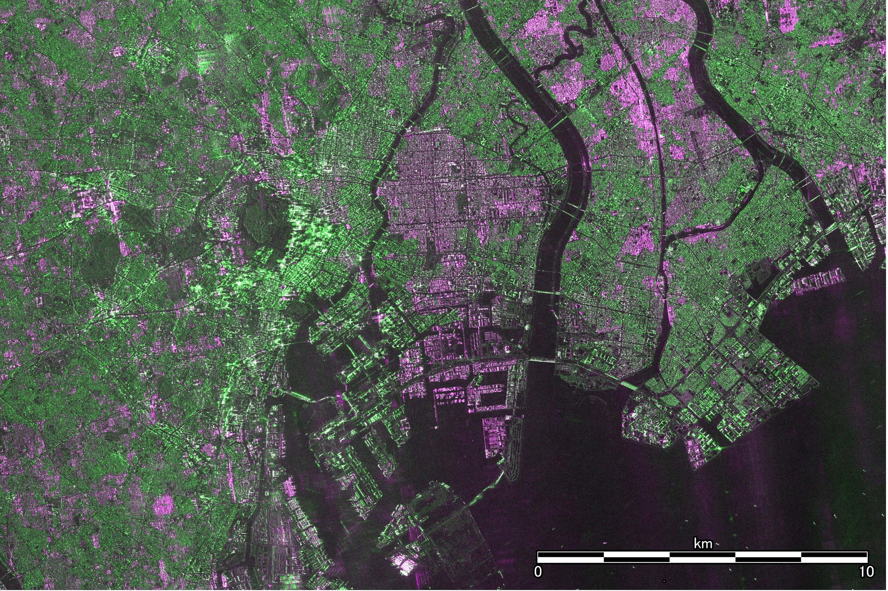
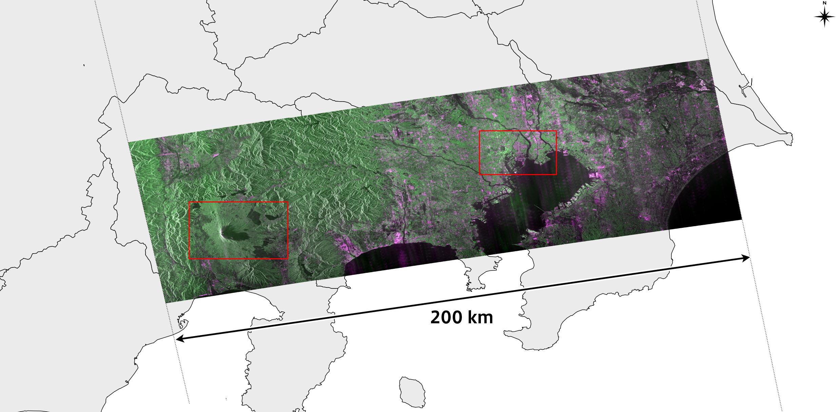
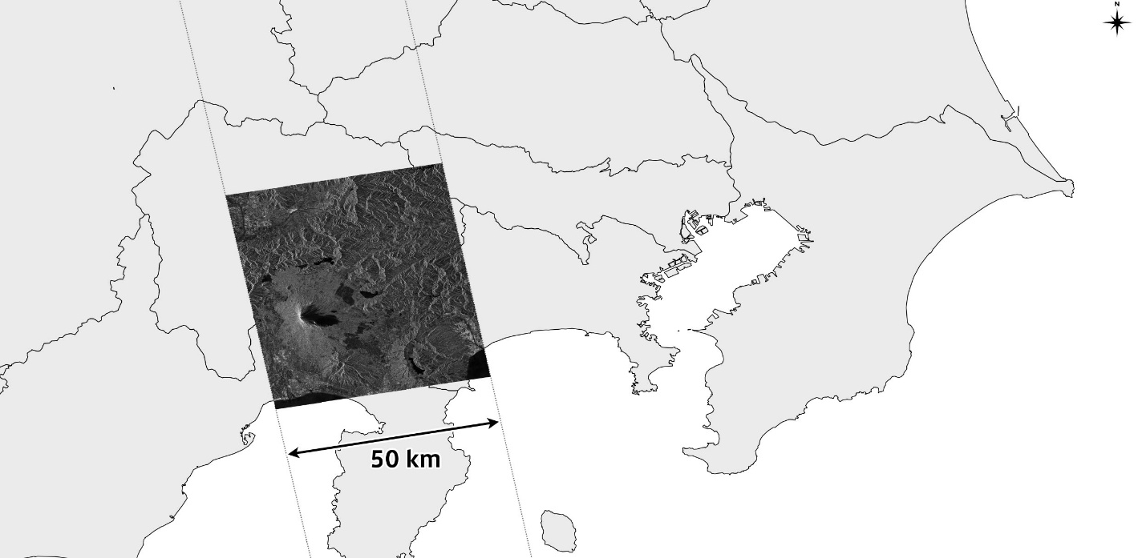
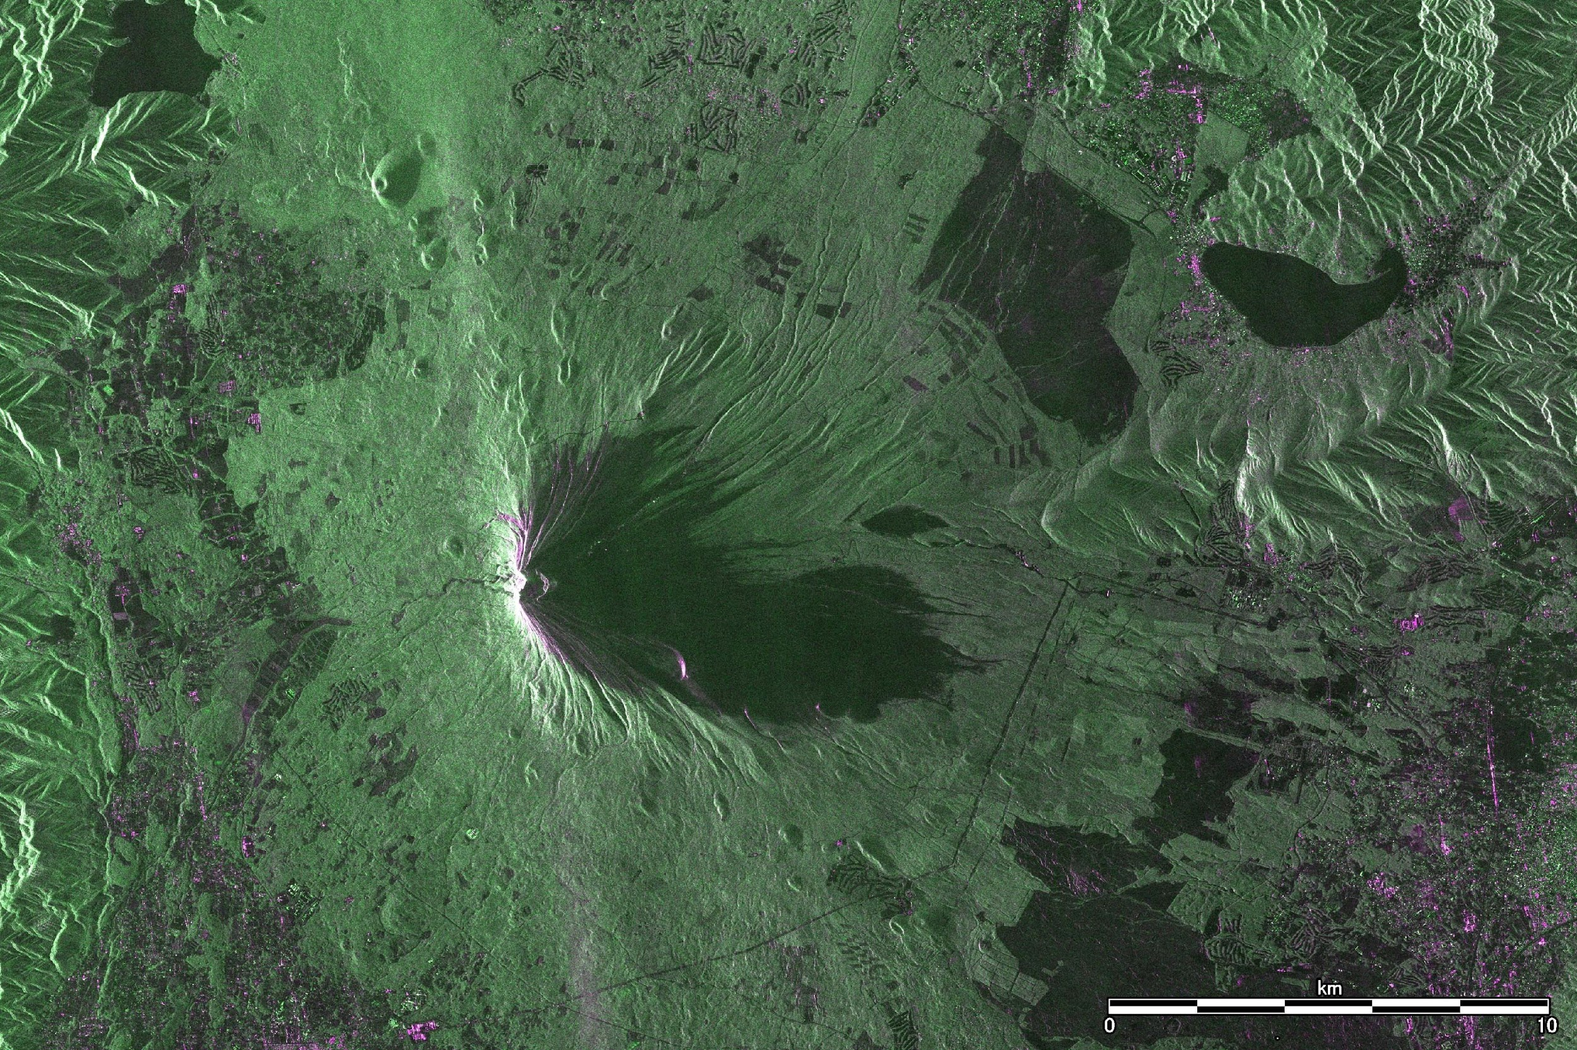
ALOS-4 First Light Images
Wide Swath and High Resolution
Successful Observation with 200km Swath Width
(15 July 2024)
ALOS-4 image (200 km)
ALOS-2 image (50 km)
↑ Central Tokyo, Japan
← Mount Fuji, Japan
(Captured by PALSAR-3 with 3m Resolution on 15 July 2024)

Slide 7
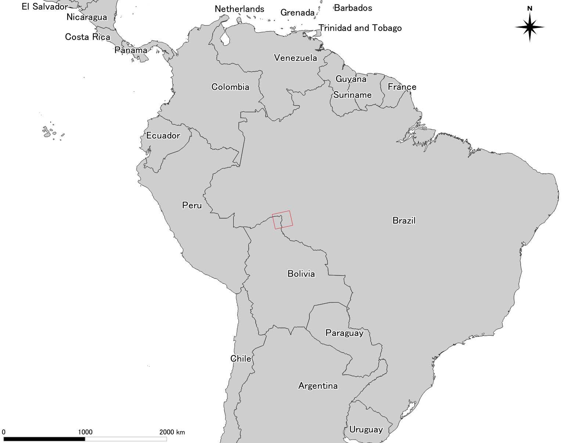
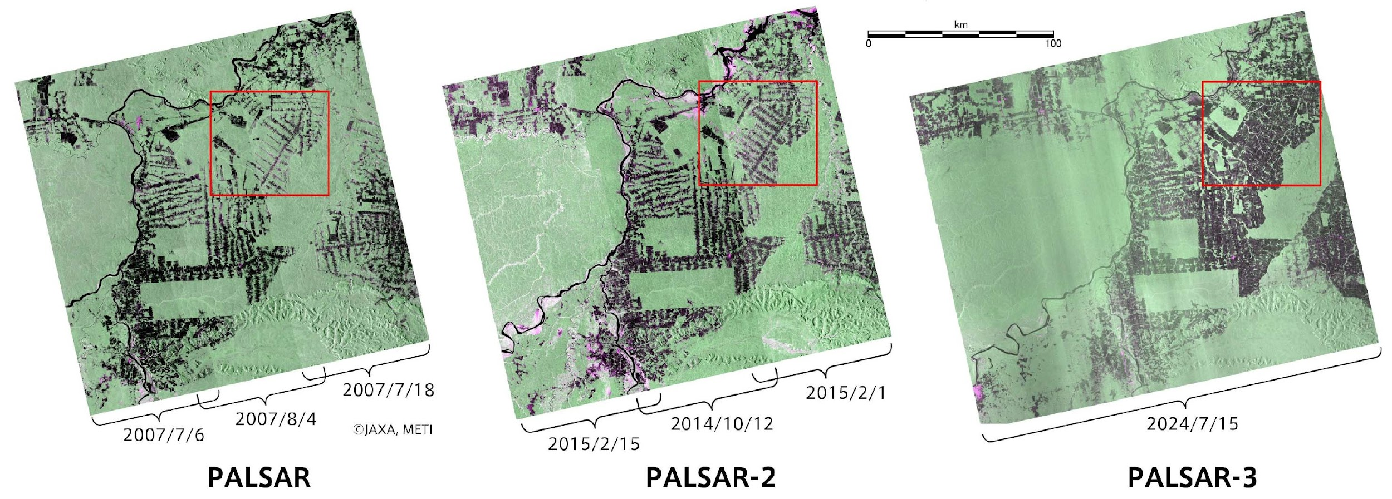
ALOS-4 First Light Images
Continuous Observation by L-band SAR
Observation Image of Rondonia, Brazil
(10m Resolution and a 200km Swath Width)
PALSAR, PALSAR-2, and PALSAR-3 are well-suited for forest observation.
Accumulation of data by PALSAR, PALSAR-2 and PALSAR-3 will contribute to forest conservation and management, efforts related to climate change mitigation.

Slide 8
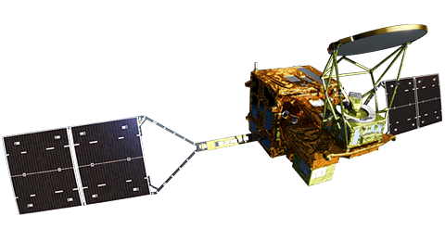
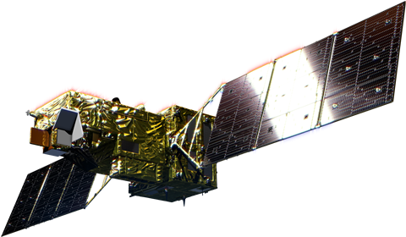


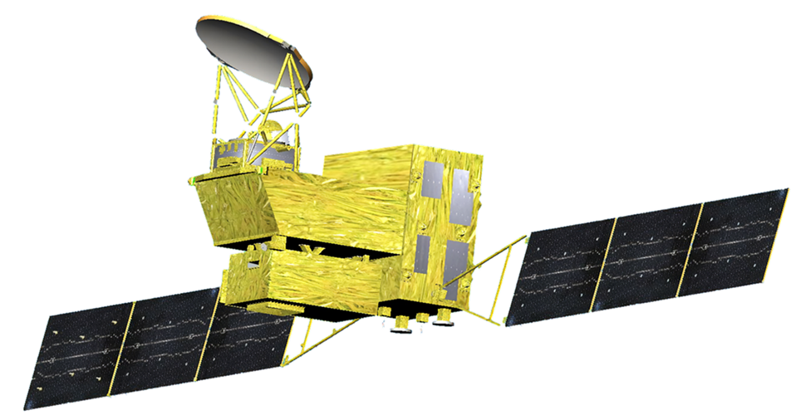

GOSAT-GW: Global Observation SATellite for
Greenhouse gases and Water cycle
Forthcoming Launch
Observing Greenhouse Gases from space.
Observing Earth's water from space.
Observing Earth's water and Greenhouse Gases from space.

Slide 9
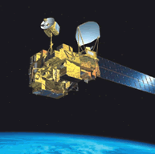
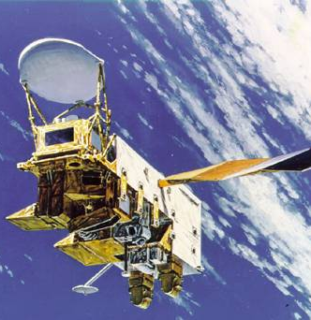
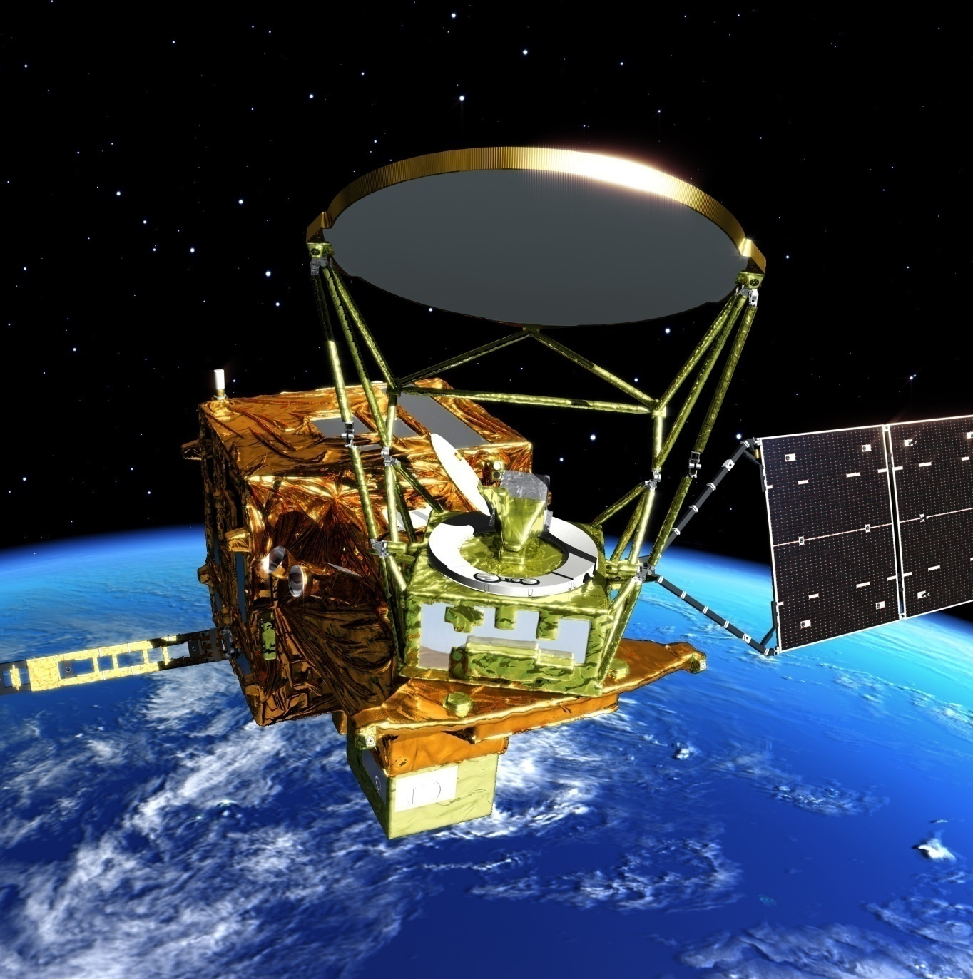
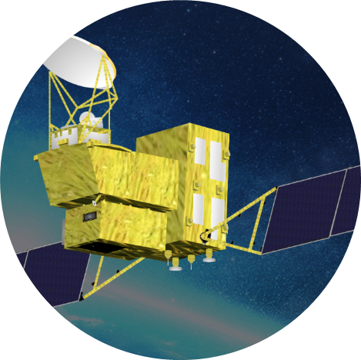
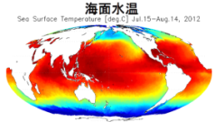
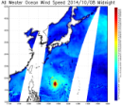
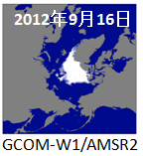
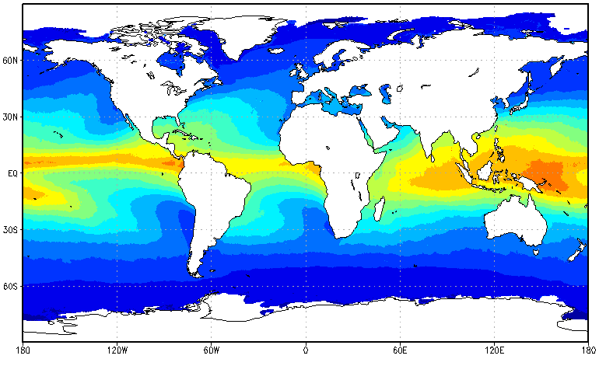
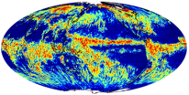


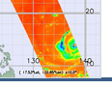
AMSR series and AMSR3
Aqua
GCOM-W
GOSAT-GW
ADEOS-II
2002-2011
Succeed AMSR-E observation
2012-present
after 2024
AMSR
Continue & improve
AMSR-E/AMSR2 observation
AMSR-E
AMSR2
AMSR3
AMSR Products
SST
Wind Speed
Sea Ice
Water Vapor
Rainfall
Snow Depth
Soil Moisture
New Products in AMSR3
High-Freq. CH
Snowfall
High-res. SST
Demonstration for operational utilization (NWP, Fisheries)
・8 geophysical products
・Spatial resolution less then 50km
Establish operational utilization by
improved data latency
・Disseminate global < 2.5H & Japan area < ~16min
Climate change monitoring by long-term observation
・Consistency with AMSR-E
・Improved calibration accuracy
Continue achievements of past AMSRs, and respond to new user needs by;
・New high-frequency channel; and
・Improve spatial resolution of products

Slide 10
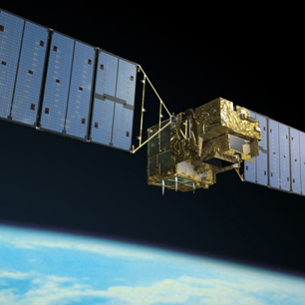
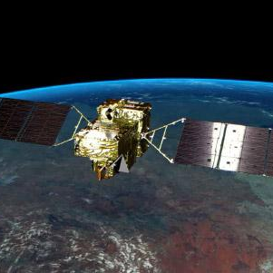
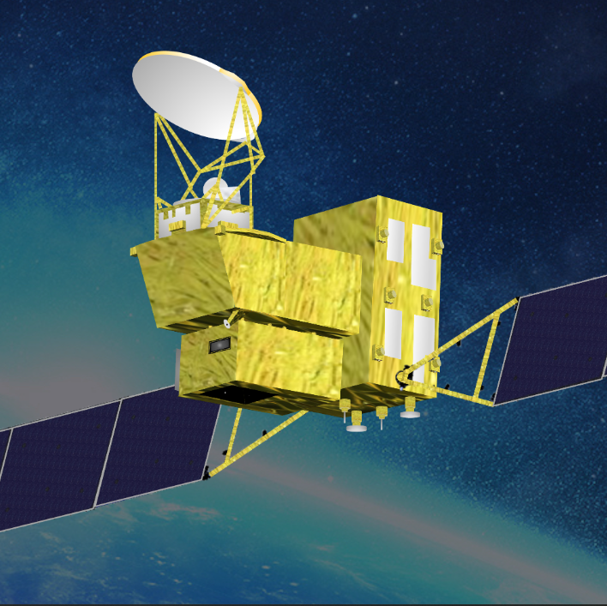
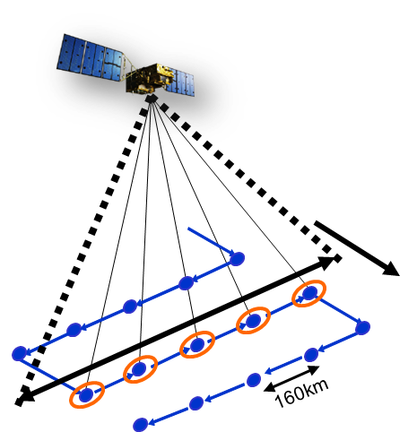
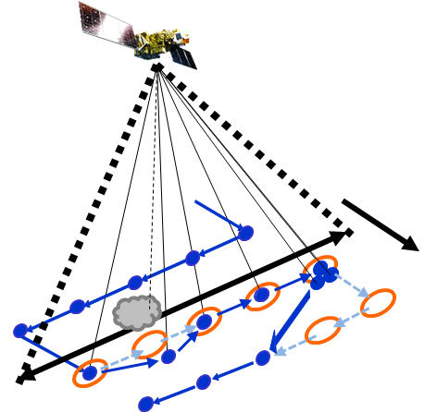
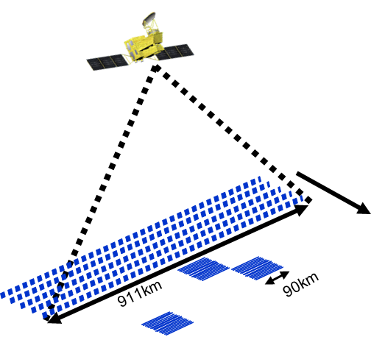
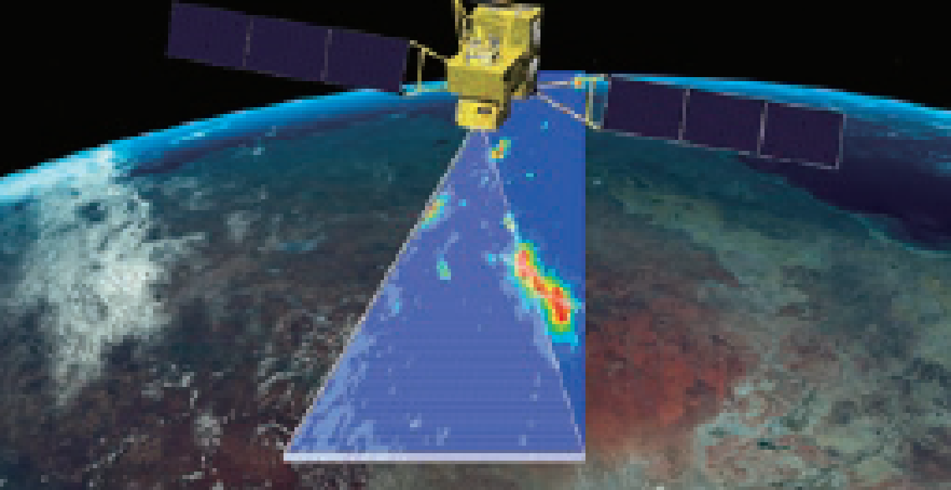
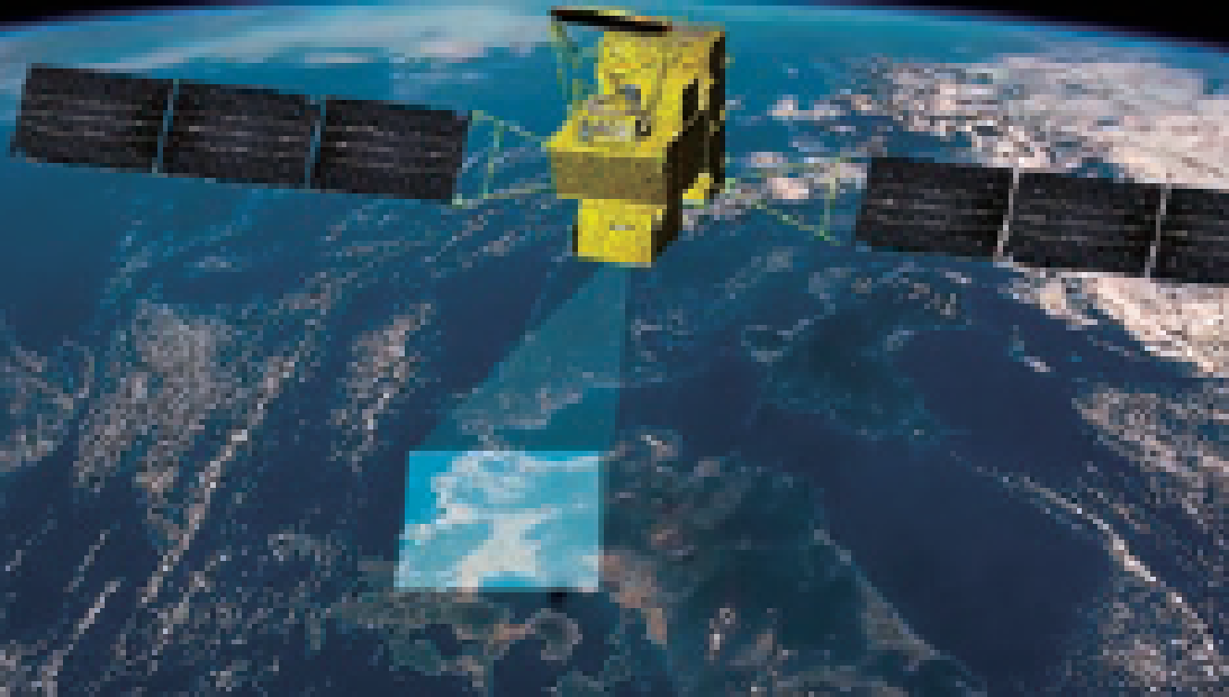

TANSO series and TANSO-3
2009-present
2018-present
after 2024
Aims of TANSO-3
・Long-term monitoring of greenhouse
gases (GHG) of entire earth
・Verification of human-induced GHG
emissions by country
・Detection of large-scale emission sources
GOSAT
GOSAT-2
GOSAT-GW
TANSO
TANSO-2
TANSO-3
Wide mode
Focus mode
Concentrated
observation
10km×92
Focus mode
10km
Avoiding clods
10km
CO₂, CH₄, etc.
CO₂, CH₄, CO etc.
CO₂, CH₄, NO₂ etc.
3km×30
Reference: https://www.env.go.jp/content/000130091.pdf, https://gosat-gw.nies.go.jp/en/index.html, https://www.satnavi.jaxa.jp/files/project/gosat-gw/en/
(Footprint: 3km - 1km)

Slide 11

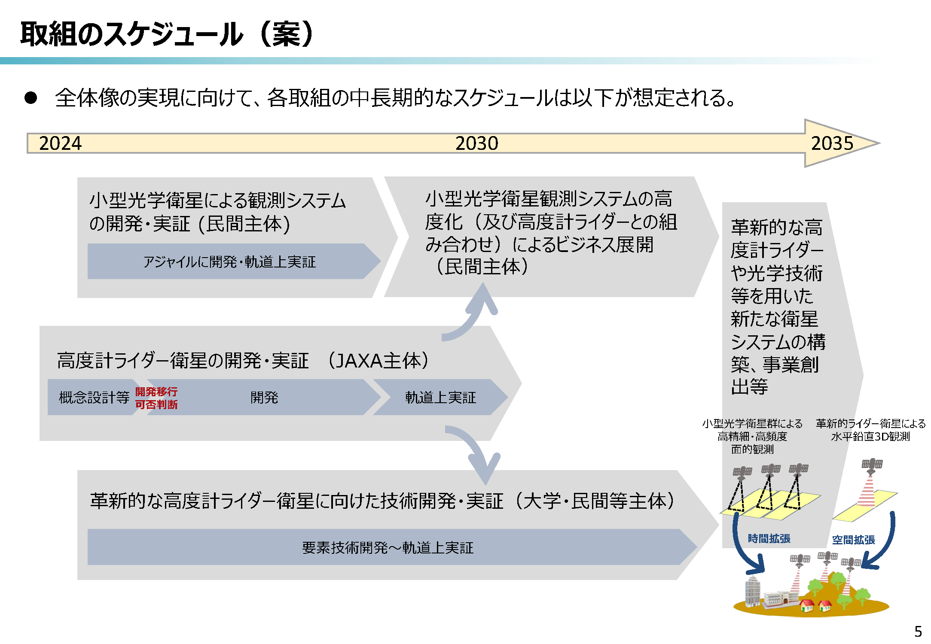


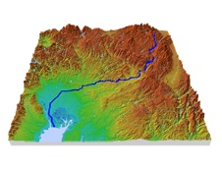
Overview and JAXA’s role in
Optical Observation Satellite Project Concept through PPP
As next generation optical observation satellite project following ALOS-3 loss, “Overview of Optical Observation Satellite Project Concept through Public-Private Partnership” was deliberated in MEXT. (25 March, 2024)
In the deliberation, the public and private sectors roles were identified as below:
Private sector: Development and demonstration of observation system deploying small optical satellites
JAXA: Development and demonstration of LiDAR altimeter satellite
*Tentative transration
Draft Schedule
To realize the overall vision , below mid-long term schedule is expected for each initiative
Development and demonstration of observation system deploying small optical satellites (Private sector)
Business development (Private sector) by upgrading small optical satellite observation system (and integration with LiDAR altimeter)
New satellite system build and business development deploying innovative LiDAR altimeter and optical technique
Agile Development, in-orbit demonstration
LiDAR Altimeter Satellite
Development and demonstration of LiDAR altimeter satellite (JAXA)
Optical Imaging Satellite
Concept
design
PDR
Development
in-orbit demonstration
High precise and frequent spatial observation by small optical satellite constellation
Horizontal-vertical 3D observation by innovative LiDAR altimeter satellite
LiDAR
measurement point
DSM by
stereo imaging
Technology development and demonstration for innovative LiDAR altimeter satellite (Academic and private sector)
Elemental Technology Development - in-orbit demonstration
Time expantion Spatial expantion
Satellite along track
DSM generation by stereopsis of stereo imaging satellite constellation
Height calibration by LiDAR altimeter
Refence: https://www.mext.go.jp/content/20240325-mxt_uchukai01-000034746_1.pdf

