Slide 1
CEOS Plenary 2024
GEMS status and plan
Jaehoon Jeong, NIER
Agenda Item 7.1.3
38th CEOS Plenary
Montreal, Canada
23rd - 24th October, 2024

Slide 2
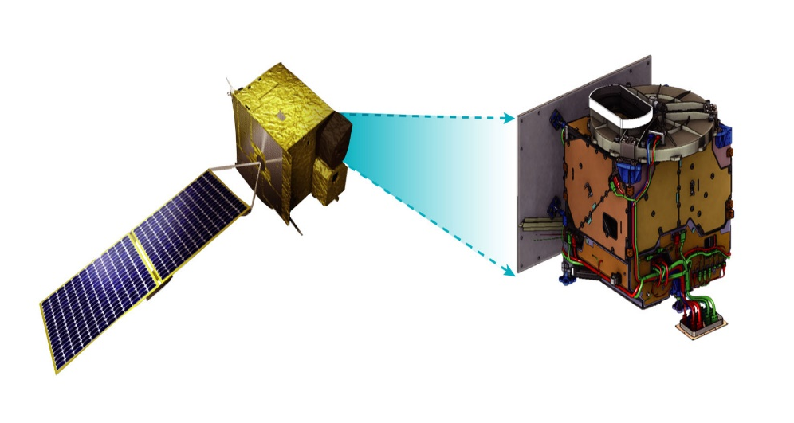
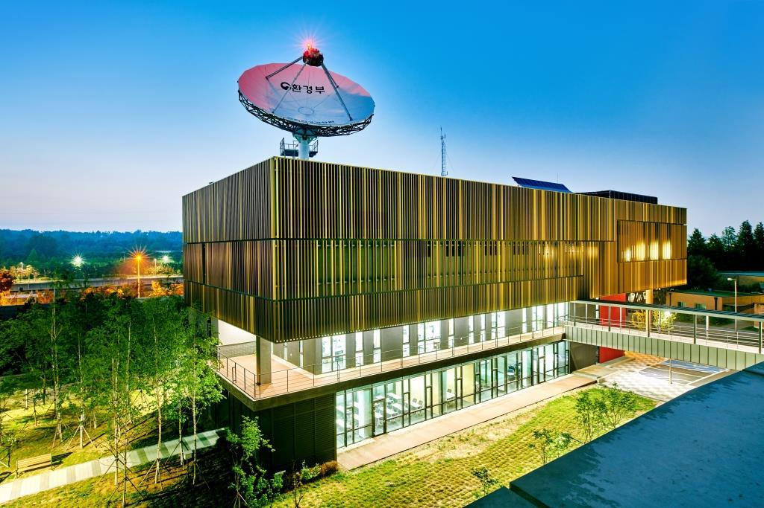
GEMS overview
GEMS provides hourly data on atmospheric pollutants, including NO₂, SO₂, O₃, volatile organic compounds such as formaldehyde (HCHO) and glyoxal (CHOCHO), as well as aerosols, all with high spatial resolution.
NIER is responsible for processing, retrieving, and distributing GEMS data, offering critical insights into the transport and spatial distribution of these pollutants.
Satellite & Payload
Environmental Satellite Center
GEMS overview
Main Targets | O₃, SO₂, NO₂, HCHO, Aerosol and so on
Mission Period | 10 years
Scan Area | 5,000km x 5,000km(5°S – 45°N, 75°E – 145°E)
Spatial Resolution | 3.5km x 8km (Ozone Profile & CHOCHO: 14x32km, SO₂: 7x16km)
Time Resolution | 8 times on average (30min scanning, 30min stand-by)
Spectral Resolution | UV-VIS, 300-500nm
Obit/Height/Longitude | Geostationary satellite/36,000km/128°E

Slide 3





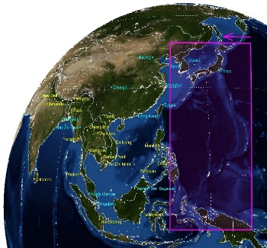
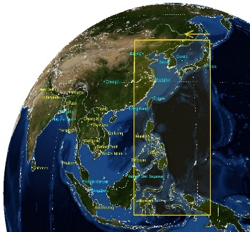
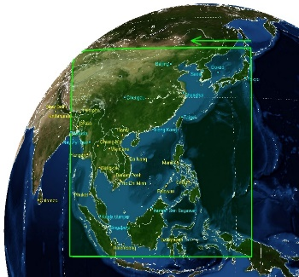
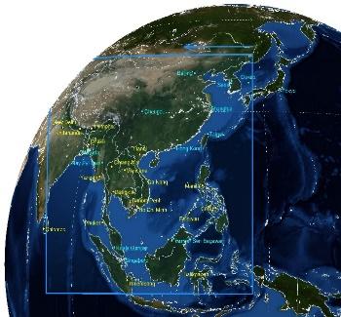















GEMS observation domain
GEMS conducts Earth observations to provide hourly air quality measurements eight times daily during daylight hours across four distinct observation modes: Half East, Half Korea, Full Central, and Full West.
GEMS starts scanning at the 45th minute of each hour and lasts for approximately 30 minutes, ensuring comprehensive coverage over East and Southeast Asia. The observation area spans from 45°N to 5°S and from 152°E to 80°E.
HE
(half East)
HK
(Half Korea)
FC
(Full Central)
FW
(Full West)
Countries in GEMS domain (20)
Brunei
Bangladesh
Bhutan
Cambodia
China
Scan
Area
India
Indonesia
Japan
Laos
Malaysia
Korea, Japan and so on | Korea, Japan, East China regions and so on | Korea, Japan, China, Southeast Asia and so on | Korea, Japan, China, Southeast Asia, India and so on
8~10 KST | 9~11 KST | 10~12 KST | 12~17 KST
Scan
Regions
Mongolia
Myanmar
Nepal
Palau
Philippines
Scan
Time
Singapore
S. Korea
Sri Lanka
Thailand
Vietnam

Slide 4
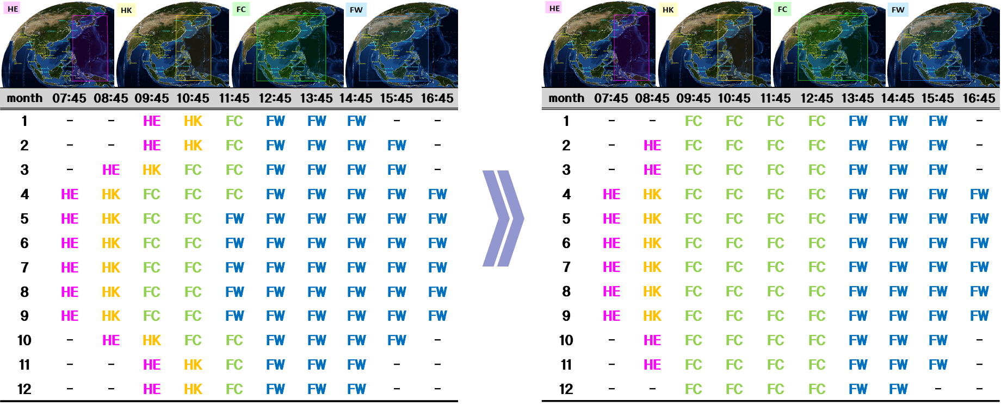
GEMS observation plan
Since February 2024, the observation schedule of GEMS have been adjusted to increase the number of observations during winter, a season characterized by severe air pollution in East Asia
These adjustments support the Airborne and Satellite Investigation of Asian Air Quality/Satellite Integrated Joint Monitoring of Air Quality (ASIA-AQ/SIJAQ) campaign, conducted from February to March 2024, by maximizing the availability of GEMS data.

Slide 5
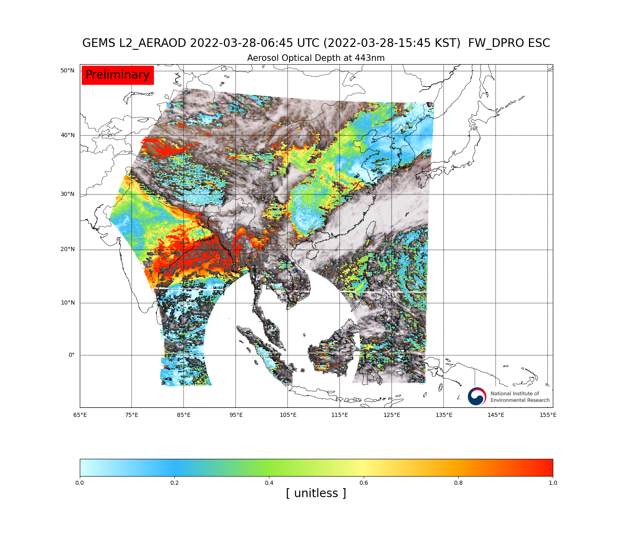
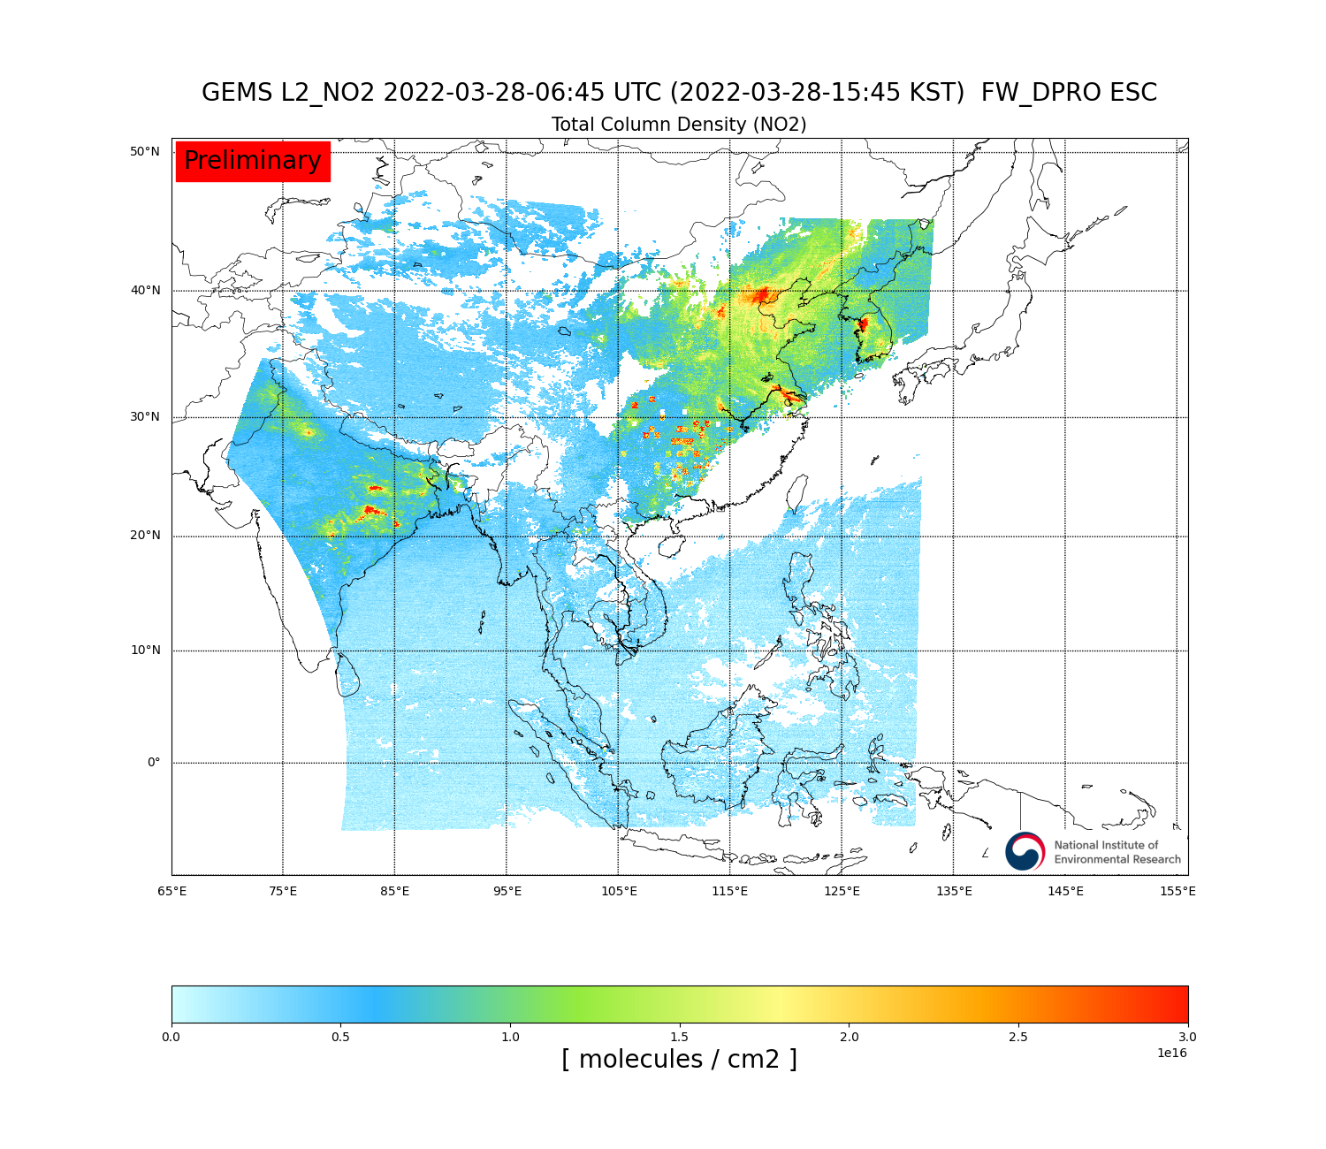
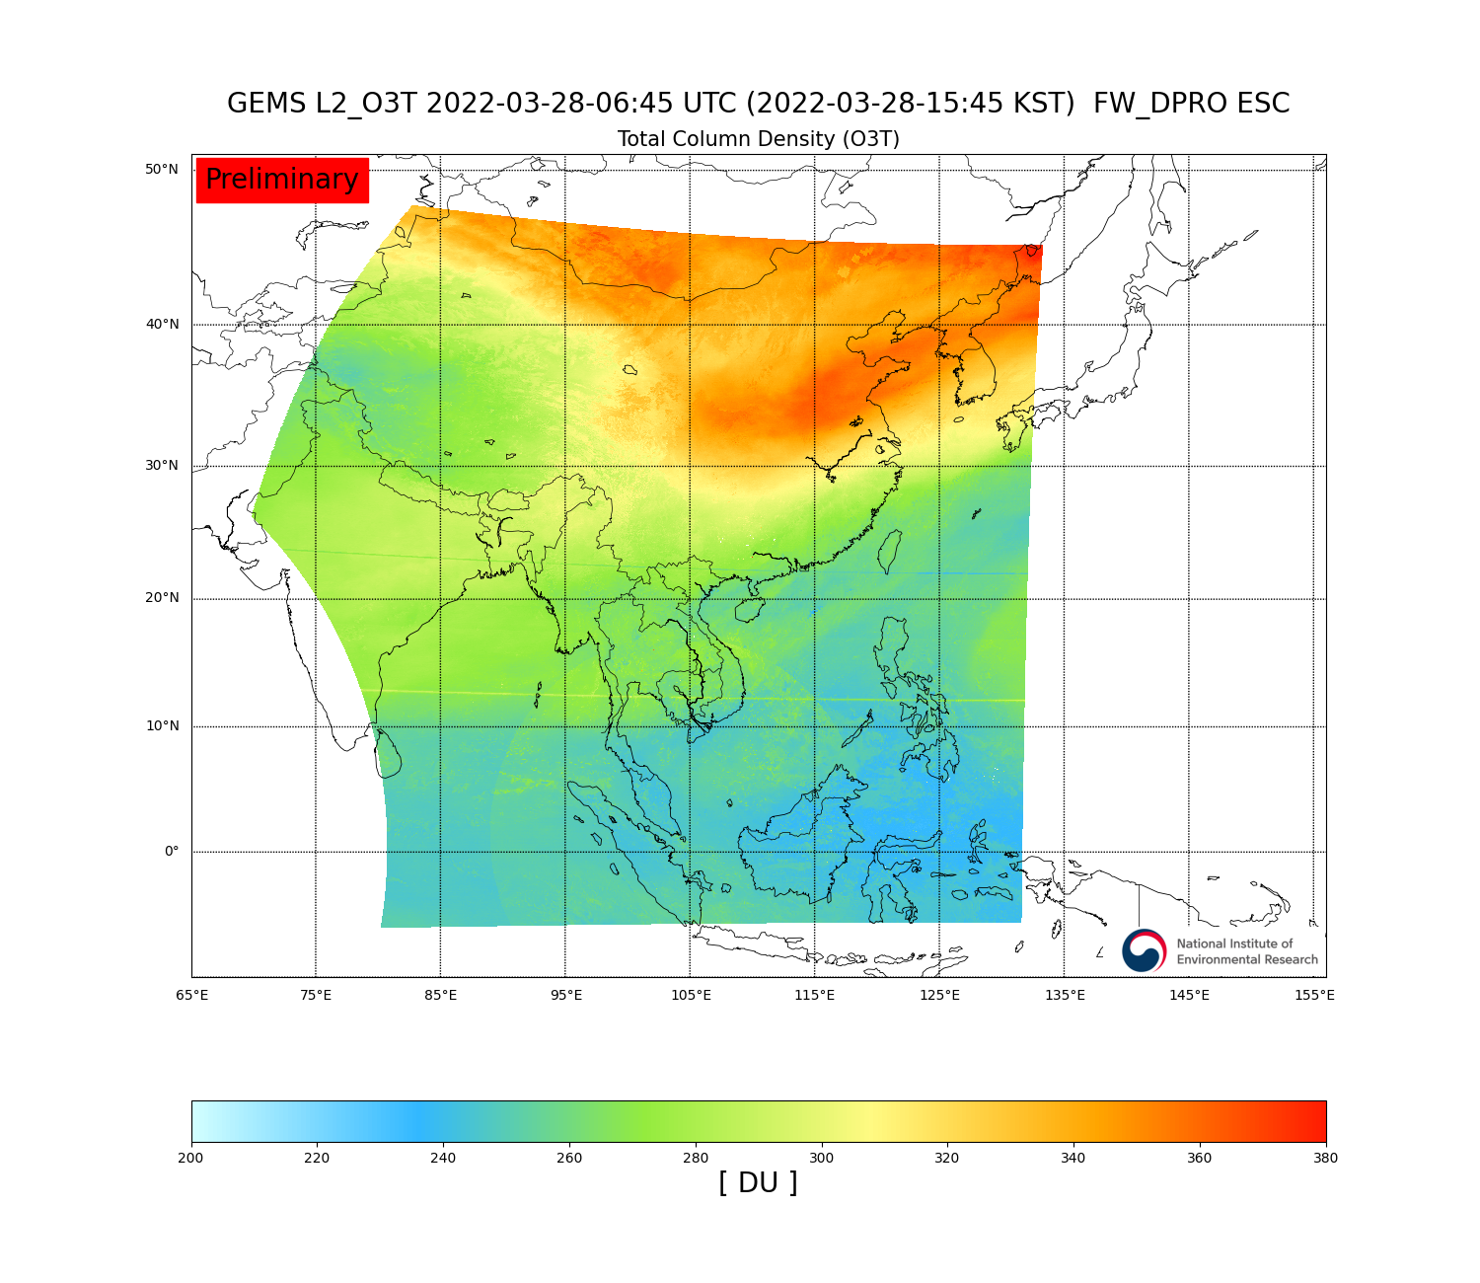
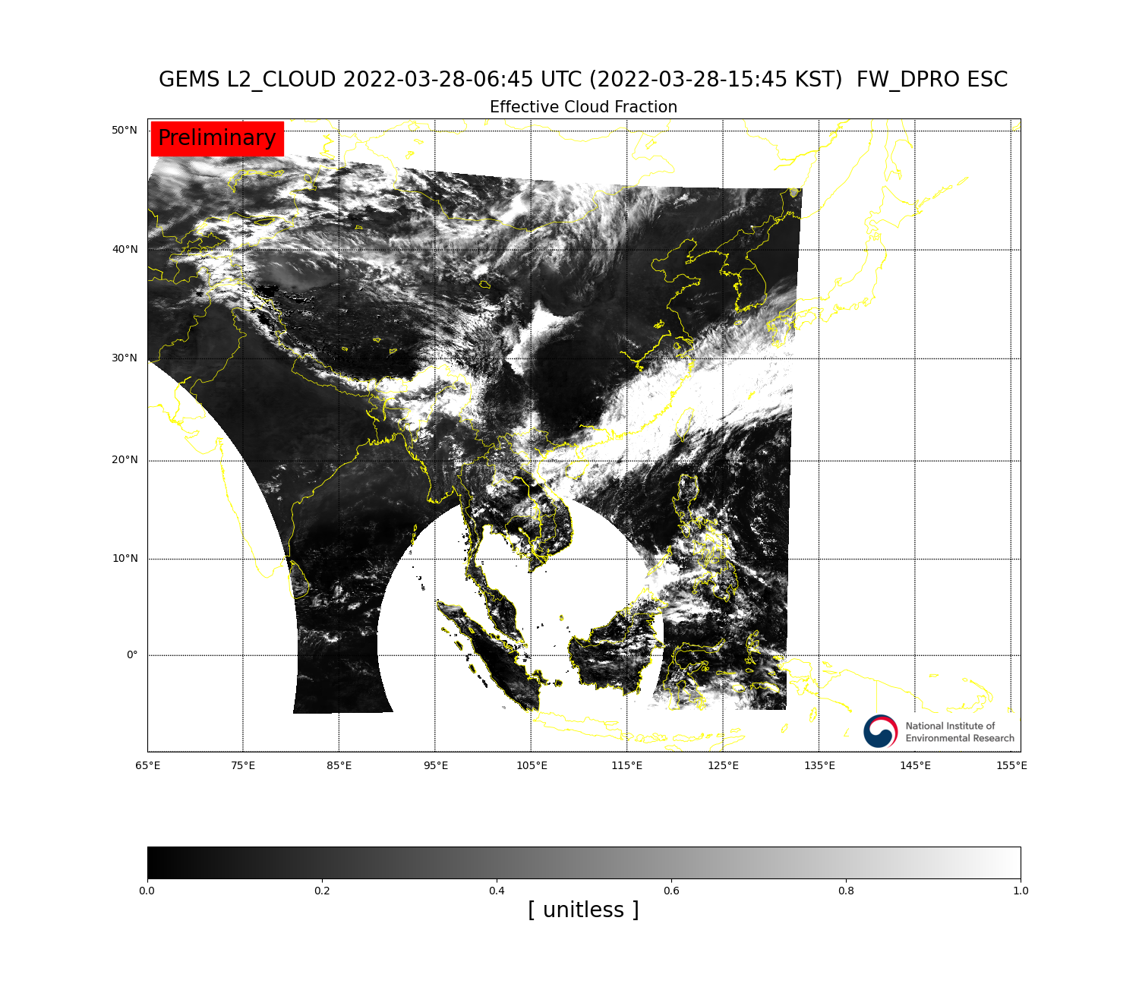
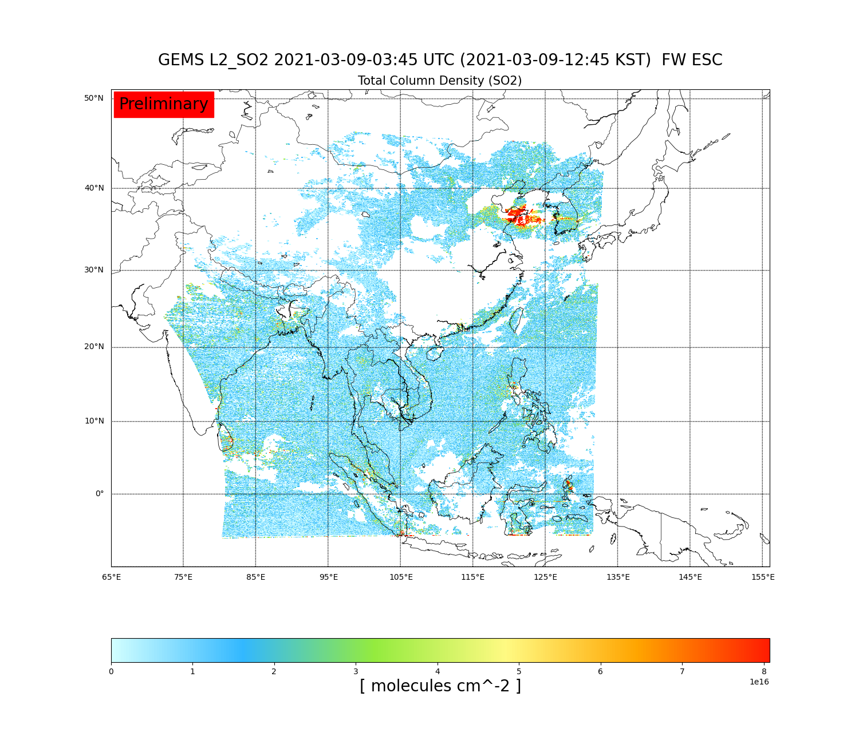
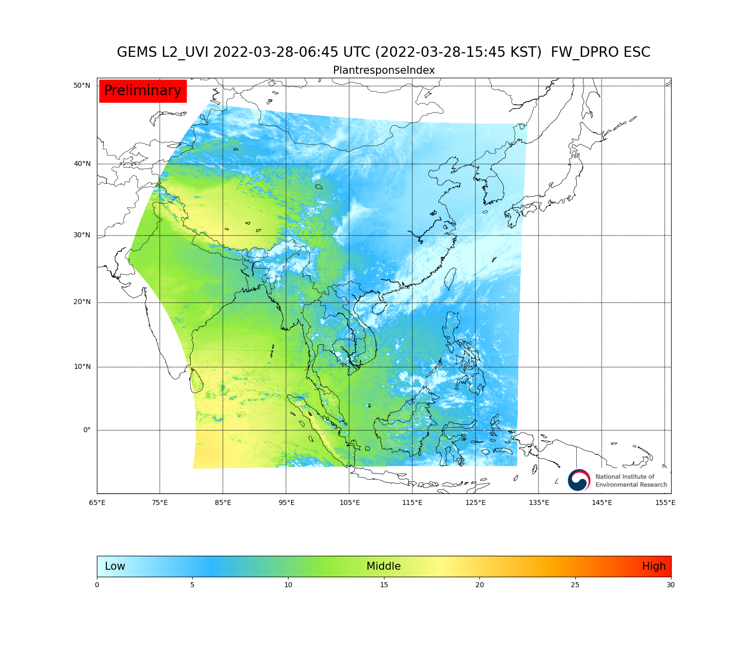
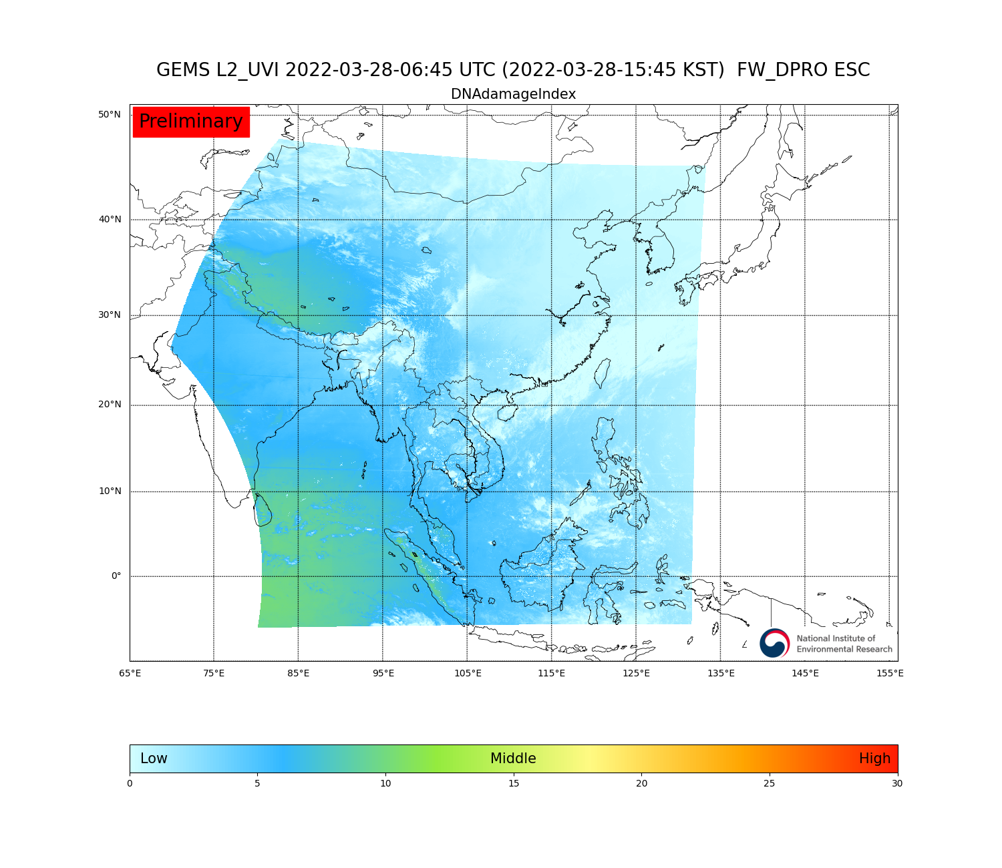
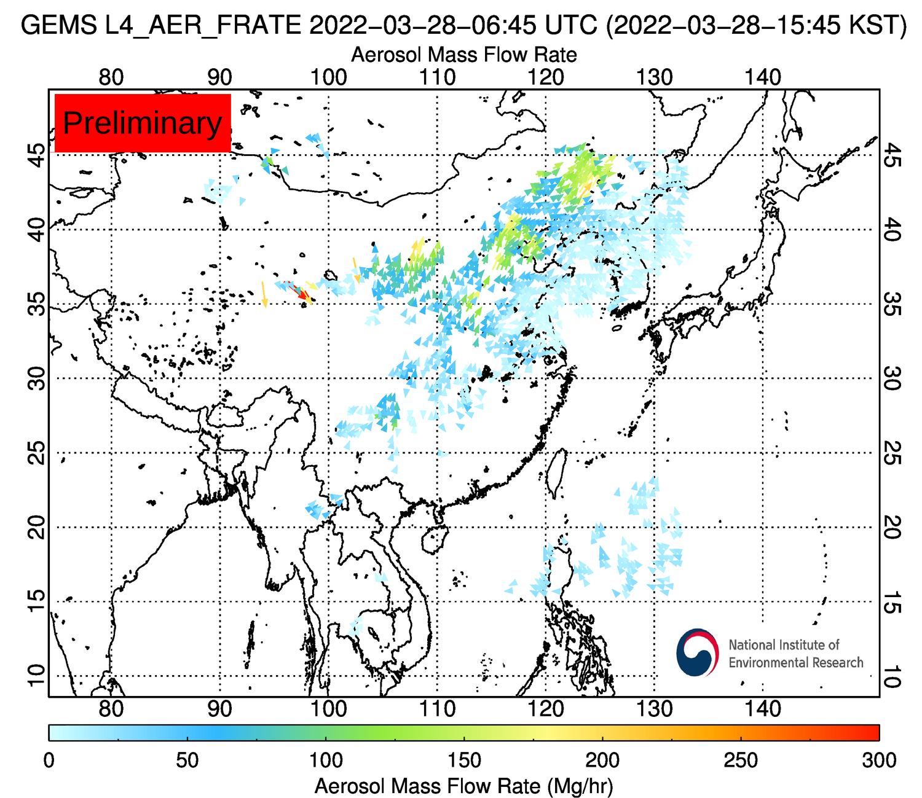
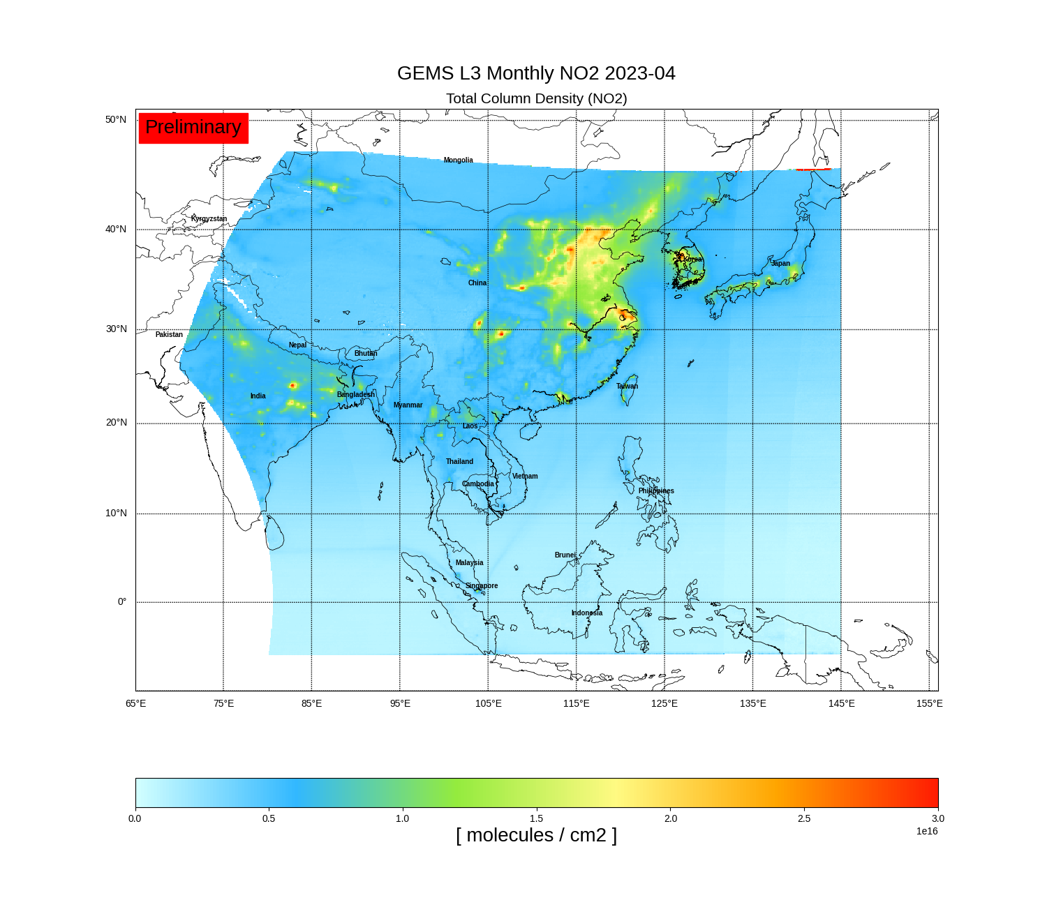
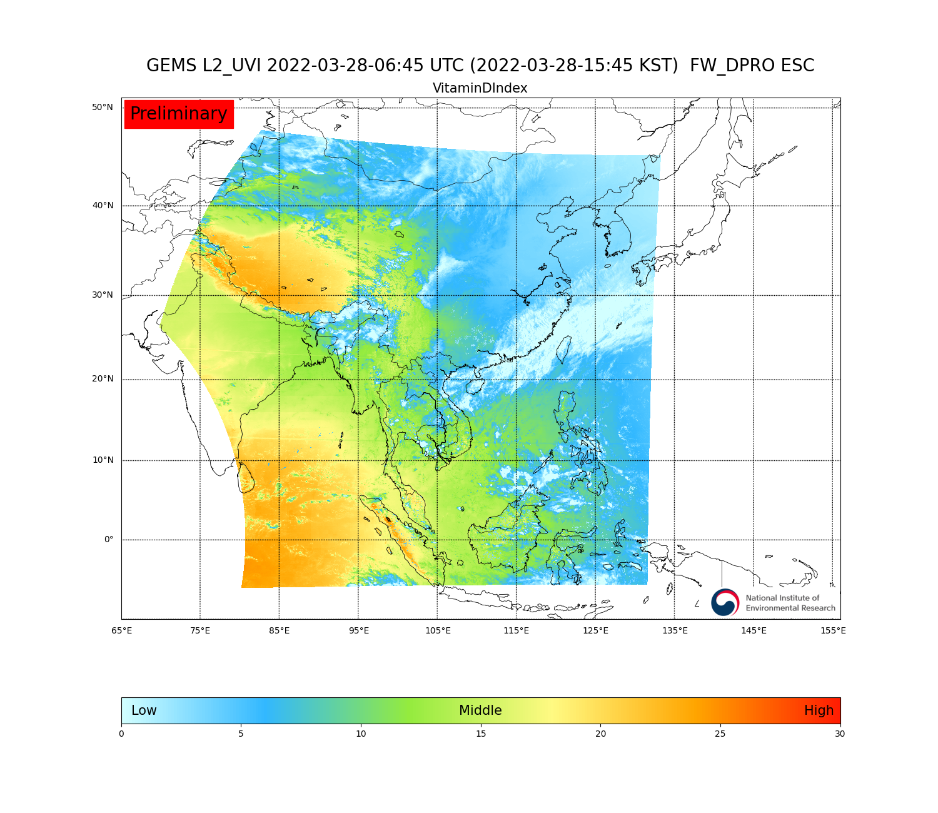
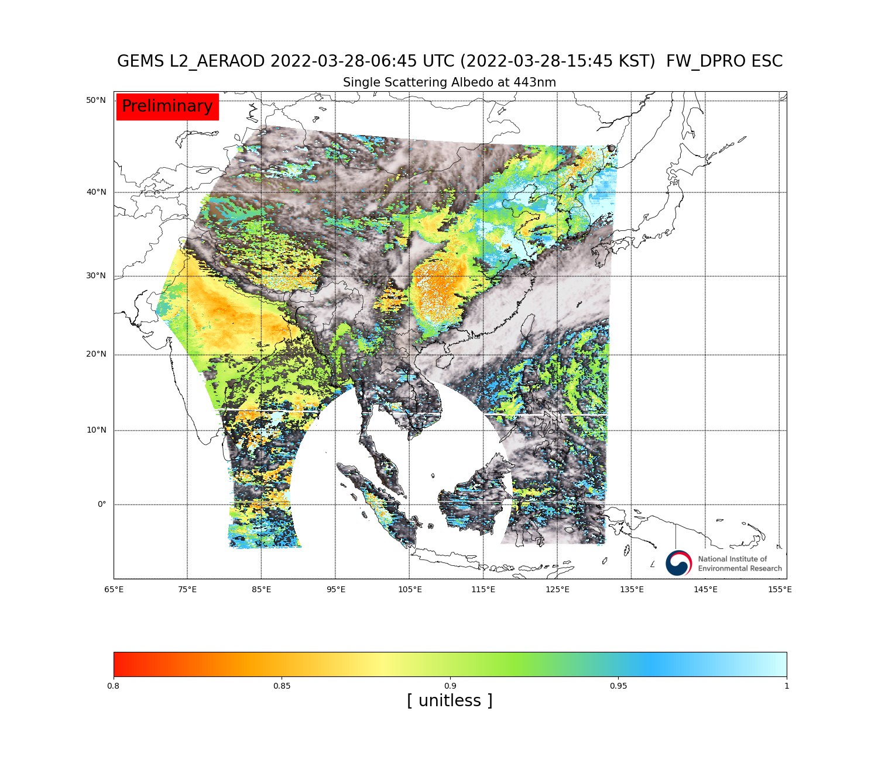
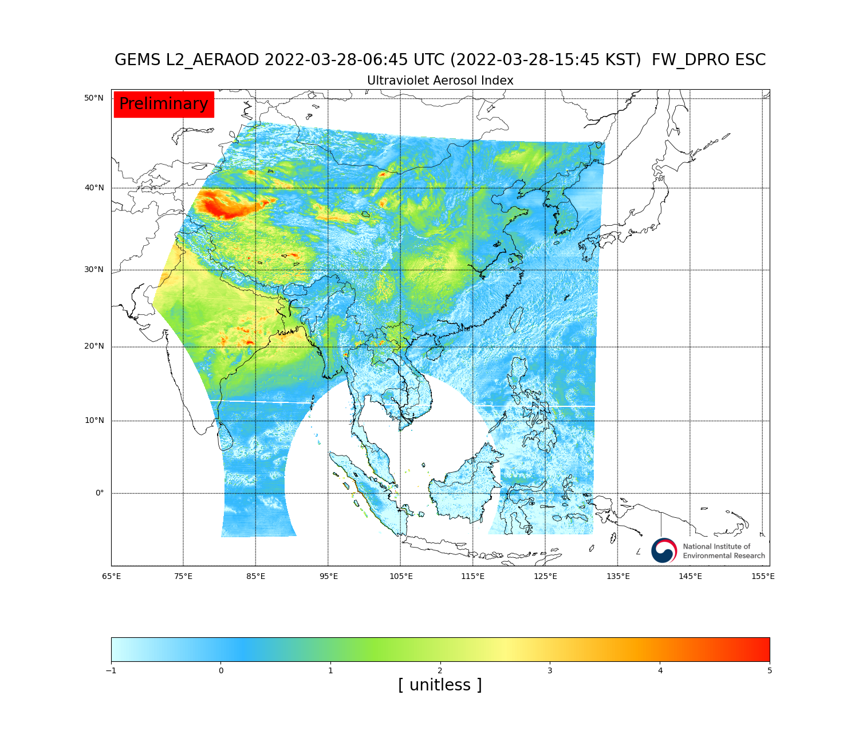
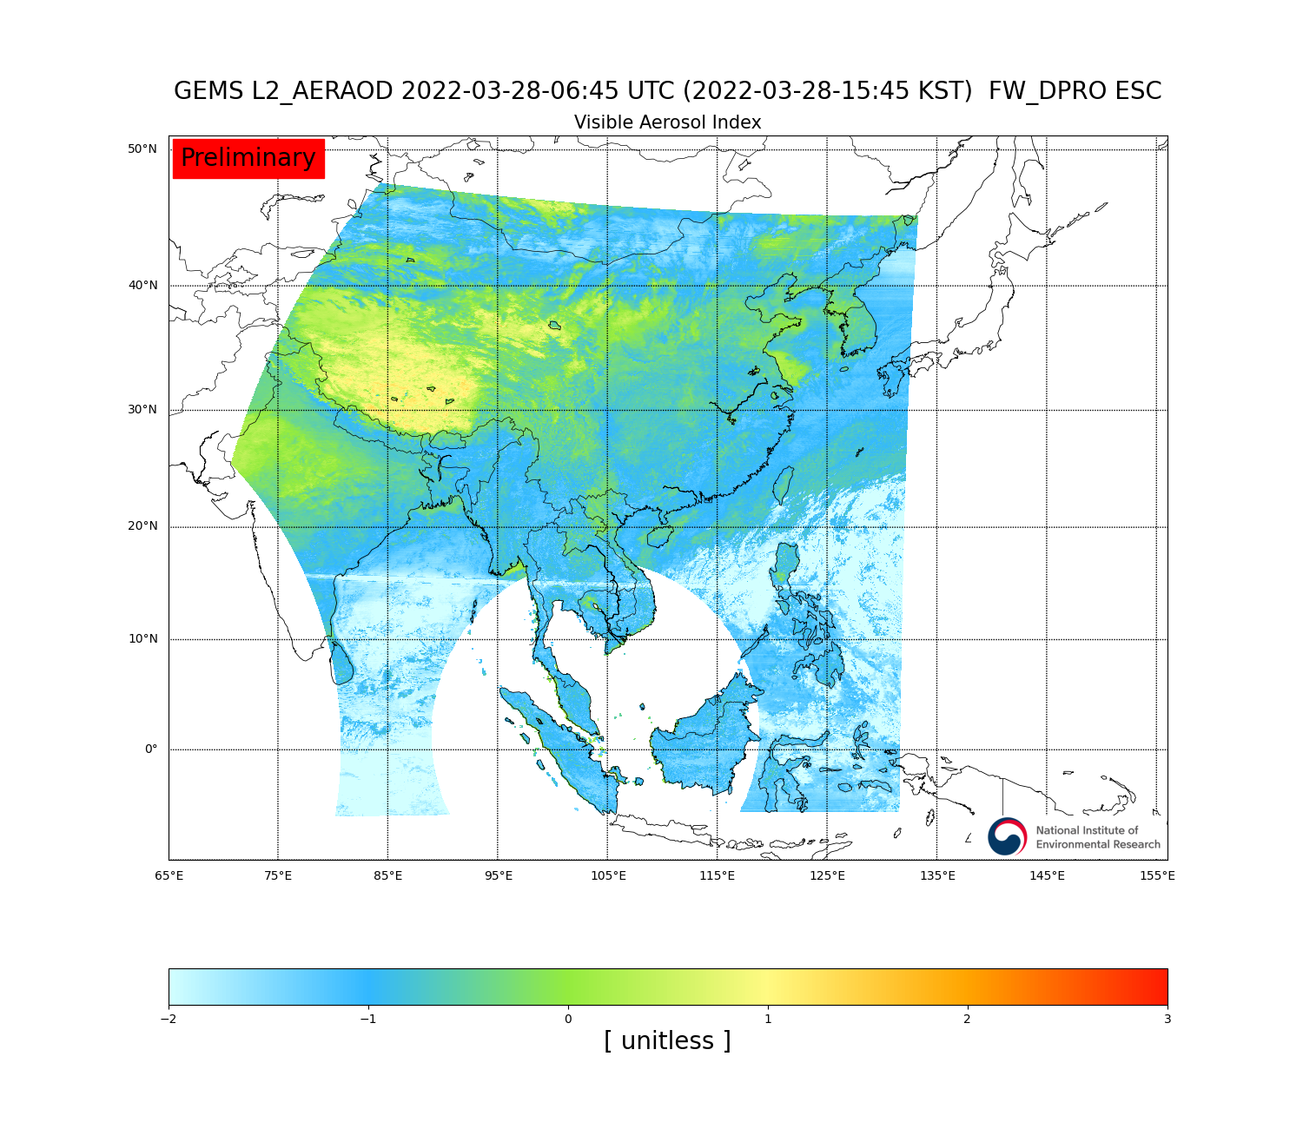
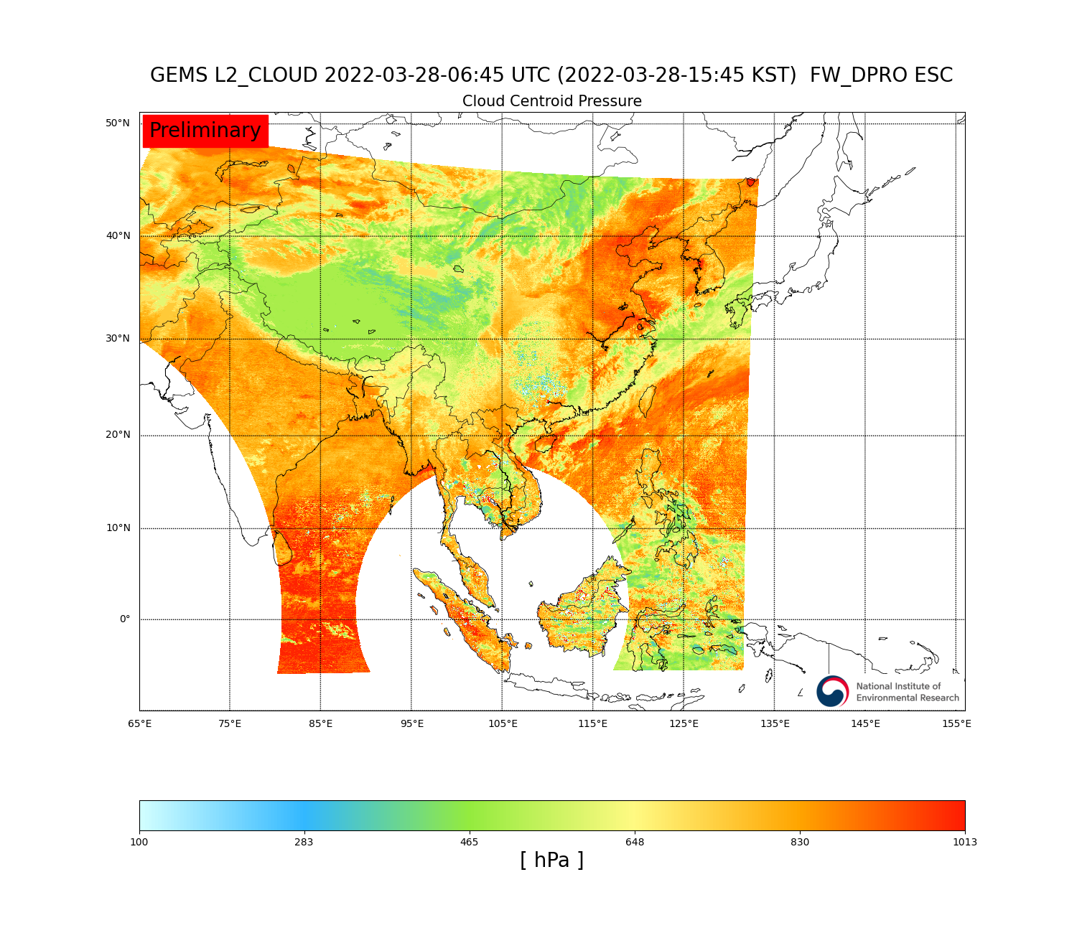

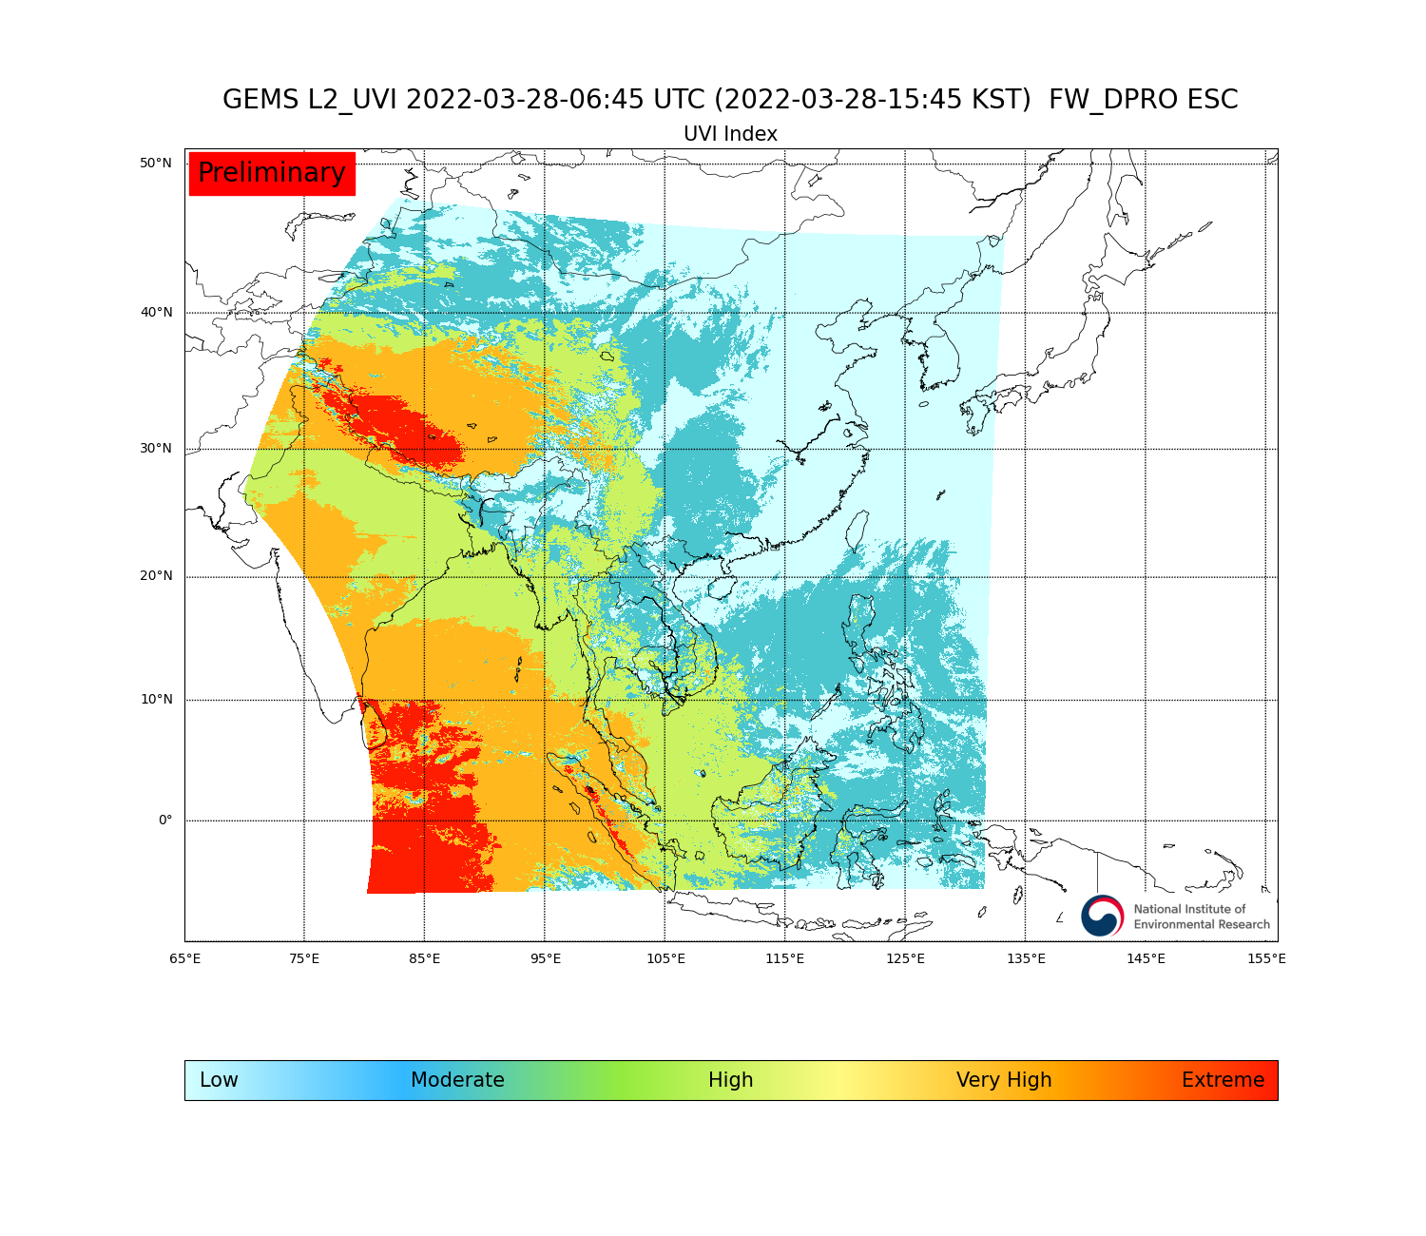
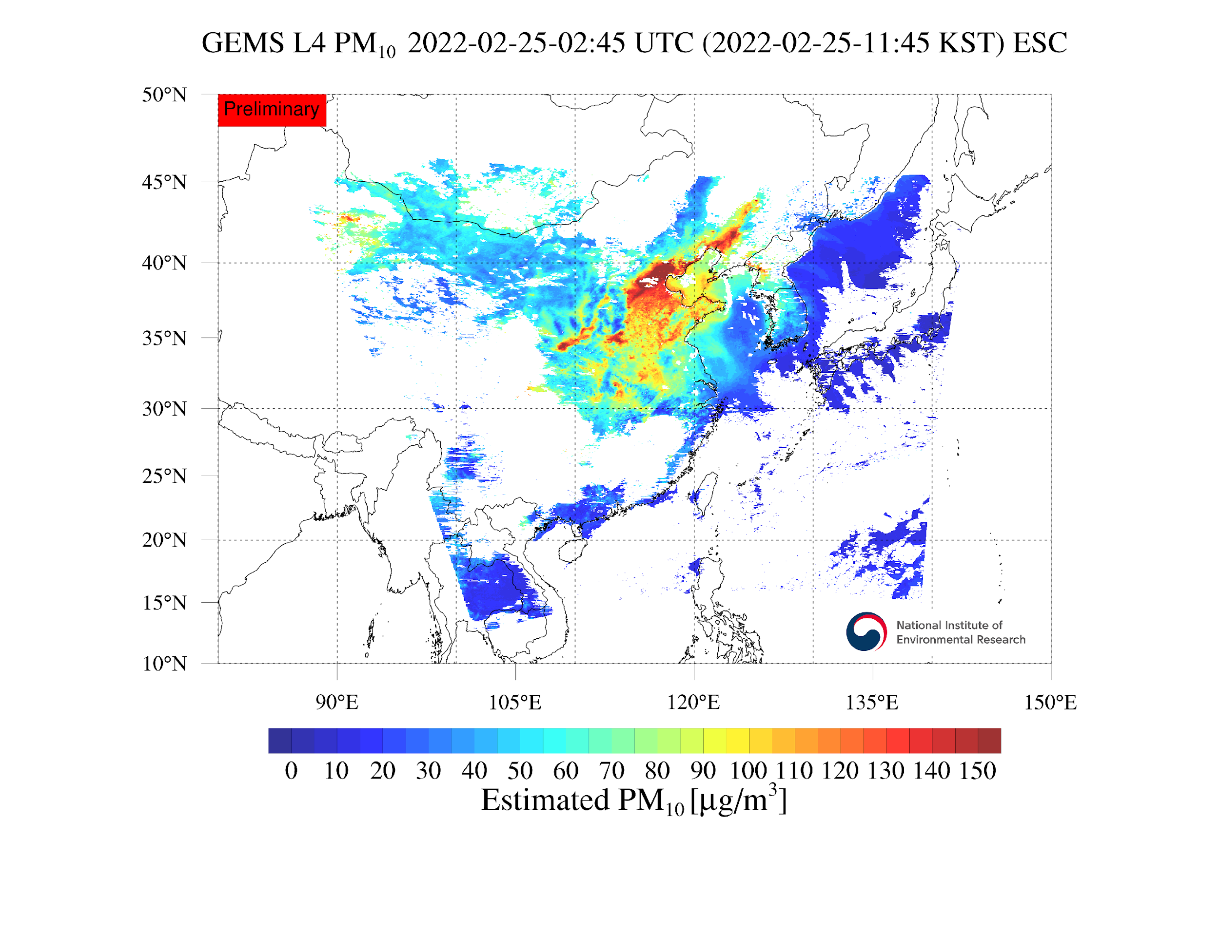
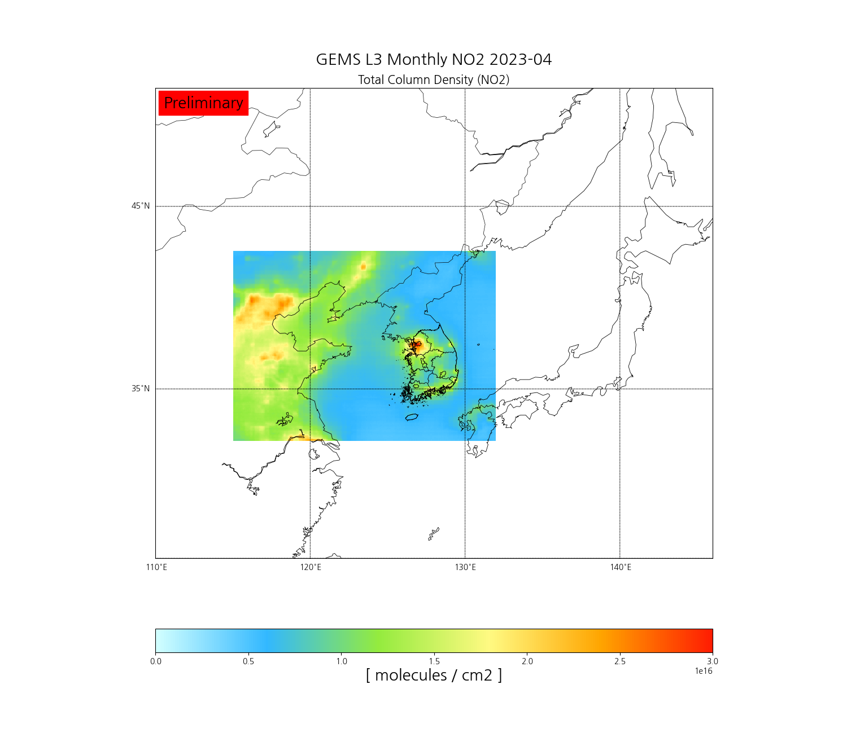
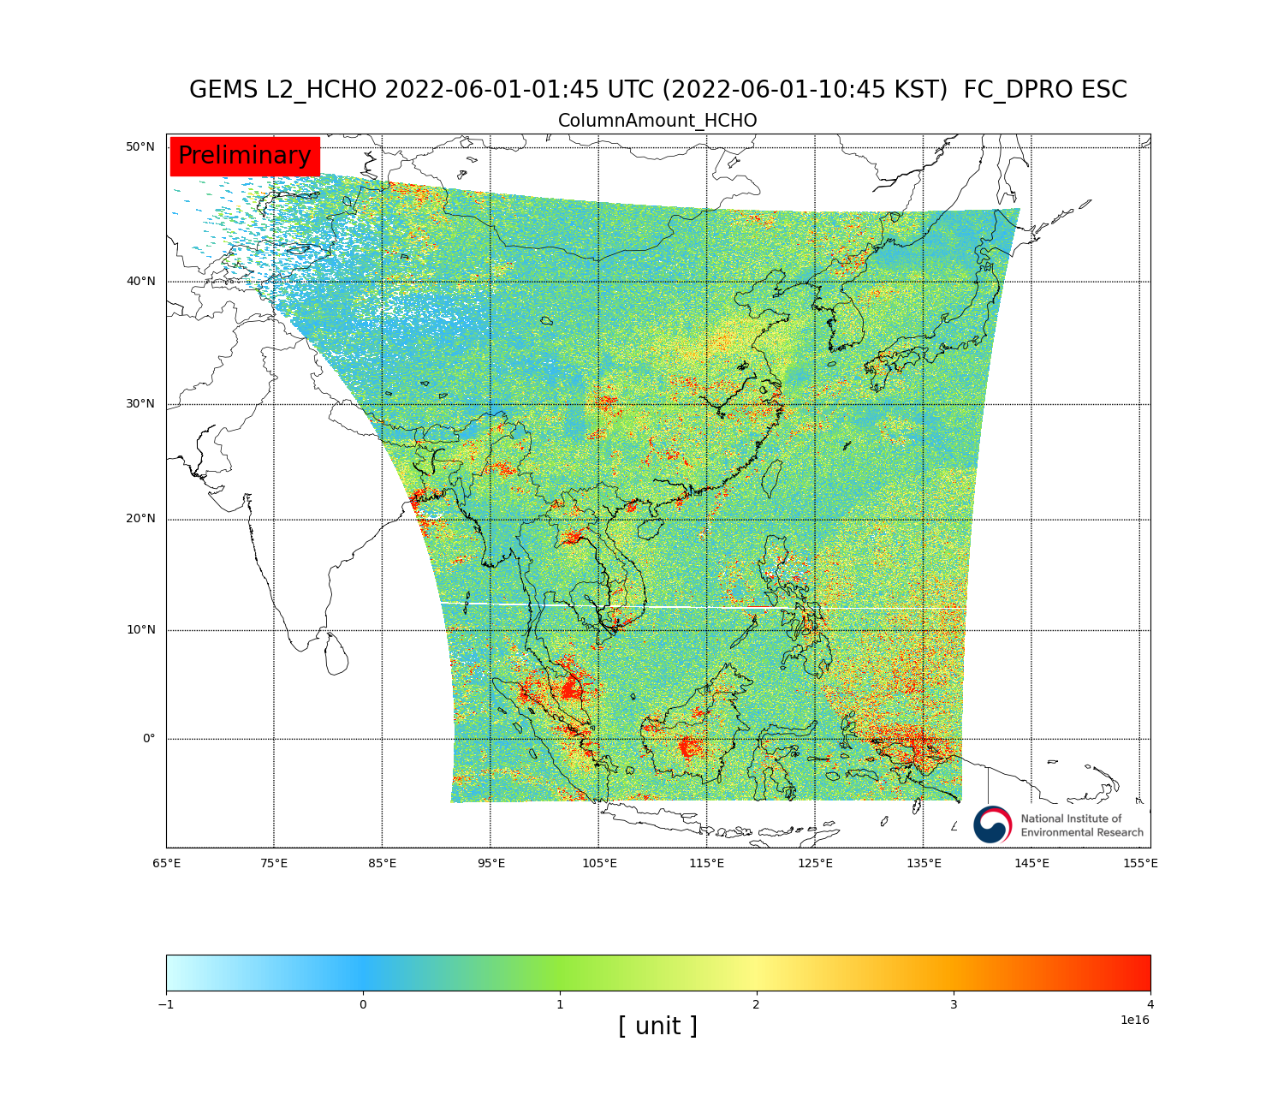
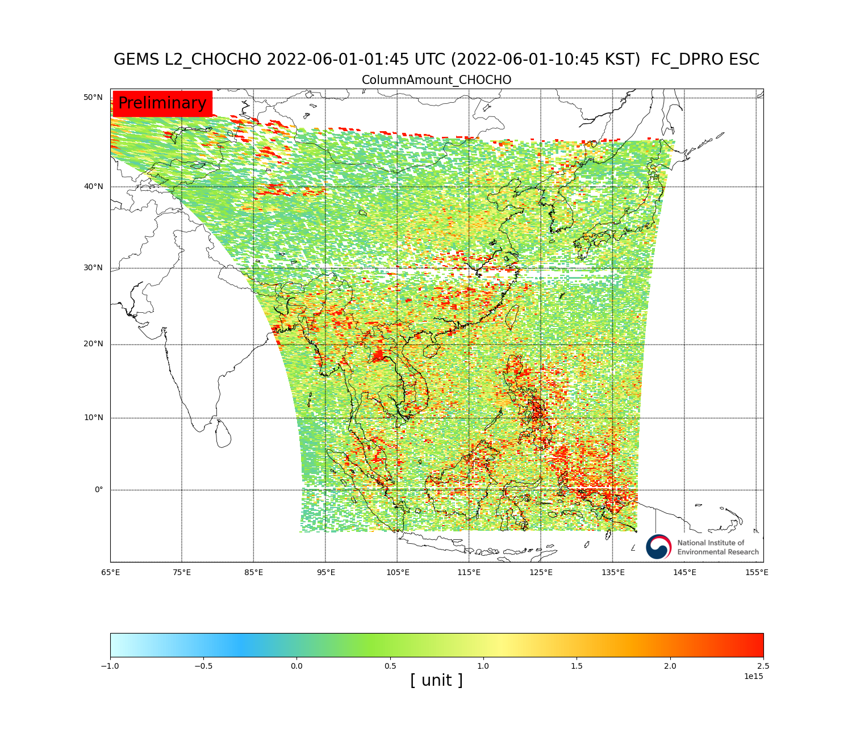
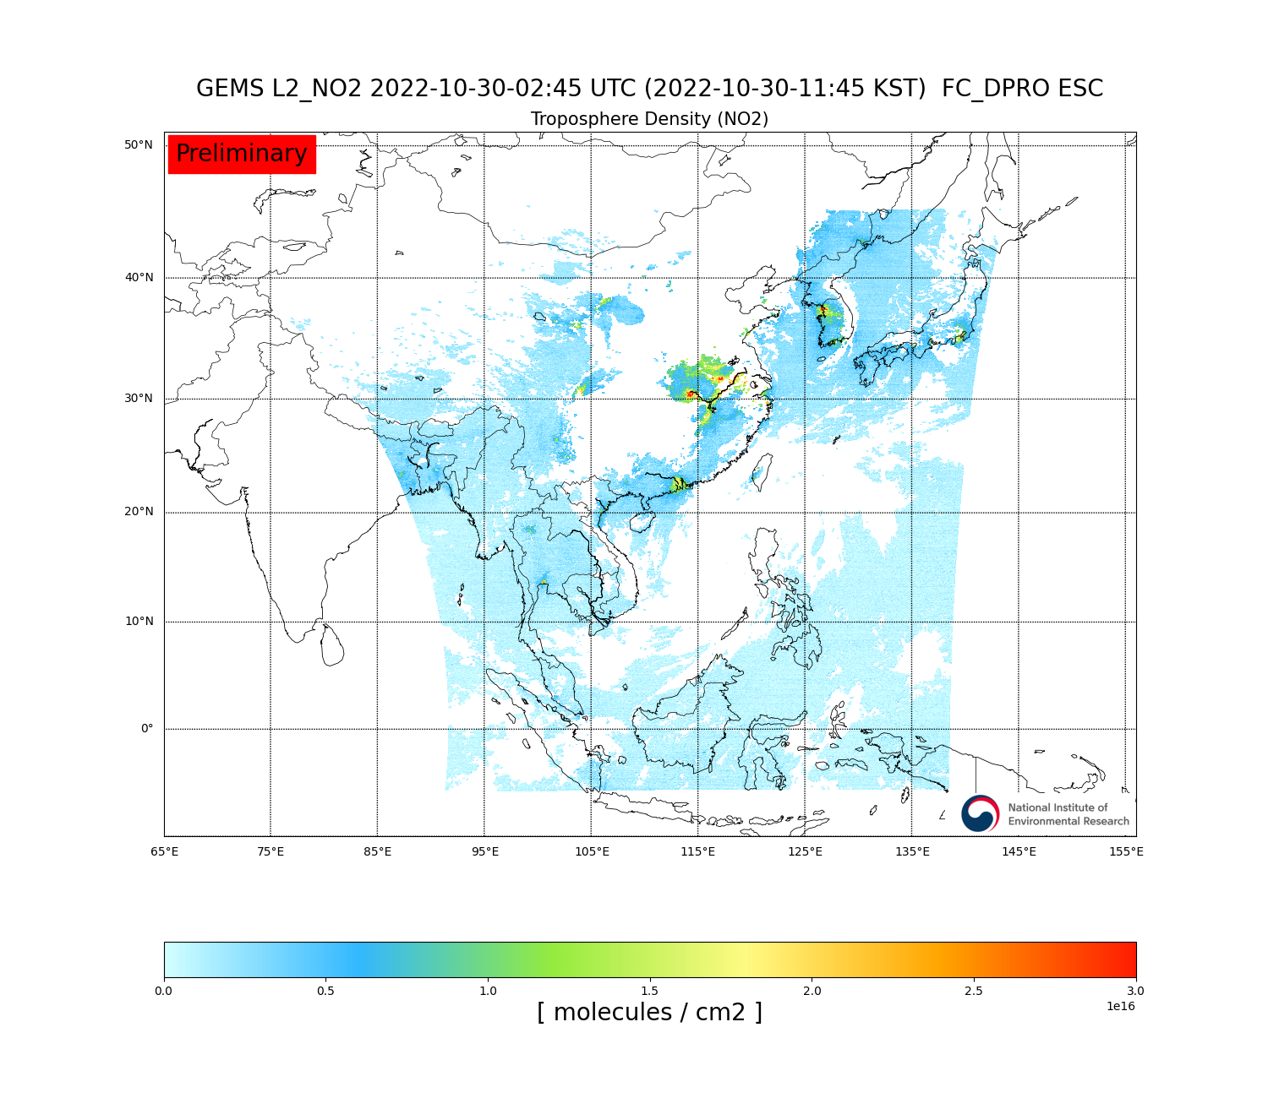
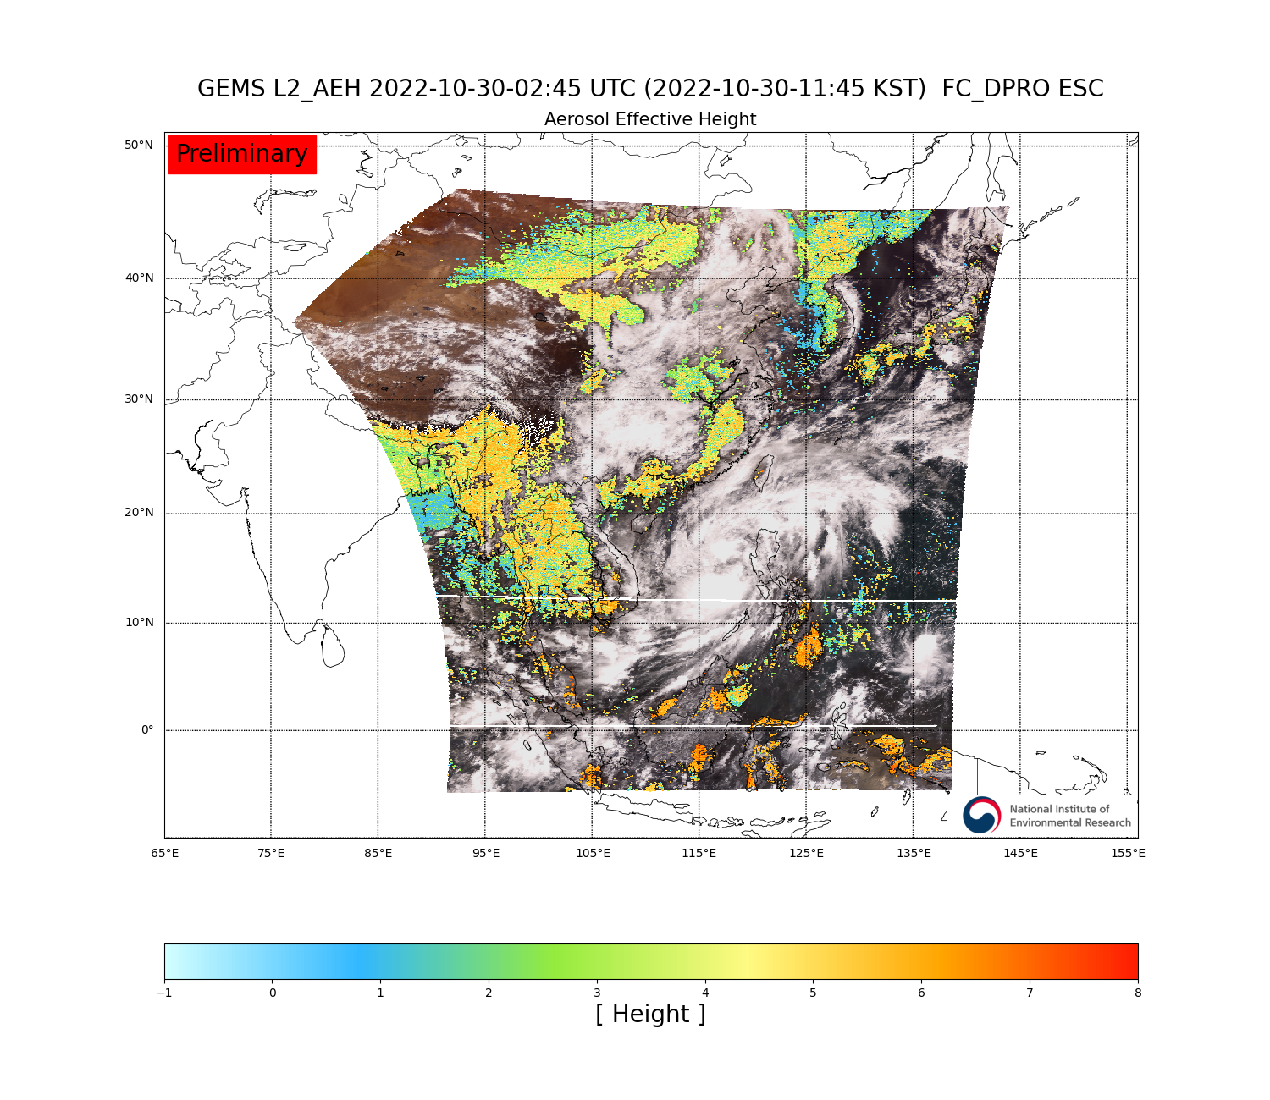
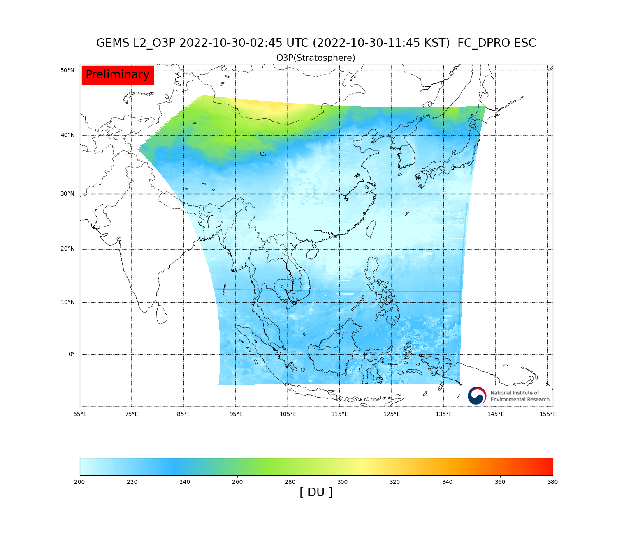
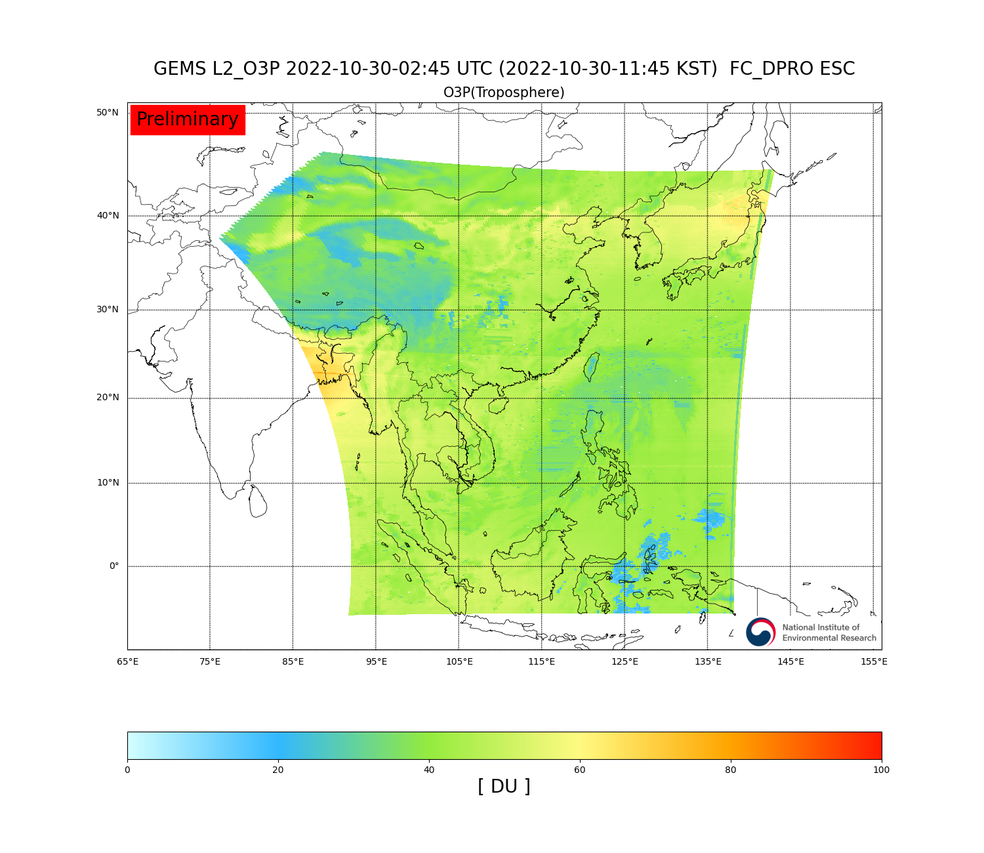
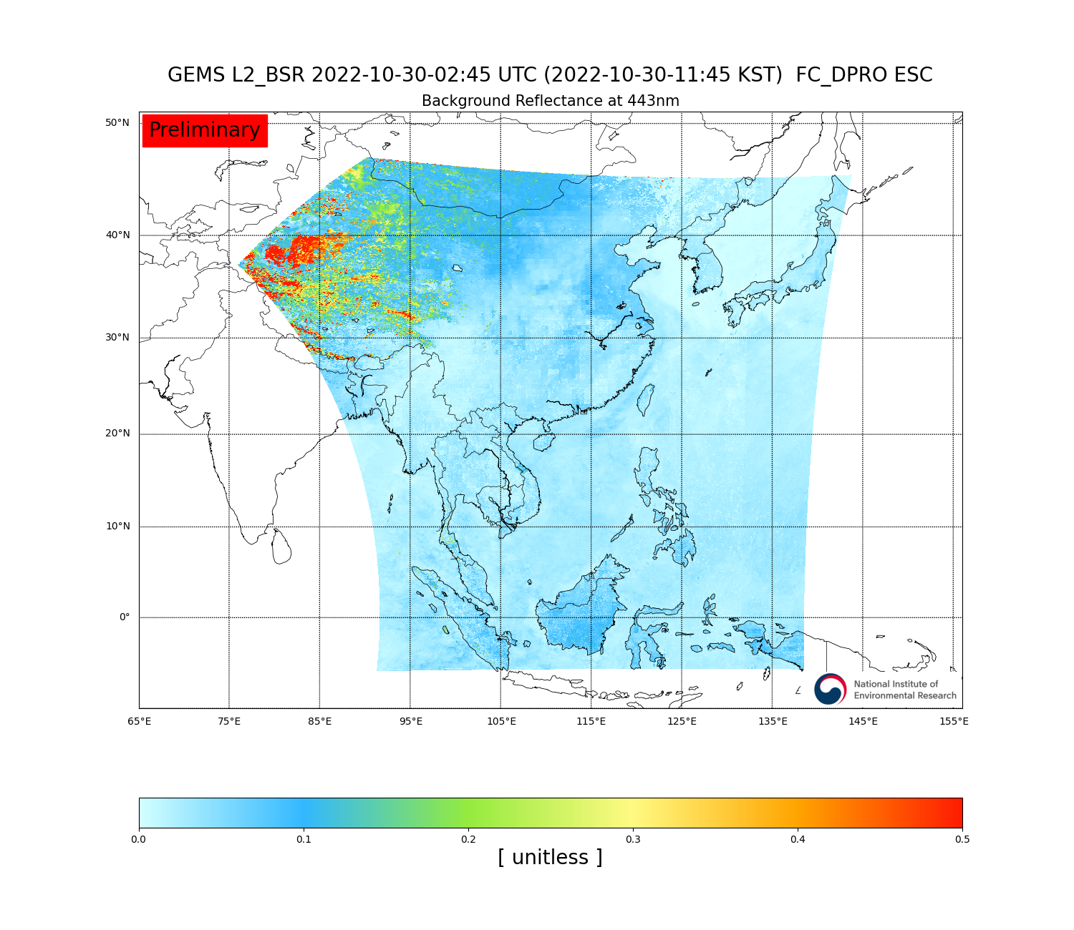
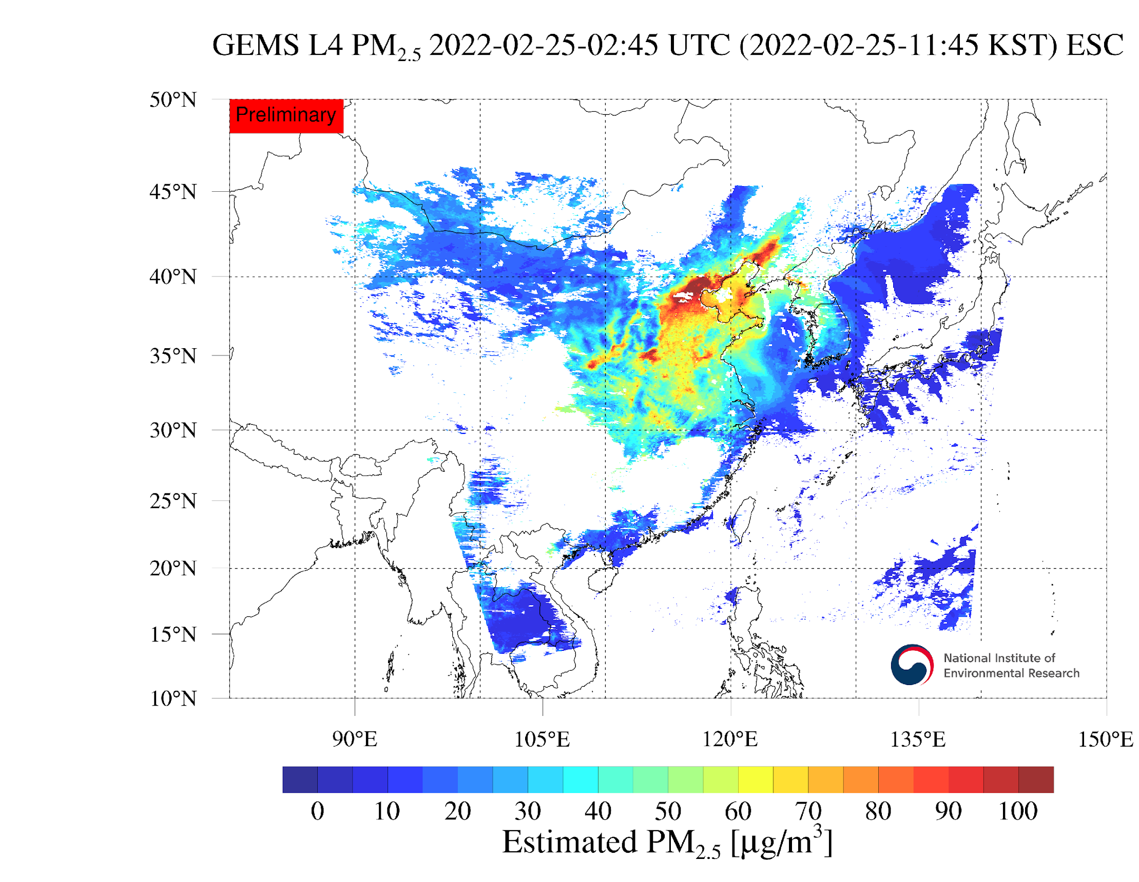
GEMS products
Level2
Level3
Level4
Aerosol optical depth
NO₂
Total ozone
Effective cloud fraction
SO₂
Plant response index
DNA damage index
NO₂ (10km)
Aerosol mass flow rate
Vitamin D index
Single scattering albedo
UV aerosol index
Visible aerosol index
Cloud pressure
Cloud radiance fraction
UV index
PM₁₀ surface conc.
NO₂ (5km)
HCHO
CHOCHO
Tropospheric NO₂
Aerosol Effective Height
Stratospheric ozone
Tropospheric ozone
Surface reflectance
PM_{2.5} surface conc.

Slide 6
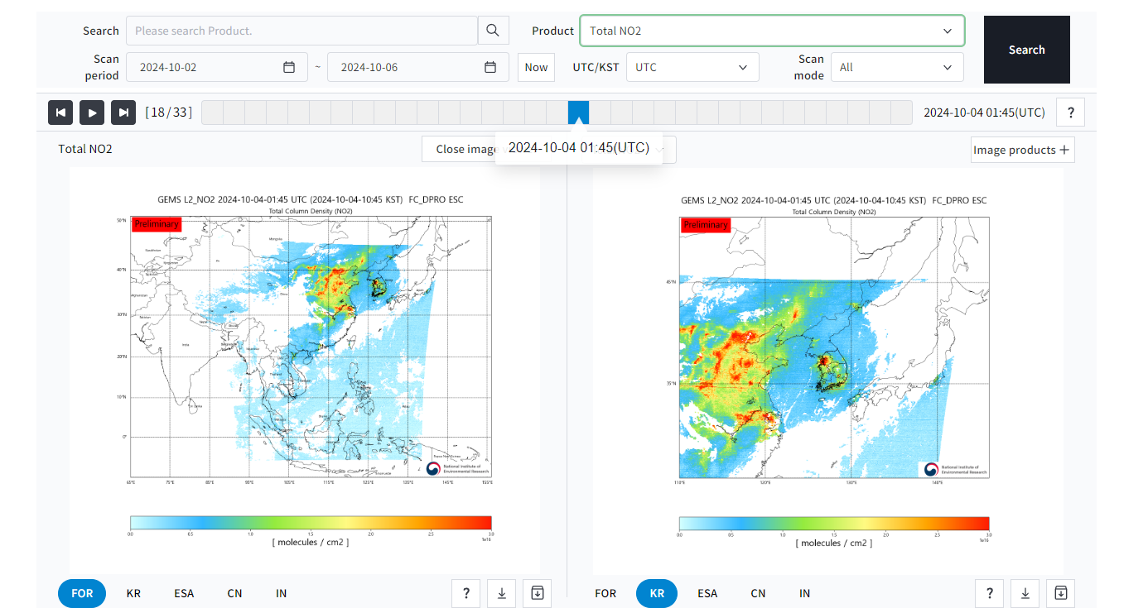
GEMS data distribution
GEMS data distribution (https://nesc.nier.go.kr)

Slide 7
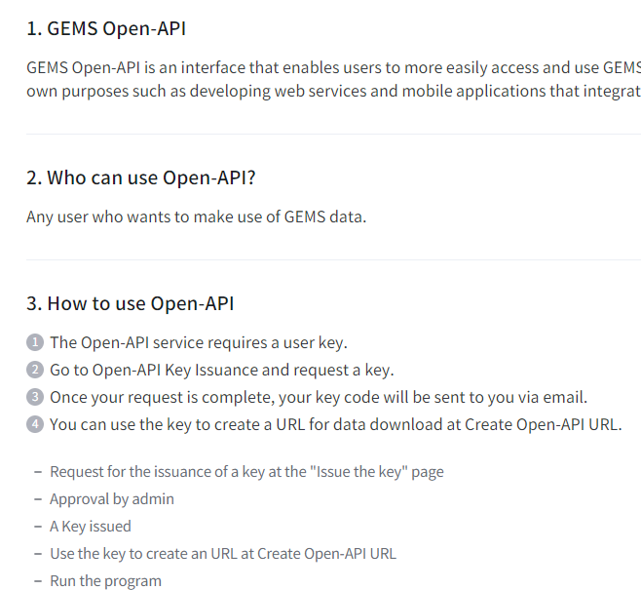
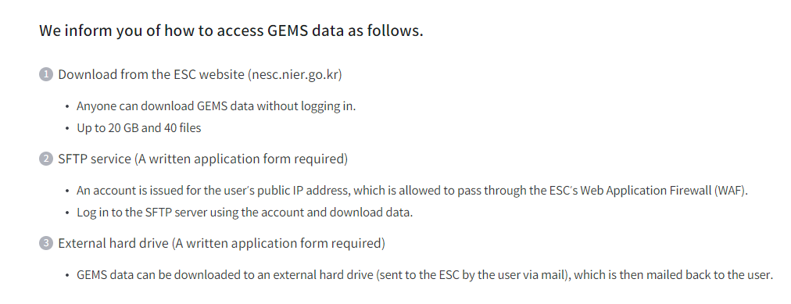
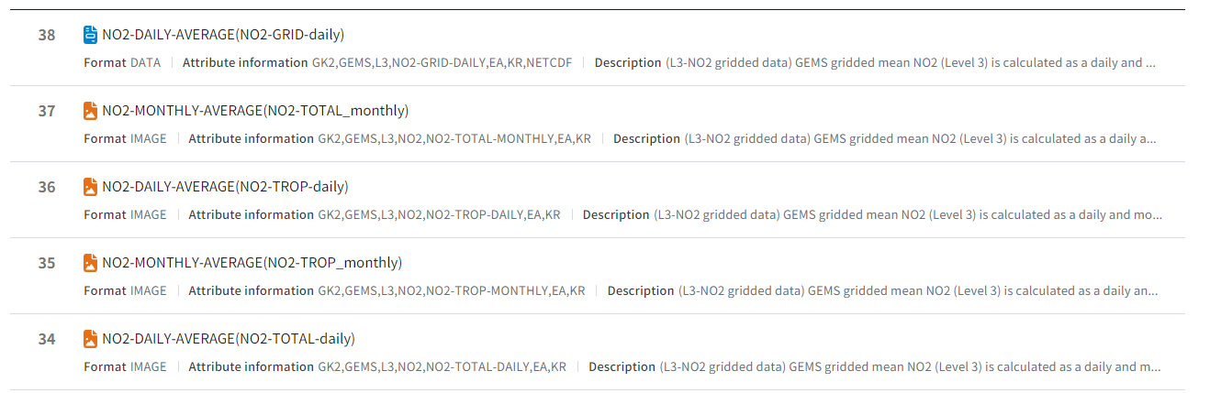
GEMS data distribution
NIER offers three primary methods for accessing GEMS data. Users can download up to 20 GB or 40 files directly from the ESC website (https://nesc.nier.go.kr/) without logging in. For larger data requests, users can apply for an SFTP account, granted upon approval of their public IP address through the Web Application Firewall (WAF) of ESC. Additionally, since June 2023, an OPEN-API service has been available, allowing users to request data by obtaining a key code and generating a URL.

Slide 8
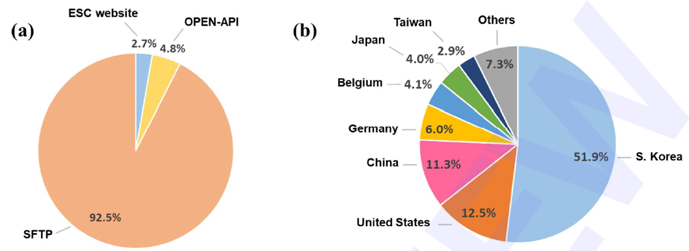
GEMS data distribution
Over the last 18 months from January 2023 to June 2024, more than 5 million GEMS data files have been downloaded by users, with 92.5% of these downloads occurring via the SFTP service.
Among approximately 40 countries accessing GEMS data, the United States, China, and Germany represent the largest users outside of South Korea. This reflects the global interest in GEMS data, applicable to both scientific research and air quality policy-making.

Slide 9
GEMS plan
NIER is preparing to enhance its environmental monitoring capabilities with the launch of a microsatellite constellation for greenhouse gas monitoring. The first satellite is planned for launch in 2027, followed by four more in 2028. These microsatellites, along with the next generation of GEMS, will strengthen the leadership of South Korea in satellite-based air quality monitoring, contributing to global efforts to improve air quality and address climate change.
NIER is preparing Next GEMS (GEMS-II + GOCI-III, 2032~) to succeed GEMS mission. The detailed specification has not been determined as it is still in planning stage, but it is expected that the spatial resolution will be increased and the visible band will be added to existing UV band.

