Slide 1
CEOS Plenary State of Play
Presenter, Organization
Agenda Item 7.1
38th CEOS Plenary
Montreal, Canada
23rd - 24th October, 2024

Slide 2
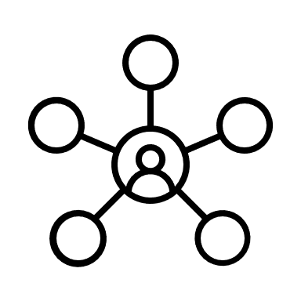
Use of Copernicus Data
1 038 300 Copernicus users
10147 TB of Sentinel data
More than 500 products in service portfolio

Slide 3
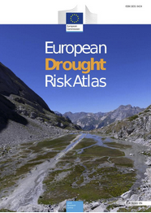
Products (examples)
The State of the Climate in Europe 2023
Copernicus Ocean State Report #8
Global and European land cover data, vegetation indices, ground motion monitoring
‹#›

Slide 4
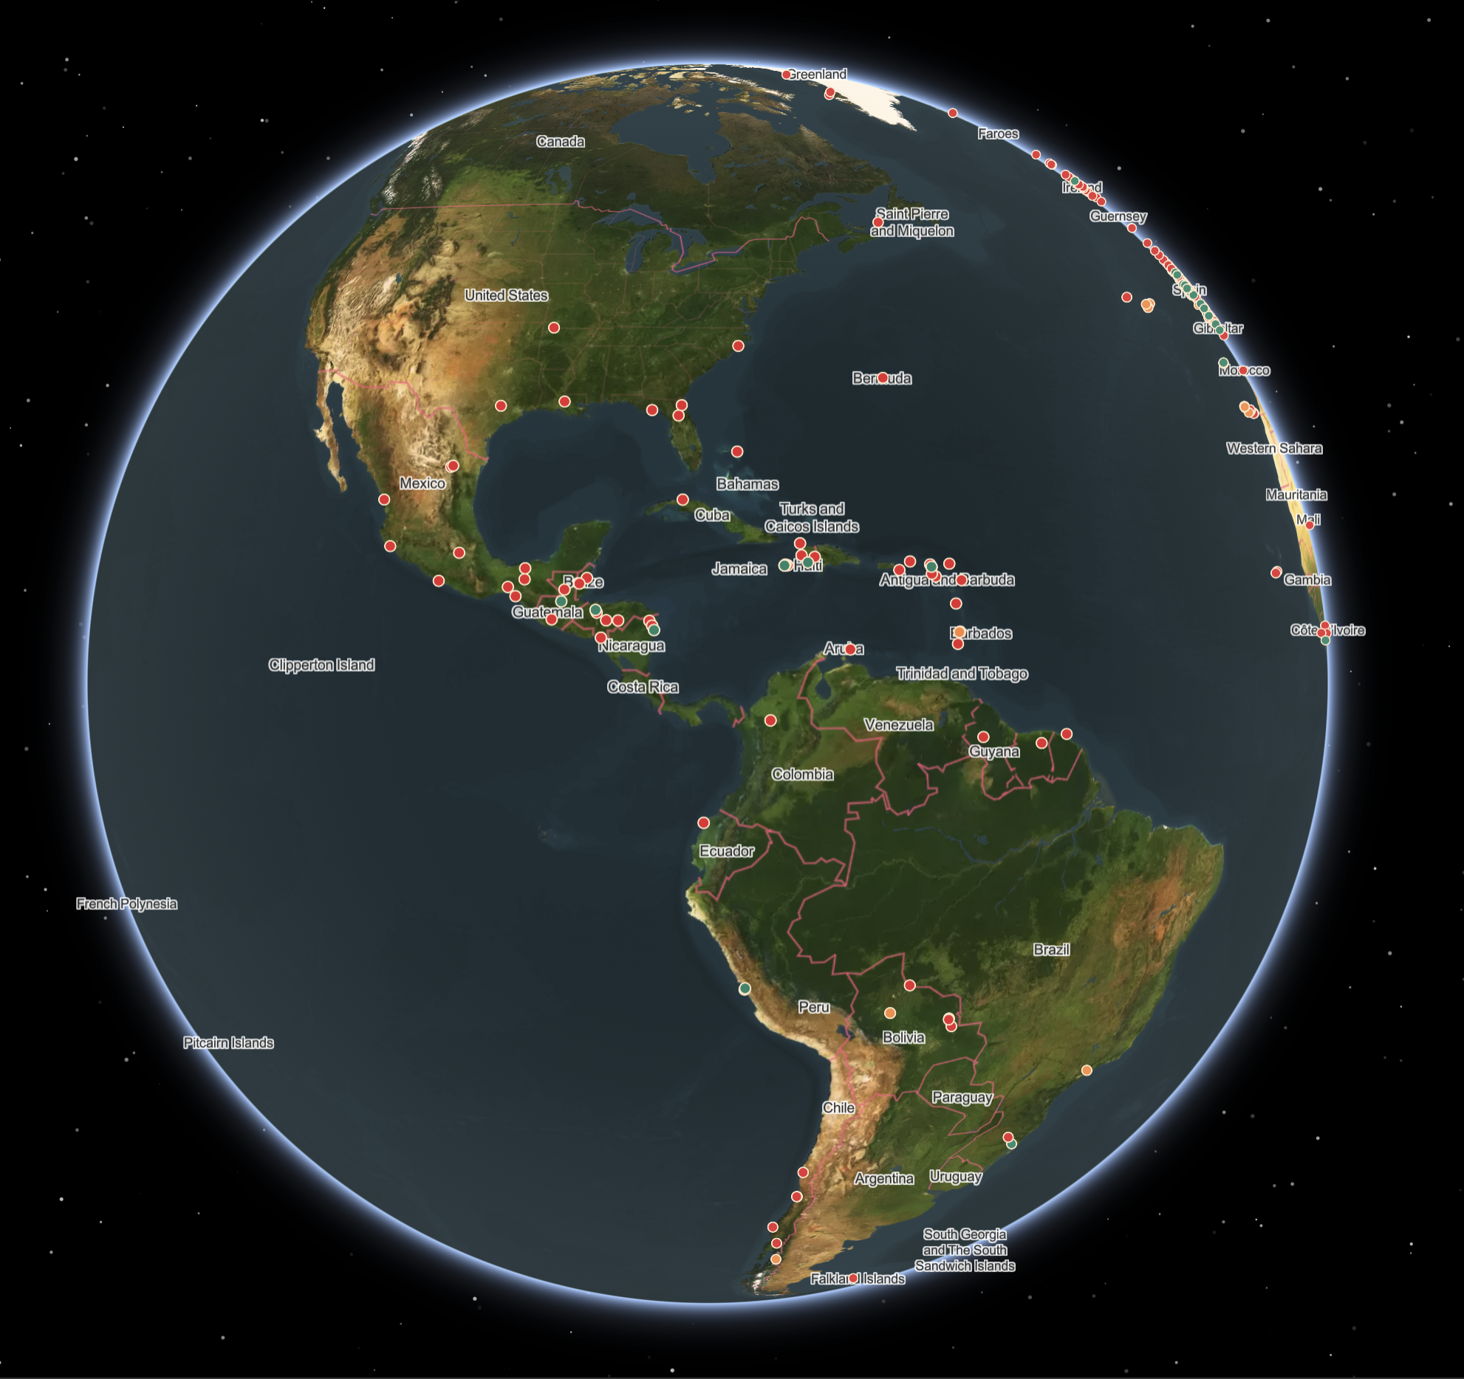
Emergency activations Over the last 12 years
12 years of Copernicus Emergency Management Service on-demand Mapping
976 activations in response to disasters
More than 8000 products released
More than 10000 images analyzed
In more than 130 different countries

Slide 5
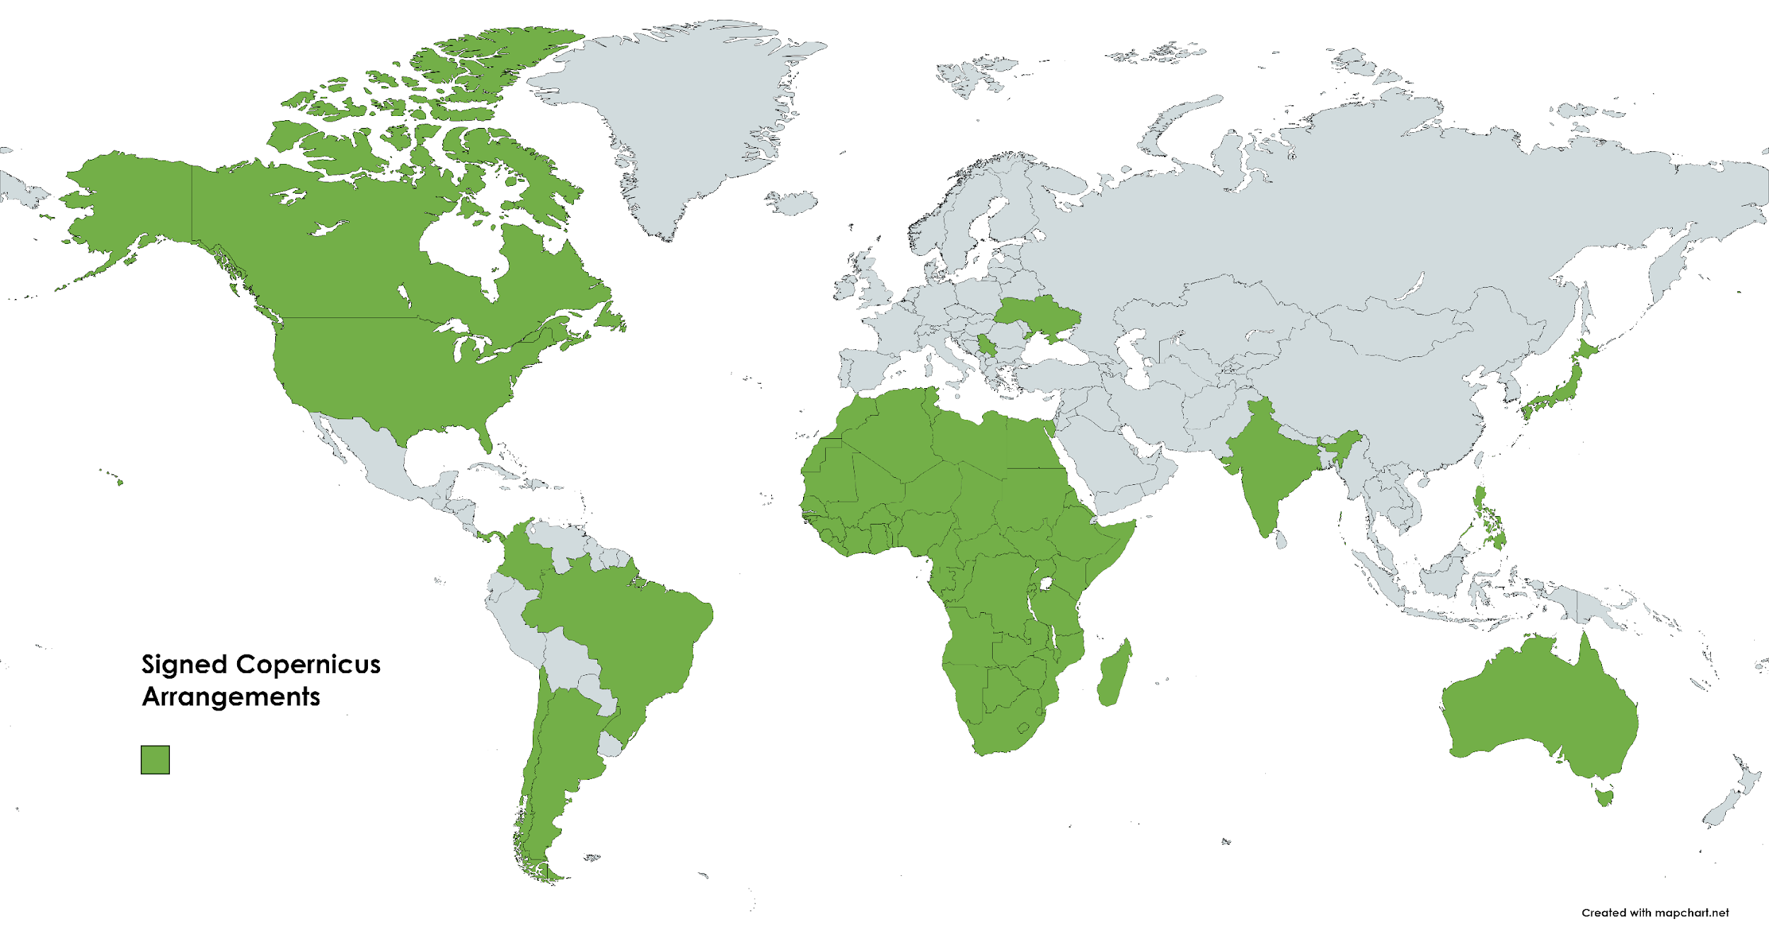
Copernicus Agreements

Slide 6
Copernicus Sentinels 1st gen deployment (tbc)
Sentinel 2C
Sentinel 1C
Sentinel 5A
Sentinel 3C
Sentinel 3D
Sentinel 1D
Sentinel 6B
Sentinel 2D
Sentinel 4B
Sentinel 4A
Sentinel 6C
Sentinel 5B
2024
2025
2026
…
2028
…
2030
2032
2034

Slide 7
Copernicus expansion missions deployment (tbc)
CO2M A
CO2M B
CO2M C
CRISTAL A
CHIME A
CIMR A
LSTM A
ROSE-L A
CRISTAL B
LSTM B
CIMR B
CHIME B
ROSE-L B
2026
2027
2028
2029
2030
2031
2032

Slide 8
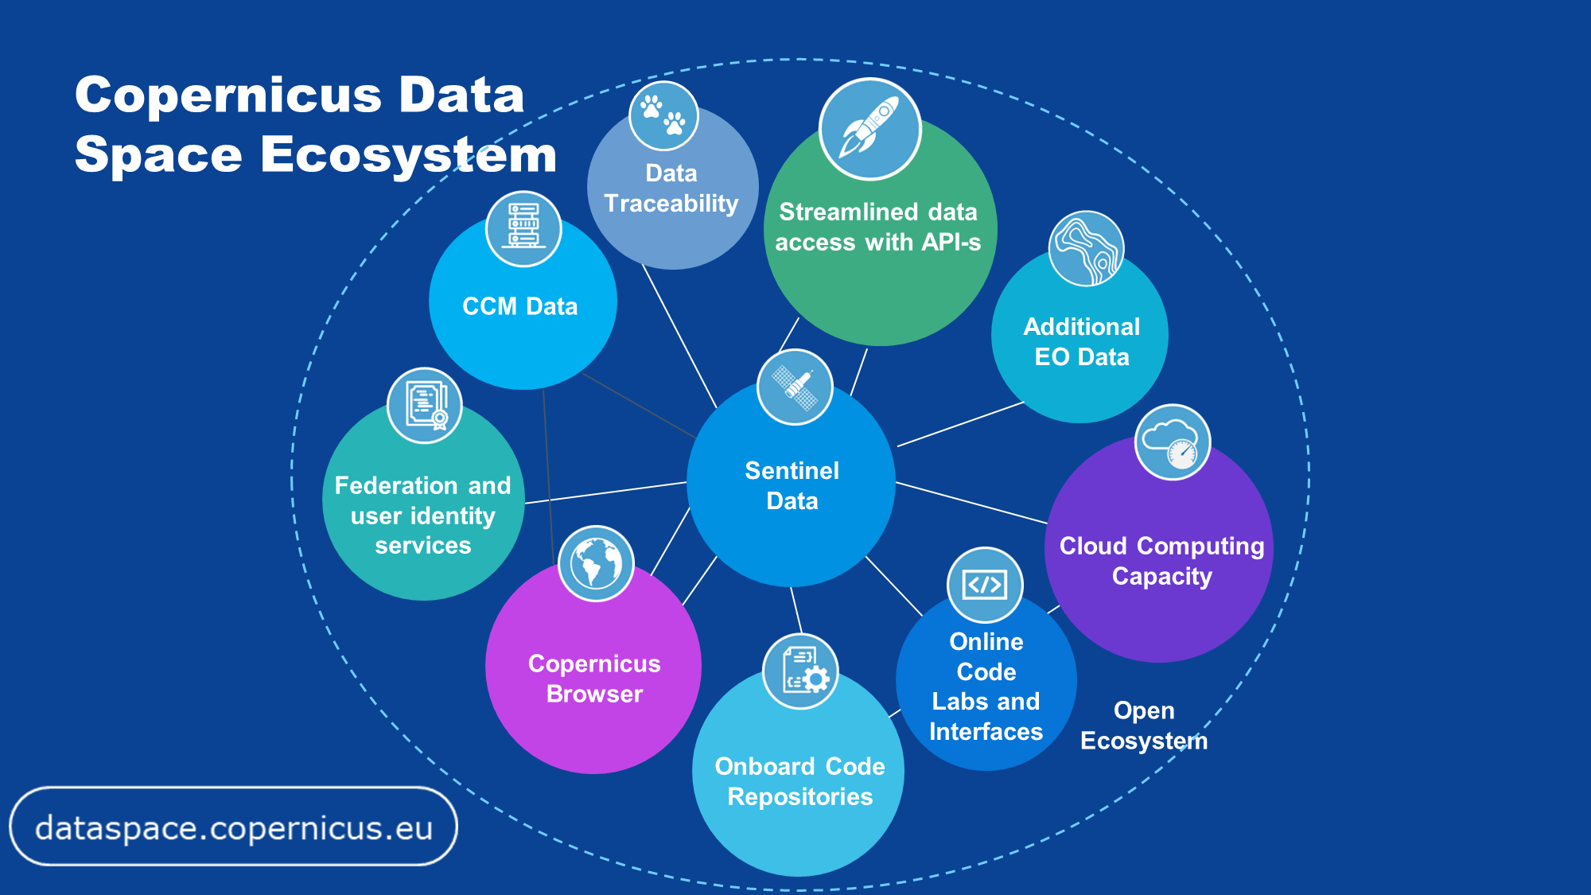
Data distribution
Notes:
The Copernicus Data Space Ecosystem means a significant leap forward in the way users can access and work with Earth observation data.
This service is the largest, immediately available data offer, available for download, streaming and on-demand processing with a wide range of cloud options.
Easy discovery, visualization, download, and analysis of vast amounts of Earth observation data.
Clear access to a set of data processing tools to extract information for a range of applications.
Open offer to provide new downstream services using the resources and interfaces made available.

Slide 9
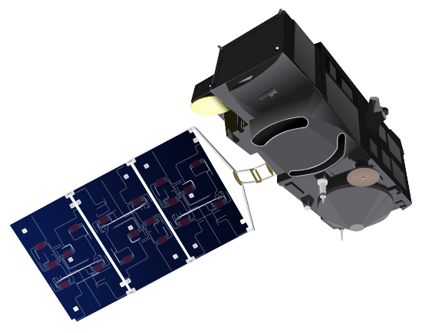
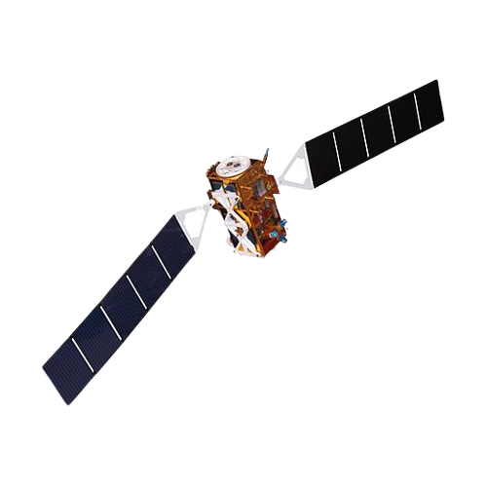
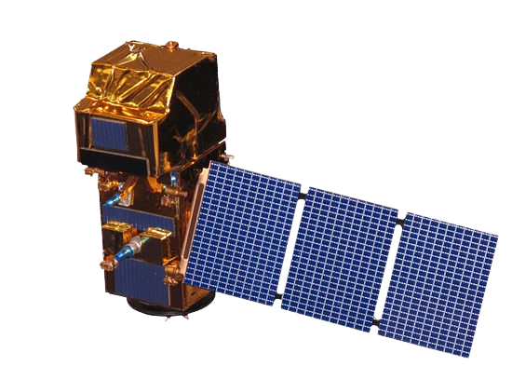
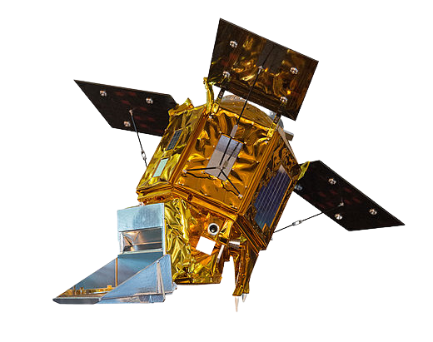
Immediately available data - Sentinels
Sentinel-1
GRD SAFE-COG
GRD SAFE (last year)
OCN
SLC
L0 RAW (Europe full, ROW last year)
Sentinel-2
L1C
L2A
Sentinel-3 Land
OLCI L1/L2 NRT and NTC (NRT last year)
SLSTR L1/L2 NRT and NTC (NRT last year)
SRAL L1/L2 NRT, STC and NTC (STC last month, NRT last year)
SYN L2 STC, NTC (STC last month)
Sentinel-5P
Level-1B NTC
Level-2 NRT and NTC (NRT last month)
If not explicitly stated otherwise, worldwide coverage, full and up-to-date collection
81 PetaBytes of Sentinel data immediately available

Slide 10
Thank you

