Slide 1
CEOS Plenary 2024
ESA Agency report
Eleni Paliouras, ESA
Agenda Item 7.1
38th CEOS Plenary
Montreal, Canada
23rd – 24th October, 2024

Slide 2

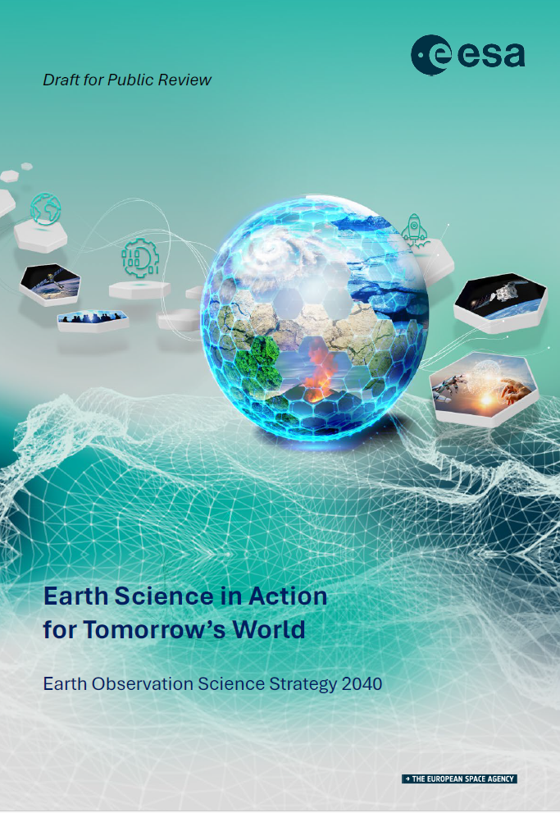
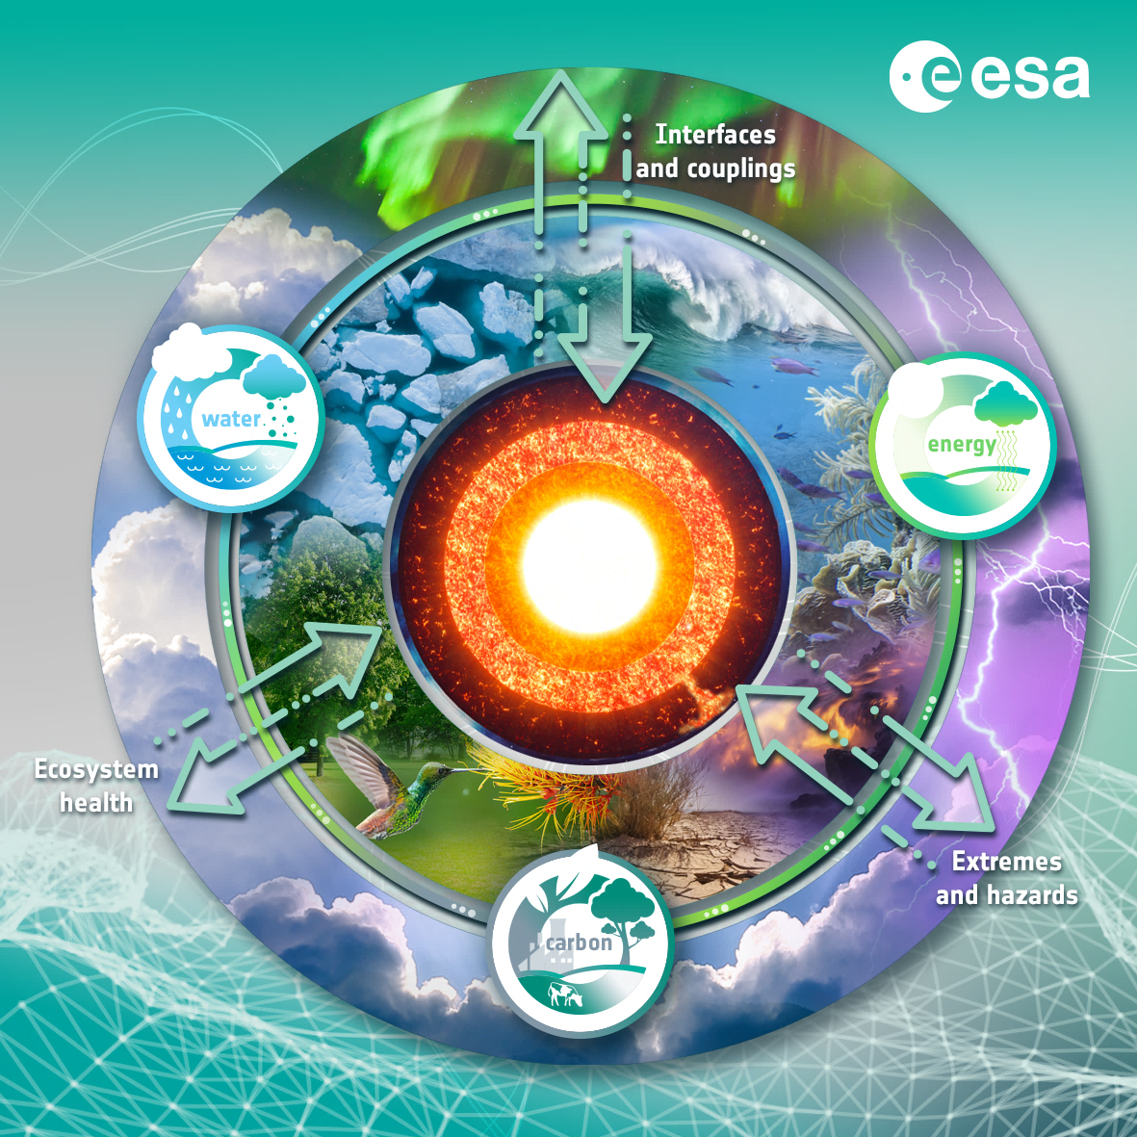
Earth Observation Science Strategy
Frontier Science and Discovery:
a strong foundation
From Science to Benefits:
meeting society’s needs
Reducing critical knowledge gaps:
taking immediate action
Filling critical observation gaps:
preparing for tomorrow starts today
Science Questions and their Relevance to
International Treaties, Agreements & Conventions
‹#›

Slide 3

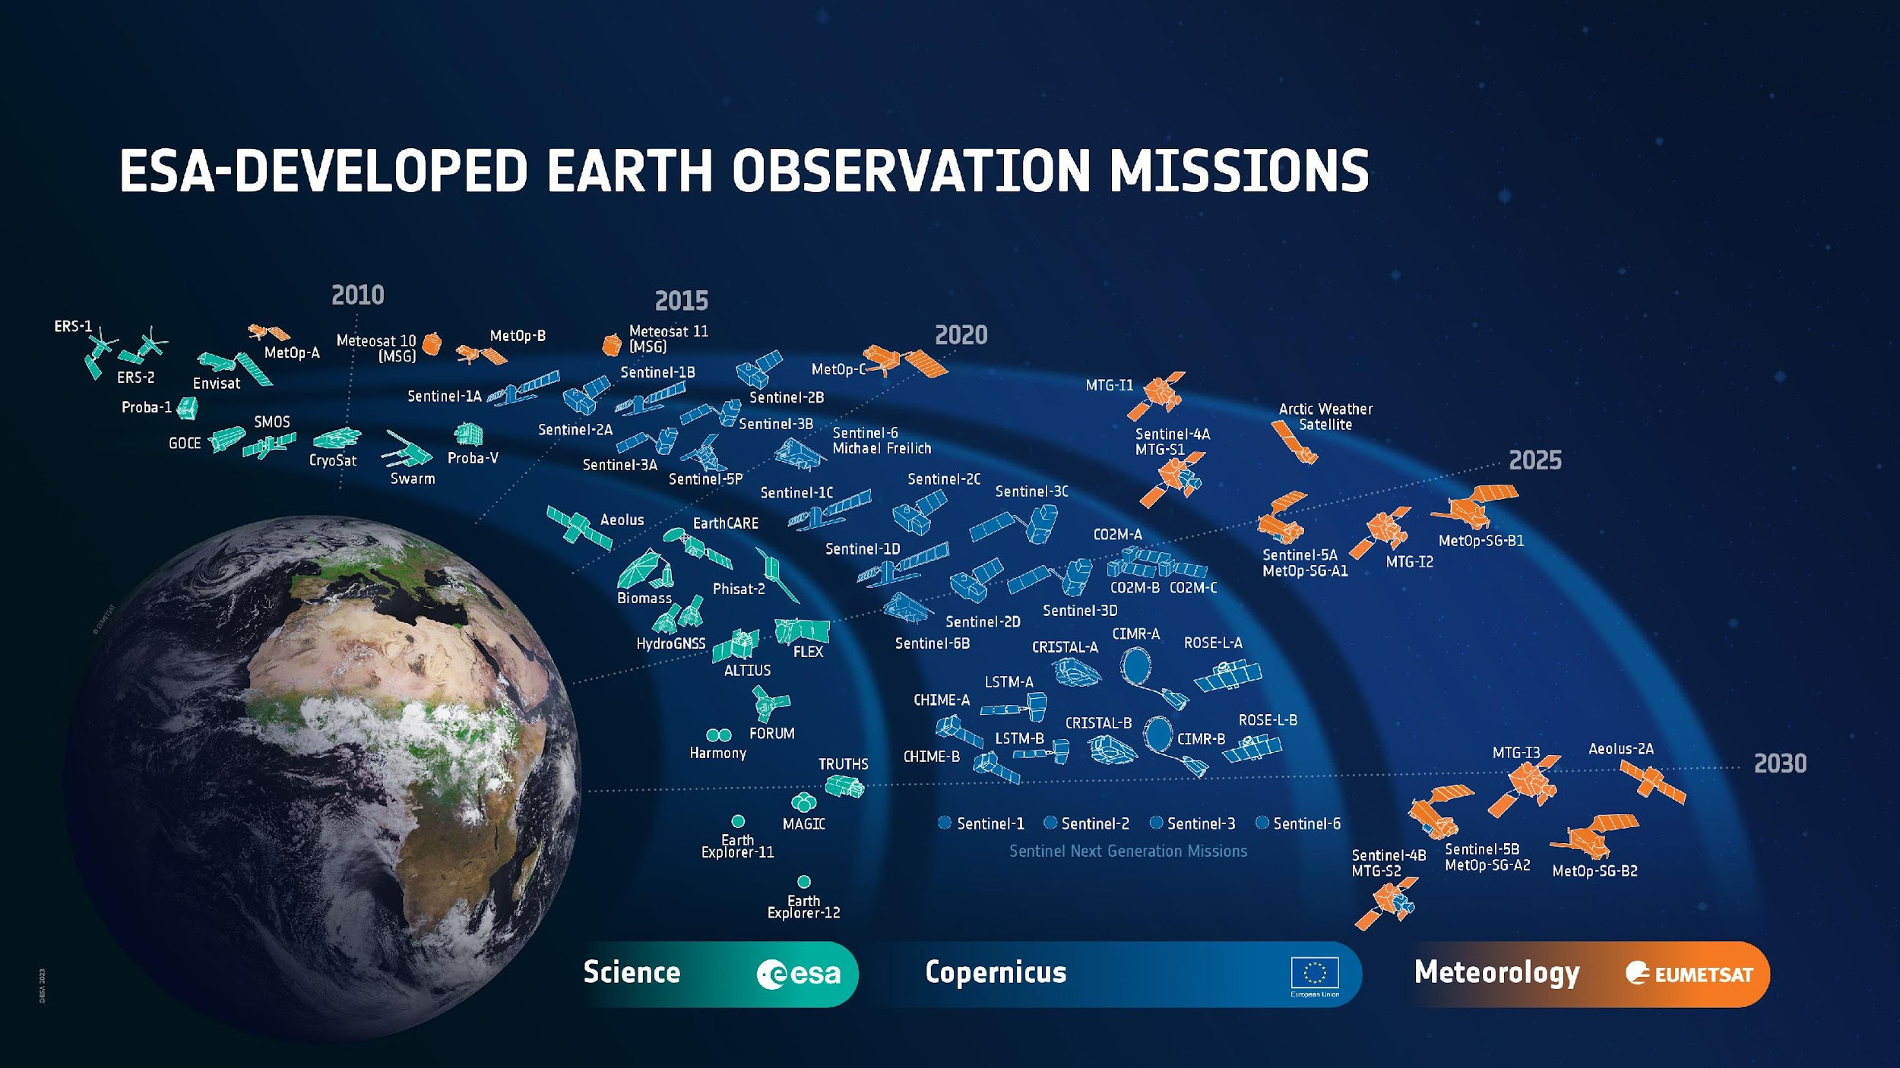
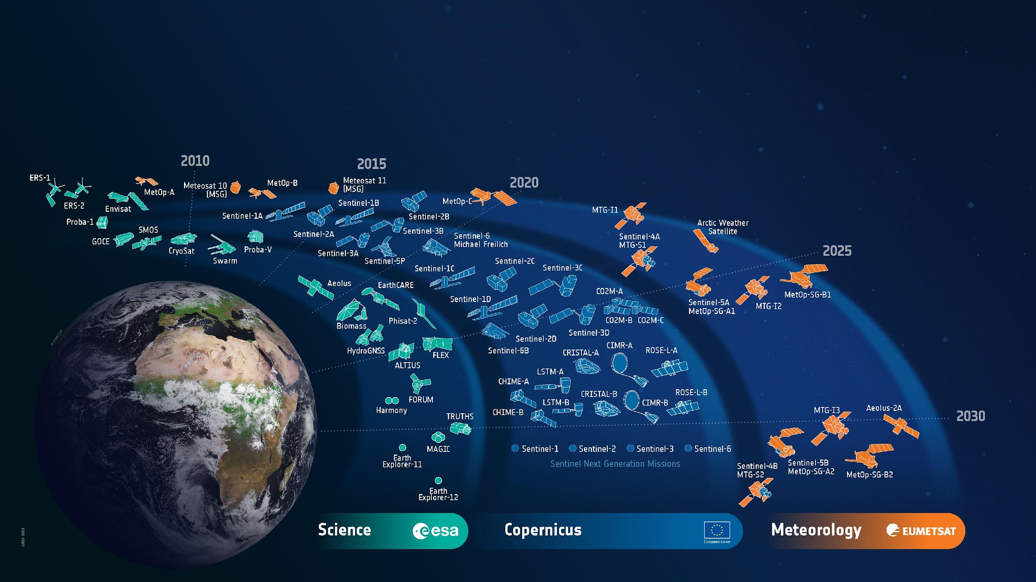

ESA’s Earth Observation Missions
Satellites
Heritage 08
Operational 15
Developing 39
Preparing 18
Total 80
World-class Earth Observation systems developed with European and global partners to address scientific & societal challenges
‹#›
Notes:
HERITAGE MISSIONS
7 Missions/8 Satellites:
Earth Explorers+ (5M/6S)
1 GOCE
1 Aeolus
2 ERS (ERS-1/2)
1 Envisat
1 Proba-1
Earth Watch (1M/1S)
1 Proba-V
Sentinels (1M/1S)
1 Sentinel-1 (S1-B)
Met Missions (2M/8S) (EUMETSAT managed so not counted in total)
7 Meteosat (#1-7)
1 Meteosat SG (#8)
OPERATIONAL MISSIONS
10 Missions (15 satellites):
Earth Explorers+ (5M/7S)
1 SMOS
1 CryoSat
3 Swarm
1 EarthCARE
1 PhiSat-2
Earth Watch (0M/0S)
0
Sentinels (5M/8S)
1 Sentinel-1 (S-1A)
3 Sentinel-2 (S-2A/2B/2C)
2 Sentinel-3 (S-3A/3B)
1 Sentinel-5P
1 Sentinel-6 (S-6A)
Met Missions (4M/8S) (EUMETSAT managed so not counted in total)
3 Meteosat SG (#9-11)
1 Arctic Weather Satellite
1 Meteosat TG (MTG-I1)
3 MetOp (A/B/C)
MISSIONS IN DEVELOPMENT
23 Missions (39 satellites):
Earth Explorers+ (5M/6S)
1 Biomass
1 Flex
1 Forum
1 Harmony
2 Scout-2 (HydroGNSS)
Earth Watch (2M/2S)
1 TRUTHS
1 ALTIUS
Sentinels (12M/23S)
2 Sentinel-1 (S-1C/1D)
1 Sentinel-2 (S-2D)
2 Sentinel-3 (S-3C/3D)
2 Sentinel-4 (S-4A/4B)
3 Sentinel-5 (S-5A/5B/5C)
1 Sentinel-6 (S-6B)
2 CO2M (A/B)
2 CRISTAL (A/B)
2 CIMR (A/B)
2 LST (A/B)
2 CHIME (A/B)
2 ROSE-L (A/B)
Met Missions (4M/8S)
1 Aeolus-2
3 Meteosat TG-I (MTG-I2/3/4)
2 Meteosat TG-S (MTG-S1/2)
2 MetOp SG (A1/B1)
MISSIONS IN PREPARATION
8 Missions (18 satellites):
Earth Explorers (3M/8S)
2 EE11
4 EE12
2 NGGM/MAGIC
0 SCOUT
Earth Watch (0M/0S)
0
Sentinels (5M/10S)
2 Sentinel-1 NG
(S-1NG A/B)
2 Sentinel-2 NG
(S-2NG A/B)
2 Sentinel-3 NG OPT
(S-3NGO A/B)
2 Sentinel-3 NG TOPO
(S-3NGT A/B)
2 Sentinel-6 NG
(S-6NG A/B)
Met Missions (0M/0S)
0

Slide 4
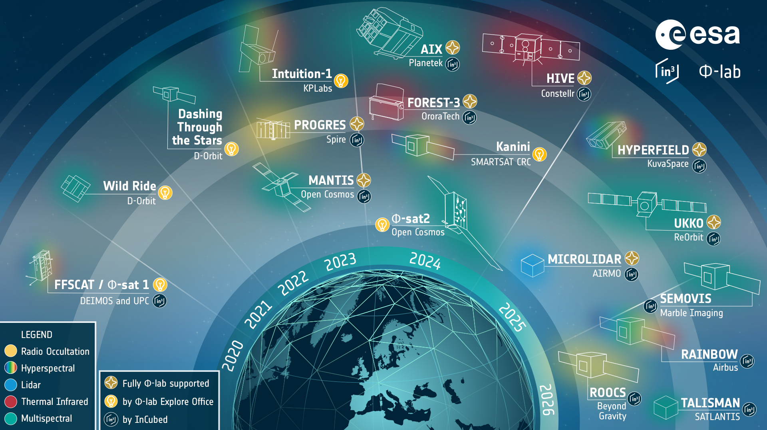
Φ-lab powered satellites and constellations

Slide 5

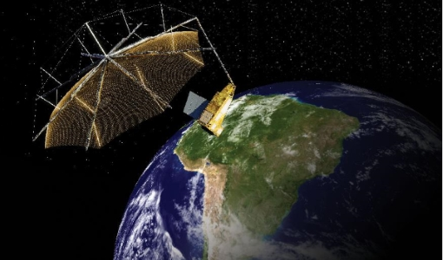
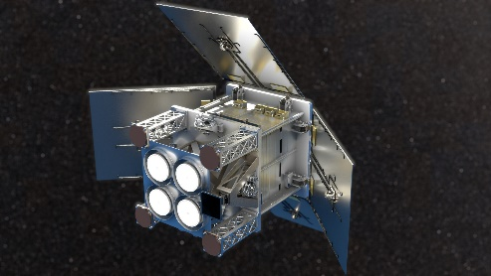
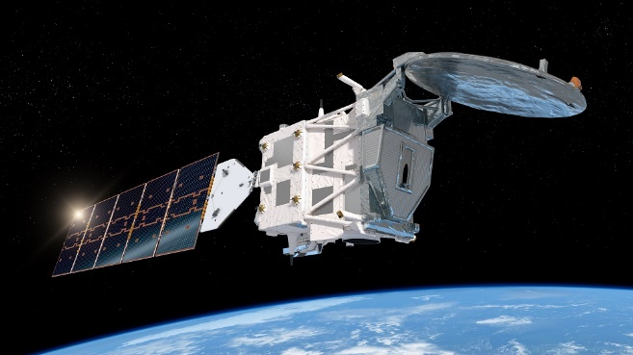
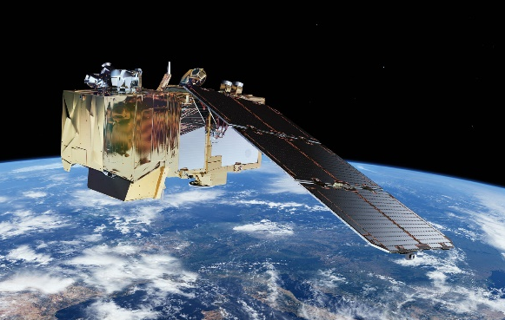
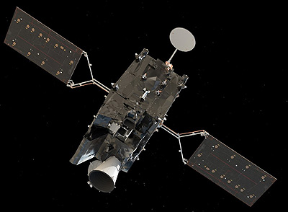
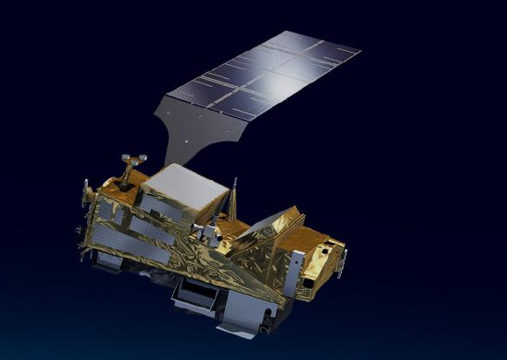
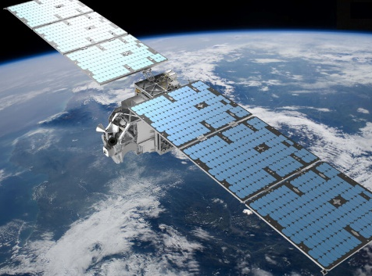

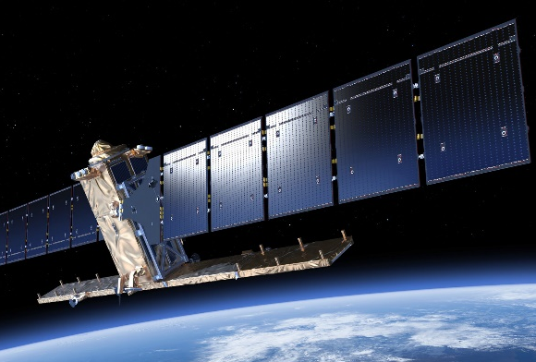

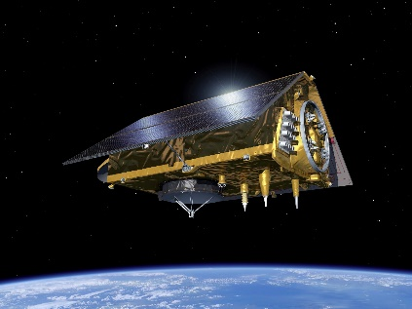
Earth Observation Mission Launch Updates
5 Satellites (4 Launches in 2024)
6 Launches in 2025 (TBC)
S1: Biomass
S1: HydroGNSS
29 May EarthCARE
4 September Sentinel-2C
Q3: MTG-S1
Q4: MetOp-SG A1
16 August Φsat-2 +
Arctic Weather Satellite
Early December
Sentinel-1C
S2: Sentinel-1D
Q4: Sentinel-6B
‹#›

Slide 6

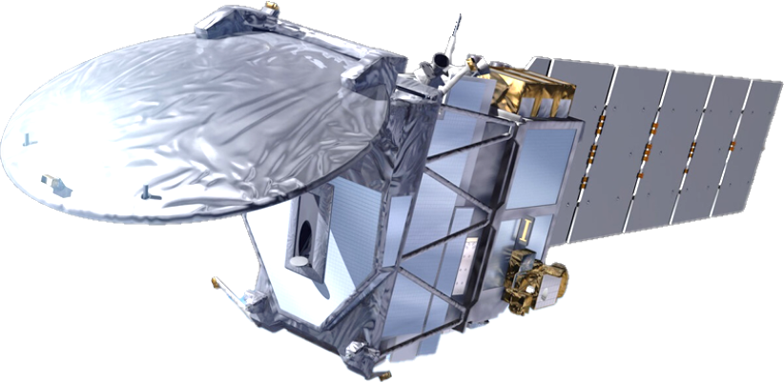
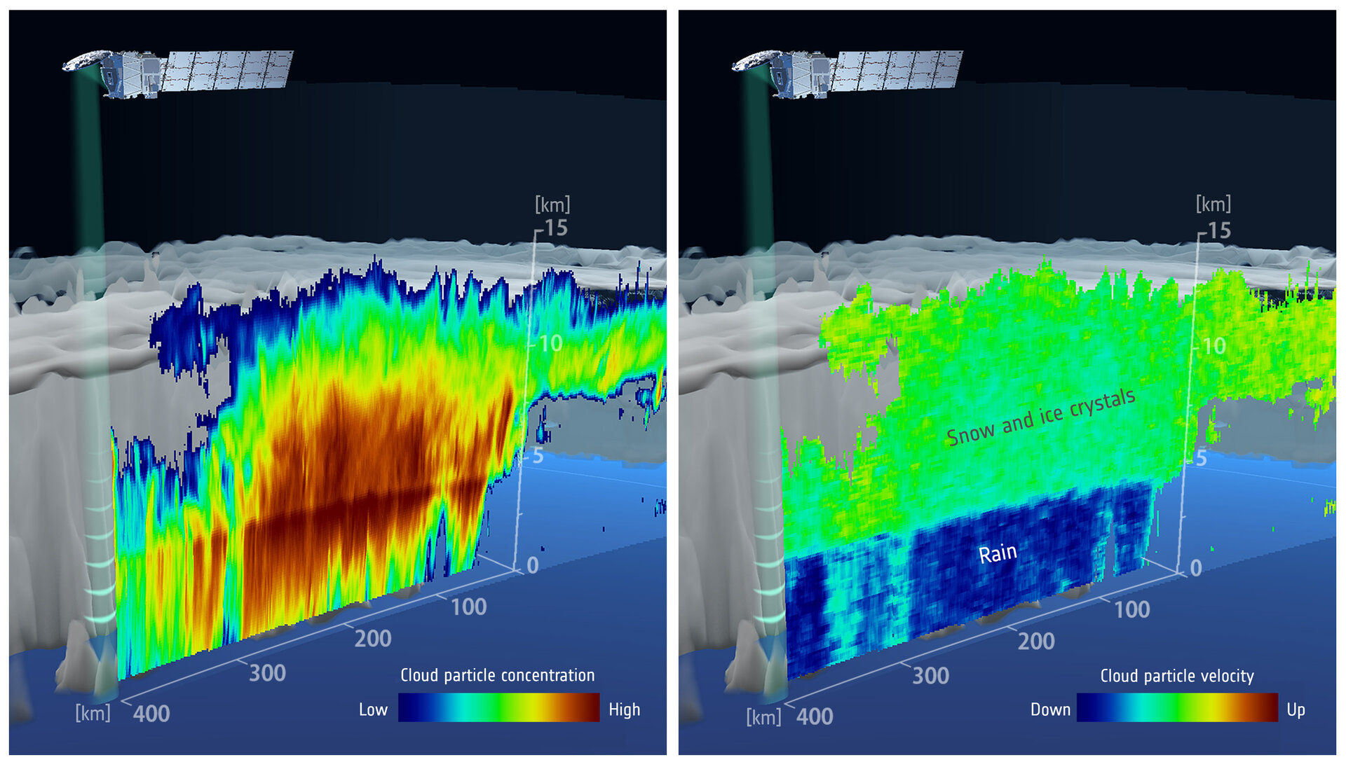
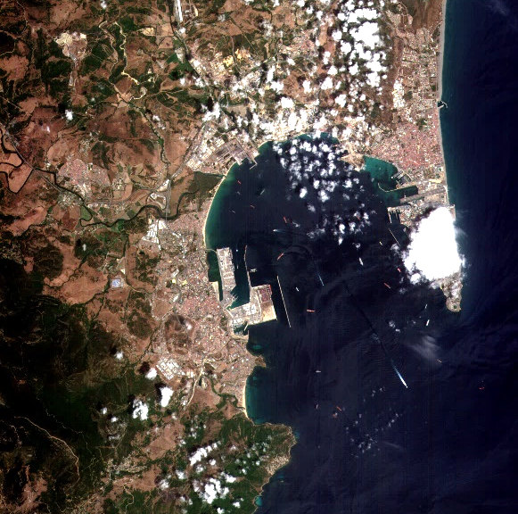
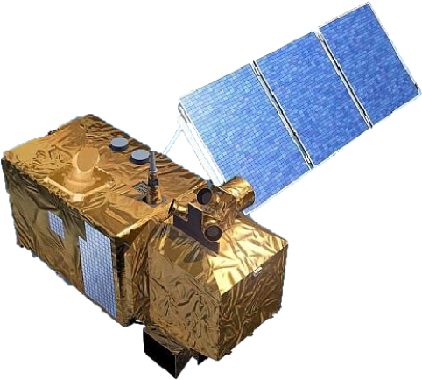
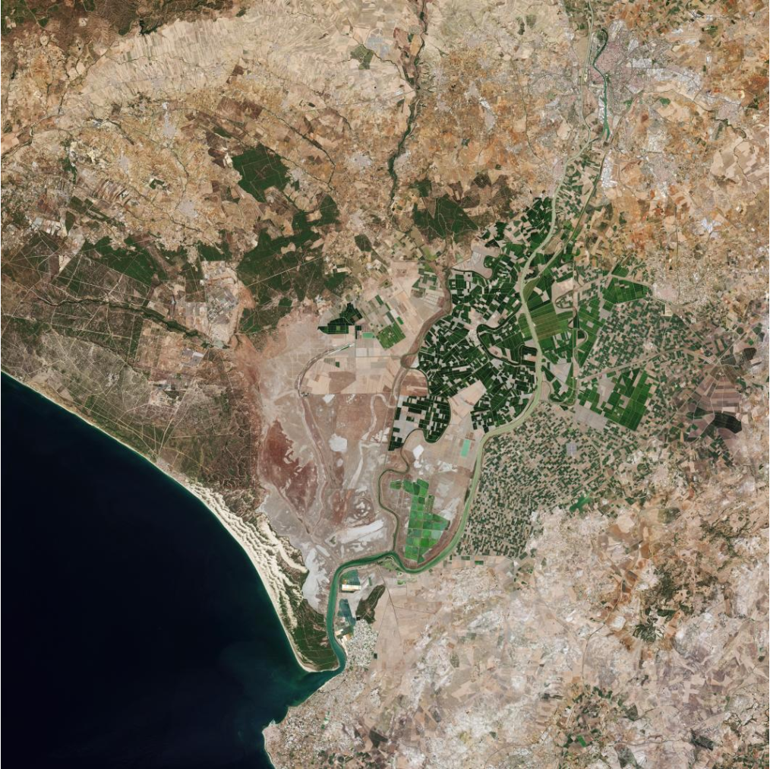
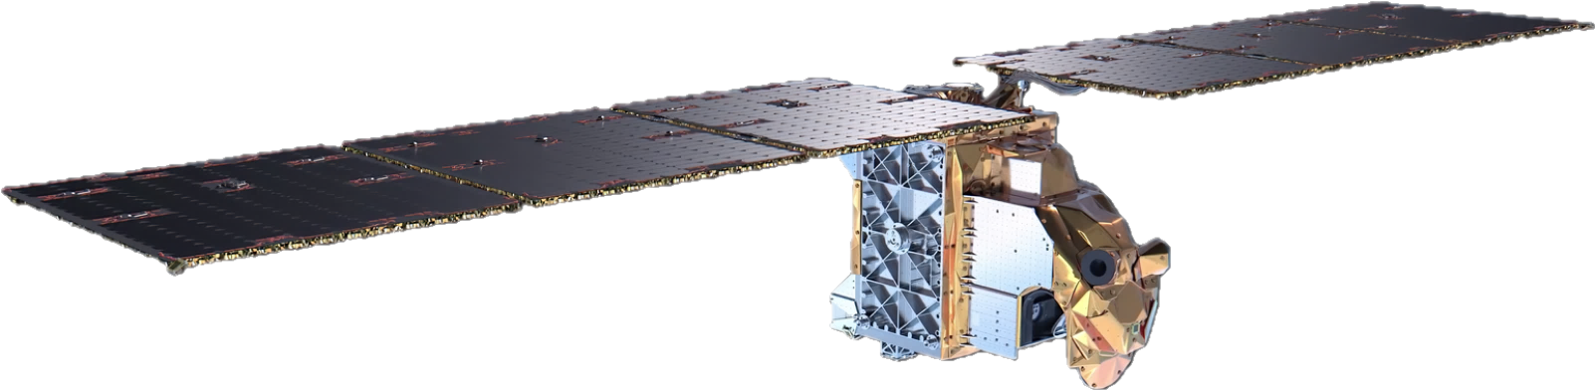
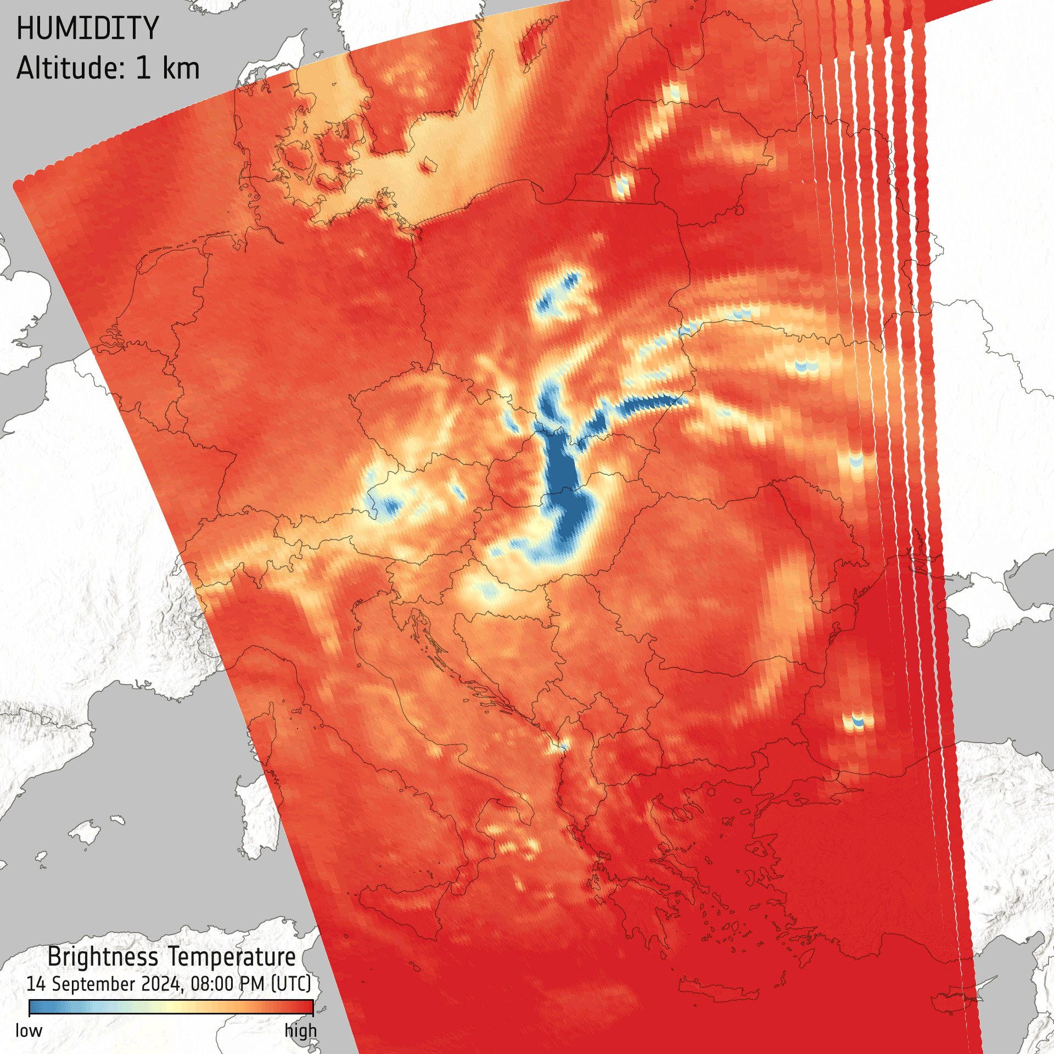
Commissioning Ongoing for all 4 Satellites: First Data Sneak-Peek
EarthCARE cloud profile over ocean east of Japan
Radar reflectivity data, taken 13 June, showing vertical structure of a cloud
Φsat-2 data showing the Bay of Gibraltar.
True colour image at a resolution of 4.8m per pixel
AWS data showing Storm Boris
Humidity data from 14 Sept. at 1 km intervals and 1 to 7 km altitude showing torrential rainfall as dark blue regions over Hungary, Slovakia and Poland.
S-2C Image of Seville
True colour image taken on 13 September at 10m resolution per pixel
‹#›
Notes:
EarthCARE cloud profile over ocean east of Japan
Radar reflectivity data, taken 13 June, showing vertical structure of a cloud
Unveils the vertically-resolved concentration of cloud particles from which it is clear to see that the denser part of the cloud is in its centre.
A clear boundary at an altitude of around 5 km is seen, which is where the ice and snow, in the upper layer, melt, forming water droplets falling as rain.
S-2C Image of Seville
True colour image taken on 13 September at 10m resolution per pixel
Φsat-2 data showing the city of in Spain.
True colour image at a resolution of 4.75m per pixel
AWS image showing Storm Boris
Humidity data from 14 Sept. at 1 km intervals and 1 to 7 km altitude showing torrential rainfall as dark blue regions over Hungary, Slovakia and Poland.

Slide 7
2024 Meetings, Workshops, Symposia (selected)
Q1 | Q2 | Q3 | Q4
15/01 EO for Health User Forum (ESRIN) | 8-12/04 SWARM 10-year anniversary Science Meeting (København, Denmark) | 16-18/09 URBIS24 Workshop (ESRIN) | 8-11/10 EO for Monitoring, Reporting, and Verification of Carbon Removals conference (København, Denmark)
6-7/03 Earth Observation for Soil Protection and Restoration (ESRIN) | 13-16/05 7th Ocean Salinity Conference (ESTEC) | 23-26/09 EO for Africa Symposium (ESRIN) | 15-16/10 EO for Cultural and Natural Heritage workshop (ESRIN)
2-3 – Space for Arctic Workshop (Tromso, Norway) | 13-16/05 EO for Agriculture under pressure Workshop (ESRIN) | 23-27/09 – ESA/NASA CRYO2ICE Symposium (Reykjavik, Iceland) | 4-6/11 SMOS Science Conference & 15-year Anniversary (Sicily)
 | 27-28/06 ESR³ TRUTHS for Climate Workshop (ECSAT) | 16-18/10 EO for Cultural and Natural Heritage workshop (ESRIN) | 13-15/11 Workshop on International Cooperation in Spaceborne Imaging Spectroscopy | Hyperspectral (ESTEC)
‹#›

Slide 8
