Slide 1
CEOS Virtual Constellation Updates – Synthesis Report
Hironori Maejima
& Osamu Ochiai
SIT Chair Team, JAXA
Agenda Item #7.3
38th CEOS Plenary
Montreal, Canada
23rd - 24th October, 2024

Slide 2
SIT Chair - VC Oversight Role
SIT Chair has responsibility for overseeing and guiding the work of CEOS Virtual Constellations
Leadership & Coordination: Guiding to ensure alignment with CEOS priorities and global initiatives.
Strategic Oversight: Coordination to CEOS activity areas, such as climate monitoring and SDGs
Facilitates Collaboration: Integration with other CEOS entities to maximize data impact
Progress Monitoring: Progress, addressing challenges and supporting new initiatives.

Slide 3
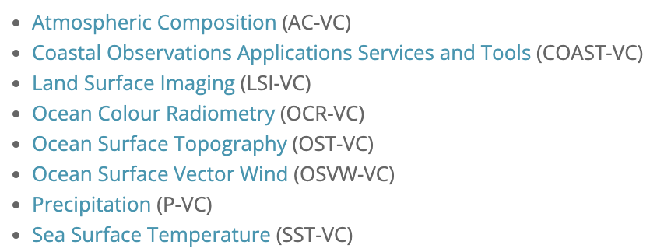
CEOS Virtual Constellations
Coordinate space-based, ground-based, data delivery systems
Meet a common set of requirements within a specific domain
Leverage inter-Agency collaboration and partnerships
Address observational gaps, sustain the routine collection of critical observations
Minimize duplication/overlaps
Maintaining the independence of individual CEOS Agency contributions
https://ceos.org/ourwork/virtual-constellations/

Slide 4












Synthesis Report Inputs
Annual reporting on activity to CEOS Plenary from SIT Chair
Inputs to this report provided by the Constellation co-leads
VC co-leads from 11 organisations
Participants from many more!

Slide 5


COAST-VC
https://ceos.org/ourwork/virtual-constellations/coast/

Slide 6
COAST-VC
COAST-VC is preparing for training in our products and Application Knowledge Hub use at UNOC3 – This is a formal CEOS workplan activity
COAST-VC has introduced several experimental products (Chesapeake Bay, Bay of Bengal and other pilot regions): Habitat Suitability Index, Marsh Mapping, Water Clarity, satellite – derived bathymetry
COAST-VC has made improvements to the Application Knowledge Hub
COAST-VC recently presented an altimetry-focused poster at the 30YPR meeting in France, describing coastal products offered to users
Recent Deep Dives into coastal data availability and need: Blue Carbon, Polar and SST (Blue Carbon and SST and extend the pilot sites to Arctic)

Slide 7
COAST-VC (continued)
COAST-VC successful cross-cutting support:
  SEO by supplying 2 impact cards to the call
  other CEOS WG/VC activities by supplying 5 bullets to the WG Climate call for COP value of satellite data statements
  CEOS wide IOC/UN Ocean Decade Talking Points Development
  Collaborations with SST-VC on joint coastal GHRSST25 special session
Future work planned: Technical meetings with SST-VC/other Subject Matter Experts on coastal SST resolution and mask needs in support of the Joint Statement On New SST Missions. Also pending collaboration with CoastPredict & Decade Collaborative Center for Coastal Resilience (DCC-CR)
We renew our call for additional agency and affiliate-level members in COAST-VC - all are welcome and encouraged to participate!

Slide 8
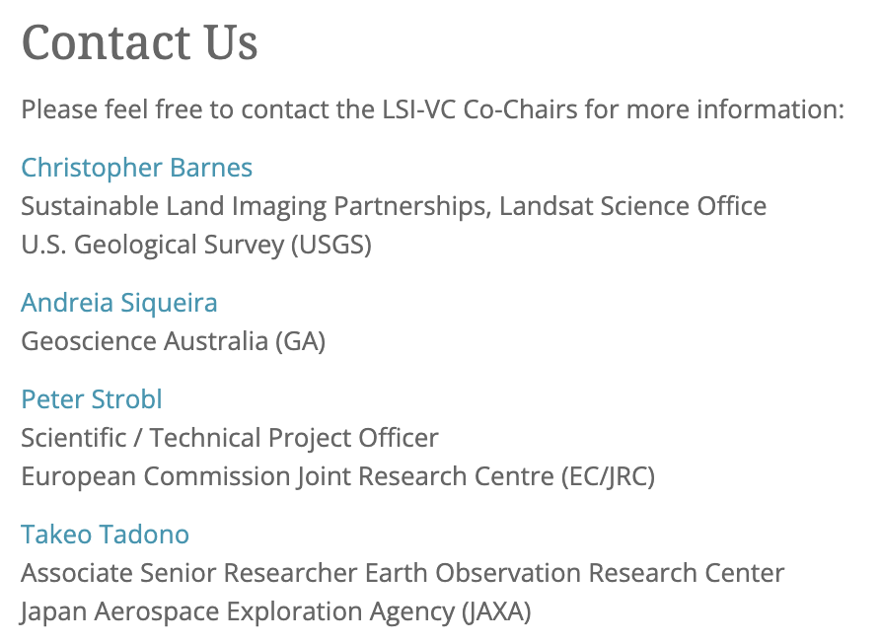
LSI-VC
https://ceos.org/ourwork/virtual-constellations/lsi/

Slide 9
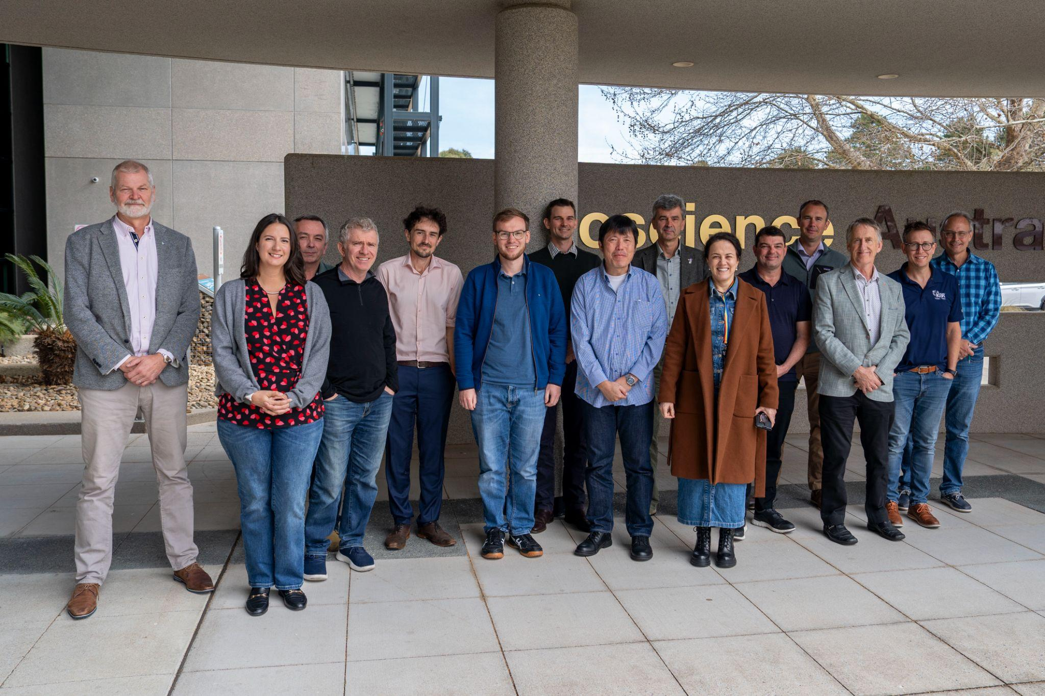
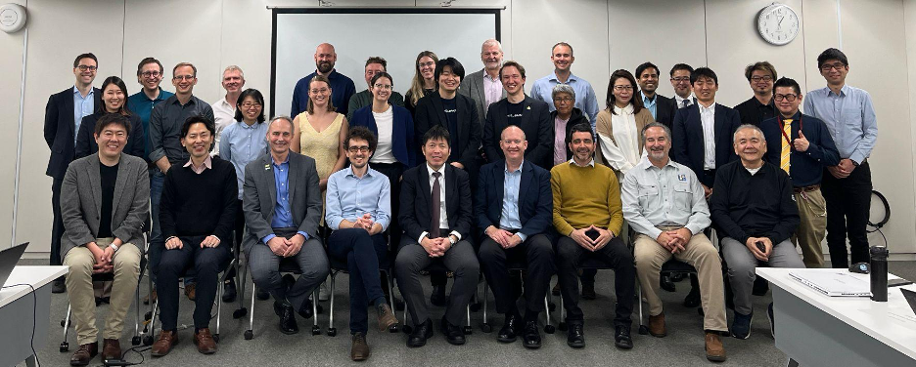
LSI-VC
LSI-VC-16 - September 2024 (Canberra) after SIT TW
  Thanks to Geoscience Australia for hosting!
  Second ARD/LSI commercial engagement workshop – this time with Australian companies. Very strong interest in CEOS-ARD and other potential modes of interaction with CEOS Agencies
  Began process of consolidating land optical CEOS-ARD PFS
  Workshop on CEOS-ARD + GitHub + STAC – new direction for increased consistency, version control, change tracking, and community engagement
LSI-VC will manage the implementation of the CEOS AFOLU Roadmap actions (Forests and Biomass Subgroup)
LSI-VC-GEOGLAM (Agriculture) subgroup looking to bolster membership to tackle Essential Agriculture Variables – CEOS agency nominations sought!
Ramsar Convention on Wetlands – potential for increased space agency engagement. Initiating consultation process with EO community.
UNCCD request for enhanced Land EO contribution to SDG indicators
How does CEOS want LSI-VC and others to engage on coordination of higher level products? Seeking CEOS Principal direction for help/guidance
LSI-VC was a key contributor to CEOS-ARD Strategy 2024
POLINSAR data requests. SIT-39 action for CEOS agencies to nominate POCs
JAXA pleased to serve as a Co-Lead reflecting long-term LSI-VC involvement and leadership of SAR CEOS-ARD, EO & Wetlands, POLINSAR, and other work tasks
LSI-VC-16, September 2024
LSI-VC-15, April 2024

Slide 10

OCR-VC
https://ceos.org/ourwork/virtual-constellations/ocr/

Slide 11
OCR-VC news
Welcoming NASA’s Dr. P. Jeremy Werdell, PACE Project Scientist, as an OCR-VC co-lead
A number of Work Plan items or actions delivered
Work Plan activities ongoing, including on the Aquatic Carbon roadmap - see item #4.3

Slide 12
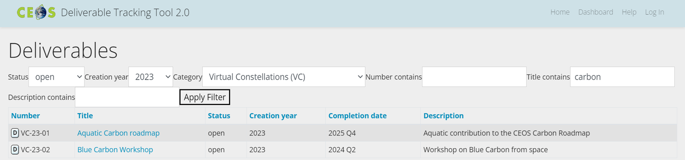
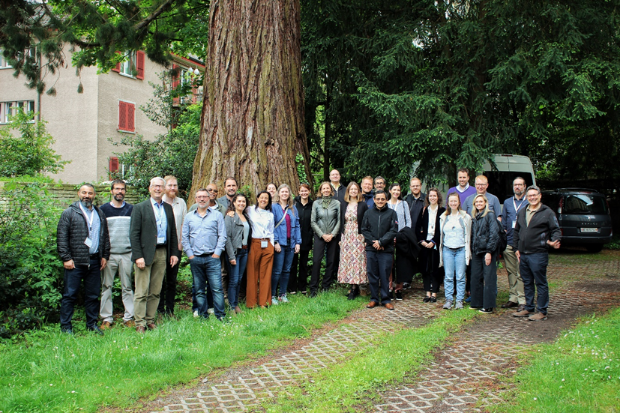
Aquatic Carbon roadmap tasks
Several activities ongoing - see item#4.3 on Wednesday at 15:20
Blue Carbon workshop
delivered
Workshop Summary – Drafted, under review by session chairs
Perspective Paper – submitted to Nature Communications collection on Coastal Blue Carbon on October 11, 2024
🡪Identifying the main gaps, challenges and opportunities related to the use of space-borne data to support Coastal Blue Carbon science and policy needs.
🡪Including a roadmap towards filling the identified research gaps.
Policy Brief – To be developed from the Workshop Policy Needs summary chapter and submitted before end of 2025

Slide 13
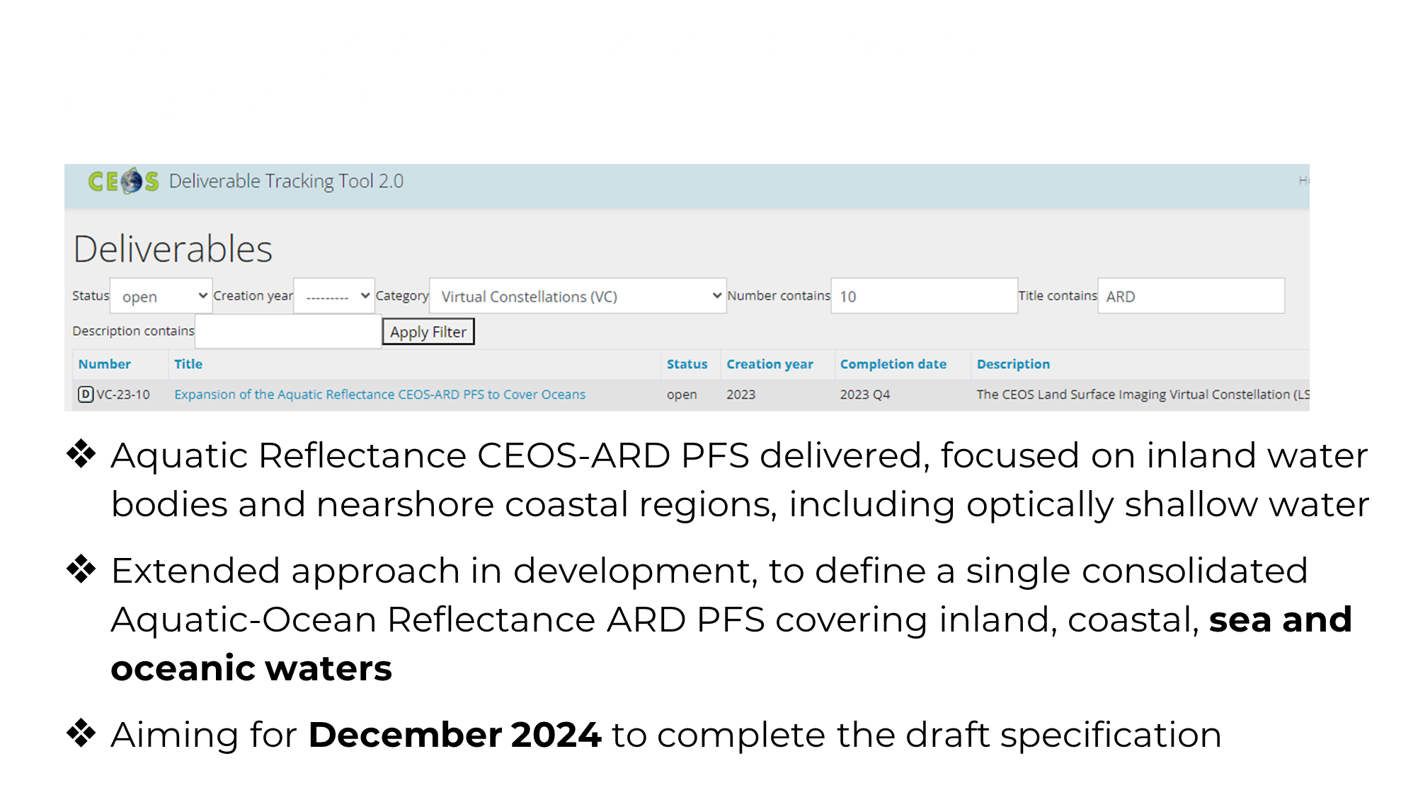

Slide 14
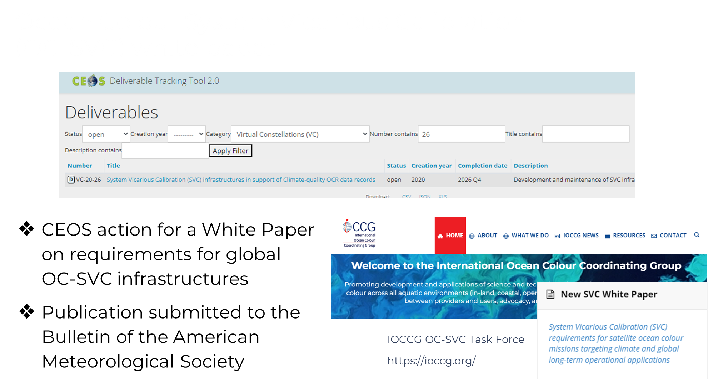

Action closed

Slide 15
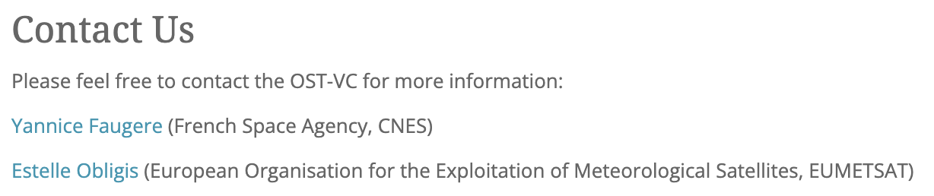
OST-VC
https://ceos.org/ourwork/virtual-constellations/ost/

Slide 16
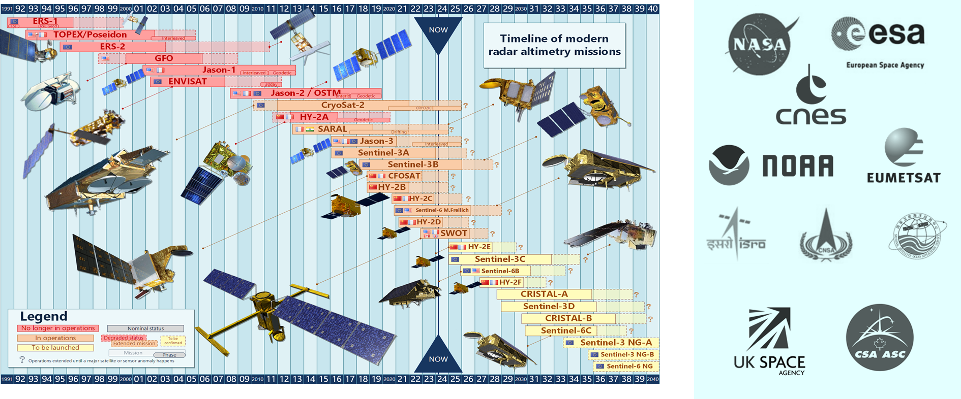
OST-VC
Significant contribution from China (HY series) but still no representative member in the VC

Slide 17
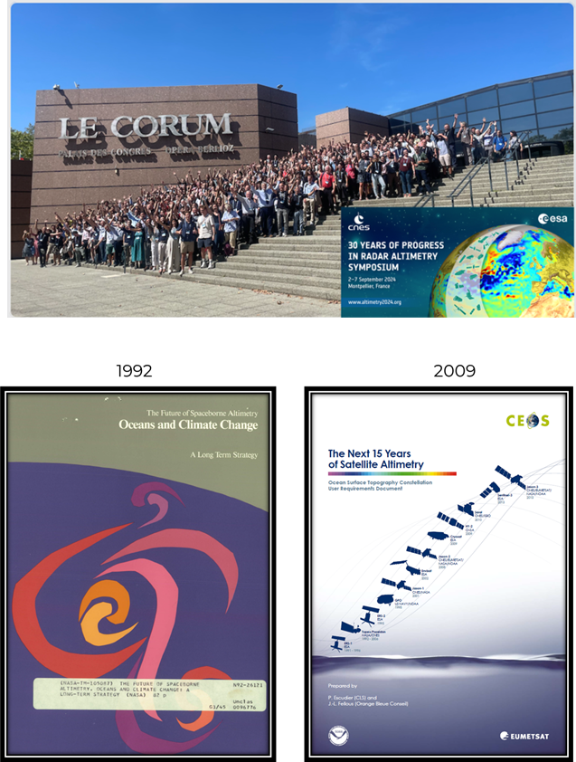
OST-VC
OSTST
  30 years of altimetry Symposium was organized by ESA and CNES, with the support of EUMETSAT, on 2-6 September
  Renewal of OSTST ongoing through 2024 TOSCA (CNES/EUMETSAT) and ROSES call
Update of the “Next 15 years of altimetry – OST Constellation User Requirement Document”, 2009.
A Coordinated International Satellite Altimetry Virtual Constellation: Toward 2050
  inventory of current user needs including emerging ones
  identification of gaps in the current international space constellation
  Editorial team: CNES-EUMETSAT
  Publication by first quarter 2025

Slide 18
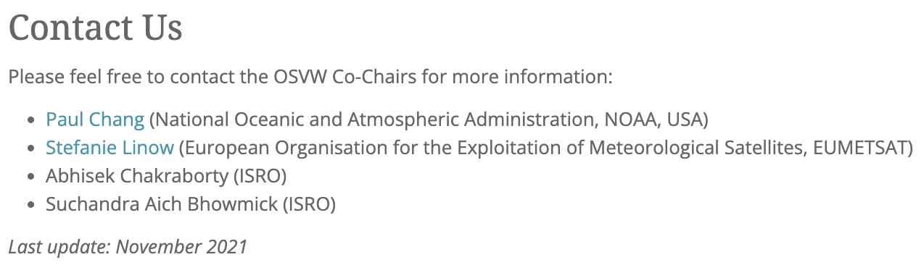
OSVW-VC
https://ceos.org/ourwork/virtual-constellations/osvw/

Slide 19
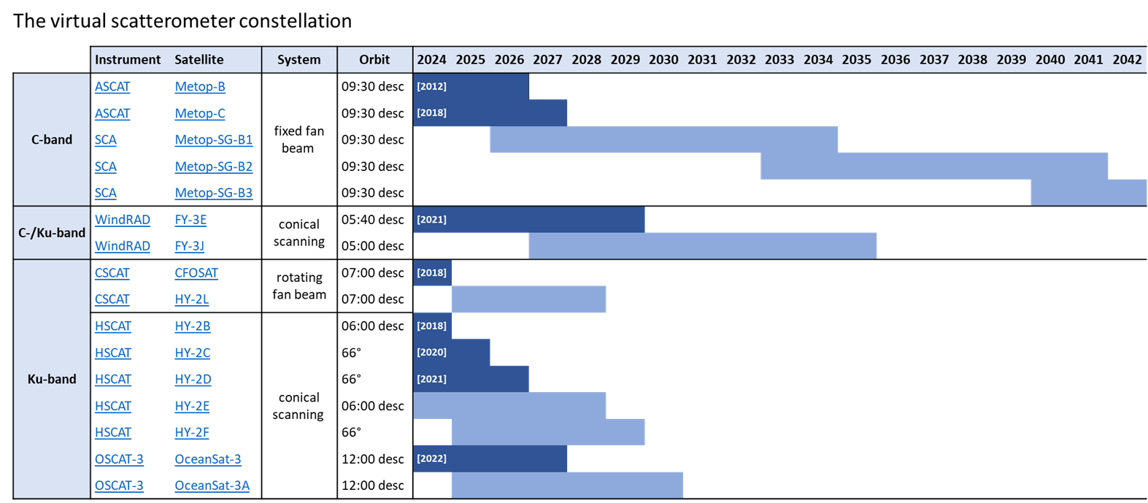
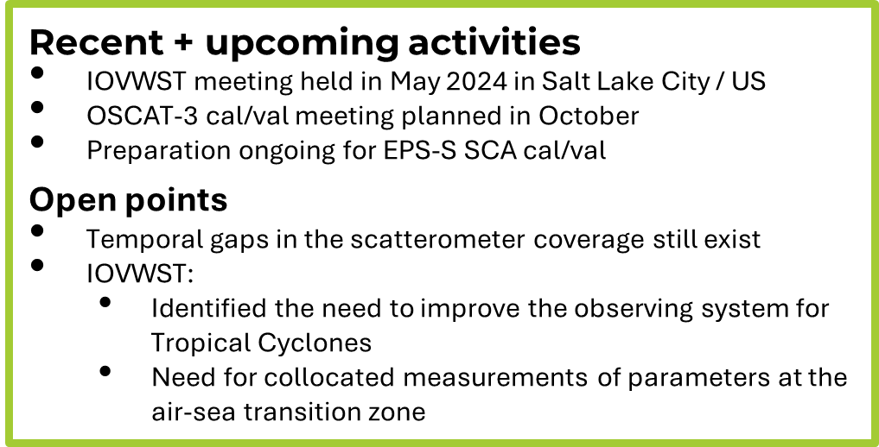
OSVW-VC

Slide 20
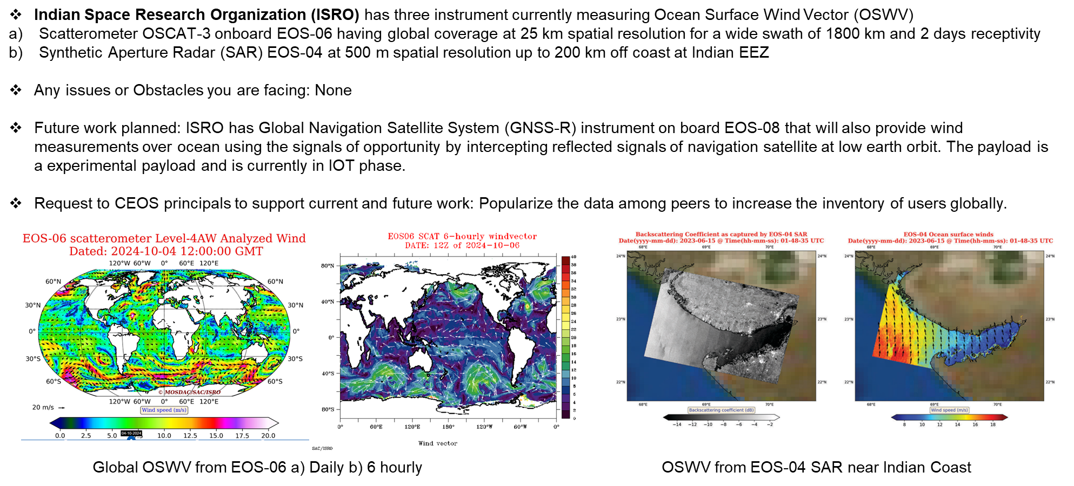
OSVW-VC
EOS-06 and EOS-04 L2 data:
https://bhoonidhi.nrsc.gov.in/bhoonidhi/home.html
Value added science products:
http://www.mosdac.gov.in

Slide 21

P-VC
https://ceos.org/ourwork/virtual-constellations/p-vc/

Slide 22
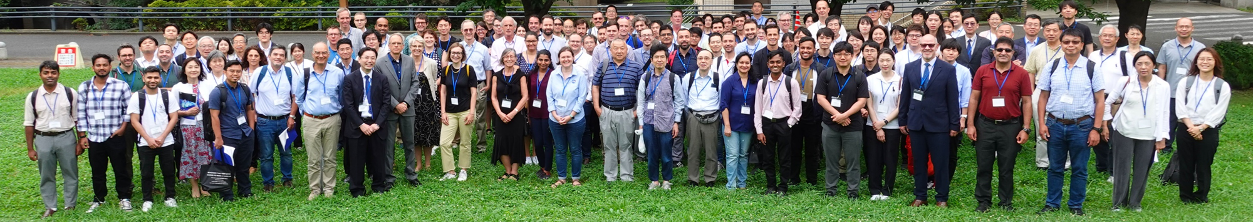
P-VC
The current precipitation constellation: 1 radar, 5 passive microwave (PMW) imagers, 6 PMW sounders. A further five sensors are currently being evaluated (TROPICS (x3) and STP-H8 (x2)).
Recent launches include the US DoD WSF-M, ESA/JAXA EarthCARE, tomorrow.io and ESA AWS
near-future launches include GOSAT-GW AMSR3, EUMETSAT EPS-SG A/B
International Precipitation Working Group (IPWG-11) workshop was hosted by JAXA at the Tokyo Institute of Technology, Tokyo, 15-18 July 2024, and the
GPM 10th Anniversary Symposium on 19 July 2024
- A low inclination, wide-frequency radiometer (GMI/AMSR-class) is deemed imperative for cross-calibrating passive microwave radiometers from agency and commercial providers.
- There is a paucity of low frequency (sub-23 GHz) passive microwave observations – sensitive to precipitation (high frequency sounders sense temperature and humidity). There are no planned commercial low frequency missions.
Ongoing evaluation and integration of new sensors (incl. commercial) into the precipitation constellation.
Work is progressing on the CEOS ARD for Precipitation with an expected implementation in 2026 with the release of the NASA/JAXA V08 precipitation data sets.

Slide 23

SST-VC
https://ceos.org/ourwork/virtual-constellations/sst/

Slide 24
SST-VC
Additional engagement to expand participation in SST-VC
  CONAE and INPE are kindly assigned PoC to the SST-VC after the SIT-39.
  Current members: SANSA, JAXA, NASA, NOAA, EUMETSAT, ESA, ISRO, BoM, CMA, KMA, CONAE, INPE
Coastal SST workshop
  SST- and COAST-VC in collaboration with the Group for High Resolution Sea Surface Temperature (GHRSST), which was established 25 years ago to promote state-of-the-art SST dataset (https://www.ghrsst.org/), had a special workshop on coastal SST on 14 Jun. 2024 during the GHRSST25 in Montreal
  Many talks regarding coastal SST observations from space and their applications are presented and we also had a panel discussion on gap areas in coastal observing systems, including issue in coastal coverage for existing and future ultra high resolution TIR instruments
  After the workshop, SST- and COAST-VC has drafted joint statement regarding above issue (next slide)
Future work planned
  Technical meetings with COAST-VC and experts on coastal SST resolution and coverage needs
  Finalize joint statement with COAST-VC to be submitted to SIT-40
  Revise SST-VC ToR

Slide 25
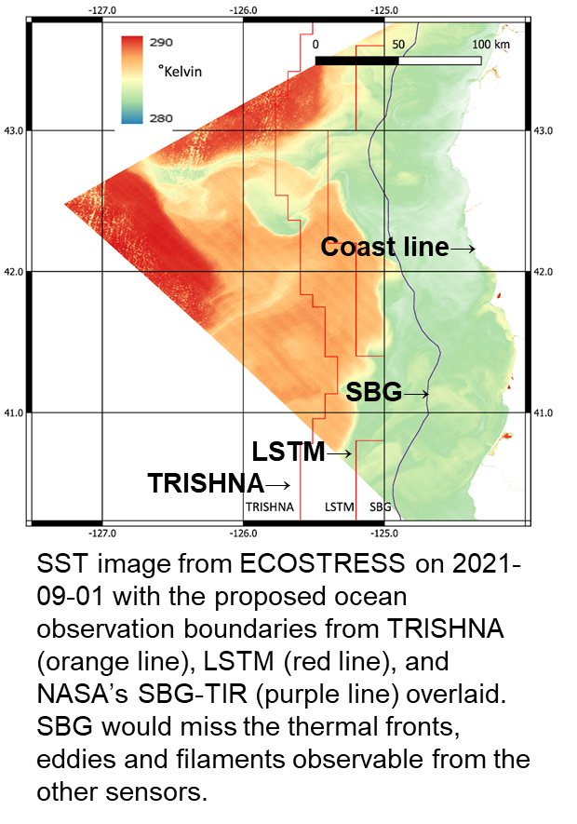
Joint statement regarding coastal SST coverage improvement
SST- and COAST-VC are drafting a joint statement regarding coastal coverage improvement in future ultra high resolution (< 100m) TIR missions
  At the SIT TWS in Sep. 2024, SST- and COAST-VC presented needs of improvements in future missions, such as TRISHNA, LSTM, SGB.
  In response to advices at the TWS, SST- and COAST-VC have started technical discussion with those missions regarding this issue
    Meeting with the NASA SBG team in Oct. 2024
    Submit abstract regarding this issue jointly with SST- and COAST-VC to the TRISHNA science meeting in Nov. 2024
We plan to finalize the joint statement reflecting outcomes from those meetings and to submit it to the SIT-40

Slide 26

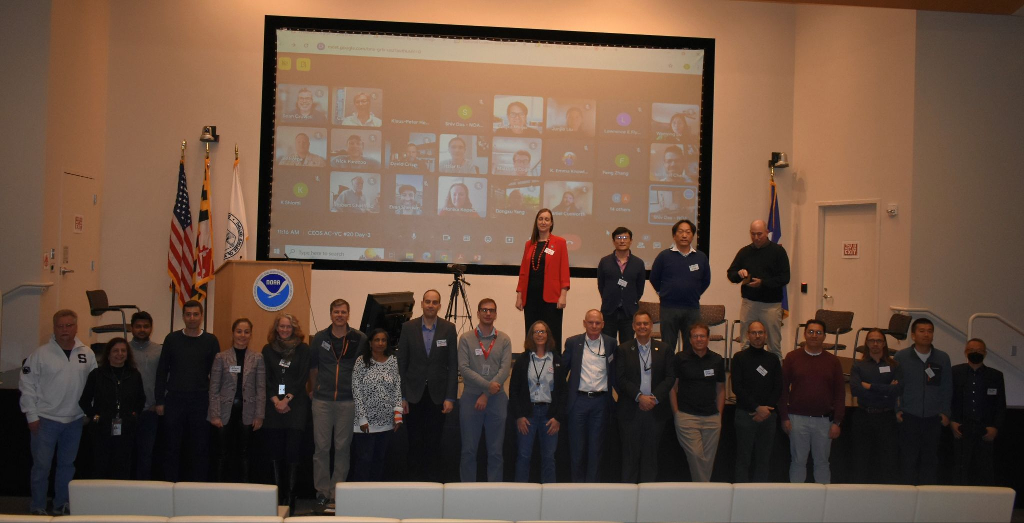
AC-VC
https://ceos.org/ourwork/virtual-constellations/acc/
AC-VC#20 Meeting 15-18 Oct 2024,
National Center for Weather and Climate Prediction, College Park, MD, US

Slide 27
AC-VC
Harmonization of tropospheric ozone datasets (VC-20-01) is progressing well: AC-VC is actively contributing to the science effort Tropospheric Ozone Assessment Report, Phase II (TOAR-II, 2020-2024). End of November 2024 is the deadline for submitting related articles to the inter-journal Special Issue (ACP/AMT/BG/GMD).
Validation and harmonization of products from the air quality missions in orbit (TEMPO, GEMS and S5P/TROPOMI) is progressing well. The ESA/DLR PEGASOS project is evaluating the GEMS L2 operational products. Cal/Val of Sentinel-4 and Sentinel-5 products (Announcement of Opportunity released in July 2024) is in preparation. (Related Actions VC-20-02, -03, and -04 had been closed).
The PM2.5 white paper is being followed up (VC-20-05). A roadmap is in the making with it pursuing the white paper recommendations and a presentation of use cases. The community is writing a review paper on ALH. This is an action that came out of AC-VC#19.
In conjunction with the CEOS-CGMS GHG task team, an update to the GHG roadmap is being submitted for endorsement this plenary.
In conjunction with the GHG task team, a first draft of the document “Common Practices for Quantifying, Reporting, Validating, and Assessing Facility Scale Methane Emissions Using Remote Sensing” was delivered. We anticipate submitting a final version for endorsement in the 2025 plenary.
The AC-VC #20 meeting was held 14-18 October 2024. Ideas for pursuing the coverage of the Middle East and Africa with hourly satellite air quality observations were presented. AC-VC activities linked to the three new CEOS Roadmaps (GHG, AFOLU, and Blue Carbon) were discussed.

Slide 28
Presenter Guidelines

Slide 30
Presenter Guidelines 1
Presenters should name their file using the following convention:
  AgendaItemNumber_LastName_Subject_Version (e.g., 1.1_Laliberté_Welcome_v1)
Documents and presentations should be uploaded to the shared folder to allow for streamlined self service
  Shared Presentation Folder (default view only, ask for upload/edit permission as required)
  For support contact the CEOS Chair Team: csa-ceos-chair-2024@googlegroups.com
  Documents for decision should be submitted by 8 October
  Presentations and documents for information should be submitted by 15 October
Reporting to engage discussion or decision is encouraged, but detailed reporting should be provided as pre-meeting reading material or in background slides.
Meeting website: https://ceos.org/meetings/38th-ceos-plenary

Slide 31
Presenter Guidelines 2
Please explicitly highlight the decisions, outcomes, or actions you are seeking. The more explicit you are, the better. i.e., feel free to provide text for a proposed action – it may be revised later, but this approach will help with the efficient preparation of the actions record of the CEOS Plenary.
Where relevant and possible, presenters are invited to highlight for the CEOS community, and especially for CEOS Principals and stakeholders, significant milestones and key accomplishments. Please reference the CEOS 2024-2026 Work Plan where relevant deliverables or other CEOS services and functions apply.

