Slide 1
Sustainable Development Goals
Coordination Group
Updates and key points
for discussion
Flora Kerblat (CSIRO)
On behalf of
SEO and SIT Chair
Agenda Item 6.1
38th CEOS Plenary
Montreal, Canada
23rd - 24th October, 2024
Notes:
Bonjour/Good morning, everyone.
I am Flora Kerblat from CSIRO, and I have been supporting this SDG topic for 8 years in CEOS, first with MJ (CSA) and Marc Paganini (ESA) in the former ad-hoc team which then became a CG 2 years ago. I am honoured to give you an update today on the SDG activities since Dave Borges (SEO) could not be with us this week.

Slide 2
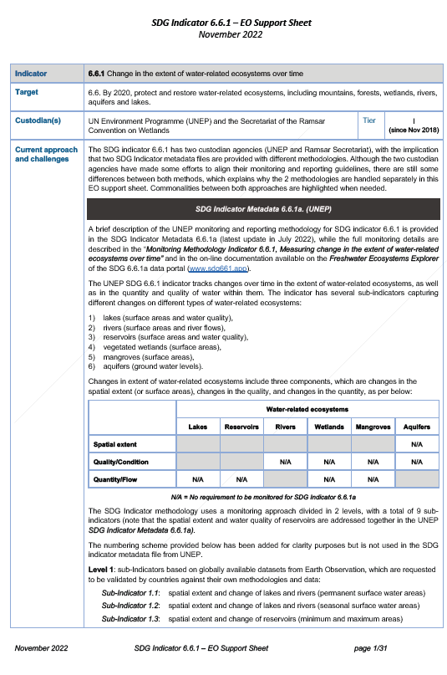
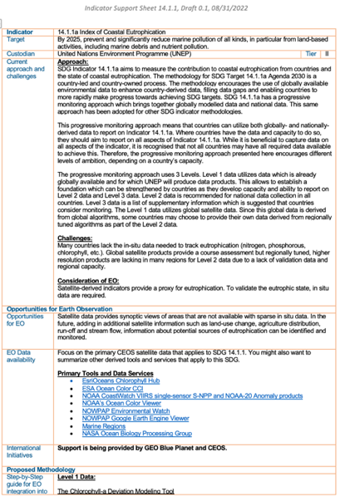
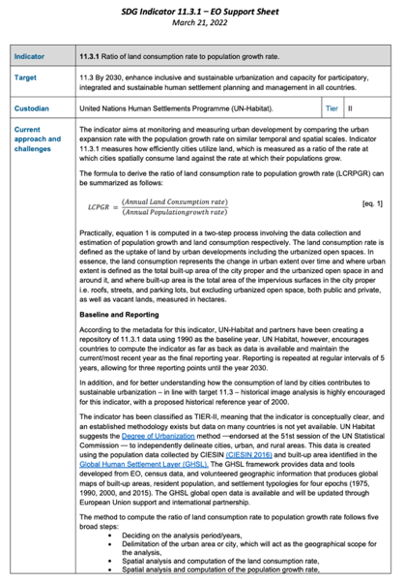
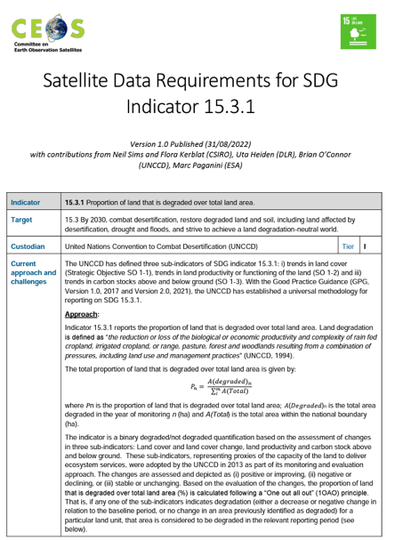
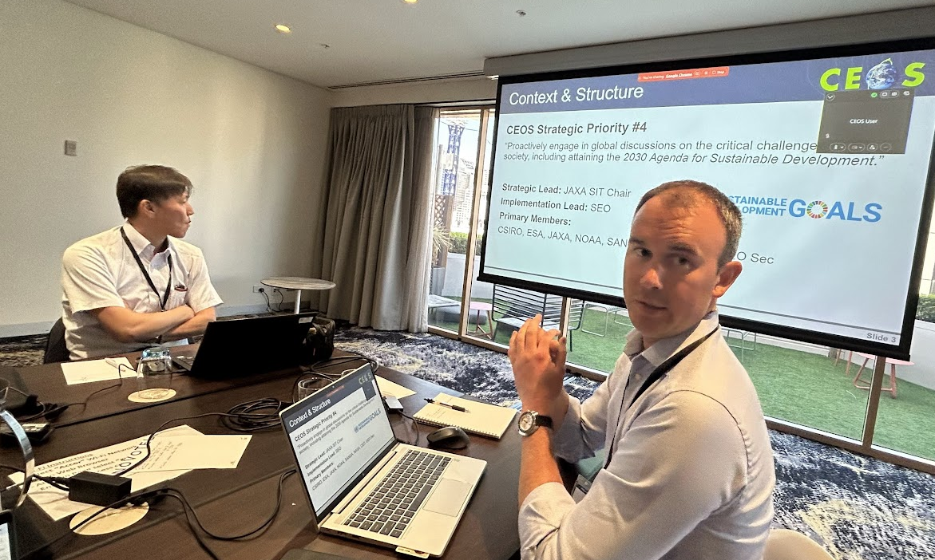
Context & journey
CEOS Strategic Priority #4
“Proactively engage in global discussions on the critical challenges that face society, including attaining the 2030 Agenda for Sustainable Development.”
2024
2023
2022
2016
SDG Coordination Group
Strategic Lead: SIT Chair (JAXA 2024-25)
Implementation Lead: SEO-NASA
Primary Members: CSIRO, ESA, NOAA, SANSA, NASA, Executive Officer, GEO Sec
2018
Ad-hoc team on SDG (AHT-SDG)
Notes:
A bit of context first: as Eric said yesterday, the SDG remains one of the 4th CEOS strategic priorities, this has been reaffirmed at the last SIT-39 meeting in Tokyo.
Let’s take a quick step back. An AHT was endorsed at the Plenary in 2016 (co-led by CSA, ESA and CSIRO), and was renewed a few times to deliver key achievements including the CEOS Handbook in 2018 and the Data Supply Analysis and Strategy in 2020. The team refined its scope to focus on 4 SDG Indicators and developed tools and material like EO support sheets, while continuing its strategic engagement with GEO, UN Custodian Agencies and other stakeholders. The team won a GEO SDG Award last year, recognising our efforts towards the global Sustainable Development Agenda.
Since 2022, the CG has been strategically led by SIT Chair team with the SEO leading its implementation. The small group includes a few active Agencies and individuals contributing to our objectives. We keep meeting every month to discuss strategic initiatives, the progress of our internal and external engagement, and any issues we face in producing the deliverables set earlier this year.

Slide 3
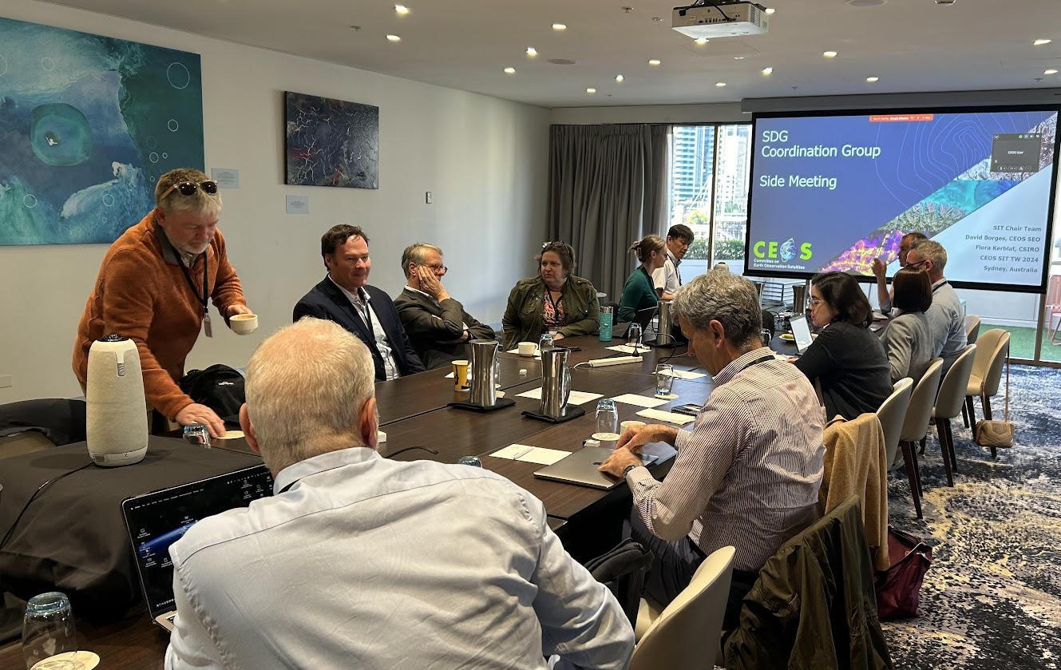
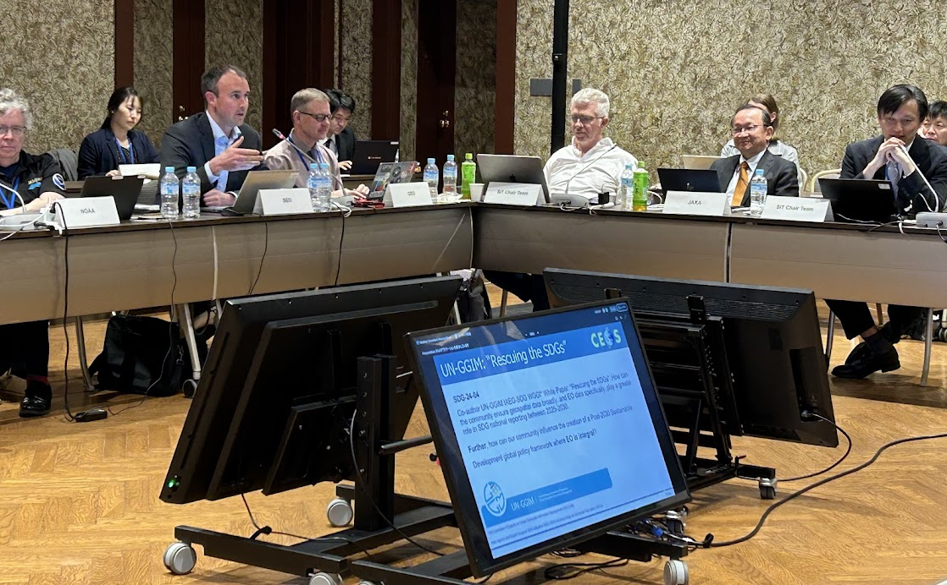
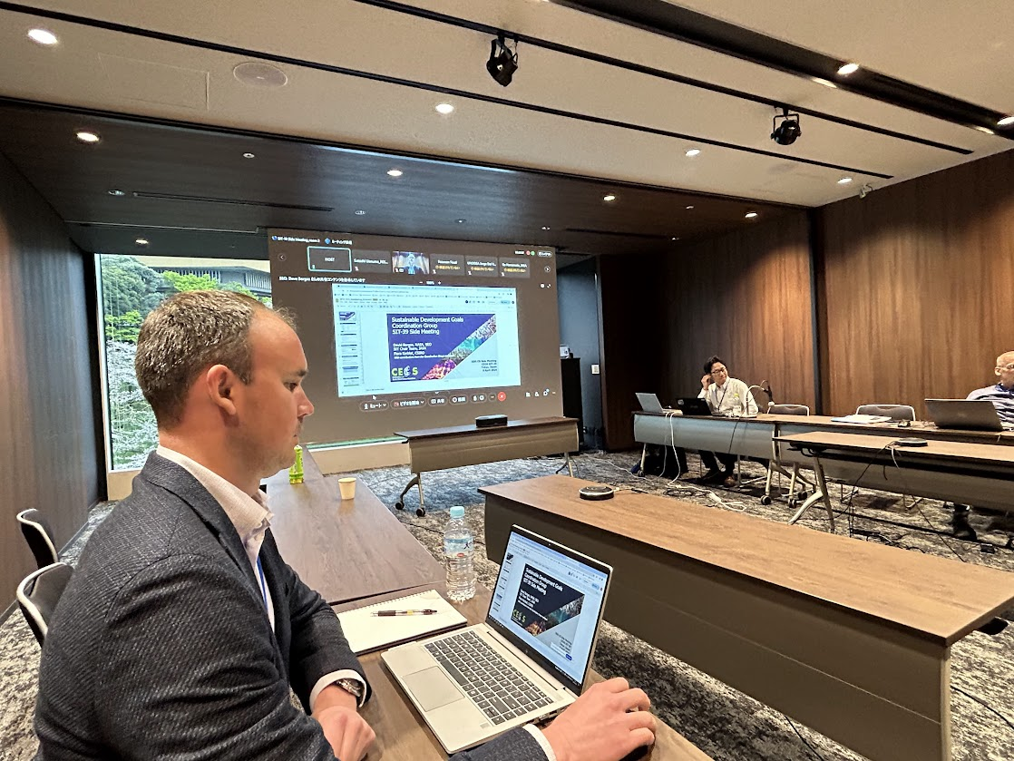
The SDG Group in 2024
Monthly meetings with running notes: https://rb.gy/zmdytq and actions tracker https://rb.gy/uh9u6e
Two face-to-face meetings in Tokyo (April) and Sydney (September)
Notes:
In addition to our monthly meetings, the group held two face-to-face meetings in Tokyo and in Sydney, alongside CEOS SIT-39 and SIT TW meetings.
These in-person meetings gathered >20 people, helped build bridges across CEOS and broaden our thinking so we can make a stronger impact.

Slide 4
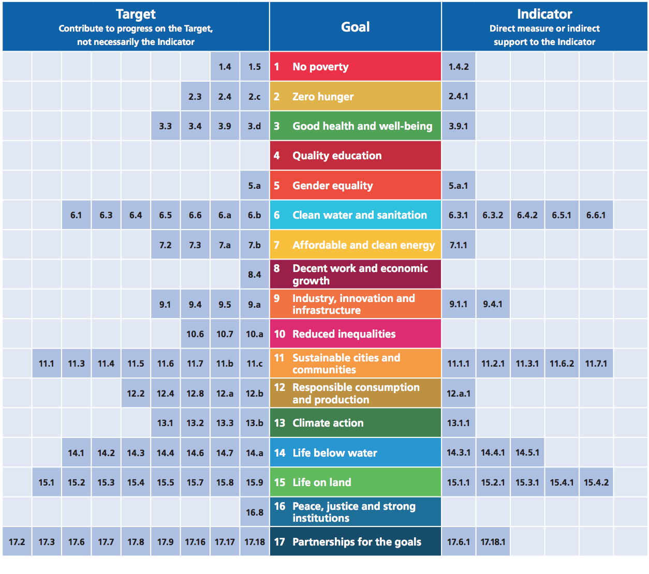
Earth Observations & Geospatial Information for SDG Monitoring
Alignment of Earth Obs. to the SDG Goals, Targets, and Indicators
SIT-39-15: CEOS Chair and SEO to engage the CEOS Secretariat meetings on the matter of invigorating support for SDGs more broadly across the organization (Members and Associates)
Notes:
This analysis was made a few years ago with the GEO EO4SDG Initiative and shows the potential contributions of Earth observations to progress on many more Targets and Indicators
Although we made progress, the group recognise that more needs to be done, especially with recent changes in GEO, and CEOS Principals reaffirmed their support at SIT-39, urging Members and Associates to join the efforts by providing additional resources so CEOS can keep playing a key role to advance the Goals.

Slide 5
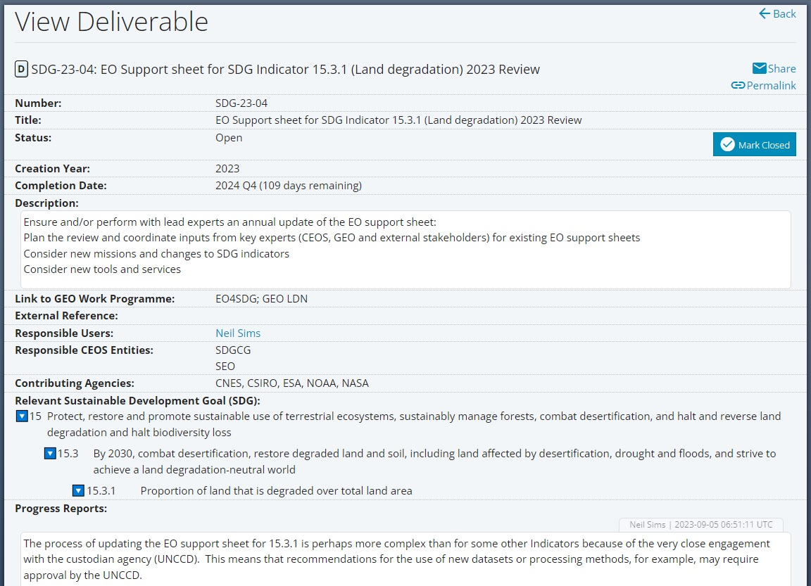
Deliverable Tracking Tool Update
Deliverable Tracking Tool 2.0
“Relevant Sustainable Development Goal (SDG)” section added across the interface.
Existing and new deliverables can add SDG-specific information, if relevant.
Notes:
Before getting into our Deliverables progress status, we want to draw your attention the Deliverable Tracking Tool: this year, and to address the need to better measure CEOS contributions to SDGs, the SEO added a feature in the Tracking Tool, so everyone in the organization can map their activities and deliverables to relevant SDGs if any: whether it contributes to meet a Goal, a Target or help monitor an Indicator. We strongly encourage every current or future deliverable owners to use this new feature carefully to help us measure our impact across the Work Plan. The SDG CG remain available if you are unsure about what to enter, or should you have any questions.

Slide 6
2024 SDG Deliverables
Number | Deliverable Title | Due | Responsible User | Responsible Agency
SDG-24-01 | EO Support sheet for SDG Indicator 6.6.1 (Water) | 2024 Q4 | Marc Paganini | ESA
SDG-24-02 | EO Support sheet for SDG Indicator 11.3.1 (Urbanization) | 2024 Q4 | Martyn Clark, Nale Mudau | GEOSEC, SANSA
SDG-24-03 | EO Support sheet for SDG Indicator 14.1.1 (Marine Pollution) | 2024 Q4 | Paul DiGiacomo, Katy Matthews | NOAA
SDG-23-04 | EO Support sheet for SDG Indicator 15.3.1 (Land degradation) | 2024 Q4 | Neil Sims | CSIRO
SDG-24-04 | UN-GGIM IAEG-SDGs WGGI Paper: “Rescuing the SDGs with Geospatial Information” | 2024 Q4 | Flora Kerblat, Dave Borges, Osamu Ochiai, Neil Sims | CSIRO, SEO, JAXA
SDG-23-05 | UNCCD: SIDS Cloud Cover Analysis Report | 2024 Q3 | Dave Borges | SEO, CSIRO
SDG-24-05 | UNCCD: SIDS Land Cover Dataset Suitability Analysis | 2024 Q3 | Dave Borges, Neil Sims | SEO, CSIRO
Where are we today?
Postponed (Q2 2025)
Final draft
Final draft
Final draft
In progress
Complete
Complete
Notes:
We are pleased to report today that 2 out of 7 deliverables have been completed, 4 are on track to be completed this month or by the end of the year the latest, and 1 is likely to be postponed until next year. Indeed, Marc P. (ESA) has requested to defer the production of his EO Support sheet on 6.6.1 noting that Ramsar Convention on Wetlands, one of the custodian Agencies, is undertaking a major revision of the wetland typology which is likely to impact the way countries will be reporting their progress in the future. Hence, like the slightly delayed update of 15.3.1 to align with UNCCD changes, it is critical to capture Ramsar changes in the support sheet. Plus, a few key initiatives are about to start including the GEO Global Ecosystem Atlas officially launched at the CBD COP held this week in Cali, Colombia as well.

Slide 7
EO Support Sheets
ceos.org/sdg
SDG-24-01
Water
SDG-24-02 Urbanization
SDG-24-03
Coastal Eutrophication
SDG-23-04
Land Degradation
The Earth Observation (EO) Support sheets are a valuable resource for the user community and Custodian Agencies: CEOS plans to keep them updated by undertaking an annual review to ensure that details including current approaches and challenges, data requirements, access and tools, and publication references remain up-to-date and useful.
Notes:
These EO support sheets are a valuable resource for the user community and Custodian Agencies: CEOS plans to keep them updated by undertaking an annual review to ensure that information remain up-to-date and useful.
02-04: Leads have made substantial progress and expect to release their updated versions on time (to be published on the website), by the end of this year

Slide 8
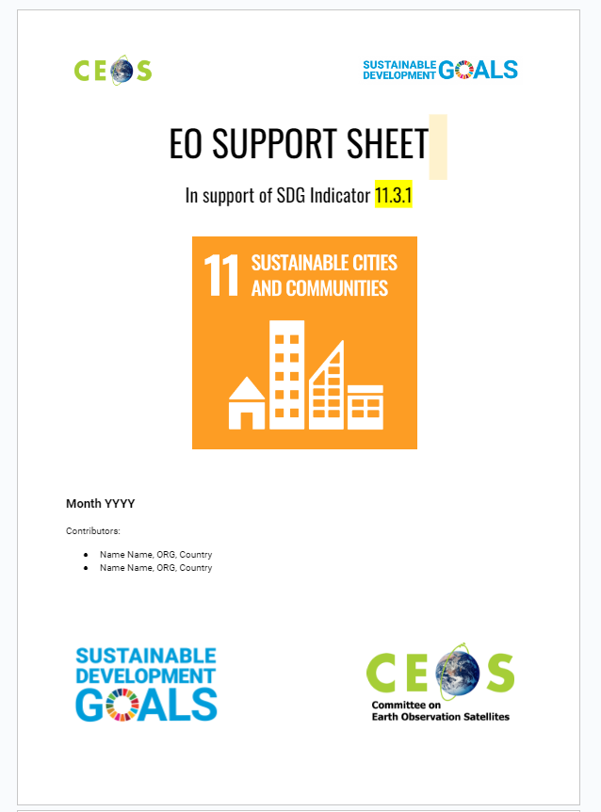
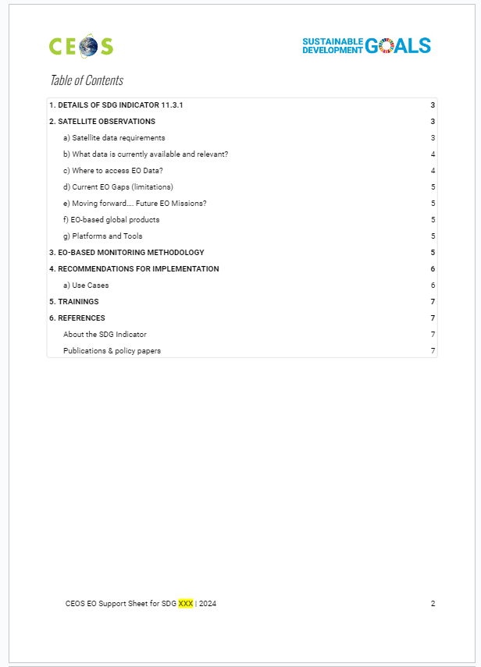
EO Support Sheets
NEW
EO Support Sheet Template
Improve content harmonization
‘One Organization’ style
Facilitate promotion internally and externally to increase impact
Capture use and impact
Increase level of details, additional data to include Future Mission considerations, and Use Cases
ceos.org/sdg
Notes:
However noting some discrepancies between the four Sheets, Libby and I developed a new Template for the EO support sheets, to improve their readability, harmonization and capture new elements (such as Future Missions that could help measure directly or indirectly some indicators), and hopefully better promote the documents, and communicate about their impact.
2024 Sheets will be published by the end of the calendar year, following the new template. It is worth noting that each Indicator is different, with various considerations, challenges, and opportunities, so the group aims to remain agile in populating those documents and assessing new ones.

Slide 9
Supporting GEO-LDN & UNCCD
SDG-23-05
Address UNCCD data concerns by conducting Cloud Cover Analysis over Small Island Developing States (SIDS), with South Pacific focus (Landsat, Sentinel-2)
Responsible: SEO, CSIRO
COMPLETED
SDG-24-05
Evaluate potential for two new Land Cover datasets to support UNCCD SDG 15.3.1 reporting guidance to member states
Responsible: SEO, CSIRO
COMPLETED
Notes:
The SEO worked directly with CSIRO and UNCCD to develop and complete those analyses.

Slide 10
UN-GGIM: “Rescuing the SDGs”
SDG-24-04
Co-author UN-GGIM IAEG-SDG WGGI* White Paper: “Rescuing the SDGs”. How can the community ensure geospatial data broadly, and EO data specifically, play a greater role in SDG national reporting between 2025-2030.
Further, how can our community influence the creation of a Post-2030 Sustainable Development global policy framework where EO is integral?
*UN Committee of Experts on Global Geospatial Information Management (UN-GGIM)
Inter-Agency and Expert Group on SDG Indicators (IAEG-SDG) Working Group on Geospatial Information (WGGI)
Notes:
24-04: It is in response to an urgent call from the UN Secretary to “rescue the SDGs” a formula somewhat provocative - that the UN-GGIM IAEG-SDGs WGGI undertook the production of a short paper outlining the benefits and calling for more systematic and targeted use of EO and geospatial data to meet the Goals.
By co-authoring this paper, we want to stress that it is critical to be part of the journey from the “beginning”, for whatever comes next after the UN Agenda 2030. Opportunities exist to advocate for an increased role of EO in a future sustainable development framework, and move away from being classified as “non-traditional” data for Earth observations.
CEOS has a unique opportunity to contribute directly to high-level and strategic policies through UN-GGIM by providing evidence of the data availability, current use, potential impact of EO satellite data to not only monitor the SDG Indicators but also address the Goals by achieving Targets..

Slide 11
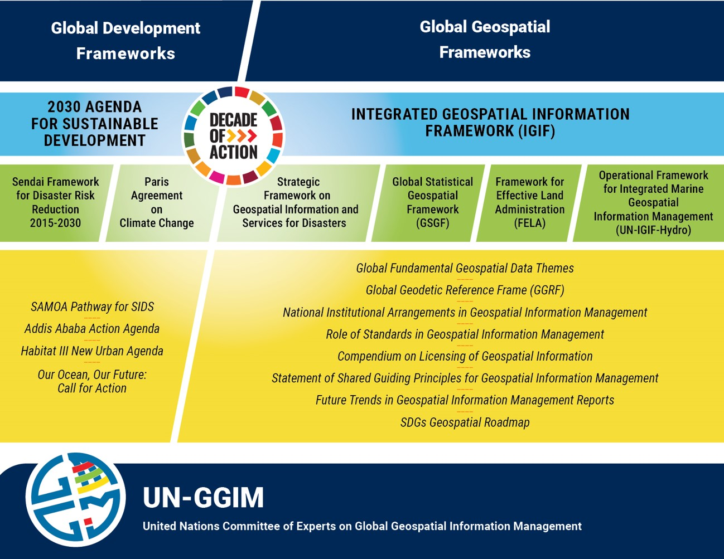
UN-GGIM: “Rescuing the SDGs”
Paper Intent
Strengthen guidance on how SDG indicators can be disaggregated by geographical location
Provide better guidance on how geography impacts indicators
Role of new data technologies and global datasets for enabling national and local SDG monitoring
Highlight need to consider improvements to SDG indicator metadata framework
Notes:
This paper intends to strengthen guidance on the use and benefits of geospatial and EO data, and enhance the role of new data technologies such as EO data analytics, and global datasets to support and complement national monitoring.
Finally, the paper aims to call for a revision to include new types of datasets (including EO from satellites).
As a contributor, we have drafted the outline and provided key elements of language to the draft paper.

Slide 12
UN-GGIM: “Rescuing the SDGs”
Paper Progress
August 2024: Endorsed at UN-GGIM 14th Session, UN HQ
September: Finalize text, submit to IAEG-SDG and produce complementary Storymap of national good practices.
October: IAEG-SDG review and hopefully adopt for submission to UN Statistical Commission.
November: Final edits and formatting, submission to Statistical Commission
January: Evaluate any response and potentially begin WGGI editing process of select, authoritative indicator metadata documents.
GEO Article: Leveraging Geospatial Data to Rescue the SDGs
Notes:
At their last meeting in August, UN GGIM endorsed the intention to publish the paper over the next few months. Noting timeframes have been quite flexible over the last few months, the eventual release and progress is at Co-chairs’ discretion, CEOS can only push for its completion.
We can definitely see the challenges for CEOS to support a global Agenda while delivering impact in the UN system.
The UN system as you all know includes Country Members and work with national delegations. GEO has played a key role in nurturing the relation between global EO community and UN system until 2022 thanks its SDG Coordinator (GEO SEC) and the EO4SDG Initiative (leadership changes). CEOS has maintained and developed direct connections with UN Custodian Agencies at the working level, which allow us to remain up-to-date with the latest on key Indicators.
Within CEOS, we have diff experiences with UN-GGIM: some of us are fully engaged and included in their national delegations, but others struggle to be heard. Hence why the SDG CG aims to develop common elements of language that CEOS Members could share and advocate for with their national delegations. We know CEOS faces similar challenges due to its nature to deal with UNFCCC on Climate, or other organisations leading global UN-based Agendas.

Slide 13
Policy Impact Opportunities
Post-2030 Sustainable Development Outlook
Open Working Group Establishment
Historically, this group was created three years prior to 2030 Agenda launch (2012)
UN Summit of the Future
Create conditions in which implementation of 2030 Agenda can more readily be achieved.
Post-2030 Sustainable Development Global Policy Framework Launch
2025
2027
2029
2024
2026
2028
2030
Comprehensive Review
Led by IAEG-SDGs, provides opportunity to improve indicator framework.
Adoption of new Framework
By decision UN Statistical Commission (UNSC)
Notes:
In a similar vein, this is to highlight the Policy Impact opportunities that we see for CEOS in the Sus Development field, with key upcoming events and milestones that CEOS may consider joining.

Slide 14
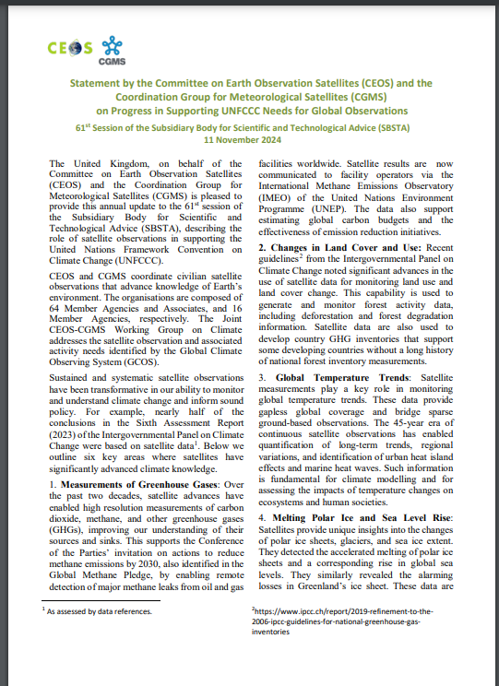
SDG CG & WG Climate
SDG 13: Take urgent action to combat climate change and its impacts
Target 13.2: Integrate climate change measures into national policies, strategies and planning
Indicator 13.2.2: Total greenhouse gas emissions per year
‘80% of the SDGs are linked to climate. Both agendas are still compartmentalized and viewed in silos, putting their achievement at risk.’
-Dennis Francis, President 78th UN General Assembly
2025: SDG CG & WG Climate to partner, explore ways to create a fifth EO Support Sheet addressing indicator 13.2.2
Notes:
Speaking of Climate. We saw yesterday the importance of the engagement with UNFCCC, the delivery of the joint CEOS-CGMS SBSTA statement showing impacts, the new GHG EO portal…
We recognise that SDGs, Climate and Biodiversity Agendas are CEOS priorities with essential synergies to build upon. So we feel like CEOS should coordinate more to address these priorities with current resources.
We have reached out directly to WG based on CEOS priorities and capacities. WG Climate has responded positively and is willing to help us address SDG 13 with the Indicator 13.2.2 (“Total greenhouse gas emissions per year).
We would like to thank Wenying (NASA) for her enthusiasm and willingness to explore the possibility of creating a new EO Support Sheet next year, noting that EO data are not yet included in the Metadata, so further work and lobbying needs to happen between UNFCCC and WG Climate on this topic.

Slide 15
SDGs & Biodiversity
UN 2024 Report: only 17% of the Sustainable Development Goals (SDGs) are on track, with progress stalled or regressed on over one-third of the goals.
Deep transformative solutions are urgently needed.
80 % of SDG targets directly linked to climate,
2023 IUCN Report:
State of biodiversity is in severe decline, with deforestation, land degradation and species extinctions all moving in the wrong direction to meet the Sustainable Development Goals
more than 12,000 species are affected by climate change according to the IUCN Red List of Threatened Species™
“A sustainable future is only possible with healthy nature at its core (...)”
Dr Grethel Aguilar, Acting Director General of IUCN. September 2023
Notes:
As per Climate, it has become more important to intersect our work with Biodiversity and Ecosystems Extent as demonstrators developed are actually great contributions to SDG 15 for instance.
In 2023, UNDESA (Department of Economic and Social Affairs supervising implementation of global Agendas and summits) and the UNFCCC Secretariat co-convened the Expert Group on Climate and SDG Synergy to tackle these intertwined challenges. by developing the First Global Report on Climate and SDG Synergies. A second report in 2024 looked into SDGs and Biodiversity synergies.
The state of biodiversity is in severe decline, with deforestation, land degradation and species extinctions all moving in the wrong direction to meet the Sustainable Development Goals.
While the Biodiversity Study Team will explore ways for CEOS to contribute in an impactful way, the SDG CG is open to discuss best ways for CEOS to provide data, tools, services to improve monitoring of key variables and help achieve ambitions of both communities.

Slide 16
CEOS Strategic direction on SDG
Plenary Discussion…
SDGs remain the least resourced of all 4 CEOS Priorities … but additional effort to fully support the SDG Framework is needed
Strategy led by SIT Chair - how to ensure its continuity
External engagement: supported by CEO/SIT Chair/Chair: UNCCD & UN-GGIM: by providing EO-based information to influence policy development and implementation
… to potentially deliver in 2025:
EO Support Sheets annual updates
Exploring ways to produce a 5th EO Support Sheet – GHG Emissions (UNFCCC and WG Climate)
Multiple requests from UNCCD – evaluation underway
Partner with any follow-on activities of Ecosystem Extent Task Team/Biodiversity - key to demonstrate the value of integration of optical/radar/hyperspectral
“Rescuing SDGs” paper outcomes – potential revision contributions of indicator metadata
Joint CEOS strategic communique to feed into national delegations to UN-GGIM and similar meetings
Synergies between SDGs, Climate & Biodiversity global Agendas to drive meaningful impact for end-users: -> support from with WG Climate is appreciated, hopefully close links with Biodiversity Study Team, and others WG CapD
Notes:
As Eric noted yesterday in his remarks, the SDGs remain the the 4th strategics priorities of CEOS but the least resourced with only a few embers in a Coordination Group, tapping into expertise as needed.
To tackle this - I would like to underline that we, in CEOS, should aim for overcoming silos and policy challenges to close the Climate, Biodiversity & SDGs ambitions gaps. It is no longer feasible to treat climate change and sustainable development separately. By tackling these two critical agendas together, we can multiply impacts and bridge investment gaps, including CEOS Agencies resources.
For instance, when this CG engages directly with UNCCD (2 deliverables this year, and more next year), or reach out internally to tap into existing expertise in Climate/GHG team, COAST VC, WG CapD or Ecosystems Extent, we are contributing to address several priorities. Moving forward, this needs to be further acknowledged and integrated in resources mobilisation to accomplish the work.
We have started to think about our future work, and what this group should be doing.
These are a few ideas that have been discussed over the last few months:
- obviously, we would like to keep an annual update of the EO ss, and explore if we could develop a new one with Climate.
We are fully aware of the UNCCD letter which potentially includes a few deliverables led by this group – this will be discussed shortly after, but noting that should CEOS Principals approve the requests outlined in the letter, this will need additional and appropriate resources.
We wish to engage further with the EETT on activities that can support both Agendas
We hope to remain involved in the Rescuing SDGs Paper as requested
And finally as mentioned before, we aim to develop a joint communique that could feed into our national delegations attending UNGGIM meetings or similar.

Slide 17
MERCI !
SDG Coordination Group
led by SEO/CSIRO and SIT Chair
Flora KERBLAT
CSIRO Centre for Earth Observation
Senior international project manager & engagement lead (CCEO & AquaWatch Australia)
flora.kerblat@csiro.au

Slide 18
Background information

Slide 19
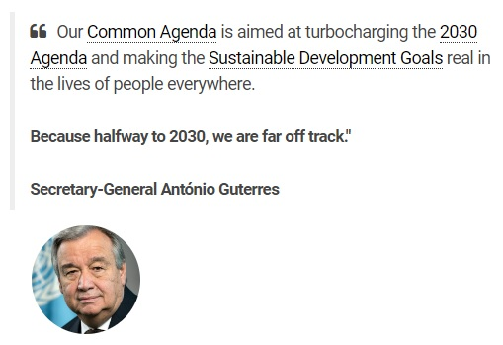
Policy Impact Opportunities
SDG reporting architectures are based on “Country-owned, Country-led” national statistical data
Large data gaps are well documented, limiting country abilities to report on progress
Earth observations were classified as “Non-Traditional Data Sources”
Opportunities exist to advocate for increased role of EO in future sustainable development framework

