Slide 1
2024 CEOS Plenary
Status of EUMETSAT programmes
Phil Evans
Director-General
Montréal, 24 October 2024

Slide 2

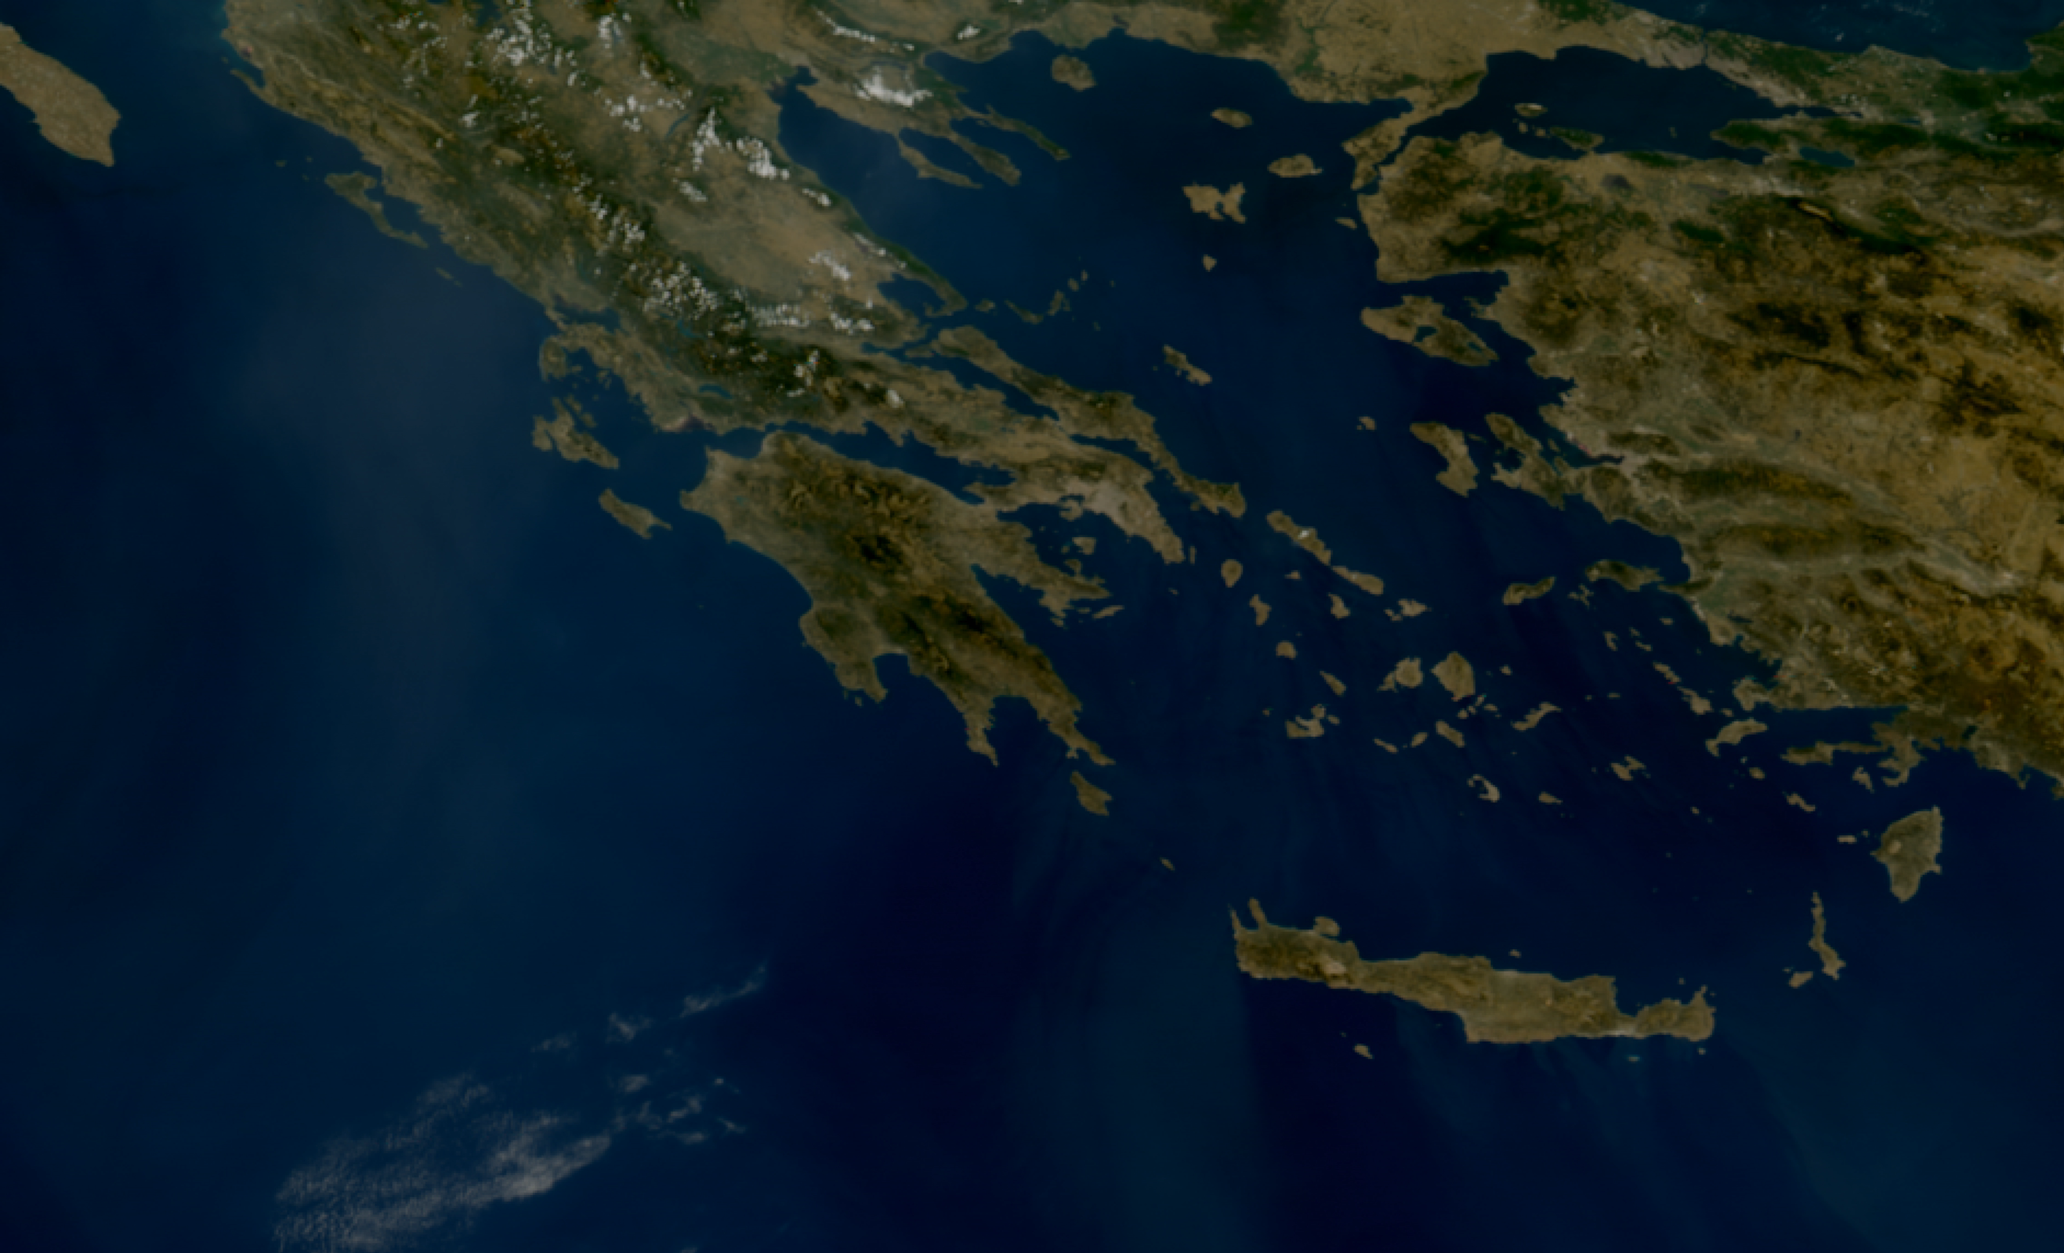
MTG-I1 goes operational
FCI and LI operational L1C products will go operational early December
MTG-I1 renamed Meteosat-12

Slide 3
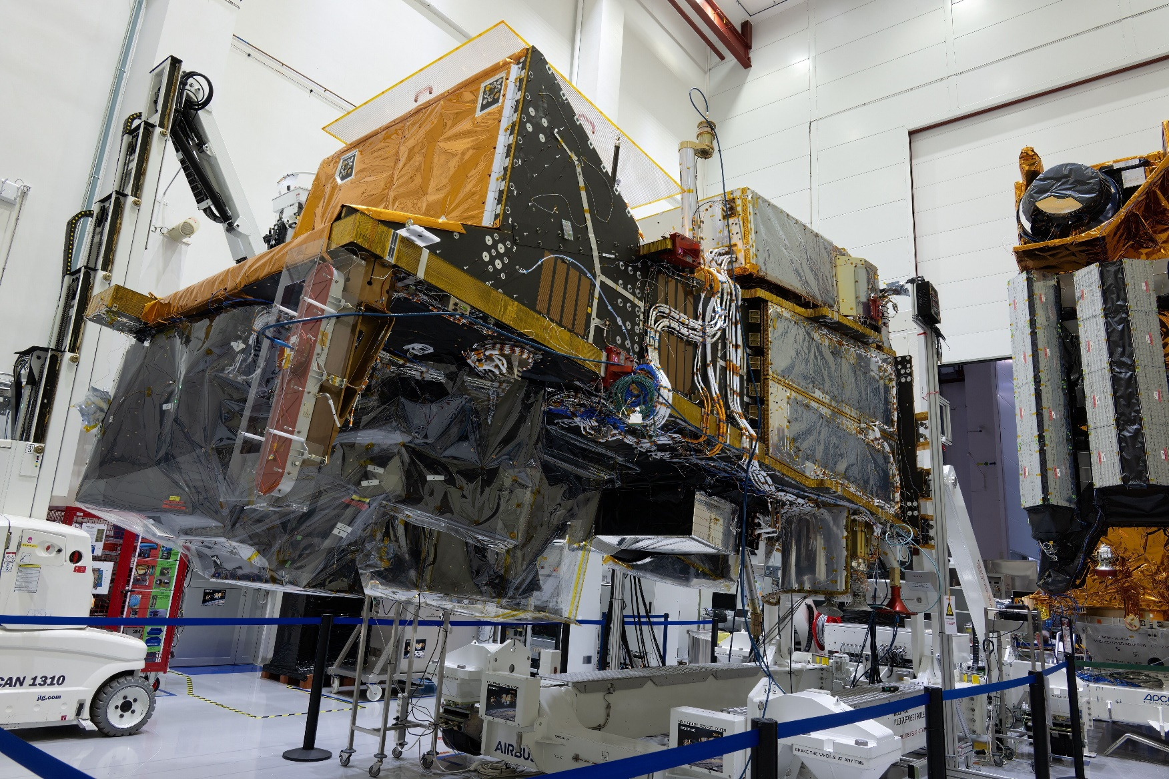

Metop-SG-A1 coming in 2025 with many launches
Launch in 2025 – 2026
- MTG-S1 : Q3/2025
- Metop-SG-A1 : Q4/2025
- MTG-I2 : Q2/2026
- Metop-SG-B1 : Q2/2026
Metop-SG-A1 and Metop-SG-B1 in Airbus clean room

Slide 4
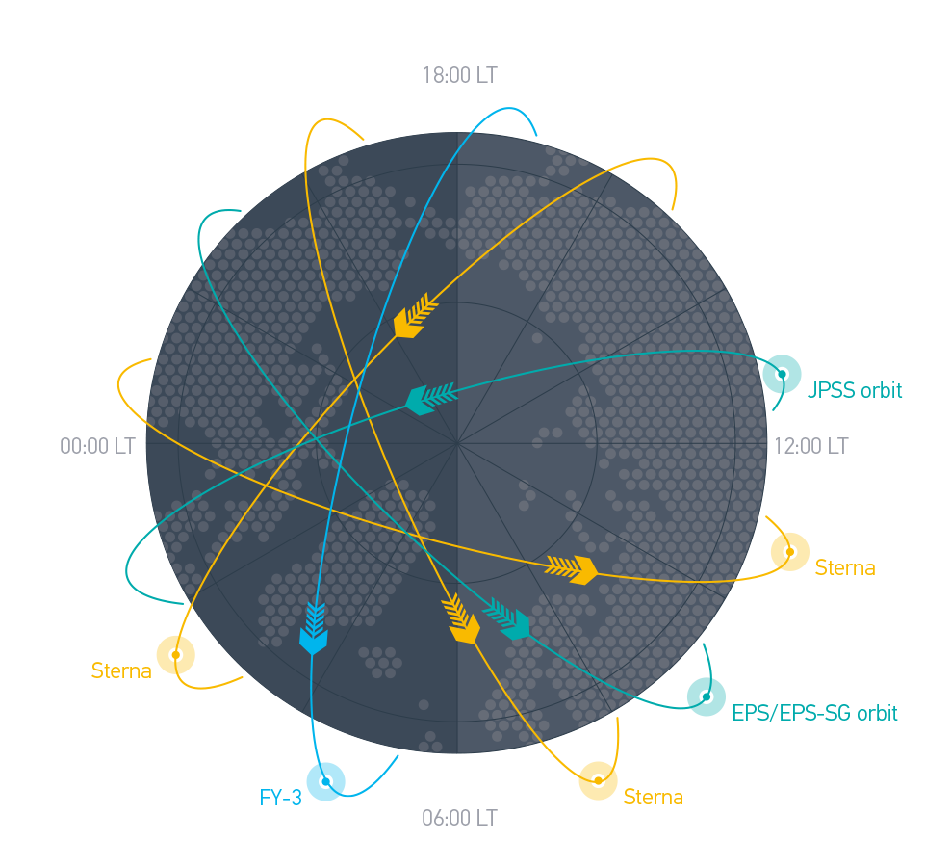
EPS-Sterna
A European contribution to the global observing system, complementary to Metop-SG, JPSS and FY-3 satellites
Relying on a Socio-Economic Benefits study demonstrating a Cost to Benefit ratio of 1:51
Opened for approval in July 2024
10 positive votes out of 30 as of today
Full approval expected by June 2025 for first launch in 2029
An opportunity for international cooperation – on-going discussions with NOAA

Slide 5
First lessons learned from commercial RO data buy
Initial Pilot Project August 2022 – August 2024 followed by new contract until August 2026
Users valued consistent processing, quality control and monitoring
The required monitoring to secure scientific quality and operations was complex and required comprehensive development and updates to processor configuration and quality control especially early in the pilot, with frequent updates and data evaluations throughout the pilot;
Diagnosing issues found in the data is more challenging than with satellites owned and controlled by EUMETSAT
EUMETSAT Member States (30) saw benefits in having the organisation doing the necessary quality control and providing the operational data flow on their behalf
Benefits of international cooperation were clear – exchange of data with NOAA through global licensing
Value of the service was demonstrated but at substantial cost of significant efforts

Slide 6

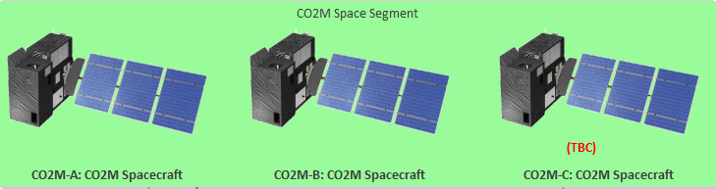
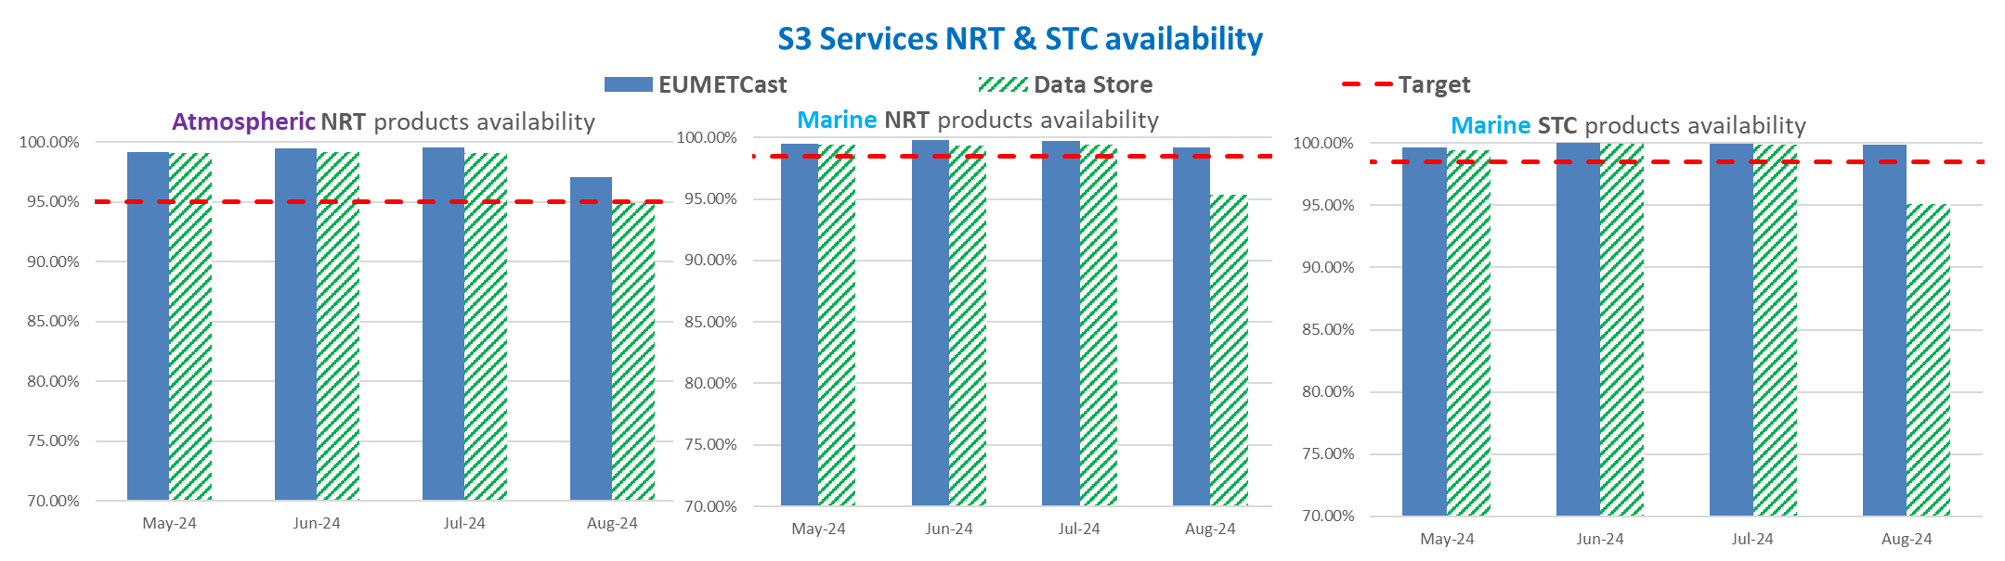
Copernicus : Operational support and ramp-up for future missions
Operational service delivered from Sentinel-3 and Sentinel-6
Sentinel-4 and -5 soon in orbit on MTG-S and Metop-SG-A1
Preparation of operations for CO2M constellation and generation of global ocean and atmosphere products from CRISTAL and CIMR

Slide 7

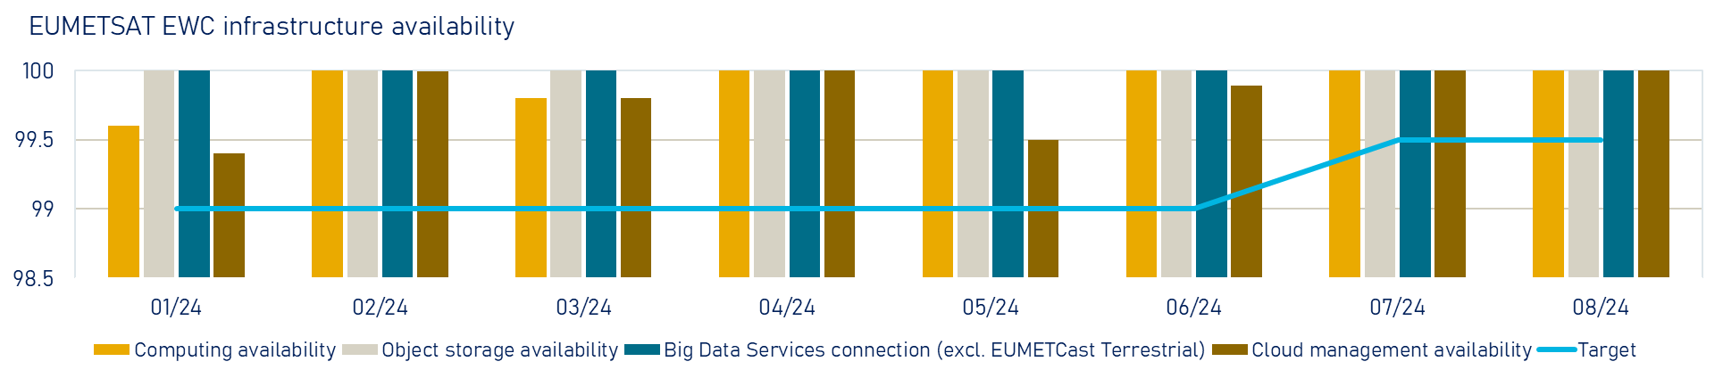

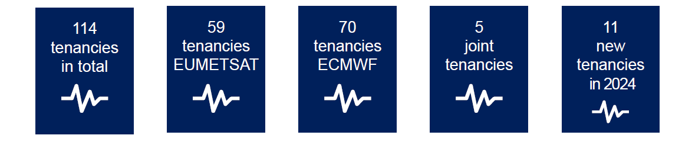
Evolution of EUMETSAT data services
Towards more cloud-based solution
EUMETSAT data store and EO portal
European Weather Cloud
DestinE Data Lake

Slide 8
And we cannot conclude without mentioning AI …
EUMETSAT AI/ML roadmap under implementation
Assessment of implication of AI on our main users starting with ECMWF
Contribution to EUMETNET E-AI programme – focus on data curation and data readiness for AI/ML applications
2022/23
M1 - Establishment of a dedicated AI/ML call for joint project (supported through fellowships)
M2 - Building EUMETSAT AI/ML coordination team
M3 - Explorative workshops for new action areas
2023/24
M4 - Running initial projects as Pathfinders for AI/ML
M5 - Tailoring EWC software for AI/ML
M6 - Developing training data set for Pathfinders
2024/25
M7 - Workshop on AI/ML EUMETSAT applications
M8 - Large AI/ML context (i.e., MOOC)
M9 - Evaluation from STG and SWG
2025/26
M10 - Evaluation of AI/ML roadmap by PAC
M11 - Approving and establishing Phase 2

Slide 9
Questions?

