Slide 1
CEOS Plenary 2024
Natural Resources Canada
Agency Report
Mathieu Benoit
Eric Loubier
Natural Resources Canada
Agenda Item 5.1.7
38th CEOS Plenary
Montreal, Canada
23-24 October 2024

Slide 2
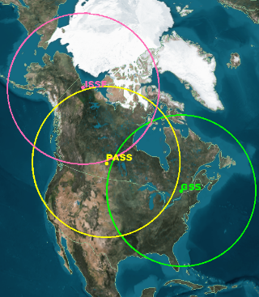
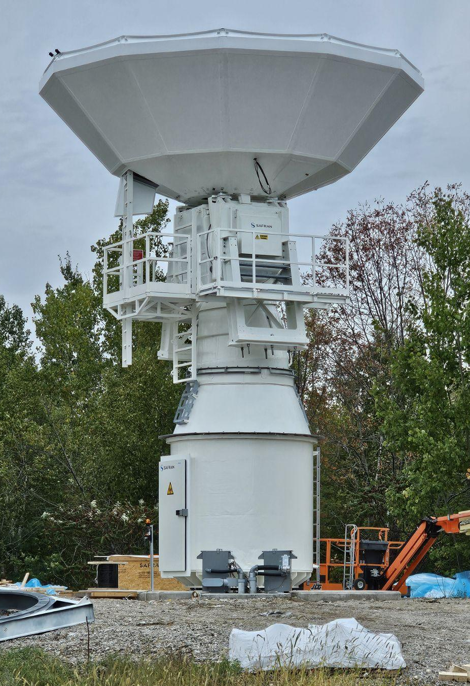
Next Generation Ground Segment
  New X/Ka/S Antennas
  +1 Gatineau
  +1 Prince Albert
  +2 Inuvik
  Increased Capacity
  Improved Resilience
  Enhanced Security
New Installation At Gatineau Satellite Station, October 2024.

Slide 3


WildFireSat (WFS) Mission
Capable of providing global coverage. International scope is presently under consideration.
Capable of providing global coverage. International scope is presently under consideration.
When fully operational in 2029, WFS will be the world’s first purpose-built operational satellite system for wildfire monitoring
Focus daily on late afternoons during peak wildfire activity – products in 30 min.
Data also will be integrated into carbon, smoke and air quality modelling and forecasting.
Capable of providing global coverage. International scope is presently under consideration

Slide 4
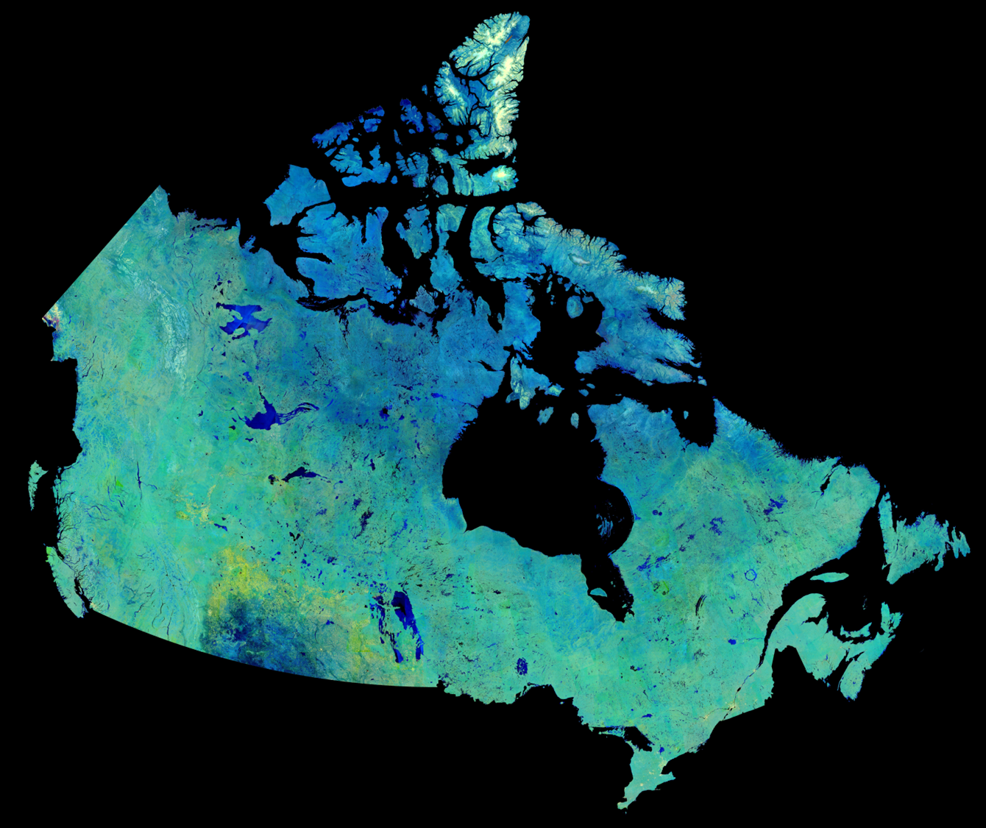




RADARSAT ARD and EODMS
Earth Observation Data Management System
Securing and Serving 3 Generations of RADARSAT Data
30m RCM Compact Polarimetry Data Processed to ARD
SAR Toolbox ⚙
SAR processing made simple

