Slide 1
CEOS Plenary 2024
Environment and Climate Change Canada
Agency Report
David Harper
Environment and Climate Change Canada
Agenda Item 5.1.6
38th CEOS Plenary
Montreal, Canada
23-24 October 2024

Slide 2
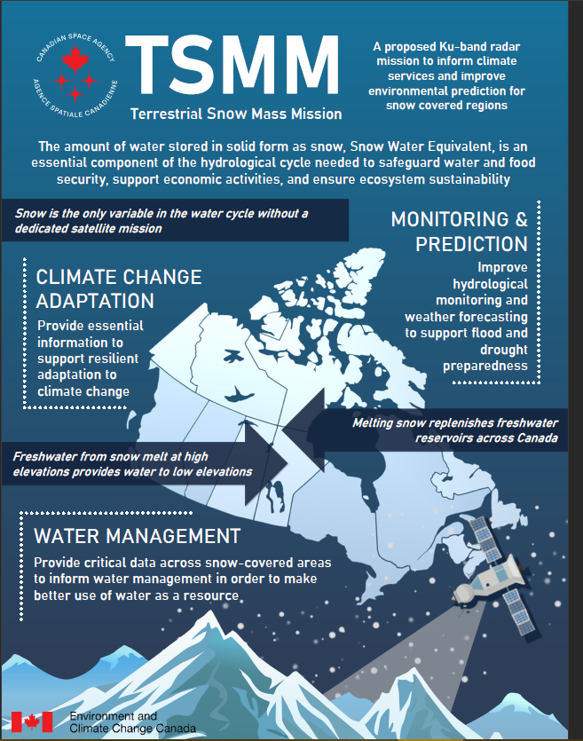
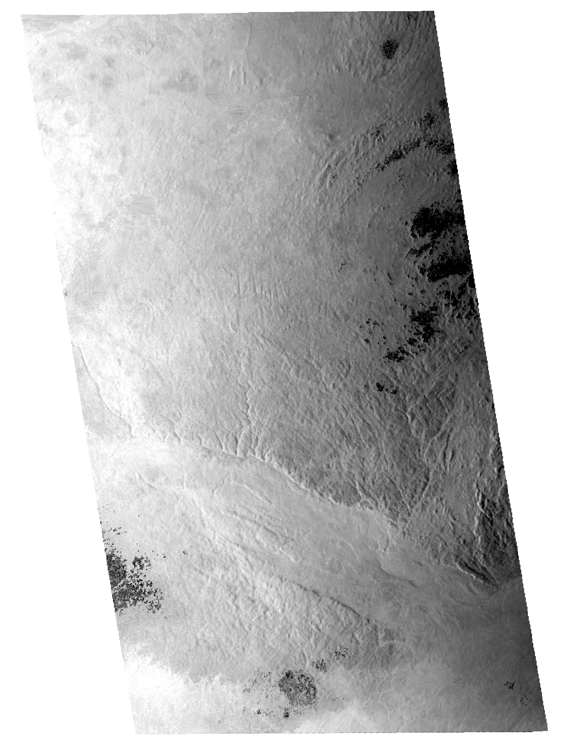
Terrestrial Snow Mass Mission
Preliminary design phase completed
Updates to the mission costing analysis are in progress to ensure responsiveness to potential funding opportunities
Mission simulator delivered to ECCC to advance science readiness
Continued development of domestic and international collaborations and partnerships
Consortium of Canadian universities working on TSMM-related science, including airborne radar campaigns
Simulated TSMM radar image (VV)
Ottawa River watershed
3 February 2023

Slide 3
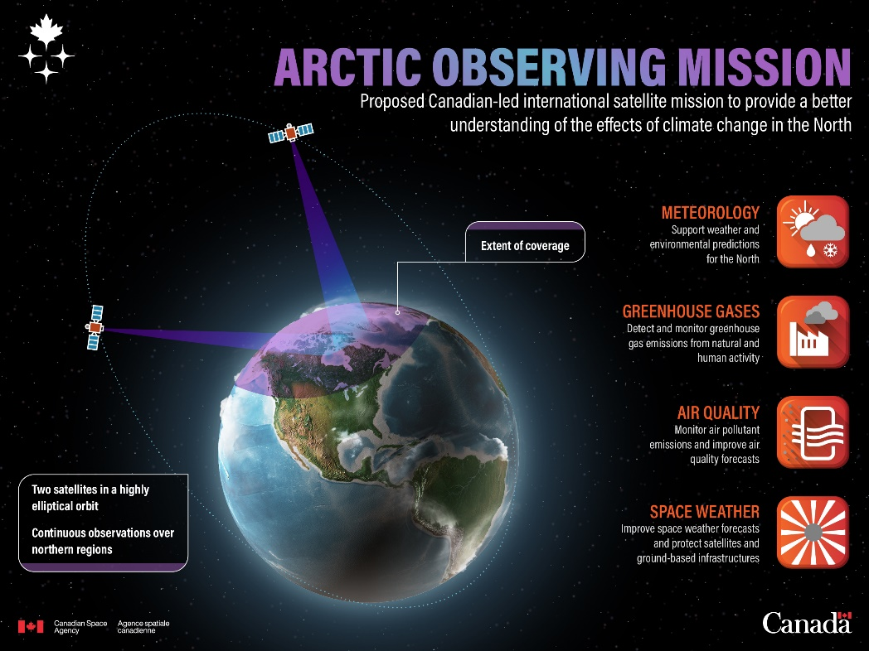
Arctic Observing Mission
AOM is undergoing a pre-formulation study
A Mission Design Contract to assess mission architecture options and costs is scheduled to be completed this year
S&T development studies are ongoing with Canadian industry and academia
Socio-economic benefit study completed in 2023, outlines significant potential benefits to Canada
Substantial proposed contributions from prospective international partners are being refined (NOAA, NASA, EUMETSAT)
Observations
north of
~40-45°N

Slide 4
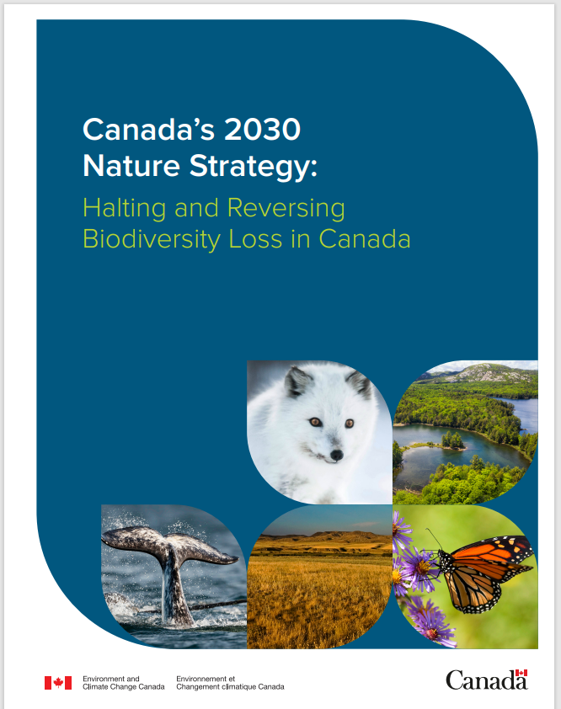
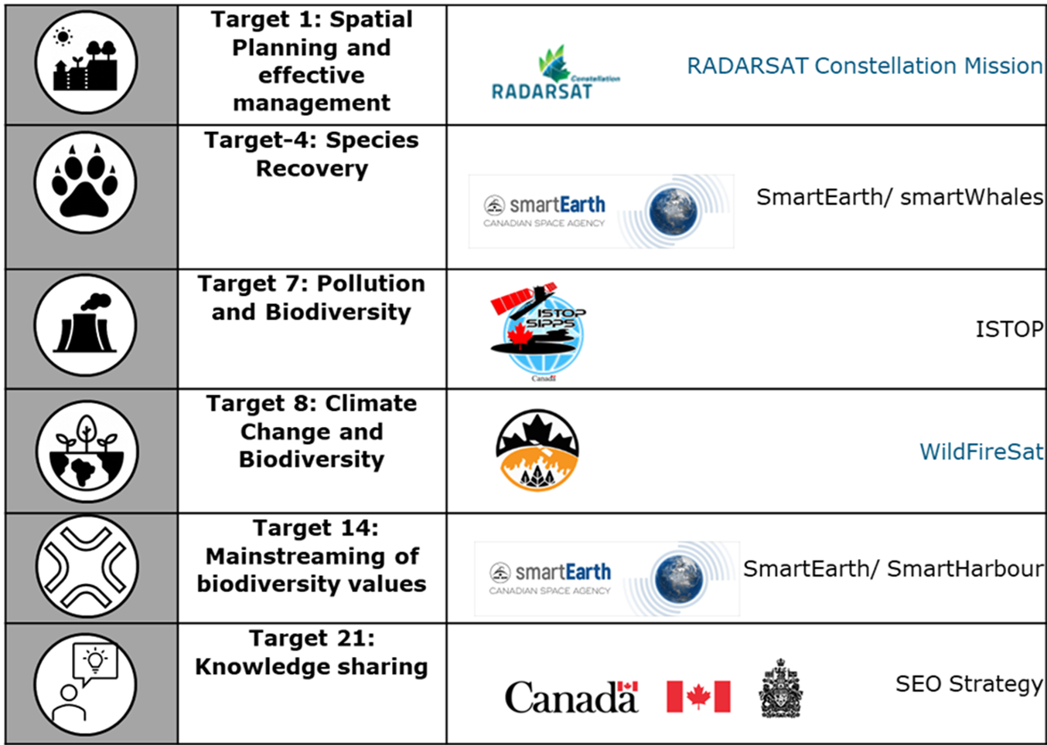
Canada’s 2030 Nature Strategy
Satellite EO references included in published strategy (June 2024)…

Slide 5












Canada’s SEO coordination approach
European Organisation for the Exploitation of Meteorological Satellites
Group on Earth Observations
Coordination Group on Meteorological Satellites
Committee on Earth Observation Satellites
International Charter on Space & Major Disasters

Slide 6
Thank you for your attention

