Slide 1
CEOS Plenary 2024
CSA Agency report
Guennadi Kroupnik, CSA
Agenda Item 5.1.5
38th CEOS Plenary
Montreal, Canada
23rd - 24th October, 2024

Slide 2
RADARSAT+
Notes:
In 2023, the Government of Canada announced $1.012 billion to address immediate and future EO data needs, including:​
​
Funding for an RCM replenishment satellite to enhance resiliency of the system and ensure coverage of areas of interest, including the Arctic​
​
Funding for the definition of a next-generation satellite system to maintain Canadian EO capabilities in the long term and meet Canada’s evolving needs for satellite SAR imagery

Slide 3
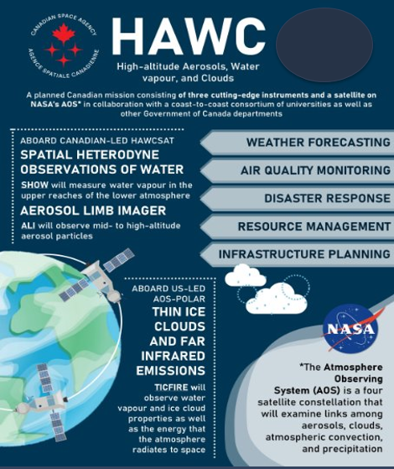
HAWC
High-Altitude Aerosols, Water Vapour and Clouds
$200 million investment from the Government of Canada
Three distinct projects
Canadian Instrument (TICFIRE) on NASA AOS Satellite
Canadian satellite (HAWCSat) with two Canadian instruments (ALI and SHOW)
Development of downstream science applications
Objective: Improve extreme weather prediction, climate modelling, and monitoring of disasters.

Slide 4
Digital Earth Canada (DEC)
Notes:
DEC is a near-term priority for the Government of Canada

Slide 5
Satellite Earth Observation office
Three high-level objectives of the SEO Office:
Coordinate consultation efforts with national stakeholders & partners
Facilitate collaborative relationships with national & international stakeholders
Collect and synthesize relevant information for the advancement of GC priorities in Earth observation
New entity hosted within CSA
Brings together EO actors within GC
Environment & Climate Change Canada (ECCC)
Natural Resources Canada (NRCan)
Canadian Space Agency (CSA)

Slide 6
Thank you! / Merci!

