Slide 1
2024 CEOS Plenary
Report from German Space Agency (DLR)
Godela Rossner & Klaus Schmidt German Space Agency, DLR
Agenda Item 5.1.4
38th CEOS Plenary
Montreal, Canada
23rd – 24th October 2024

Slide 2
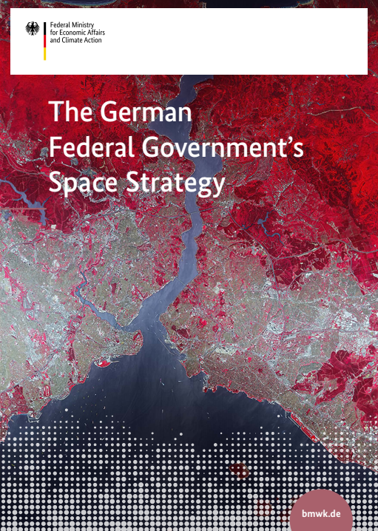
New German Federal Government´s Space Strategy
Focus on
European and international cooperation
Space industry as a growing market: high-tech and new space
Climate change, resources and environmental protection
Digitalisation, data and downstream
Security, strategic ability to act, and global stability
Sustainable use of space
Space research
International space exploration
Space in dialogue and talent recruitment
https://www.bmwk.de/Redaktion/EN/Pressemitteilungen/2023/09/20230927-adoption-of-the-federal-governments-new-space-strategy.html

Slide 3
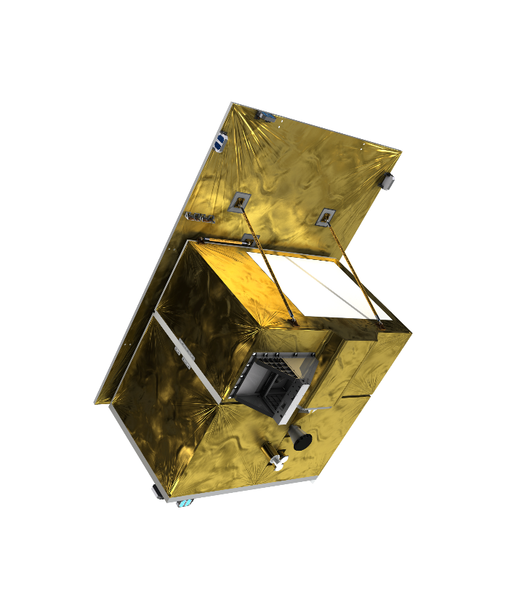
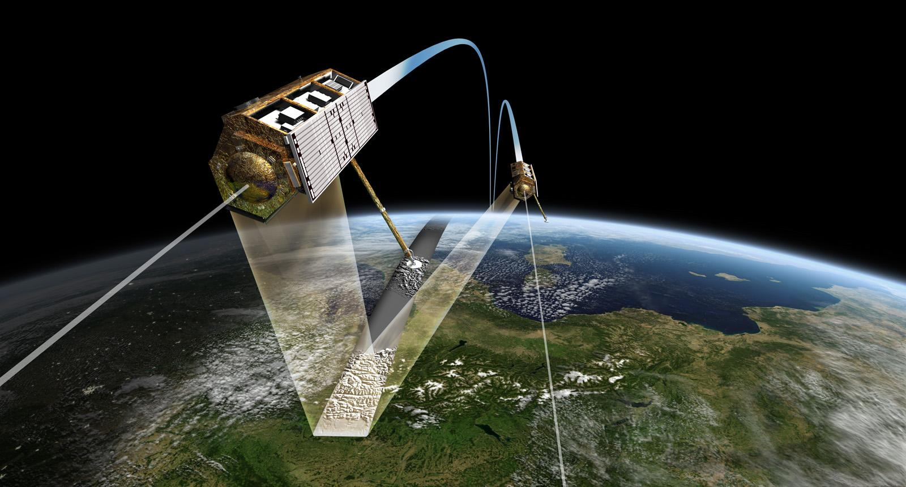
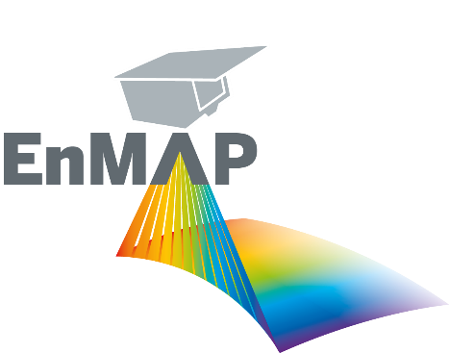
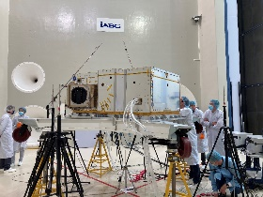
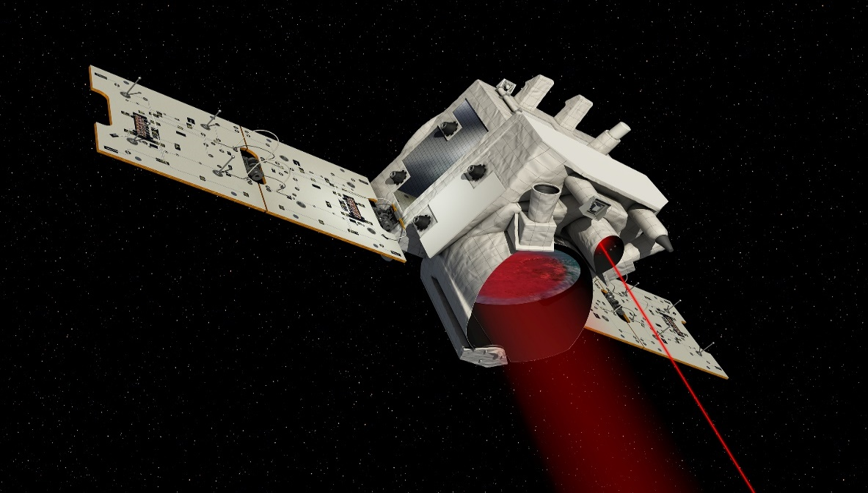
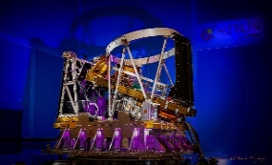
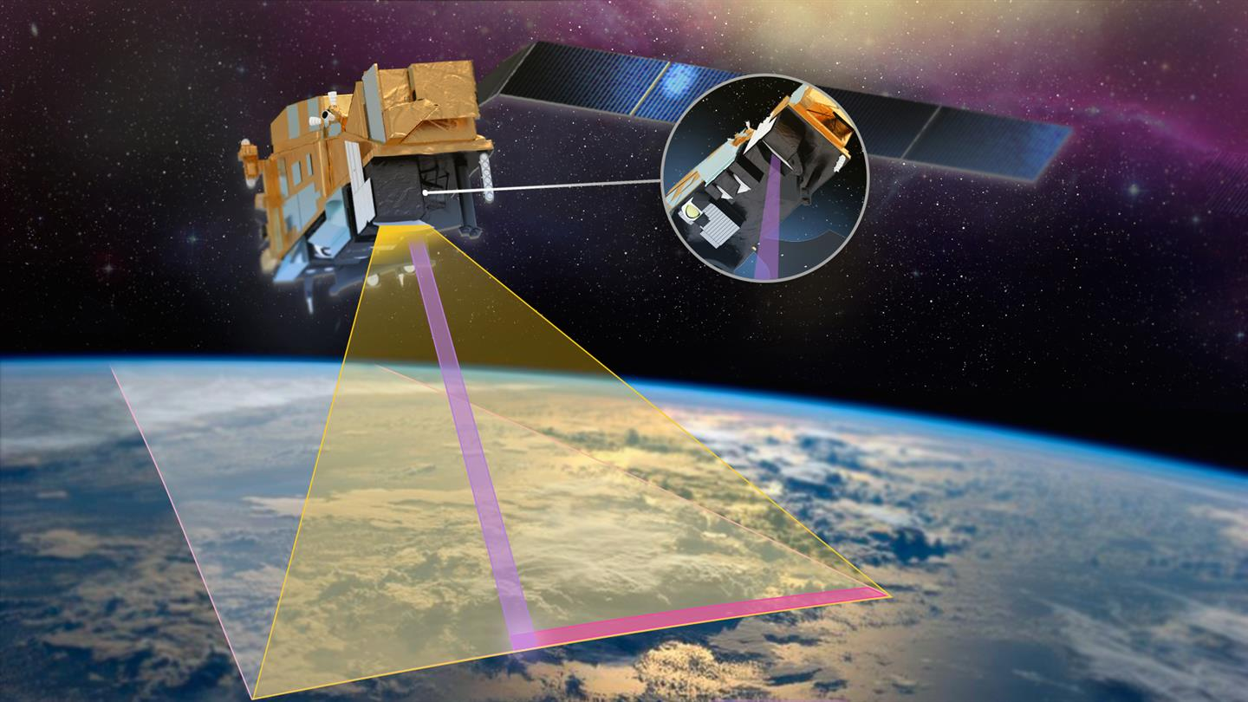
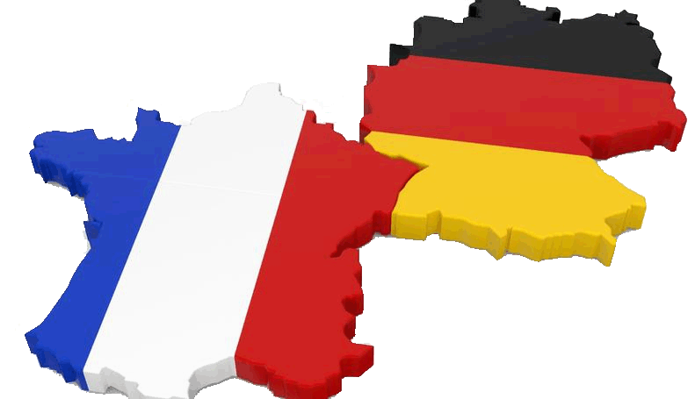
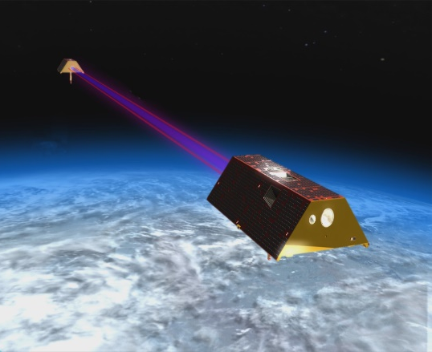
Earth‘s surface
Environment, Resources
Mission X-Band-Radar
- TerraSAR-X (2007)
- TanDEM-X (2010)
New Radar-Mission
- X-Band Continuity
- Focus on multistatic
Current status
- Phase 0 studies
Mission Hyperspectral
EnMap (2022)
Objectives
- Technology lead, F&E
- Establish applications
- Continuity in Copernicus
Current status
- Phase E
Climate
Weather
Mission LIDAR
Merlin (2029)
Objectives
Measurement of global CH4-concentration
Current status
Phase D
Mission Multispektral
METimage (2025) + 2 recurrent units
Objectives
- Establish German technology in MetOP-Program
- Strengthen German industry in optics
Current status
PFM delivered, Phase D
Gravity, Hydrology
Mission Laserlink/Platform
GRACE FO (2018)
Objectives GRACE-C (2028)
Continuity to GRACE FO
Collaboration with NASA
Current status
Phase C

Slide 4
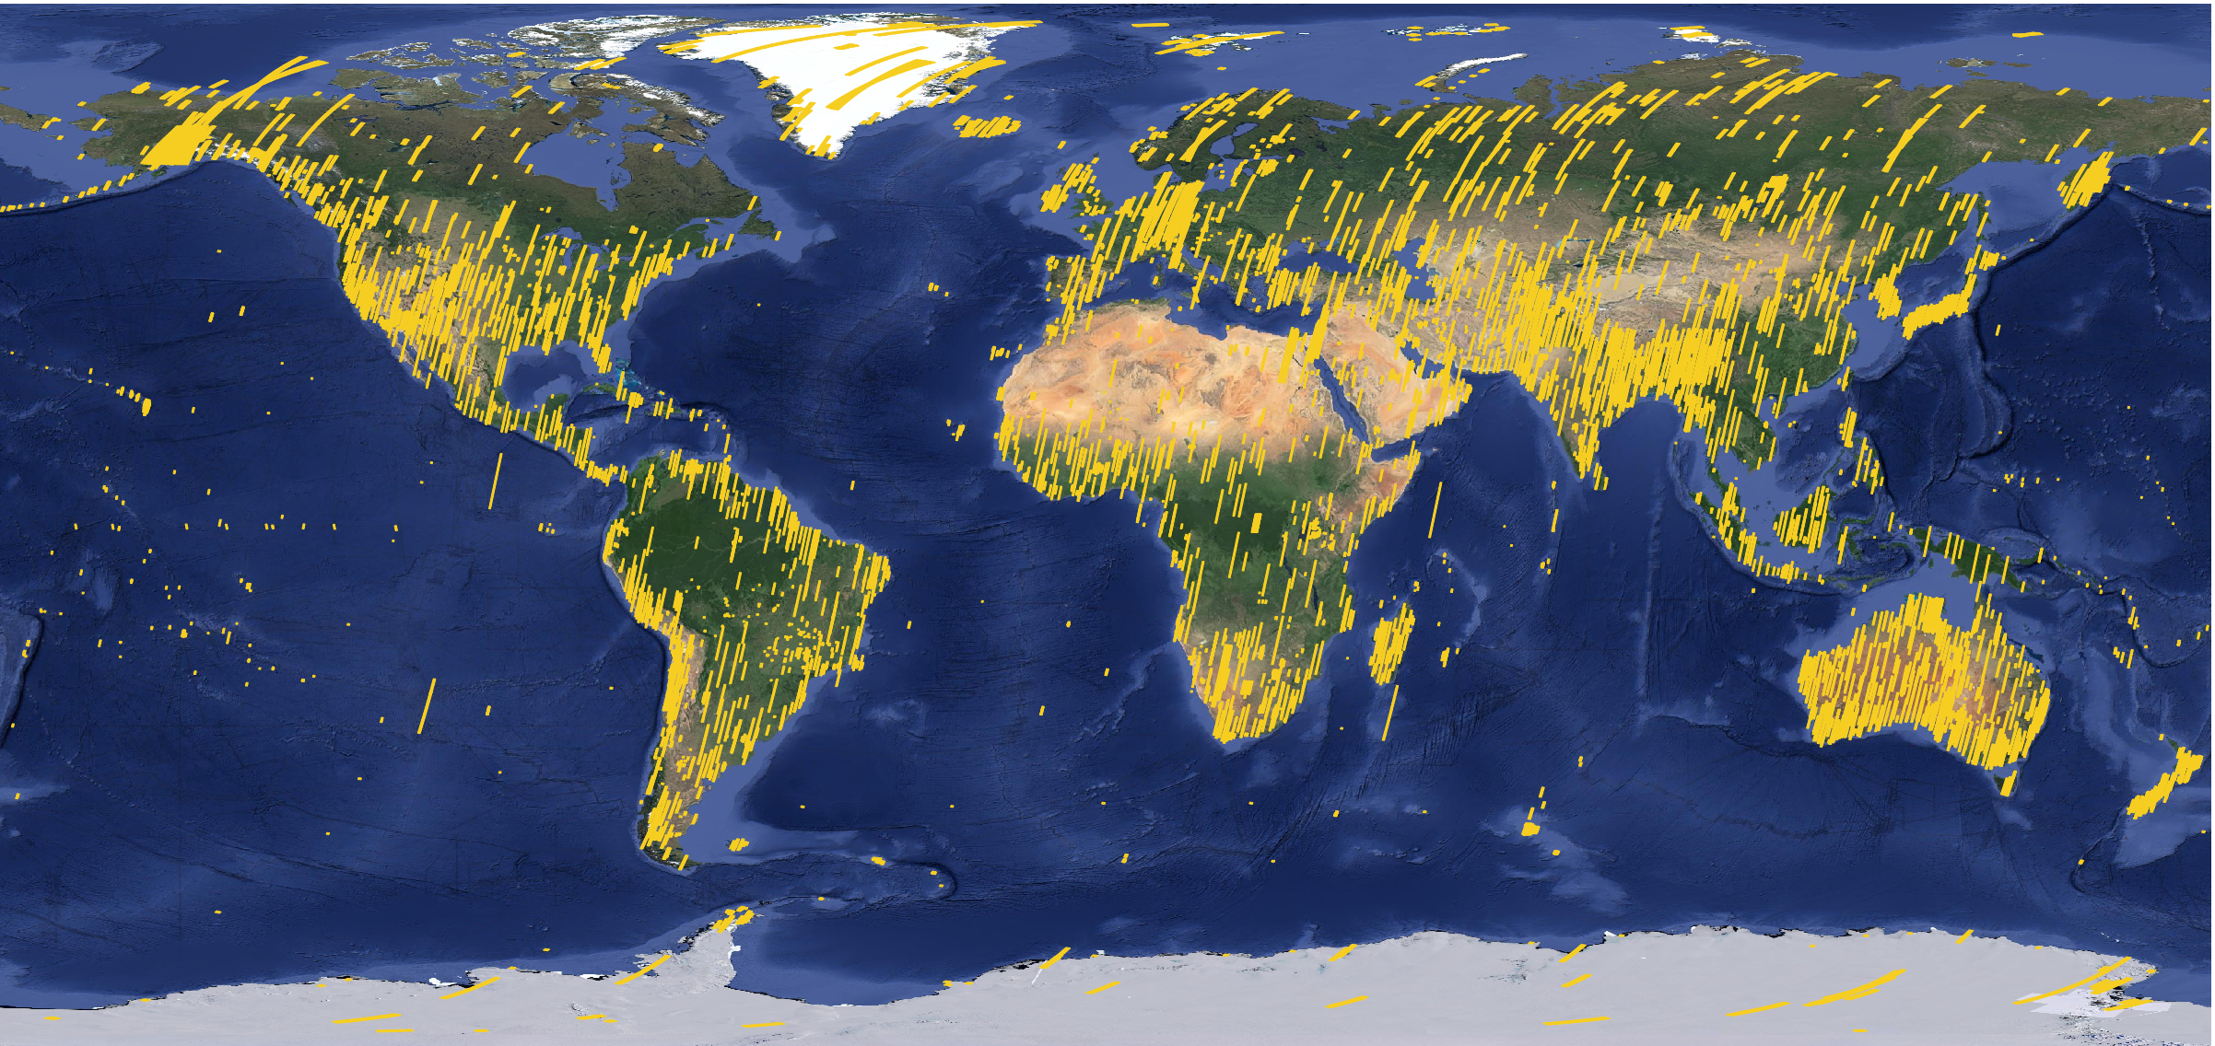
Data & Access
EnMAP - Environmental Mapping and Analysis Program
Mission in routine operation – Phase E
all infos here
all infos here 🡪
Request future orders
Archived Data
L1B, L1C, L2A data
On demand processing
Full Mission
Archive
https://planning.enmap.org/
L2A
Analysis Ready Data
Large volumes
Data explorer
credit: Emiliano Carmona
Data quality beyond expectations !
Worldwide User community and many application cases !
2024: European Foreground Mission based on User Workshops
Global Background Mission covering CHIME, IMEO and PIC sites
Ongoing validation activites and campaign coordination with support of GFZ Potsdam
Open Science program: MOOCs and HyperEDU
L0 quicklooks
2nd EnMAP Workshop
all infos here 🡪
2 – 4 April 2025 in Munich (Germany)
Registration and abstract submission open!
Launch
Operational phase
2022
now
2026

Slide 5
Data & Access
EnMAP - Environmental Mapping and Analysis Program
Mission in routine operation – Phase E
all infos here
all infos here 🡪
Request future orders
Archived Data
L1B, L1C, L2A data
On demand processing
Full Mission
Archive
https://planning.enmap.org/
L2A
Analysis Ready Data
Large volumes
Data explorer
credit: Emiliano Carmona
credit: Nicole Pinnel
Data quality beyond expectations !
Worldwide User community and many application cases !
2024: European Foreground Mission based on User Workshops
Global Background Mission covering CHIME, IMEO and PIC sites
Ongoing validation activites and campaign coordination with support of GFZ Potsdam
Open Science program: MOOCs and HyperEDU
L0 quicklooks
2nd EnMAP Workshop
all infos here 🡪
2 – 4 April 2025 in Munich (Germany)
Registration and abstract submission open!
Launch
Operational phase
2022
now
2026

Slide 6
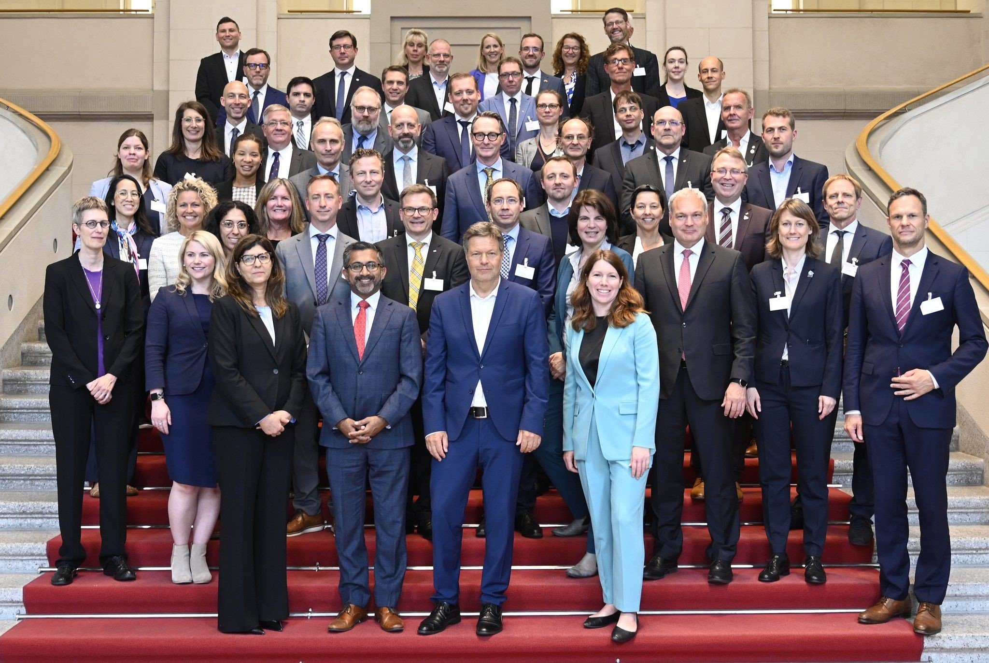
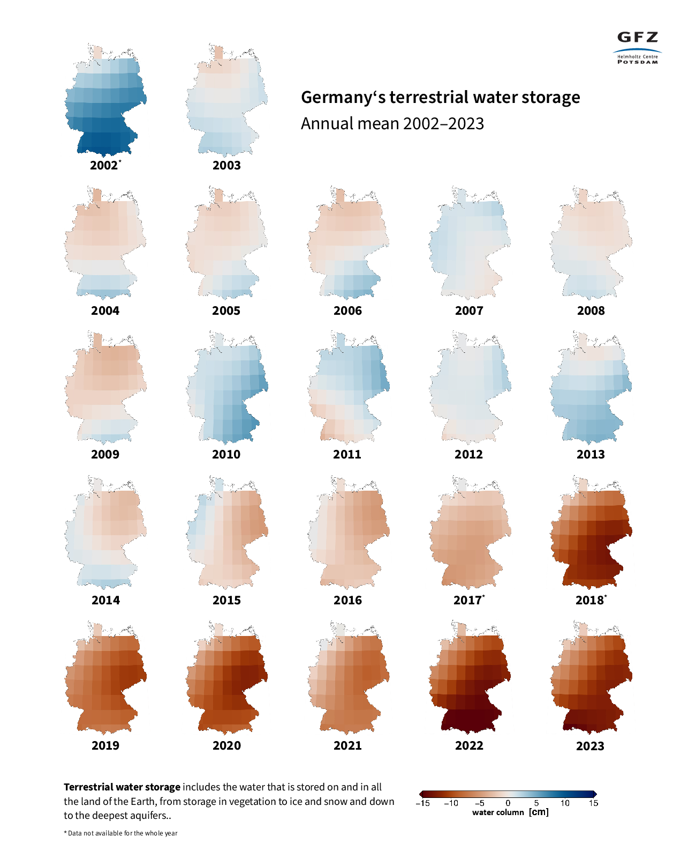
US – German Series of Gravity Missions, 2002-present
Global Climate Observing System (GCOS) defined Terrestrial Water Storage (TWS) in 2020 as Essential Climate Variable (ECV)
Germany is committed, as international partner to the US, to implement continuity in TWS monitoring beyond GRACE-FO
The NASA-DLR mission GRACE-Continuity (GRACE-C) has completed phase B successfully in 2024 and is currently finishing the design activities, with CDR scheduled for spring 2025.
Laser ranging interferometry (LRI, technology demonstrated on GRACE-FO) now replacing microwave ranging.
German contributions similar to GRACE-FO: optical components LRI, launcher, mission operations, SDS contribution; management by German Space Agency
German Contributions are supported by German national partners GFZ and AEI
GRACE-C Launch is scheduled for end of 2028
Notes:
US-German missions GRACE and GRACE-FO are a success story providing gravity data of unprecedented quality (2002 - present)

Slide 7
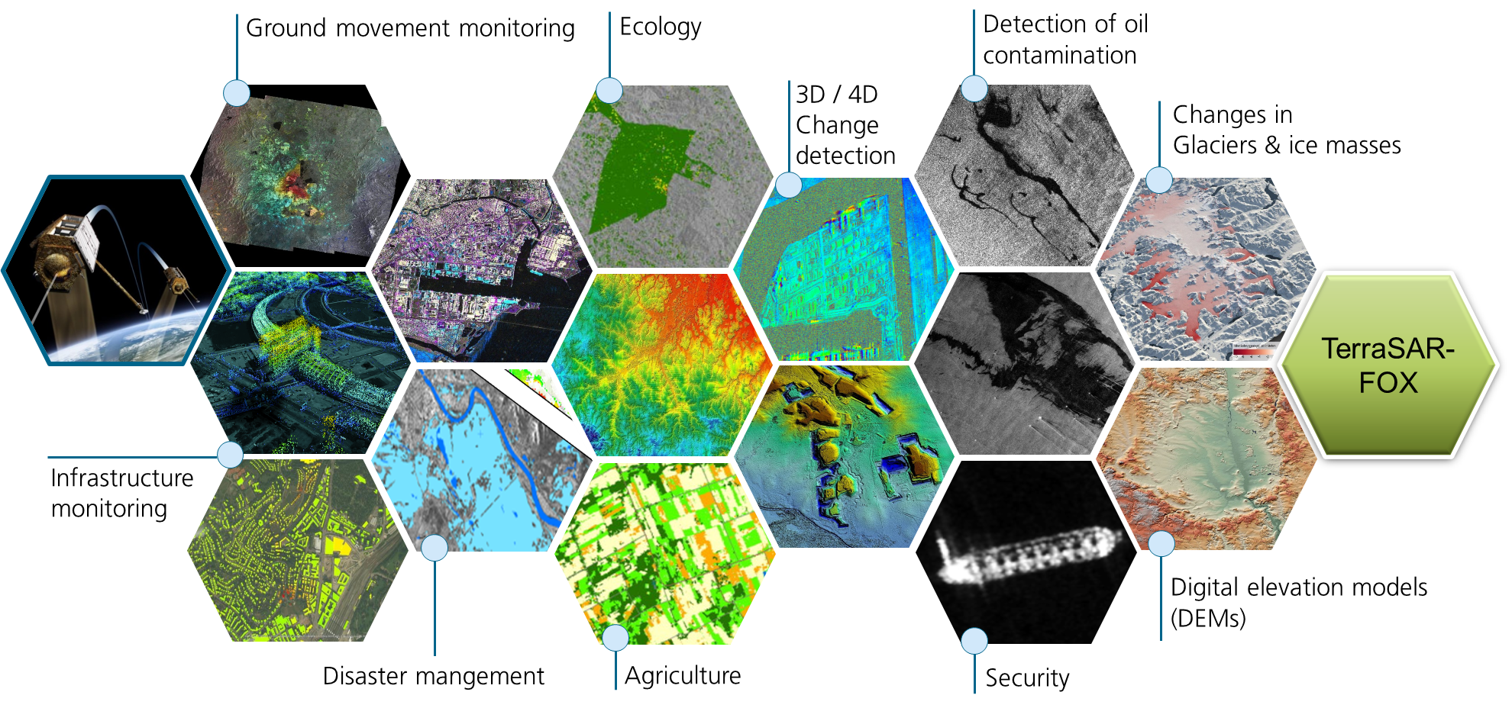
TerraSAR-FOX mission (TerraSAR Follow-On X-Band)
Call for new mission concepts
Development of a new X-Band SAR mission that satisfies the most important national needs on X-Band SAR-Data.
Two parallel Phase 0 studies started in July 2024.
Phase A is funded and scheduled to begin in 2025.
Published September 2024
Calls for mission concepts for future German EO missions
Institutional missions
SmallSats
Directed at German industry, scientists and other relevant institutions
4 feasibility studies planned in 2025
Images from TSX/TDX | Copyright: DLR e.V. and © Airbus Defence and Space GmbH

Slide 8
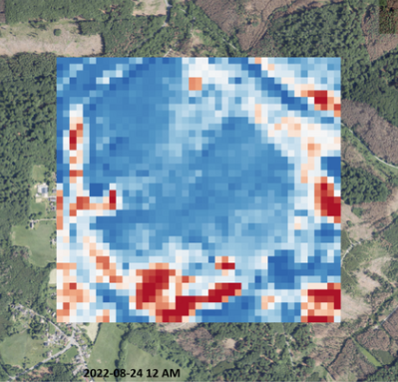
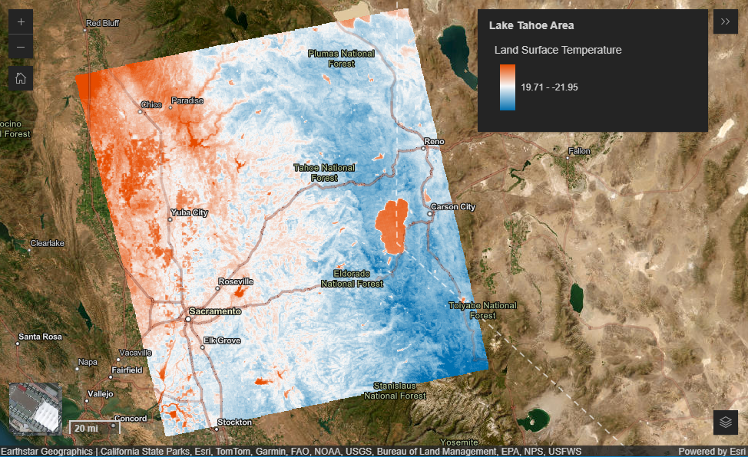
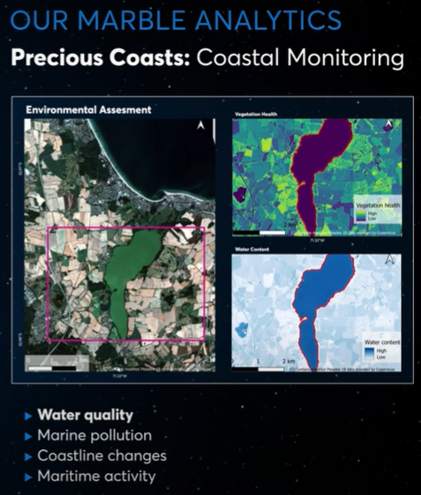
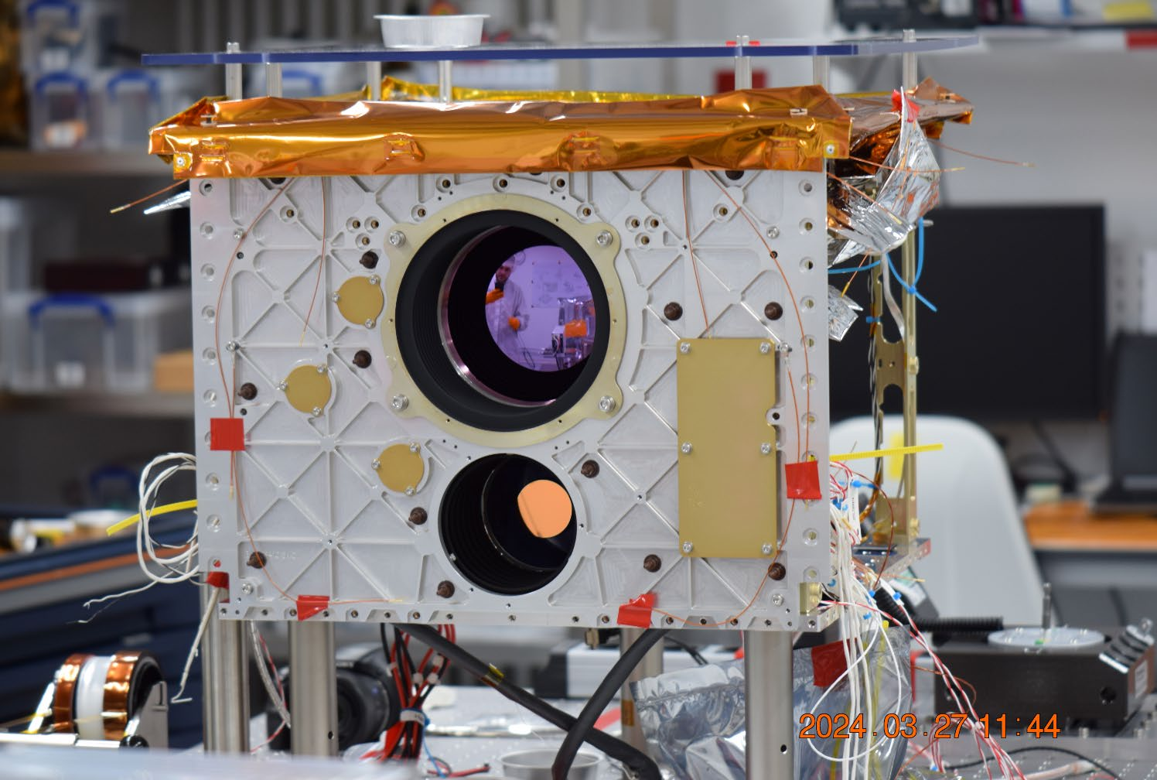
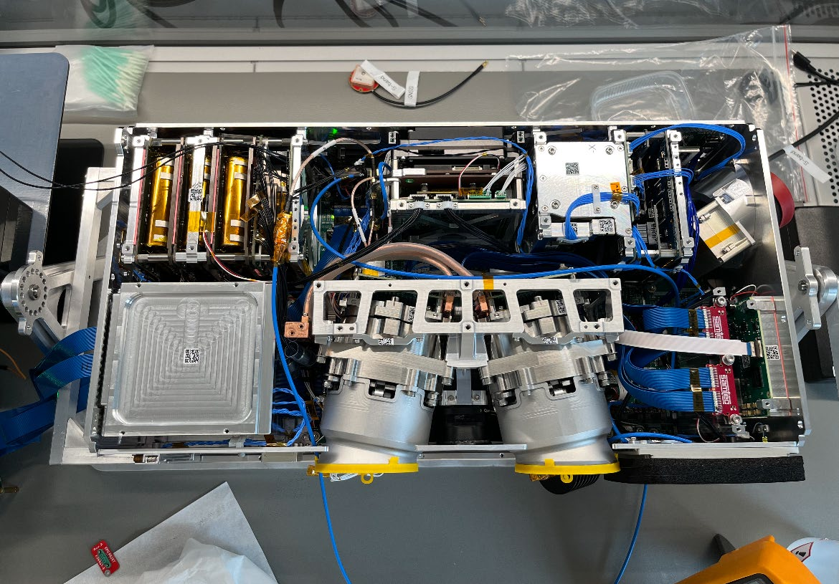
NewSpace Missions made in Germany
In Orbit:
AFR Sat by Berlin Space Technologies
Forest-1 and Forest-2 by OroraTech
Ongoing developments:
OroraTech payloads on 8 Spire Sats in 2025
HiVE by ConstellR (early 2025)
MarbleSat by Marble Imaging (Q1 2026)
planned:
96 Sat Constellation by OroraTech
4 Sat Constellation by ConstellR
200 VHR Sats constellation by Marble Imaging
Supported by DLR via ESA Incubed and data buys
https://ororatech.com/
https://www.constellr.com/
https://marble-imaging.de/
TIR image by ConstellR
Forest-2 image by OroraTech
HiVE payload by ConstellR
Marble Imaging product
Forest-3 payload by OroraTech

