Slide 1
CEOS Plenary 2024
Agency report: ECMWF
V.-H. Peuch, ECMWF
Agenda Item #5.1(3)
38th CEOS Plenary
Montreal, Canada
23rd - 24th October, 2024

Slide 2
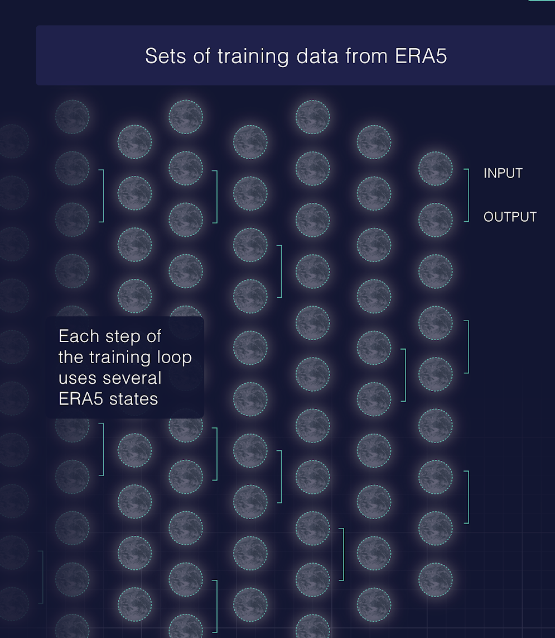
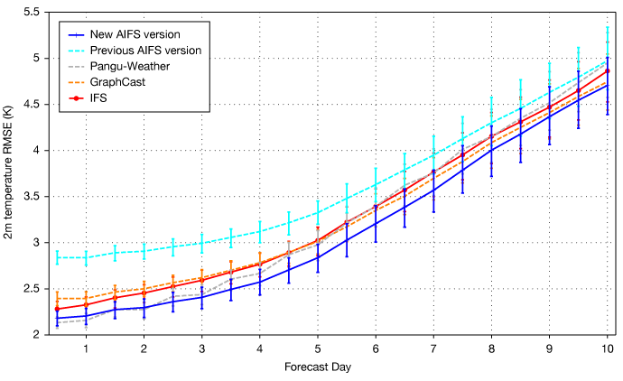
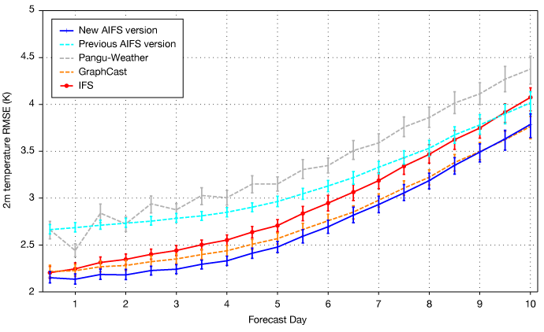
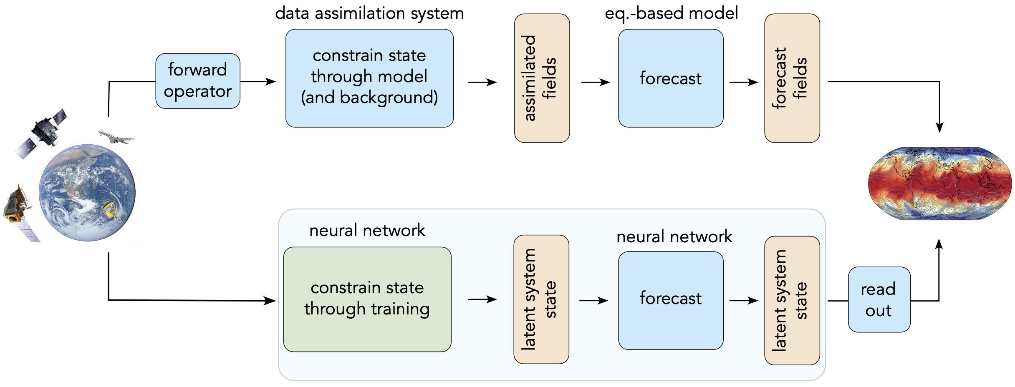
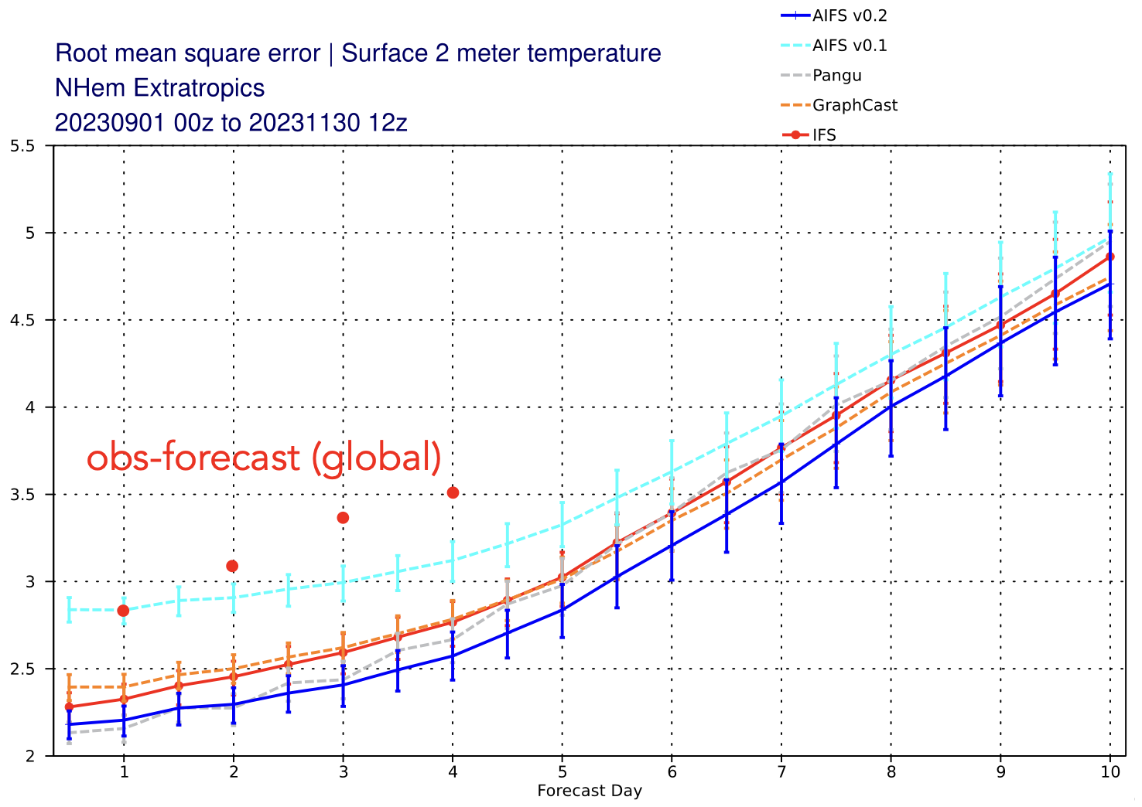

Agency report: ECMWF (AI)
Northern hemisphere 2m-temperature
Southern hemisphere 2m-temperature
Lower = better
Sept-Oct-Nov 2023
https://charts.ecmwf.int/catalogue/packages/ai_models/
AI/ML-based weather forecasts are making giant strides. These are all trained on reanalysis. Can a fully “data-driven” approach become competitive?
McNally et al., arXiv:2407.15586, 2024.

Slide 3
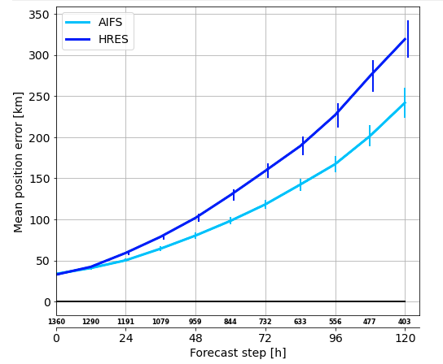
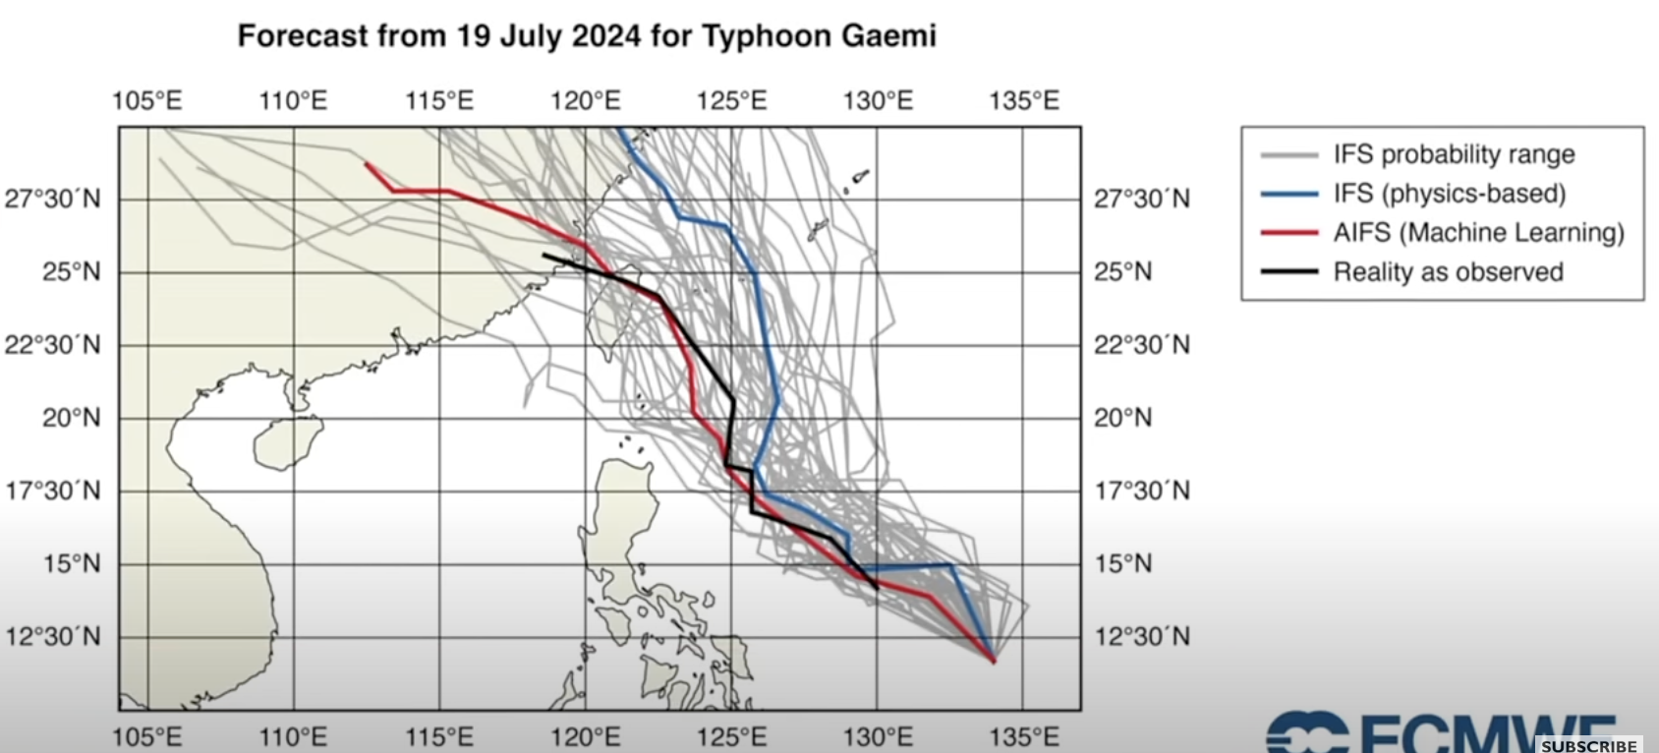
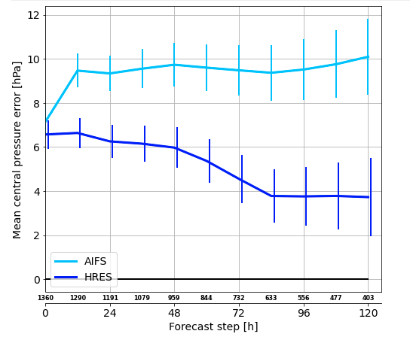
Agency report: ECMWF (AI cont.)
Skill over 2022 and 2023
Position error
Central pressure bias

Slide 4
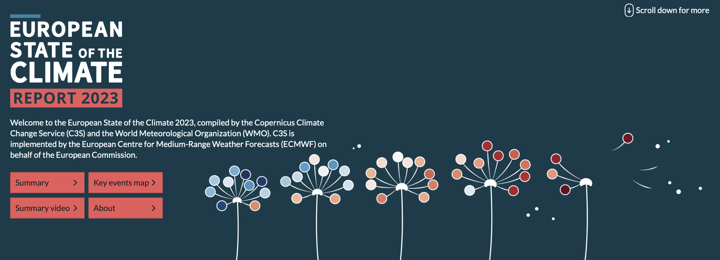
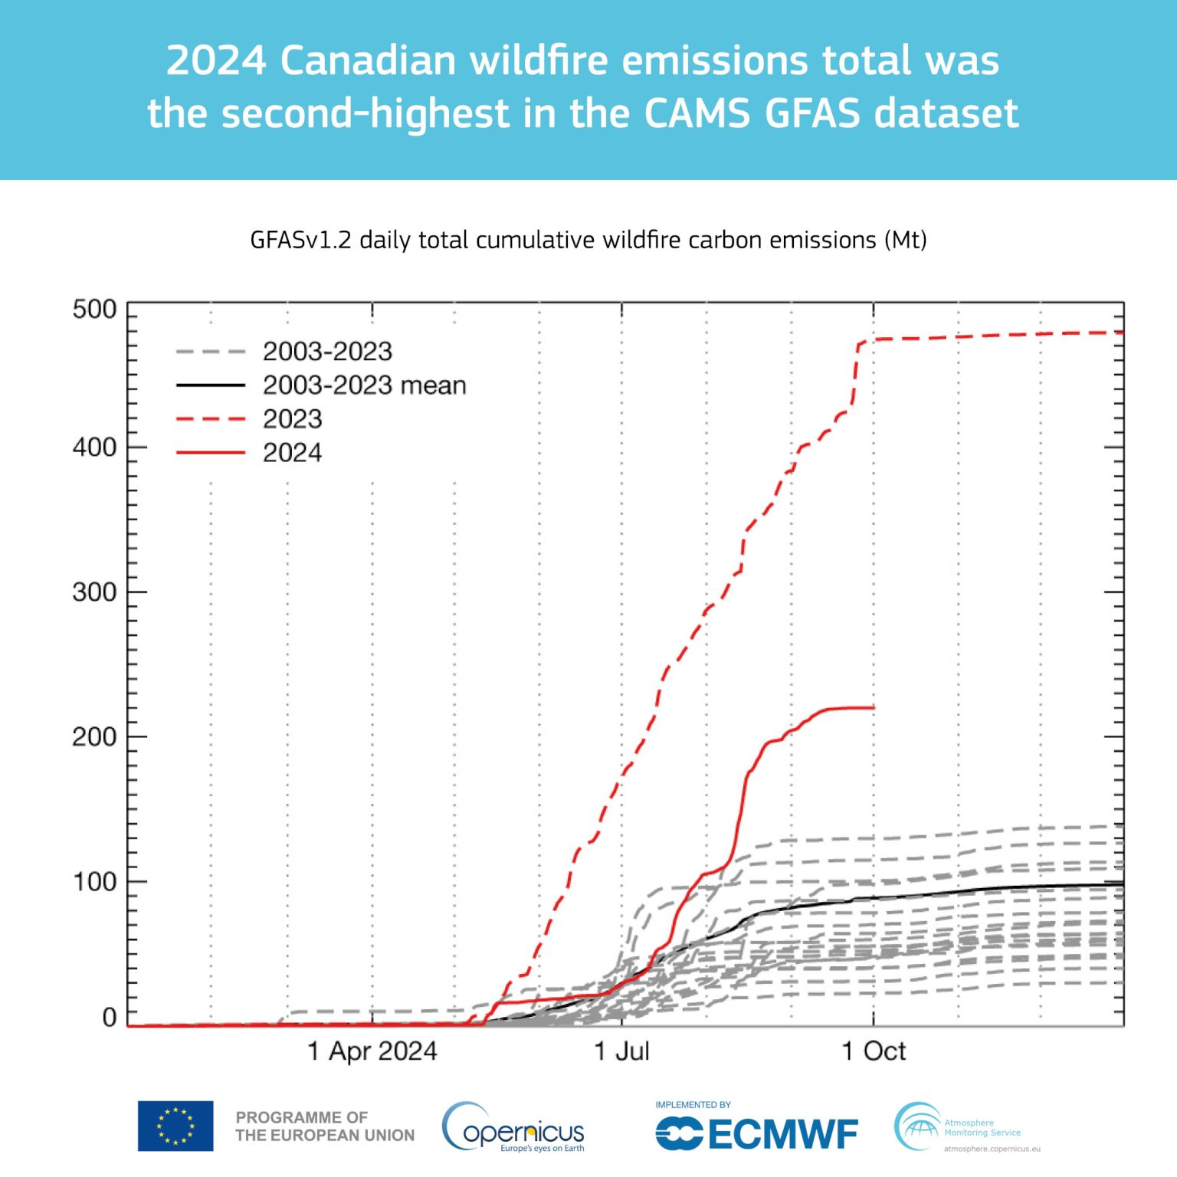
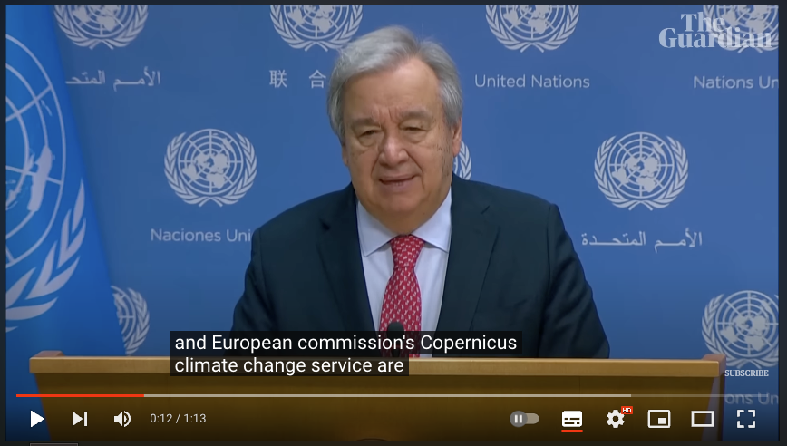
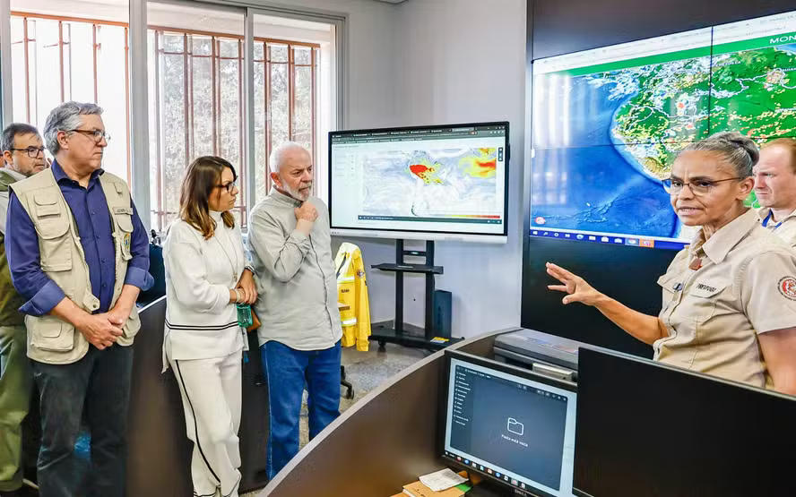
Agency report: ECMWF (Impact)
EO-based monitoring continuing its progress towards mainstream information source on climate and environment monitoring.
Carbon emissions by wildfires in Canda (October 2024)
European State of the Climate 2023 produced together with WMO (April 2024)
Fires in Amazonia and impact on air quality (Sept. 2024).

Slide 5
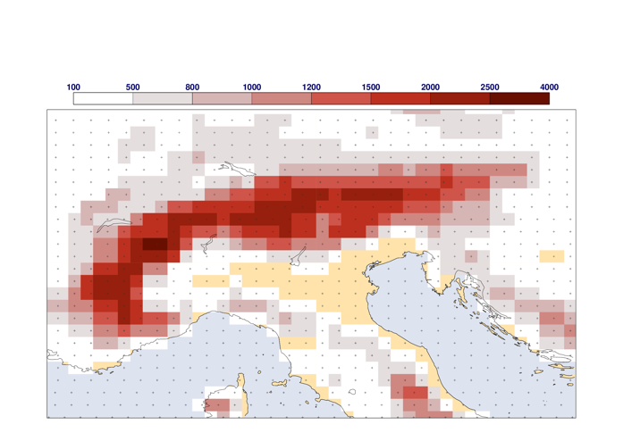
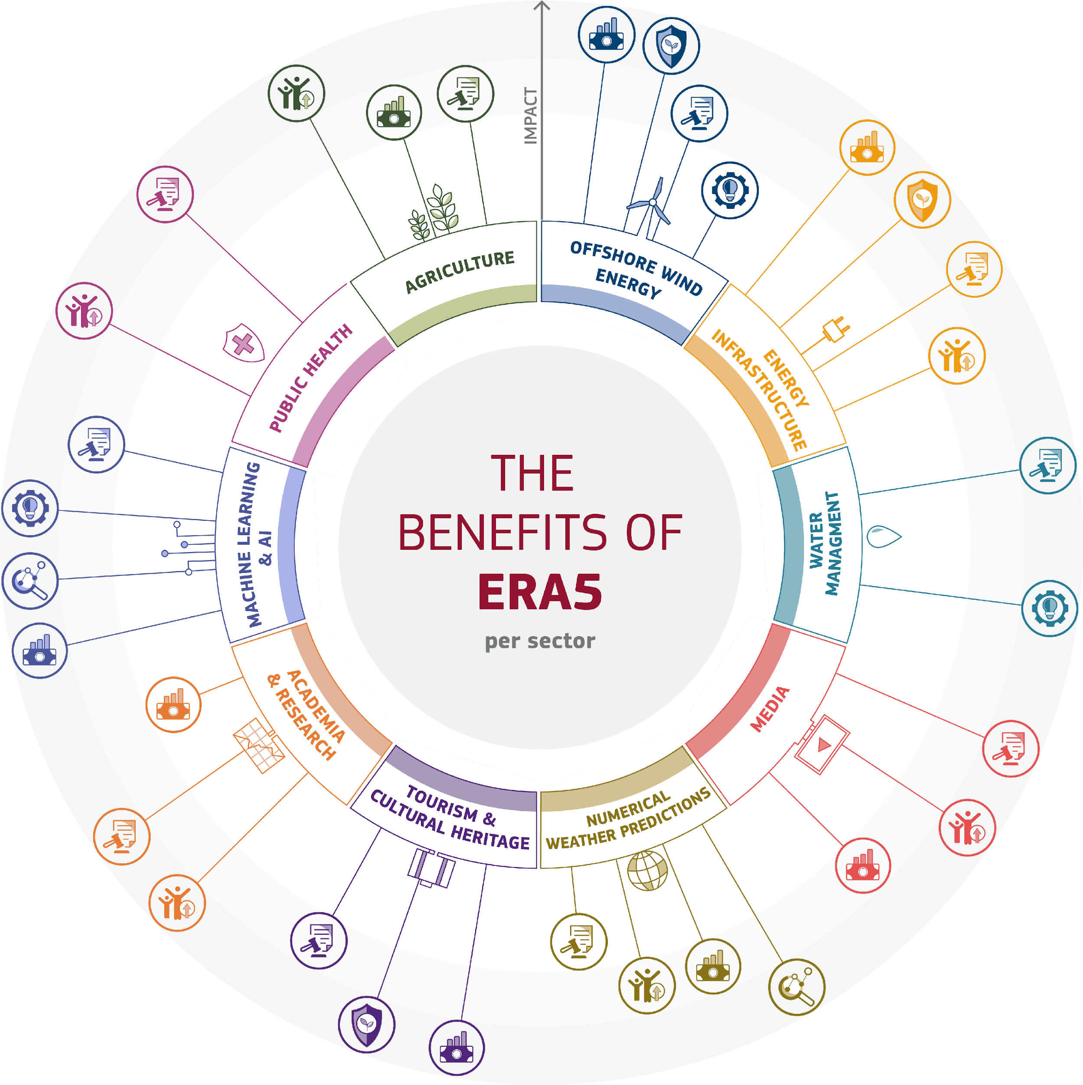
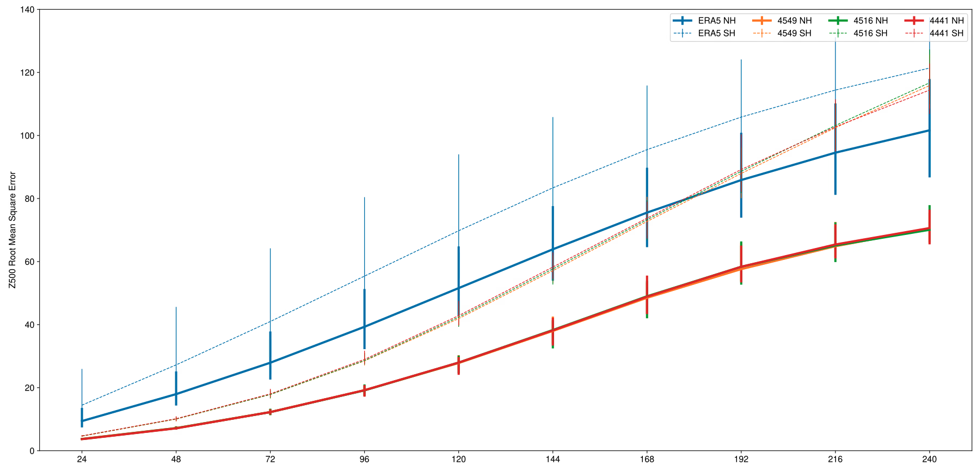
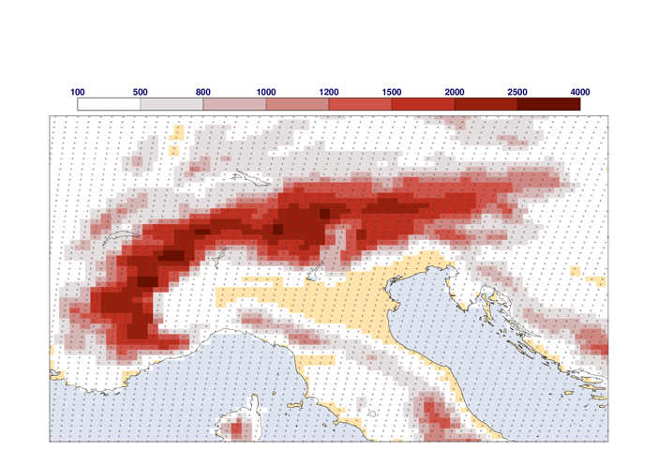
Agency report: ECMWF (Reanalyses)
Following several years of development and building on extensive reprocessing (Eumetsat…) and data rescue efforts, we will start production of our next global reanalysis (ERA6) in January.
ERA5 (~31km)
June-July-August 2020
Verified against own analysis
Verified at 1.5ºx1.5º
NH
SH
Prototype ERA6 (~14km)
An external study was commissioned to quantify the benefits of the current global reanalysis (ERA5). One highlight is that the economic benefit from the wind energy sector alone repays the entire EU investment in the Copernicus Climate Change Service (C3S).

