Slide 1

CEOS Plenary 2024
WMO
Agency report
Albert Fischer
Director, WMO Integrated Global
Observing System (WIGOS)
Agenda item 5.1.2
38th CEOS Plenary
Montreal, Canada
23 - 24 October 2024

Slide 2

WMO Space Programme
Requirements and framework for an integrated space-based observing system as part of WIGOS
Availability and Use of Satellite Data and Products
Capacity Building and User Engagement
Space Weather Coordination
Radio Frequency Coordination

Slide 3
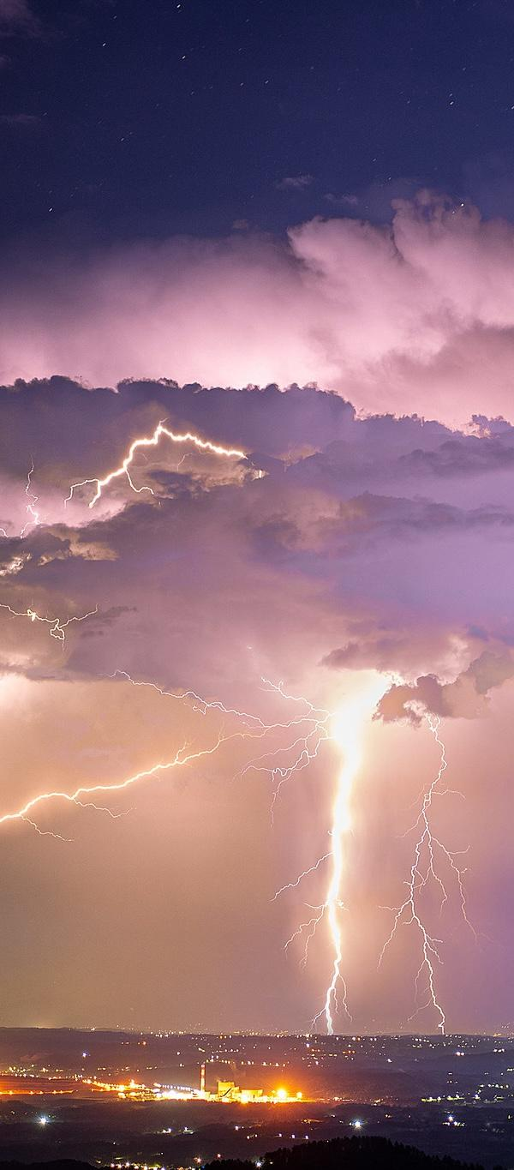



WMO: Weather, climate, water applications
Drivers of an Earth System approach
space-based
Weather
Climate
Water
Related
Environmental
Services
Atmosphere
Hydrology
Cryosphere
Ocean
Terrestrial
Space weather
e.g., quality of air, water, soil;
space weather
Hydrological services
surface-based
Photos: Various authors, WMO Calendar Competition 2024, cc
Notes:
Model for work has to evolve – partnership with actors outside of met services

Slide 4
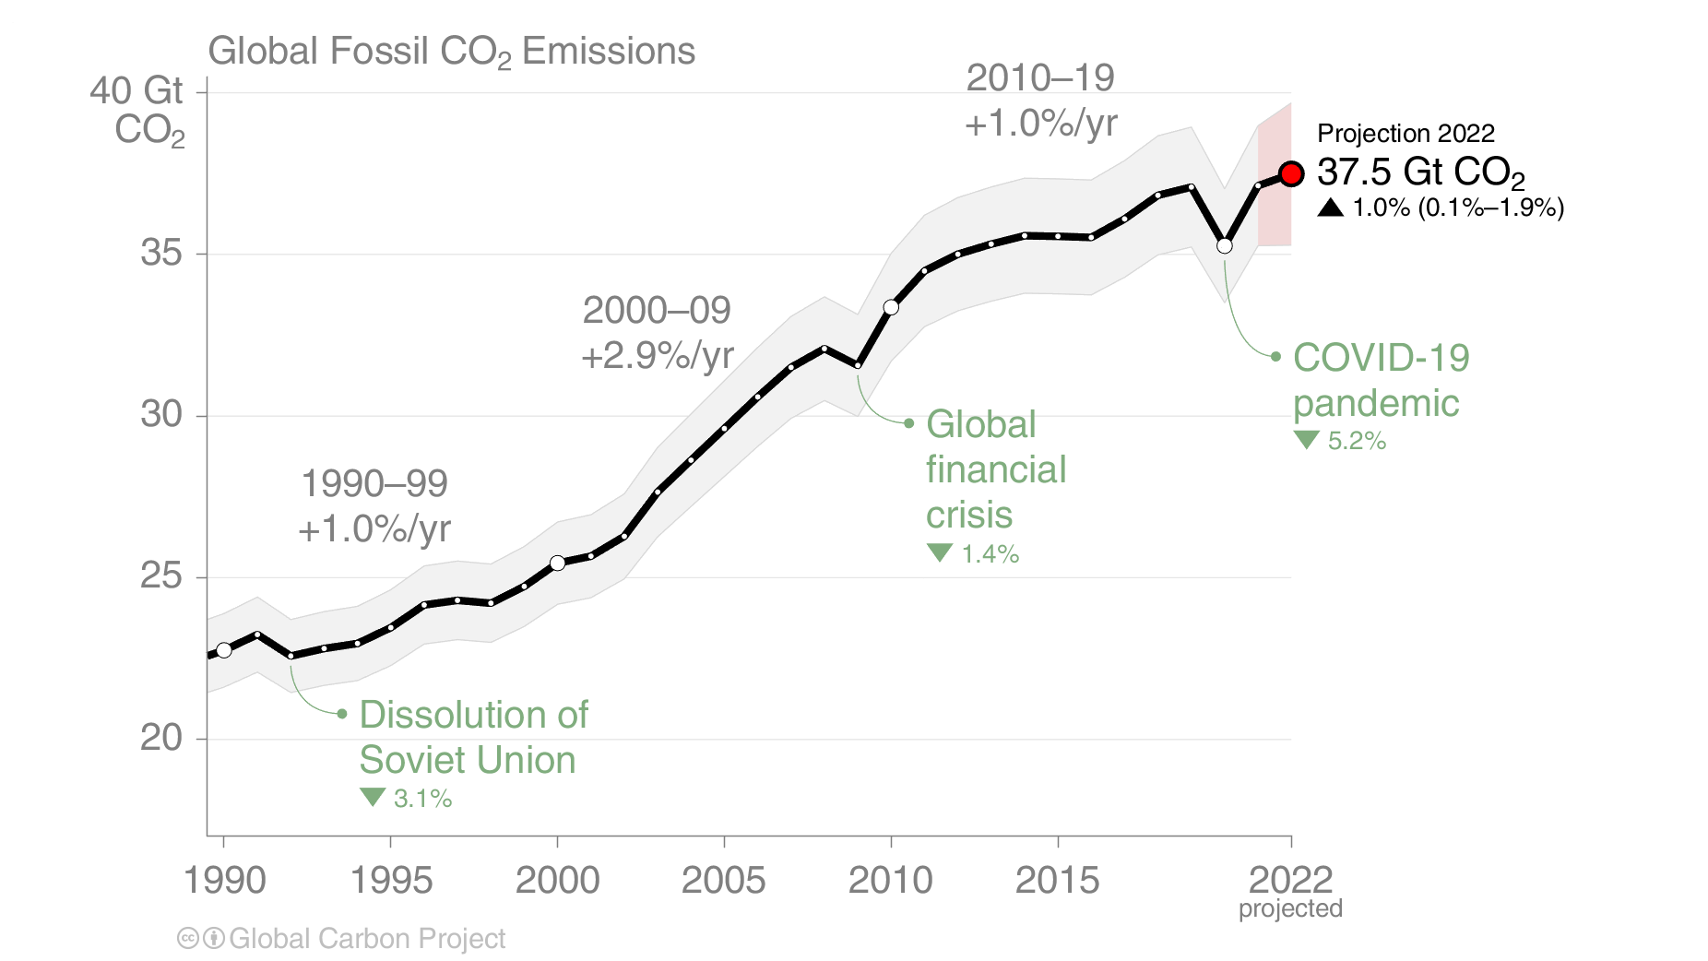
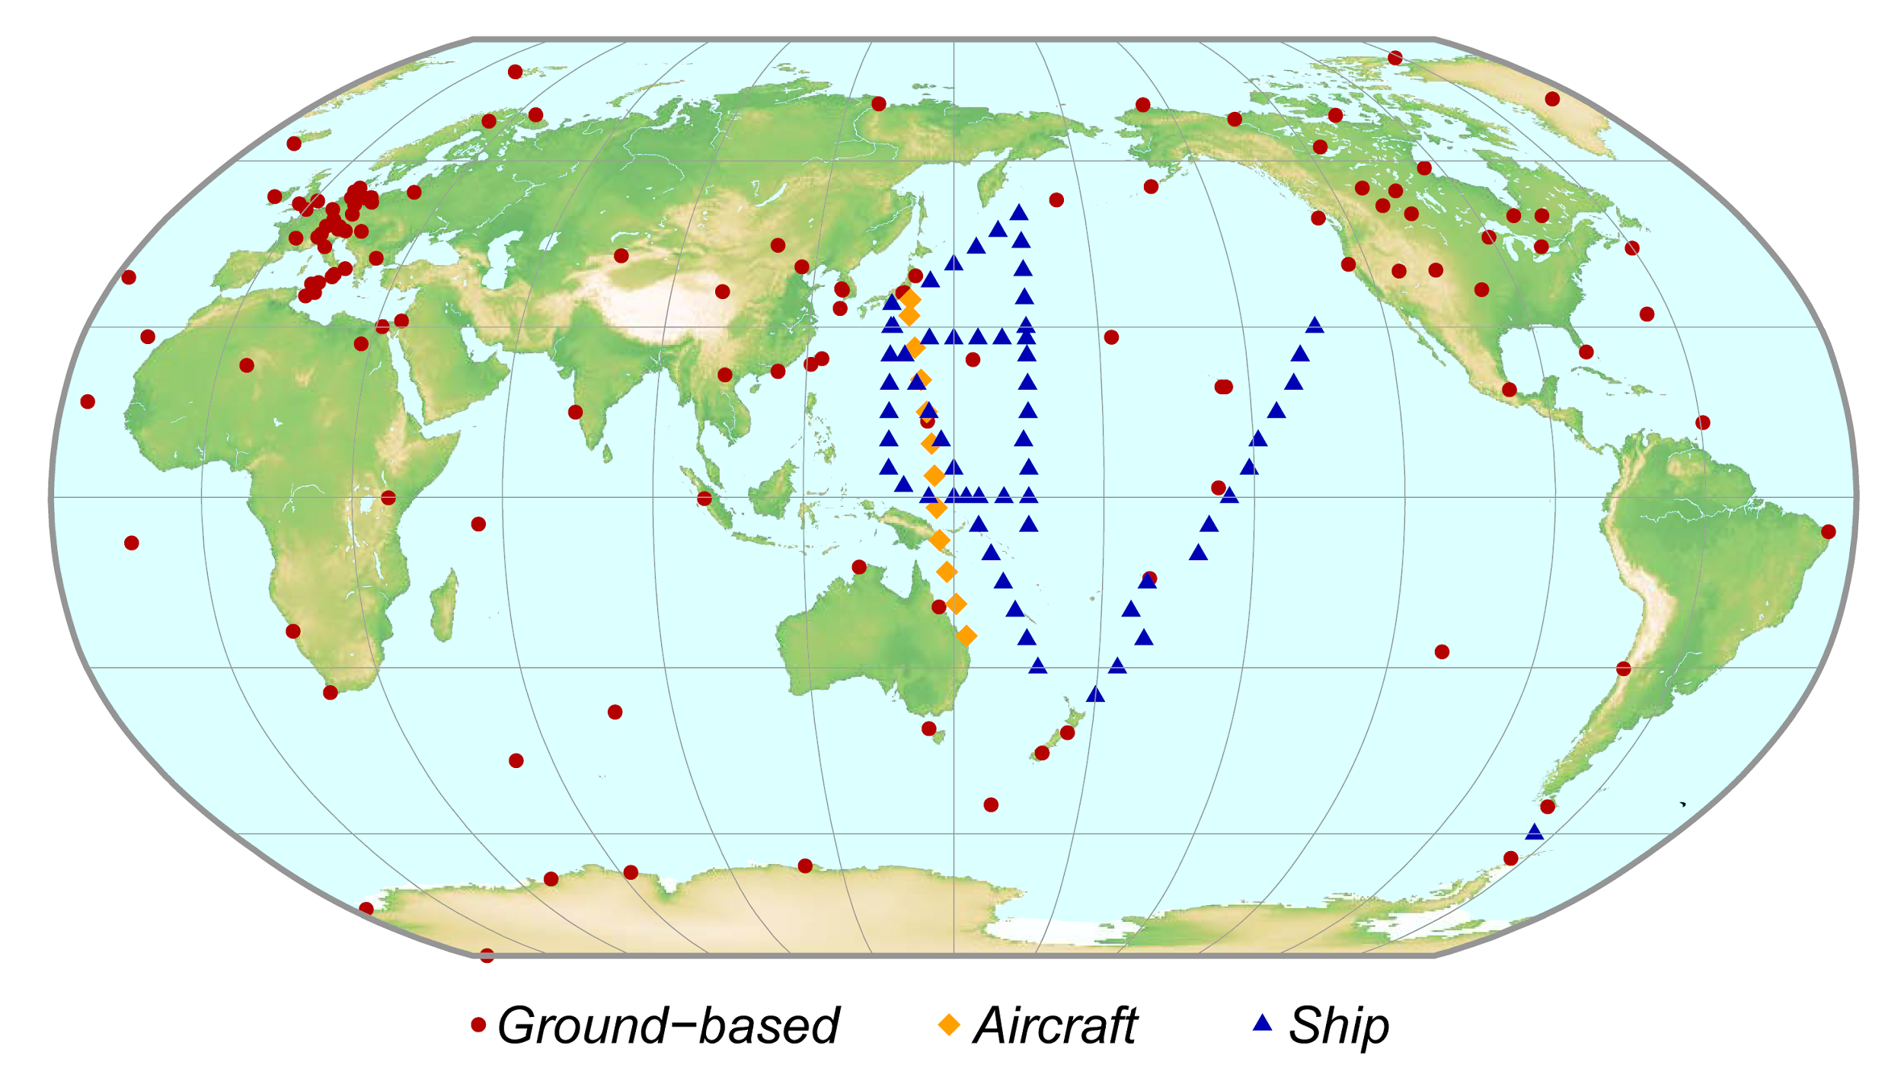
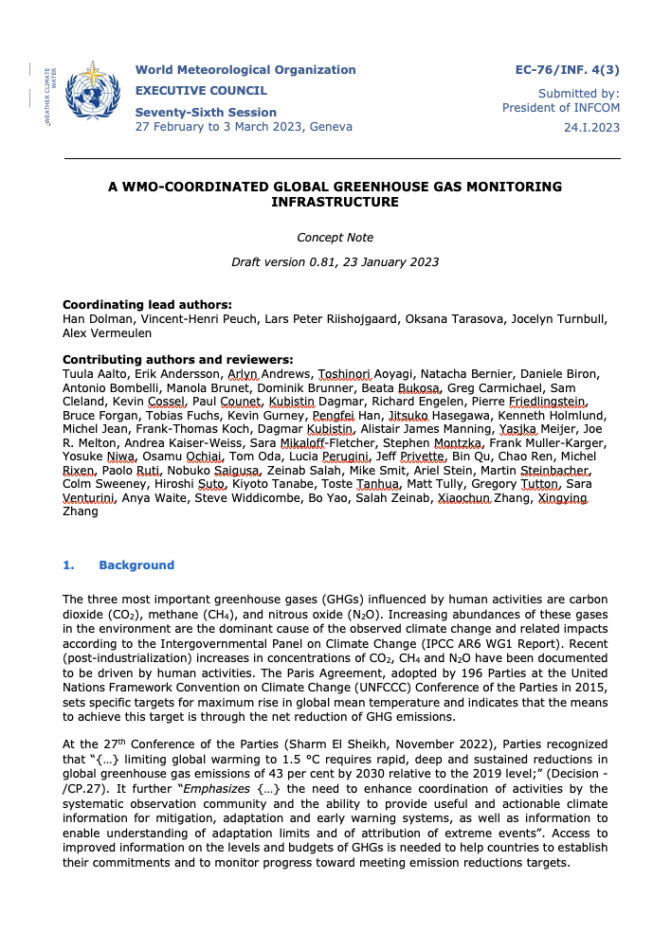
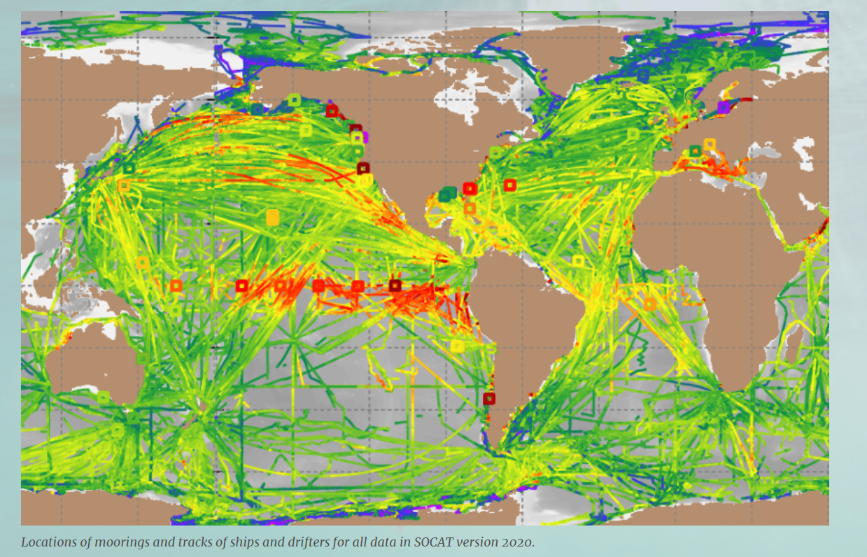
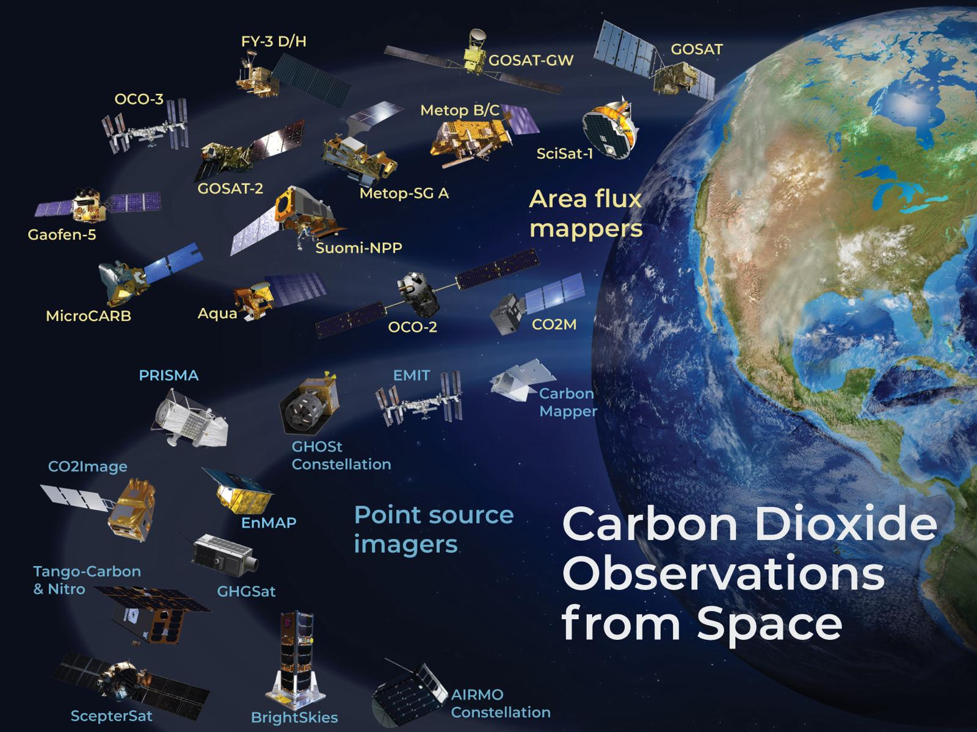
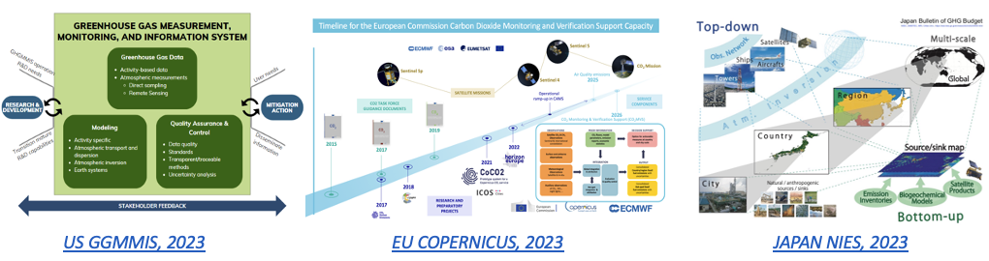
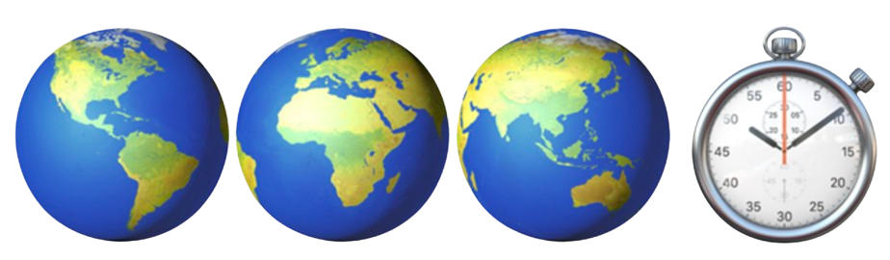
The vision and concept behind G3W
Global Greenhouse Gas Watch presented to EC-76, adopted by Cg-19 Congress and endorsed by EC-78.
Substantial research efforts have been
on-going and will remain essential, but transition to sustained operations is a necessity in the context of the climate crisis.
There is good alignment with fast-track GHGs information efforts, such as in EU, JAPAN, US… and large investments in the space sector.

Slide 5
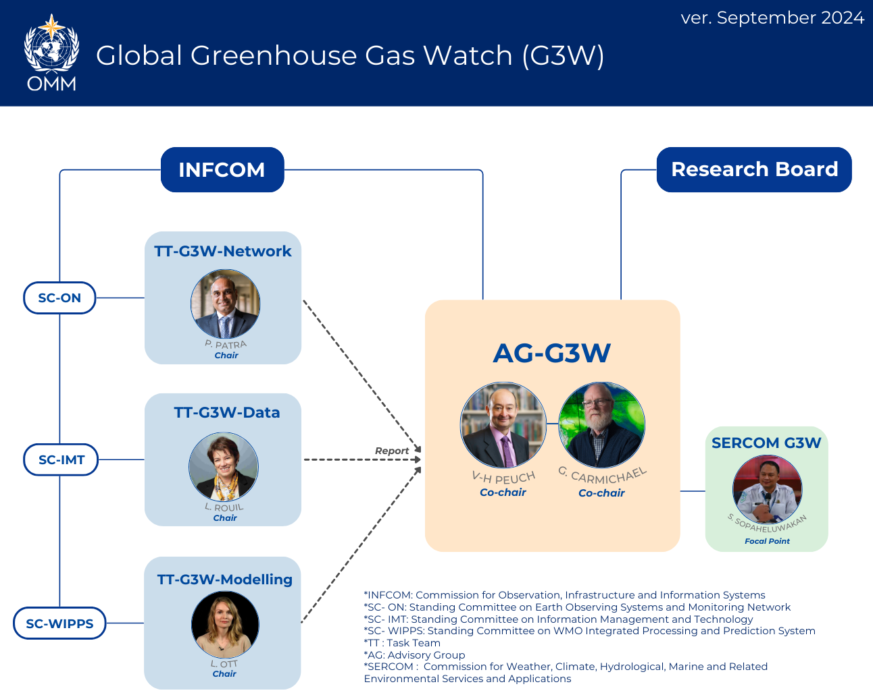
TT-G3W-Network:
Comprehensive inventory of the GHG Obs, and a Network-design presented to the INFCOM.
TT-G3W-Modelling:
WIPPS manual is updated to include G3W operations and recommendations on the methods and protocols for the quality control and verifications of infrastructure outputs are established and presented to the INFCOM.
TT-G3W-Data:
Mapping of the current practices related to GHG data characterization, data exchange, data management and data policies.
Design of the architecture for global data sharing in support of G3W.

Slide 6
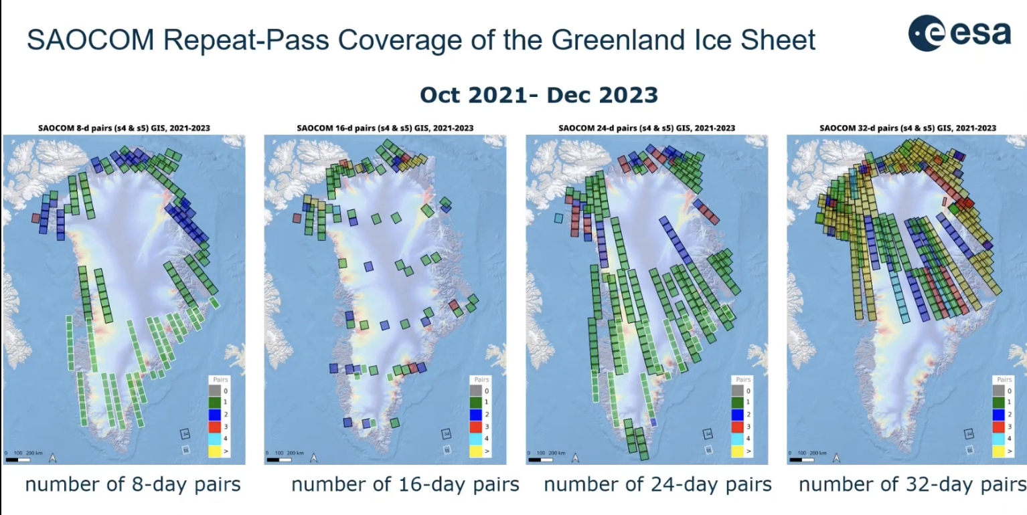
Polar Space Task Group follow-on
Improving observations of the cryosphere in polar and high-mountain regions needs both meteorological and Earth Observation satellite systems
Purpose: Promote space agency cooperation and coordinate on acquisition plans, coherent and interoperable multi-mission datasets, and data dissemination
On the horizon:
5th International Polar Year 2032-33

Slide 7

WIGOS Vision 2040 update
Space component: expresses long-term vision of requirements, and architecture
WMO performs gap analysis against 2040 Vision
New space opportunities, long planning horizons
Update process aiming for adoption by WMO’s Congress in 2027
photo: Alexandra Chalkousi / Flickr cc

