Slide 1
Session 4: Carbon, Climate Policy Impact, Greenhouse Gas Observation Coordination
Session Close
Hironori Maejima
JAXA SIT Chair team
Agenda item 4.8
38th CEOS Plenary
Montreal, Canada
23rd - 24th October, 2024

Slide 2
2025 - Climate Policy Impact
COP-29 & EID engagement led by WGClimate in a few weeks
WGClimate to conclude their input to the GST Lessons Learned
SIT Chair will invite comments and feedback from internal & external CEOS stakeholders
Continue dialogue with IPCC and others
Finalise Lessons Learned at SIT-40
Initiate GST Strategy Update and actions - for completion 2025 by SIT Chair

Slide 3
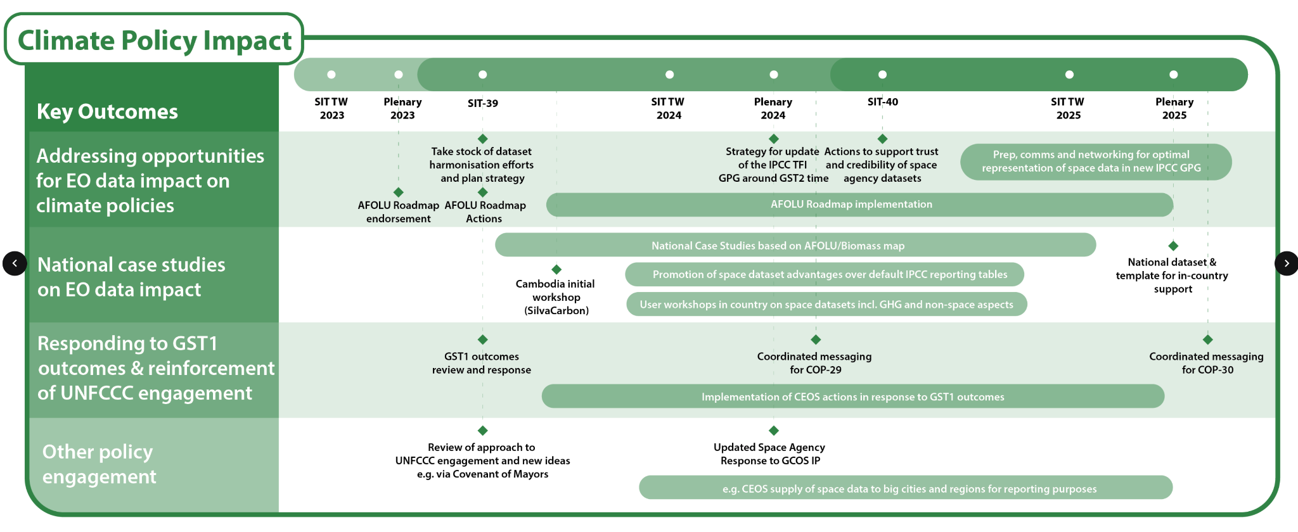
SIT Term master timelines

Slide 4
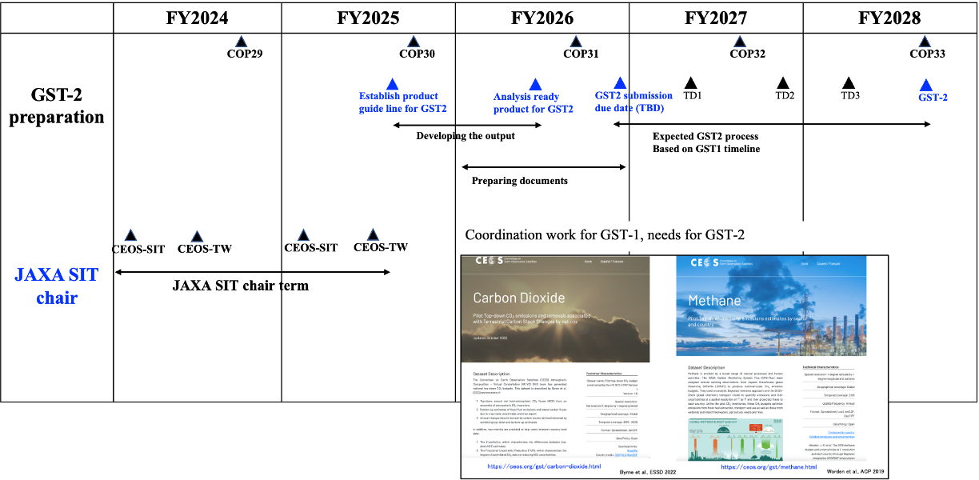
Milestones towards GST-2 (tentative & expected)

Slide 5
Contributions to GST products
Soliciting contributions to activities needed to prepare CEOS GST2 products
Clearly defining stakeholder needs (e.g., fluxes @ 1 x 1 degree for G3W, NRT for IMEO MARS)
Identifying ongoing efforts within CEOS agencies that meet those needs
Identifying gaps (L1 to L4)

Slide 6
Stakeholders’ Needs
Space-based GHG measurements could provide transparent, traceable, independent assessments of emissions and collective progress toward the mitigation and adaptation goals of the Paris agreement
Different stakeholders have different requirements
UNFCCC - Sector-specific annual/biennial national-scale inventories of emissions
High accuracy & traceability to internationally-recognized standards (e.g., IPCC-TFI)
UNEP IMEO Methane Alert Response System, MARS
Low-latency alerts to large CH₄ emissions from fossil fuel extraction, transport, use
WMO Global Greenhouse Gas Watch
Global 1° x 1° gridded estimates of GHG concentrations and fluxes at monthly intervals
Carbon cycle science community
Climate forcing by greenhouse gases and response of the natural carbon cycle to human activity and climate change

Slide 7
Ongoing efforts within CEOS (1 of 2)
CEOS Strategic Implementation Team (SIT)
Coordinate overall effort across CEOS organizations
Working Group on Climate GHG Task Team (WGClimate GHG TT)
Implement GHG Roadmap actions to foster transition from science to operations
Manage interfaces with WMO GGGW, IMEO, UNFCCC and other stakeholders
Working Group on Calibration and Validation (WGCV)
Identify on-orbit radiometric, spectroscopic and geometric calibration standards and traceability of space-based observations to these standards to facilitate the development of interoperable GHG observations
Coordinate campaigns to cross calibrate public and private sector sensors against available standards
Share the results via the portal site

Slide 8
Ongoing efforts within CEOS (2 of 2)
Atmospheric Composition Virtual Constellation (AC-VC)
Track sensor capabilities and mission timelines to identify opportunities and gaps
Coordinate retrieval algorithm and emission flux model intercomparisons with L1-L4 gap analysis
Define use-case-dependent concentration and flux validation standards and coordinate campaigns to cross validate public and private sector concentration and flux products against these standards
Agriculture, Forestry and Other Land Use Task Team (AFOLU TT)
Coordinate efforts to refine activity and emission factors for agriculture and forestry to facilitate the combined use of top-down & bottom-up emissions data
Working Group on Capacity Building and data Democracy (WGCapdD)
Coordinate development of materials to educate and foster interactions between the space-based GHG and stakeholders communities

Slide 9
Milestone and goal setting
Guideline for CEOS GST2 products and collaborators
GST2 will start later 2026 (after COP31?) with guiding questions.
Available data: until 2026
Improve the L2-L4 products though the AC-VC and WGCV activities
Engage with multi-agencies activities (e.g., OCO2-MIP, CAMS, )
Need collaborators and guideline (e.g., OCO2-MIP protocol for GST-1 products. )

Slide 10
2025 - GHG Observations
GHG Roadmap Implementation - led by WGClimate
SIT Chair will help coordinate 3 Roadmap connections
Best Practices document endorsed in 2025
Continued stakeholder engagement: IMEO & G3W
Cooperation with UKSA/CEOS Chair towards COP-30 impact
Updated CEOS GHG Mission Portal

Slide 11
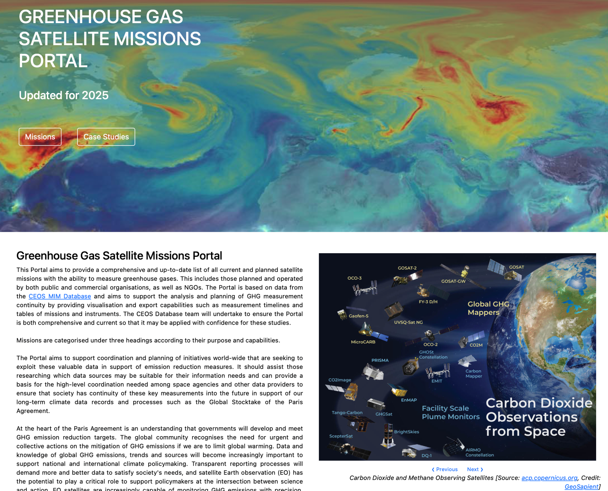
CEOS GHG Mission Portal Update - 2024

Slide 12
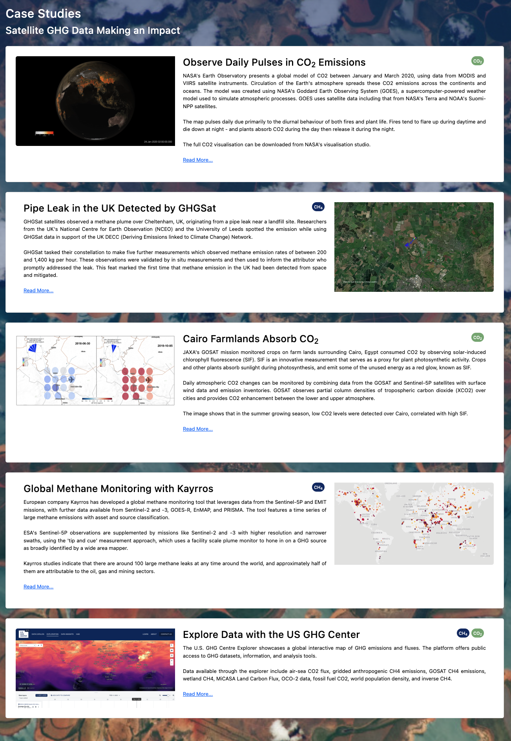
New additions - Case studies
Adding a case studies section
Links to web stories showing the impact of satellite GHG data
More suggested case studies welcome!

Slide 13
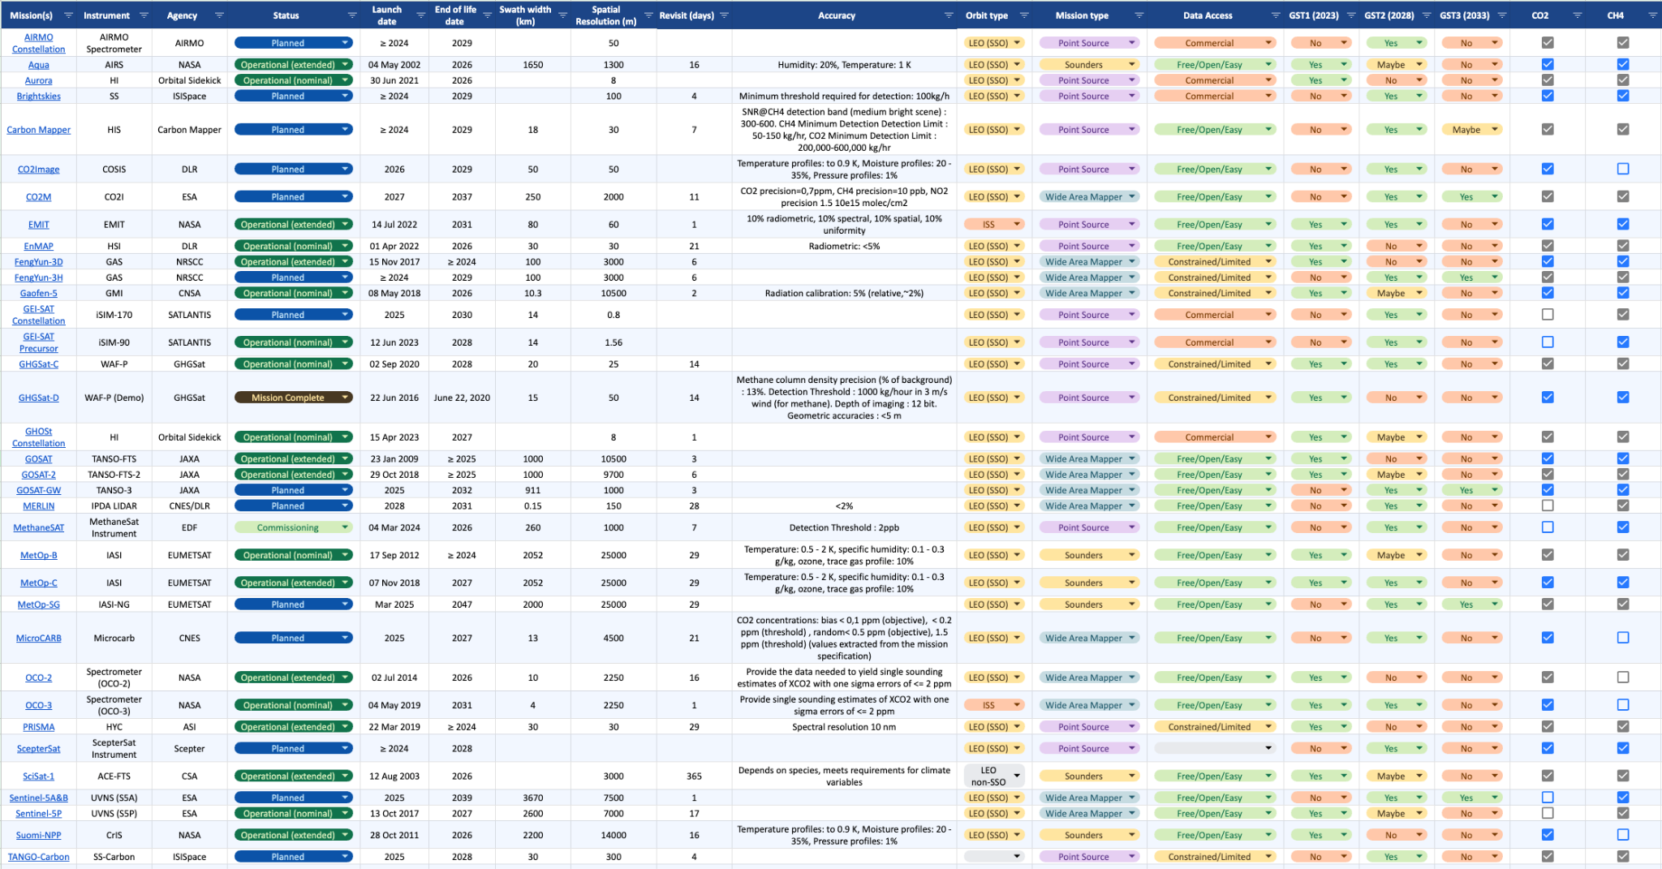
New additions - Constellation builder
GHG Constellation builder spreadsheet now available
Select requirements using filter functionality to build a constellation of satellites to suit specific applications
GHG Constellation Builder

Slide 14
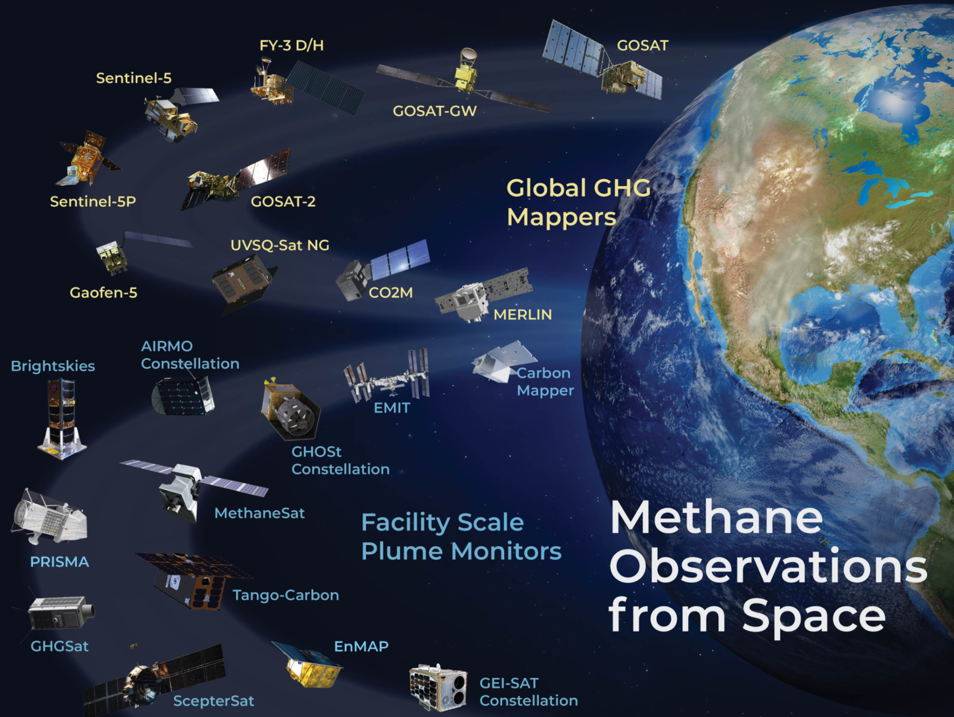
Update is now live
In support of our GHG Roadmap and coordination activities
ceos.org/ghg

Slide 15
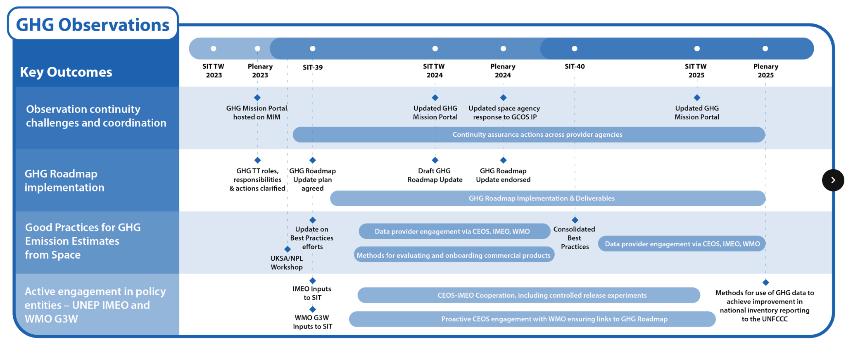
SIT Term master timelines

Slide 16
Thank you!
To the many workers for the very substantial effort and progress in 2024
Yasjka, Wenying, Dave and many more for the GHG Roadmap update
John and Paul for the Best Practices leadership
Wenying for the GST Lessons Learned leadership
SIT Chair Team for the GHG Portal Update (ceos.org/ghg)
And to all those not listed who advanced our agenda this year.

