Slide 1
CEOS Plenary 2024
GEOGLAM
Alyssa K. Whitcraft GEOGLAM
Agenda Item # 4.7
38th CEOS Plenary
Montreal, Canada
23rd - 24th October, 2024

Slide 2
Back to the Future! With thanks to CSA
The first GEOGLAM meeting on EO requirements was here in 2012!
🡨 Yves Crevier, Ian Jarvis, Brian Killough, Chris Justice, Bradley Doorn, Shin-Ichi Sobue, Inbal Becker-Reshef, Alyssa Whitcraft – and several others

Slide 3
Bottom Line Up Front
A united “co-community” of CEOS & GEOGLAM can best determine the priorities based on the intersection of observations, methods, capacity, and need/impact
SIT Action ID | SIT Action | Proposed Plenary Action (clarifying/improving SIT actions)
SIT-39-05 | Action: CEOS Agencies to identify points of contact to contribute to the LSI-VC Subgroup on GEOGLAM. | Action: CEOS Agencies to identify points of contact with missions and agriculture and/or applications expertise to contribute to an 18-month Essential Agriculture Variables (EAV) stocktake and LSI-VC Subgroup on GEOGLAM scoping effort. Additional support could be workshop + support person to “chase” and pull together the stocktake
SIT-39-06 | Action: SIT Chair to confer with LSI-VC and its GEOGLAM Subgroup leads regarding the visibility of CEOS Agriculture activities. | Update: In progress, reliant upon result of above action Many possibilities, but this will be easier to do once stocktake and scoping effort is undertaken Visibility will materialize

Slide 4
GEOGLAM Reminders
GEOGLAM was established in 2011 by G20 (France)
Action Plan on Food Price Volatility and Markets
G20 has renewed our mandate each year since 2016
China, Germany, Argentina, Japan, Saudi Arabia, Italy, Indonesia
We use EO data to increase transparency in outlooks on food production as they impact agricultural markets and food security
Major users: AMIS, Ministries of of Agriculture, regional/global early warning
GEOGLAM community spans applied EO-for-ag researchers to users of EO-based information
GEOGLAM also supporting national statistics, AFOLU, UN Sustainable Development Goals, Sendai…
11. We acknowledge the important contributions of… GEOGLAM to enhance agricultural market transparency and and support coordinated responses for food security and nutrition. We reaffirm our commitment to support strengthening of AMIS and GEOGLAM for greater transparency to avoid the negative impact of food price volatility.

Slide 5
Essential Agriculture Variables integrate EO to impact
EAVs are satellite-based “building blocks” that in combination with one another and/or other non-EO information support actionable, policy-required information on the state, change, and forecast of agricultural land use and productivity.
~40 variables, 50-50 breakdown between “Climate & Weather” and “Agriculture Domain” Variables
~50% intersect with ECVs
Learning from ECV process
Developed by ~30 “EAV Stewards” from operational research through user communities
Responding to need to ”simplify” toward “analysis ready information” – to ease user update of satellite data
2018 Survey of GEOGLAM end users:
“We want to use EO, but cannot keep up to date with products or which are good.”
2018 Survey of GEOGLAM EO-for-Ag practitioners:
Universal desire for standard products:
Cloud-free, harmonized time series (“ARD”)
Essential Agriculture Variables like crop type map, crop calendar…
Notes:
EAVs are that integrator – meeting multiple information mandates with an internally coherent set of variables that meet the most needs for the most people
All variables are remotely-sensible
This has been happening on our side of house – that is to say, within GEOGLAM and not within LSI-VC’s subgroup

Slide 6
EAV Status + Endpoints
Status:
EAVs are characterized
Select variables operational (e.g. global crop condition) or currently demonstrated (e.g. global crop type maps via ESA WorldCereal)
Workshops on product quality with LPV:
Sept 2023 🡪 Cropland Crop Type Mapping
Planning 🡪 Evapotranspiration
EAVs have been useful
e.g. EAV for ET used as partial justification ESA LSTM
A common resource for demonstrating EO data capabilities
EAV process endpoint: Full characterization of variables with current gaps and potentials for closing gaps in current, near-term, and mid-term in line with mission timelines - with regular updates
Updates will be required
EAV endpoint: EAVs available at their ideal levels of implementation
Validated Products - at global, regional, or national-level
Pipelines/systems for on-demand product generation
Good-practices documentation for producing and assessing the quality of the variables

Slide 7
Why Work Together on EAVs
GEOGLAM users need these data to strengthen food security and reduce price volatility
We don’t have a synoptic view of progress toward EAVs-as-products, what we’re missing, what we can/should do next
We do not know what (most) agencies are doing now or into the future in the agriculture domain
Harder to communicate what we need
We probably aren’t using all of the instruments we could be
“EAVs” have traction – we are now at risk of the term – and their impact – being diluted
We need to be the unified voice on quality and good practices
And, in some case, the source for the actual EAV product itself
Notes:
Awesome to see it catch on, awesome to see new-space kick off… but like all of these companies are (or should be) looking to CEOS and the individual agencies for cal/val support, they should also be looking to us for best practices

Slide 8
Specific Ask of Plenary: Designate a Representative for Telecon in February Led by JAXA SIT Chair Team
SIT Chair Hosted Telecon
Stocktake and Scoping Workshop 2025
GEOGLAM EAV Workplan Meeting
Objectives:
Engage agencies who are not currently participating in GEOGLAM activities
Determine best path/PoC for agency involvement in LSI-VC Subgroup on GEOGLAM
Proposed Attendees:
JAXA SIT Chair Team
Agency Representatives
GEOGLAM Secretariat
Objectives:
Stocktake of past, current, and future EAV-related projects, activities, and missions/instruments
No comprehensive record!
Clarify and agree upon CEOS-GEOGLAM “Scope of Work”
Last done in 2019
Proposed Attendees:
CEOS: agency missions & ag applications
GEOGLAM: stewards
Precursors:
CEOS Agency PoCs ID’d (SIT-39-05)
Workshop support (Plenary-38 Update)
Including a “chaser” to manage
Objectives:
Robust gap analysis:
🡨 Observations (current, planned)
🡨 Methods (Open? Transferrable? Scalable? Validated? Good?)
🡨 Dependencies?
Establish a short- and mid-term implementation plan for EAVs
Level of effort and funding needs for different EAV “work packages”
Decision points for CEOS and GEOGLAM leadership
Proposed Attendees:
GEOGLAM: stewards
CEOS: LSI-VC + select agency PoCs
Notes:
3AFakvRe

Slide 9
After 12 months…
At Plenary-39 🡪 Present the scope and priorities of the (reinvigorated!) LSI Subgroup on GEOGLAM on EAV timelines and priorities
By SIT-41 🡪 LSI-VC, SIT Chair, GEOGLAM formulate what to do next
Especially with respect to EAVs
Observations
Capacity
Method Richness
Proposed Plenary-38 Action
Action: CEOS Agencies to identify points of contact with missions and agriculture and/or applications expertise to contribute to an 18-month Essential Agriculture Variables (EAV) stocktake and LSI-VC Subgroup on GEOGLAM scoping effort. Additional support could be workshop + support person to “chase” and pull together the stocktake
Need/Impact
Priorities toward what to do next
Notes:
And then…
GEOGLAM publishes operational R&D agendas
Support agencies & others on targeted investments
And then GEOGLAM seeks support to produce highest-value EAVs at appropriate “endpoints”
Broader CEOS-enabled efforts
MIM database updating for agriculture
Cross-domain efforts on select common EVs

Slide 10
Thank you
Contact:
Alyssa Whitcraft, GEOGLAM Programme Scientist
akwhitcraft@geoglam.org
Sven Gilliams, GEOGLAM Secretariat Director
sgilliams@geosec.org

Slide 11
Appendix

Slide 12
Bottom Line Up Front
A united “co-community” of CEOS & GEOGLAM can best determine the priorities based on the intersection of observations, methods, capacity, and need/impact
SIT Action ID | SIT Action | Proposed Plenary Action (clarifying/improving SIT actions)
SIT-39-05 | Action: CEOS Agencies to identify points of contact to contribute to the LSI-VC Subgroup on GEOGLAM. | Action: CEOS Agencies to identify points of contact with missions and agriculture and/or applications expertise to contribute to an 18-month Essential Agriculture Variables (EAV) stocktake and LSI-VC Subgroup on GEOGLAM scoping effort. Additional support could be workshop + support person to “chase” and pull together the stocktake
SIT-39-06 | Action: SIT Chair to confer with LSI-VC and its GEOGLAM Subgroup leads regarding the visibility of CEOS Agriculture activities. | Update: In progress, reliant upon result of above action Many possibilities, but this will be easier to do once stocktake and scoping effort is undertaken Visibility will materialize

Slide 13
Past is prologue
2012-2019 – “Co-Community” in Ad Hoc WG
Highly collaborative, CEOS as the site of much work
2019-2023 – GEOGLAM Subgroup in LSI-VC
Established on understanding that near-term EO data coordination activities would be within GEOGLAM
Return to the “Co-Community” concept?
Demonstrated model for CEOS-GEOGLAM Relationship
Shared responsibility, unified voice for enriching commercial EO + EO applications
Provides macro example of national/regional relationships
e.g. CSA + AAFC
e.g. ESA + WorldCereal
e.g. JAXA + Asia-RiCE

Slide 14
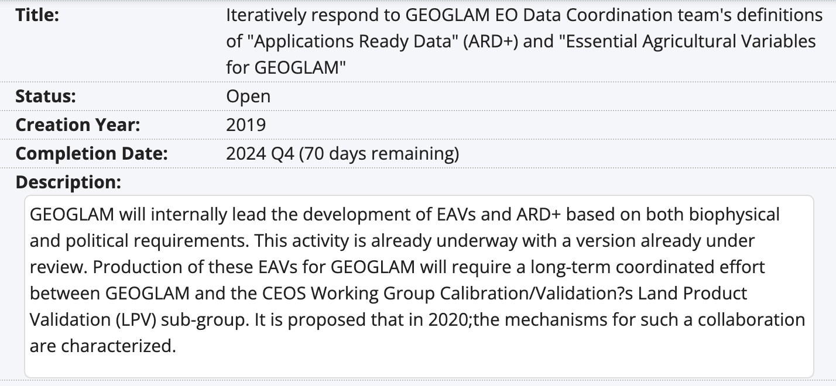
Workplan Items & Deliverables

Slide 15
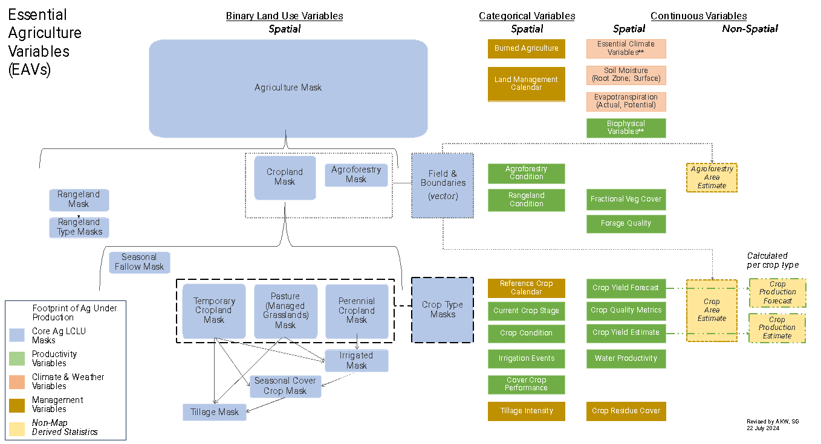
Global products demonstrated
National Products Demonstrated
Notes:
I am not even sure I got all of this right – which brings the point into focus… it has to be a community effort

Slide 16
Example EAV trajectory Global Cropland and Crop Type Mapping
ESA supported GEOGLAM community in undertaking a gap analysis, requiring:
Community consensus on mapping typology/hierarchies and requirements
Community consensus on product quality requirements
An actual product suite 🡪 Global mandates = global analysis
Example activities
ESA World Cereal
Post-harvest mapping of corn, wheat, barley, sorghum
GEOGLAM Crop Monitor Crop Type Maps (NASA-funded)
Aggregation of maps of corn, soy, wheat, rice
Example Gaps & Possibilities
Gap: What happens after 2026 (end of ESA WorldCereal)?
Possibility: Sustained production more easily enabled because we have created the “good practices” and demonstrated at-scale
Not within-season – limits quantitative production forecasting at finer levels
Possibility: evaluating applicability of current post-harvest methods to run within-season
Missing crops (e.g. rice)
Possibility: Asia-RiCE goes global!
Underpinning questions always about levels of effort and from whom/where

Slide 17
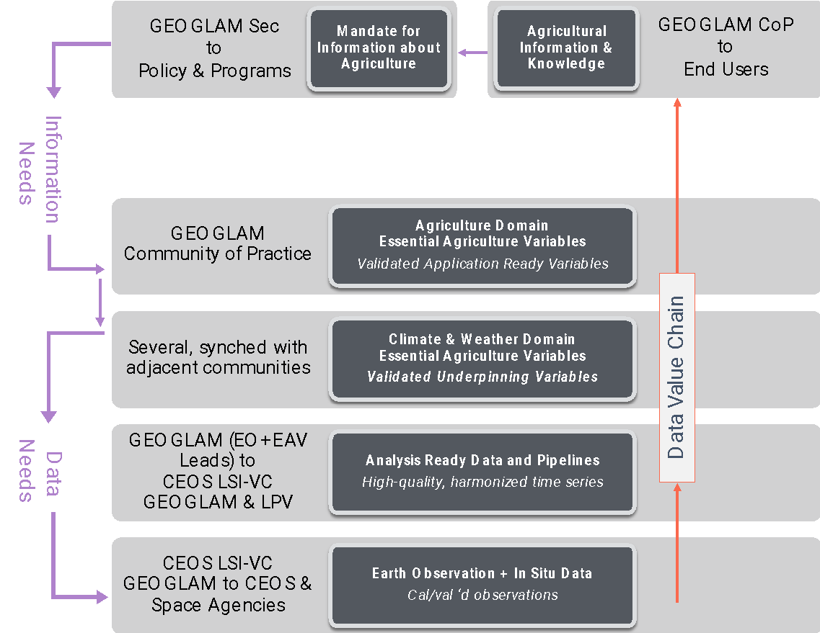
From a 2018 GEOGLAM community survey
(small sample, but representative)
From Ag Monitoring “End User” organizations:
All agreed that their organization would benefit from a greater use of EO data in their org’s decision making
Q: If your organization does not use satellite EO at any level of their decision making process, why is that the case?
“…org interested in EO, unsure how to incorporate”
“…org thinks EO data are too expensive or difficult to access…”
“…org thinks EO data are too unreliable to implement operationally…”
Other answers:
Can’t keep up to date with which products are good
From EO-for-Ag practitioners:
<50% agreed that they had access to all of the EO they needed for their analyses
65% agreed they required additional technical support to download, process, or utilize EO (even seasoned EO practitioners!)
Strong indication of desire for standard products:
Cloud-free, intercalibrated/harmonized time series (“ARD”)
Essential Agriculture Variables like crop type map, crop calendar …
Most consistent boundary identified: lack of field data!
Whitcraft, et al. (2018)
Notes:
Recurring theme of difficulty in access/discovery as well as in perceived/actual unreliability.
New sensors, new methods 🡪 constant iteration
Need consensus voice 🡪 what’s real, what isn’t?

Slide 18
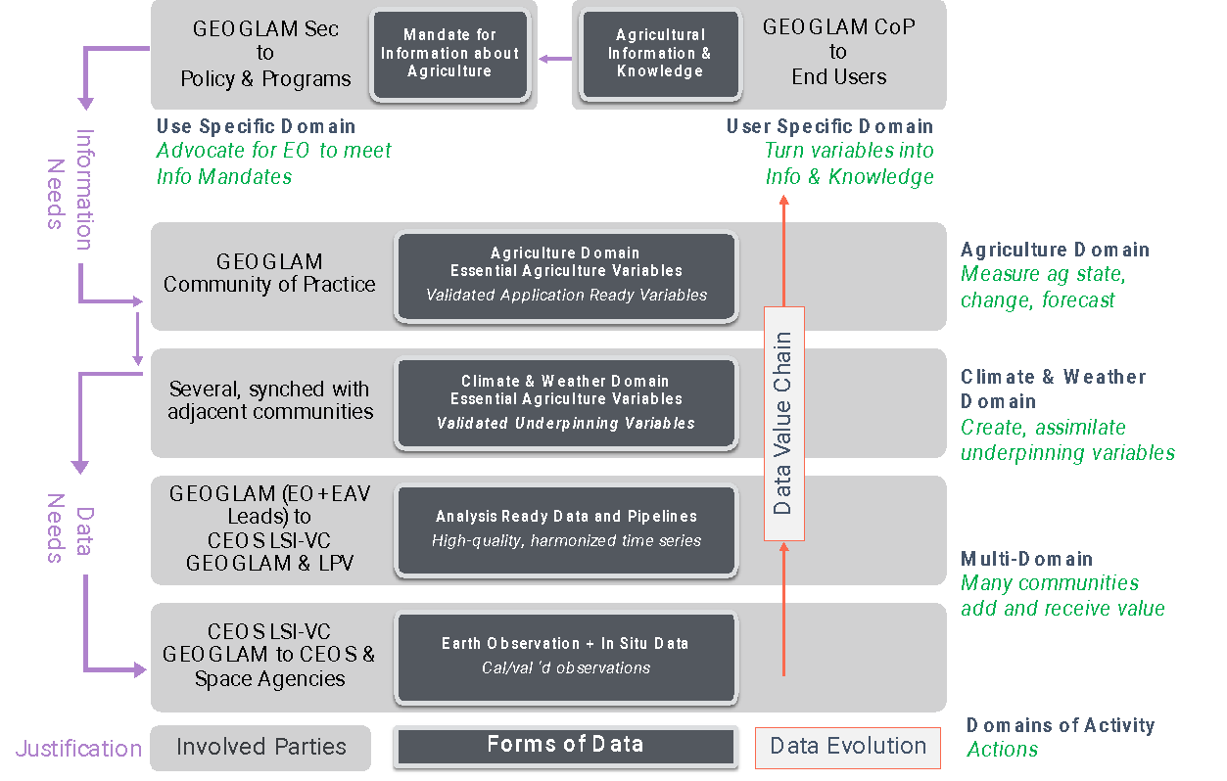
Satellite Data Value Chain
“Data produced must be policy-relevant and not exist for its own sake.” (UN Statistics Division, 2017)
Clear mandate to harmonize and synergize
“Essential Agriculture Variables” (EAVs) emerged as a unifying framework to maximize EO value and meet multiple information and decision needs

Slide 19
~50% the EAVs are related to ECVs
(**either exact same, same physical quantity but different resolution requirement, or linked/referenced in some way but not specified)
Ag Domain EAVs
Water Productivity**
Irrigated Cropland Map**
Reference Crop Calendars
Current Crop Stage
GDD
Crop condition assessment
Crop yield forecast
Crop Yield estimation
Rangeland Condition assessment
Land Management Calendar
Agriculture Mask (likely ECV)
Cropland Mask (likely ECV)
Rangeland Mask
Seasonal Fallow mask
Seasonal Cover Crop Mask
Non-Perennial Cropland Mask
Perennial Cropland Mask
Managed Grasslands Mask
Crop Type Masks
Field Boundaries
Crop Type Area Estimation
Agricultural Burned-Area Map**
Met & Land Domain EAV
Land surface temp (ECV)
Air temperature (ECV)
Surface Soil Moisture (ECV)
Root Zone Soil Moisture (ECV)
Wind Speed (ECV)
Precipitation (ECV)
LAI (ECV)
fAPAR (ECV)
Incoming radiation (ECV)
Relative humidity (ECV)
Reference Evapotranspiration**
Actual Evapotranspiration**
Seasonal Dynamics of Surface Water Availability**
Aboveground Agricultural Biomass
Fractional Cover
Soil Carbon (ECV)
Runoff**
Residue Cover
Surface roughness
+ARD (multispectral data and simple Indices)
Notes:
** indicates where there is a link to ECVs but the product isn’t explicitly named or isn’t totally clear
Surprised the phenology is missing

Slide 20
For a specified USE CASE…
Policy Conditions (Secretariat Summarizes all information and does engagement/advocacy around EO uses and pathways there)
Conditions for EO adoption in producing Agriculture Information and Knowledge
Organizational Conditions
Current status of EO usage
Mandate
Funding
Summarized Variable Conditions
EO data source
in situ data source
method source
operational product provision
Integrated Analysis System
Method for integrating EO data/products
Compute/IT
Technical capacity to use analysis system(s)
Operational transition
Ownership of initial system
Capability to manage changes (in variables, IT, sensors, new methods)
Ag Variable 1
Ag Variable 2
Ag Variable n
Conditions for Production of Ag Domain Variables
Summary of C&W variables
In situ source (specific to this variable) 🡪 collected, accessible
Method status 🡪 open or closed; scalable/transferable Y/N; validated Y/N; performance quality
In which regions/systems do we have good methods, in which regions/systems do we not?
Is there a standard product for this variable broadly accessible?
C&W Variable 1
C&W Variable 2
C&W Variable n
Conditions for Production of Climate and Weather Variables
EO data source 🡪 collected, accessible
In situ source 🡪 collected, accessible
Method status 🡪 open or closed; scalable/transferable Y/N; validated Y/N; performance quality
Is there a standard product for this variable broadly accessible?
Notes:
Use Case
For each underpinning variable
EO data source 🡪 collected, accessible
In situ source 🡪 collected, accessible
Method status 🡪 open or closed; scalable/transferable Y/N; validated Y/N; performance quality
Is there a standard product for this variable broadly accessible?
For the use case – is the information needed being developed continuously and operationally?
Organizational conditions --> has the organization mandated someone to create EO-based information, and supporting them with sufficient resources?
Are the standard products for underpinning variables in place?
Technical capacity of individuals in organization
If not, are there resources to do the training/tech transfer/ongoing support?
Is there sufficient public documentation of related variables and tools (i.e. “Knowledge management”)

Slide 21
For a specified USE CASE…
Policy Conditions (Secretariat Summarizes all information and does engagement/advocacy around EO uses and pathways there)
Conditions for EO adoption in producing Agriculture Information and Knowledge
Organizational Conditions
Current status of EO usage
Mandate
Funding
Summarized Variable Conditions
EO data source
in situ data source
method source
operational product provision
Integrated Analysis System
Method for integrating EO data/products
Compute/IT
This informs:
CEOS observation,
In situ observations
analysis platforms
”science team” funding priorities
Technical capacity to use analysis system(s)
Operational transition
Ownership of initial system
Capability to manage changes (in variables, IT, sensors, new methods)
This informs:
CapDev Guidance and Priorities
IT working group priorities
Ag Variable 1
Ag Variable 2
Ag Variable n
Conditions for Production of Ag Domain Variables
Summary of C&W variables
In situ source (specific to this variable) 🡪 collected, accessible
Method status 🡪 open or closed; scalable/transferable Y/N; validated Y/N; performance quality
In which regions/systems do we have good methods, in which regions/systems do we not?
Is there a standard product for this variable broadly accessible?
C&W Variable 1
C&W Variable 2
C&W Variable n
Conditions for Production of Climate and Weather Variables
EO data source 🡪 collected, accessible
In situ source 🡪 collected, accessible
Method status 🡪 open or closed; scalable/transferable Y/N; validated Y/N; performance quality
Is there a standard product for this variable broadly accessible?
Notes:
Use Case
For each underpinning variable
EO data source 🡪 collected, accessible
In situ source 🡪 collected, accessible
Method status 🡪 open or closed; scalable/transferable Y/N; validated Y/N; performance quality
Is there a standard product for this variable broadly accessible?
For the use case – is the information needed being developed continuously and operationally?
Organizational conditions --> has the organization mandated someone to create EO-based information, and supporting them with sufficient resources?
Are the standard products for underpinning variables in place?
Technical capacity of individuals in organization
If not, are there resources to do the training/tech transfer/ongoing support?
Is there sufficient public documentation of related variables and tools (i.e. “Knowledge management”)

Slide 22
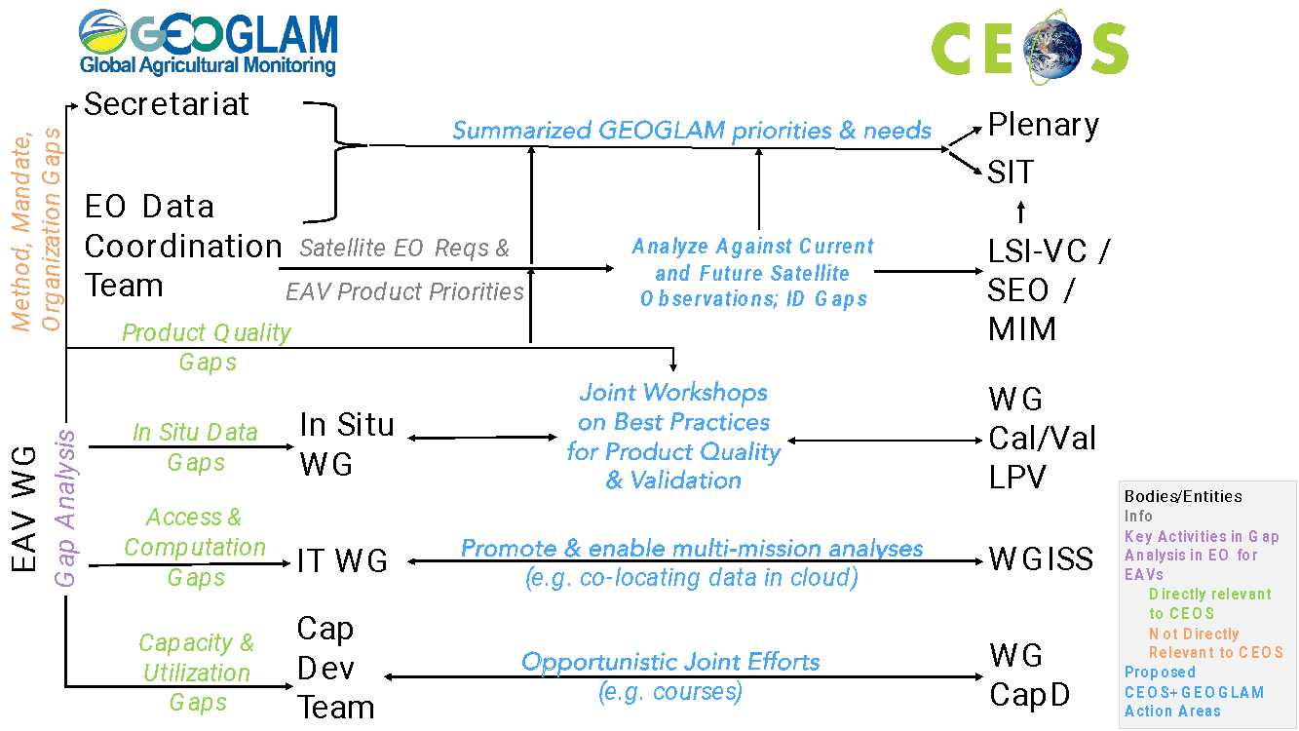
Opportunities for Collaboration
Draft schematic conceptualized by Alyssa Whitcraft

