Slide 1
CEOS AFOLU Roadmap
Osamu Ochiai
JAXA SIT Chair team
Agenda item 4.6
38th CEOS Plenary
Montreal, Canada
23rd - 24th October, 2024

Slide 2
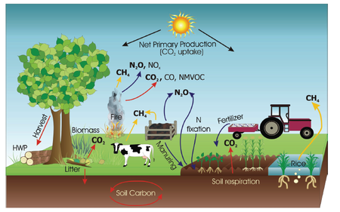
AFOLU elements (IPCC, 2019)
Key elements from satellites:
LC/LU
Forest inventory & REDD+
AGB
Emission factors
Stocking density?
CH4 emissions from rice etc
Mangrove extent
etc.

Slide 3
AFOLU Roadmap
A framework for long-term coordination of agency programmes in support of the needs of society for Agriculture, Forestry and Other Land Use (AFOLU)-related information, with a particular focus on the needs and ambition cycle of the Global Stocktake of the 2015 Paris Climate Agreement.
A guiding vision for long-term space agency coordination around AFOLU.
An effective means for communicating the intentions of CEOS
Address basic observation continuity and necessary agency coordination to achieve goals of sustained land-imaging of land-use and land cover change and biomass estimates

Slide 4
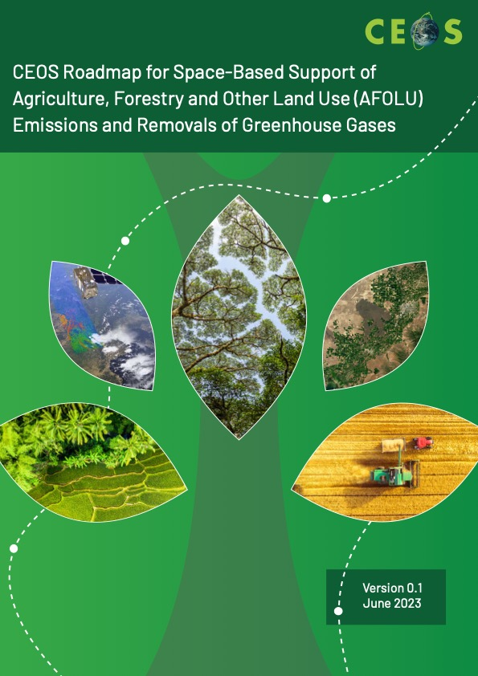
CEOS AFOLU Roadmap
AFOLU Roadmap approved by CEOS Plenary Nov 2023
Implementation actions presented in draft at SIT-39 in April 2024
LSI-VC Forests & Biomass Team has been progressing the actions since in coordination with SIT Chair Team

Slide 5
Three Classes of actions
Actions across all Recommendations broadly fall into three categories:
Those pertaining to presently available data to support AFOLU procedures as in the 2006 IPCC Guidelines for National GHG Inventories vol.4, and their 2019 Refinement.
Actions to develop new or improved products that would allow more accurate and/or easier implementation of the Guidelines
Actions to facilitate greater interaction with the GHG Roadmap and hence improve characterisation of land management emissions through MVS based on satellite-based atmospheric inversions.
- at this stage the focus is on the first two action classes above due to technical reasons related to MVS integration
Notes:
- focus at this stage on two action classes above for technical reasons on MVS integration)

Slide 6
Recommendations - Summary
Recommendations from AFOLU Roadmap:
Universal access to satellite data needed for national reporting
Continuity and backward compatibility for missions providing activity data and emission factors
Improve data use in UNFCCC reporting and IPCC Guidelines
Enable dialogue between inventory practitioners and CEOS community
Reconcile bottom-up, top-down, and inventory estimates of GHG emissions and removals
Systematically target activities to support IPCC Land Cover classes
Work with New Space to provide comprehensive coverage for national GHG inventories
Consistency of AFOLU and GHG Roadmaps for integrated national GHG inventory system, GHG+.
Notes:
- focus at this stage on two action classes above for technical reasons on MVS integration)

Slide 7
Actions (examples with the work behind)
Action 2.2: Coordination with IPCC TFI through meetings, workshops, regular COP/SBSTA participation and side events for engagement. Establish agreed IPCC-consistent land cover definitions based on satellite data with other actors. Explore possibility of a systematic and comprehensive approach to submission of CEOS agency datasets to the IPCC Emission Factors Database
Notes:
- focus at this stage on two action classes above for technical reasons on MVS integration)

Slide 8
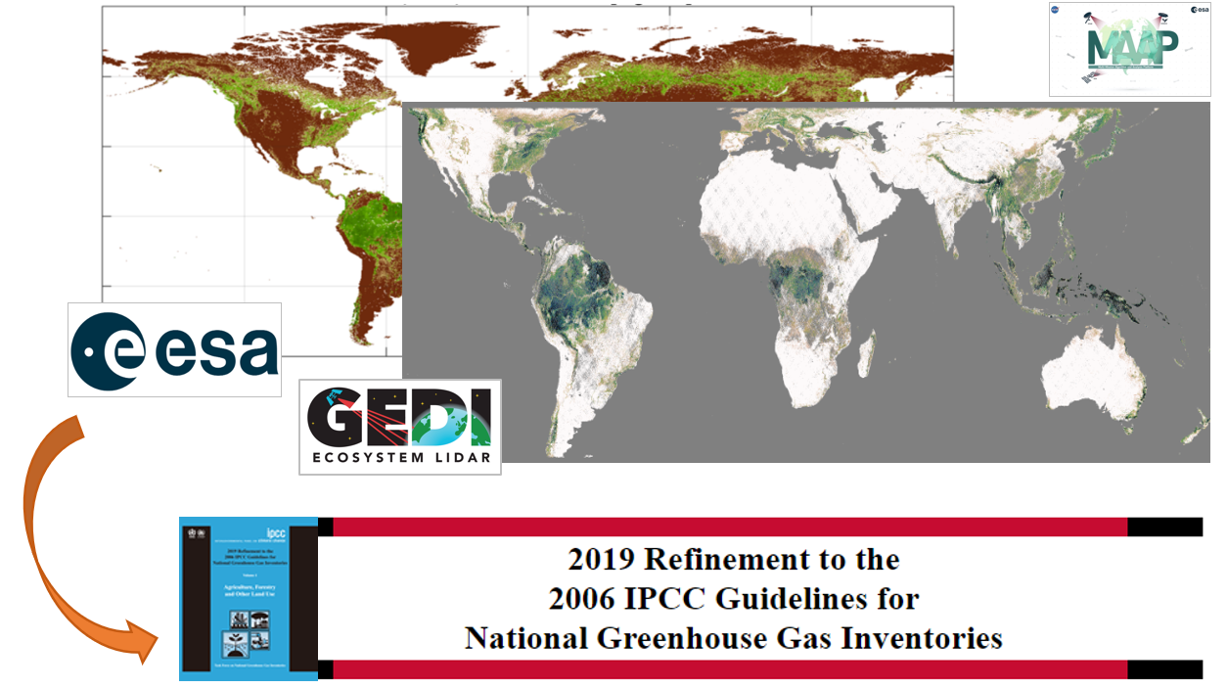
Biomass Harmonization: IPCC EFDB
The research generates natural forests biomass estimates in the format of Intergovernmental Panel on Climate Change (IPCC) Tier 1 values
The approaches leverage strengths of various EO-derived datasets, compiled in a transparent, open-science framework
The dataset will be regularly updated as biomass maps improve in accuracy
Request for this to be a CEOS submission to the IPCC EFDB
Pre-print available
Notes:
This submission to Emissions factors database is hpp

Slide 9
Actions
Action 2.3: Following the model of GFOI MGD practice, establish an agreed methodology for use of AGB in emissions inventories. Work with national agencies towards uptake of CEOS-based measures via demonstration studies with different countries and NFI efforts (needs research teams and funding), engage with GFOI R&D component with priority action on biomass map integration in national estimation, Update of CEOS Biomass Protocol towards biomass change validation, prepare for GFOI MGD updates/modules on the topic and SilvaCarbon activities.
Upcoming GFOI workshop: Informed use of biomass maps in MRV procedures
23-25 October, Potsdam, Germany
Organized by GFOI R&D Component, GFZ and ESA
Objectives:
Provide an updated perspective of the country needs and developments related to improving forest aboveground biomass estimations
Develop a draft of a supporting Biomass Module for GFOI guidance on the use of space-based biomass estimates for MRV purposes
Identify next steps in country engagement for research activities
Participants: MRV specialists, NFMS country teams, and biomass map experts
More information: martin.herold@gfz-potsdam.de , daniela.requena.suarez@gfz-potsdam.de
Notes:
- GFOI methods and guidance module for biomass map and NFI inte

Slide 10
Actions
Action 2.5: Biomass harmonisation group to work with GEO-TREES to implement validation of CEOS biomass products with GEO-TREES data.
Notes:
- focus at this stage on two action classes above for technical reasons on MVS integration)

Slide 11
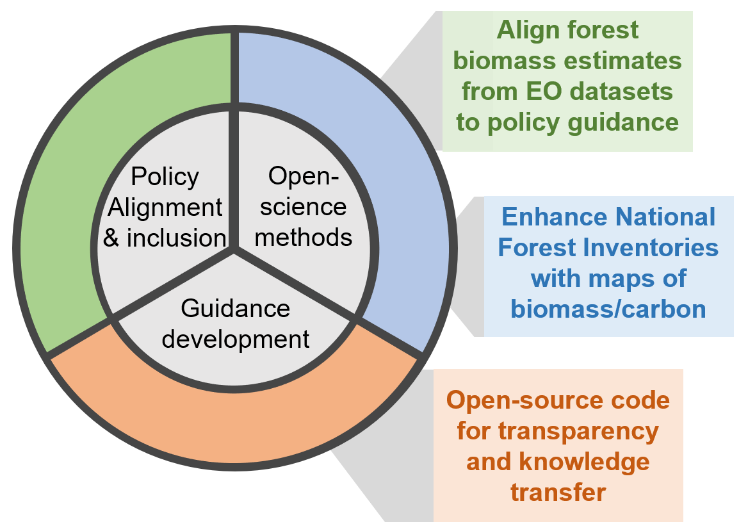
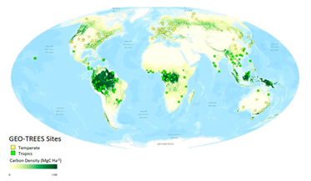
Biomass Harmonization
Under CEOS Biomass Harmonization, there are ongoing country case-studies on the improvement of GEDI biomass estimates and integration with NFIs
Generally, there is an increasing interest of NFI and EO integration techniques from countries
GEO-TREES will provide a global biomass reference network - this an action toward biomass product validation
CEOS Biomass Harmonization planning a submission of forest biomass estimates to IPCC Emission Factors Database (EFDB)
Notes:
This submission to Emissions factors database is hpp

Slide 12
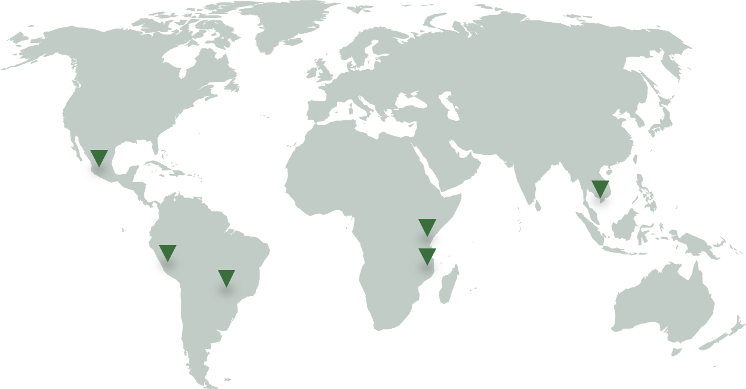
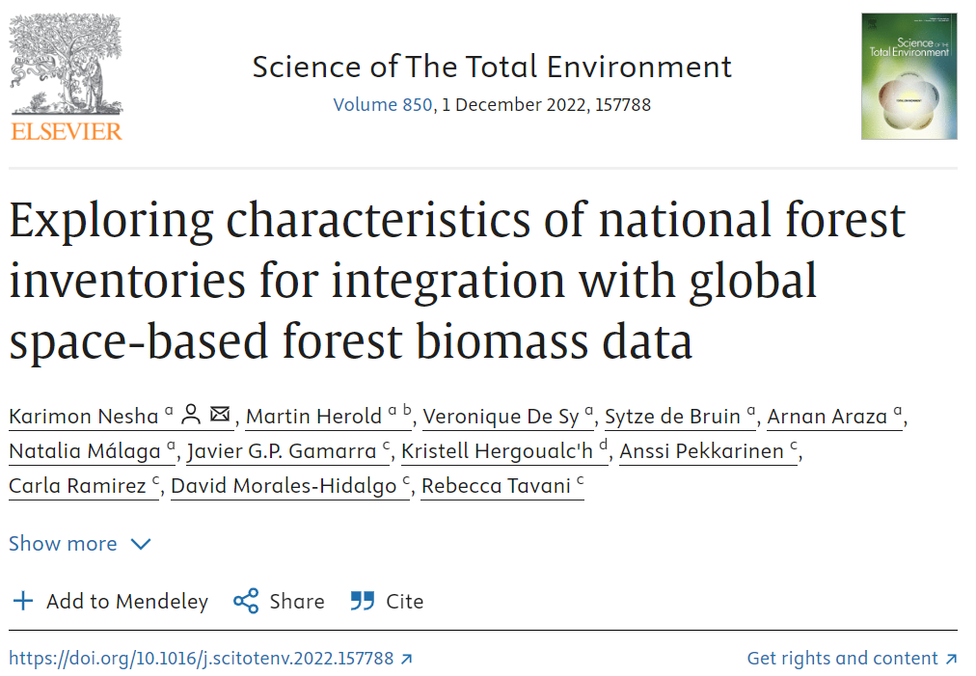
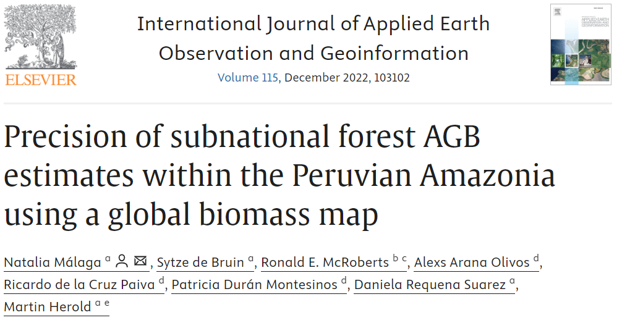
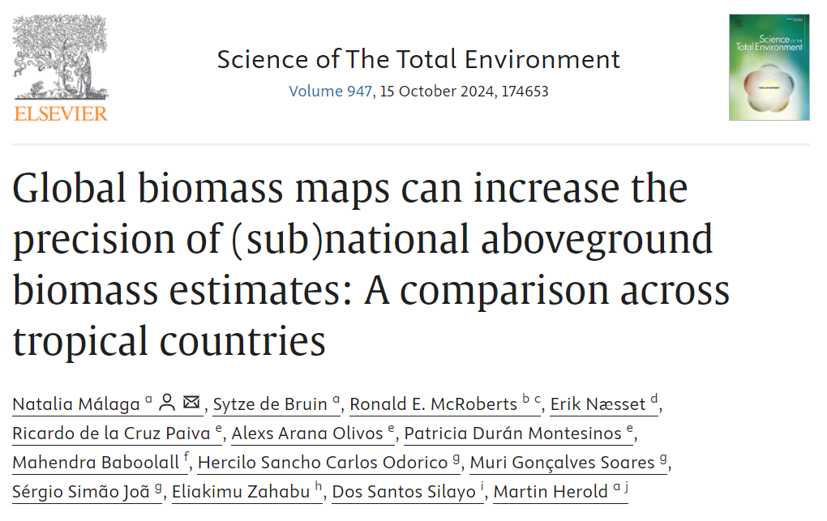
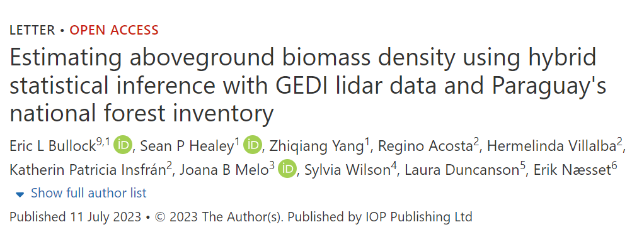
Actions
Action 3.1 Dedicated country demonstrations / field campaigns for better ground/space data integration
Facilitating and disseminating research in partnership with national organizations with the purpose of leveraging National Forest Inventory (NFI) data in combination with EO to enhance the estimation of forest biomass
Notes:
- Several case studies with country NFI agencies are ongoing to demonstrate different technical approaches for varying country circumstances - more case studies needed (more engagement with NFI agencies), comparison using different space-based biomass datasets …

Slide 13
Actions
Rec 3 block: Enable dialogue between inventory practitioners and CEOS community, recognizing that different countries have various requirements to support their system for reporting
Notes:
- focus at this stage on two action classes above for technical reasons on MVS integration)

Slide 14
AREAS OF IMPACT FROM CEOS
1. Mangroves mapping and carbon estimation using global datasets 2. Biomass estimation and improving emission factors using space data
PILOT COUNTRIES WITH RESULTS
LatinAmerica: Paraguay, Guatemala
South East Asia: Cambodia, Laos, Thailand
Africa: Gabon
Pacific Islands: Vanuatu, Fiji

Slide 15
Actions
Recommendation 4: Support efforts to reconcile bottom-up, top-down, and inventory estimates of GHG emissions and removals
Action 4.1: Develop guidance and datasets to support the consistent comparison and assessment of bottom-up and top-down methodologies with national GHG inventories.
Notes:
- focus at this stage on two action classes above for technical reasons on MVS integration)

Slide 16
Bottom-up & top-down approaches
3 different approaches can be used to monitor GHG budgets:
1. Top-down (TD) estimates from atmospheric inversions based on atmospheric GHG measurements from in-situ monitoring networks or satellites with atmospheric transport models.
2. Bottom-up (BU) approaches based on process-based or bookkeeping models for natural and anthropogenic fluxes.
3. Bottom-up approaches using activity statistics combined with emission factors, or empirical or process-based modelling.
The first two approaches are used in GHG budgets by the GCP, while most NGHGI follow the third type of bottom-up approach, with different levels of details based on different Tiers defined by IPCC guidelines.
Notes:
GHG - AFOLU - Aquatic carbon (from Ben, [...] trade and aquatic carbon flows helps reconcile TD and BU at state levels.”

Slide 17
ESA RECCAP2: reconcile TD & BU

Slide 18
Actions
5.1: Provide demonstration studies (nationally/regionally but also globally) that illustrate and demonstrate capacity to generate IPCC classes through amalgamation of mapped FAO LCCS classes, given the latter can be mapped directly from Earth observation data or reconstructed from existing land cover products.
Notes:
- focus at this stage on two action classes above for technical reasons on MVS integration)

Slide 19
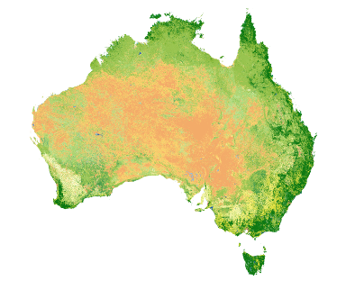
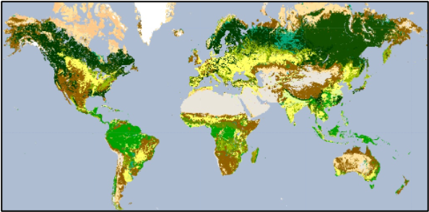
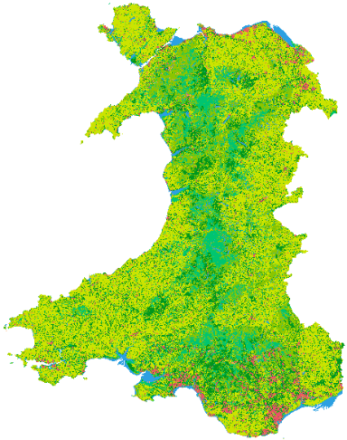
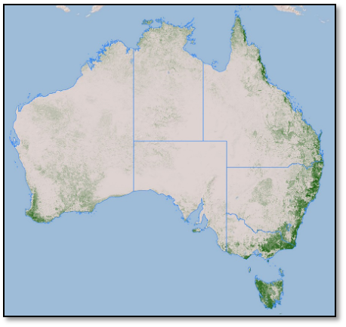
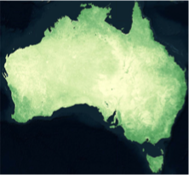
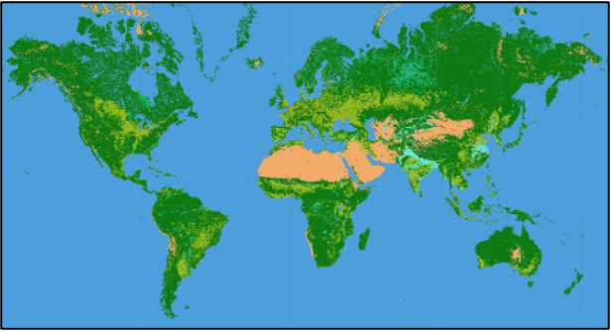
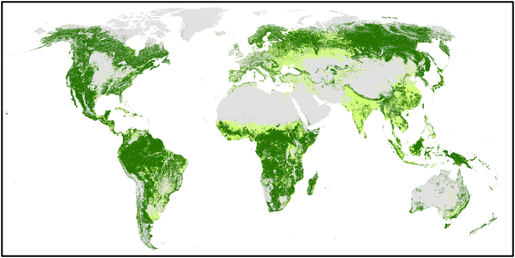
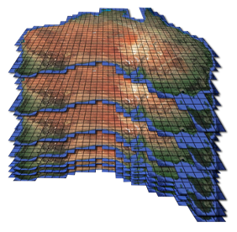
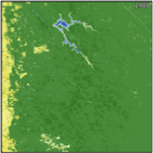
Review of land cover mapping
The IPCC AFOLU utilises 6 broad land cover classes that cannot be easily classified from Earth observation data.
By contrast, classes of the Food and Agriculture Organisation’s (FAO) Land Cover Classification System (LCCS) can be constructed from environmental descriptors a) retrieved or classified separately from Earth observation data or b) deconstructed from existing (often machine-learned) land cover products, with 10 able to be combined to give the 6 AFOLU classes.
The use of EDs with predefined units (e.g., m, %, time) or categories ensures scalability across space and time and hence applicability from local to global scales.
The FAO LCCS classes can be translated to the AFOLU classes but not vice versa.
Hence, the proposal is to establish capacity to use of the FAO LCCS as an optional standard for providing more detail than the existing IPCC AFOLU classes.
FAO LCCS MAPS CONSTRUCTED FROM ENVIRONMENTAL DESCRIPTORS RETRIEVED OR CLASSIFIED FROM EARTH OBSERVATIONS
DECONSTRUCTED FROM EXISTING LAND COVER MAPS AND RECONSTRUCTED INTO THE FAO LCCS
Time 1
Time n
Digital Earth Australia
Living Wales
EXAMPLE:
ESA CCI Land Cover
(300 m)
EXAMPLES OF EDs (AUSTRALIA)
DECONSTRUCTED EDs (GLOBAL)
+
Lifeform: Woody/ Herbaceous Fractions
Canopy cover (%)
FAO LCCS Level 3
Lifeform: Woody (Tree/Shrub)/Herbaceous
FAO LCCS
IPCC
1988-2024
Mining, Western Australia
TIME-SERIES COMPARISONS OF THE FAO LCCS PROVIDES MORE DETAILED TRANSITION MATRICES.
TIME-SERIES COMPARISONS OF LAND COVERS AND EDs PROVIDES EVIDENCE FOR CHANGE IMPACTS ~ PRESSURES
*Woody lifeform needs to be separated into trees and shrubs

Slide 20
Actions
5.3: Review and consolidate current approaches to characterising, mapping and monitoring Blue Carbon Ecosystems (BCEs) and establish approaches that are consistent globally and across scales, including the detection of change and links between terrestrial and aquatic environments.
5.4: Explore the development of new CEOS initiatives on wetlands mapping and monitoring. Ensure new CEOS missions consider wetlands amongst their mission goals, recognising the heterogeneity of wetlands and the need for multi-sensor approaches.
5.4: Establish closer collaboration with the Ramsar Convention Secretariat and Scientific and Technical Review Panel (STRP)
First ever EO day planned with the Secretariat on 6 Dec
Notes:
- focus at this stage on two action classes above for technical reasons on MVS integration)

Slide 21
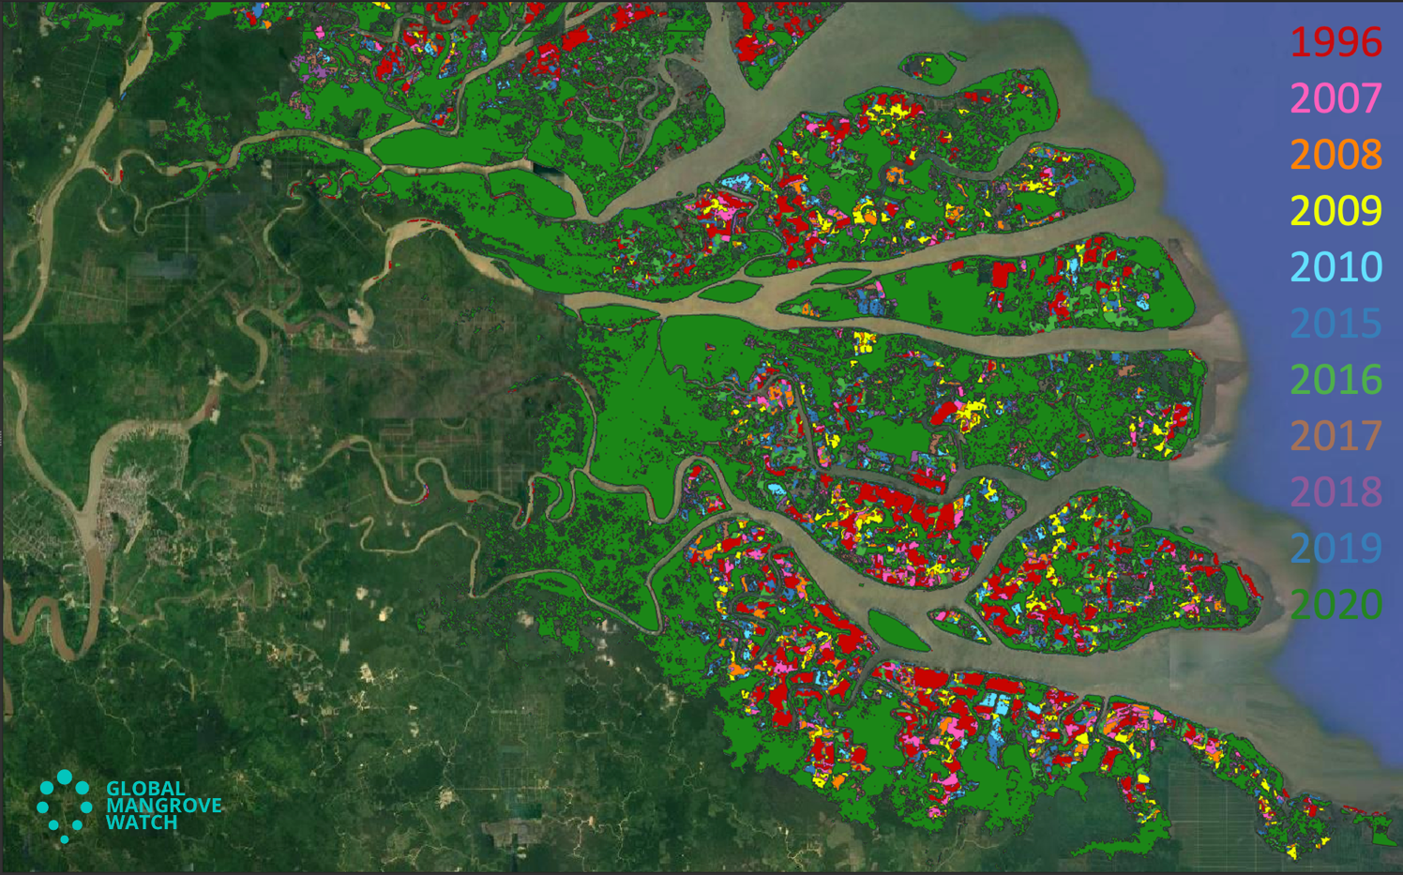
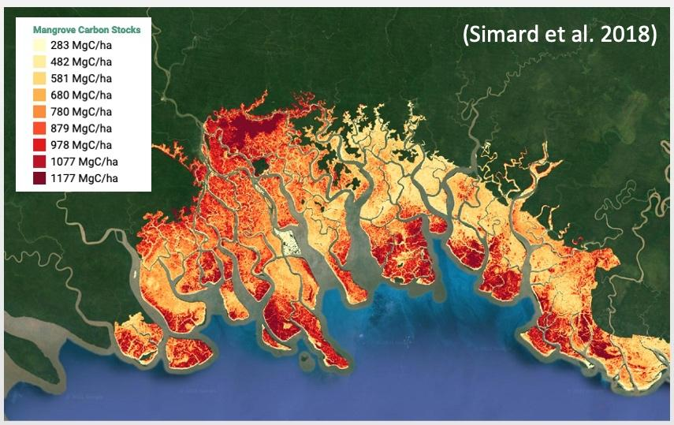
Other Land Use - Wetlands
MANGROVES (Forest / OLU-Wetlands)
Activity Data: Global Mangrove Watch (JAXA Kyoto & Carbon (K&C))
Global maps of mangrove area and annual changes at 25 m derived from L-band SAR and optical data 1996 - 2020.
New baseline map for 2020 at 10 m developed. Open access in public domain (Zenodo.org). 1996–2023 change maps available by Q1/2025
* GMW constitutes the default mangrove layer used by UNEP for reporting on SDG Indicator 6.6.1 (Mapping wetland extent and change over time)
Emission Factors: LCLUC Global Mangrove Mapping (NASA JPL/GSFC)
Global maps of mangrove Height, AGB and Total Biomass.
New 2015 baseline at 12 m from TanDEM-X DEM and GEDI finalized, Methods paper in review and data publicly available on NASA ORNL Data Archive.
(Bunting et al. 2022)
Notes:
- focus at this stage on two action classes above for technical reasons on MVS integration)

Slide 22
AFOLU Actions Status
Need a final push from the co-leads (Inge (ESA), Lola (NASA), Osamu (JAXA)) to have a consistent and complete set of actions which are well characterised, with due dates and POCs
LSI-VC-16 meeting confirmed that LSI-VC will coordinate the annual update and reporting of the AFOLU Roadmap Actions status - timed to support the annual CEOS WP update
Carbon Roadmap alignment is necessary and LSI-VC looking to SIT Chair Team for coordination
Notes:
- focus at this stage on two action classes above for technical reasons on MVS integration)

Slide 23
Thanks
To the many agency and non-agency personnel who have supported the AFOLU Roadmap and actions efforts, including: Steve Briggs, Ben Poulter, Lola Fatoyinbo, Inge Jonckheere, Frank Martin Seifert, Clement Albergel, Laura Duncanson, Neha Hunka, Joana Melo, Martin Herold, Ake Rosenqvist, Richard Lucas, Shaun Quegan, Sylvia Wilson, Daniele Requena, Yasjka Meijer, Dave Crisp, Sven Gilliams, Zolti Szantoi, Vincent-Henri Peuch - and more…
Notes:
- focus at this stage on two action classes above for technical reasons on MVS integration)

