Slide 1
CEOS Plenary 2024
Aquatic Carbon Roadmap
Status
Marie-Helene RIO, ESA-ESRIN
Agenda Item 4.3
38th CEOS Plenary
Montreal, Canada
23rd - 24th October, 2024

Slide 2
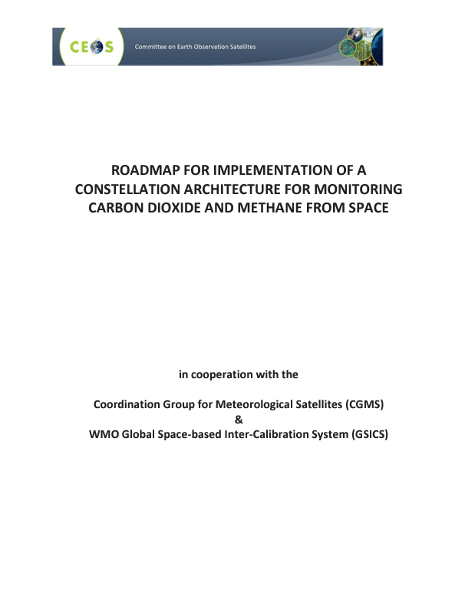

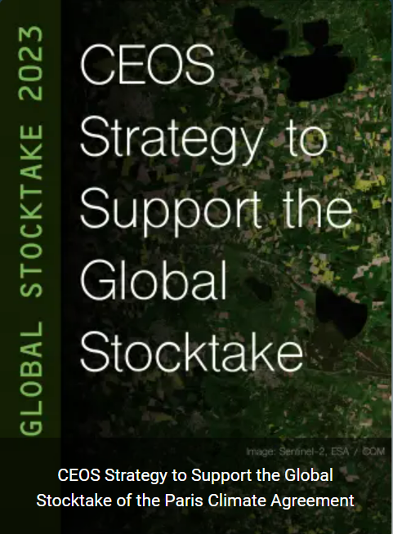

Towards the Aquatic Carbon Roadmap
CEOS Global Stocktake strategy paper
🡪 to demonstrate the value of Earth Observation satellite datasets to support the Global Stocktake process
CEOS
Aquatic Carbon Roadmap
Agriculture, Forestry & Other Land Use Roadmap 2023
Greenhouse Gas Roadmap
2020

Slide 3
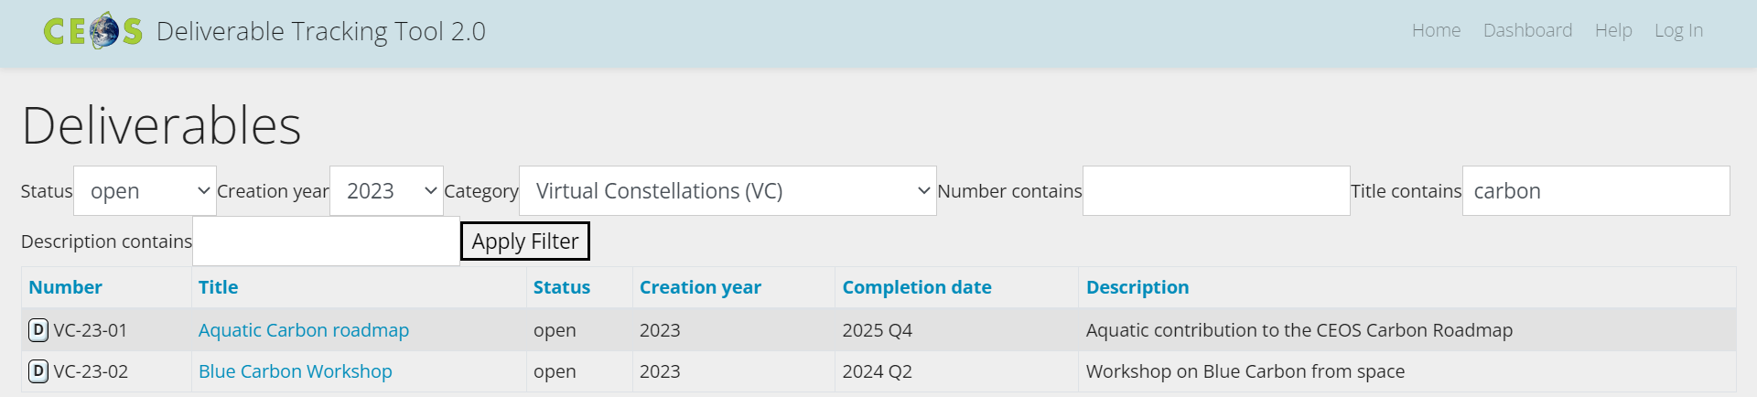

OCR-VC contribution to the CEOS Workplan
2023-2025
DONE
Aquatic Carbon Roadmap was endorsed at CEOS Plenary last year (November 14-16 2023)

Slide 4
Aquatic Carbon Roadmap Objectives
Deliverable VC-23-01
To provide a framework and serve as a guiding vision for long term (~ 15+ years) coordination of CEOS agency observing programmes in support of the science and policy needs for Aquatic Carbon related information in the context of the CEOS carbon strategy.
To contribute to support the needs and ambition cycle of the Global Stocktake of the Paris Climate Agreement, by
            driving the inclusion of inorganic and organic Aquatic Carbon within global and regional carbon assessments constraining the global carbon budget;
            supporting countries reporting on their NDC by improving the estimation and monitoring the changes in CO₂ fluxes from/to the inland and coastal waters at country level (within each country’s exclusive economic zone (EEZ));
            improving the monitoring of major Blue Carbon coastal ecosystems’ extent and carbon stock around the world.
To characterize the needs, gaps and challenges, regarding the required data and products to support science, services and applications and the observing systems that can support their developments, including the needs to plan for ground and space segments. This includes addressing basic observation continuity and the necessary agency coordination to achieve it.
To clarify the importance and elevate the profile of remote sensing and satellite Earth Observation that are already routinely used within carbon assessments, highlighting how Earth Observation has much more to offer beyond its current use and serve as an effective means for communicating our intentions to society, UNFCCC, national inventory community.

Slide 5
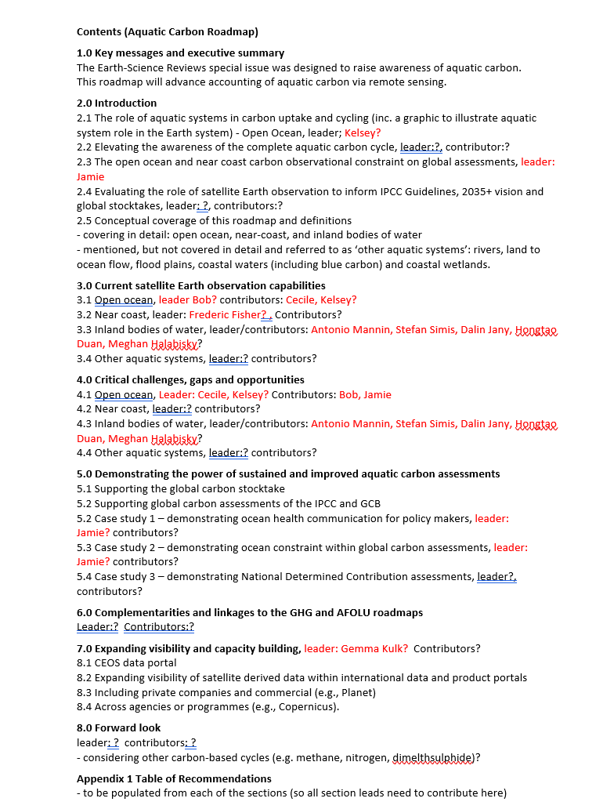
Toward an Aquatic Carbon Roadmap – Status
Coordinators
Marie-Helene Rio (ESA)
Laura Lorenzoni (NASA)
Hiroshi Murakami (JAXA)
Scientific leaders
Jamie Shutler (University of Exeter)
Bob Brewin (University of Exeter)
Cecile Rousseaux (GSFC-NASA)
Kelsey Bisson (NASA)
And many contributors from the CEOS OCR-VC / IOCCG space agencies and the scientific community
Roadmap Outline re-drafted
Book Captains by chapters assigned
Contacting contributors still on-going
Monthly progress meetings scheduled until Roadmap completion, last meetings on September 12th, October 18th, next one on December 1st

Slide 6
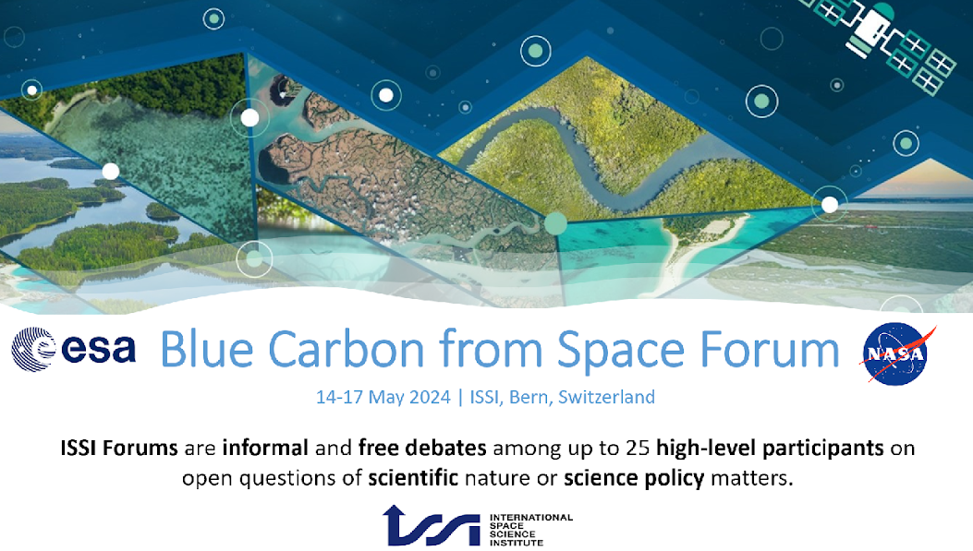

Slide 7
Blue Carbon from Space Forum objective
Deliverable VC-23-02
Bring together Coastal Blue Carbon experts from different fields (remote sensing, in-situ, modelling), relevant stakeholders and international initiatives to discuss the state of the art, challenges and opportunities regarding the use of satellite observation to advance Blue Carbon key priority areas including:
Observing systems – discussing the capabilities of Earth Observation to map blue carbon ecosystem extent/ carbon stock/ change and answer user and policy needs
User and Policy Needs – with a specific focus on the ambition cycle of the Global Stocktake of the Paris Climate Agreement
Economic Value - covering current carbon crediting methodologies and how remote sensing can support
External threats impact and recovery - how Earth Observation can support the monitoring/prediction of how external drivers affect blue carbon ecosystems and their carbon stocks/sequestration potentials
Climate Change Mitigation and Adaptation - impact of ecosystem conservation, restoration, and creation on mitigation capabilities and how Earth Observation can contribute to quantifying the added value of those strategies

Slide 8
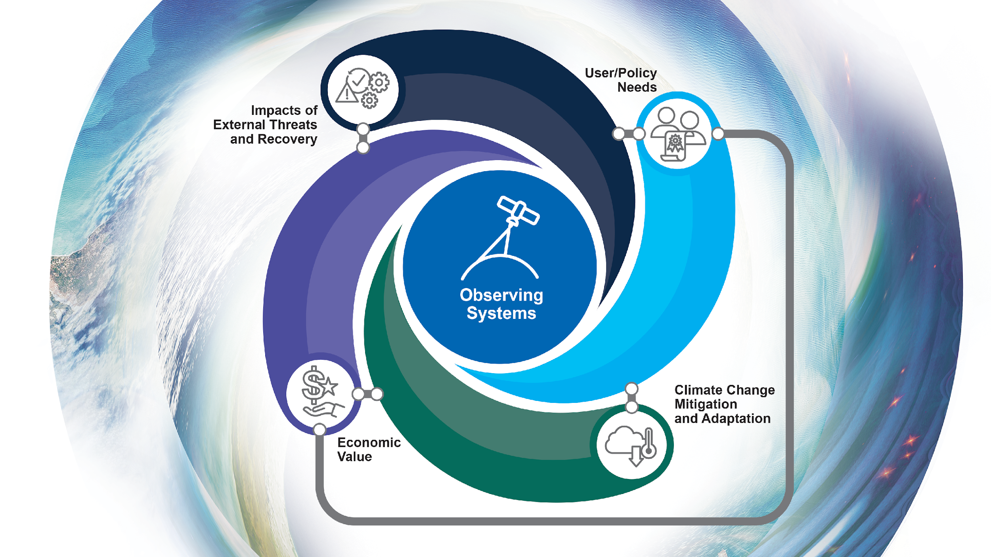
Aquatic Carbon
key priority areas

Slide 9
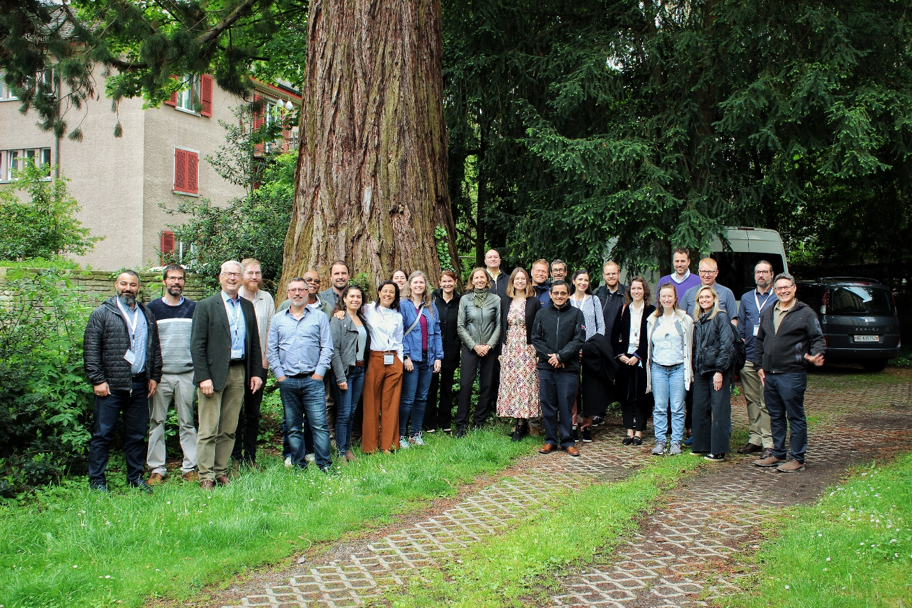


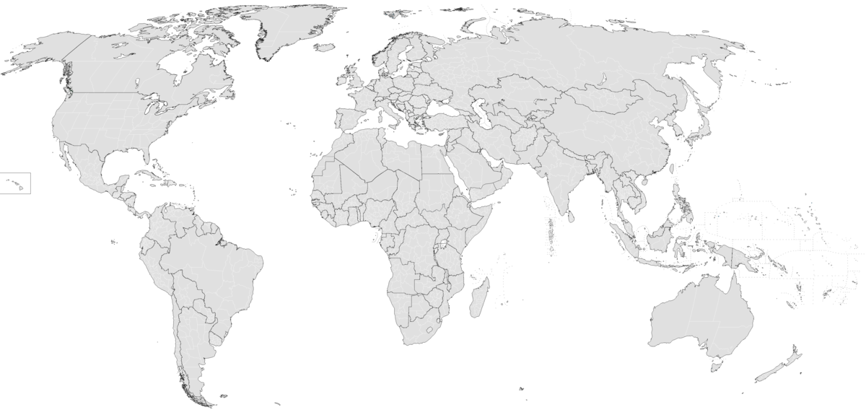


Participants
Forum co-conveners: Marie-Helene Rio (ESA), Laura Lorenzoni (NASA), Benjamin Poulter (NASA), Stephen Plummer (ESA), Clement Mathieu Jacques Albergel (ESA), Sophie Hebden (ESA), Sarah Connors (ESA), Alina Blume (ESA)
Participants
Attending Organisers
1
3
1
Gender Split
5
1
2
2
6
1
1
1
1
1
1
Organized jointly by ESA and NASA with the support of the International Space Science Institute (ISSI), it gathered 24 participants from 14 different countries across six continents (North America, Central America, Africa, Australia, Europe, Asia), with diverse and complementary expertise in the realm of blue carbon including remote sensing and in-situ observations experts, blue carbon ecosystems and climate change ecologists, marine biologists, and representatives of international organizations and NGOs (IPCC, UNESCO, Wetland Internationals, Conservation International, the Nature Conservancy, GRID-ARENDAL). Participants also included the partners of the newly launched ESA Application project on Coastal Blue Carbon (consortium led by I-Sea, France).

Slide 10
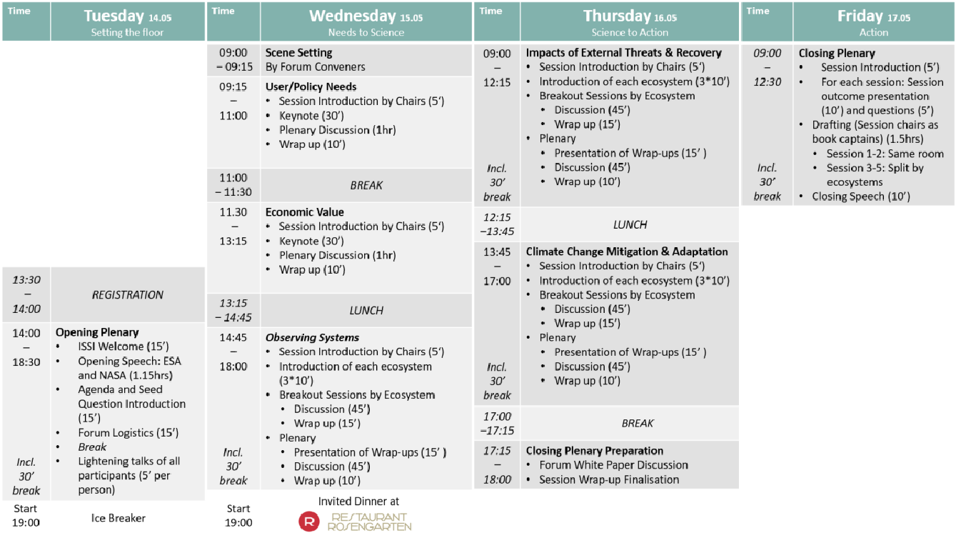
Blue Carbon from Space Forum program

Slide 11

Blue Carbon from Space Forum outcome
Workshop Summary – Drafted, under review by session chairs
Perspective Paper –to be submitted to Nature Communications [initially collection on Coastal Blue Carbon by October 11th, 2024 – but we are taking a few more days to finalise – Final review from author expected today]
Identifying the main gaps, challenges and opportunities related to the use of space-borne data to support Coastal Blue Carbon science and policy needs.
Including a roadmap towards filling the identified research gaps.
Policy Brief – To be developed from the Workshop Policy Needs summary chapter and submitted before end of 2025
Workshop Summary and Papers will directly contribute to the CEOS Aquatic Carbon Roadmap

Slide 12
Blue Carbon From Space perspective paper
10 key questions were selected by the contributing authors (28):
Q1. What role does EO play in supporting global climate action?
Q2. How can the integration of EO data in policy-making support better climate change adaptation and mitigation strategies?
Q3. What is the role of EO in Measurement, Reporting and Verification (MRV) of blue carbon projects?
Q4. How can EO support the extrapolation of emission factors at different spatial scales?
Q5. How can we optimise EO technologies to robustly estimate blue carbon ecosystem baselines and carbon fluxes following conservation and restoration actions?
Q6. How can EO support the move towards landscape-seascape approaches?
Q7. What is the relationship between resolution and accuracy of blue carbon products from earth observation data?
Q8. How to capture spatial variability in blue carbon stocks across different scales (spatial and temporal) using EO data?
Q9. How can EO help identify changes in blue carbon ecosystems, and help in improving process-based models that are used to forecast impacts on blue carbon stock?
Q10. How can we leverage EO data to identify high risk - high opportunity areas for blue carbon conservation and restoration?

Slide 13

Upcoming events
CALL FOR ABSTRACT OPEN
UNTIL December 1st
Ocean Carbon dedicated session:
A.08.09 Ocean Carbon
F.04.17 Coastal Blue Carbon

Slide 14
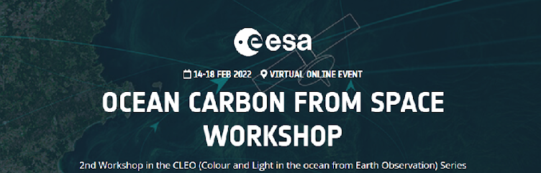
Upcoming events
https://oceancarbonfromspace2022.esa.int/
Preparing for Ocean Carbon From Space 2025 workshop (~December still TBC)

Slide 15
Thank you for your attention!

