Slide 1
CEOS GST Strategy Update
Osamu Ochiai
JAXA SIT Chair team
Agenda item 4.2
38th CEOS Plenary
Montreal, Canada
23rd - 24th October, 2024

Slide 2
SIT Chair Term Overview
2024
2025
SIT-39
SIT-TW
Plenary
Canada
SIT-40
SIT-TW
Plenary
UK
COP-30
GST STRATEGY
GST 1 LESSONS LEARNED
GST STRATEGY UPDATE
Draft
Draft & CEOS WP actions
CARBON ROADMAPS
GHG ROADMAP UPDATE
Draft
SIT CHAIR TO ENSURE LINKAGES NEEDED
AFOLU ROADMAP ACTIONS
ROADMAPS ACTIONS IMPLEMENTATION
AQUATIC CARBON ROADMAP DEVELOPMENT
IMEO & G3W
INTERFACES
PROGRESS IMEO & G3W TOPICS/challenges
GHG Best Practices
CEOS GHG BEST PRACTICES
UKSA COP-30 actions
GCOS IP
CEOS RESPONSE
Mid-2025 for CEOS & CGMS
ECV INVENTORY
VERSION 5
VERSION 6
STRATEGIC TOPICS
NEW PATHWAYS/TARGETS
NEW CEOS WP ACTIONS RE GST2
INTEGRATED PLANNING FOR COP & SBSTA
NATIONAL ENGAGEMENT

Slide 3
GST Strategy update
SIT Chair Team undertakes to update the strategy in 2025 to reflect on GST Lessons Learned exercise and our operating context
Needs good support from WGClimate, AFOLU & GHG Roadmap teams, SilvaCarbon etc

Slide 4
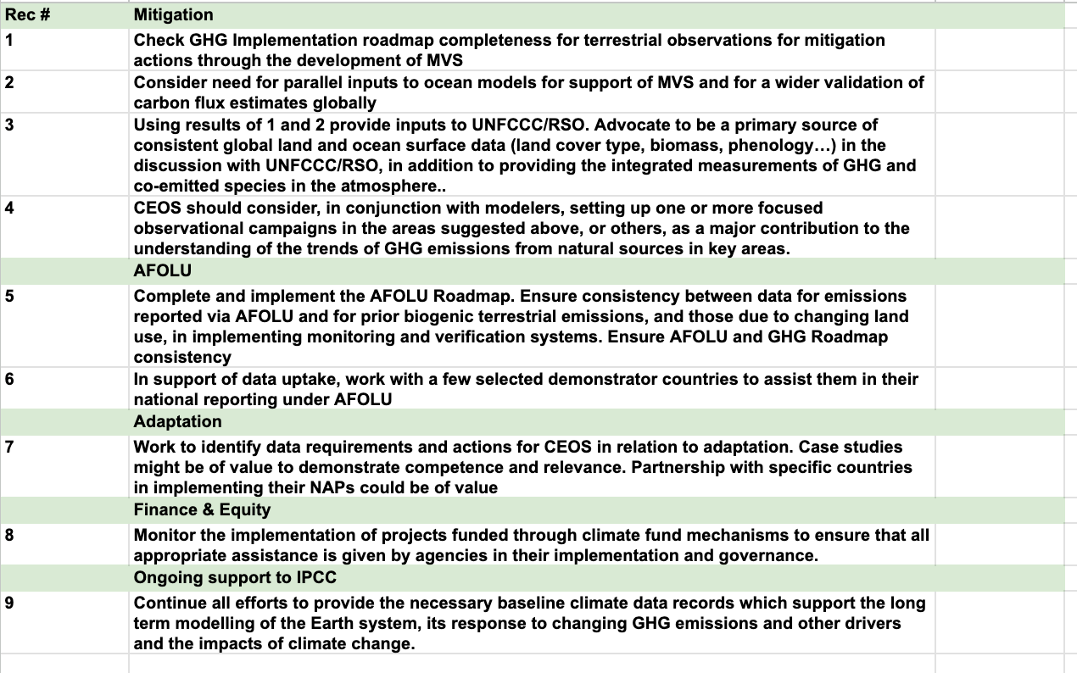
CEOS GST Strategy (abbreviated)

Slide 5
LL Categories from WGClimate
Recommendations to Improve GHG Products for Science Application
Recommendations for GHG Product Development and User Engagement
Recommendations for Space Agencies for the Second GST
Recommendations on UNFCCC Engagement and Collaboration within RSO
Recommendations for Engagement with Other Organizations
Communication Gaps to Address

Slide 6
Proposed discussion topics (3 only)
Assuming we continue to prioritise UNFCCC/SBSTA/COP engagement..
What should we do different regarding that engagement?
Nature of the engagement with UNFCCC SEC?
Other stakeholders and possible partners (Parties, WMO, GCP….)
Do we have enough clarity on the GST2 process to design a strategy?
If not, how do we?
What are our priorities?
What inputs do we target and with/for whom?
How might we more concretely and directly support Pledges?
Do we think that closer collaboration with IPCC (TFI, TSU..) will help improve our impact?
Which groups and processes are most relevant?
What are the opportunities?

Slide 7
Next Steps
SIT Chair Team will continue to convene the Climate Policy Impact call series with CEOS stakeholders
And outreach to key external stakeholders including IPCC, UNFCCC SEC, GCP etc
Finalise Lessons Learned conclusions for SIT-40 with WGClimate, and initiate the GST Strategy Update

Slide 8
SIT Term Overview
2024
2025
SIT-39
SIT-TW
Plenary
Canada
SIT-40
SIT-TW
Plenary
UK
COP-30
GST STRATEGY
GST 1 LESSONS LEARNED
GST STRATEGY UPDATE
Draft
Draft & CEOS WP actions
CARBON ROADMAPS
GHG ROADMAP UPDATE
Draft
AFOLU ROADMAP ACTIONS
SIT CHAIR TO ENSURE LINKAGES NEEDED
AQUATIC CARBON ROADMAP DEVELOPMENT
IMEO & G3W
INTERFACES
PROGRESS IMEO & G3W TOPICS/challenges
GHG Best Practices
CEOS GHG BEST PRACTICES
UKSA COP-30 actions
GCOS IP
CEOS RESPONSE
Mid-2025 for CEOS & CGMS
ECV INVENTORY
VERSION 5
VERSION 6
STRATEGIC TOPICS
NEW PATHWAYS/TARGETS
NEW CEOS WP ACTIONS RE GST2
INTEGRATED PLANNING FOR COP & SBSTA
NATIONAL ENGAGEMENT

Slide 9
CEOS GST Portal

Slide 10
CEOS GST Portal
ceos.org/gst has been updated by SIT Chair for 2024 with updates to multiple dataset profiles, some substantial
The site continues to be a valuable focal point to direct users and policy bodies (eg IPCC) towards the wide range of CEOS agency EO-derived datasets of interest to the GST process
Thanks to the agency POCs for their inputs
Feedback and additions welcome at any time - to the JAXA SIT Chair team

