Slide 1
Session 4: Carbon, Climate Policy Impact, Greenhouse Gas Observation Coordination
Hironori Maejima
JAXA SIT Chair team
Agenda item 4.1
38th CEOS Plenary
Montreal, Canada
23rd - 24th October, 2024

Slide 2
Session Objectives
“Climate Policy Impact” priority of JAXA’s 2-year SIT term seeks to address obstacles and opportunities for CEOS agency data to have maximum impact in the key climate policy processes such as the Global Stocktake of the Paris Agreement
CEOS and its agencies invest more effort in the climate sphere than any other
We need to assess and reflect on whether we are engaging with the right stakeholders in the best way - or whether we might consider alternate or additional strategies

Slide 3
Some opportunities & achievements
The Global Stocktake of the Paris Agreement is a data-driven policy exercise - its the observations community’s opportunity to play a key role!
For GST1, CEOS collaborated with WMO, GCOS and other community players in promoting the role of observations in the process (“ GST-1 synthesis report”)
We delivered the first national-scale global budgets of GHG emissions, providing a critical, atmospheric baseline for both anthropogenic and natural GHG sources and sinks of CO2 and CH4 that could be used in the future
Highlighted key datasets from across CEOS agencies in the GST portal, ceos.org/gst
Developed a CEOS GST Strategy under SIT Chair to coordinate activities across the CEOS structure
All on top of ongoing fundamental work on ECV inventory, GCOS IP response, GHG Roadmap, AFOLU Roadmap and more…

Slide 4
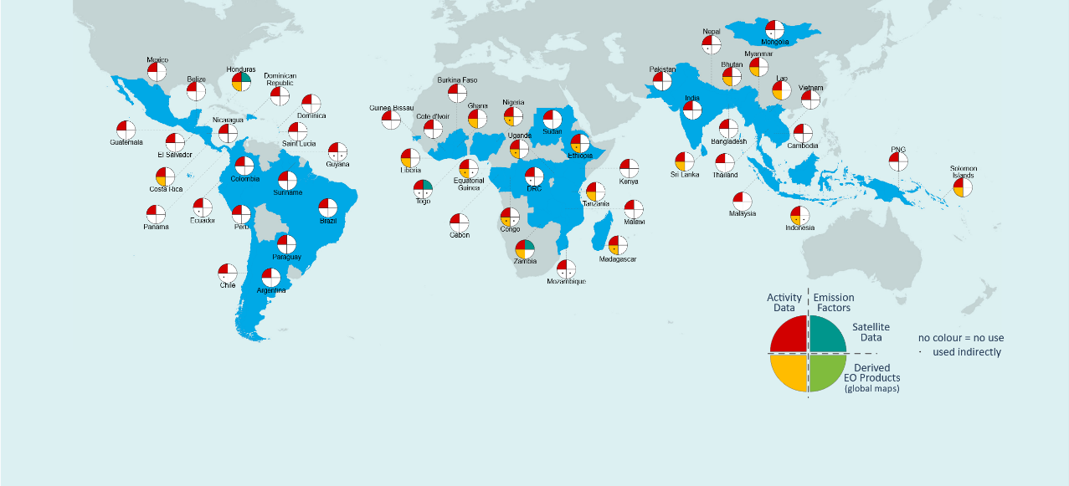
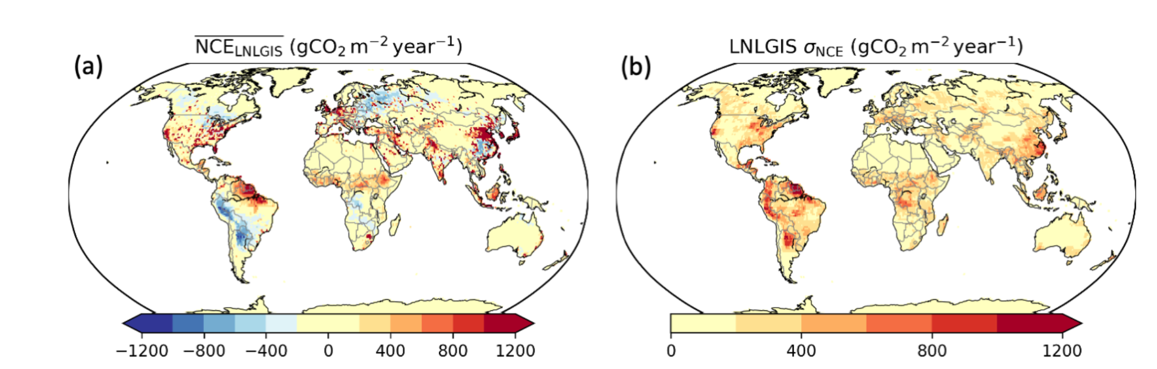
Some of our challenges…
Almost no countries use our derived global products in their forest reporting to UNFCCC
The biomass harmonisation work highlights challenges of user confidence in ‘competing’ products from different CEOS agencies
Pilot top-down national GHG products developed for GST1 got no traction. Indeed, only IPCC inputs appear to have had impact

Slide 5
SIT Term priorities - Climate policy impact
Addressing opportunities for EO data impact on climate policies
  Progress AFOLU Roadmap implementation
  Insights and new opportunities from important dataset harmonization studies
National Case Studies on EO data impact
  Asia focus of SilvaCarbon: working dataset for reporting and more
Responding to GST1 outcomes and reinforcement of UNFCCC engagement
  EO-related support arising from 1st Global Stocktake
  Effort targeting EO data role in the next update of the IPCC Task Force on Inventories Good Practice Guidance (circa GST2 in 5 years)
  Insecure interfaces for CEOS (and the observations community) to climate policy processes
Other policy engagement
  Updated Space Agency Response to GCOS IP (2025)
  Alternate angles (eg large cities)

Slide 6
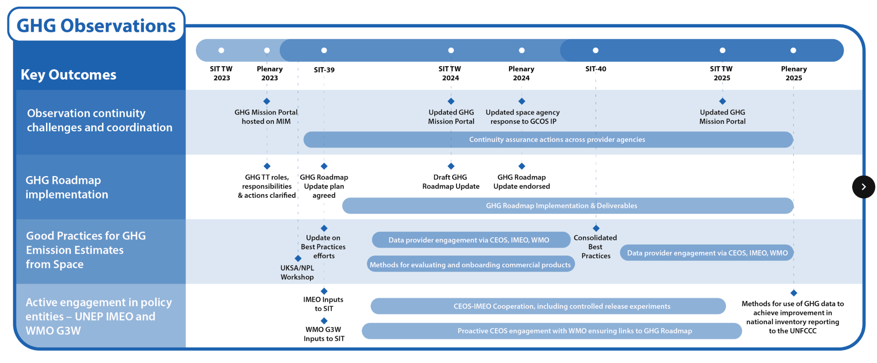
SIT Term priorities - GHG Observations

Slide 7
Some specific updates
Dialogue with Global Carbon Project
  Improved coordination on inventory products
  Possible joint comms for COP etc
Dialogue with IPCC/TSU
  Suggesting a more systematic and comprehensive process for submission of CEOS-agency candidate datasets for the IPCC Emission Factors Database

Slide 8


Our session
4.2: Outcomes to date from WGClimate-led harvesting of lessons learned from GST1 (WGClimate, Wenying Su)
  Plus discussion to further develop conclusions and actions to take forward into an updated CEOS GST Strategy
4.3: Aquatic Carbon Roadmap update (OCR-VC, TBC - remote)
4.4: GHG Roadmap V2.0 (Wenying and Yasjka)
4.5: GHG Best Practices (John Worden, JPL)
4.6: AFOLU Roadmap update (Osamu, JAXA)
4.7: 20mins discussion and AOB (inc GST Portal)

Slide 9
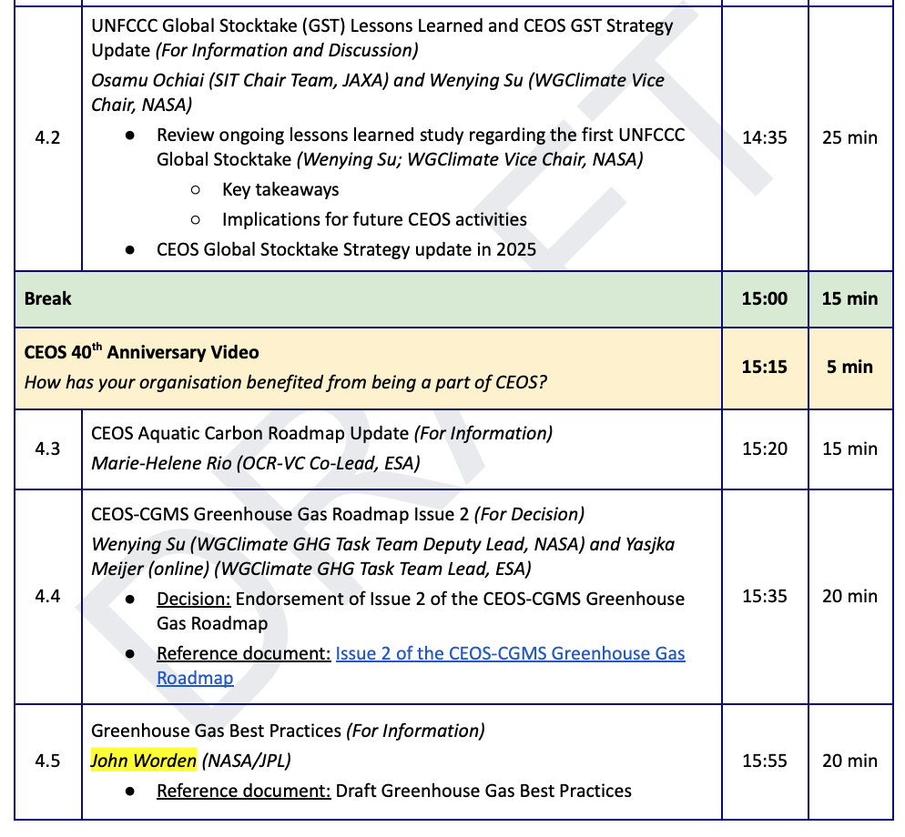
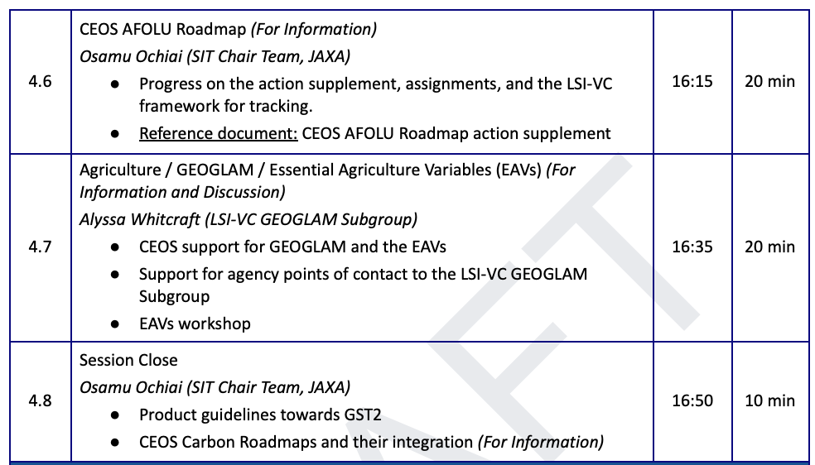
Our session

