Slide 1
WGClimate Report
Agenda item 3.6
Jeff Privette, NOAA
Wenying Su, NASA
CEOS Plenary
23-24 October 2024
Montreal, Canada

Slide 2
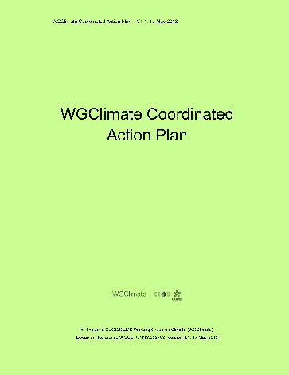
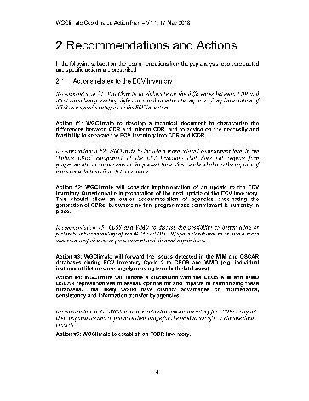

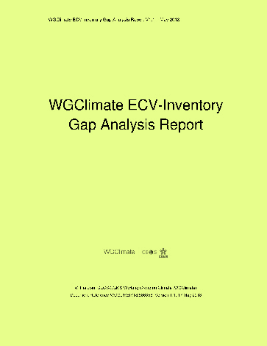
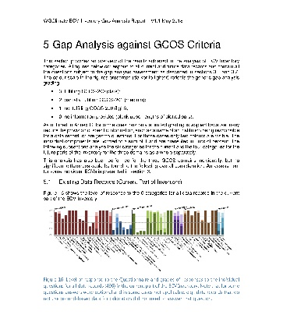
WGClimate’s Overarching Workflow
ECV Inventory
WGClimate
Climate Experts
Improved CDRs
Gap Analysis
Data producers
Improved observing system
Coordinated Action Plan
WGClimate
CEOS / CGMS

Slide 3
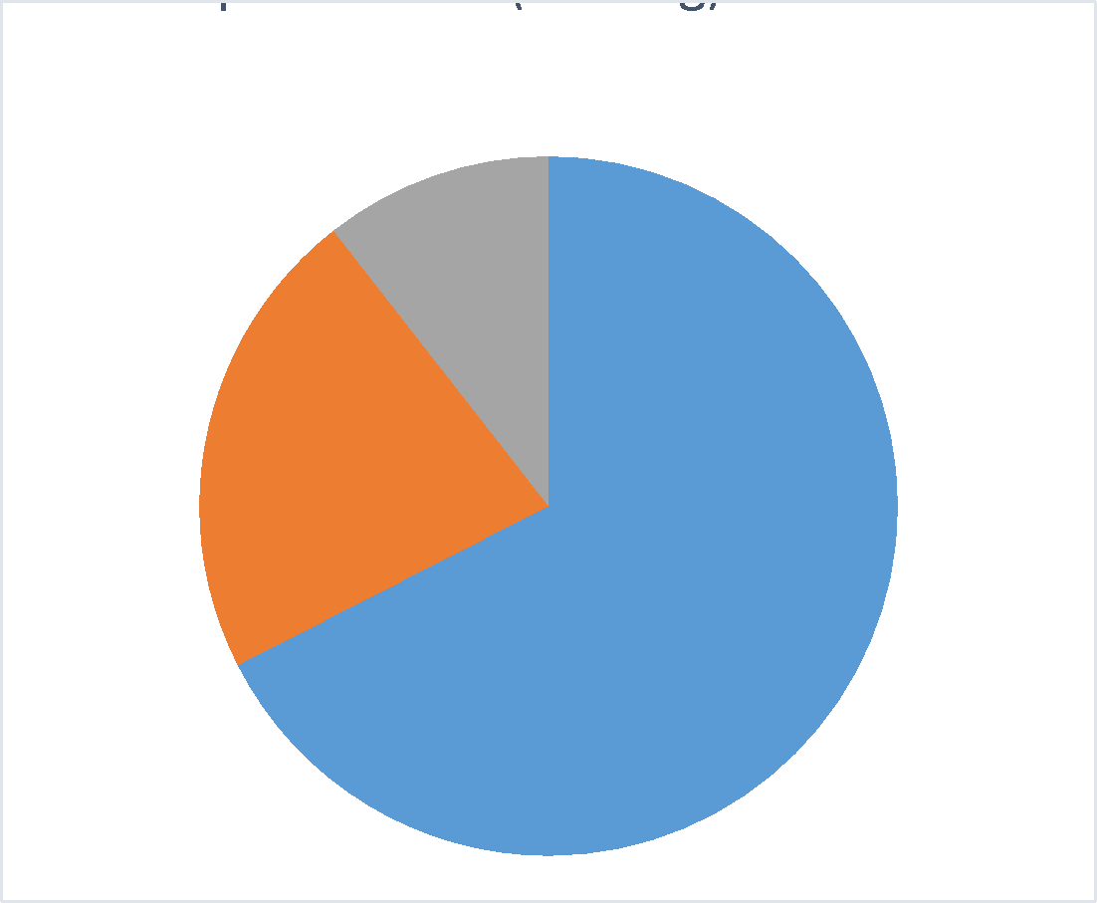
Evolution of ECV Inventory
Purpose
The only international compendium of current and future CDR metadata
Used internally to determine space architecture requirements to sustain CDRs
Used by CDR user and developer communities as authoritative one-stop CDR library
Accessible at https://www.climatemonitoring.info
History
V2.0: October 2017
V3.0: August 2020
V4.0: October 2021
V4.1: November 2022 (CDR entries: 870 existing, 381 planned)
Next
V5.0: ~November 2024
    - Adds 45 previously-submitted records

Slide 4
Redesigned Inventory Coming in 2025
Simplified structure -- easier for providers, maintainers, reviewers
  WGClimate informed new design
  EUMETSAT building, hosting, populating and maintaining
  Expected release: ~May 2025
Features
  New onboarding process will reduce workload
  Will be continuously updated and publicly available, reference versions issued as needed
  Enhanced user experience (search, visualisation, filtering)
  Improved reporting capabilities
  Renaming to Satellite Agency Climate Data Record Inventory (SACDRI)
GCOS revising its ECV binning structure (Products won’t change)
  WGClimate is monitoring GCOS ECV rationalisation activity

Slide 5
Gap Analysis & Coordinated Action Plan
Purpose
  Identify shortcomings for climate monitoring in the current and future space architecture
  Identify opportunities to improve CDR production for GCOS ECVs and Fundamental CDRs
  Coordinated Action Plan leverages Gap Analysis to inform WGClimate work agenda
New: 2024 Gap Analysis Report and Coordinated Action Plan
  Based on Inventory v3 and 4.1
  Addresses 16 ECVs related to the energy, water and carbon cycles
  Updated Action Plan: Continues 8 actions from 2018 Plan, adds 8 new from latest Gap Analysis
    2018 Plan outcome: 18 closed, 2 abandoned, 8 carried forward
  Released for Agency review on 17 October
    See CEOS Plenary materials; CGMS review via Secretariat
    Open for comment for 4-6 weeks
    Plan to seek virtual endorsement
    If preferred, can seek endorsement at the March 2025 SIT meeting

Slide 6
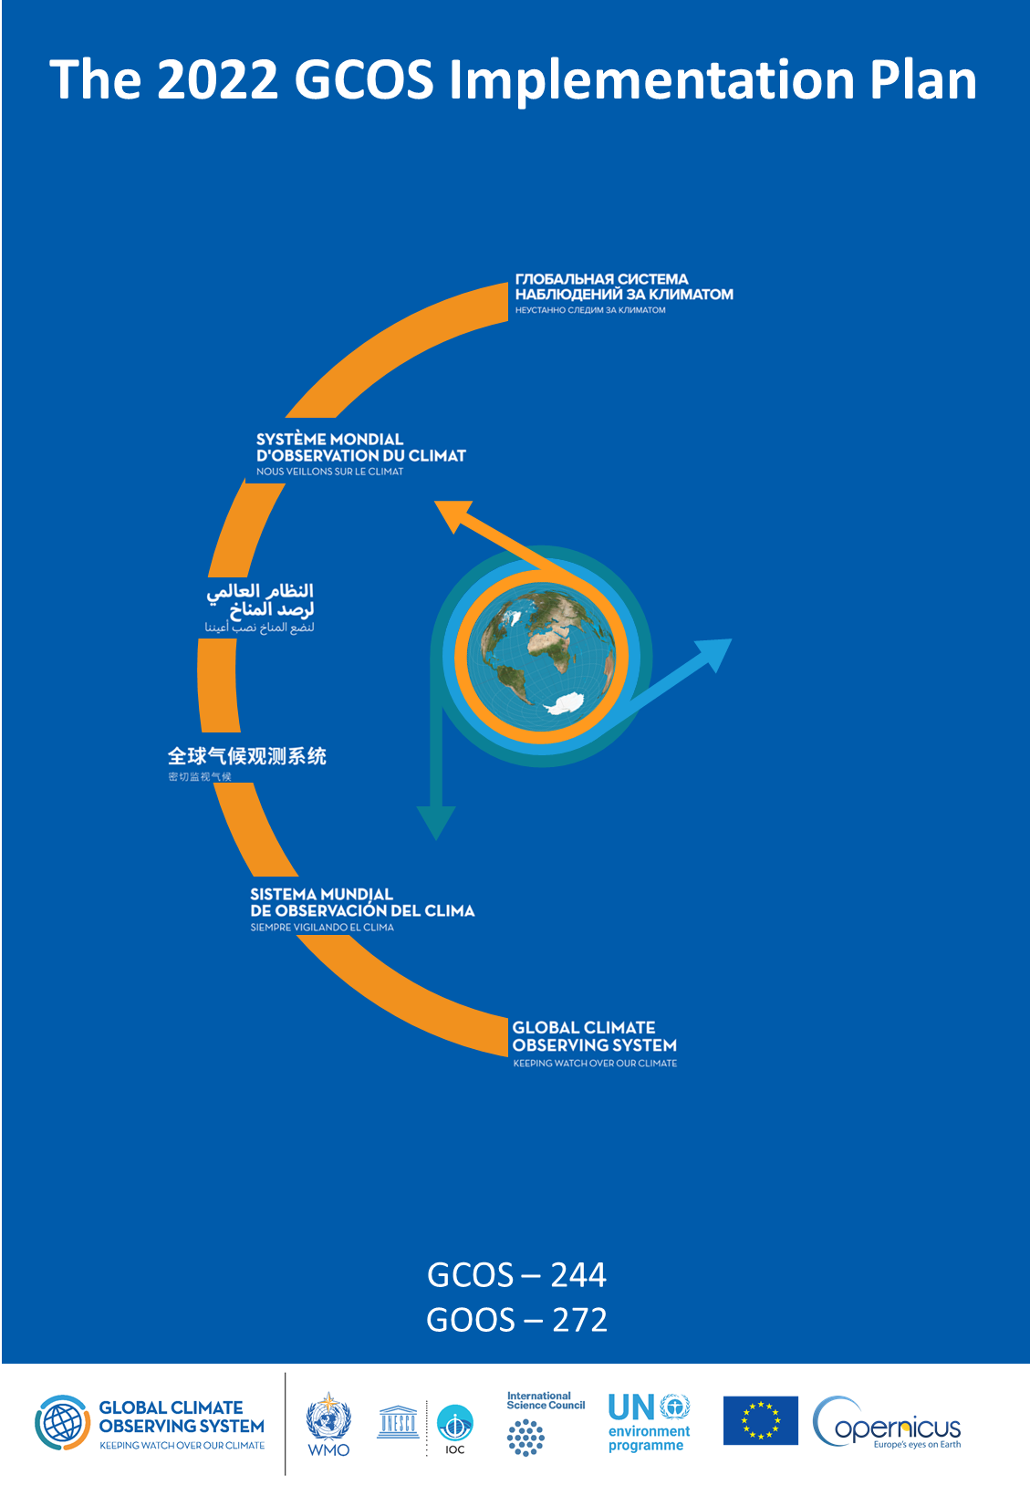
Agency Response to GCOS IP (2022)
Purpose
  Describes needs/gaps in Global Climate Observing System
  Produced every 5-6 years
  2022: GCOS provided 16 Actions, each with multiple Activities
  WGClimate addressing with a two-phase response
  Completed 21 Activities in 2023 (more straightforward)
  Addressing similar number in 2024 (more complex)
  Status
  Material inputs captured, synthesizing to consistent narrative form
  GCOS review to start January 2025
  Distribute to CEOS and CGMS for endorsement at March SIT
  GCOS will start working on its Status Report in early 2026

Slide 7
COP-29 Statement for SBSTA
Context
  UNFCCC’s Subsidiary Body for Scientific and Technological Advice (SBSTA)
  meeting at the Conference of Parties (COP)
  Invites CEOS and CGMS jointly to submit and read a short Statement at meeting
Changes for 2024
  Prior years featured CEOS’s climate-related activities, accomplishments, advocacy
  2024 focuses on satellite-enabled climate advances and understanding, support to recent GHG initiatives
    Global Methane Pledge
  UNEP’s International Methane Emissions Observatory
  WMO’s Global Greenhouse Gas Watch
  Global Stocktakes
Status
  Agencies reviewed in September
  Delivered to UK Space Agency early October
  Shorter version for oral delivery in development
  Seeking Plenary endorsement

Slide 8
COP-29 Earth Information Day (EID)
EID agenda not yet announced
      Likely a half-day event featuring a plenary and an interactive session
      WGClimate contributed 3 theme ideas in August
      Expecting there will be an extreme events component
Provided input for Information Note
      For policy-makers and obs community
      Responded to UNFCCC request for updates on Earth observation, mandates, milestones, outcomes, tools and initiatives
        Updated GHG Roadmap (v2)
        Lessons Learned from Global Stocktake 1

Slide 9

Vice-Chair Nomination: Vincent-Henri Peuch (ECMWF)
Background
Joined ECMWF in 2011. Led initiation and implementation of Copernicus Services at ECMWF. Founding Director of the Copernicus Atmosphere Monitoring Service for 10 years.
Current member of ECMWF Directorate as Director for engagement with the European Union and Head of ECMWF Bonn (190 staff) -- the centre of gravity for ECMWF EU activities including Copernicus and Destination Earth.
30-years experience in atmospheric composition modelling, composition-climate interactions and data assimilation of observations of atmospheric constituents (>105 publications, h-index: 48).
Active in international scientific and steering bodies including WMO’s Global Atmospheric Watch and Global Greenhouse Gas Watch Study Group (co-chair) and ESA’s Advisory Committee for Earth Observation and Climate Science Advisory Board.
ECMWF representative to Joint CEOS-CGMS Working Group on Climate and ECMWF’s CEOS contact since 2022. Contributes to Greenhouse Gas aspects, Space Agencies response to GCOS IP and provides liaison with relevant ECMWF/C3S/CAMS/DestinE activities: reanalyses, link to policy stakeholders, data stores, use cases…
Wenying Su (NASA; current Vice-Chair) rotates to Chair position at CEOS Plenary.
Requesting CEOS Plenary endorsement

Slide 10
Greenhouse Gas Task Team Overview
Global Stocktake Lessons Learned (Item 4.2)
Greenhouse Gas Roadmap Update (Item 4.4)
Towards an operational space and ground system backbone
  Motivation: WMO’s Global Greenhouse Gas Watch et al. need operational satellite observations
  Goal (draft): Design a sustained, fit-for-purpose backbone system which, in coordination with other observing capabilities (e.g., in situ), that supports the space-based GHG data and information needs of specific users (e.g., G3W, Global Stocktakes, UNEP IMEO). The system will be sufficiently flexible to allow evolution, augmentation and innovation insertion.
  CGMS Non-paper identified 8 focus areas of backbone (see backup slides)
  WGClimate and GHG TT met with CGMS Working Group chairs on June 3rd for initial dialog
    Will convene periodically going forward to sustain the momentum
  CGMS’s Simon Elliot serving as cross-WG liaison to the GHG Task Team, supported v2 Roadmap

Slide 11
Thank you
jeff.privette@noaa.gov

Slide 12
Backups

Slide 13
CGMS WG Capabilities Mapped to Plenary GHG Non-Paper Implications
Observational Data Requirements for G3W – WGClimate, WG-I, and WG-II
Sustain and operationalize the Observational Framework – WGClimate, WG-II and WG-III
Commercial providers – WG-III
Standardization – WG-II and WG-IV
Infrastructure and Data Management – WG-I and WG-IV
Enhanced Analytical Approaches – WG-II
Integration of AI and ML methods – WG-II
Support and Collaboration - WG-IV

Slide 14
2024 Coordinated Action Plan: New
Based on 2024 Gap Analysis Report and prior Action Plan
1 | GCOS panels to continue improvements on the requirements framework towards a more physical approach that leads to time and space scale dependent requirements. This might be achieved by dedicated research projects.
2 | GCOS to continue the consolidation of the GCOS ECV Products into physical quantities that match WMO OSCAR physical quantities to allow a seamless use of OSCAR and the ECV Inventory.
3 | CEOS and WMO to continue activities for a better interoperability of the MIM and OSCAR/Space databases to ensure seamless use of both.
4 | GCOS to attempt a simplification of the ECV focusing on creating ECVs for fluxes between Earth’s surface and atmosphere.
5 | GCOS to improve interactions with specialist groups when creating new GCOS Implementation Plans or updates of requirements.
6 | Agencies with interest in the Above Ground Biomass ECV shall operationalize the production of this ECV inclusive of comprehensive validation of resulting data records.
7 | Agencies with interest in soil moisture to support L-band passive microwave and SAR missions and to plan for the generation of L-band based ECV soil moisture data records based on the data collected by instruments on missions such as SMOS, SMAP, CIMR, SAR-L, and ROSE-L utilizing an ensemble of algorithms.
8 | Agencies operating altimeters suitable for sea level estimates shall consider operational climate data record production including past sensors.

Slide 15
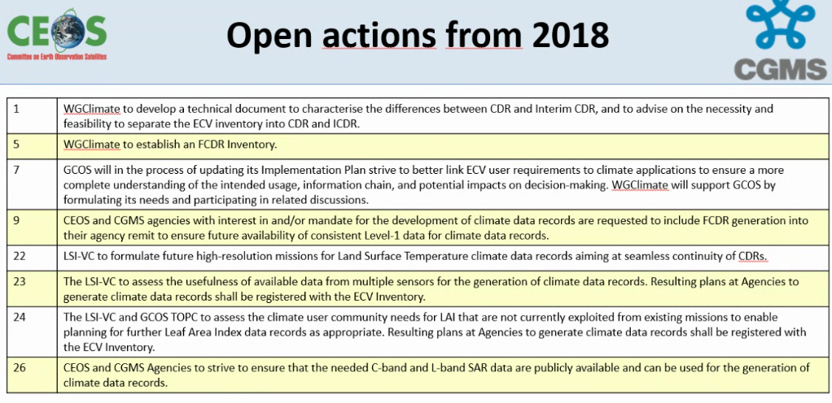

Slide 16
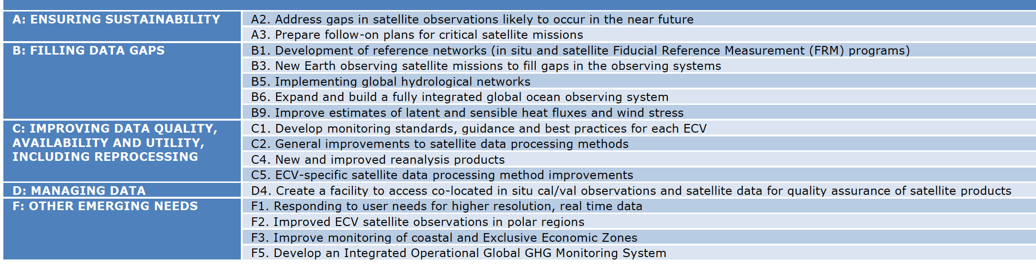
16 Actions in GCOS IP
Space Agency Supplement
Most Actions have multiple Activities
Space agencies play minor role in 3 additional Actions
Space agencies collaborate with others on 2 additional Actions

Slide 17
Inventory Evolution Since 2017
Publication timeline:
V2.0: October 2017
V3.0: August 2020
V4.0: October 2021
V4.1: November 2022
V5.0: planned for Q4.2024 (mostly backlog since V4.1)
Domain | Version | Total | Existing | Planned
All | V2.0 | 913 | 496 | 417
 | V3.0 | 1137 | 766 | 371
 | V4.1 | 1251 | 870 | 381
Atmosphere | V2.0 | 658 | 376 | 282
 | V3.0 | 801 | 535 | 266
 | V4.1 | 851 | 587 | 264
Land | V2.0 | 135 | 56 | 79
 | V3.0 | 203 | 141 | 62
 | V4.1 | 262 | 191 | 71
Ocean | V2.0 | 120 | 64 | 56
 | V3.0 | 133 | 90 | 43
 | V4.1 | 138 | 92 | 46
Process for 2025 and beyond:
Agency Focal Points identify CDR access points (e.g., Copernicus Climate Data Store)
EUMETSAT derives the needed information; updates Inventory with draft records
EUMETSAT provides draft Inventory records back to Focal Points for verification
Focal Points provide corrections, fill gaps as needed
EUMETSAT updates online inventory on rolling basis (not episodic versions)
Notes:
Caveat I: on numbers is that they contain also interim CDRs (mostly for domain atmosphere) and particularly from V3 to V4 some have been redefined by data providers leading to more individual quantities records.
Caveat II: Some records were still left out from V4.1, e.g., from C3S, because information arrived too late to be verified. Thus a next version will see more records. It also further increases the imbalance of provision of records to Europe
Caveat III: We were generous in letting data records in applying a rule of thump on 10 year length as a minimum, also opting for taking a record that is not a CDR if there is no other, but certainly some content does not qualify to be in the Inventory
Number of records has increased from version to version mostly indicating more completeness and some competed records (mostly from Europe) and some new planning
Biggest increase is in domain atmosphere, mostly on provided not on planned, which either points to the periodicity of plans, e.g., ESA and EUMETSAT new programmes or to a lack of responses. One cannot decide what the reason is, maybe both
For the land domain we see a big increase in the existing, which is mostly due to the fact we covered more. High fluctuation in planned, which is related to the level of response.

Slide 18
History of Inventory Gap Analyses
  2018 Report
    Inventory v2.0, 8 ECVs addressed in 2018 report
      Atmosphere: CO2*, CH4*, and other GHG*, Precipitation
      Land: LST, LAI*, AGB*
      Ocean: SST, SSS
  2024 Report
    Inventory v3.0, 10 ECVs addressed:
      Atmosphere: Aerosols, Surface winds, Upper-Air Winds, Water Vapour
      Land: Fire*, Land Cover*, Soil Moisture
      Ocean: Sea Level, Sea State, and Ocean Surface Heat Flux
  Inventory v4.1, 9 ECVS:
      Atmosphere: Greenhouse Gases (GHGs)
      Land: Anthropogenic GHG fluxes, Above ground Biomass (AGB), Land cover, Leaf Area Index (LAI), Fraction of Absorbed Photosynthetically Active Radiation (FAPAR), Fire, Permafrost
      Ocean: Ocean Colour
*readdressed in 2022 with V4.1

Slide 19
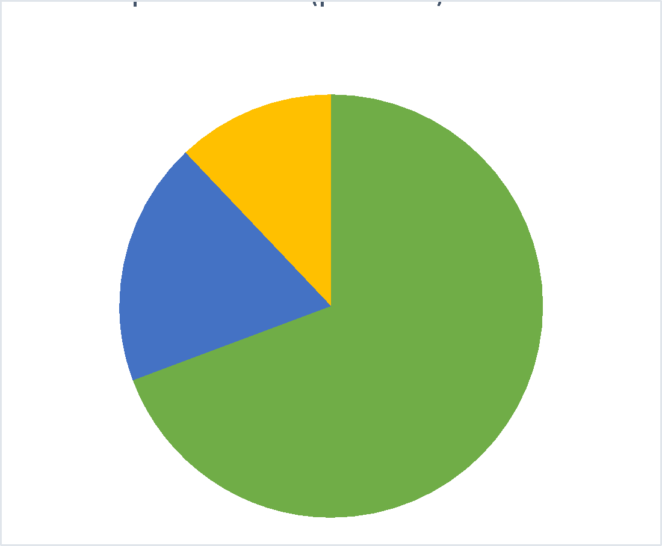
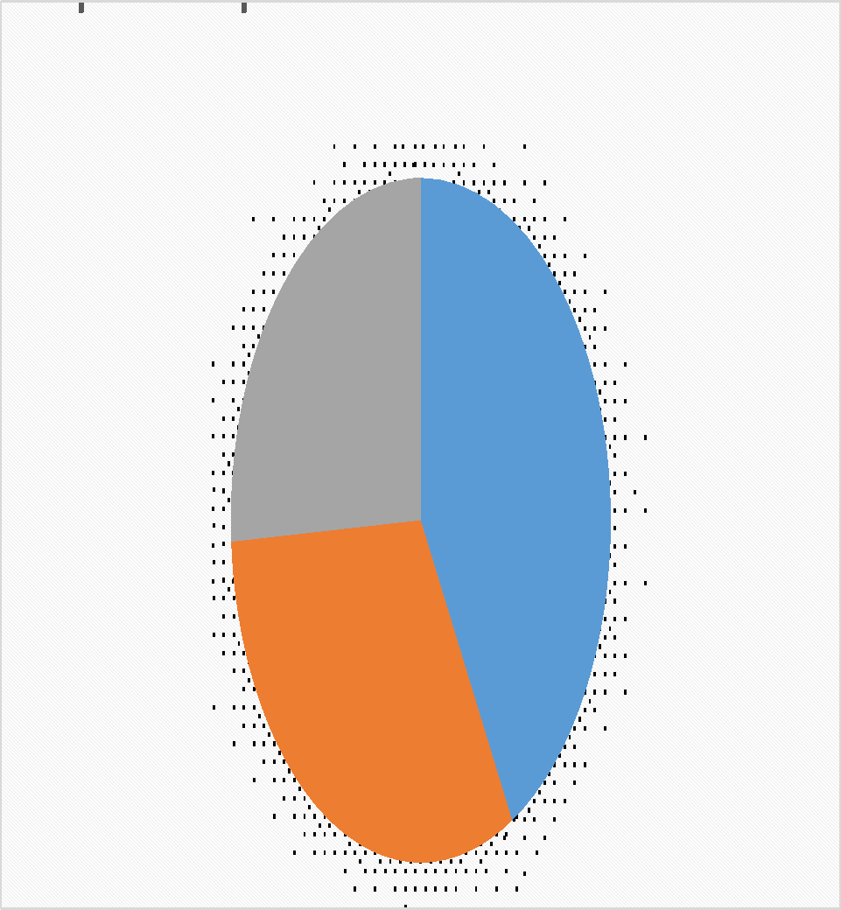
Data records per domain (V4.1)
CDR Population vs. Product Fraction
Notes:
Notes:
-overwhelming amount of atmospheric ECVs compared to other domains
-Ocean has the most non feasible from space
-transition from existing to planned keeps relations – thus many are continued in the future
ECVs per domain is from GCOS IP 2022 and added more ECV products particularly for land domain, e.g., on sea ice.

Slide 20
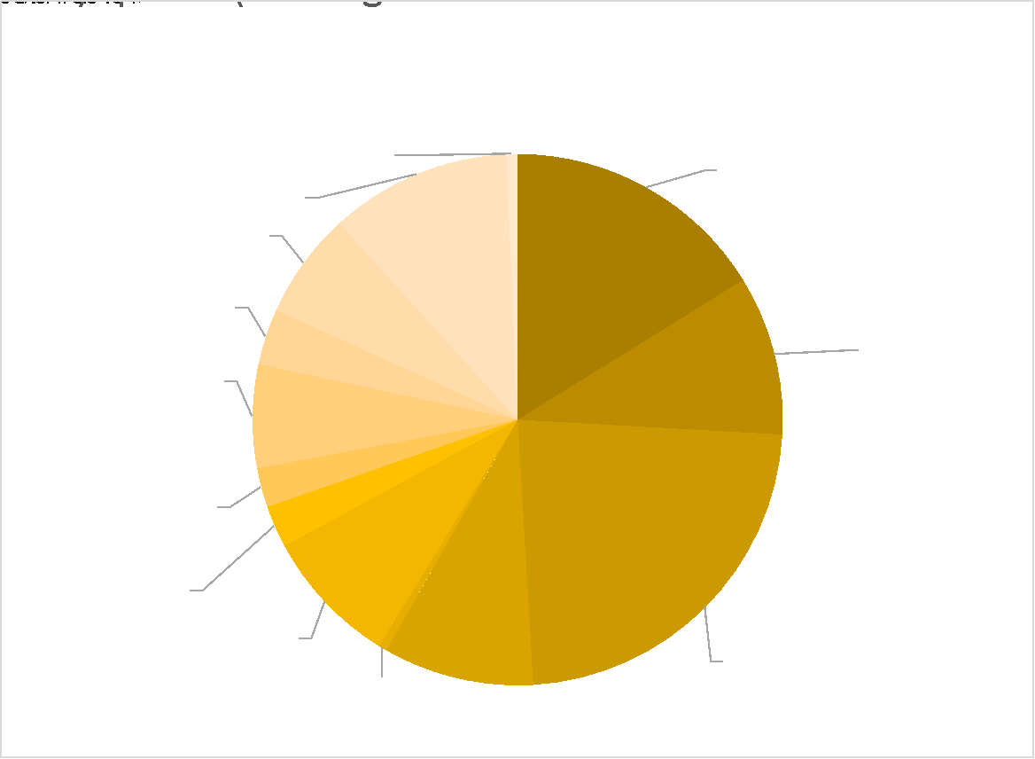
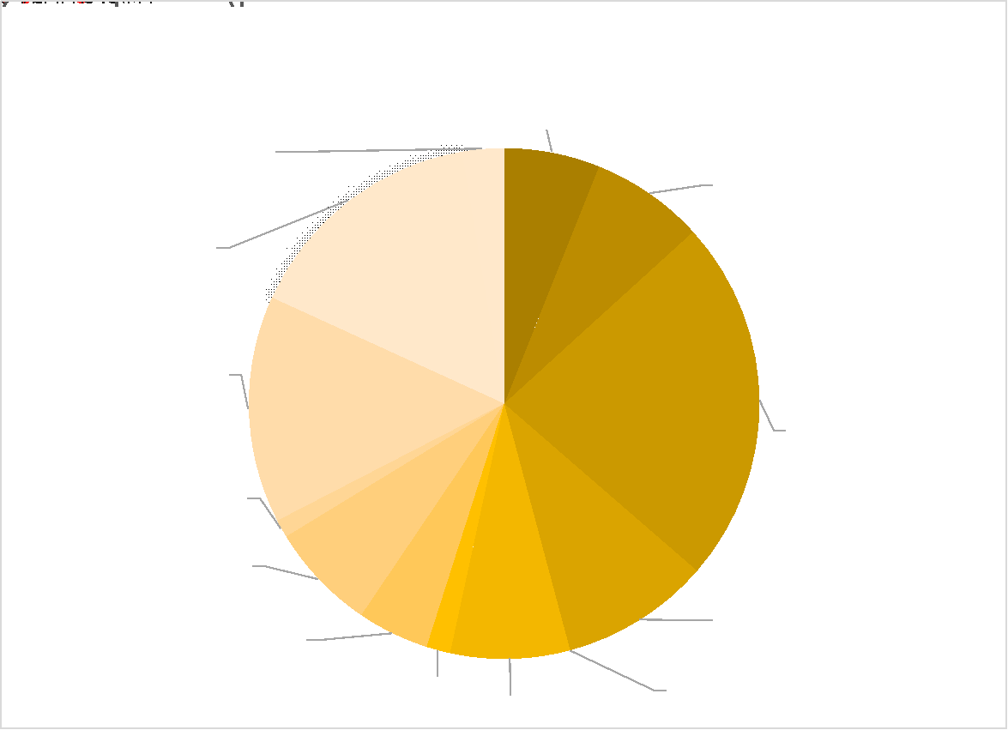
CDR Product Fractions: Atmosphere
Notes:
Notes:
still low number of precipitation compared to its importance
very few upper air winds
missing in planning is lightning although new sensors, particularly in geostationary orbit are in space

Slide 21
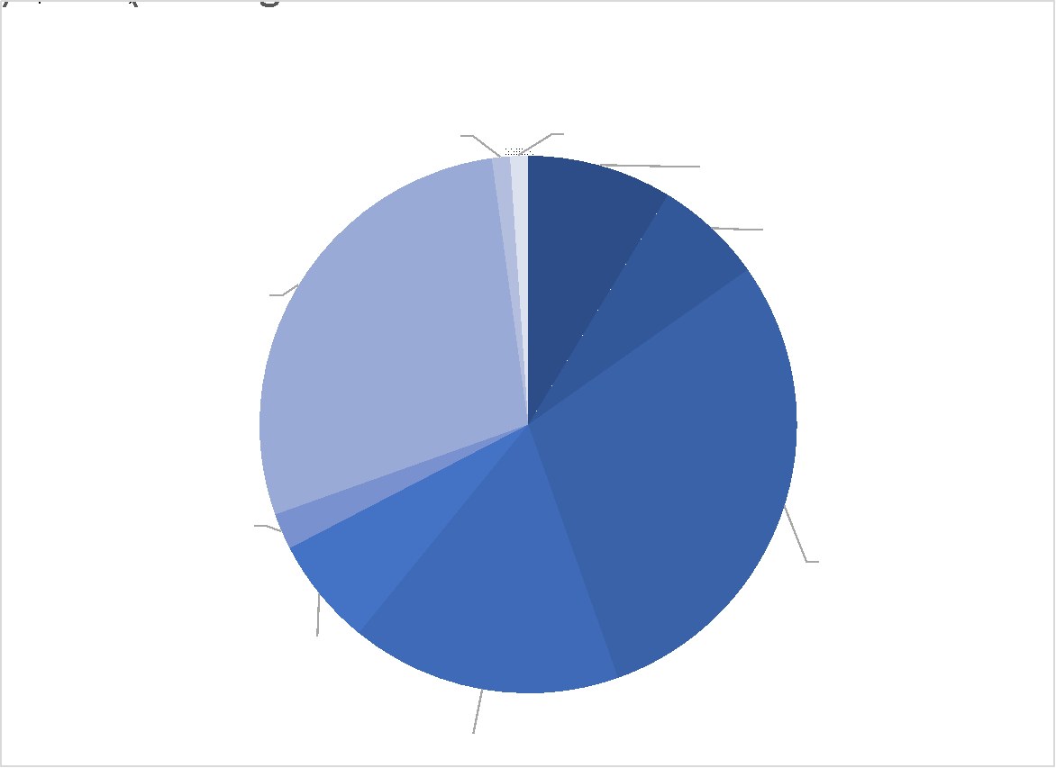
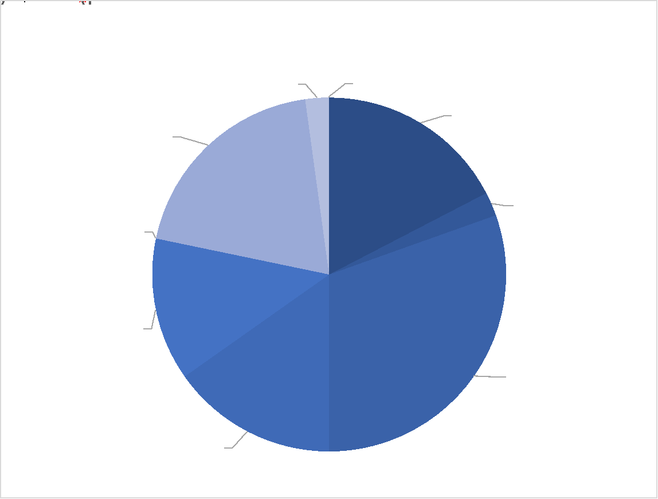
CDR Product Fractions: Ocean
Notes:
no gaps in terms of ECVs
some gaps in plans, but this is the status end of 2022

Slide 22
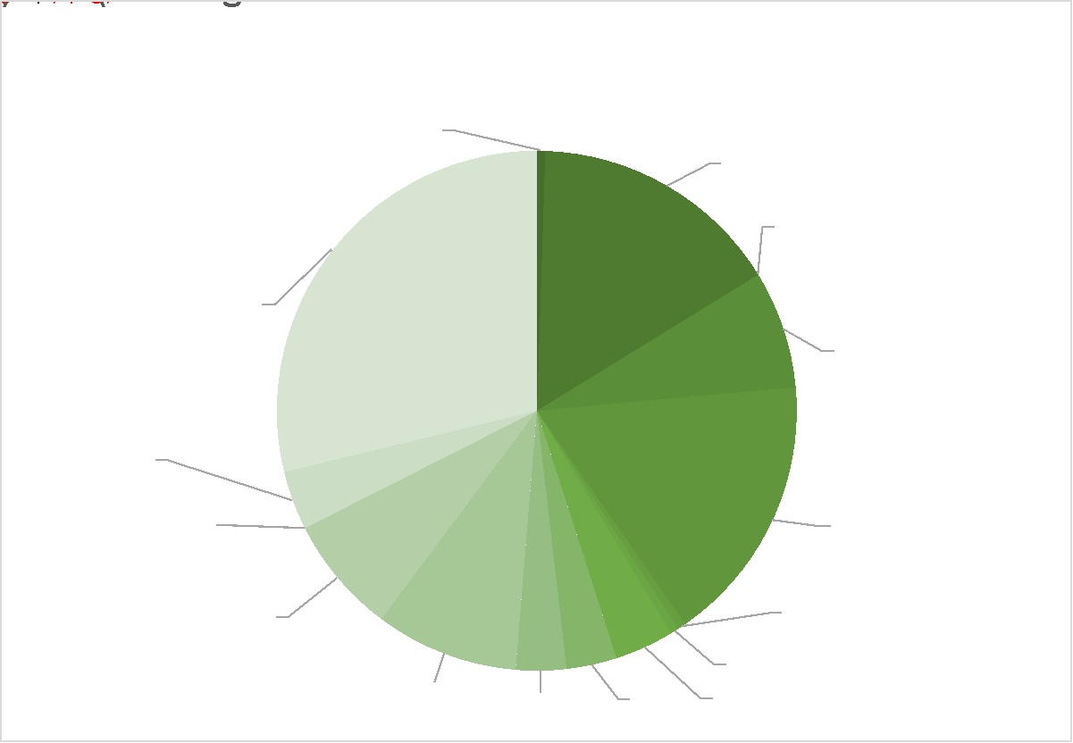
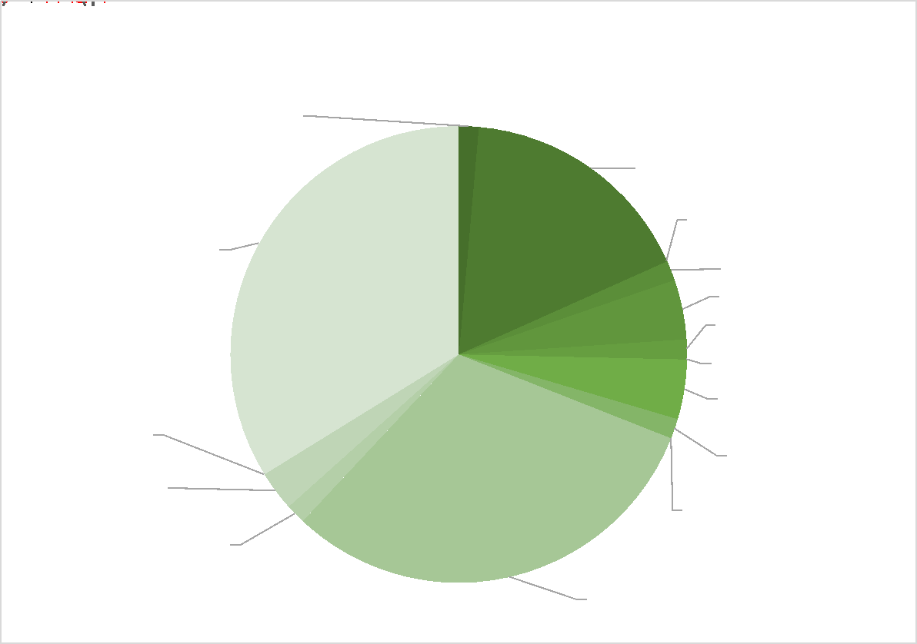
CDR Product Fractions: Land
Notes:
gaps in inventory on permafrost – know that NH data exist from ESA – next update
still information missing on planned data sets, demonstrating the limits of the ECV inventory process

