Slide 1
Working Group on Information Systems and Services (WGISS)
Tom Sohre, WGISS Chair
Agenda Item 3.5
38th CEOS Plenary
Montreal, Canada
23rd - 24th October, 2024

Slide 2
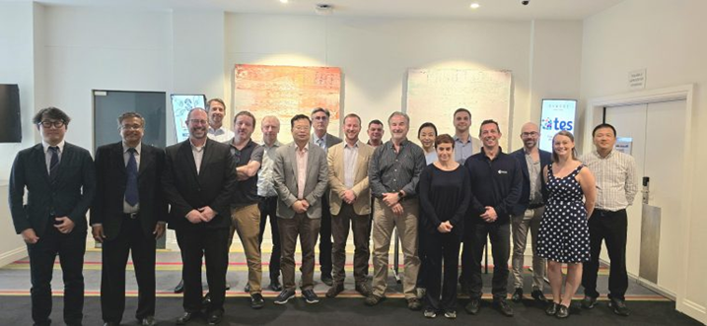
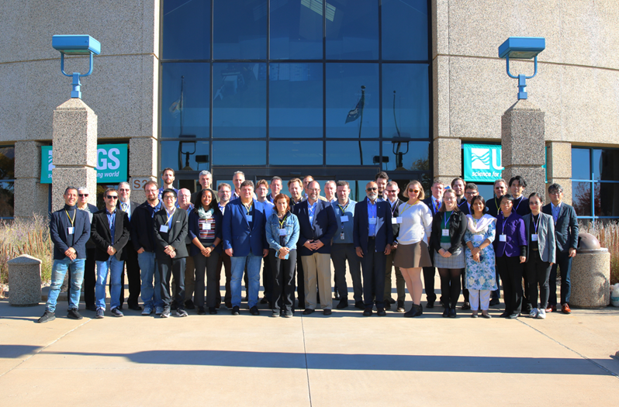
2024 Working Group Meetings
4-7 March 2024, Sydney, Australia
Hosted by GA and CSIRO
15-18 October 2024, Sioux Falls, South Dakota, U.S.
Hosted by USGS (EROS)
Highlights:
Joint meeting with Working Group on Calibration and Validation (WGCV)
Participation from CEO and SEO Teams
GEO, CGMS, and commercial engagement

Slide 3
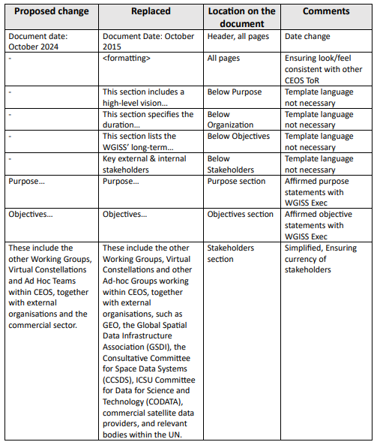
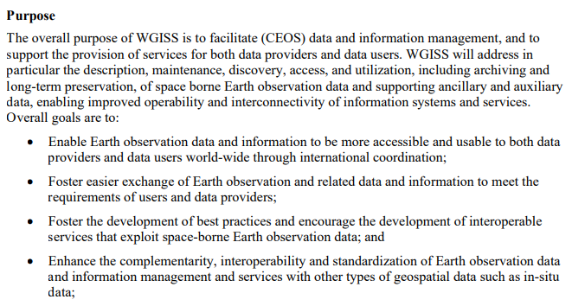
WGISS ToR Update (endorsement)
Driver: ToR had not been updated since 2015.
Purpose and Objectives reviewed; updates not required.
Stakeholder section updated; Included commercial sector.

Slide 4
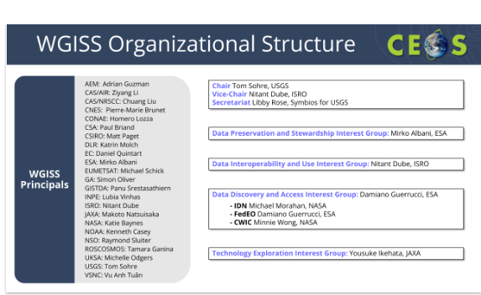
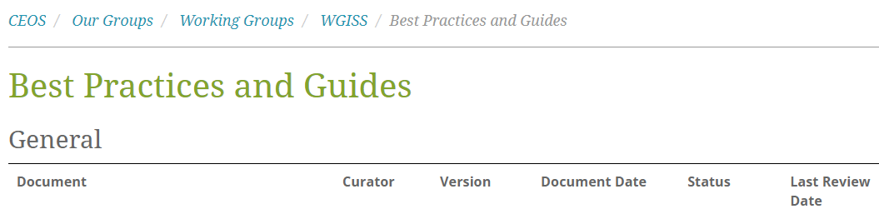
Additional WGISS Governance
Documented “WGISS Document and Web Page Review Cycle”
  Review of WGISS Web Presence:
    Frequency: every 2 years @ Chair transition
    Responsibility: WGISS Chair Team
  Review of WGISS Principals and Interest Group Membership
    Frequency: every 2 years @ Chair transition
    Responsibility: WGISS Chair Team + IG Leads
  Review of WGISS Best Practices and Guides
    Frequency: every 2 years (based on publish date)
    Responsibility: WGISS Interest Group Leads

Slide 5
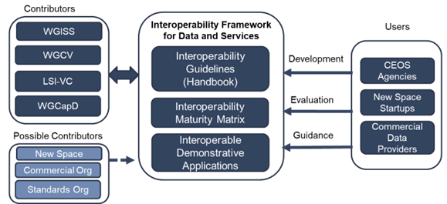
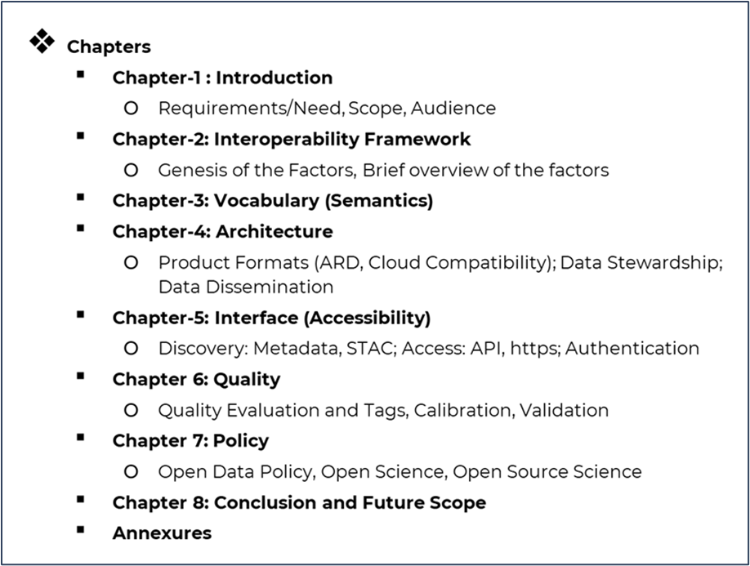
Interoperability Update
How to Participate:
  Join Interoperability mailing list by send request to libby@symbioscomms.com
  Submissions to Interoperability GitHub: https://github.com/ceos-org/interoperability-handbook

Slide 6

DATA-22-05: STAC Guidance
The STAC (SpatioTemporal Asset Catalog) specification is a common language to describe geospatial information, so it can more easily be worked with, indexed, and discovered.
  Community Specification … vs. “Standard” (like ISO or OGC)
  For Data providers, Developers, and Data Users
Briefing from 2024 STAC Summit @ WGISS-58
  Engagement with Commercial organizations including AWS, Radiant Earth, Element84
WGISS had completed Release v1.0.0 “CEOS STAC EO Collection and Granule Discovery Best Practice” and is performing final review prior to publishing.
Contributions welcome via CEOS GitHub

Slide 7

DATA-24-01: EO Data collections management
  Topics related to Collections management :
  Common understanding of the concept of collection;
  Preservation of “master" collections and Archiving Policy
  Reproducibility of master collections (algorithm availability);
  Master collections data citation;
  Cross-collection validation
  Approach to transitioning from one collection to another (time overlap, communication, etc.);
  General Interoperability and Governance approaches.
  CEOS Collections Management Best Practice in development; planned release in 2025.

Slide 8
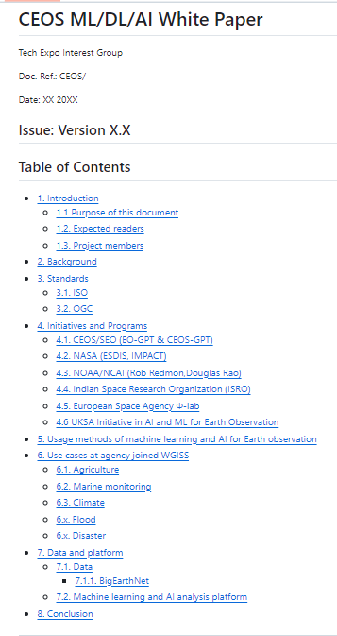
DATA-23-01: AI/ML White Paper
Survey of CEOS Organizations conducted to gather current state and use cases
Current version of white paper migrated into CEOS GitHub to enable collaboration.
Evolving topic with many organizations actively developing strategies and AI/ML organizational guidance.
Plan to publish “current state” but continue to update as a living document.
Explored concept of Knowledge Graphs at WGISS-58 with potential demonstrator use case.

Slide 9
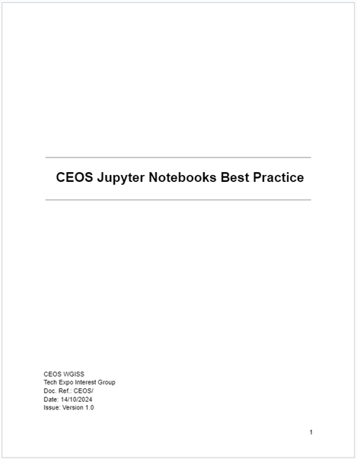
DATA-22-01: Jupyter Notebook Best Practice
History:
  Jupyter Notebook Day as a joint activity with WGCapD
  Two webinars held w/ WGCapD & SEO
  Workshop held adjacent to WGISS-56
WGISS is reviewing Release v1.0.0 “Jupyter Notebook Best Practice” prior to publishing later this year.

Slide 10
Additional Activities
Ongoing support for CEOS IDN and FedEO Search and Discovery Tools
Published Data Management and Stewardship Maturity Matrix
Heritage Data Recovery Efforts with AVHRR
Consideration of Communication Strategies and Commercial Engagement Opportunities
(new) Collaboration with WGCV re: Terminology GitHub (KCEO Glossary)
(new) Software Preservation White Paper
(new) User Federation and Authentication
(new) Data Volume Challenges including data replication and authentication

Slide 11


Future Meetings
WGISS-59
  Bangkok, Thailand
  March 24-28, 2025
WGISS-60
  Oberpfaffenhofen, Germany
  October 13-17, 2025

Slide 12
Ways to Support WGISS
Become involved in an Interest Group(s)
  Data Preservation and Stewardship (mirko.albani@esa.int)
  Interoperability and Use (nitant@sac.isro.gov.in)
  Discovery and Access (damiano.guerrucci@esa.int)
  Technology Exploration (ikehata.yousuke@jaxa.jp)
Nominate next Vice Chair, Nov. 2025-Nov. 2027
  Contact Tom Sohre (tsohre@usgs.gov)
Collaborate on active work via GitHub.com/ceos-org

