Slide 1
Early Warnings for All (EW4All)
CEOS Engagement with the UN’s Initiative
Osamu Ochiai
JAXA SIT Chair Team
Agenda Item 3.4
38th CEOS Plenary
Montreal, Canada
23rd - 24th October 2024

Slide 2
Action SIT-39-11
SIT-39-11 | SIT Chair to confer with WGDisasters Chair and Vice Chair regarding potential CEOS contributions to the UN’s Early Warnings for All (EW4All) initiative. | SEC-321
 | Rationale: The objective is to identify potential CEOS contributions to the EW4All to be communicated to the UN and through WMO.

Slide 3
What is Early Warnings for All?
Launched in 2022 by UN Secretary-General, António Guterres
Early Warnings for All is striving for global early warning coverage by 2027
Includes hazardous weather, water, and climate events

Slide 4
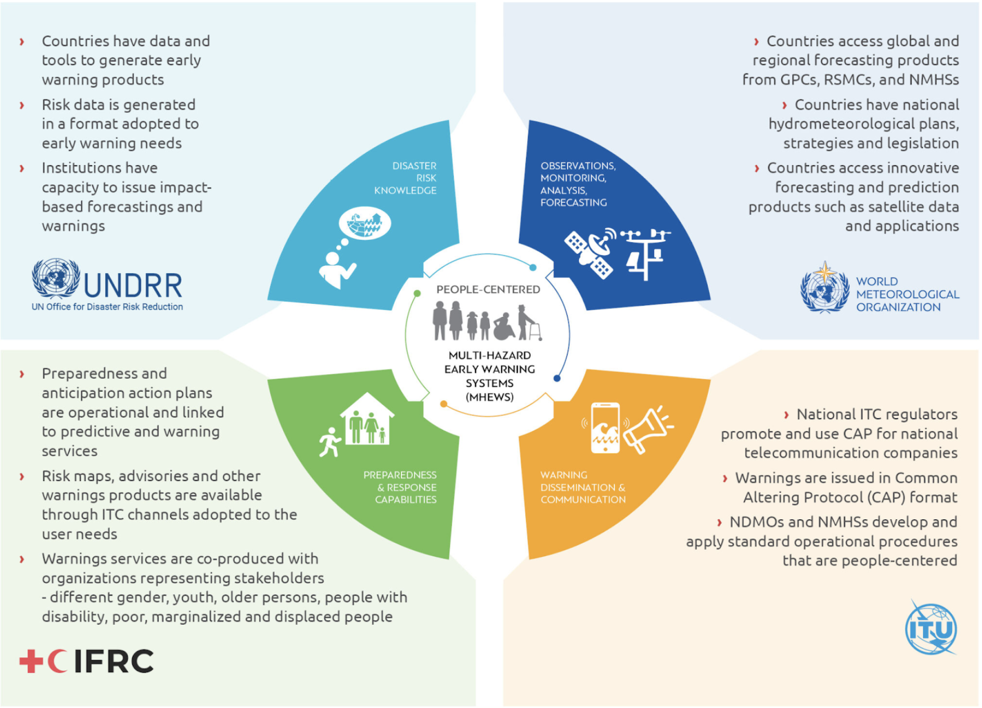
EW4All - The Four Pillars
Disaster risk knowledge and management (led by UNDRR)
Detection, observation, monitoring, analysis, and forecasting (led by WMO)
Warning dissemination and communication (led by ITU)
Preparedness and response capabilities (led by IFRC)

Slide 5
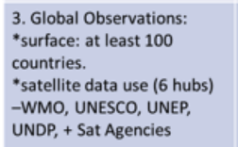
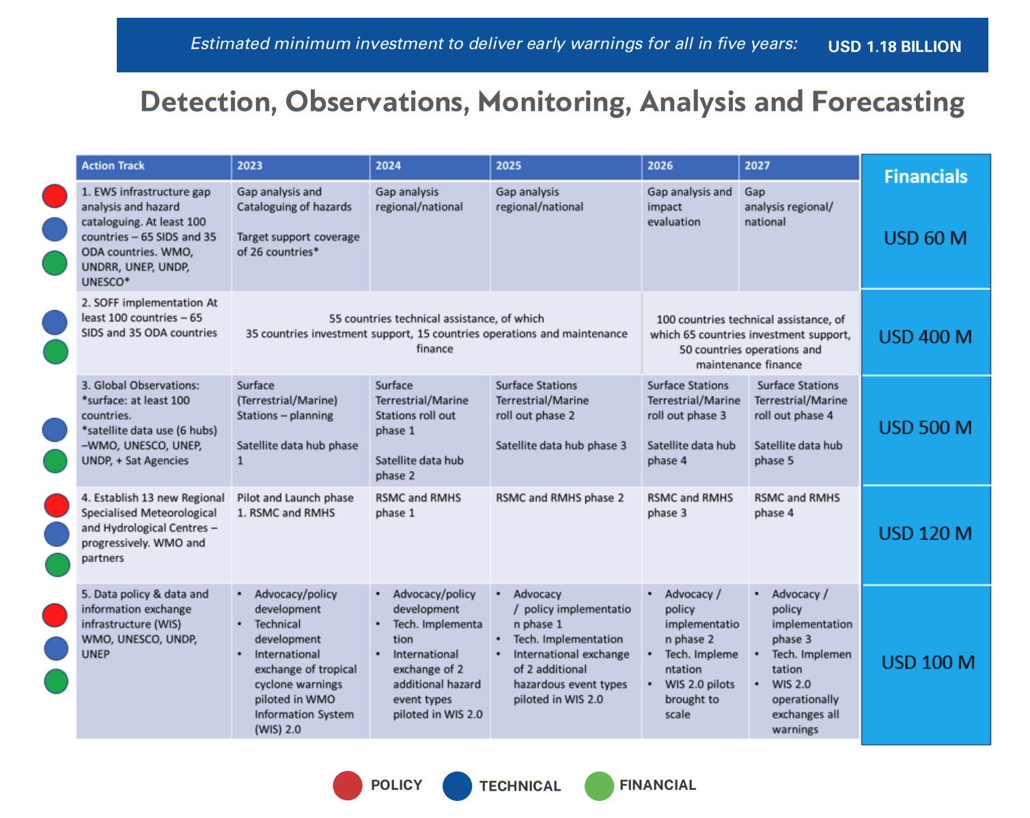
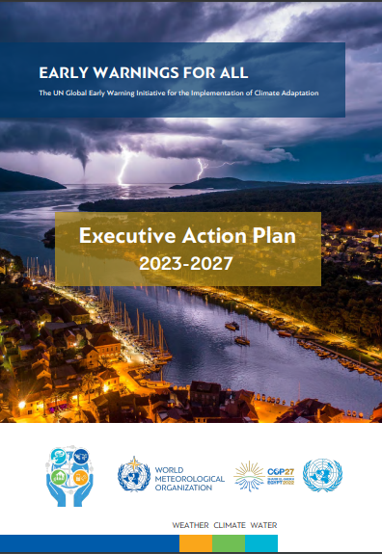
Pillar 2: Detection, Observations, Monitoring, Analysis & Forecasting
Key Action Area 1B:
Enhance the timely access to, and use of satellite observations and of advanced technologies (radar, lightning detection) to build up detection and forecasting capabilities: action: establish satellite nowcasting facilities in Africa and South America.
Key Action Area 2B:
Close ocean and cryosphere observation gaps in hot spots (coastal areas, high mountains, etc.)

Slide 6
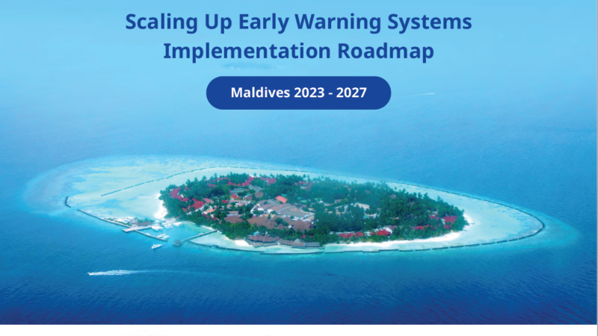
30 countries for the first phase of the initiative
The UN Secretary-General has sent a letter to heads of state and government of an initial group of countries to receive coordinated and targeted support.
Asia and Pacific: Bangladesh, Maldives, Nepal, Lao (People’s Democratic Republic), Cambodia, Kiribati, Samoa, Solomon Islands, Fiji, Tonga
Africa: Djibouti, Somalia, Sudan, Chad, Comoros, Ethiopia, Liberia, Madagascar, Mauritius, Mozambique, Niger, South Sudan, Uganda
Latin America and Caribbean:
Guyana, Haiti, Barbados, Antigua Barbuda, Guatemala, Ecuador
Central Asia:
Tajikistan​​
Countries are formulating EW4ALL national roadmaps

Slide 7
Letter to CEOS Members, Sept 2023
WMO Secretariat sent a letter to CEOS & CGMS Agencies in September 2022:
“We are soliciting your response to the data call for the Early Warnings for All (EW4All) initiative in relation to the satellite products and applications.”
This was not a direct request of CEOS as an organisation, rather the members
WGDisasters was requested to help compile responses

Slide 8
SIT Chair Recommendation
While the scope of EW4All is broader than WGDisasters, WGDisasters is best placed to lead the CEOS response
Coordinate with other teams as necessary
Similar to WGISS leading Interoperability, and WGClimate leading GHG Task Team
WGDisasters has already created a subgroup to have these discussions
Members from relevant CEOS teams should be included in the subgroup
Suggested Decision:
WGDisasters shall lead the CEOS response to the UN EW4All Initiative, coordinating with other Working Groups, Virtual Constellations and Ad Hoc Teams where necessary.

