Slide 1
CEOS Plenary 2024
Working Group on Disasters (WGDisasters) and Collaboration with EW4All initiative
Laura Frulla, CONAE
Agenda Item 3.3
38th CEOS Plenary
Montreal, Canada
23rd - 24th October, 2024

Slide 2
Pillars of EW4All
The EW4All initiative is built on four pillars to support countries in building and operating effective and inclusive multi-hazard early warning systems:
  Pillar 1-UNDRR: Disaster risk knowledge
  Pillar 2-WMO: Detection, observation, monitoring, analysis, and forecasting
  Pillar 3-ITU (International Telecommunication Union): Warning dissemination and communication
  Pillar 4-IFRC (International Federation of Red Cross and Red Crescent Societies): Preparedness and response capabilities

Slide 3
WG Disasters Activities during 2024 regarding EW4All
WG Disasters and EW4All have been exchanging information since the spring of 2024, with a view to understanding which on-going initiatives within WG Disaster might make a contribution to EW4All or are related, and to which pillars.
After a consultation within the WG Disasters, it was determined that several initiatives are relevant, principally to pillar 1 (Disaster risk knowledge-UNDRR), but also to pillar 2 (Detection, observation, monitoring, analysis, and forecasting-WMO).

Slide 4
WG Disasters Activities during 2024 regarding EW4All
WG Disasters agreed to conduct a mapping exercise to identify CEOS activities in relation to the 30 countries and compile a list of related organizations working within CEOS WG Disasters.
To better cooperate and be engaged, WG Disasters formed a subgroup whose leadership will be defined at the next meeting of the subgroup, which will be the first one.
  initially: WG Disasters participants and CEOS CEO
  now: GEO, Australian National University and Crisis Management State Academy of Armenia
The main expected contributions are to pillar 1 and to some extent pillar 2.

Slide 5
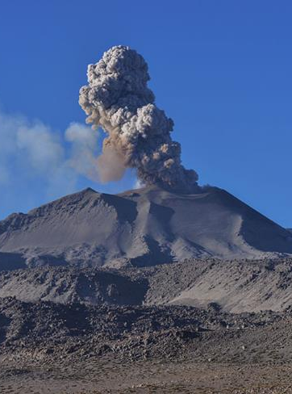
WG Disasters projects Compatible with EW4All
  G-VEWRS: volcano EW activity from monitoring volcanoes in state of unrest.
    close collaboration with volcano observatories;
    generates high spatial and temporal resolution products during unrest
    information shared with local authorities
Global Volcano Early Warning and Eruption Response System

Slide 6
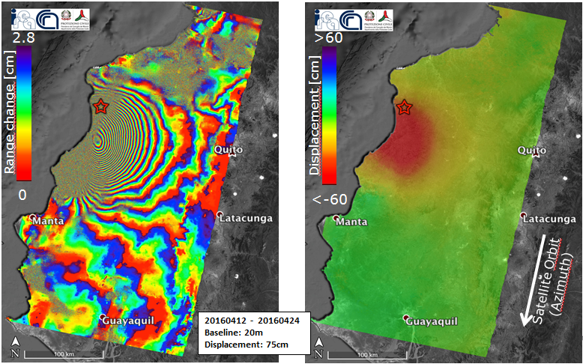
WG Disasters projects Compatible with EW4All
  Seismic Initiative: support the generation of globally self-consistent deformation rate estimates and the mapping of active faults at the global scale.
    collaboration with GSNL
    especially relevant for understanding earthquake risk and vulnerabilities
    information shared with local authorities
2016 Ecuador earthquake
Interferogram generated by CNR-IREA, exploiting two Copernicus Sentinel-1 images acquired before and after the event, respectively

Slide 7
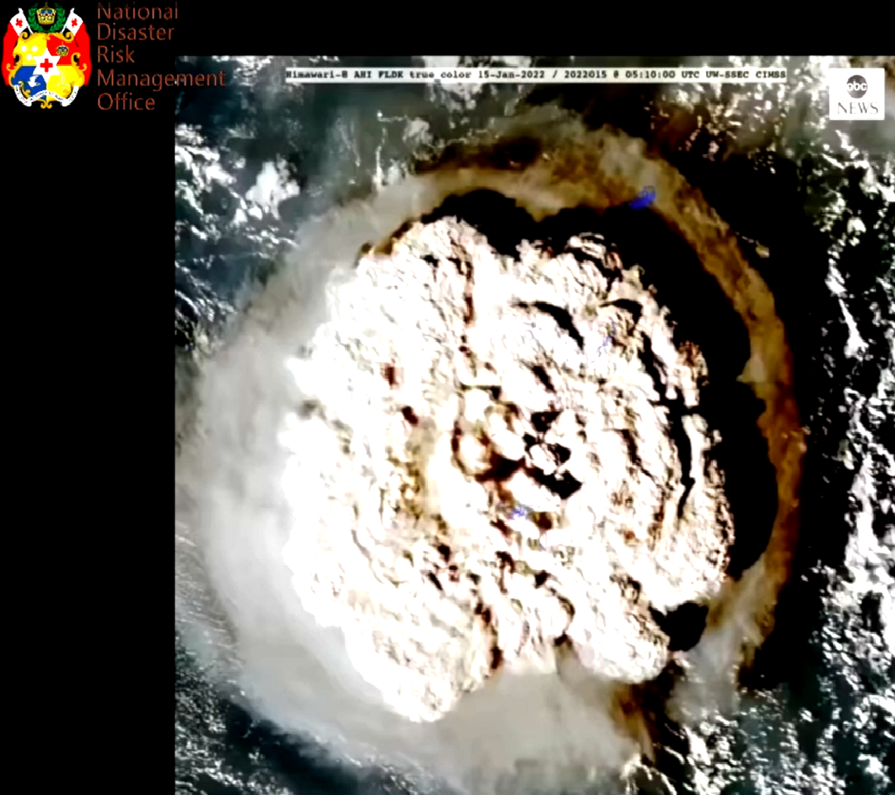
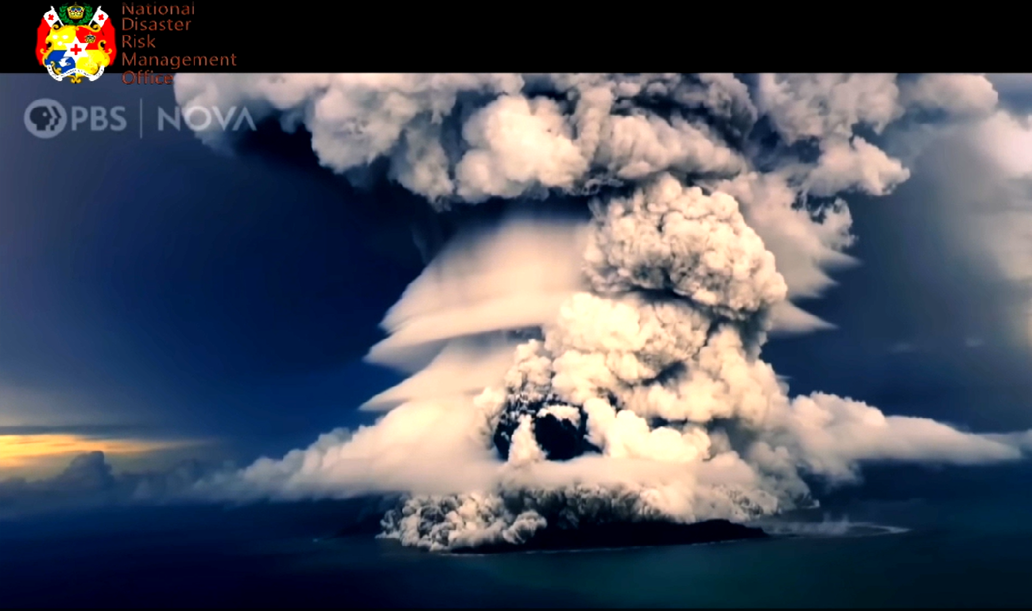
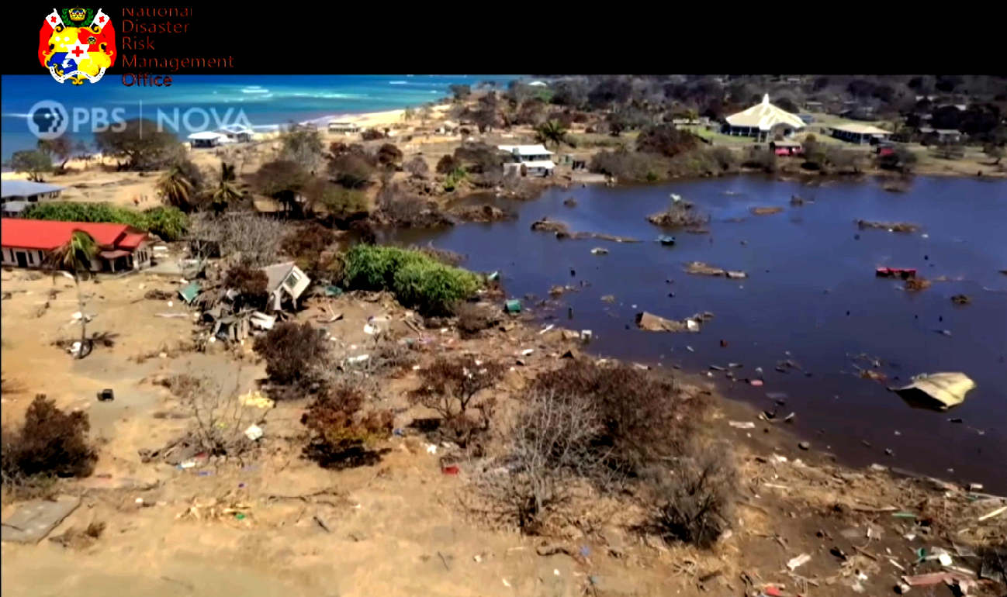
WG Disasters projects Compatible with EW4All
  Tonga preparedness pilot: dedicated pilot to use EO data to increase understanding of risk
    one of the 30 priority EW4All countries
    it was developed a dedicated platform to integrate EO data in a GIS
    capacity building is required for the use of the different products received

Slide 8
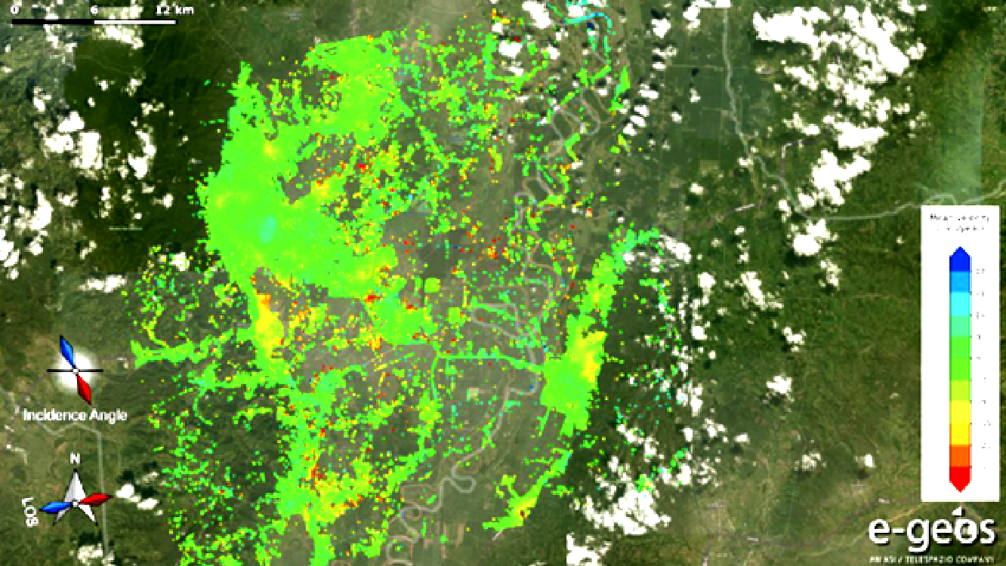
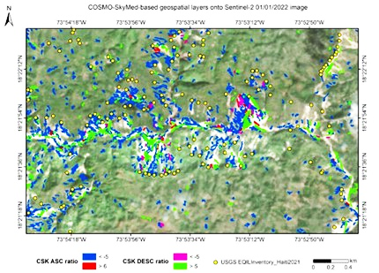
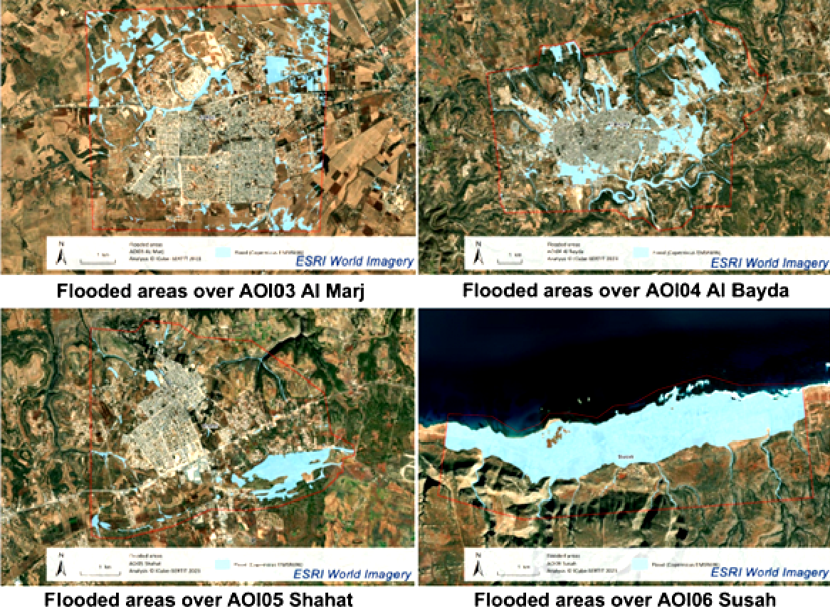
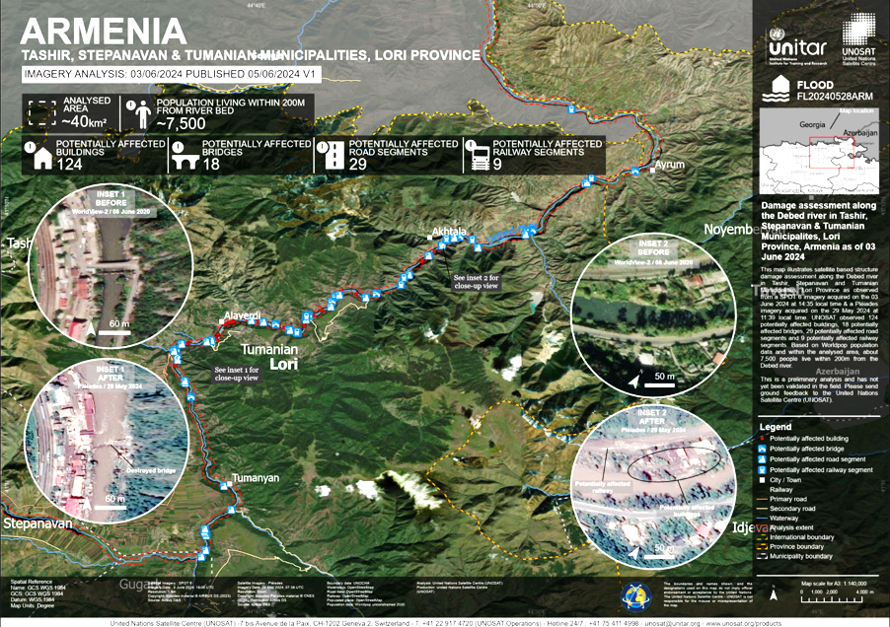
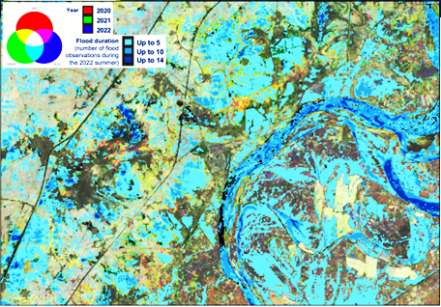
WG Disasters projects Compatible with EW4All
  Recovery Observatory: technically it is dedicated to recovery, but it has capacity building components which increase the resilience and clearly contributes to pillar 1 on country-by-country basis
    collaboration with GSNL
    its link with EW is through capacity building

Slide 9
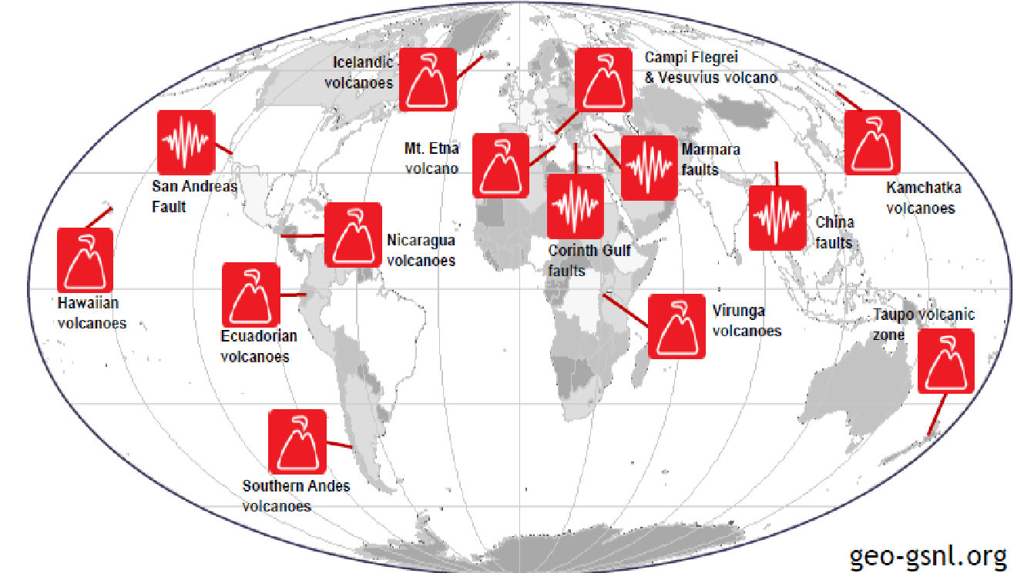


WG Disasters projects Compatible with EW4All
  GSNL: voluntary international partnership aiming to improve, through an Open Science approach, geophysical scientific research and geohazard assessment, promoting rapid and effective uptake of the new scientific results for enhanced societal benefits in Disaster Risk Reduction (DRR).
    Supersites generate large volumes of data and information in support of pillar 1.

Slide 10
Some Comments and Conclusions
There is an opportunity for CEOS to adopt a much more ambitious role in the coordination of satellites to collect information in areas where gaps have been identified
This requires resources, especially on the value added products generation.
Contributing with data will not meet pillar 1 needs, and the generation of value added products is outside the resource scope of most CEOS agencies willing to contribute.
Pillar 2, there are also possible contribution opportunities, but again they require resources as this would be done in pre-operational or operational mode, and the activities of the WG are based on the best efforts activities.

Slide 11
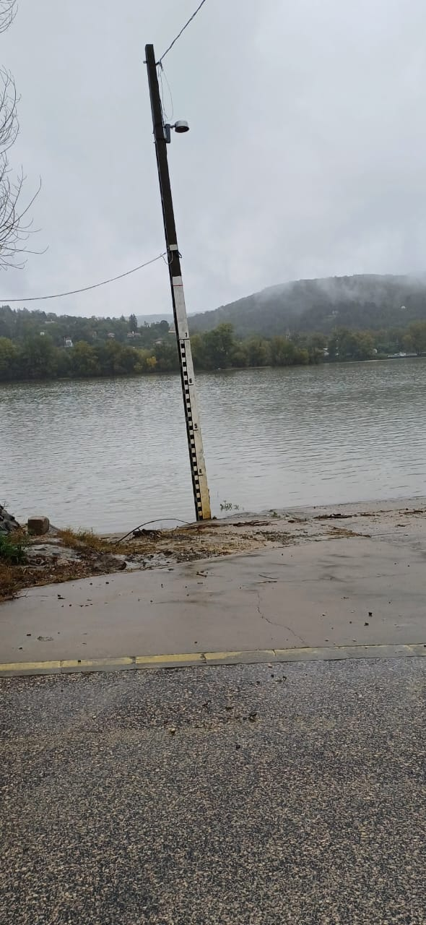
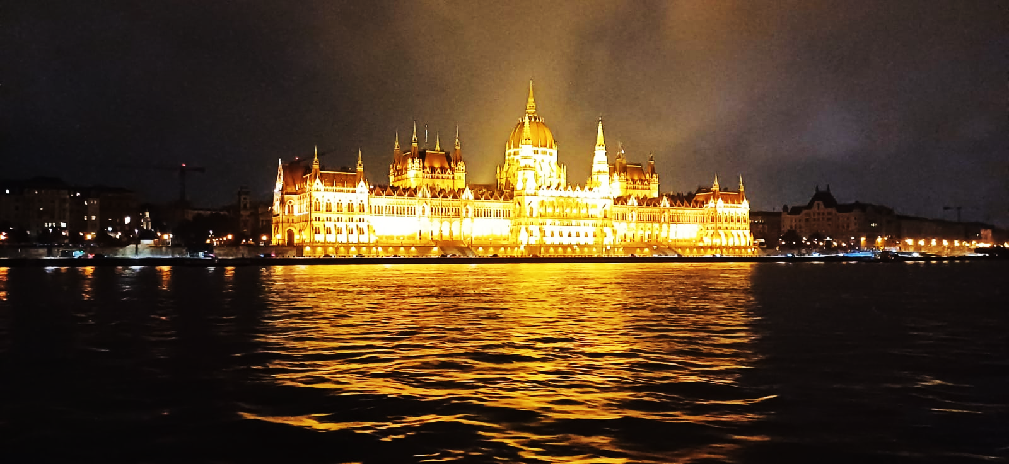
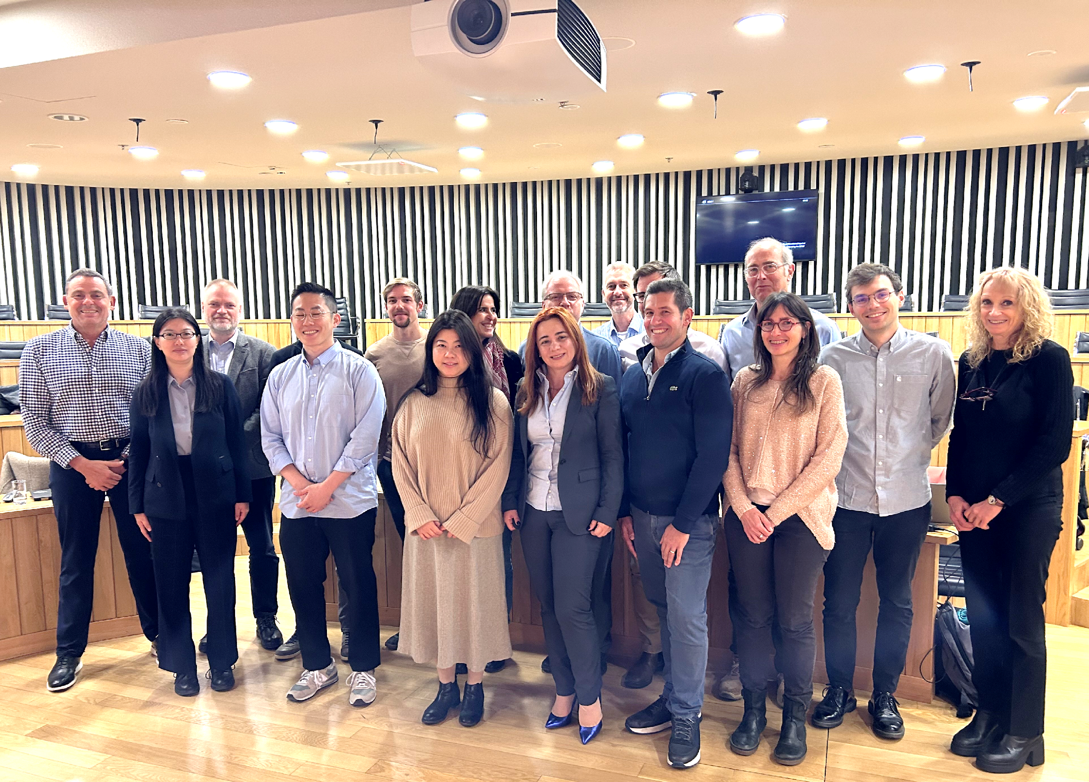
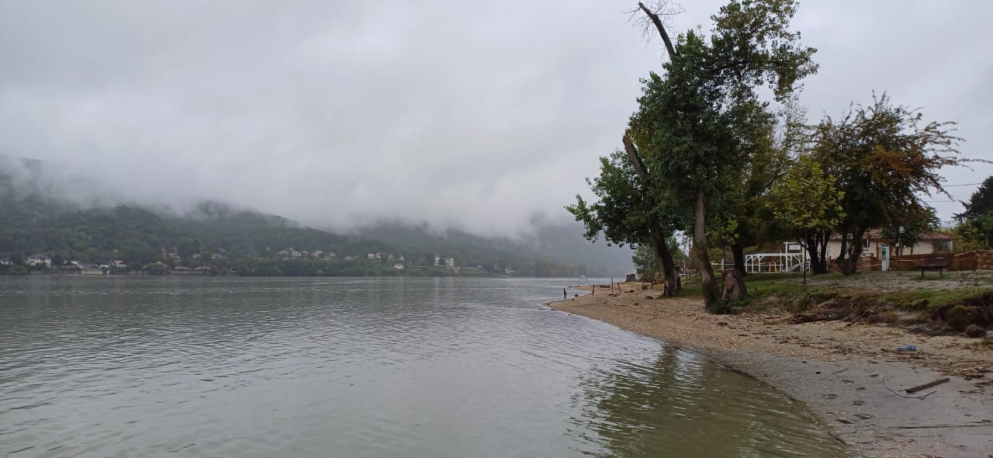
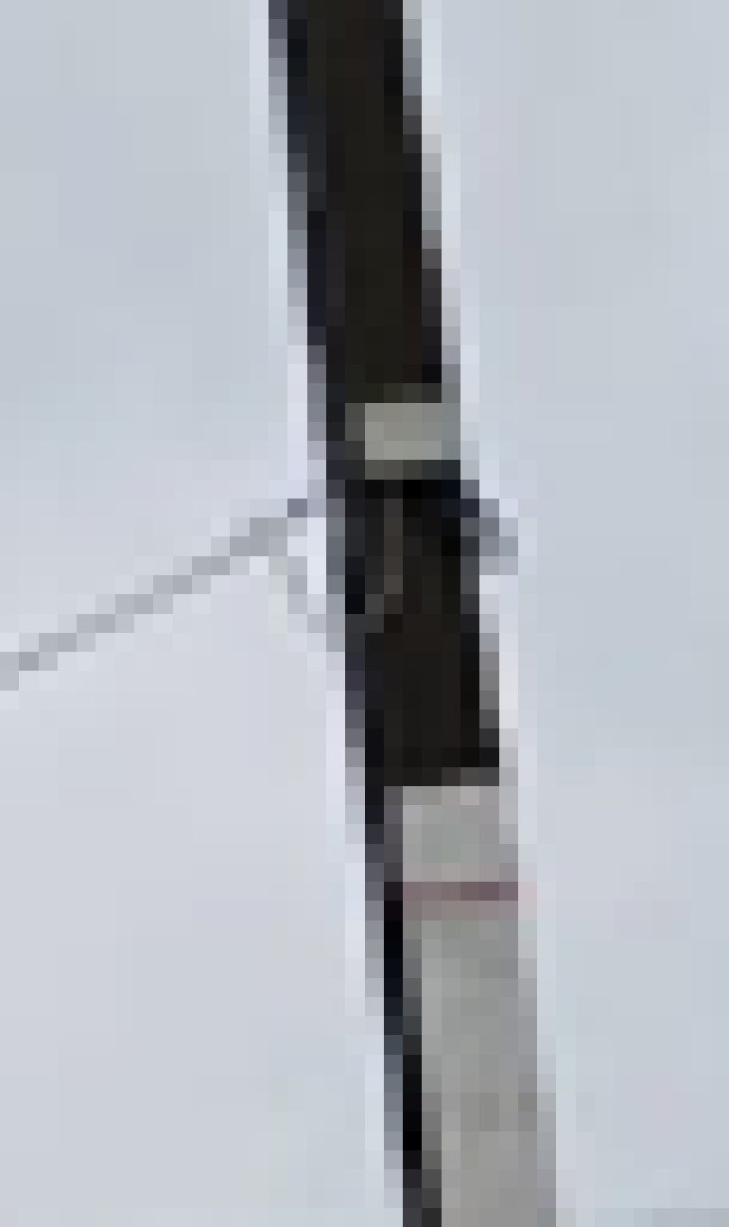
WG Disasters Meetings
  WG Disasters meeting number 22,
  Budapest, October 1-4, 2024

Slide 12

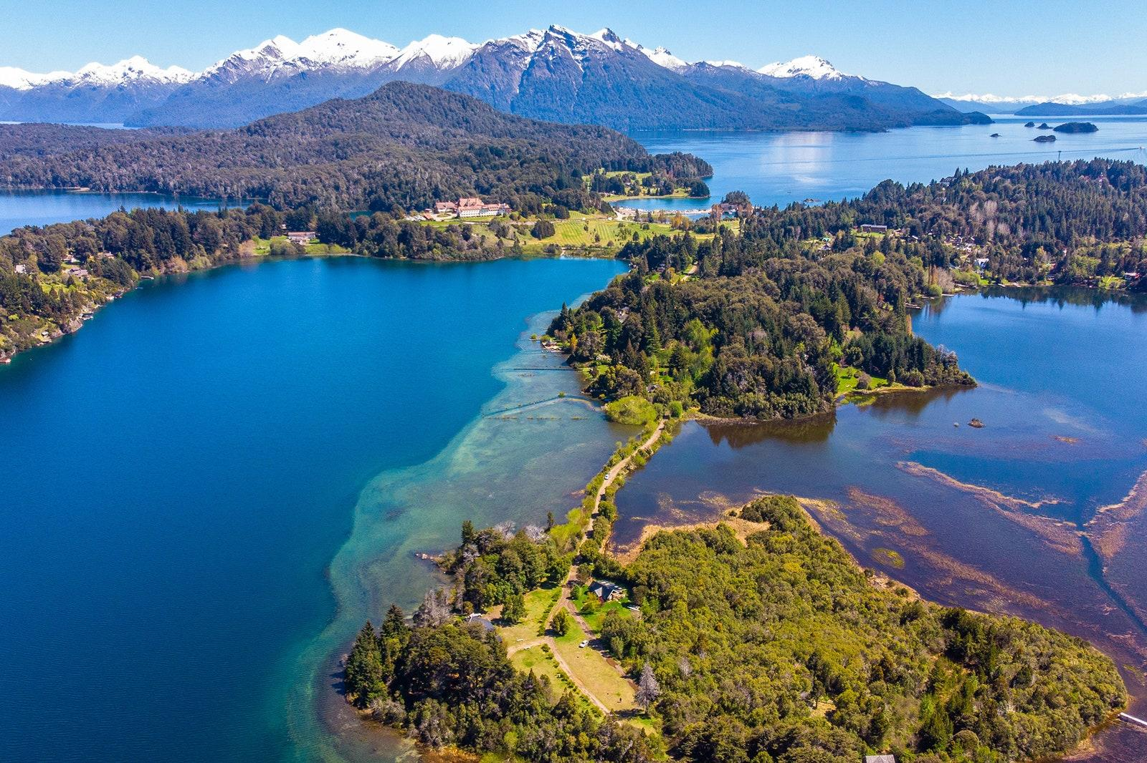
WG Disasters Meetings
  WG Disasters meeting number 23, Catania (Italy), March, 2025 at the invitation of the National Institute of Geophysics and Volcanology (INGV)
  WG Disasters meeting number 24, San Carlos de Bariloche (Argentina), September, 2025 at the invitation of CONAE

Slide 13
Thank you !

